Slide 1
Baja Mesopotamia
UR
Ruben Tenorio Carvallo

Slide 2
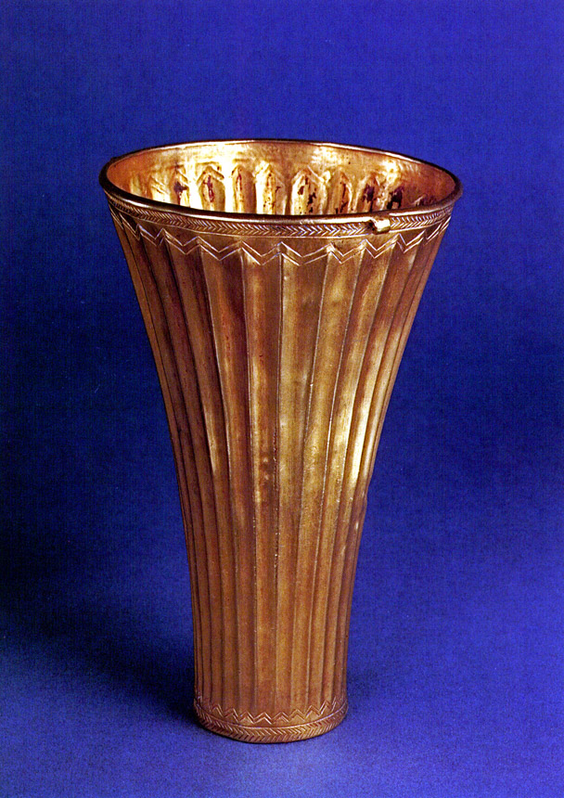
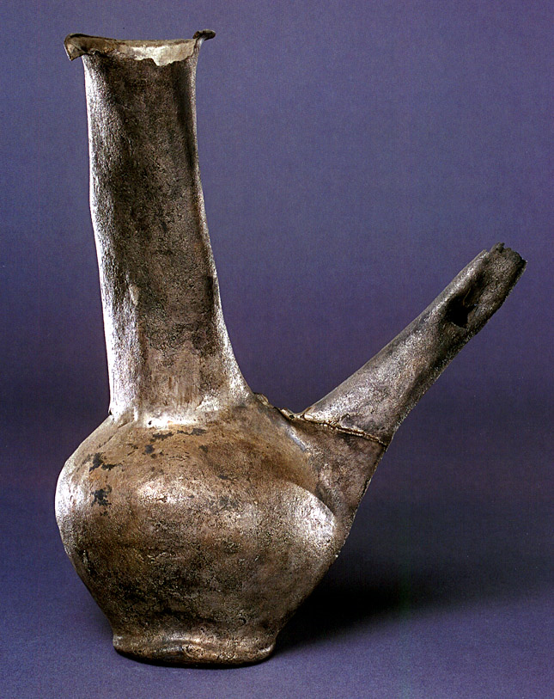
UR 3000- 2400 AC BRONCE TEMPRANO 3300-2100 AC
Its walls enclose circa 60 hectares. Ur was excavated by a joint expedition of the British Museum and the University of Pennsylvania under Sir Leonard Woolley between 1922 and 1934.
Notes:
SUS MURALLAS ENCIERRAN 60 Ha.
UR REPRESENTA UN PERIODO CULTURA.

Slide 3
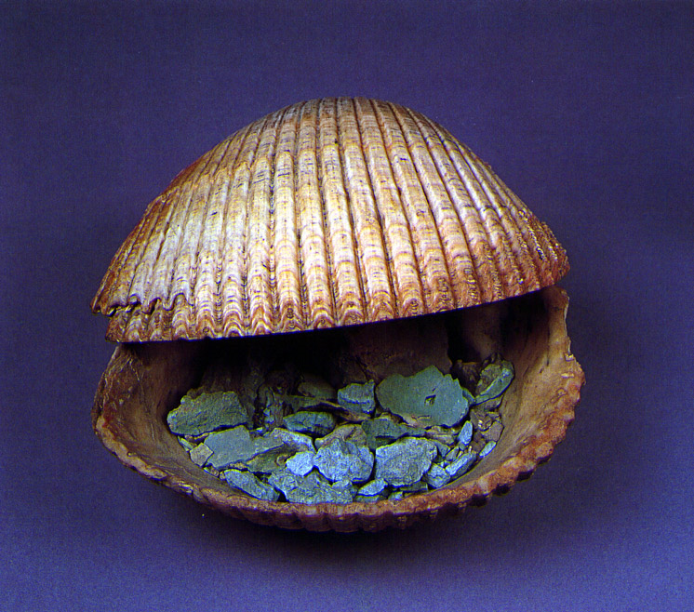
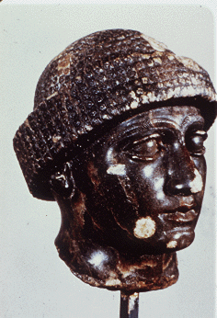
The earliest occupation of the site belonged to the Ubaid Period but and the most flourishing period for the city was the Early Dynastic Period (circa 3000 - 2400 BC).
Notes:
UR FUE OCUPADO EN PRIMER LUGAR POR EL PERIODO UBAID.
SU PERIODO DE FLORECIMIENTO ES EL PERIODO DINASTICO TEMPRANO
SUS OBJETOS SON DE BRONCE Y ORO.

Slide 4
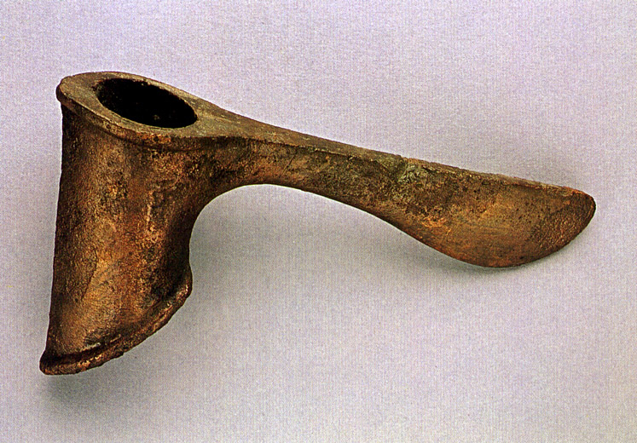
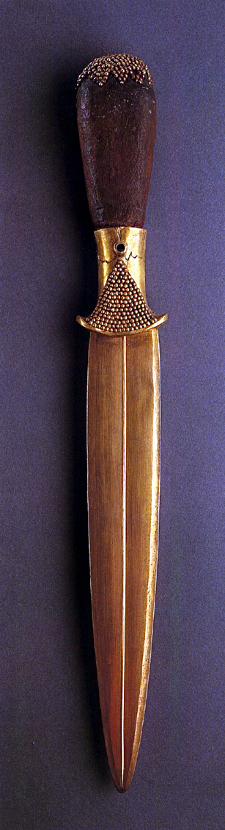
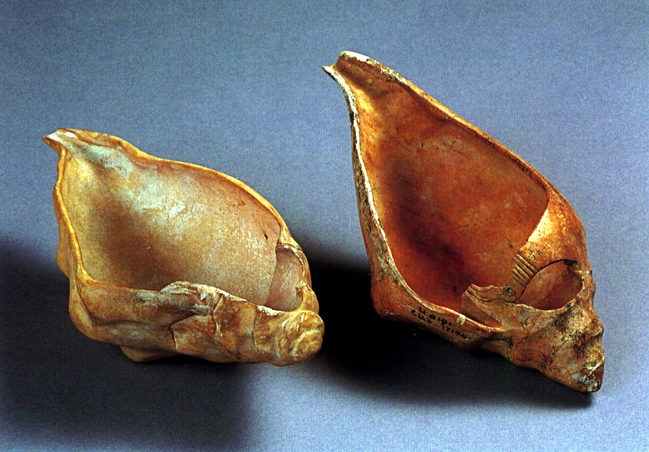
To this period belong the celebrated tombs of the Royal Cemetery with their wealth of goods made of gold - lapis lazuli - other precious materials. There is also evidence of the sacrifice of human attendants of the dead kings and queens.
TOOLS & WEAPONS
Notes:
EL HALLAZGO MÁS IMPORTANTE DE ESTE PERIODO SON LAS TUMBAS REALES DEL CEMENTERIO.
SE REALIZABAN SACRIFICIOS HUMANOS DE LOS ASISTENTES DEL REY Y DE LA REINA.

Slide 5
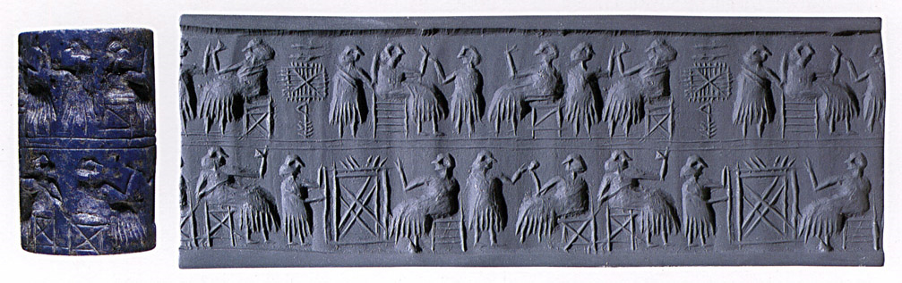
After a period of decline Ur flourished again in the time of the Third Dynasty of Ur in the 21st century BC which saw the final flowering of Sumerian achievement. The founder of this dynasty Ur-Nammu built a great Ziggurat to the city's patron deity Nanna the Moon God.
CYLINDER SEALS
Notes:
EL PERIODO II TIENE UNA DECLINACIÓN.
UR FLORECIÓ EN LA TERCERA DINASTIA DE UR EN EL SIGLO 21, ES LA ÉPOCA DE ABRAHAM, FUNDADA POR UR NAMMU.

Slide 6
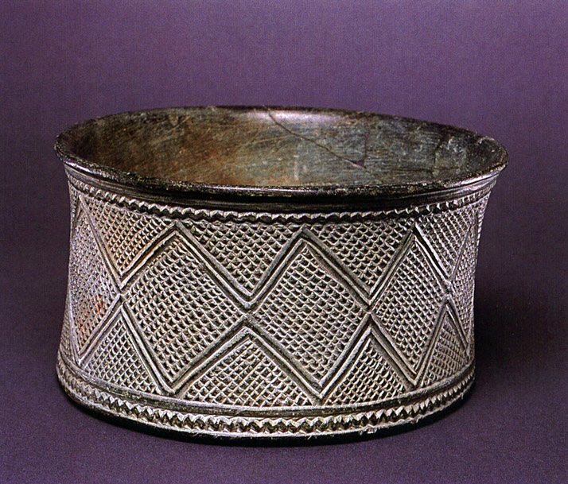
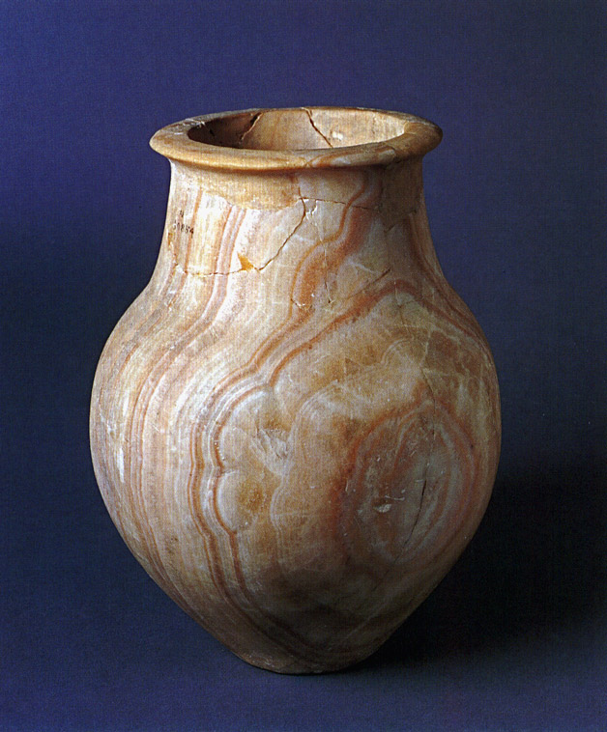
The city continued to thrive in the Old Babylonian Period and the Bible claims Ur as the home of Abraham before he left for the west. Later the city declined and was finally abandoned in the 4th century BC
STONE VESSELS

Slide 7
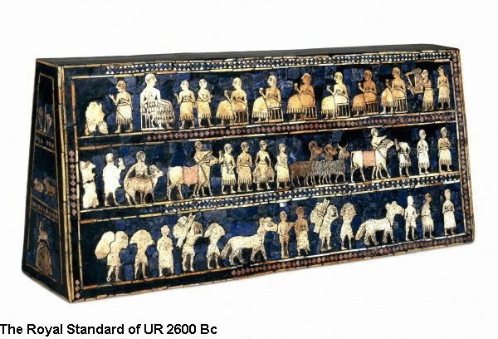
Notes:
TRES CLASES DE LA SOCIEDAD DE UR:
1. LOS REYES Y SACERDOTES
2. LOS AGRICULTORES Y ARTESANOS Y GANADEROS
3. LOS SIRVIENTES
HABÍAN CASAS ASEGURADAS. ALGUNAS DE DOS PISOS Y CON DRENAJE.
HABÍA UNA UNIVERSIDAD QUE ENSEÑABA MATEMATICAS, GEOGRAFIA, ASTRONOMÍA.

Slide 8
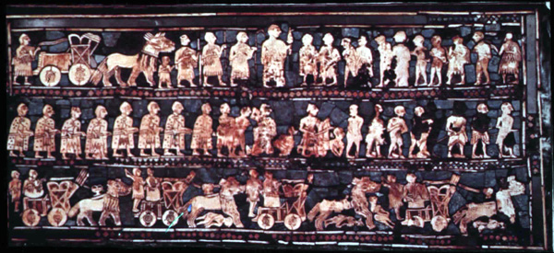
Side with warfare
Notes:
OTRA PARTE DE LA SOCIEDAD:
LOS GUERREROS:
LOS GENERALES
LOS CAPITANES
LOS SOLDADOS

Slide 9
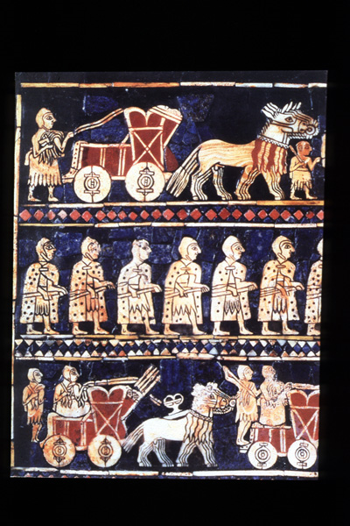
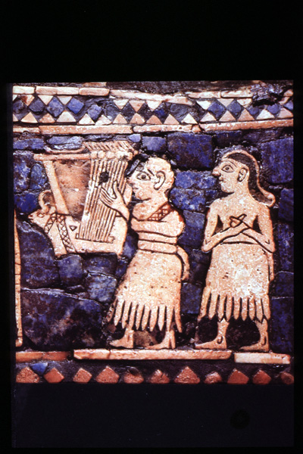
MUSICOS QUE ALEGRAN AL REY
Notes:
LOS MUSICOS ERAN PERSONAL DE LA REALEZA.

Slide 10
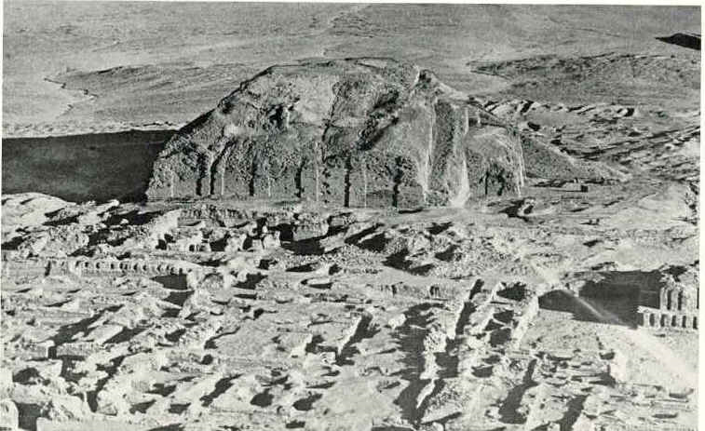
This ziggurat was erected to the moon god Nanna.
It was built by Ur-Nammu at Ur around 2113-2096 B.C

Slide 11
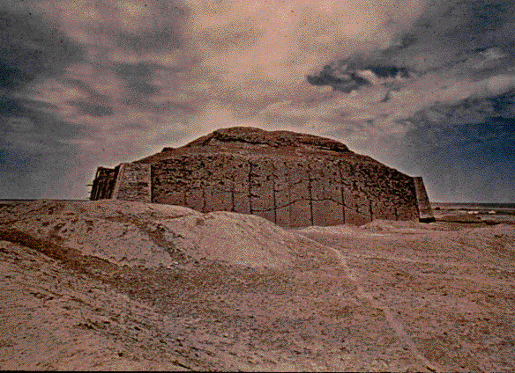
Notes:
ZIGURAT RECONSTRUIDO

Slide 12
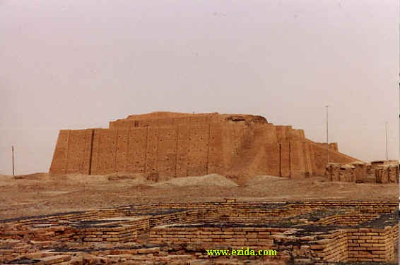

Slide 13
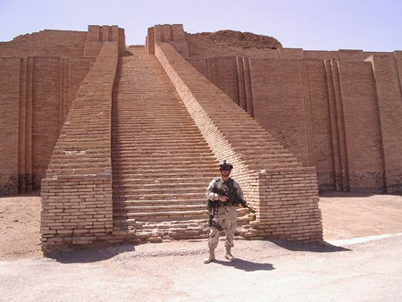
Notes:
SOLDADO DE USA EN LA GUERRA RECIENTE.

Slide 14
Tumbas Reales
Extravagant jewelry of gold, lapis lazuli, and carnelian, cups of gold and silver, bowls of alabaster, and extraordinary objects of art and culture were among the Mesopotamian treasures uncovered in the late 1920s by renowned British archaeologist C. Leonard Woolley in a joint expedition by the British Museum and the University of Pennsylvania Museum.

Slide 15
One of the most spectacular discoveries in ancient Mesopotamia (modern day Iraq), the royal tombs at Ur opened the world's eyes to the full glory of ancient Sumerian culture (2600-2500 BC) at its zenith.

Slide 16
The Ur site excavated by C. Leonard Woolley and his team contained about 1800 burials. Woolley classified 16 of these as "royal" based on their distinctive form, their wealth, and the fact that they contained burials of servants and other high-ranking personages along with the "royal" person.
Notes:
DESCUBRIERON 1800 SEPULCROS.
16 DE LA REALEZA.

Slide 17
The royal cemetery tomb of Queen Puabi, like the tomb of King Tutankhamun, was an especially extraordinary find for being intact, having escaped looting through the millennia.
Notes:
UNICA TUMBA INTACTA DE LAS TUMBAS REALES ES LA DE LA REINA PUABI.

Slide 18
The tomb featured a vaulted chamber set at the bottom of a deep "death pit"; the lady was buried lying on a wooden bier. She was identified by a cylinder seal bearing her name that was found on her body. The seal is carved in cuneiform and written in Sumerian, the world's first written language.
Notes:
EL LENGUAJE ESTÁ EN CUNEIFORME SUMERIO, EL PRIMER LENGUAJE ESCRITO DEL MUNDO.

Slide 19
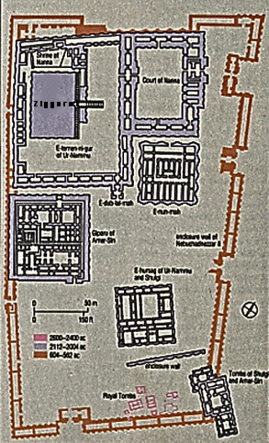
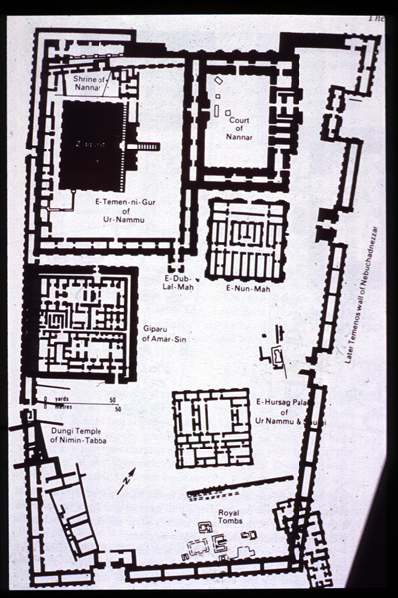
TUMBAS REALES
Plan of the central temenos of Ur, showing location of the Royal Cemetery

Slide 20
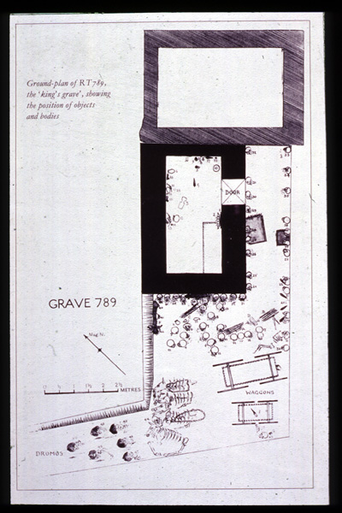
Plan of the so-called "King's Grave"

Slide 21
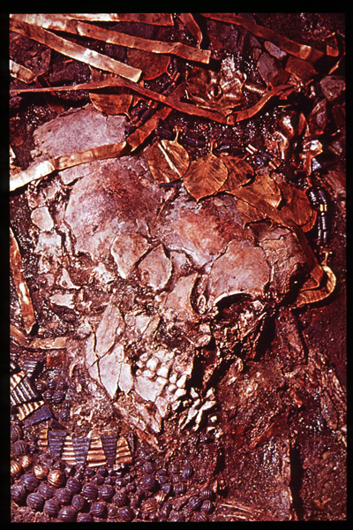
Crushed skull of a female attendant, with jewelry and headdress

Slide 22
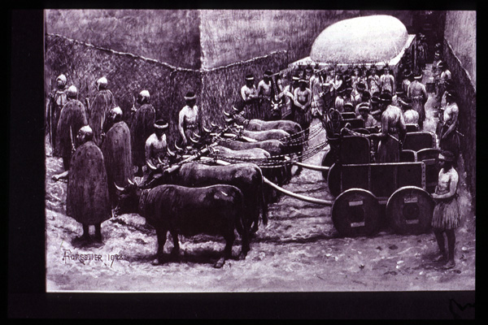
Reconstruction of a funeral in the cemetery
Notes:
LOS ARQUEOLOGOS CREEN QUE TODOS SE UBICABAN LISTOS PARA MORIR Y BEBIAN ALGUN VENENO.
POR SUS CREENCIAS ERA UN HONOR MORIR JUNTO AL REY.

Slide 23
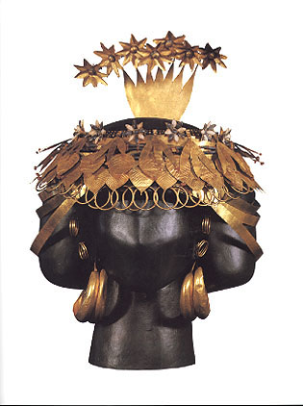
QUEEN PUABI'S HEADDRESS. (40K) Gold, lapis lazuli, and carnelian.

Slide 24
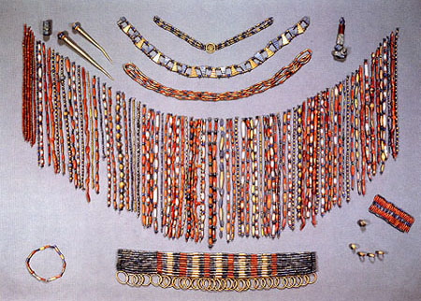
QUEEN PUABI'S BEADED CAPE AND JEWELRY. (89K) Gold, lapis lazuli, carnelian, and various stones.
Notes:
JOYAS Y CUENTAS O COLLARES

Slide 25
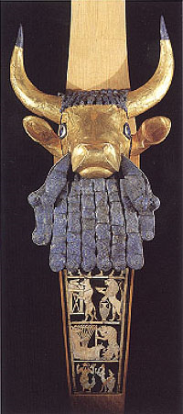
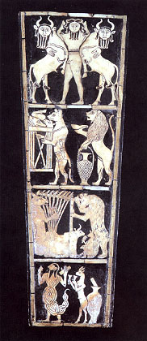
REAT LYRE FROM THE "KING'S GRAVE." (Left = 40K Right = 39K) Gold, lapis lazuli, shell, bitumen, and wood. Height of head 35.6 cm, Height of plaque 33 cm.
Notes:
IZQUIERDA: UNA LIRA

Slide 26
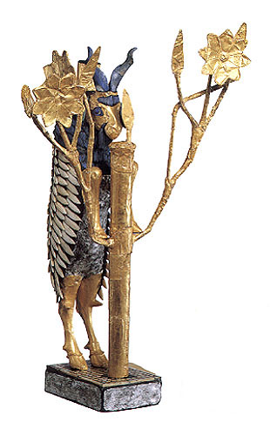
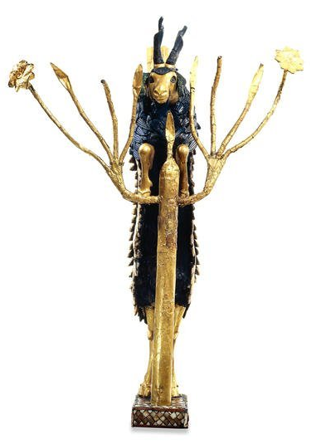
"RAM CAUGHT IN A THICKET." (46K) Gold, silver, lapis lazuli, copper, shell, red limestone, and bitumen. Height 42.6 cm.
Notes:
LA HISTORIA DE ABRAHAM CUANDO IBA A MATAR A SU HIJO PUEDE REFLEJAR UNA LEYENDA DE UR DE LOS CALDEOS CON RESPECTO A UN CARNERO ENREDADO EN UN ARBUSTO.

Slide 27
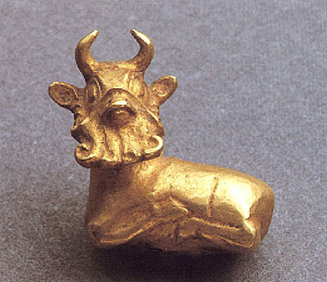
GOLD BULL AMULET. (44K) Height 1.5 cm, Width 1.5 cm.

Slide 28
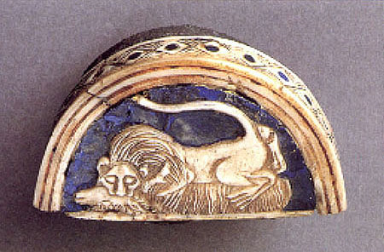
COSMETIC BOX WITH INLAID LID. (59K) Silver, lapis lazuli, and shell. Height 3.5 cm, Diameter across lid 6.4 cm.
Notes:
CAJA DE COSMÉTICOS.

Slide 29
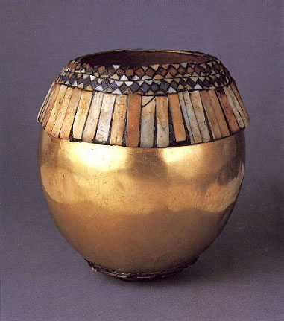
GOLD VESSEL IN THE FORM OF AN OSTRICH EGG. (47K) Gold, lapis lazuli, red limestone, shell, and bitumen. Height 14.6 cm, Diameter 13 cm.
Notes:
VASIJA DE ORO CON LA FORMA DE UN HUEVO DE AVESTRUZ

Slide 30
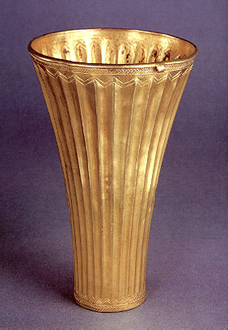
TUMBLER. (37K) Electrum. Height 15.2 cm.

Slide 31
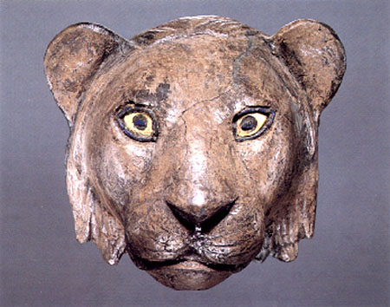
SILVER HEAD OF A LION. (55K) Silver, lapis lazuli, and shell. Height 11 cm, Width 12 cm.
Notes:
EL LEON ES EL SIMBOLO DE LA CULTURA MESOPOTAMICA

Slide 32
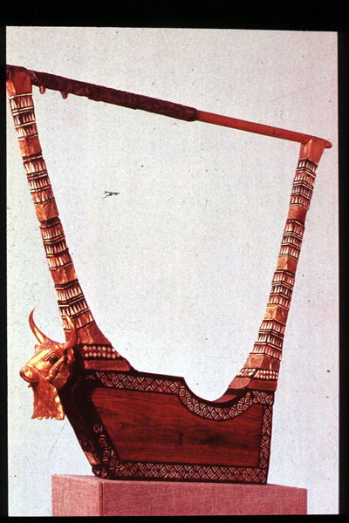
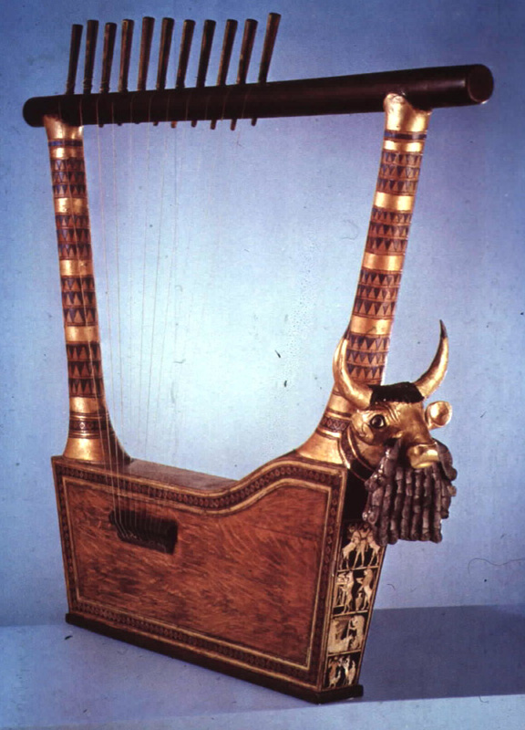
Lyre from tomb of Meskalamdug, restored

Slide 33
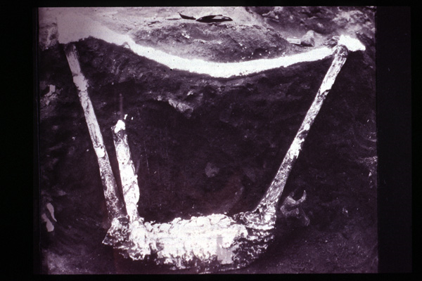
Notes:
LA LIRA TAL COMO LA ENCONTRARON

Slide 34
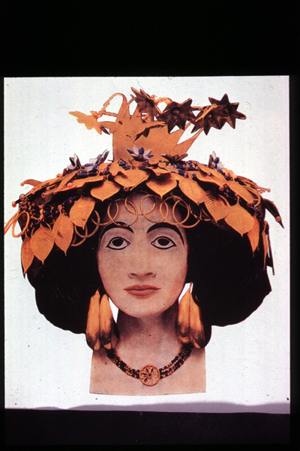
Headdress and jewelry of Queen Pu-Ab

Slide 35
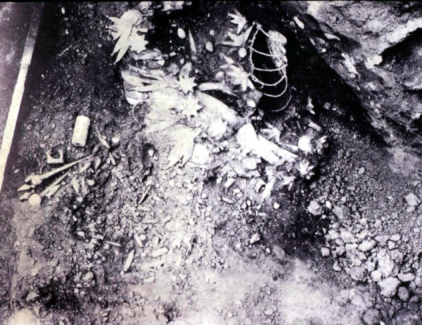
Notes:
AQUÍ ESTÁ LOS RESTOS DE LA REINA PUABI

Slide 37
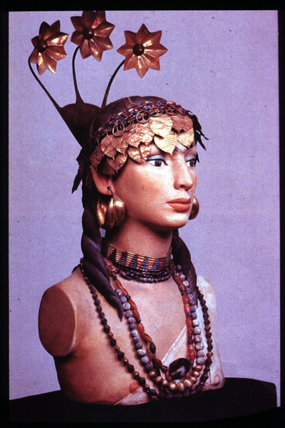
Restoration of headdress and jewelry (gold and lapis lazuli) of a female attendant
Notes:
RECONSTRUCCIÓN DE LA MUJER QUE LE APLASTARON EL CRANEO. ERA ASISTENTE DE ALGUIEN DE LA REALEZA.

Slide 38
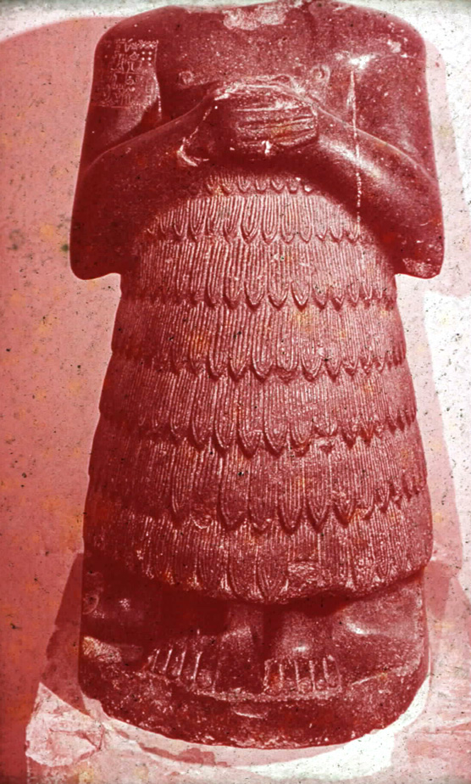
Stone worshipper statuette of Entemenna of Lagash
Notes:
ESTATUA DE PIEDRA DE UN ADORADOR

Slide 39
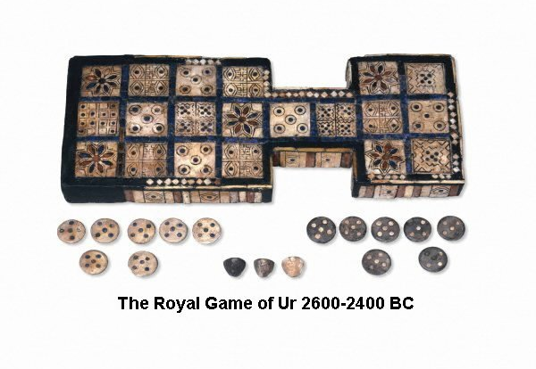

Slide 40
WOOLLEY AND THE GREAT FLOOD
Among C. Leonard Woolley's discoveries at Ur were thick layers of water-laid clay found beneath Ur and dating back to between 4,000 and 3,000 BC. Woolley declared this find to be evidence of the "Great Flood" recorded in Mesopotamian narratives and in the Book of Genesis.
Notes:
DESCUBRIMIENTOS DE WOOLLEY SE ENCUENTRAN CAPAS GRUESAS DE ARCILLA QUE FUERON ENCONTRADAS DEBAJO DE UR Y QUE SE DATAN ENTRE LOS AÑOS 4.000 A 3.000 ANTES DE CRISTO, Y SE PRESENTAN COMO EVIDENCIA DE UN GRAN DILUVIO REGISTRADAS EN EL LIBRO DE GENESIS Y EN LAS NARRACIONES MESOPOTAMICAS.

Slide 41
Included in the exhibit are samples of the "Flood Mud" discovered beneath Ur, and the Nippur Tablet, a clay tablet from ancient Nippur which is the only surviving document of the Sumerian flood story.
Notes:
ADEMÁS DE LO ANTERIOR TAMBIEN SE ENCONTRO LA TABLILLA DE NIPPUR QUE SUPUESTAMENTE PERTENECIÓ AL ANTIGUO NIPPUR Y QUE SOBREVIVIÓ PARA CONTAR LA HISTORIA DEL DILUVIO SUMERIO

Slide 42
Dating from the 17th century BC, the tablet contains six columns of text, three per side, with 10-15 lines in each column. Written in Sumerian, it not only tells the flood story, but also describes the creation of humans and animals, and records the names of antediluvian cities and their rulers.
Notes:
LA TABLILLA ES DEL SIGLO XVII AC, CONTIENE SEIS COLUMNAS DE TEXTOS, TRES POR CADA LADO, ESCRITO EN SUMERIO. DESCRIBE EL DILUVIO, LA CREACION DE LOS ANIMALES Y HUMANOS Y LOS REGISTROS DE LOS NOMBRES DE LOS ANTEDILUVIANOS CON SUS CIUDADES Y SUS GOBERNANTES.

Slide 43
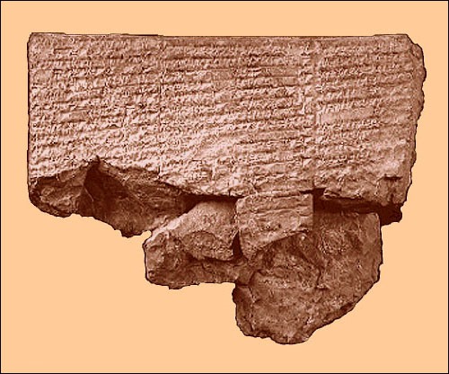
Notes:
ESTA ES LA TABLETA DE NIPPUR.

Slide 44
Archaeologists and language specialists today doubt that the Ur (or Kish) floods could be the source of the Mesopotamian flood narratives. Instead, they view the discovered flood deposits merely as evidence that flooding was a persistent hazard in the flat alluvial plain of southern Mesopotamia.
Notes:
LOS ARQUEOLOGOS Y ESPECIALISTAS DUDAN DE LAS NARRATIVAS DEL DILUVIO. CREEN QUE ERA UNA AMENAZA PERSISTENTE DE LA LLANURA DEL SUR DE MESOPOTAMIA.

Slide 45
On the other hand, many scholars believe that the Mesopotamian flood tradition was reshaped by Hebrew writers of the 8th and 6th centuries BC into the biblical account of Noah and the Great Deluge found in the Book of Genesis.
Notes:
POR OTRO LADO, ALGUNOS CIENTIFICOS CREEN QUE EL DILUVIO DE LA TRADICIÓN MESOPOTAMICA FUE RECONSTRUIDO POR LOS ESCRITORES HEBREOS ENTRE LOS SIGLOS 8 AL 6 AC EN EL REGISTRO BÍBLICO DE LA GRAN HISTORIA DE NOE EN EL LIBRO DE GENESIS.
CUAL ES EL PROBLEMA? ESTE RELATO FUE ESCRITO ANTES DEL RELATO BIBLICO.

Slide 46
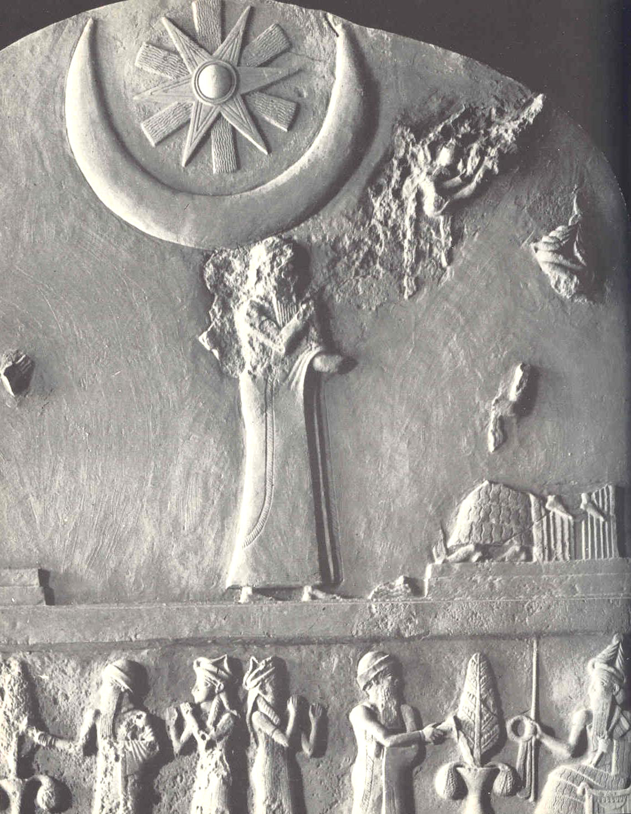
ESTELA DE UR-NAMU 2100 AC
Notes:
OTRO HALLAZGO.
TAREA. INVESTIGAR SOBRE ABRAHAM Y LA TIERRA DE UR.
LOS ANTIGUOS CONSIDERABAN A LOS REYES COMO DIOSES: LOS ADORABAN Y LO RESPETABAN.

