Slide 1



Standard and Advanced Modes
The getKanban Board Game can be played in one of three modes. This slide deck is for Standard and Advanced modes.
The slide deck for Quick Play mode, as well as Apple Keynote versions can be found at www.getkanban.com
This deck includes the Facilitator’s Guide, Game Setup, and Game Instructions. If you are new to the game and will be facilitating it, start with the Facilitator’s Guide.
  Contents
  Facilitator’s Guide
  Game Setup
  Game Instructions
Game version: 3.0
Slide deck version: 3.0.std.adv.pp1
© getKanban Ltd, 2012

Slide 2
Facilitator’s Guide
  Facilitator’s Guide
Hello Facilitator
Thank you for your interest in The getKanban Board Game! Before playing the game with a group, it will pay to read through this slide deck, familiarize yourself with the physical components of the game, and run through the game by yourself.
This deck contains many animations, so it is best to view it in Slide Show view (i.e. play it), rather than edit view.
The instruction slides are very prescriptive to avoid ambiguity as you are starting out. If you facilitate the game often, you may wish to modify the startup procedure and rules to your own taste.
Feel free to modify and print this slide deck for your own use. Please don’t hesitate to contact us if you need any assistance with the game, or to make suggestions for improvement.
Kind regards
Russell Healy
Principal Consultant
getKanban Limited
Wellington, New Zealand
russell.healy@getkanban.com
  Facilitator’s Guide Contents
  Modes of play and game duration
  Teams
  Approach
  FAQ and facilitation tips
  Caveats and errata
  Game kit contents

Slide 3

Modes of play and game duration
  Facilitator’s Guide
The game can be played in one of three modes: Quick Play, Standard, or Advanced. This slide deck is for Standard and Advanced modes.
Quick Play
Quick Play mode is designed to be played in 60 – 90 minutes, so is suitable for an evening community event, or similar. It runs for seven simulated days from Day 9 through Day 15. Only one chart is tracked, cycle time data is not collected, WIP limits may not be adjusted, and many learning points are skipped over.
Standard
Standard mode is designed to be played in approximately two and a half hours. It runs for ten simulated days from Day 9 through Day 18. All of the charts are tracked, cycle time is collected, WIP limits may be adjusted (from Day 13), the concept of class of service is introduced. There is less opportunity for reflection and discussion during the game. The strategies used, particularly related to choice of WIP limits, do not have time to play out fully.
Allow approximately:
45 minutes for game instructions
75 minutes for game play
30+ minutes for debrief
Advanced
Advanced mode is designed to be played for a minimum of 3 hours. It runs for sixteen simulated days from Day 9 through Day 24. More advanced concepts are introduced, and winning and losing strategies make themselves much more evident in the final stages of the game. There are more opportunities to analyze and discuss the impact of events, and other aspects of the game.
Allow approximately:
45 minutes for game instructions
120 – 180 minutes for game play
30 – 60+ minutes for debrief and discussion
Mode Indicators
Several components of the game have mode indicators:
Quick Play
Standard
Advanced
A mode indicator indicates that the component, or instruction is only to be used in that mode of play. If there is no mode indicator, the component or instruction is used in all modes.
Other Slide Decks
The slide deck for Quick Play mode, as well as Apple Keynote versions can be found at www.getkanban.com

Slide 4



Teams
  Facilitator’s Guide
The game is designed to be played by a team of people. It involves constant decision making, and can sometimes suffer from lengthy analysis.
To counter this, it is best when multiple teams play at the same time. You can enhance the competition by either offering a bonus for the first team to finish (as described in the Game Instruction slides) or setting a fixed time limit at which game play must stop.
The ideal team size is about six players. There are five specific roles that some players will take, which require significant attention from the people playing them, so it is good to have additional players to operate the board. If there are less than five players, players can take on multiple roles, or choose not to track some of the charts.
Be careful not to have too many people on a team. If there are more than eight players per team, some people may disengage.

Slide 5
Approach
  Facilitator’s Guide
Set up kits
Ensure that any dry-erase markings left on the board, charts, and tickets from previous games are removed. Set up the game kits as shown in the Game Setup slides.
The Game Instruction slides contain a lot of animation, and some long slide sequences. In order to show you how far through a slide sequence you are, indicators like these are provided in the top right-hand corner. Open dots show how many clicks are remaining in the sequence.
The Game Instructions include a facilitator-led walkthrough of Day 9. This is the most effective way to “boot up” the game. All of the decisions are made already, including the dice rolls, and which tickets to pull in. This enables you to compare the teams’ boards at the end of Day 9 with the illustrations provided in the slides, to confirm that the teams have played correctly.
As you step through Day 9, the teams learn the rules of the game in detail. This enables them to play the rest of the game without needing to ask a lot of questions.
The teams are asked to pause before the end of Day 10, when further instructions are given. This is done to move some of the instructions closer to where they are needed.
Important: include only two (not three) green dice when setting up the game kits. The teams will request the third green die on day 14 of the game.
Do not hand out the Expedite tickets, E1, E2, and E3. Do not hand out the Outcome cards. The teams will request these items during the game.
Present instructions and Day 9
Present the Game Instruction slides. The first three slide sequences are supplementary. They introduce concepts that are useful for playing the game. You may not need to present them if the players are already familiar with them.

Slide 6
Approach
  Facilitator’s Guide
Play the game
After walking through Day 9, and pausing at the end of Day 10, you will let the teams play on their own. They should be able to play almost un-aided, though there will be some questions, so it is important that you understand the game fully before facilitating it. It is best if you have played it yourself first.
Facilitation tips
These are some things to look out for as the teams play.
Day 12 is the first time that teams play through the end of a billing cycle on their own. Pay close attention to ensure that they read and follow the Daily Steps guide accurately and in order. Make sure that when the Ready queue is replenished, tickets are pulled all the way through to Analysis in Progress.
Check regularly to make sure that the Day Ready and Day Deployed fields are updated on the tickets.
End of game and debrief
Be sure to take photos of the charts and financial summary sheets at the end of the game. There is a debrief section at the end of the slide deck. It is long, so don’t try to cover everything. You might want to choose your favorite questions beforehand, and perhaps add some of your own.
Clean off dry-erase
Be sure to clean all dry-erase markings from the boards, charts, and tickets. The last Event Card of the game asks the teams to do this for you. These items are dry-erase treated, and designed to be written on, but when markings are left to dry they become difficult to remove. Old markings may be removed with white-board cleaner and a cloth if necessary, but this may shorten the life of the board if done repeatedly.

Slide 7
Frequently Asked Questions
  Facilitator’s Guide
Why do we have to prioritize the tickets, and work on tickets in priority order?
In the real world, when we set out to work, we don’t know beforehand how much we are going to get done. It would be unrealistic to roll the dice, to find out how much we achieved, then decide what to work on. Additionally, this rule reduces decision-making during the day, and helps the game run more quickly and smoothly.
Why is there no limit on the Ready to Deploy column?
This is because in the game we have releases every three days, so work is not able to accumulate too much here and become a problem. In a real-life situation, if this was a problem, or if deployments were less regular, you might choose to limit finished work that is not yet deployed.
Can we lose subscribers on a brown Standard ticket if the result of the calculation for subscribers is negative?
Yes. The quality of your feature is so poor, that some of your existing customers went elsewhere!
Can we choose not to finish brown Standard tickets if they are too late?
No. Any Standard tickets left on the board at the end of the game must have their subscriber calculations done as if they were deployed on the last day of the game. If the result is negative, you lose subscribers. If it is positive you do not gain any because the work is unfinished.
Does a blocked item count towards the WIP limits?
Yes.
What color marker pen should the Control Chart Tracker use for the white Expedite tickets?
A black marker pen.
When we have completed purple Intangible ticket I2, which tickets do we apply the outcome to?
All tickets in the whole game with any test work remaining. This includes any tickets still in the backlog, and any tickets that have not finished Testing.

Slide 8
Caveats and Errata
  Facilitator’s Guide
Caveats
The Kanban board used is an example board, not “the definitive Kanban board.” Each Kanban system should be designed for the context within which it is being used, and should evolve and improve over time.
The game uses resource allocation exclusively to address bottlenecks. This is to keep the game simple yet maintain tension in the process. In reality, flow problems will need to be analyzed for root cause and addressed appropriately in the specific context. For example, it may be that quality at an upstream station is poor, and needs to be addressed.
The real power of Kanban is that it makes impediments to flow visible, enabling us to do something about them. Without this appreciation, there is a risk that people understand the mechanism, but limit the value they gain from it.
The activities of rolling dice, striking off work, tracking charts etc are overhead that does not exist when using Kanban in real work. There are software tools available, and we don’t usually roll dice to get our jobs done!
Kanban does not require that work remaining on individual items is burned down (as it is on the stories in the game) or reported, neither does it stop you doing this.
The game has a “pushy” pull mechanism, in that tickets are pulled downstream to satisfy WIP limits, not pulled when work begins on the ticket. This is a limitation of using dice and aggregating the work available to spend on tickets. If we only pulled when work started on a ticket, there would always be one ticket in any In Progress column, even though there are multiple people on the team, and it just wouldn’t look right.
Don’t copy this mechanism in a real Kanban system. In real life, it is better to have downstream stages pull from upstream when the downstream stage is ready to begin the work. This will make date-stamps on tickets more accurate. If you need to add a buffer before a bottleneck stage or a non-instant availability resource, do so explicitly.
Errata
The Day 8 circle at the top of the Financial Summary Sheet should already have a tick in it.
The term “Cycle Time” should be replaced with the term “Lead Time” throughout the game.

Slide 9


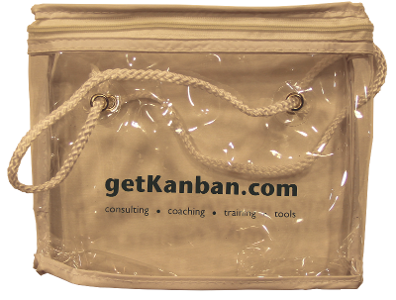
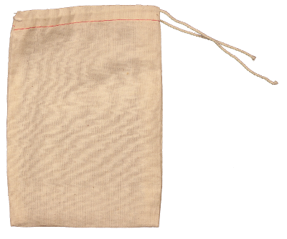
Game Kit Contents
  Facilitator’s Guide
One game kit includes one green sleeve, one clear tote bag, and one cotton bag. If you have multiple game kits, you should have one of each of these bags per kit.
One black carry bag will hold up to three game kits comfortably.

Slide 10
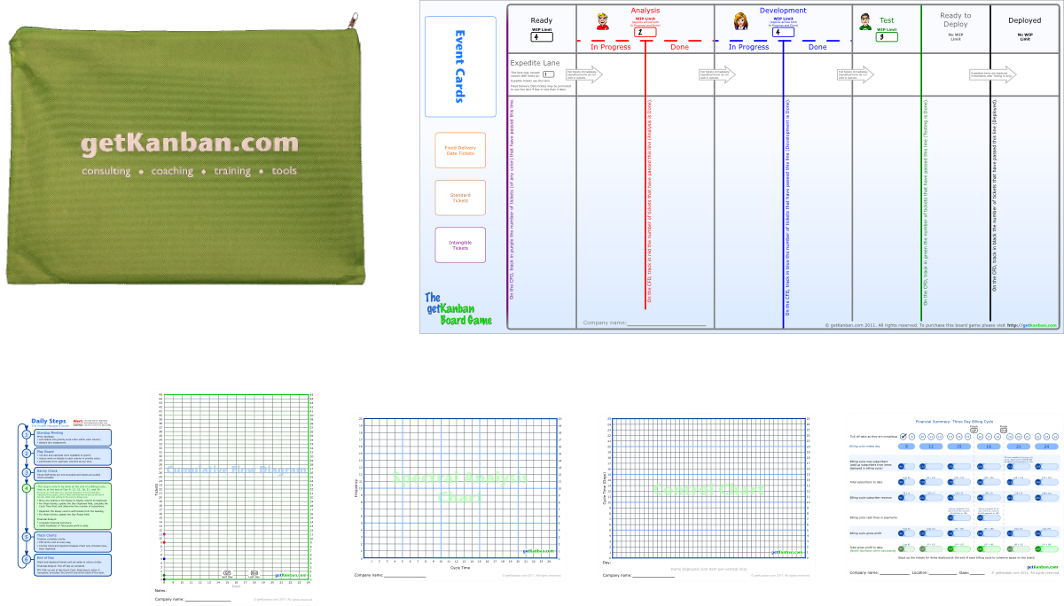
Game Kit Contents
  Facilitator’s Guide
The green sleeve contains one six-fold game board, one Daily Steps Guide, one CFD chart, one Spectral Analysis Chart, one Control Chart, and one Financial Summary sheet.
The six-fold game board can be confusing to fold down, so pay attention as you open it up, and take care when folding it back down.

Slide 11
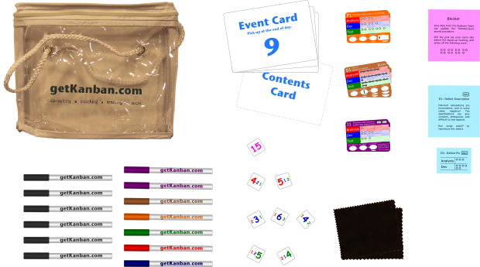
Game Kit Contents
  Facilitator’s Guide
The clear tote bag contains:
16 Event Cards labeled 9 – 24
one Contents Card
40 tickets: S1 – S36, F1, F2, I1, I2
Dice: 2 Red, 3 Blue, 2 Green, 1 Pink
Dry-erase markers: 6 Black, 2 Purple,
1 Brown, 1 Orange, 1 Green, 1 Red, 1 Blue
Pink blocker stickies
Blue Defect Description stickies
Blue Defect Fix Stickies
6 cloths

Slide 12
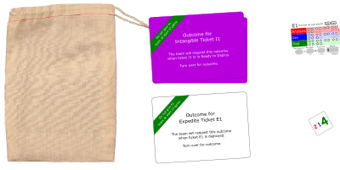
Game Kit Contents
  Facilitator’s Guide
The cotton bag contains:
1 Green die
3 White tickets: E1, E2, E3
3 White ticket outcomes: E1, E2, E3
2 Purple ticket outcomes: I1, I2

Slide 13

Game Setup: Standard and Advanced Modes

Slide 14
Facilitator: Prepare a Visible Scoreboard
Standard mode requires days 9, 12, 15, and 18 only
Team \ Billing Cycle End
Day 9
Day 12
Day 15
Day 18
Day 21
Day 24

Slide 15
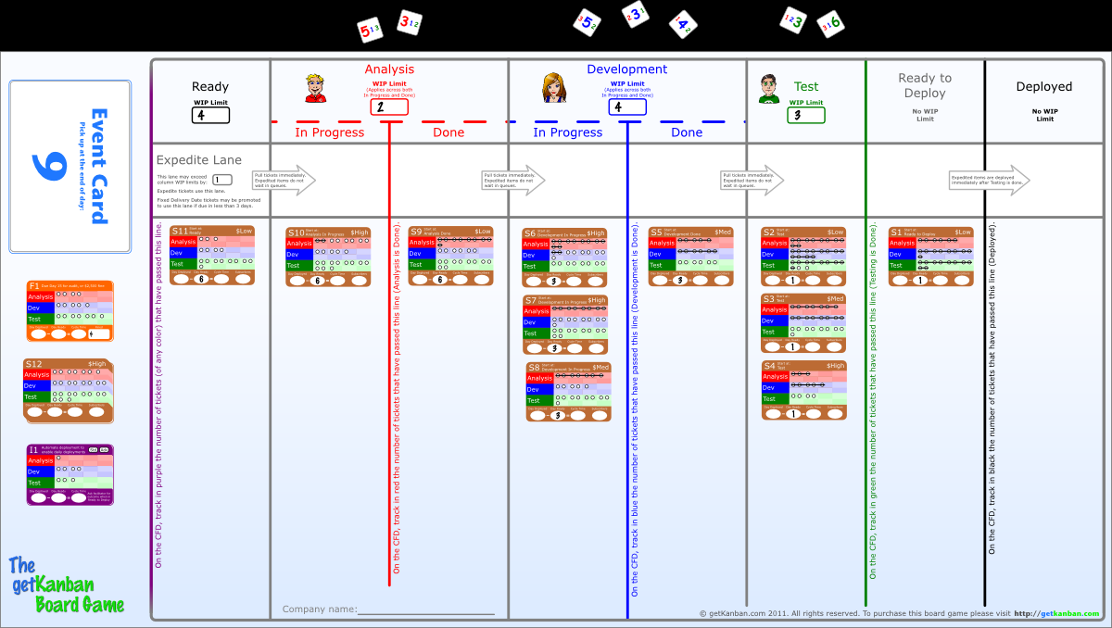

Board Setup
The boards should be set up as indicated. Tickets S1 – S11 should be placed in the column indicated “Start at” on the ticket. For example, S1 starts at Ready to Deploy:
Remaining tickets should be stacked in the designated areas to the left of the board. The following tickets and Event cards are not used in Standard mode: orange Fixed Delivery Date ticket F2, Event Cards 19 - 24.

Slide 16
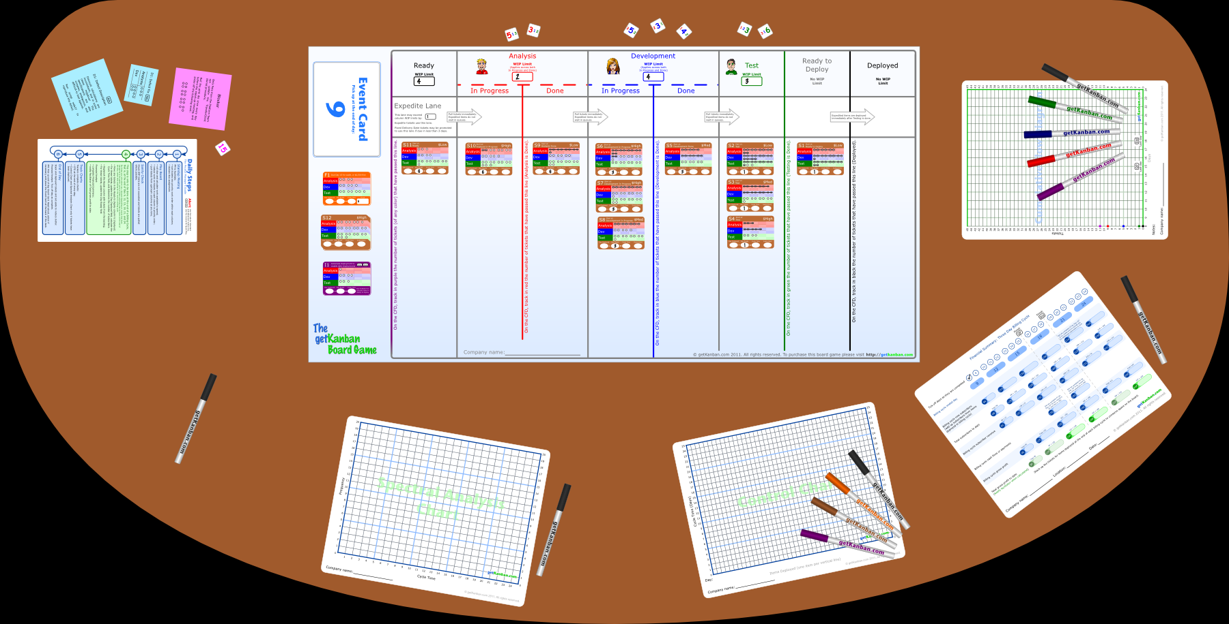
Component Setup
The components of the game should be laid out as shown.
It is important that the colored marker pens are placed with the correct charts.

Slide 17
Game Instructions: Standard and Advanced Modes

Slide 18
Supplementary Slides
The next few slides introduce some key concepts. You might want to skip them if the concepts are already understood.
The concepts are:
Costs associated with long cycle time
W. Edwards Deming, who is referred to in the game
The basic mechanics of Kanban
  Skip these slides

Slide 19




Examples of Costs Resulting from Long Cycle Time
I need to know if this estimate you gave me last month is still accurate.
Yes, it’s a defect, and I’ve built all this other stuff on top of it!
x
I don’t think this requirement is valid any more, is it?
I don’t have time to fix it all properly now. I’ll do a quick fix and tidy it up later.
OK. I’ll get it to you by Monday, I’m in on the weekend anyway.
Can you take a look at this? I think it’s a defect.
I’ll check with Jim when he get’s back. He’s away for a few days.
But I worked on that three weeks ago! I’ll have to read through the code again.
x
x
Project
Manager
x
?
?
Analyst
Developer
Tester
Knowledge decay
+ increase in the cost of fixing defects
+ reduced quality
+ information becomes stale and needs rework
+ delays accumulate
= reduced customer value

Slide 20
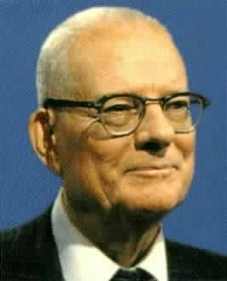
W. Edwards Deming
“Improve constantly and forever the system of production and service, to improve quality and productivity …”
“Eliminate management by objective. Eliminate management by numbers, numerical goals. Substitute leadership.”
“Hold everybody accountable? Ridiculous!”
“A bad system will defeat a good person every time.”
“Drive out fear”

Slide 21
Kanban Mechanics in a Nutshell
Ready (4)
Analysis (2)
Development (4)
Test (3)
Ready to Deploy
Deployed
In Progress
Done
In Progress
Done
10
9
8
5
4
1
11
6
2
12
7
3
13
14
Here is an example Kanban board. Notice the stages of the process, represented as columns. Notice the WIP limits in parentheses beside the column names.
Let’s say testing of ticket 1 is complete. We move it downstream to indicate that it is ready to deploy.
Now we have 2 items in Test, with a WIP limit of 3, so we may pull a ticket from Development Done into Test, leaving 3 in Development, which has a WIP limit of 4, so we may pull a ticket into Development from Analysis Done, and so forth.
Because our WIP limit in Development covers both In Progress and Done, when we complete development on a ticket, we may move it to the Development Done column to indicate that it is completed, without breaking a WIP limit.
WIP limits stop work being pushed downstream when there is insufficient capacity to receive the work. If development work on ticket 5 is completed, it cannot be “pushed” into Test, because Test is already at its WIP limit.
A ticket completes Testing, a slot comes free, and ticket 5 may now be pulled into Test.
The Ready queue may be replenished to its WIP limit with new work from the customer.

Slide 22
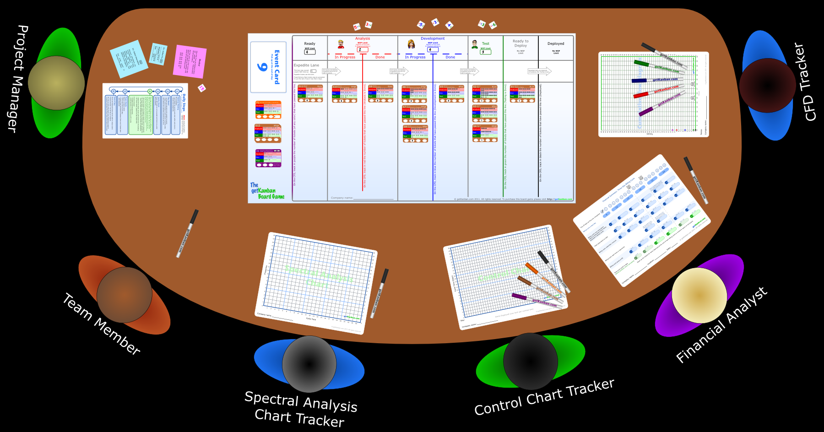
Team Setup
Teams should be set up as indicated.
It is best if all players are able to view the board right side up (rather than upside down).

Slide 23
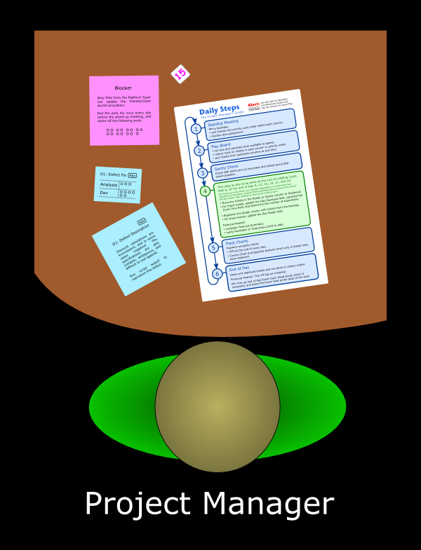

Project Manager
The Project Manager should be confident to read aloud with a booming voice so all the team can hear. No mumbling PMs, please! The PM should be seated to the left of the board, since she will be turning over and reading the Event Cards during the game. Her job is to coordinate the team and get the team through the game as quickly as possible.
The PM will need the Daily Steps guide (be sure that it is turned to the Std / Adv mode side), the pad of pink Blocker sticky notes, the die with pink numbers on it, the pad of blue Defect Descriptions, and the pad of blue Defect Fixes.

Slide 24
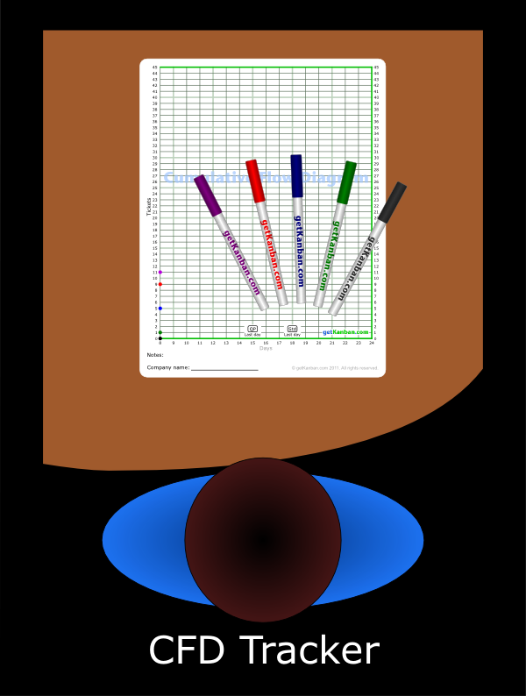
CFD Tracker
Tracking the CFD is the most difficult role in the game. The CFD (Cumulative Flow Diagram) Tracker should be confident with numbers. She should be seated to the right of the board, since she will be processing tickets as they are deployed.
The CFD Tracker will need the Cumulative Flow Diagram, and the following colored marker pens: black, green, blue, red, and purple.

Slide 25
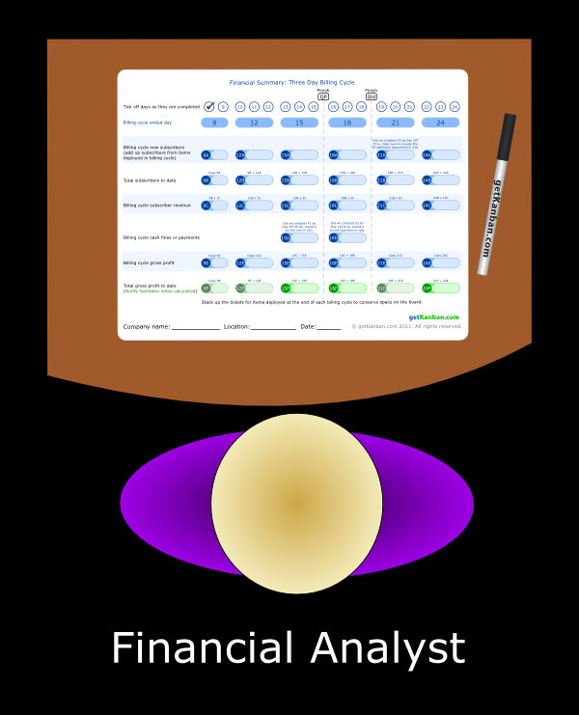
Financial Analyst
The Financial Analyst should be comfortable adding and multiplying numbers. He should be seated to the right of the board, since he will be processing tickets as they are deployed.
The Financial Analyst will need the Financial Summary sheet and a black marker pen. A calculator will be very useful.

Slide 26
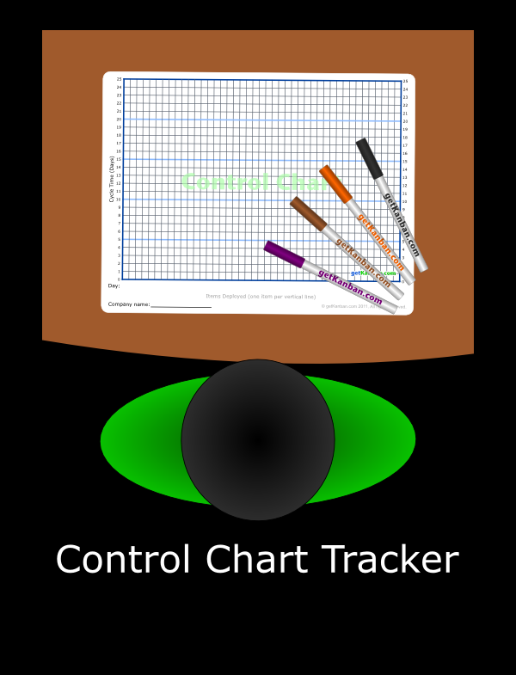
Control Chart Tracker
The Control Chart Tracker will be processing tickets as they are deployed, but has a less complex task than the CFD Tracker.
She will need the Control Chart, and the following colored marker pens: black, orange, brown, and purple.

Slide 27
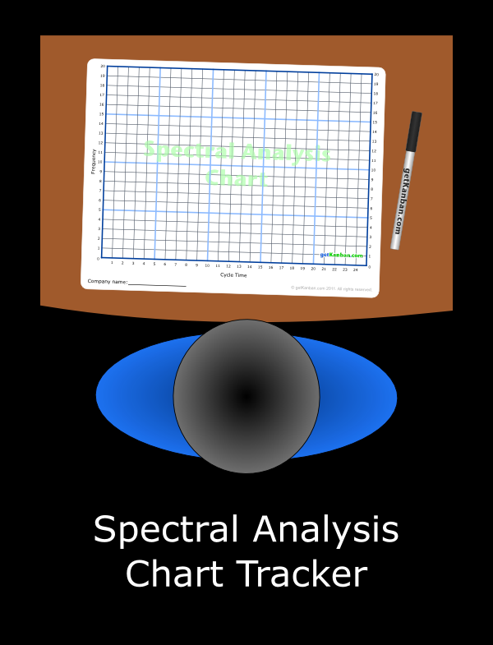
Spectral Analysis Chart Tracker
The Spectral Analysis Chart Tracker will be processing tickets as they are deployed, and also has a relatively simple task.
He will need the Spectral Analysis Chart, and a black marker pen.

Slide 28
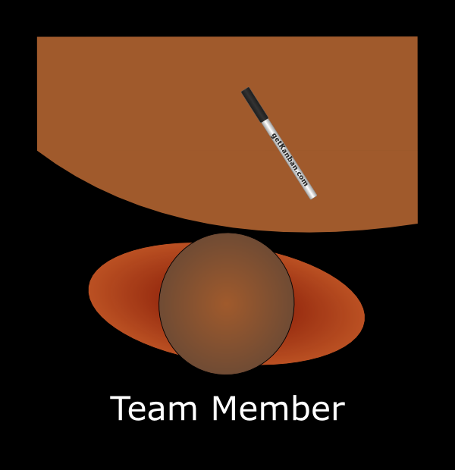
Remaining Team Members
Then remaining team members will have plenty of work to do. They can be seated anywhere around the board and will need a black marker pen each.

Slide 29
Arrange Roles and Seating
Arrange your roles and seating now.

Slide 30
Background
Your team is a software company.
You make a web application with a subscription-based revenue model.
The more subscribers you can attract, the more money you will make.
You bill your customers at the end of every third day. We call this the billing cycle.
Your goal is to maximise profit by attracting subscribers and therefore growing your revenue stream.

Slide 31
Choose a name for your company

Slide 32
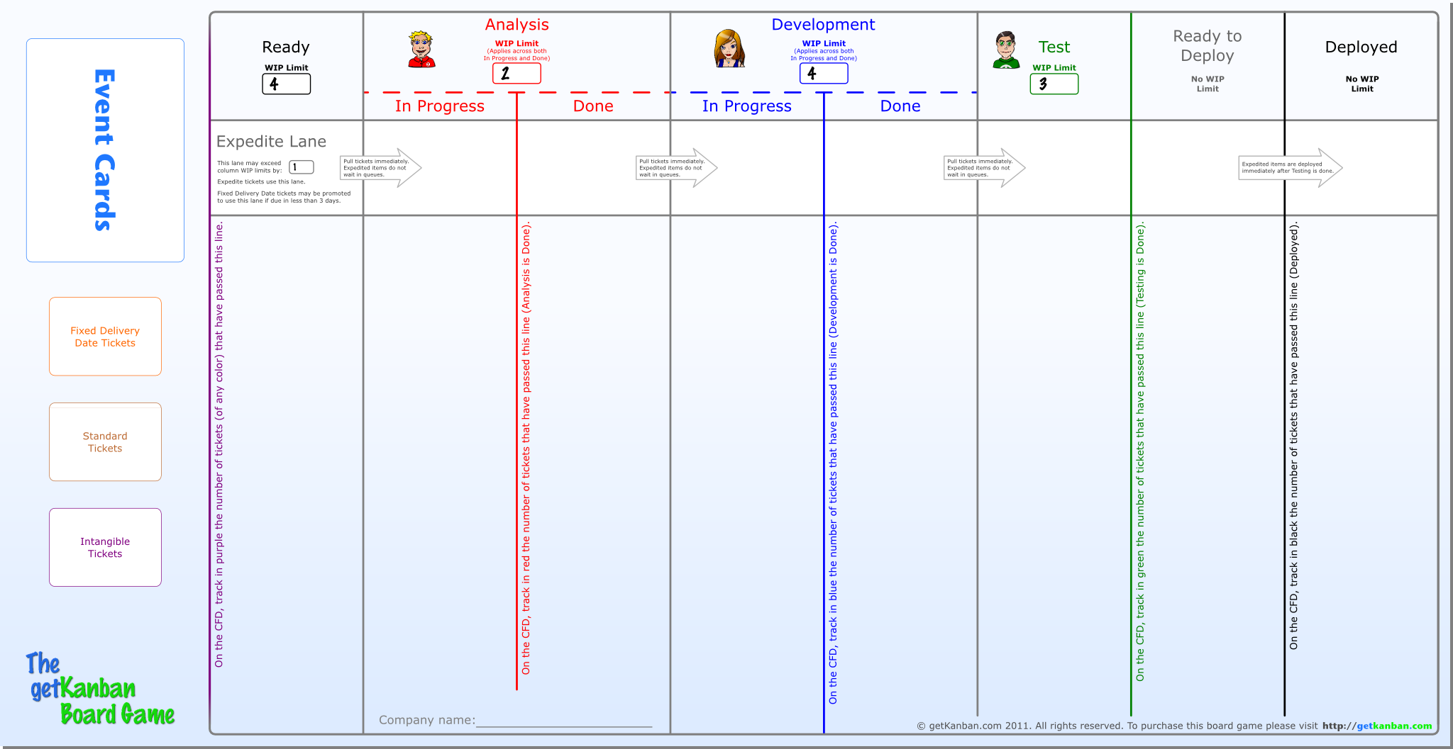
Write your company name at the bottom of your board

Slide 33
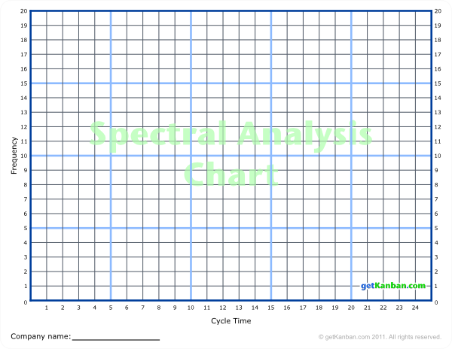
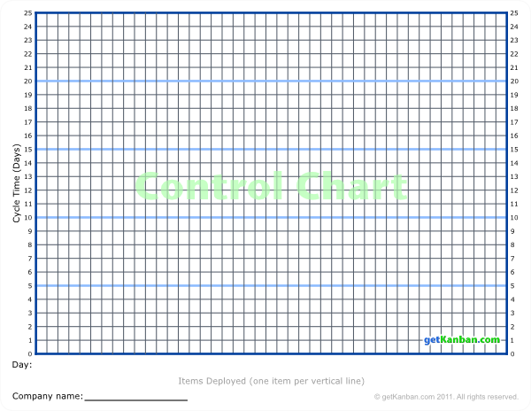
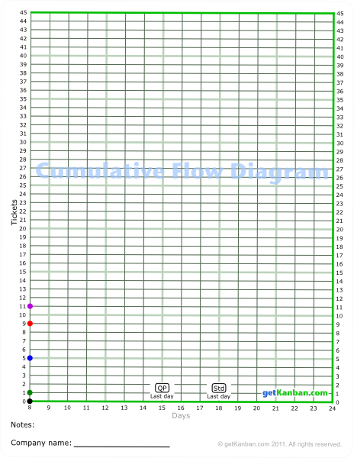
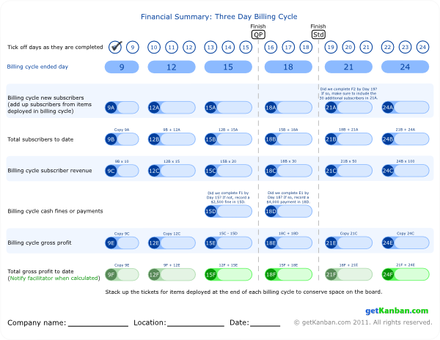
Chart Labels
Financial Analyst and Chart Trackers, complete the labels at the bottom of your sheets.
These are important, since we will take a photographic record at the end of the game.

Slide 34
Facilitator: Update Scoreboard with Team Names
Team \ Billing Cycle End
Day 9
Day 12
Day 15
Day 18
Day 21
Day 24
Faster Co
Wildcats
Flow Co
Extreme

Slide 35
WIP Limits
Notice that WIP limits for Analysis apply across In Progress and Done, the same is true for Development.
Notice that there are no WIP limits for Ready to Deploy and Deployed.

Slide 36
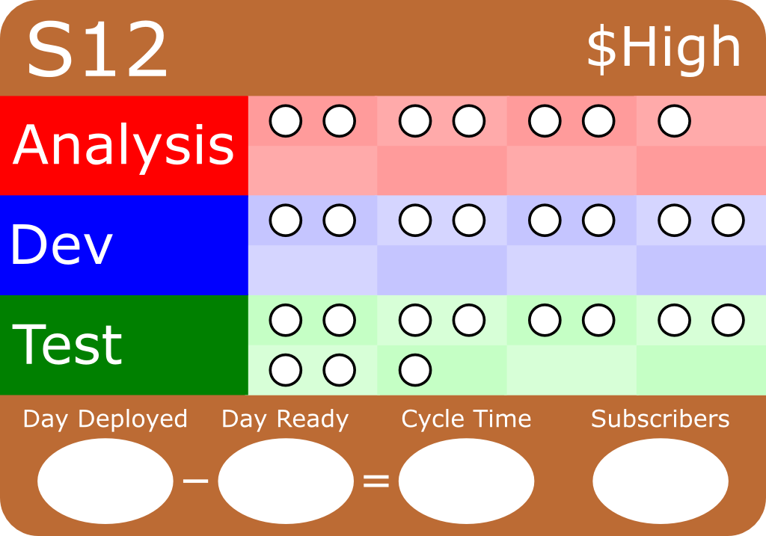
The three colored sections of each ticket
…
correspond to the three colored columns on the board.

Slide 37
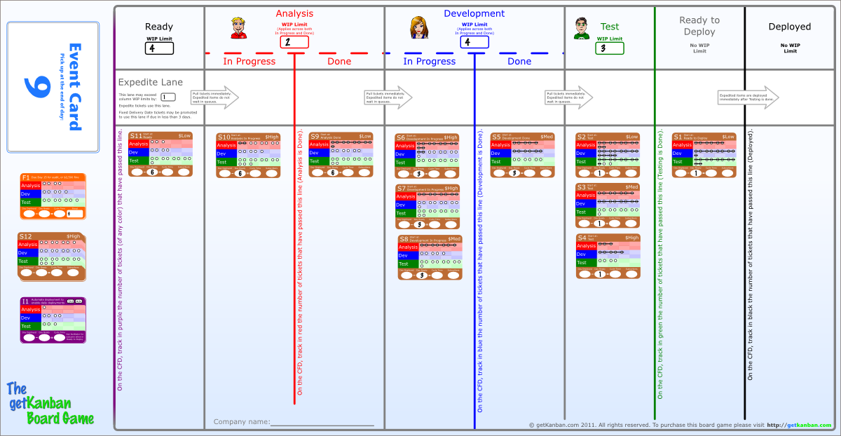
Starting on Day 9
You are about to start Day 9 of a project already underway. The topmost Event Card tells you the current day.

Slide 38
Starting on Day 9
You can see that work has already been done on some of the tickets.
You may not turn over tickets to see the outcome on the back until they are deployed.

Slide 39
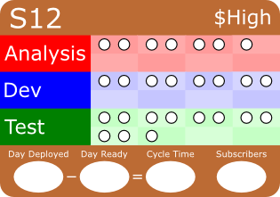







Your Team
This is your team. You have two analysts, represented by two dice with large red numbers, three developers represented by blue dice, and three testers represented by green dice.
Developer assigned to Analysis
2 Analysts
2 Testers
3 Developers
As you roll dice during the game, you will strike work off the corresponding section of the ticket.
You may choose to assign your team members to work in other specialties, but they are generally not as effective.

Slide 40


Optional: Divide Dice Among the Team
If you choose to, you may divide the dice among the team, such that one player is responsible for Analysis, another for Development, and another for Testing

Slide 41
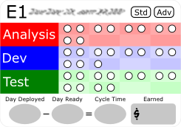
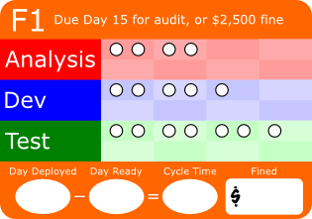
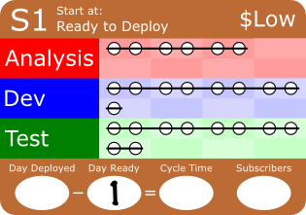
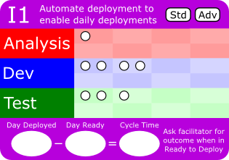
Classes of Service
There are four classes of service in operation in the game. The color of the ticket indicates which class of service it is to receive.
White tickets represent work that is very urgent and expected to be of high value. They receive an Expedite class of service. You do not have any Expedite tickets at the start of the game, but they will be introduced by Event Cards during the game.
Orange tickets have a Fixed Delivery Date. That is, they must be deployed on or before the date indicated on the ticket in order to gain the potential value (or avoid the cost of missing the date).
Brown tickets represent new product features. These receive a Standard class of service. Deployment of Standard tickets results in new Subscribers.
Purple tickets represent work for which the outcome is not expected to result in immediate or direct business value. These receive an Intangible class of service.

Slide 42
Ticket Value
Marketing has estimated the market value of each Standard ticket as High, Medium, or Low. High value tickets are expected to attract more subscribers. Marketing is usually right, but not always.
The actual outcome for each ticket is provided on the back of the ticket. You are not allowed to view the back of a ticket until it is deployed.

Slide 43
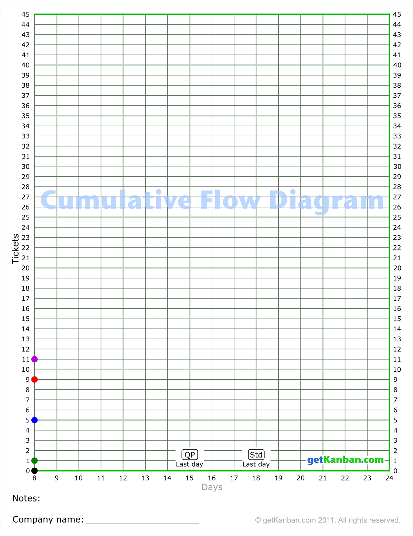
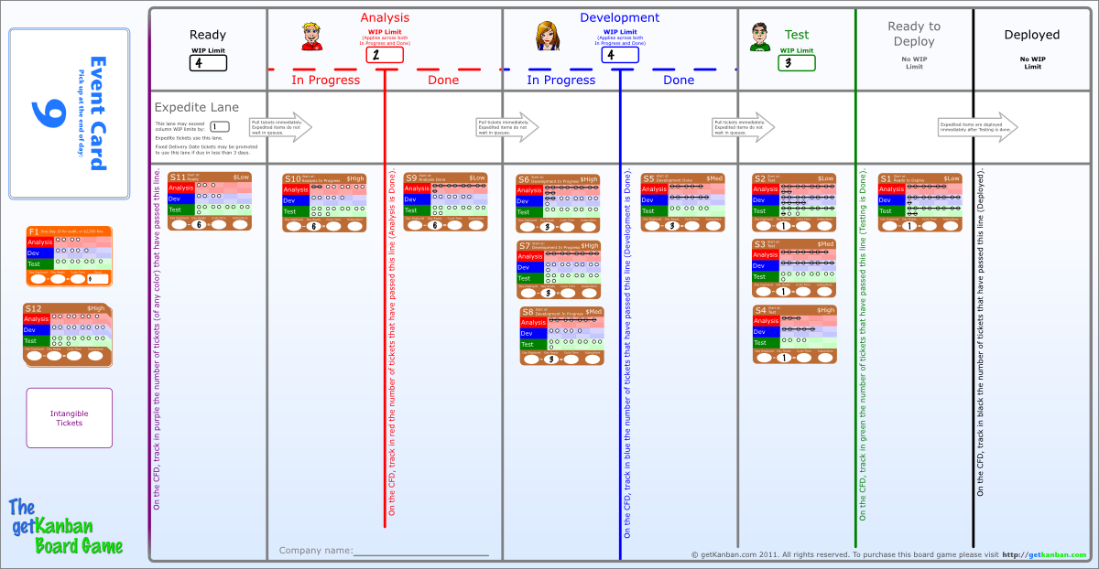
Understand the CFD at the end of Day 8
Zero tickets have passed the black line, and there is a black check mark at zero on Day 8 on the CFD. One ticket has passed the green line, and there is a green mark at one on the CFD. Five tickets in total have passed the blue line, there is a blue mark at five. Nine tickets have passed the red line, and eleven have passed the purple line.

Slide 44



Modes of Play
The game can be played in one of three modes, represented by these labels:
Quick Play
Standard
Advanced
Your Facilitator will tell you which of these modes you are playing in now.
If you see a label in the game, the labelled item is only used in the indicated mode. If there is no label, the item is used in all modes.

Slide 45
Day 9
We are now going to step through Day 9.
All of the decisions will be made for you, and you will follow along.
After Day 9, you will understand how to play, and you will make all further decisions yourselves.

Slide 46
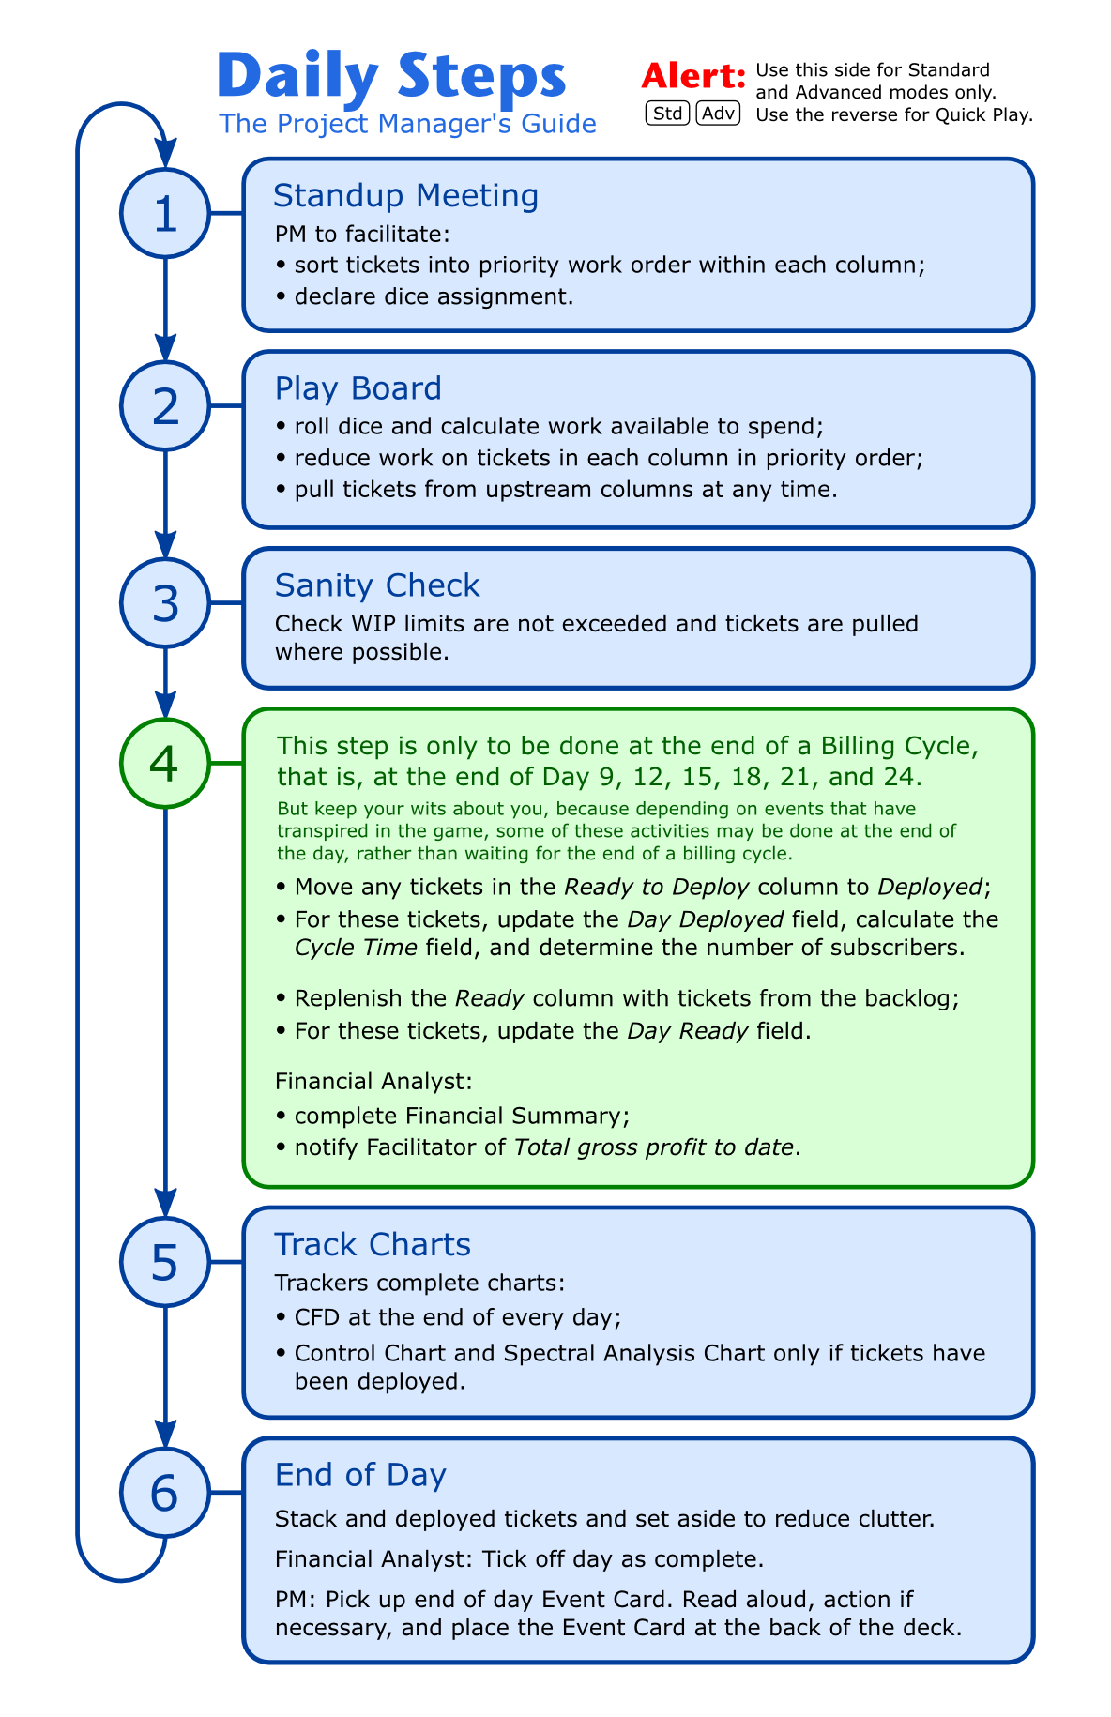
Daily Steps Guide
We are going to follow the steps on the Daily Steps Guide.
Project Managers: ensure that you are using the correct side of the Daily Steps Guide for the mode you are playing in (Std / Adv, not QP)

Slide 48
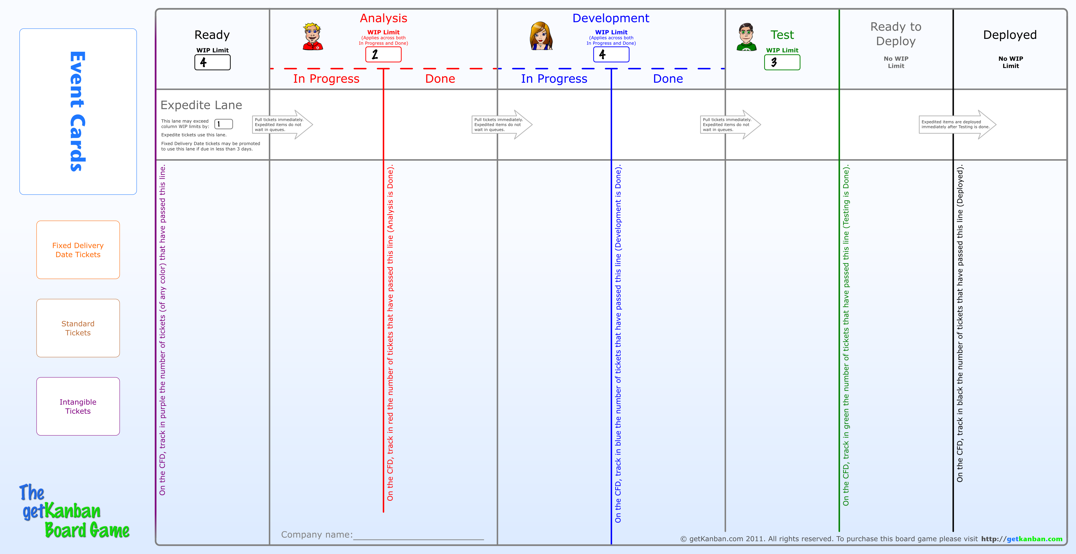
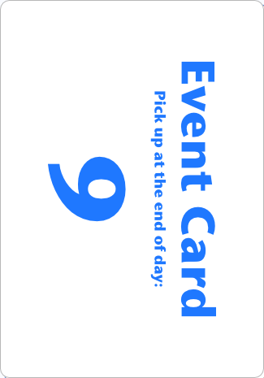
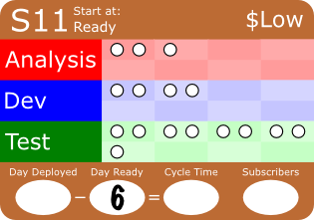
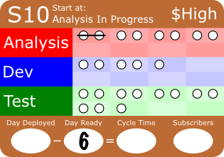
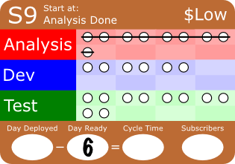
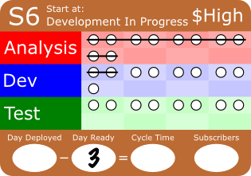
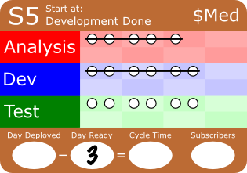
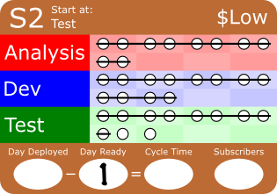
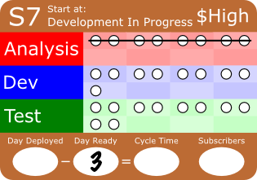
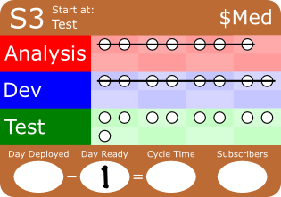
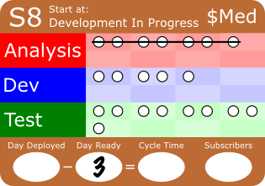
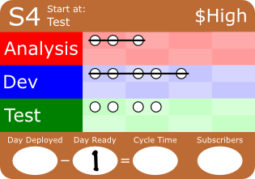
Step 1: Standup Meeting – Sort Tickets in Priority Work Order within each Column
Although ticket S2 has a low market value estimate, it has very little work remaining, so will leave S2 at the top of the Test column.
Ticket S4 has a higher value estimate, and less work remaining than S3, so we will prioritise it above S3.
We will leave all other tickets as they are.

Slide 49
Step 1: Declare Dice Assignment
There is enough work in each specialization, so we will assign each die to work in its usual place.
Place the dice with the big red numbers above the Analysis columns, the blue dice above Development, and the green above Test.

Slide 51
Step 2: Roll Dice
The dice have been rolled for you. Important: arrange your dice exactly like those shown above.

Slide 52
Step 2: Calculate Work Available
8
12
9
Calculate the number of points of work available for each specialization.
For Analysis: 5 + 3 = 8, for Development: 4 + 3 + 5 = 12, for Test: 3 + 6 = 9.
Write these values on the board in each column.

Slide 53
Step 2: Reduce Work on Tickets in Priority Order
8
12
9
7
Important: Follow the example shown, and do not skip ahead (at least for Test), else you will probably miss something.
We have 9 points to spend in Test. Strike the remaining 2 points of Test work from S2, reduce the points left to spend in Test to 7. Move S2 to the Ready to Deploy column immediately, and pull tickets from across the board to satisfy WIP limits.
Pause to check that all teams have completed these steps correctly.

Slide 54
Step 2: Reduce Work on Tickets in Priority Order
8
12
9
7
3
We have 7 points left to spend in Test.
Strike the remaining 4 points of Test work from S4, reduce the points left to spend in Test to 3, move S4 to Ready to Deploy. Notice that there are no tickets available in Development Done to pull into Test.

Slide 55
Step 2: Reduce Work on Tickets in Priority Order
8
12
9
7
3
Strike 3 points of Test work from S3, and cross off the last 3 points Test work on the board.
Leave S3 in the Test column, because the Testing of S3 is not finished.
Pause to check that all teams have completed these steps correctly.

Slide 56
Step 2: Reduce Work on Tickets in Priority Order
8
12
5
9
7
3
We have 12 points of Development work to spend.
Strike the 7 remaining points of Dev work from S6, reduce the points left to spend in Development to 5. Move S6 directly into Test (since Test has a WIP limit of 3, but only 2 tickets).

Slide 57
Step 2: Reduce Work on Tickets in Priority Order
8
12
5
9
7
3
Strike 5 points of Dev work from S7, and cross off the 5 remaining points of Dev work on the board.
Leave S7 in the Development In Progress column, because the development work on the ticket is not complete.

Slide 58
Step 2: Reduce Work on Tickets in Priority Order
8
2
12
5
9
7
3
We have 8 points of Analysis work to spend.
Strike the 6 remaining points of Analysis work from S10, reduce the points left to spend in Development to 2, and move S10 into Development In Progress.

Slide 59
Step 2: Reduce Work on Tickets in Priority Order
8
2
12
5
9
7
3
Strike 2 points of Analysis work from S11, and cross off the 2 remaining points of Analysis work on the board.
Leave S11 in the Analysis In Progress column.
Pause to check that all teams have completed these steps correctly.

Slide 60
Step 2: Reduce Work on Tickets in Priority Order
8
2
12
5
9
7
3
Clean working from the board

Slide 62
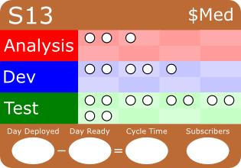
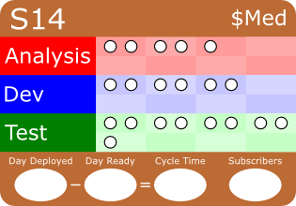
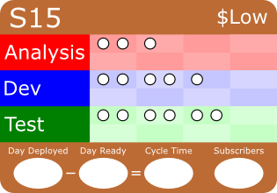
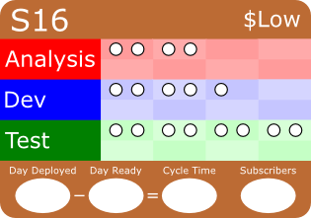
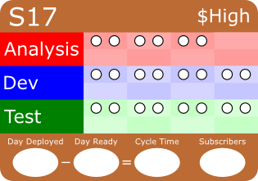
Step 3: Sanity Check
Check that WIP limits are not exceeded.
Check that tickets are pulled where possible.

Slide 63
Step 4: End of Billing Cycle
We are about to go to Step 4 in the Daily Steps Guide.
Important: we only do Step 4 at the end of a billing cycle, that is, at the end of every third day.
At the end of the billing cycle, three important things happen:
  We deploy our software, with any newly completed features
  We meet with Margaret the Marketing Manager to select the next tickets with which to replenish the Ready queue
  We bill our customers, and calculate our financials
Important: we only deploy tickets, and replenish the Ready queue at the end of a billing cycle, not at the end of a regular day.

Slide 65
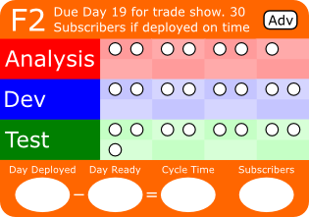
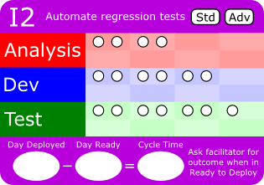
Step 4: Deploy Completed Tickets
Move tickets S1, S2, and S4 from Ready to Deploy to Deployed.

Slide 66
Step 4: Deploy Completed Tickets
9
8
For each deployed ticket, update the Day Deployed field with the current day. You can tell the current by looking at the topmost Event Card.
Calculate the Cycle Time for each deployed ticket, using the formula provided: Day Deployed – Day Ready = Cycle Time. For ticket S1 this is 9 – 1 = 8.

Slide 67
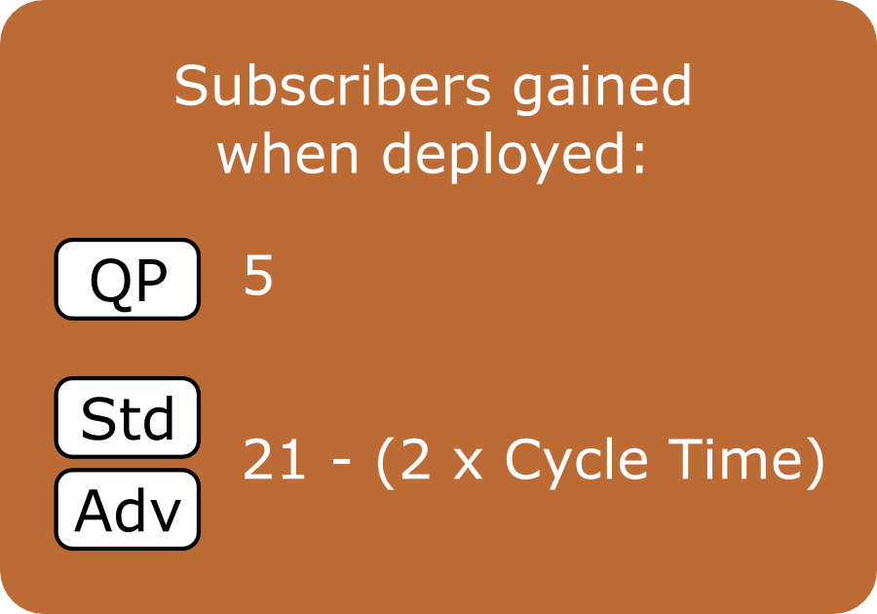
Step 4: Deploy Completed Tickets
9
8
5
Turn over each deployed ticket, calculate the subscribers using the formula provided, and write the number of subscribers gained in the Subscribers field on the front of the ticket. For ticket S1 this is 21 – 2 x 8 = 5
Notice that the number of subscribers decreases as Cycle Time increases. Why might this be the case?
Notice the mode labels. We are playing in Standard or Advanced mode, so we use the formula.

Slide 68
Step 4: Deploy Completed Tickets
9
8
5
9
8
6
9
8
10
S1 earned 5 subscribers, S2 earned 6, and S4 earned 10.

Slide 69
Step 4: Replenish the Ready Column from the Backlog
9
8
5
9
8
6
9
8
10
We have met with Margaret the Marketing Manager, and she selected the following tickets to replenish the Ready queue: S12, S13, S14, S15, and F1. Pull these in from the backlog.
Notice that we pulled ticket S12 all the way into Analysis In Progress, since Analysis, has a WIP limit of 2.
In subsequent days you will choose which tickets Margaret selects, and you will be allowed to reorder the backlog.

Slide 70
Step 4: Replenish the Ready Column from the Backlog
9
9
8
5
9
9
9
8
6
9
8
10
9
9
Update the Day Ready fields on the tickets that have just been pulled in, to the current day, Day 9.

Slide 71

Add up subscribers from items deployed in the billing cycle
21
9
8
5
5
+
21
9
8
6
6
+
210
9
8
10
10
___
21
210
210
Faster Co
NYC
3/5/12
Notes:
Follow the instructions in light blue above the fields.

Slide 72
Facilitator: Post Team Scores Visibly
Team \ Billing Cycle End
Day 9
Day 12
Day 15
Day 18
Day 21
Day 24
Faster Co
210
Wildcats
210
Flow Co
210
Extreme
210

Slide 74
Step 5: Track the CFD
9
9
8
5
9
9
9
8
6
9
8
10
9
9
3 tickets
10 + 6 = 16
3 + 3 = 6
3 + 0 = 3
6 + 4 = 10
The CFD is tracked at the end of every day. It is now the end of Day 9.
Three tickets have passed the black line, so track 3 in black on Day 9. No further tickets have passed the green line, so track 3 + 0 = 3 in green on Day 9. An additional three tickets have passed the blue line, so add 3 to the 3 already accounted for, and track 3 + 3 = 6 in blue on Day 9. An additional four have passed the red line, so track 6 + 4 = 10 in red on Day 9. An Additional six have passed the purple line, so track 10 + 6 = 16 in purple.
Pause to check that all teams have completed this step correctly.

Slide 75

Step 5: Annotate the CFD
We’re
off!
Make note of any significant events that occurred on the day at the bottom of the chart.

Slide 76

9
8
5
9
8
6
9
8
10
9
Faster Co
The Control Chart is tracked very differently from the CFD.
On the Control Chart, track the Cycle Time of one ticket per vertical line on the chart.
Track using the same marker pen color as the ticket (e.g. use the brown marker pen for brown tickets).
Indicate the day a ticket or group of tickets were deployed.
Faster Co
NYC
3/5/12
Notes:
Follow the instructions in light blue above the fields.

Slide 77

9
8
5
9
8
6
9
8
10
Faster Co
On the Spectral Analysis Chart, tally the Cycle Time of each ticket against the Cycle Time provided on the chart. Use a black marker pen.
Faster Co
NYC
3/5/12
Notes:
Follow the instructions in light blue above the fields.

Slide 79
Step 6: End of Day – Stack and Set Aside Deployed Tickets
9
9
8
5
9
9
9
8
6
9
8
10
9
9
Stack any deployed tickets and set aside to reduce clutter.

Slide 80
21
21
210
210
210
Faster Co
NYC
3/5/12
Notes:
Follow the instructions in light blue above the fields.

Slide 81
It is important to understand what the Fixed Delivery Date tickets are for …

Slide 82
F1: Security Audit
Following a number of high-profile security breaches, new regulations require regular audits of customer data security.
This ticket is to correct a design flaw that would cause us to fail the audit. If we have not finished this ticket by the end of Day 15, we will be fined $2,500.
Notes:
Note: F2 is not used in QP mode.

Slide 83
F2: Trade Show
There is an industry trade show on Day 20.
Rumour has it that our arch-rival MeToo Inc will have a new feature ready in time for the show. If we don’t have the same feature in time, MeToo will attract all the potential subscribers at the show, and none will be interested in us.
If we have F2 ready by Day 19, in time for the show, we can expect to gain 30 new subscribers, if not, we will gain no new subscribers from the trade show.
Notes:
Note: F2 is not used in QP mode.

Slide 84



Step 6: End of Day – PM Pick up End of Day Event Card
9
9
9
9
9
Project Manager: Pick up the end of day Event Card for Day 9, and read aloud.
The Event Card for Day 9 has a section with an Advanced Mode (Adv) label. If you are playing in Advanced mode, read and discuss this section. If you are playing in Standard mode then ignore this section.

Slide 85
Rules: Dice, Work, Tickets
Dice allocation must be done at the stand-up meeting. All dice must be allocated before any are rolled.
Tickets within each column should be prioritized during the stand-up meeting. When work is struck off tickets, start with the ticket at the top of the column, and work down (i.e. in priority order).
Tickets may be pulled in any order, both from the backlog, and across the board, and may be pulled into any position in the receiving column.
Tickets must be pulled to satisfy WIP limits if possible.
There are no additional rules to restrict how dice are rolled, how work is struck off tickets, or how tickets are selected or pulled.
Notes:
Note to Facilitators: the second rule aims to reduce detailed conversations about what work to strike off during the day in order to save time.

Slide 86
It’s now the beginning of Day 10, and your turn!
Continue, starting at Step 1 of the Daily Steps Guide.
Important: Pause before you turn over the Event Card at the end of Day 10. You will then be given some final instructions.
CFD Tracker, if you don’t yet understand how to track your chart, you may wait until the end of the day, when we will go through it again together.

Slide 87
End of Day 10
(before turning over the Event Card)
Remember:
we only deploy tickets at the end of a billing cycle.
we meet with Margaret from Marketing at the end of a billing cycle, and only then do we replenish the Ready queue.
So we don’t deploy any tickets or replenish the Ready queue today.
Since we don’t deploy any tickets today, there is nothing for the Control Chart Tracker, or the Spectral Analysis Tracker to track. The CFD Tracker has a job to do at the end of every day.

Slide 88
The Intangible Tickets
Intangible ticket I1 is to automate deployments.
Intangible ticket I2 is to automate regression tests.
Intangible tickets may be deployed immediately, they do not need to wait for the end of a billing cycle. When you deploy an Intangible ticket, ask the Facilitator for the outcome.
Notes:
Note: F2 is not used in QP mode.

Slide 89
The Expedite Lane
The Expedite Lane may be used to fast-track white Expedite tickets which will be introduced during the game. It may also be used to fast-track orange Fixed Delivery Date tickets if they are due in less than 3 days. It may not be used for brown Standard tickets.
The Expedite Lane has a WIP limit of 1 which applies horizontally across the lane. It is in addition to the column limits. There may be at most one ticket in the Expedite lane at a time.

Slide 90
We are going to take one last look at the CFD, to make sure the CFD Tracker fully understands how to track it…

Slide 91
9
9
9
9
9
0
Let’s assume the board looks like this at the end of Day 10.
First, notice that no new tickets have passed the black line since yesterday, so the black line on the CFD will stay flat.

Slide 92
9
9
9
9
9
1
Second, count how many tickets have passed the green line, but have not yet passed the black line. In this case, there is one ticket, S3.
So count one horizontal line up from the black line on the CFD, and track the data point in green.
Notice that if there are no tickets in the Ready to Deploy column, the green data point will be the same as the black one, as it was at the end of Day 9.

Slide 93
9
9
9
9
9
4
Third, count how many tickets have passed the blue line, but have not yet passed the green line. In this case, there are four tickets.
So count four horizontal lines up from the green line on the CFD, and track the data point in blue.

Slide 94
9
9
9
9
9
3
Fourth, count how many tickets have passed the red line, but have not yet passed the blue line. In this case, there are three tickets.
So count three horizontal lines up from the blue line on the CFD, and track the data point in red.

Slide 95
9
9
9
9
9
5
Finally, count how many tickets have passed the purple line, but have not yet passed the red line. In this case, there are five tickets.
So count five horizontal lines up from the red line on the CFD, and track the data point in purple.
Notice that the purple line is flat between days 9 and 10 on the chart. This correctly represents the fact that no new tickets were pulled onto the board in Day 10.

Slide 96
9
9
9
9
9
What do the colored lines on the board and on the CFD represent?
All tickets that have passed the black line on the board have been deployed. The cumulative number of these tickets is tracked in black every day on the CFD.
All tickets that have passed the green line have finished Testing. All tickets that have passed the blue line have finished Development. All tickets that have passed the red line have finished Analysis. All tickets that have passed the purple line have been pulled onto the board.

Slide 97
9
9
9
9
9
Notice that the green line will come into contact with the black line whenever there are no tickets sitting in Ready to Deploy, as it did on Day 9.
This is correct and will happen whenever all completed tickets are deployed, such as at the end of a billing cycle.

Slide 98
CFD Trackers, make sure you understand how to do your job before moving on. Ask the Facilitator now if you need help.

Slide 99
Trackers: Take Note of Special Tickets and Events
If anything special happens to a ticket, put a check mark on the ticket as a reminder. When the ticket is deployed, the Control Chart Tracker and Spectral Analyst should circle the data point on their charts.
For example, a defect is about to be raised in the Event Card for Day 10. Put a red check mark on the affected ticket, and when it is deployed, circle the data point in red on the Control Chart and Spectral Analysis Chart.
If anything special happens on a particular day, the CFD Tracker should take note of it on their chart.

Slide 100

Optional: Bonus
The first team to finish will receive an in-game bonus cash prize.
If playing in Standard mode, the last day is Day 18, and the bonus prize is $2,000.
If playing in Advanced mode, the last day is Day 24, and the bonus prize is $4,000.

Slide 101

Optional: Slack Points
Record every point rolled on the dice that is not used against tickets (except for the pink die). We will call these slack points.
At the end of the game, you will receive one extra minute of game time for every slack point, less however many slack points the winning team had collected, up to a maximum of ten minutes. This will give you more time to improve the way you work.
For example if Team A records 8 slack points during the game, and Team B records 2 slack points, Team A may finish the game up to 6 minutes after Team B, and still win the bonus cash prize.
It is the responsibility of the team that finishes first to start the timer (on a phone or similar) and declare how many slack points they had collected.

Slide 102
Does anyone have any questions?
(See the FAQ section of the Facilitator’s Guide earlier in this slide deck)
Pick up the Event Card for Day 10 and continue.

Slide 103

End of the Game
Continue to the end of game and debrief slides

Slide 104
Old Standard Tickets
If there are Standard tickets on the board that have been in process for a very long time, and are not yet deployed, they may turn out to lose subscribers when they are eventually deployed. Or if these features are never deployed, you can guarantee our competitors will be offering them, and we’ll lose subscribers.
Calculate the number of subscribers that would be gained (or lost) for any brown Standard tickets that have a Day Ready that is more than eight days ago. If the number of subscribers is negative, you must subtract this number from the number of subscribers gained in the final billing cycle. If the number of subscribers is positive, you don’t get these subscribers, because these features aren’t deployed yet!

Slide 105

Control Chart
At the end of the game, the Control Chart Trackers need to connect the data points with the correct colors as shown. If they haven’t yet circled the data points for the blocked and defective tickets, they need to do so.

Slide 106

Spectral Analysis Chart
Spectral Analysis Chart Trackers need to connect the data points on their charts as shown.
If they haven’t yet circled the data points for the blocked and defective tickets, they need to do so.

Slide 107


Arrange the Financial Summary Sheet and Charts for Analysis
Be sure to take photographs!
You may share the photos with the community if you wish to at www.getkanban.com

Slide 108
Debrief
The remaining slides are suggested debrief questions . There are a lot of them, so select the most appropriate ones for your session.
You can click through the debrief slides as usual, or you can hover your mouse over a title in the left-hand menu to go to that group of questions.

Slide 109

Debrief: The Winners
The Winners
The Winners
Congratulate the winning team (audit their financials first if necessary!)
Review the scoreboard:
  see if there is an obvious point at which the winning team pulled away.
  does the scoreboard tell us anything else?
Review the Financial Summary sheets. How many subscribers did each team gain? When did they gain them?
Winning team:
  what strategies, tactics, or events do you think contributed to your victory?
  what might you do differently if you were to play again?
Other teams:
  what were contributing factors to your loss?
  what might you do differently if you were to play again?
WIP Limits
Cycle Time
The Team
The Work
The Blocker
Queue Replenishment
Carlos’ Testing Policies
Fixed Delivery Date Tickets
Expedite Tickets
Intangible Tickets
The Defect
SLAs
The Charts
Options: Bonus and Slack

Slide 110
Debrief: WIP Limits
The Winners
WIP Limits
Did you ever roll more points on the dice than you were able to use on the tickets (i.e. accumulate slack points if you were using that option)? How did it feel, and how did you react to it?
What WIP limit changes did you make and why? How did you determine what limits to set?
Did you feel a tension between reducing WIP limits and avoiding slack? If so:
did you discuss it?
would you change your choices of WIP limits if you were to play again? If so, how?
WIP Limits
Cycle Time
The Team
The Work
The Blocker
Queue Replenishment
Carlos’ Testing Policies
Fixed Delivery Date Tickets
Expedite Tickets
Intangible Tickets
The Defect
SLAs
The Charts
Options: Bonus and Slack

Slide 111
Debrief: Cycle Time
The Winners
Cycle Time
Is the relationship between cycle time and the number of subscribers gained realistic (as described by the formula on the back of the Standard tickets)?
What are some costs resulting from longer cycle time that might have reduced the number of subscribers gained?
WIP Limits
Cycle Time
The Team
The Work
The Blocker
Queue Replenishment
Carlos’ Testing Policies
Fixed Delivery Date Tickets
Expedite Tickets
Intangible Tickets
The Defect
SLAs
The Charts
Options: Bonus and Slack

Slide 112
Debrief: The Team
The Winners
The Team
Did you choose to divide the dice among the team? If so:
  how did the players responsible for each specialization interact with each other?
  what impact did the visibility of flow across the value stream have on decision making?
What sorts of things were you discussing in your stand-up meetings?
How did you make decisions, were you making quantitative, objective assessments? If so, what data were you using?
Who was participating in the analysis and decision making, one person, or many people? How well did this work?
WIP Limits
Cycle Time
The Team
The Work
The Blocker
Queue Replenishment
Carlos’ Testing Policies
Fixed Delivery Date Tickets
Expedite Tickets
Intangible Tickets
The Defect
SLAs
The Charts
Options: Bonus and Slack

Slide 113
Debrief: The Work
The Winners
The Work
Did you analyze the backlog to select which tickets to pull, and did you analyze the tickets on the board to prioritize them within columns? If so
  what factors did you take into account in selecting and prioritizing tickets?
  Did your selection criteria change as the game progressed?
Were some days more important than others for completing work?
Were some billing cycles more important than others?
WIP Limits
Cycle Time
The Team
The Work
The Blocker
Queue Replenishment
Carlos’ Testing Policies
Fixed Delivery Date Tickets
Expedite Tickets
Intangible Tickets
The Defect
SLAs
The Charts
Options: Bonus and Slack

Slide 114
Debrief: The Blocker
The Winners
The Blocker
How long did it take teams to resolve the blocker? Was there high variability in resolution times between the teams?
What might have been causing the variability in Pete's availability? (The pink die was Pete)
Could this variability be a concern for us? Why, or why not?
What impact might this have had if we were frequently dependent on Pete?
Does this happen in real life?
WIP Limits
Cycle Time
The Team
The Work
The Blocker
Queue Replenishment
Carlos’ Testing Policies
Fixed Delivery Date Tickets
Expedite Tickets
Intangible Tickets
The Defect
SLAs
The Charts
Options: Bonus and Slack

Slide 115
Debrief: Queue Replenishment
The Winners
Queue Replenishment
What might have caused Margaret to agree to replenish the Ready queue daily?
What benefits did you get from the daily replenishment?
WIP Limits
Cycle Time
The Team
The Work
The Blocker
Queue Replenishment
Carlos’ Testing Policies
Fixed Delivery Date Tickets
Expedite Tickets
Intangible Tickets
The Defect
SLAs
The Charts
Options: Bonus and Slack

Slide 116
Debrief: Carlos’ Testing Policies
The Winners
Carlos’ Testing Policies
What did you observe when Carlos arrived? When he left?
What was the cause of this effect?
What was Carlos' reaction to the problem? Do you think his solution would have worked? Was it sustainable?
What impact might Carlos' solution have had on the Testers?
Why did the problem become manifest so quickly? Are the effects of policy decisions always so obvious? Why, or why not?
Could this be a real-life scenario?
Why would Carlos have set such policies? What might his motivations be?
How might W. Edwards Deming have viewed the situation, and what sort of advice might he have given?
Did Alison make good decisions? Why, or why not?
Did you swarm to work down the Testing backlog? Did you see a jamming affect upstream? If so, why did this occur?
What impact did the additional Tester have on throughput?
WIP Limits
Cycle Time
The Team
The Work
The Blocker
Queue Replenishment
Carlos’ Testing Policies
Fixed Delivery Date Tickets
Expedite Tickets
Intangible Tickets
The Defect
SLAs
The Charts
Options: Bonus and Slack

Slide 117
Debrief: Fixed Delivery Date Tickets
The Winners
Fixed Delivery Date Tickets
When did start work on the Fixed Delivery Date tickets, and when did you complete them? Were these sensible decisions?
Did anyone finish F1 early? If so, did this choice have an opportunity cost, and can you quantify it approximately?
  Did anyone deploy F2 early?
WIP Limits
Cycle Time
The Team
The Work
The Blocker
Queue Replenishment
Carlos’ Testing Policies
Fixed Delivery Date Tickets
Expedite Tickets
Intangible Tickets
The Defect
SLAs
The Charts
Options: Bonus and Slack

Slide 118
Debrief: Expedite Tickets
The Winners
Expedite Tickets
Did you decide to do E1? Did you swarm on it? Why did you make those decisions?
What impact did working E1 have on the other work in progress?
  Did you decide to do E2? E3? Why did you make those decisions?
  What policy was in place for accepting Expedite tickets? Was it sufficient? If not, why not? What might be an example of a better policy?
WIP Limits
Cycle Time
The Team
The Work
The Blocker
Queue Replenishment
Carlos’ Testing Policies
Fixed Delivery Date Tickets
Expedite Tickets
Intangible Tickets
The Defect
SLAs
The Charts
Options: Bonus and Slack

Slide 119
Debrief: Intangible Tickets
The Winners
Intangible Tickets
Did you decide to work on the intangible tickets?
How did you make those decisions?
How did you prioritize the Intangible tickets against the other work items, and why?
If you completed the Intangible tickets, what affect did they have?
WIP Limits
Cycle Time
The Team
The Work
The Blocker
Queue Replenishment
Carlos’ Testing Policies
Fixed Delivery Date Tickets
Expedite Tickets
Intangible Tickets
The Defect
SLAs
The Charts
Options: Bonus and Slack

Slide 120
Debrief: The Defect
The Winners
The Defect
What color ticket was the defect found on? What impact did it have?
What priority did you give the defect fix, and why? Was that a good decision? If not, why not?
What are some advantages and disadvantages of the approach used for addressing defects? What are some alternative approaches?
WIP Limits
Cycle Time
The Team
The Work
The Blocker
Queue Replenishment
Carlos’ Testing Policies
Fixed Delivery Date Tickets
Expedite Tickets
Intangible Tickets
The Defect
SLAs
The Charts
Options: Bonus and Slack

Slide 121
Debrief: Service Level Agreements
The Winners
Service Level Agreements
What SLAs would you choose for Standard class of service tickets? What would a reasonable target cycle time be for an SLA with 95% confidence?
What SLAs would you choose for Fixed Delivery Date class of service tickets?
What information informs your choices of SLA?
WIP Limits
Cycle Time
The Team
The Work
The Blocker
Queue Replenishment
Carlos’ Testing Policies
Fixed Delivery Date Tickets
Expedite Tickets
Intangible Tickets
The Defect
SLAs
The Charts
Options: Bonus and Slack

Slide 122
Debrief: The Charts
The Winners
The Charts
What stories do your charts tell, can you see the impact of the events that transpired?
What do the "staircases" on the CFD represent, and why do they go away?
Did throughput change at some point, and if so, why do you think it did?
Can you see the relationship between WIP and Cycle Time?
Can you see the impact of Carlos' policies, and how long it took to recover?
Compare the charts of the most profitable and least profitable teams. Could you deduce from the charts which team won, and if so, how?
Can you see any relationships or correspondence between the different charts?
Which teams saw the most variation, which saw the least, and what were the contributing factors?
Does variability matter? If so, why, and to whom?
WIP Limits
Cycle Time
The Team
The Work
The Blocker
Queue Replenishment
Carlos’ Testing Policies
Fixed Delivery Date Tickets
Expedite Tickets
Intangible Tickets
The Defect
SLAs
The Charts
Options: Bonus and Slack

Slide 123
Debrief: Options: Bonus and Slack
The Winners
Options: Bonus and Slack
If playing the bonus option, did your team choose to play quickly for the bonus or not? Did your choice pay off?
If playing with the slack option, did it make a difference?
Can slack time be useful in the real world? If so, what for?
WIP Limits
Cycle Time
The Team
The Work
The Blocker
Queue Replenishment
Carlos’ Testing Policies
Fixed Delivery Date Tickets
Expedite Tickets
Intangible Tickets
The Defect
SLAs
The Charts
Options: Bonus and Slack

