Slide 1
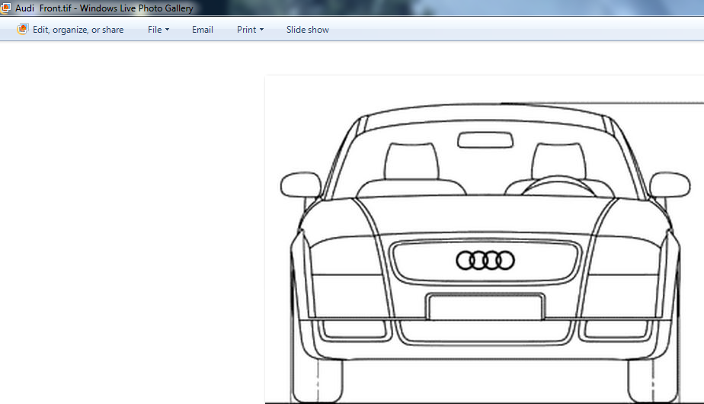
Raster Images can be imported in studio shape module (UG NX 8.0), details below.
Step 1 – Save the image file into tiff format

Slide 2
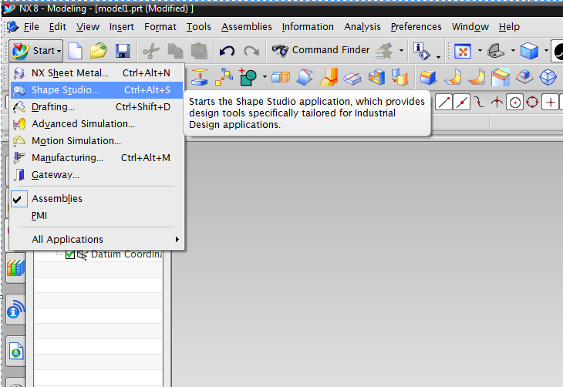
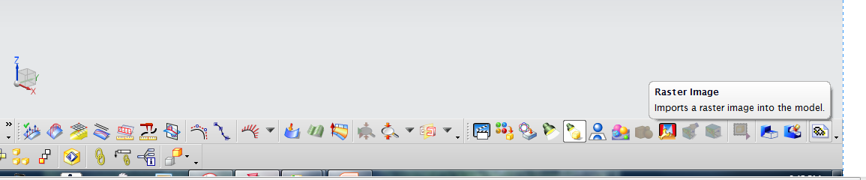
Step 2
Open shape studio module.
Step 3
Select option raster image and import .tiff file

Slide 3
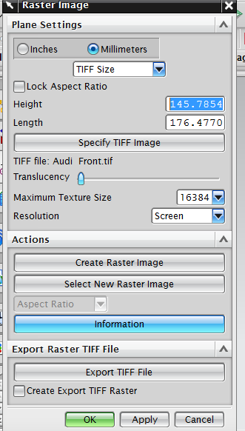
Step 4 -
Select TIFF image and import the file
Step 5 -

Slide 4
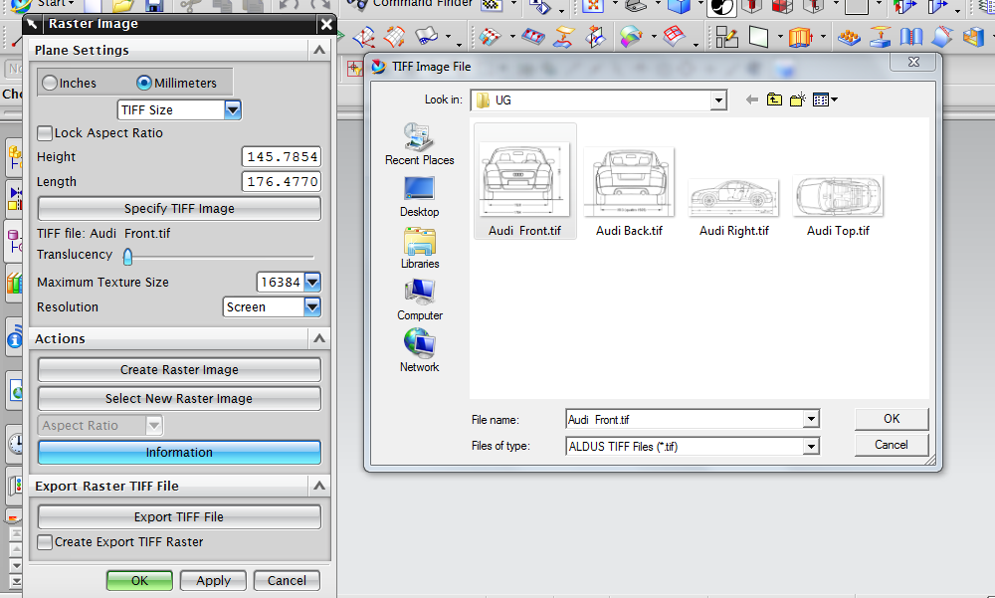
Step 3 – In details

Slide 5
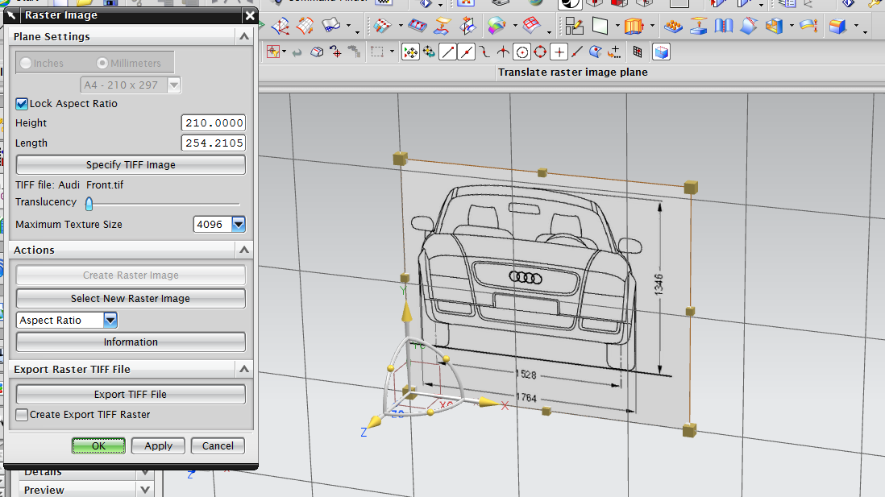
Raster Images Imported, as per required the file can be edited

