Slide 1
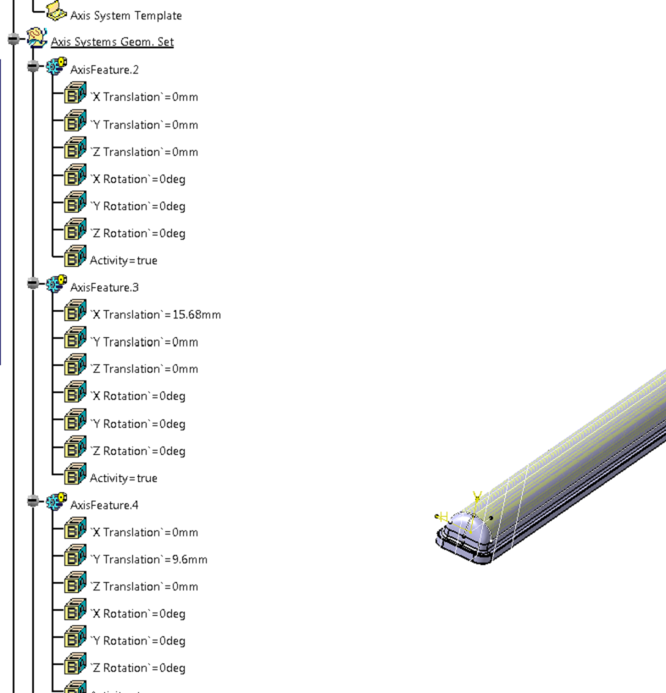
This is the feature created using user feature.
You can see translation x,y,z and rotation x,y,z in axis feature 2,3,4, etc
If I modify translation x in axis feature.3, the entire model is getting changed.
You can try for rotation x,y,z also.

