Slide 1
Grab cad tutorial challenge
TASK:
CREATION OF A HEXAGONAL NUT WITH A HELICAL CUT ON I’TS INNER SIDE

Slide 2
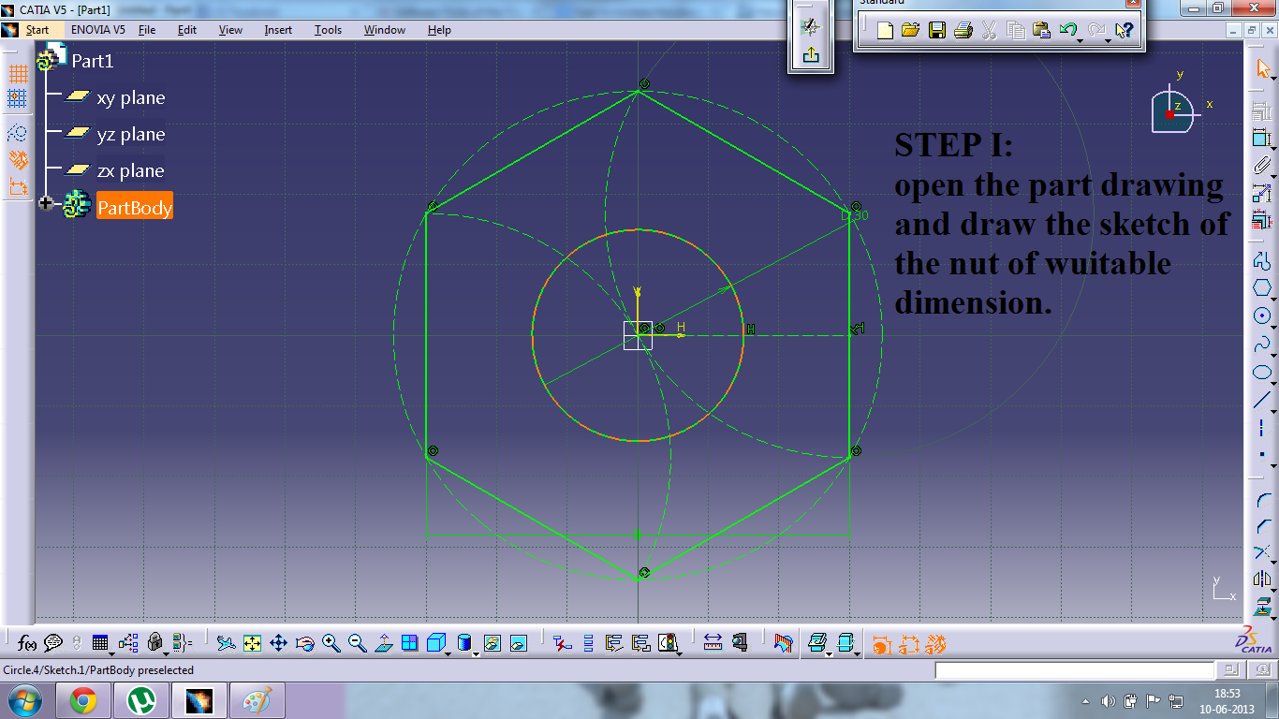

Slide 3
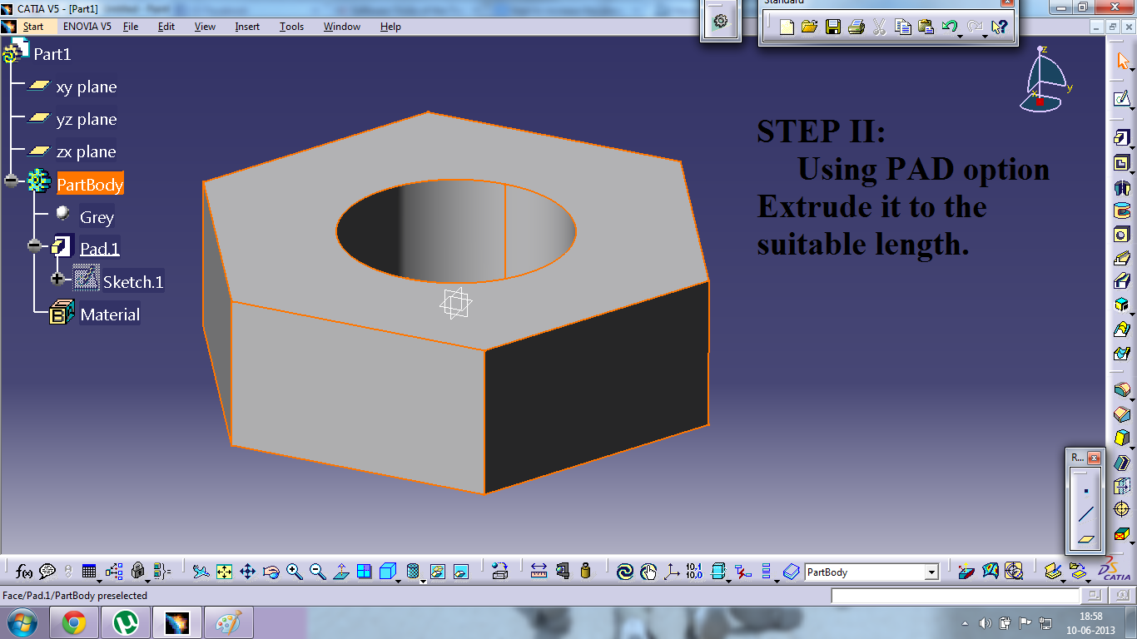

Slide 4
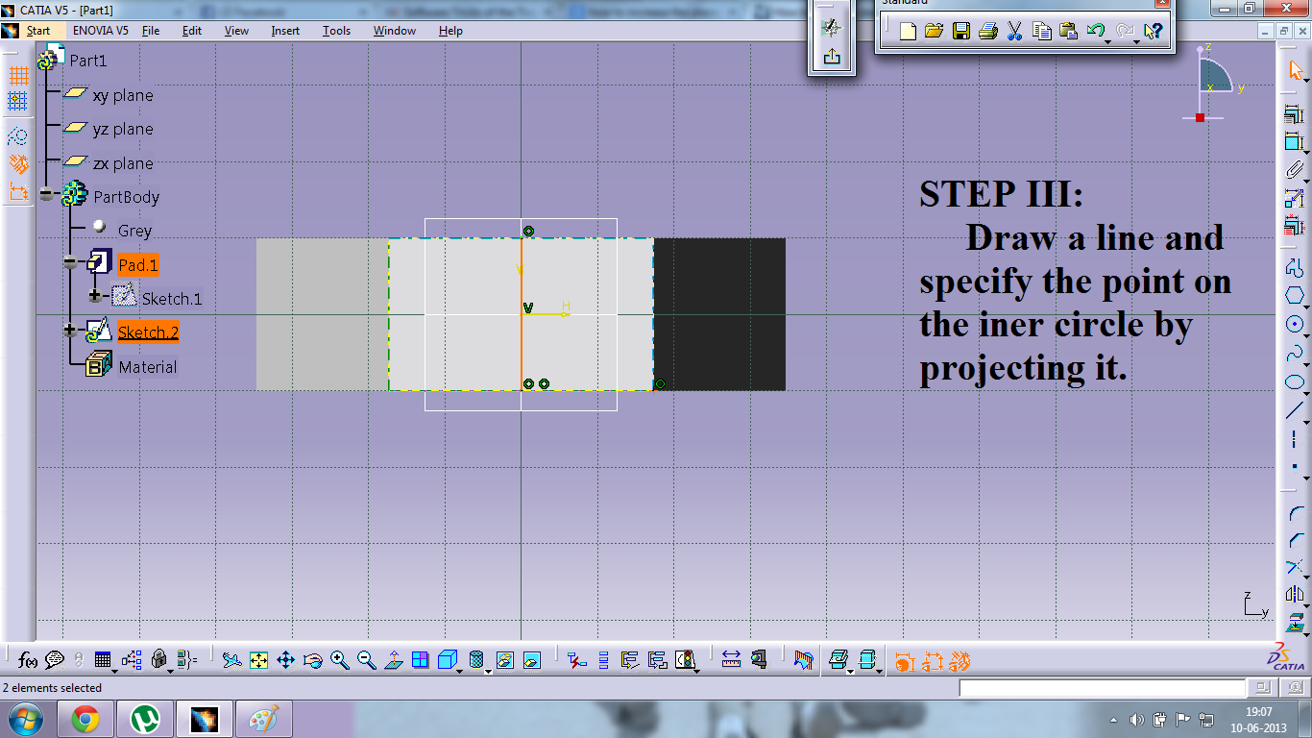

Slide 5


Slide 6
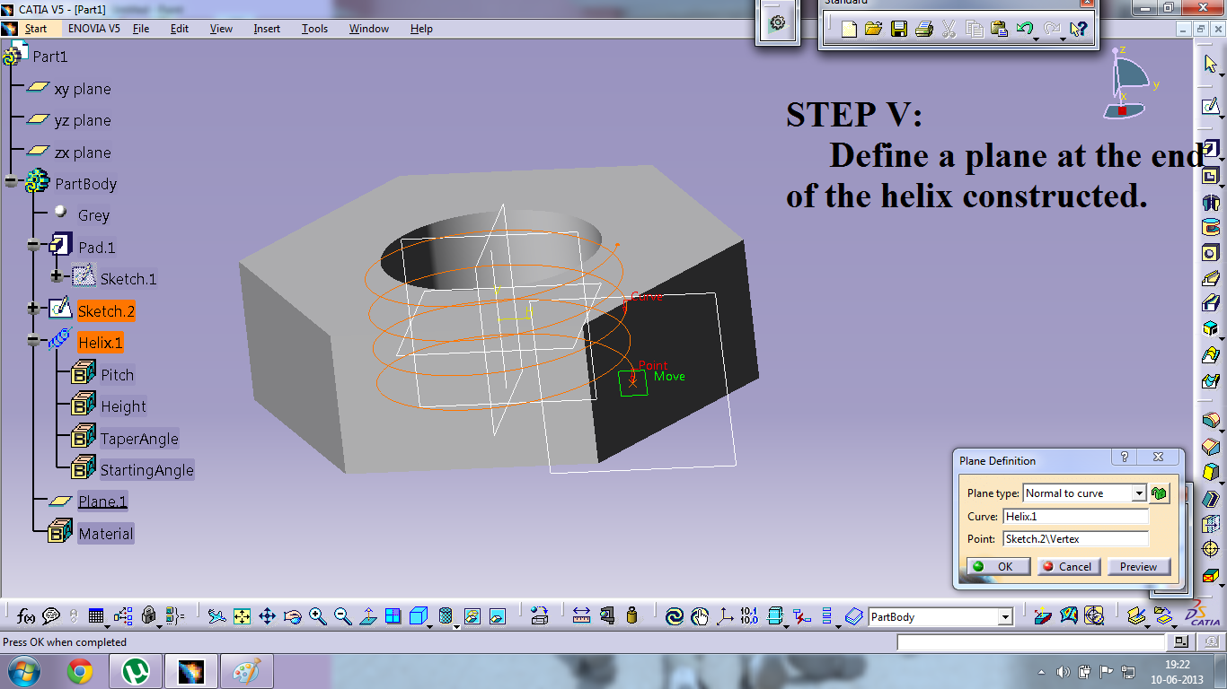

Slide 7
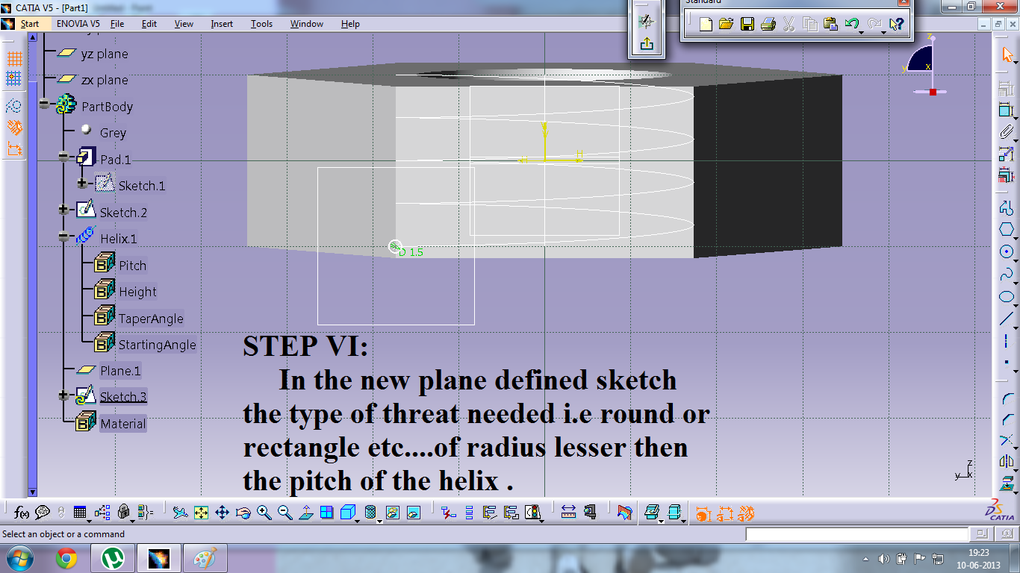

Slide 8
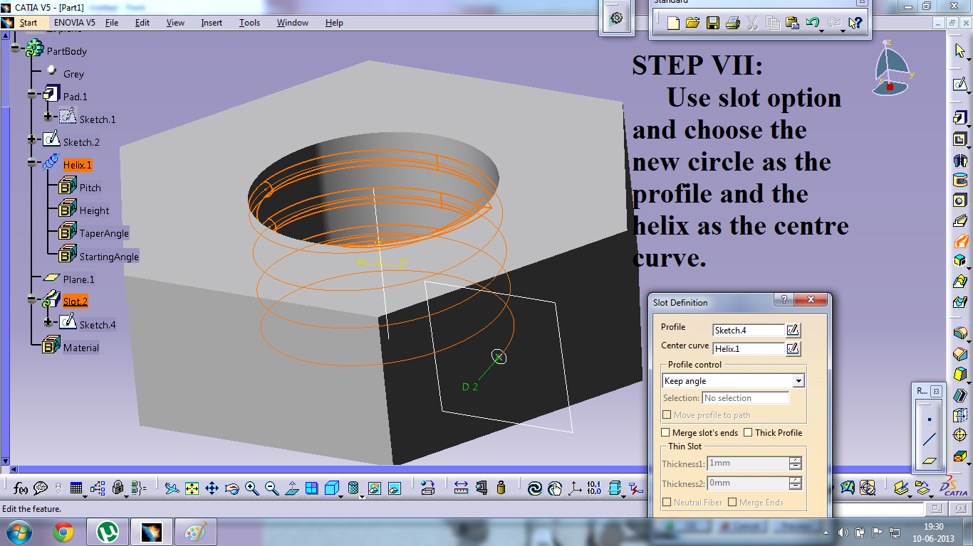

Slide 9
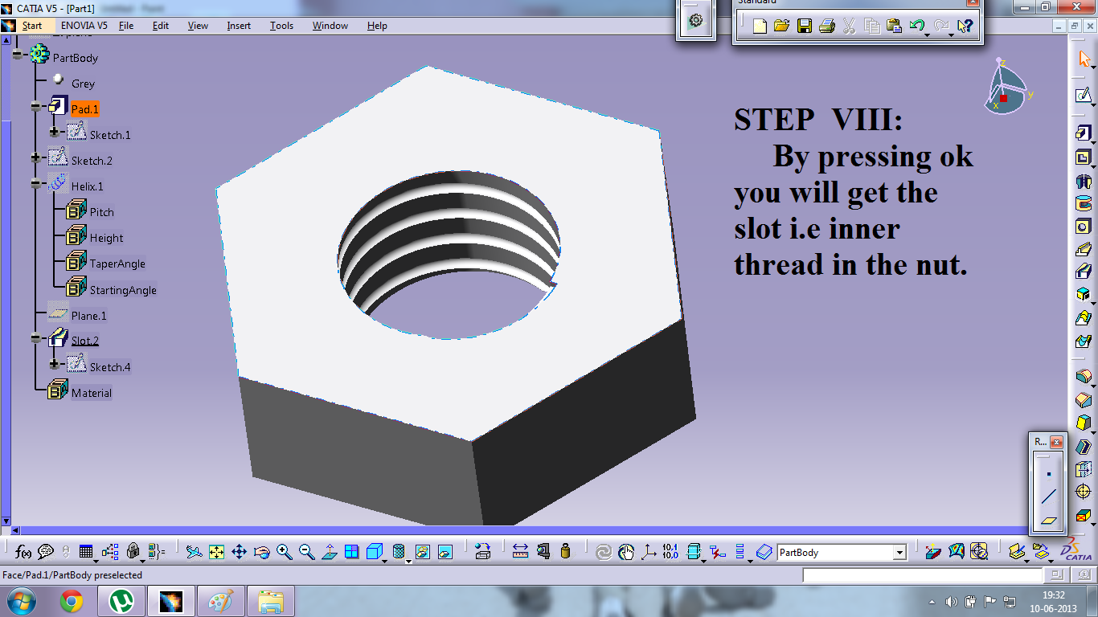

Slide 10
Thus in a Eight step it is possible to create a nut with a helical cut on it’s inner side.
Thank you

Slide 11
THE END

