Slide 1


The Christmas
Story
Adapted and hand coloured by Catherine Slight
from How to Cheat at Visual Aids by Judith Merrell and Pauline Adams
PowerPoint by Lin Pearson
This image by David Choate
FreeMinistryResources.org

Slide 2
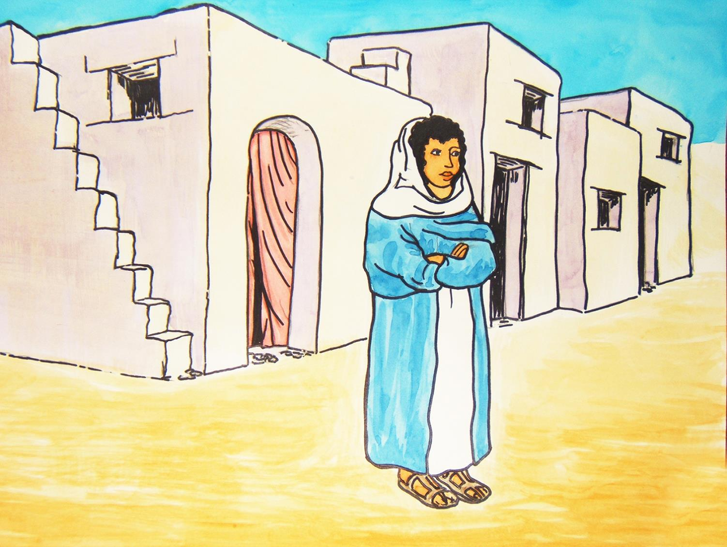

Slide 3
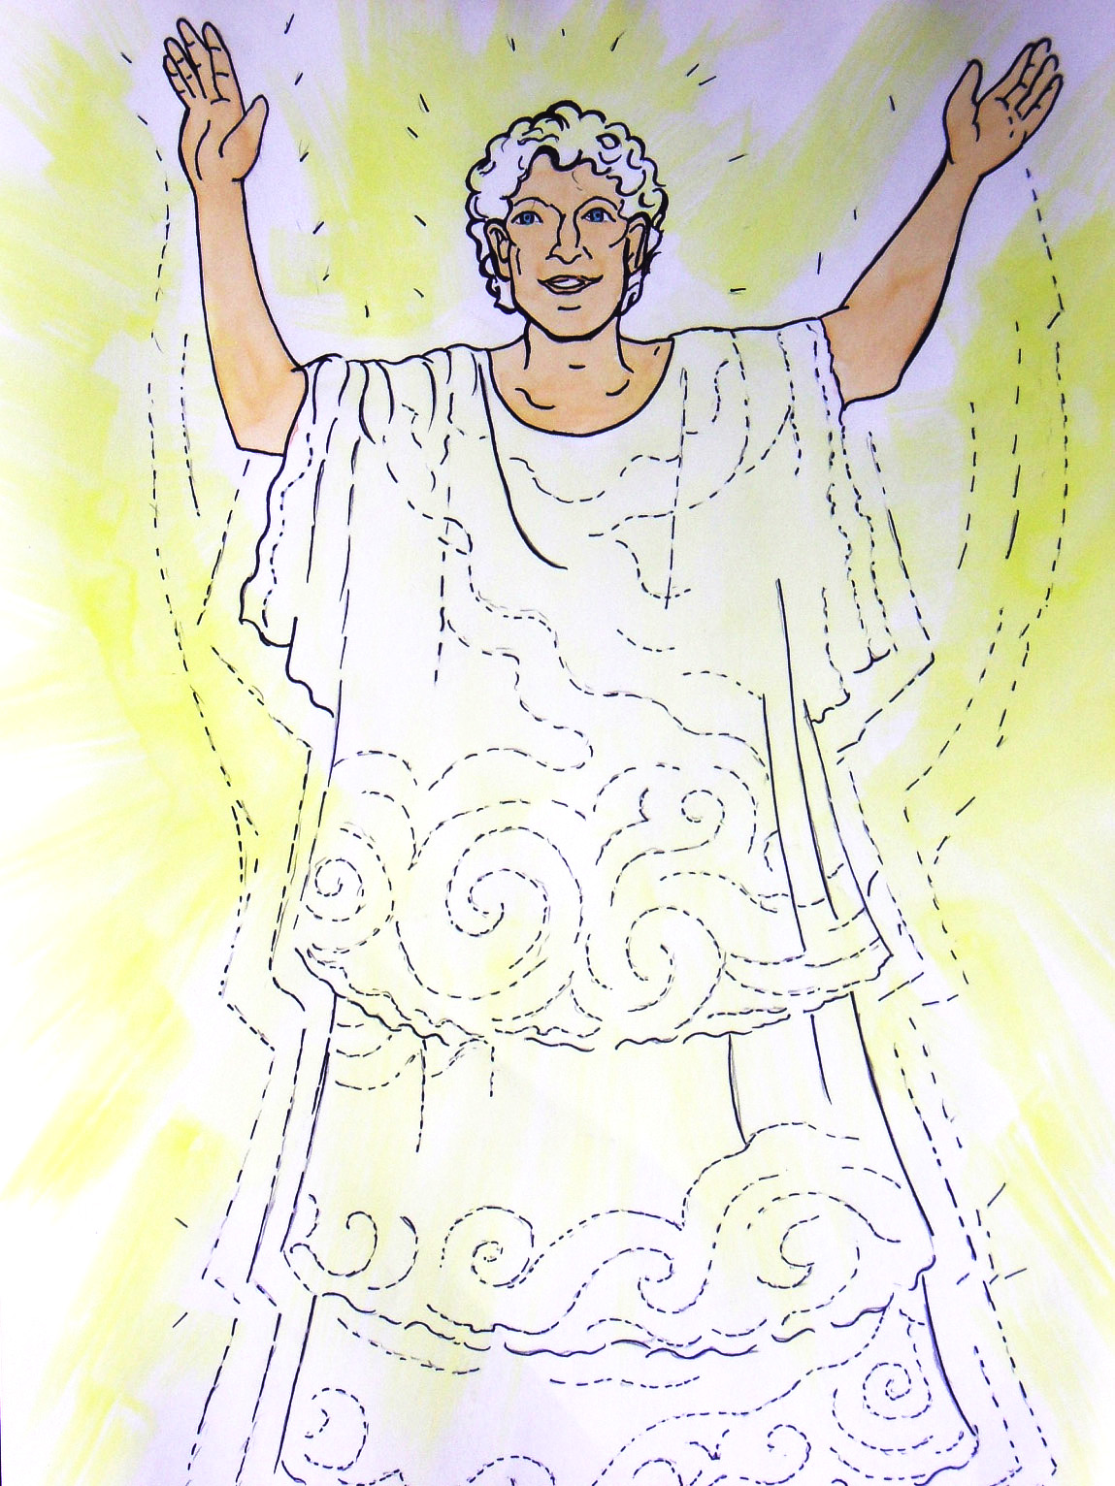

Slide 4
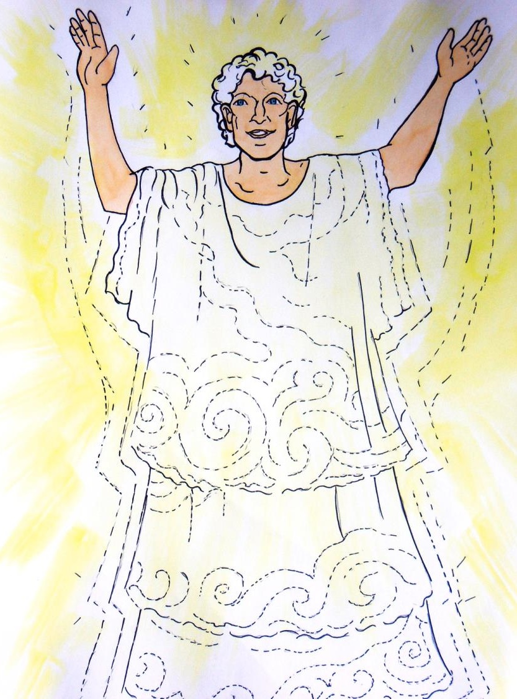

Slide 5
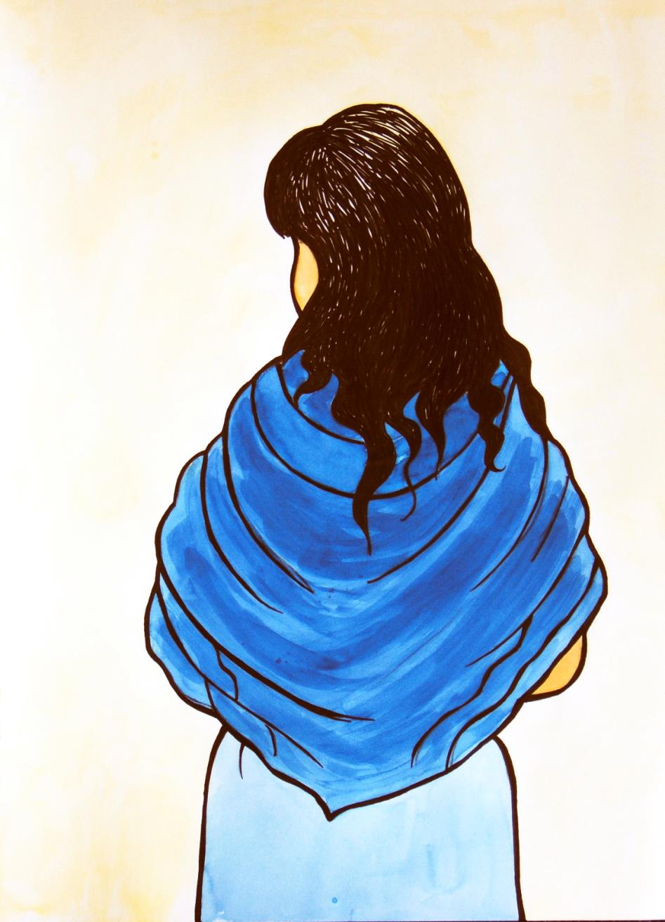

Slide 6
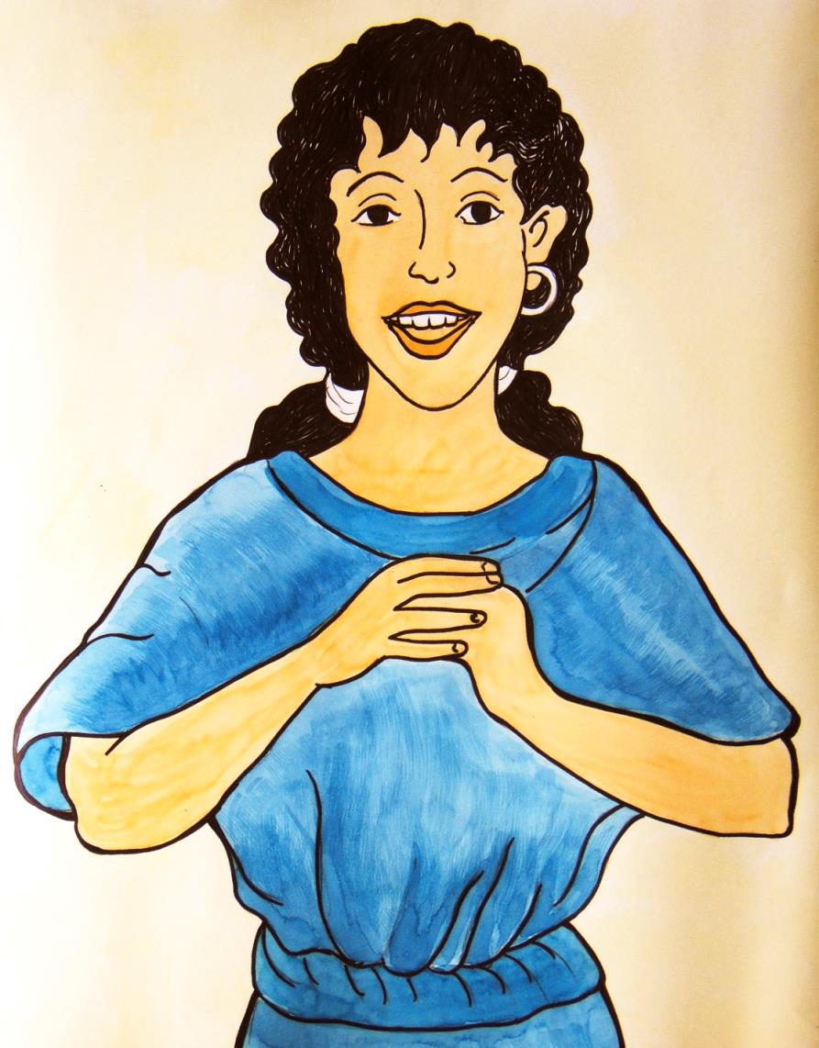

Slide 7



Slide 8

Stealing
Fighting

Slide 9

We will
live
without
God

Slide 10


Slide 11
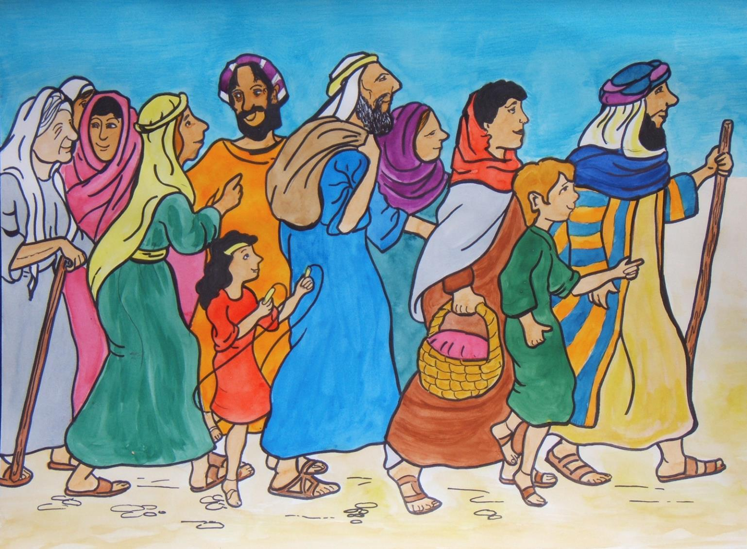

Slide 12
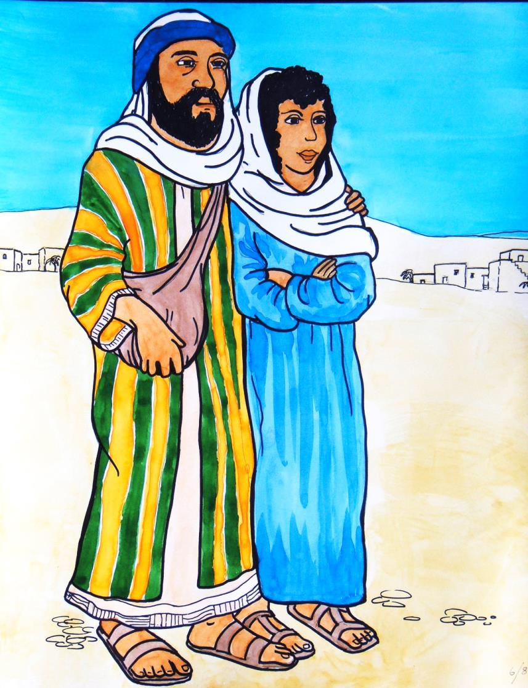

Slide 13
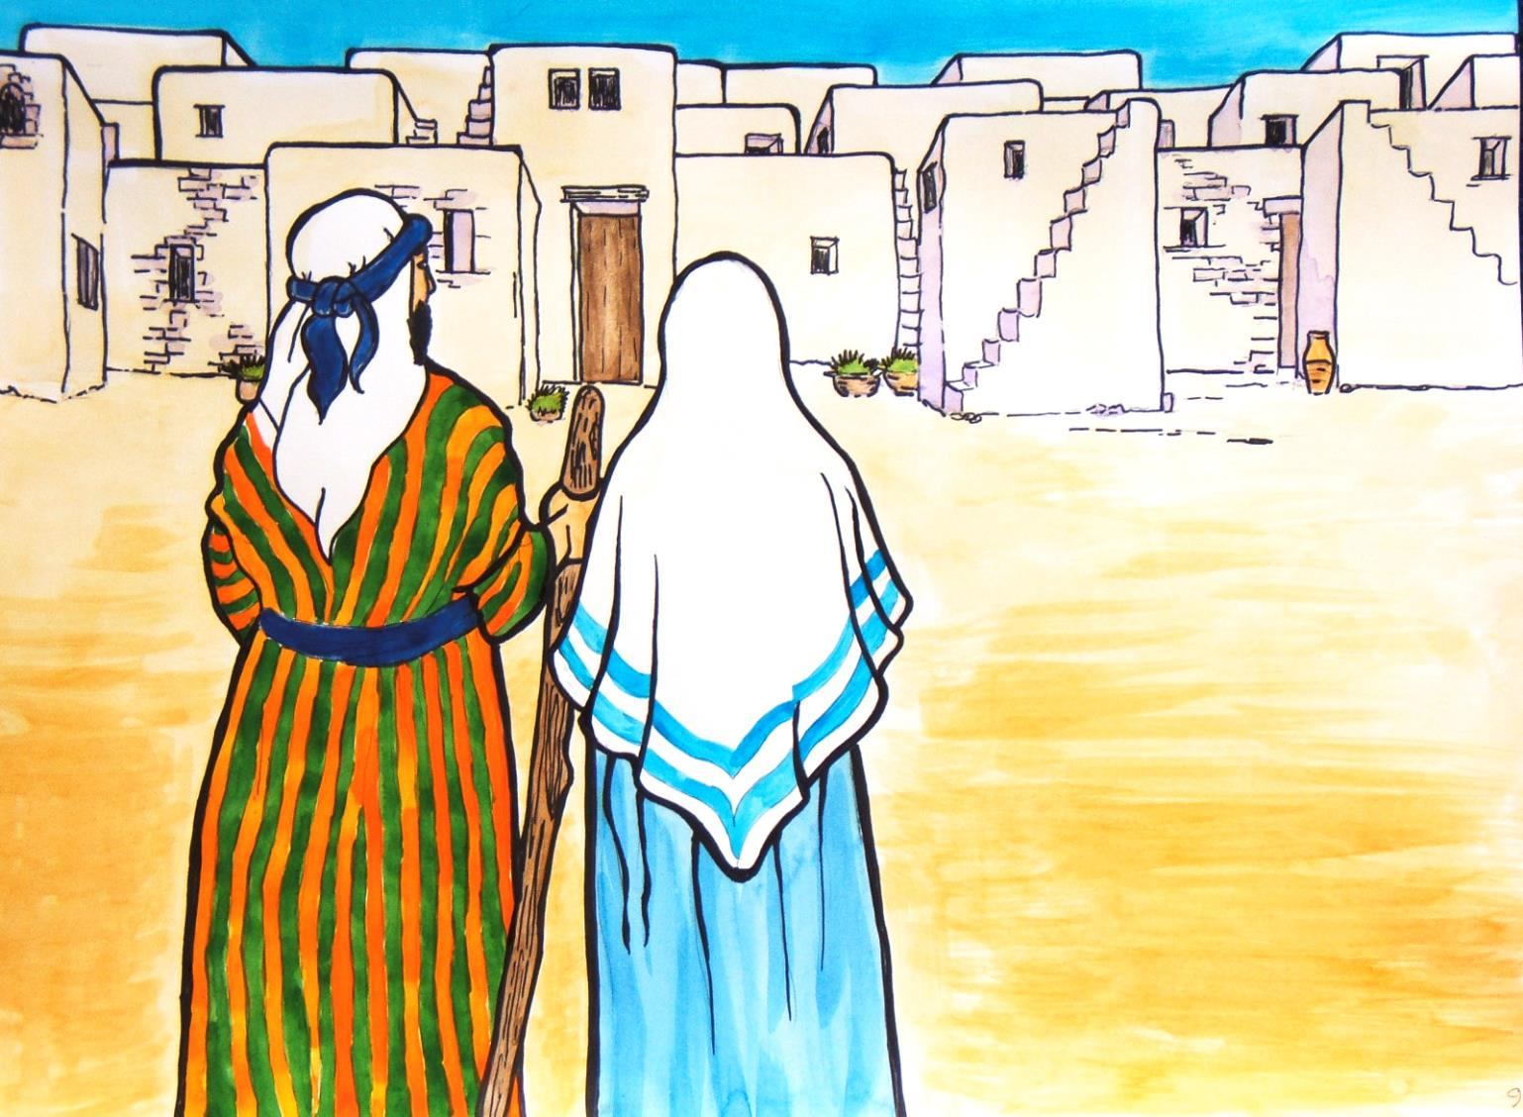

Slide 14
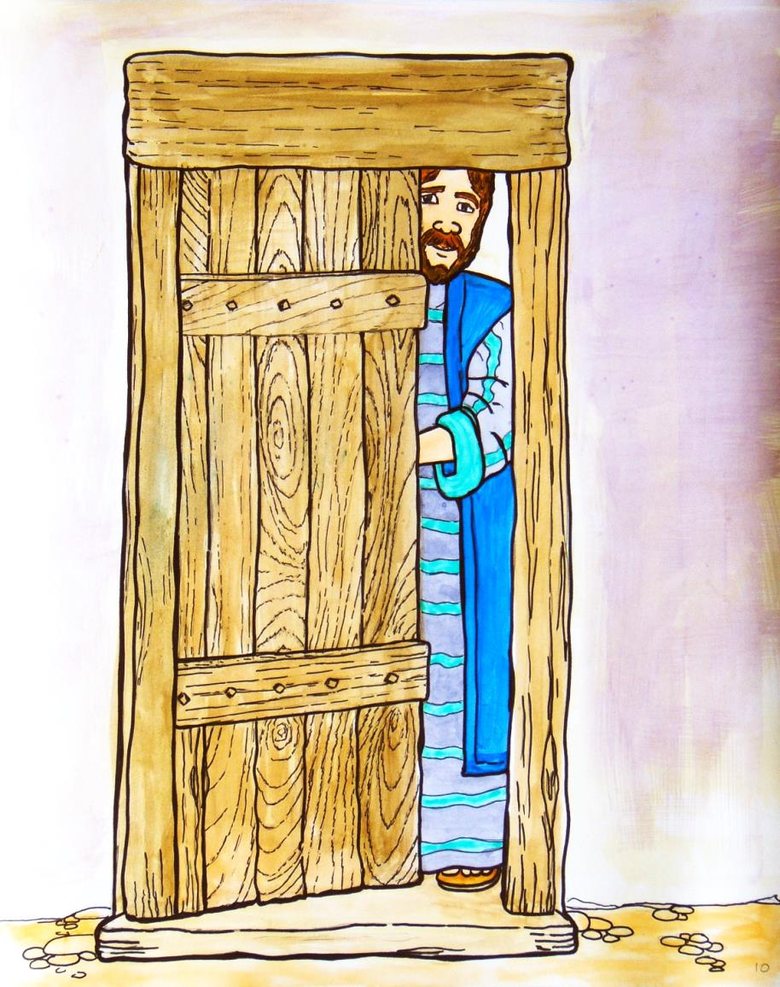

Slide 15
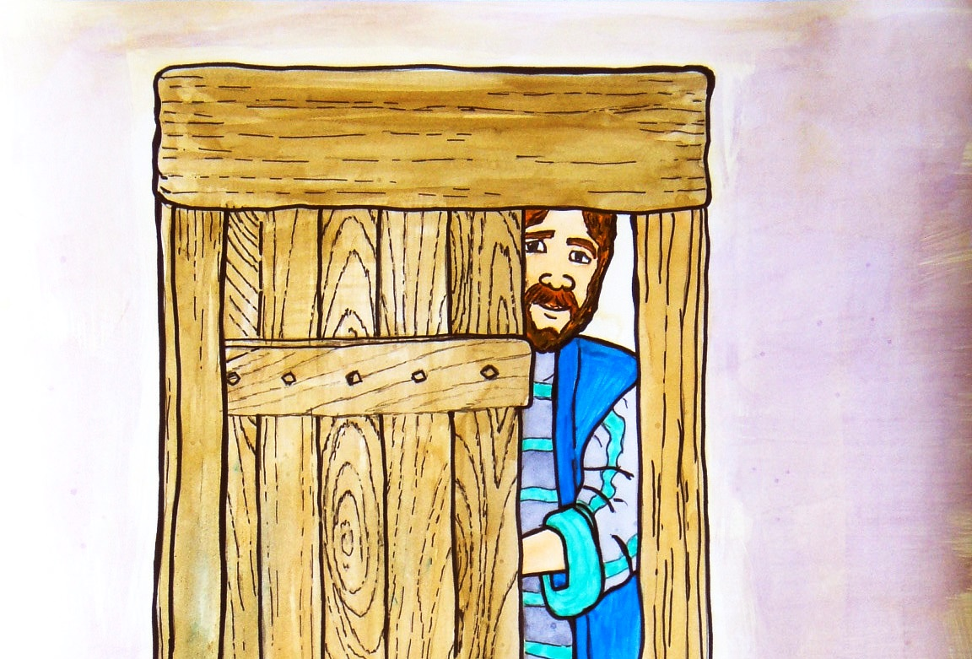

Slide 16
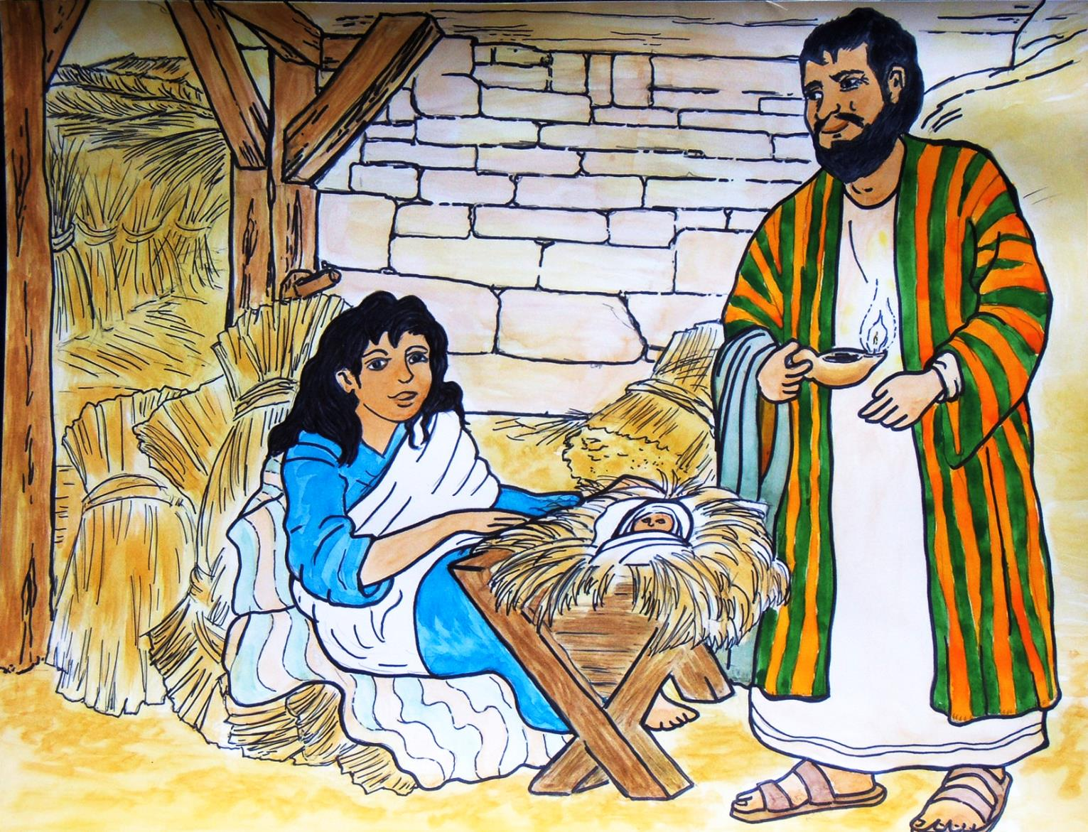

Slide 17
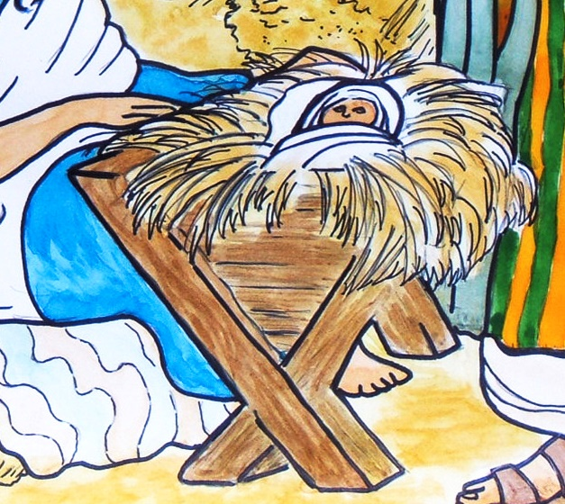

Slide 18
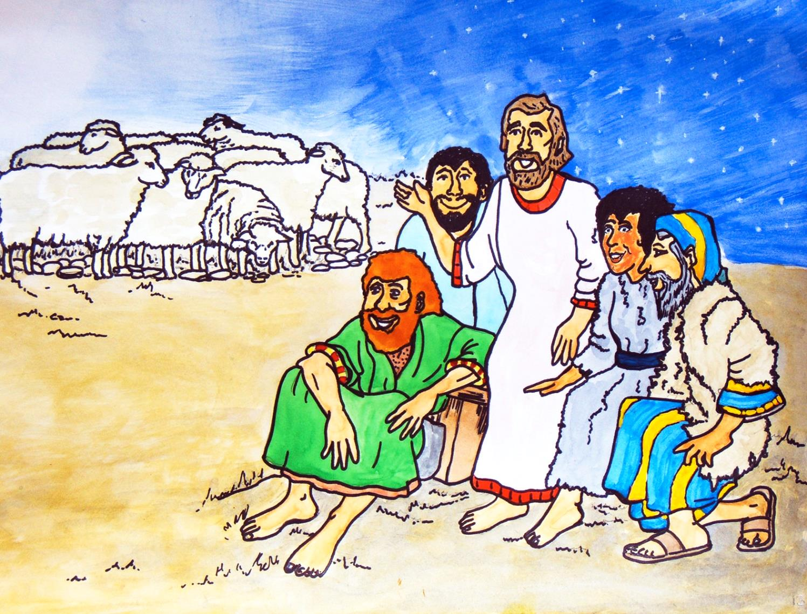

Slide 20
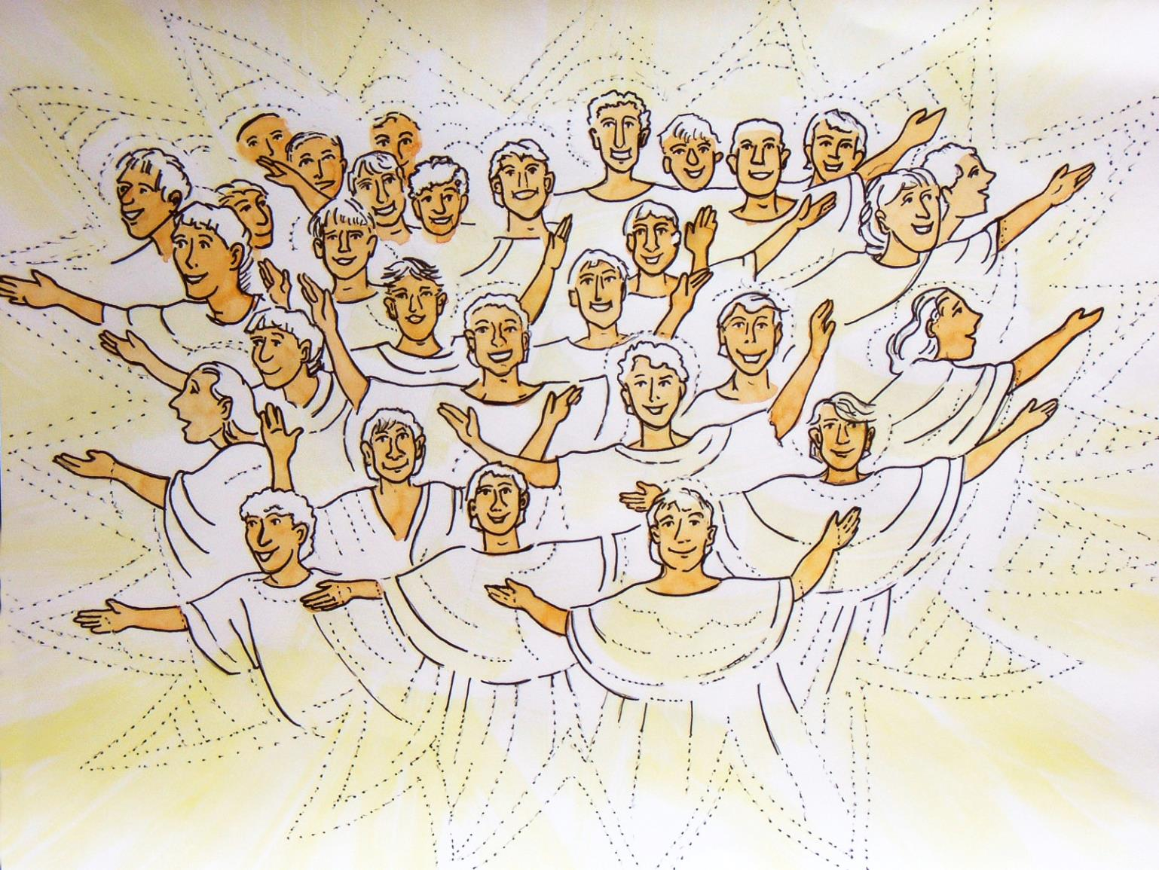

Slide 21
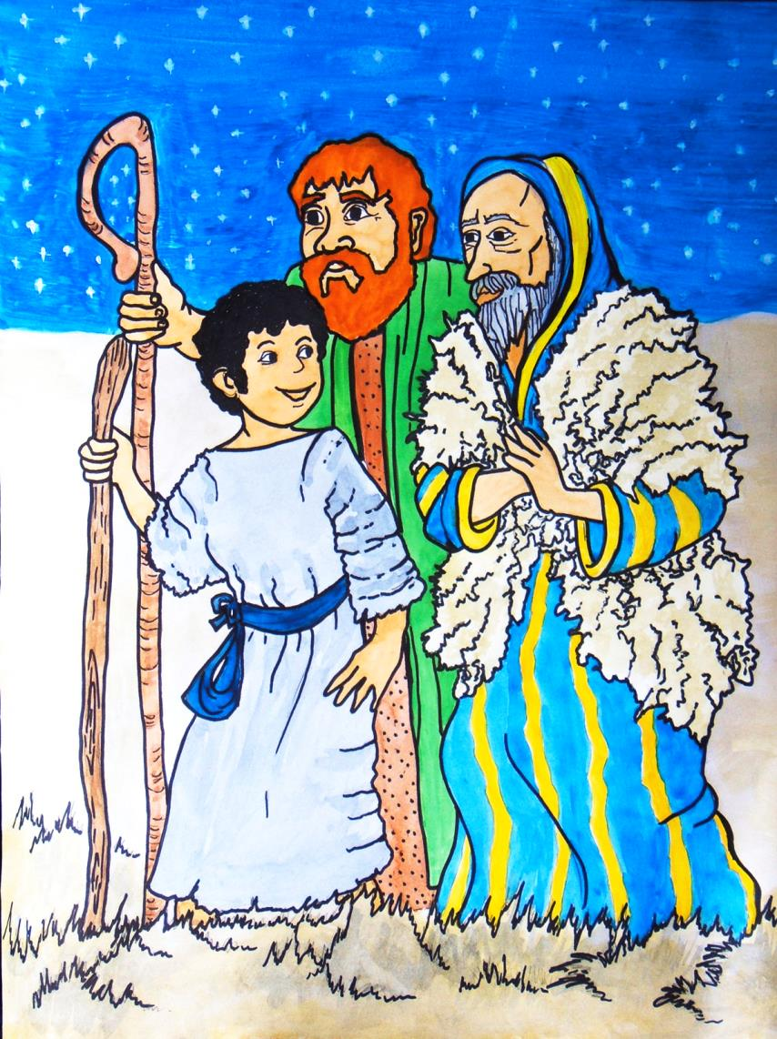

Slide 22
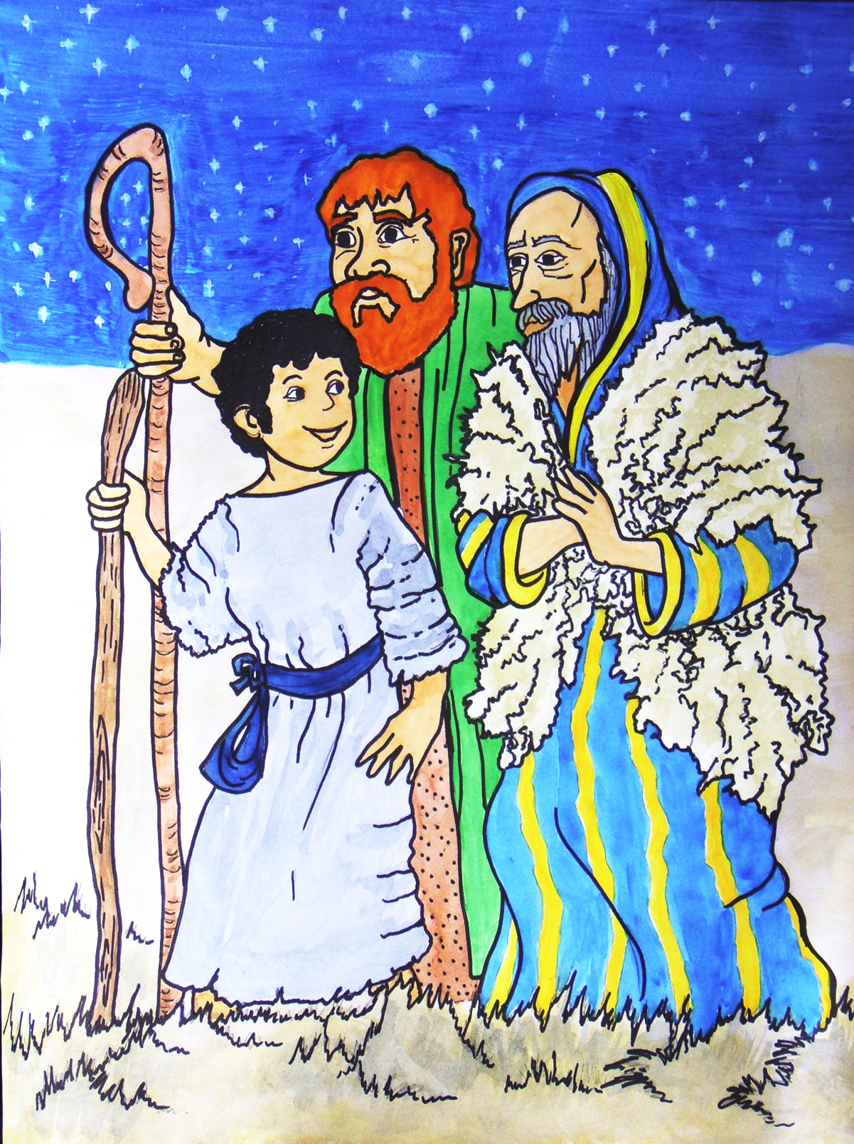

Slide 23
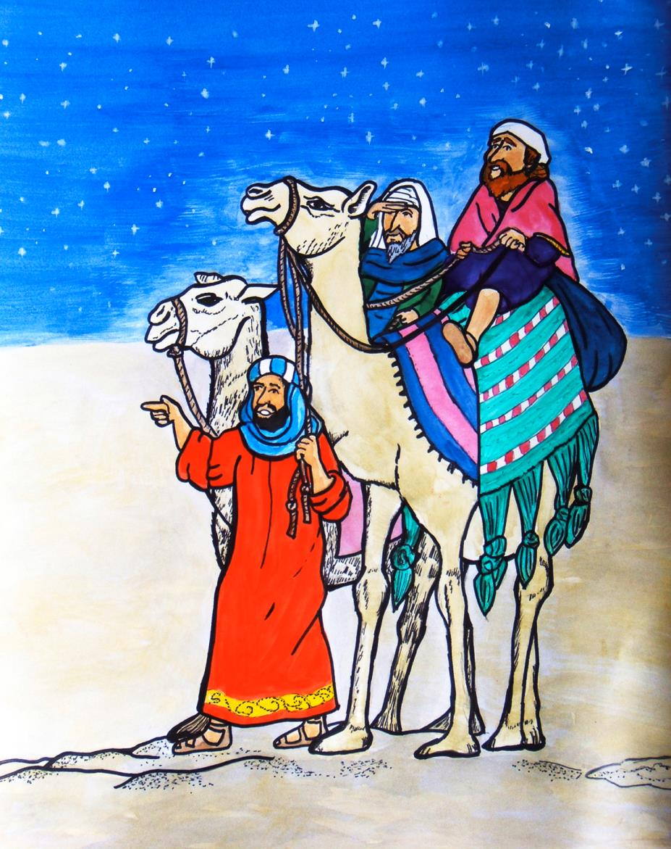

Slide 24
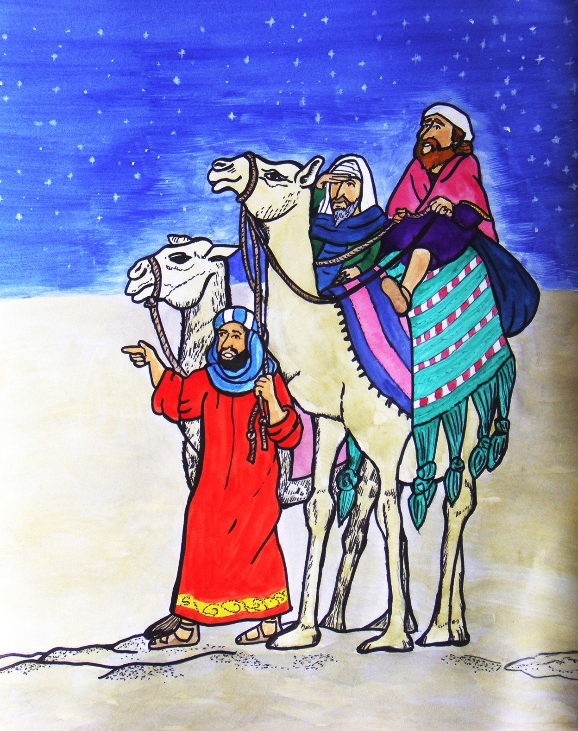

Slide 25
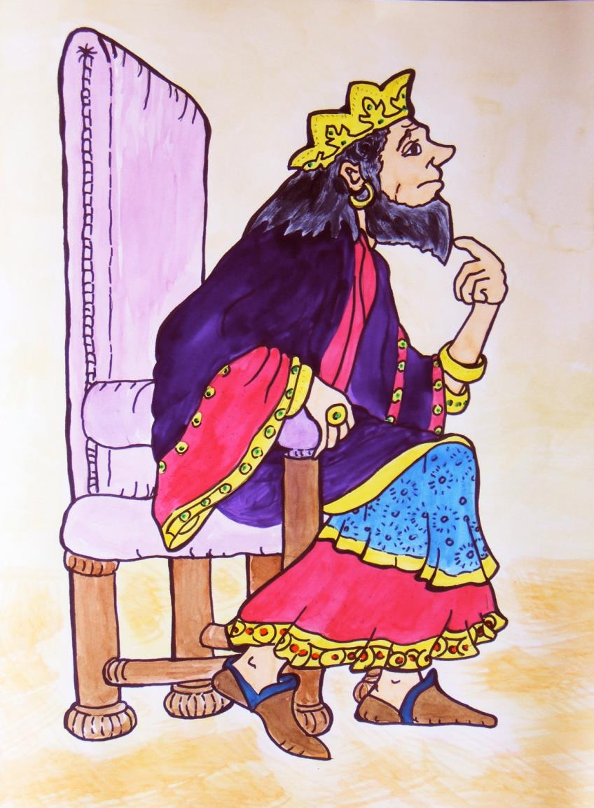

Slide 26
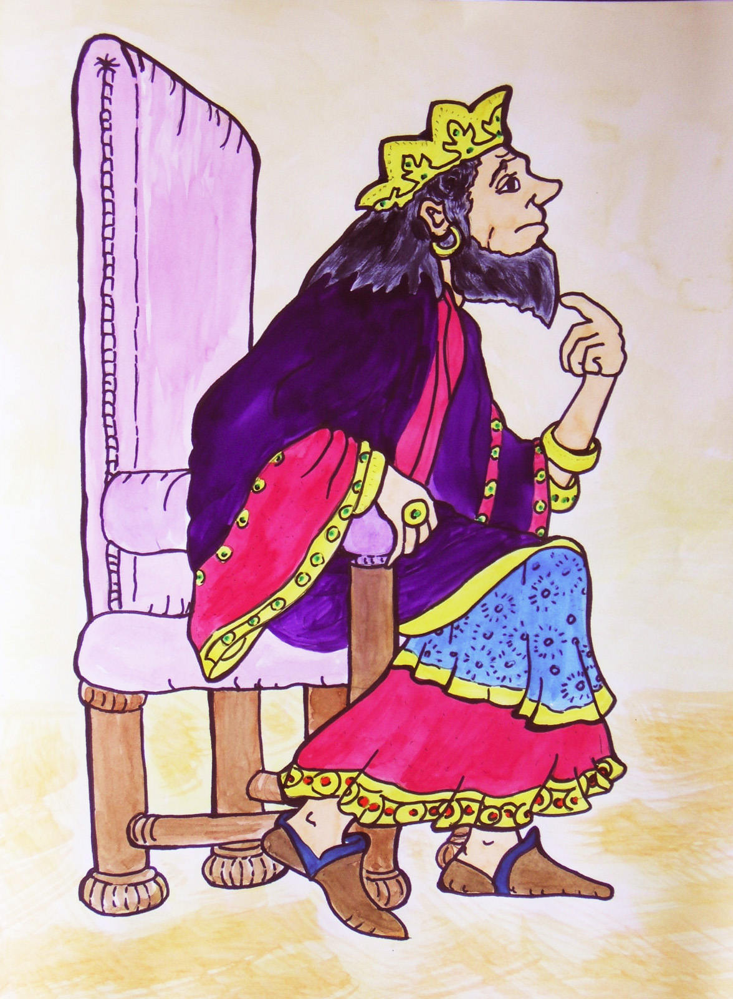

Slide 27

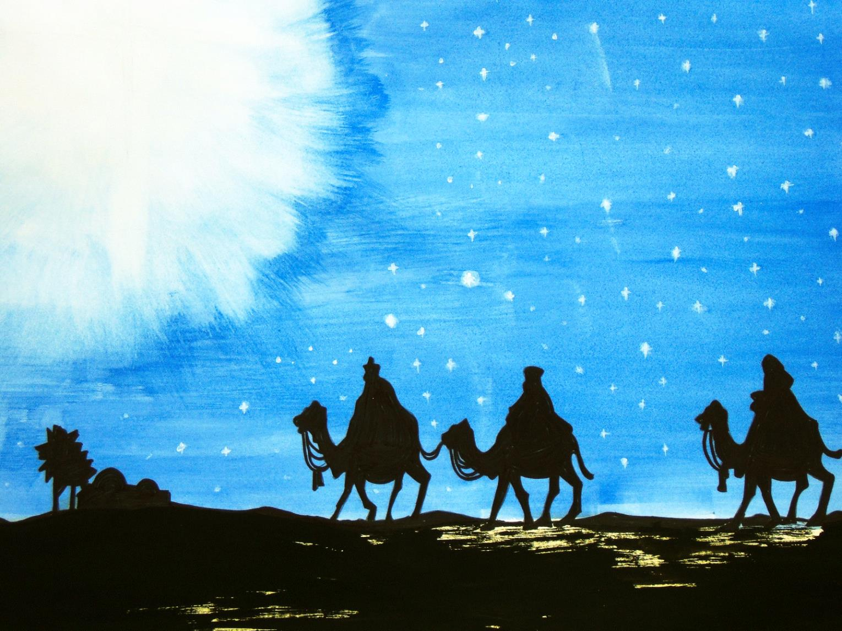

Slide 28
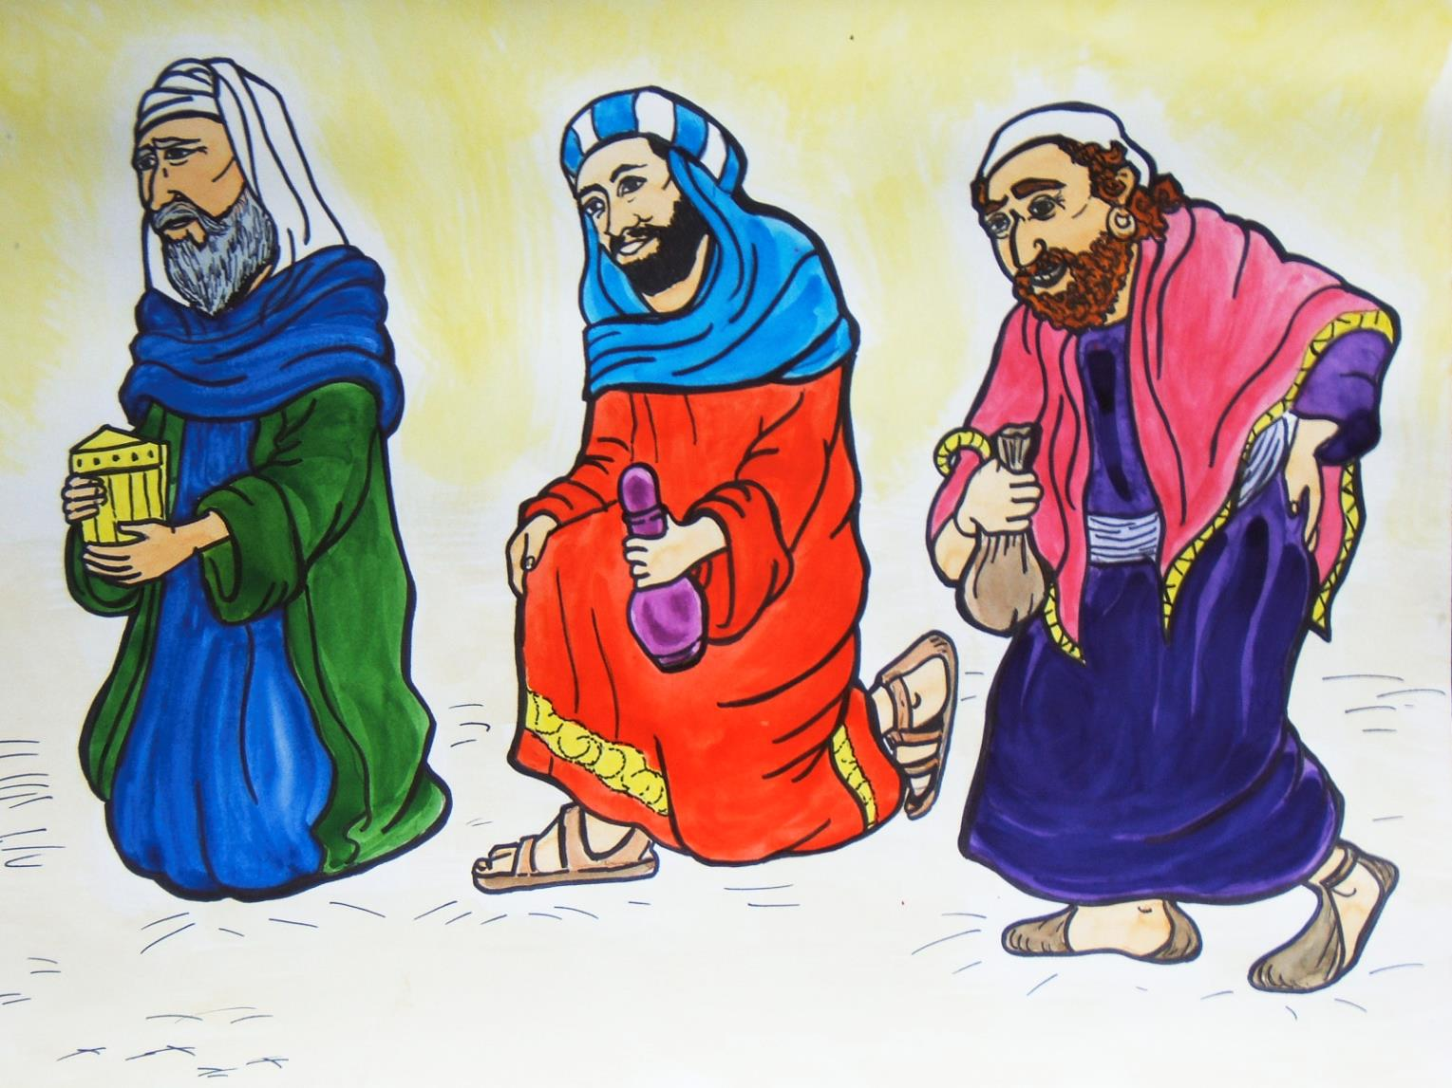

Slide 29

Think
Say
Do
✓
✓
✓

Slide 30
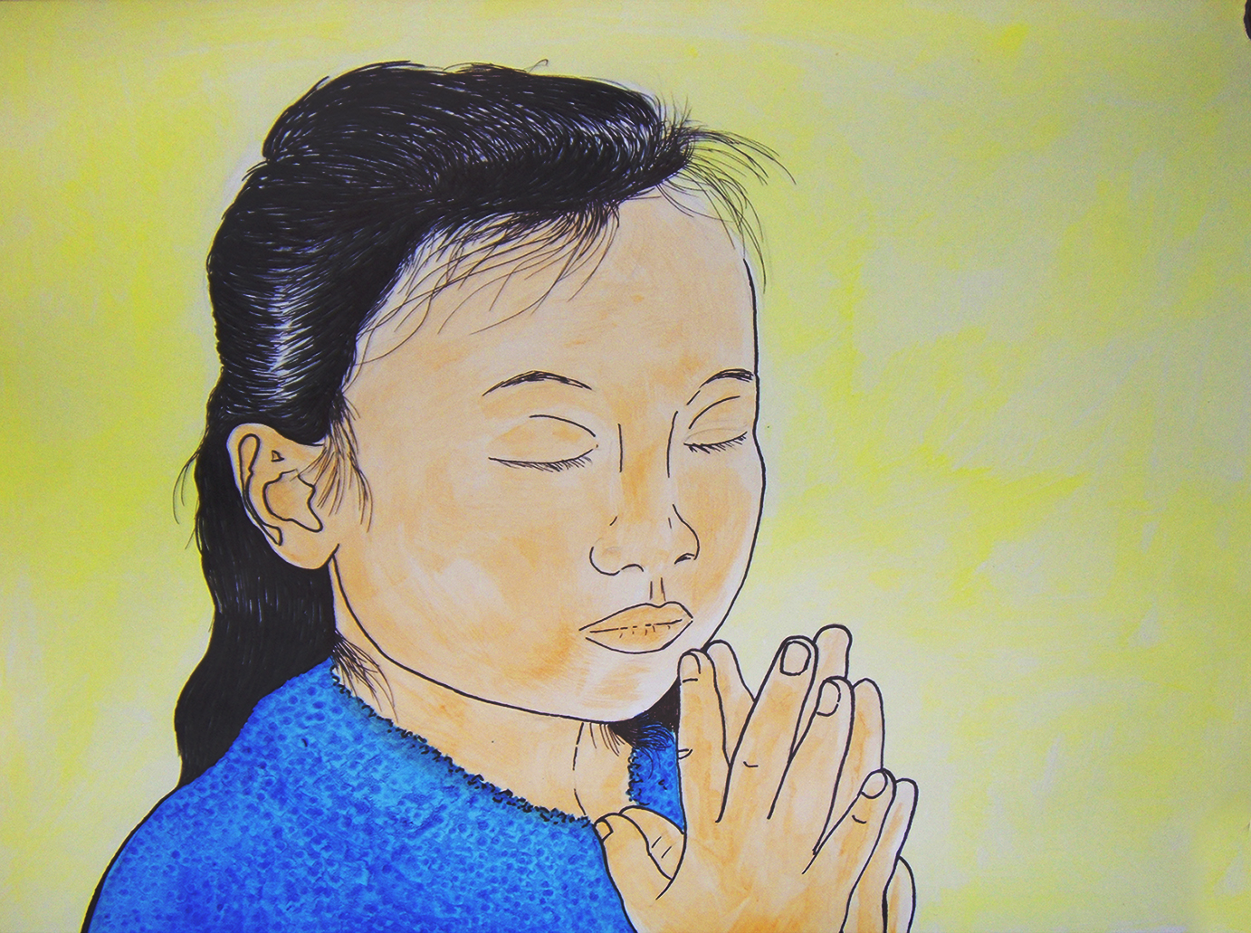
I am sorry
Please
forgive me
Come into
my life and
help me

Slide 31


Slide 33

He is my Saviour

Slide 35
We
worship him

Slide 37
We
worship him

Slide 38
The Peace and Joy
of Christmas

Slide 40
This presentation comprises slides developed and hand coloured from black and white images found on the C-ROM: How to Cheat at Visual Aids by Judith Merrell and Pauline Adams , published by Scripture Union.
This is a reproducible and adaptable resource of illustrations.
This PowerPoint presentation was made by Catherine Slight and Lin Pearson.
You may like to visit our website: FreeMinistryResources.org for free downloadable resources.
A suggested script for this presentation is also available there at https://freeministryresources.org/a-simple-illustrated-nativity-story/
You are free to use this PowerPoint presentation for the purpose it was intended – to teach the biblical account of Christmas.
Please see the next slide for terms of use.

Slide 41
Terms of Use
This presentation is the work of Catherine Slight and Lin Pearson, and is copyrighted*, and may be used under the following terms.
Any image which has a copyright line must not have that copyright line removed. Where images have no copyright line, this in no way implies that the images are copyright free.
You may use our resources unaltered for the purpose of study and teaching. We will be delighted if you find them of use.
Copying
Please do not pass on extra copies or files to anyone else. Instead, we would be very grateful, and it would benefit our site greatly, if you would direct people to FreeMinistryResources.org, where they can download the materials for themselves.
Reuse of images
Please do not extract slides or images from any of our items to use in another presentation you wish to make.
Many images are licensed to us on the understanding that they are used only in our resources, and are not to be distributed for the use of others.
*FreeMinistryResources.org, including all its resources by Catherine Slight and Lin Pearson, is licensed under the following license:
Creative Commons Attribution-Non-Commercial-No Derivative Works 4.0

