Slide 1

S.T.O.P.
A Pattern for Personal Prayer
By Catherine Slight and Lin Pearson
FreeMinistryResources.org

Slide 2

Take Time
to Pray

Slide 3
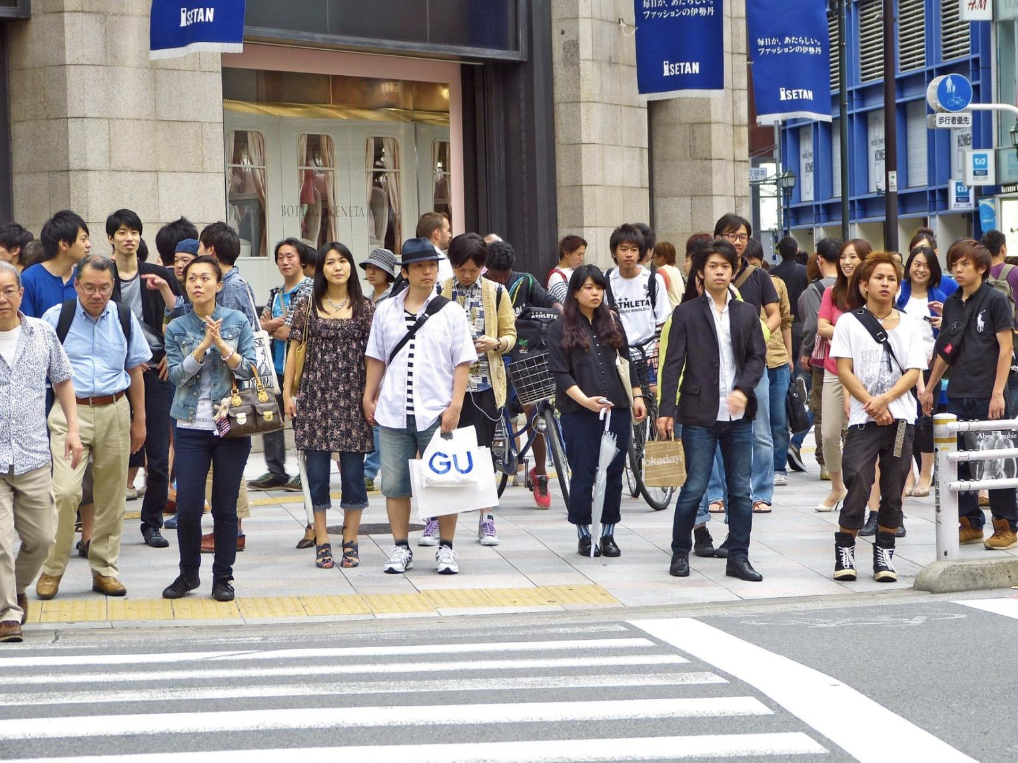

Slide 4


Slide 5


Slide 6


Slide 7
STOP

Slide 8


Slide 9
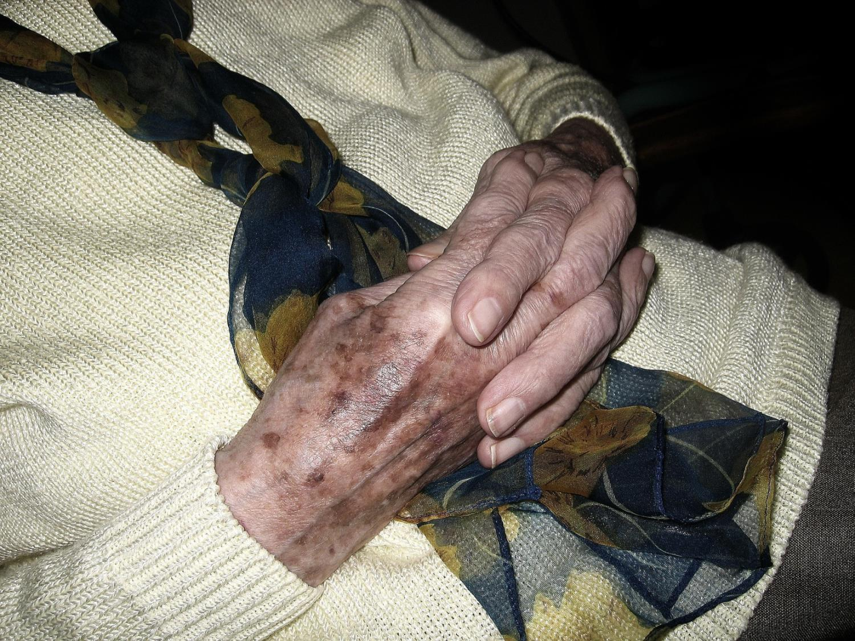

Slide 10


Slide 11

I am not sure how to pray

Slide 12

Find a suitable place
Quiet
Few distractions
Alone if possible

Slide 13

Set a time

Slide 14

Make notes

Slide 15

You can write down:
Things to pray about
The answers to those prayers
Bible verses that come to mind
Thoughts that might distract you

Slide 16

S
T
O
P

Slide 17
S
orry
T
O
P

Slide 18
S
orry
T
hank you
O
P

Slide 19
S
orry
T
hank you
O
h!
P

Slide 20
S
orry
T
hank you
O
h!
P
lease

Slide 21
We can pray at ANY TIME
and ANYWHERE

Slide 22

Thank you, God, for fun and friends

Slide 23

Lord, please help me understand my lessons

Slide 24
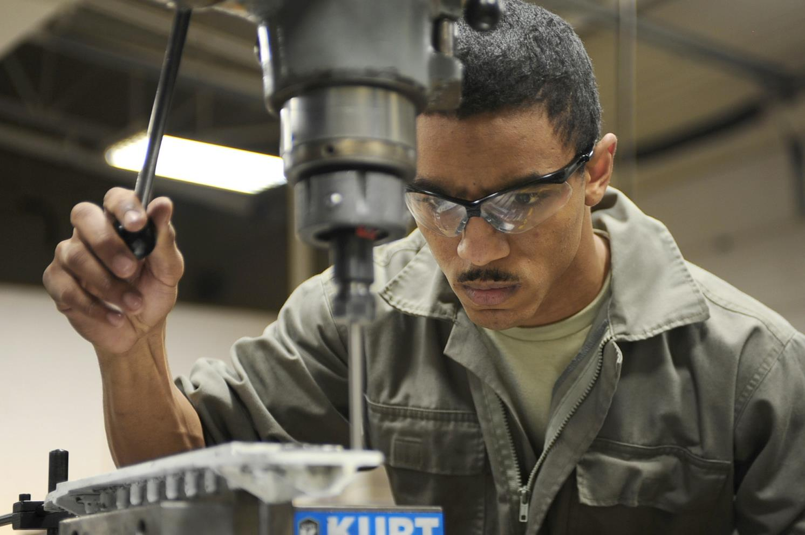
Thank you for
my job, Father.
Please help me
to do it well.

Slide 25
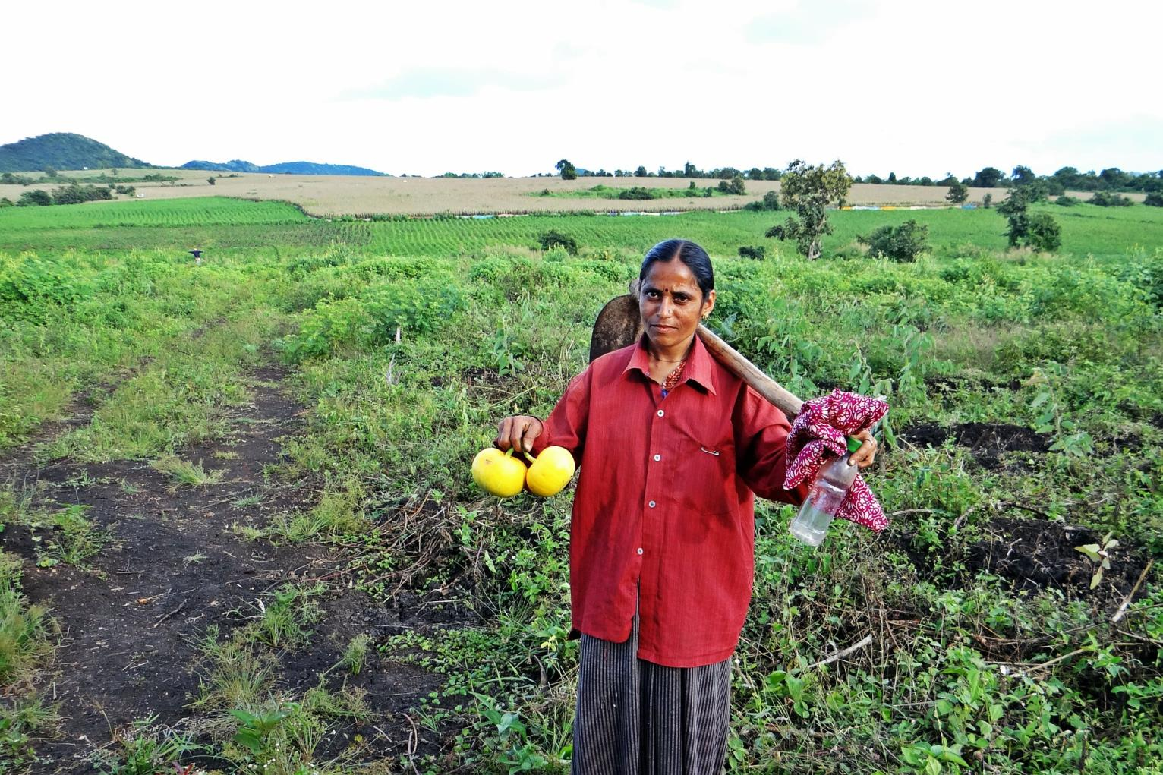
Lord, please
give me a
good harvest.

Slide 26
We can pray at ANY TIME
and ANYWHERE

Slide 27
We can pray at ANY TIME
and ANYWHERE
Turn your thoughts to God
and talk about what is on your heart.

Slide 28


Slide 29


Slide 30
“If I go up to the heavens, you are there;
if I make my bed in the depths,
you are there…
…even there your hand will guide me,
your right hand will hold me fast.”
Psalm 139:8-10 New International Version (NIV)

Slide 32
TERMS of USE
This presentation is the work of Catherine Slight and Lin Pearson, and is copyrighted*, and may be used under the following terms.
Any image which has a copyright line must not have that copyright line removed. Where images have no copyright line, this in no way implies that the images are copyright free.
You may use this PowerPoint unaltered for the purpose of study and teaching. We will be delighted if you find it of use. But it may not be sold, nor should a charge be made for people to view it.
Copying
Please do not pass on extra copies or files to others. Instead, we would be very grateful, and it would benefit our site greatly, if you would direct people to https://freeministryresources.org/how-should-i-pray/ where they can download the materials for themselves.

Slide 33
Reuse of images
Please do not extract slides or images from this PowerPoint to use in another presentation you wish to make.
Many images are licensed to us on the understanding that they are used only in our resources, and are not to be distributed for the use of others.
Script
The script for this presentation may be downloaded from
https://freeministryresources.org/how-should-i-pray/
*FreeMinistryResources.org, including all its resources by Catherine Slight and Lin Pearson, may be used under the following license:
Creative Commons Attribution-Non-Commercial-No Derivative Works 4.0

