Slide 1
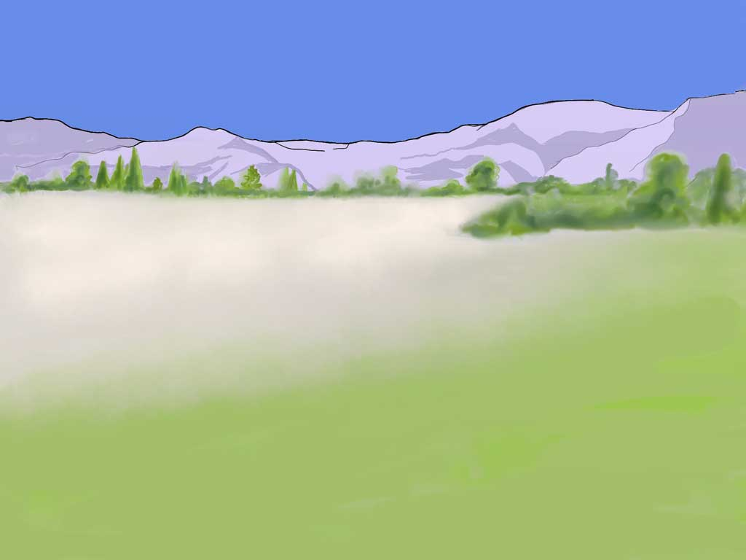
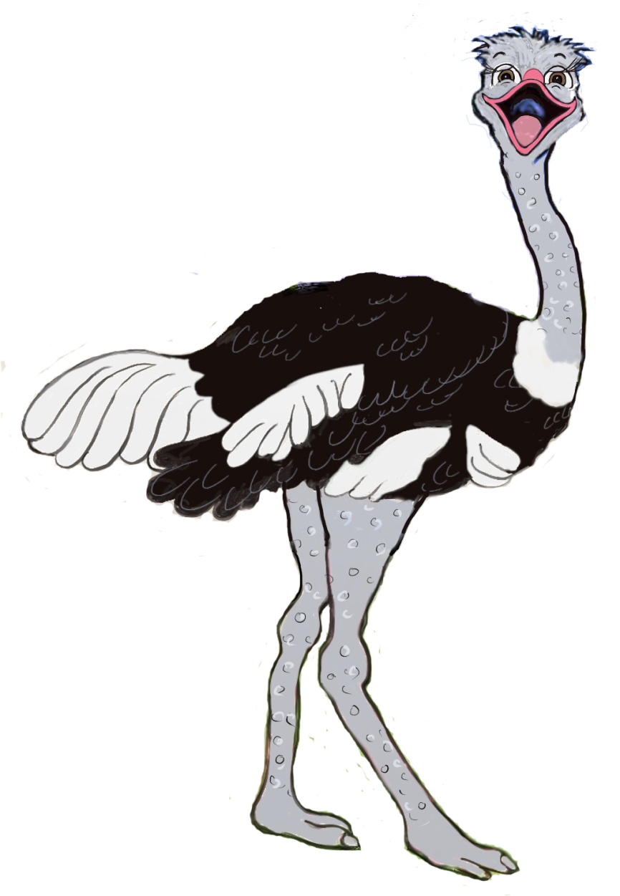

Ozzie’s
Scary
Night
Written and illustrated by
Catherine Slight
FreeMinistryResources.org
Notes:
This is the story of Ozzie Ostrich. I think he'd want to introduce himself and he'd say...

Slide 2
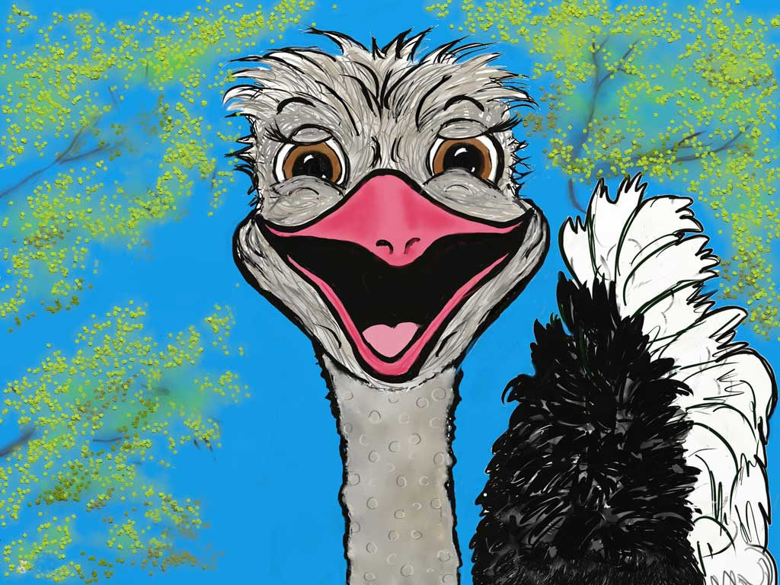
Notes:
... "Hi! I'm Ozzie!”

Slide 3
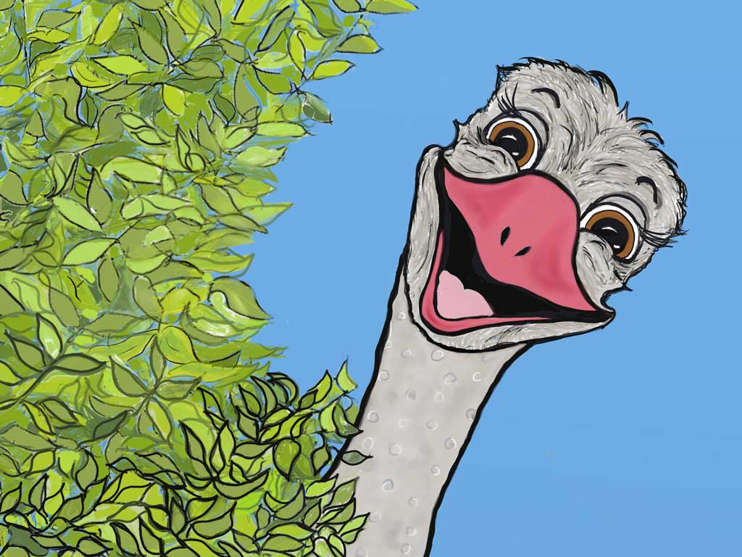
Notes:
Ozzie lived with his brother Olly …

Slide 4
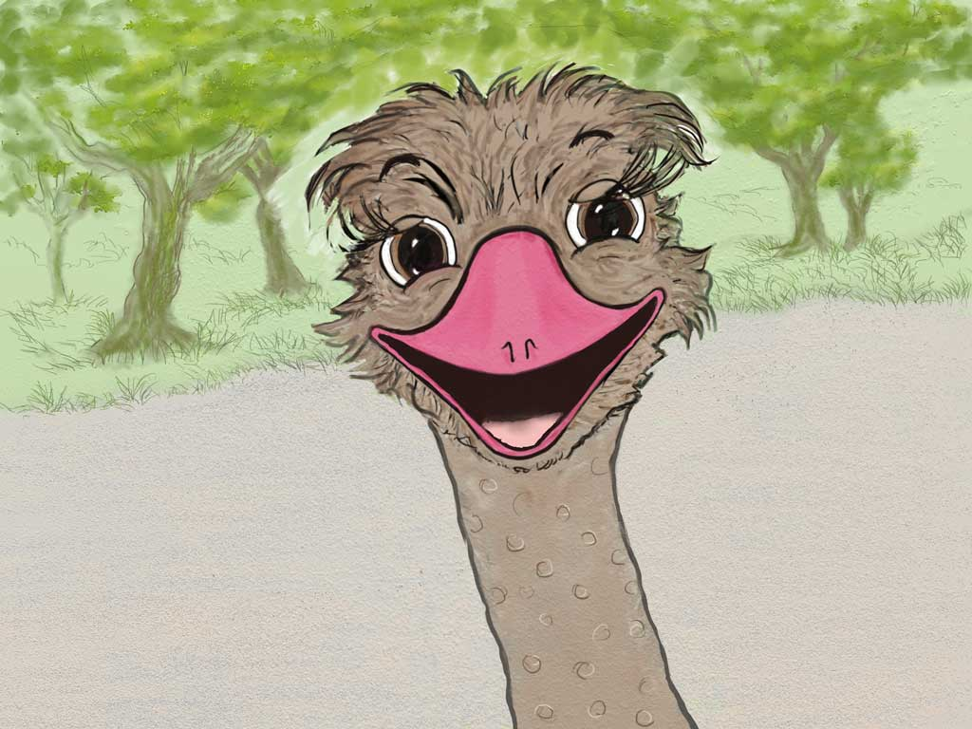
Notes:
…and his sisters Olive ….

Slide 5
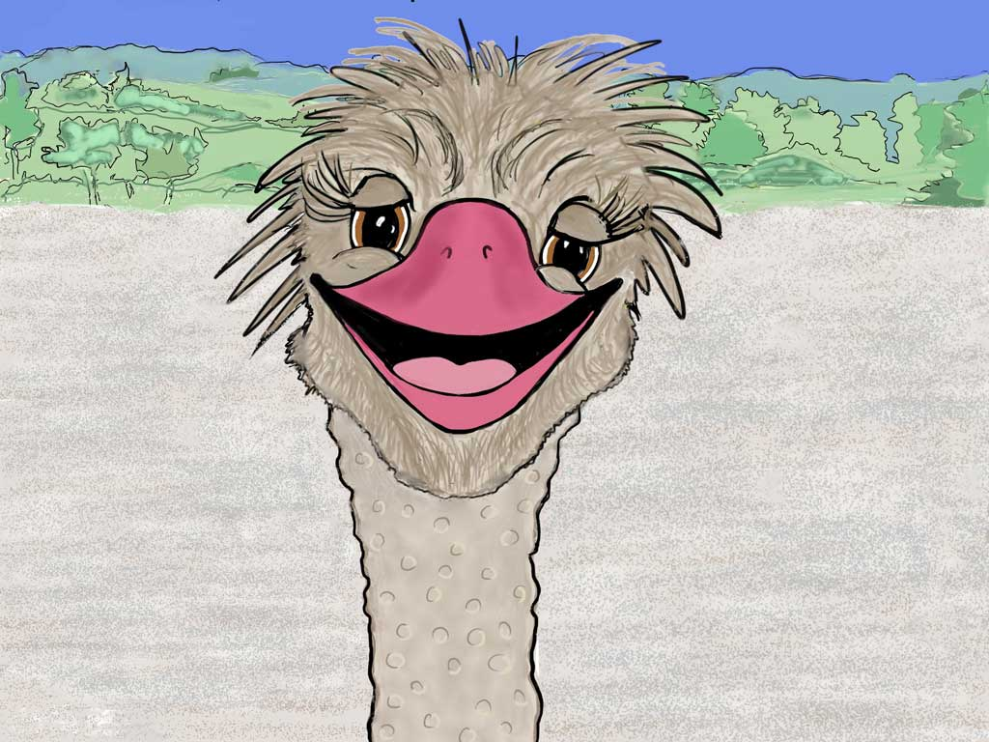
Notes:
…and Olga ...

Slide 6
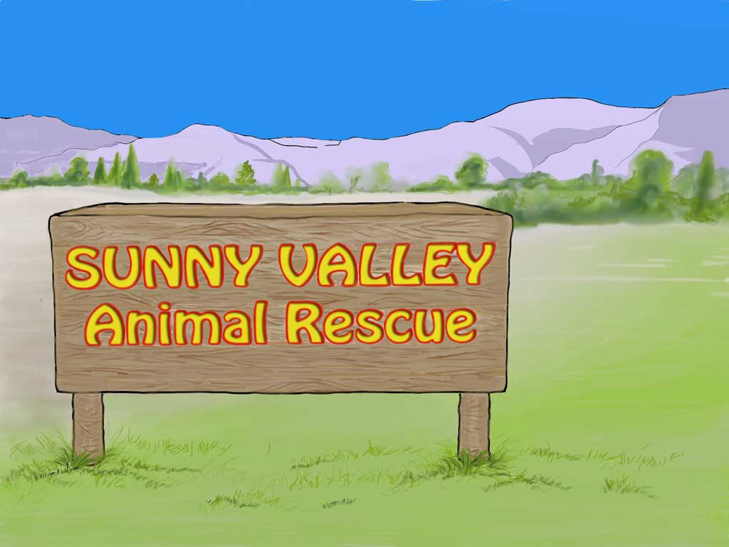
Notes:
..at Sunny Valley Rescue Park. Some of the animals and birds living there had been neglected or cruelly treated before they had come to Sunny Valley. All had been hurt and scared but, now, it was so different!

Slide 7
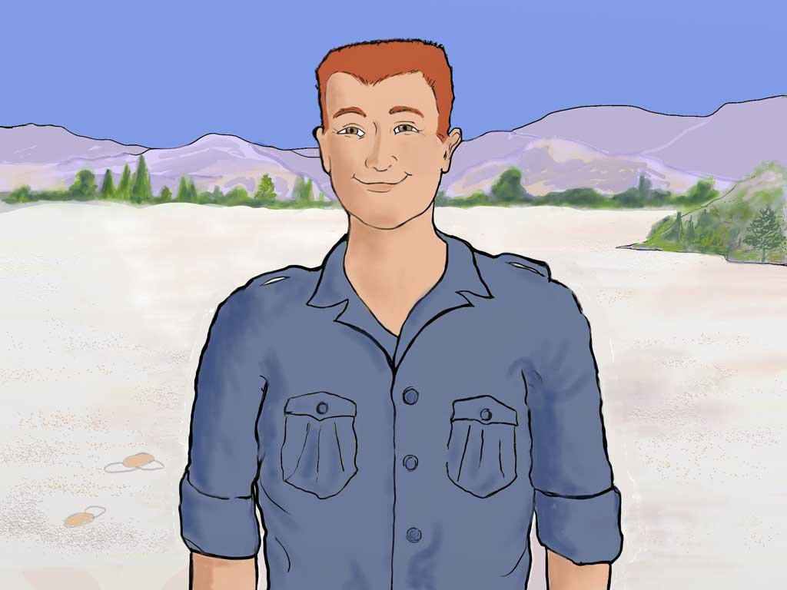
Notes:
Tom, the man who had saved their lives, brought them there. He said, “I'll take care of you.” and he did.

Slide 8
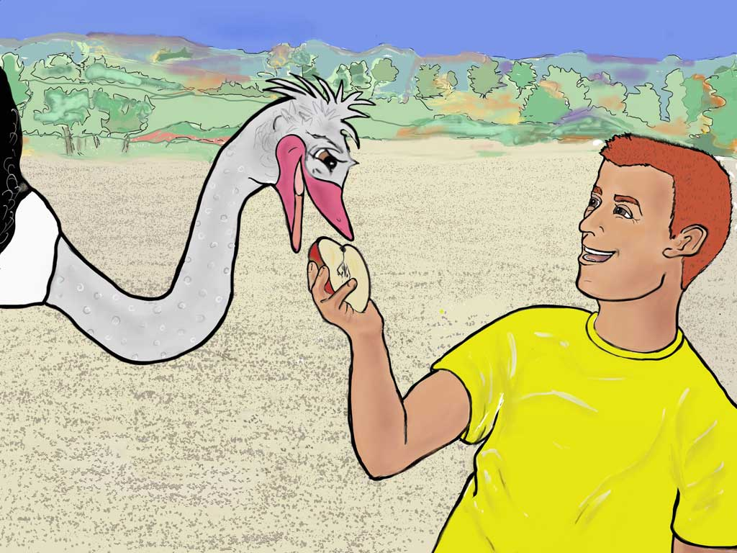
Notes:
He fed them fruit they liked and the ostriches felt safe and happy. Tom had given them a new life.

Slide 9
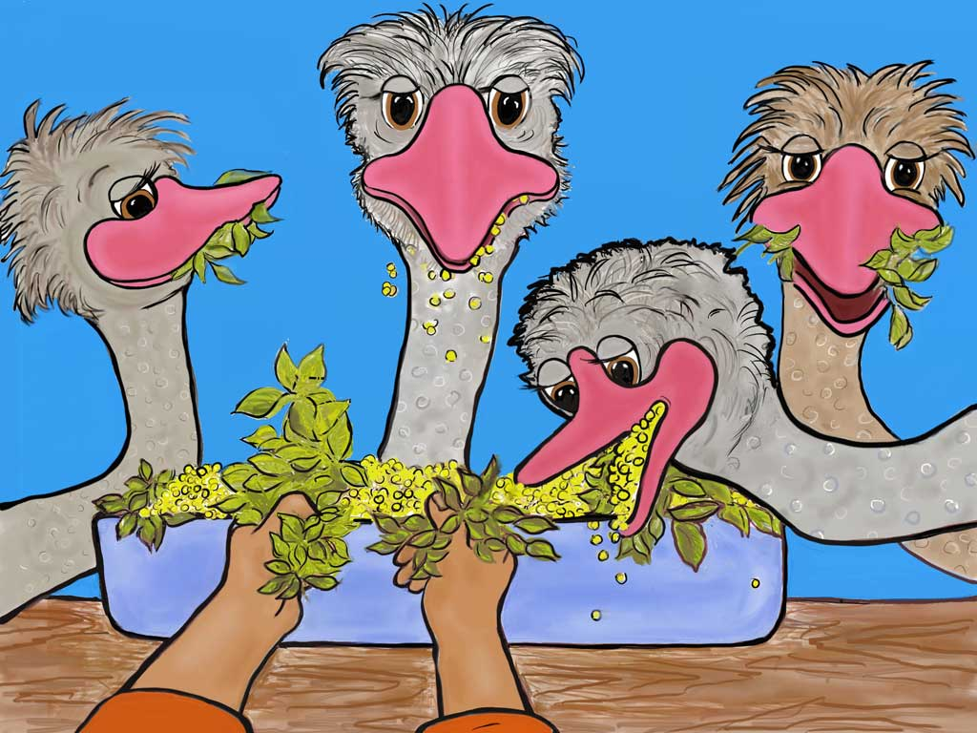
Notes:
He made sure they had plenty of the other good food and everything else they needed.

Slide 10
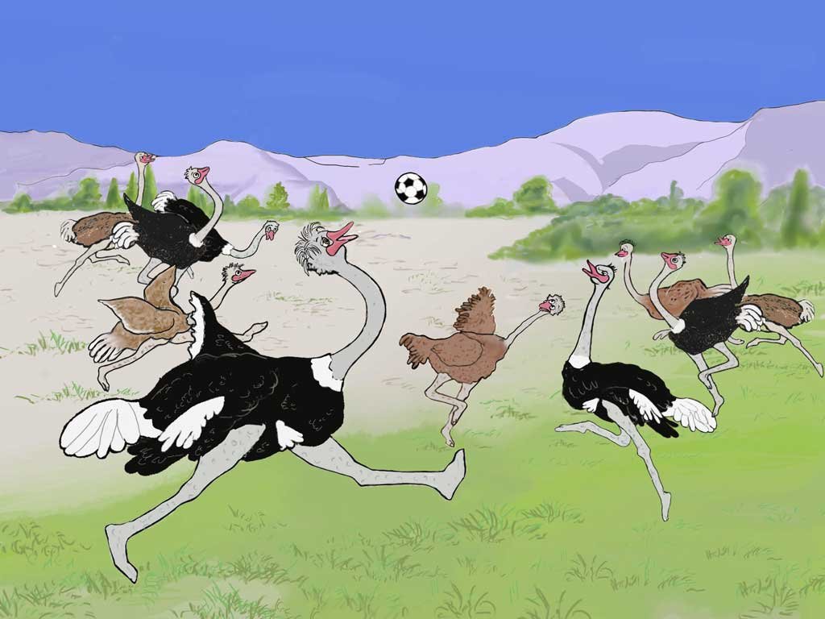
Notes:
All the ostriches loved playing and they could play at Sunny Valley. One favourite games was football. Boy ostriches are bigger than the girls but still they didn't always win the game. For instance, once …

Slide 11
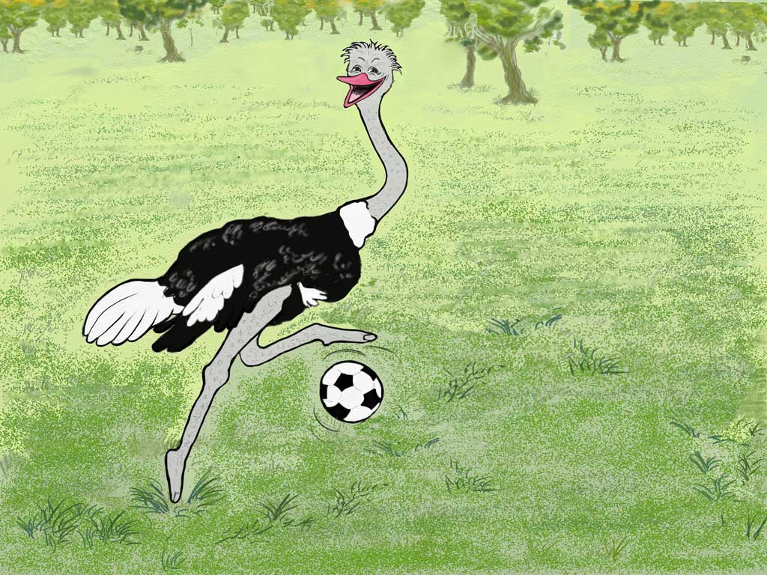
Notes:
…when Ozzie had the ball and was smiling proudly at those watching the game, …

Slide 12
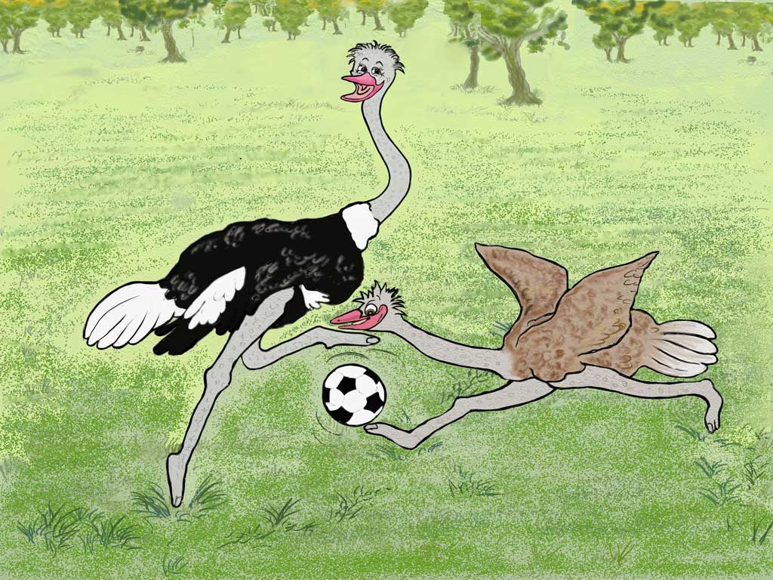
Notes:
Olive sneaked in and took the ball!

Slide 13
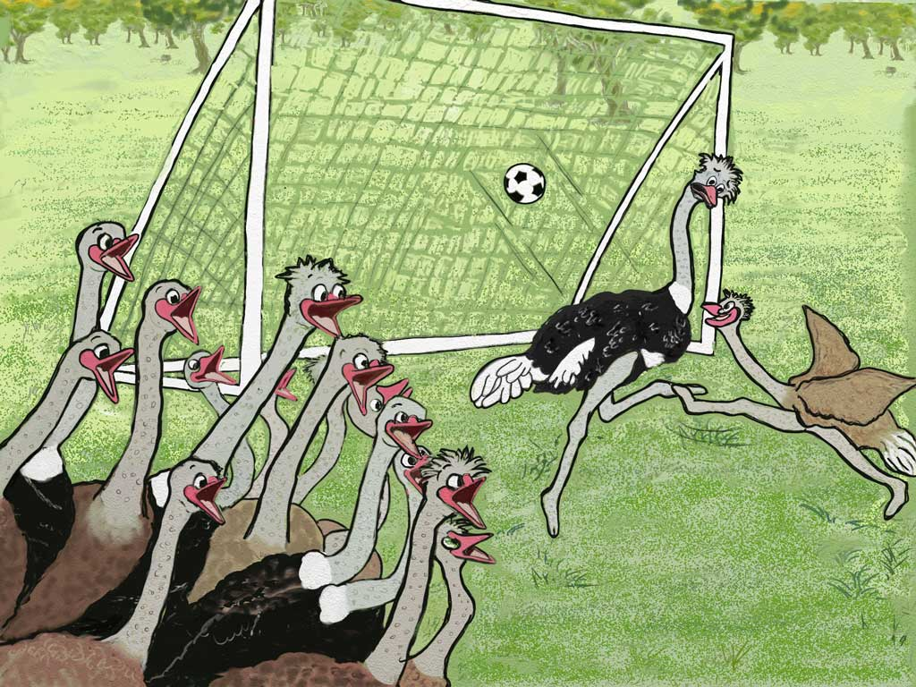
Notes:
Then she kicked really high…

Slide 14
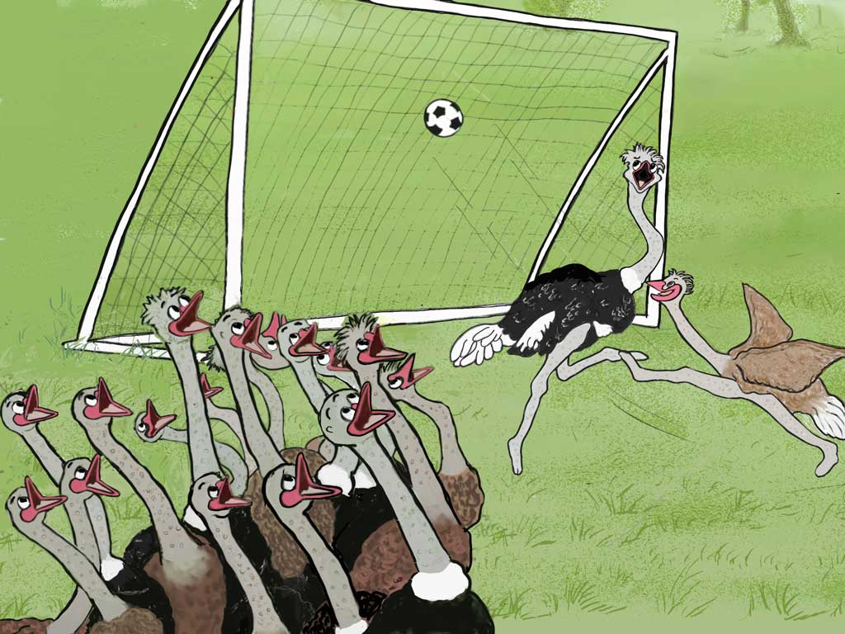
Notes:
…and scored an amazing goal! This was funny and all the ostriches were impressed!

Slide 15
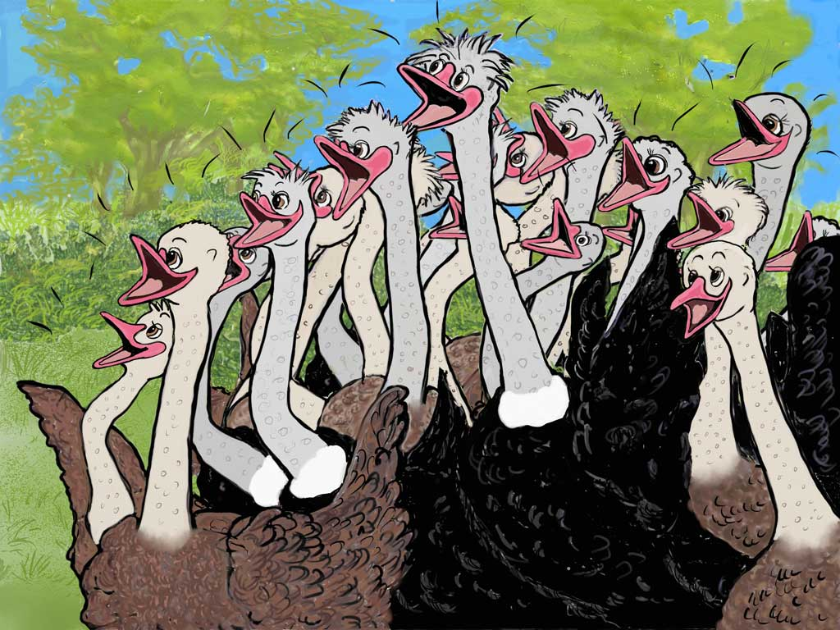
Notes:
Not only the ostriches in her team but both teams shouted, “Well done Olive!” because they were all such good sports.

Slide 16
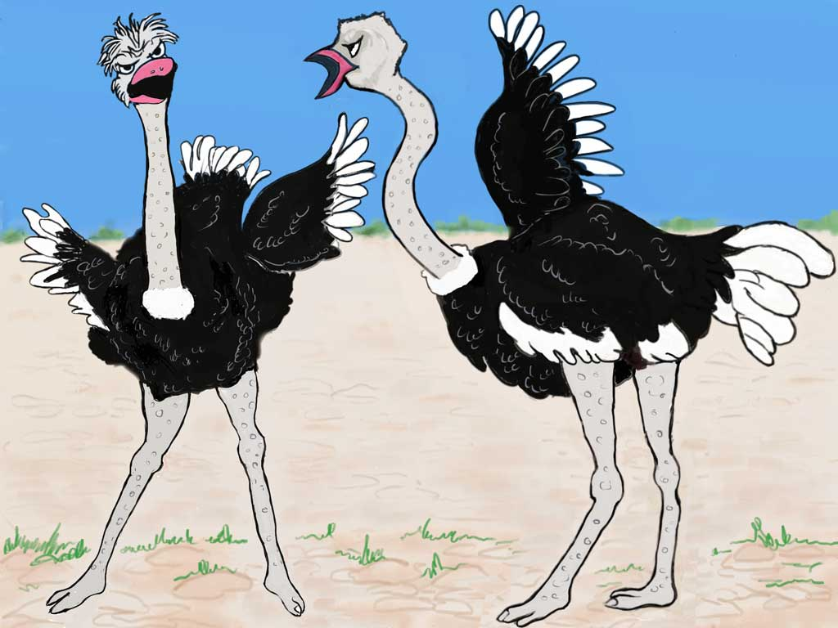
Notes:
But sometimes the ostriches misbehaved! Ozzie and Olly would fight! And the more they fought the more angry and unhappy they got!

Slide 17
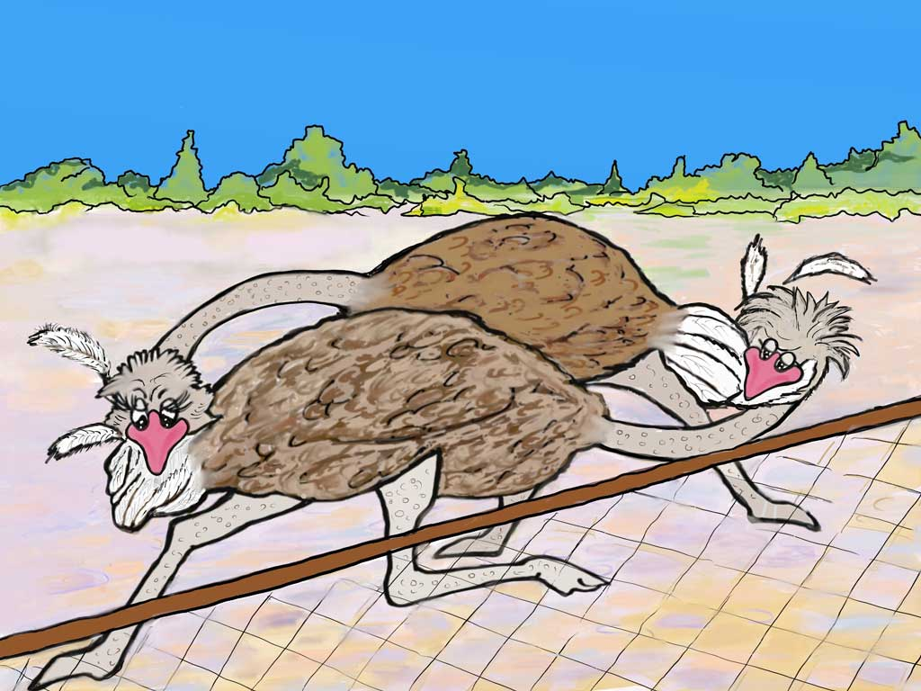
Notes:
The girls were just as bad because they too would argue and even pull feathers out of each other!

Slide 18
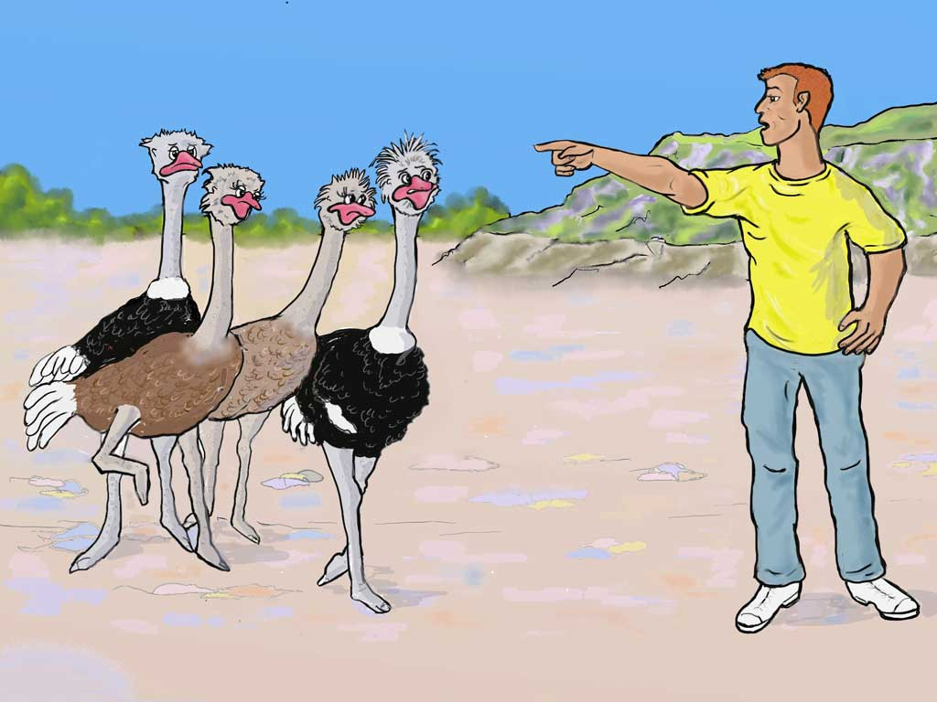
Notes:
Then Tom would call to them “Hey you lot, stop fighting and arguing! You know this is not the way to behave!”

Slide 19
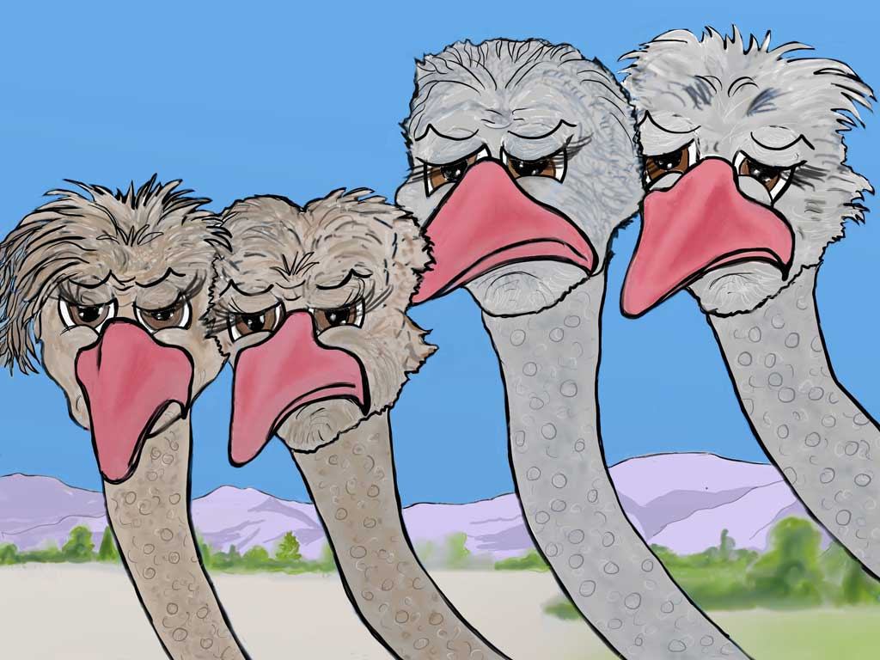
Notes:
The ostriches knew when they weren't pleasing Tom, who had rescued them. They felt ashamed that they'd let him down so they’d come to him to say “Sorry!”

Slide 20
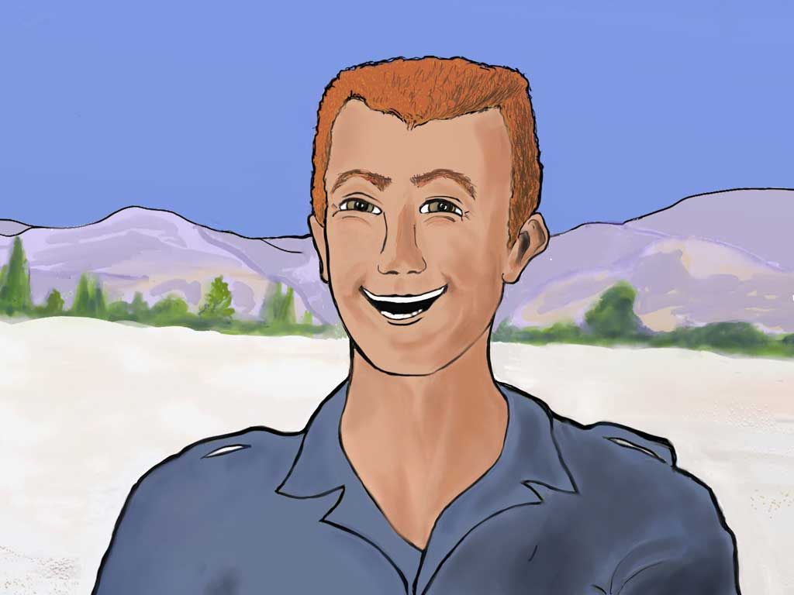
Notes:
And Tom would say, “I want you to know that I still love you and I forgive you but, listen! You mustn’t hurt each other by what you say or do. This is wrong! Do what I ask you and you will have the good life I have planned for you.”

Slide 21
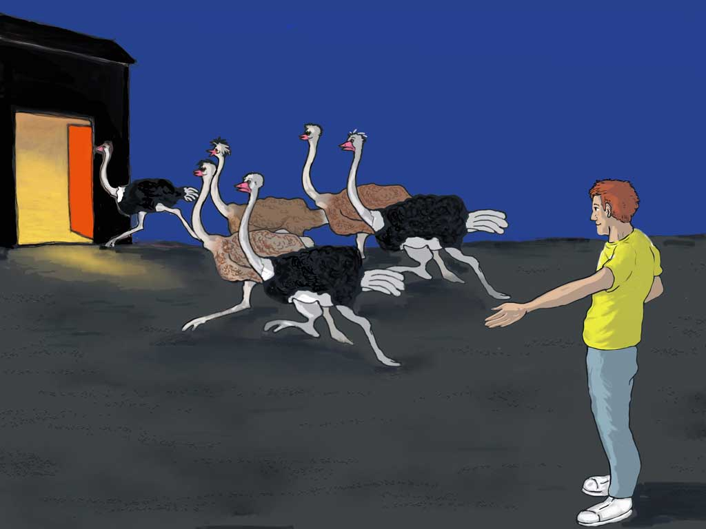
Notes:
Now although Sunny Valley was a safe place to be, at night when it got dark, Tom or his helpers would call to Ozzie and the others “Come on girls! Come on boys! It's time to go into your ostrich house!”
The ostriches loved their warm, cosy, safe place and they made happy ostrich sounds as they raced in.
Now they really needed to be in this safe place because, although they didn't know it, someone was planning to steal from them.

Slide 22
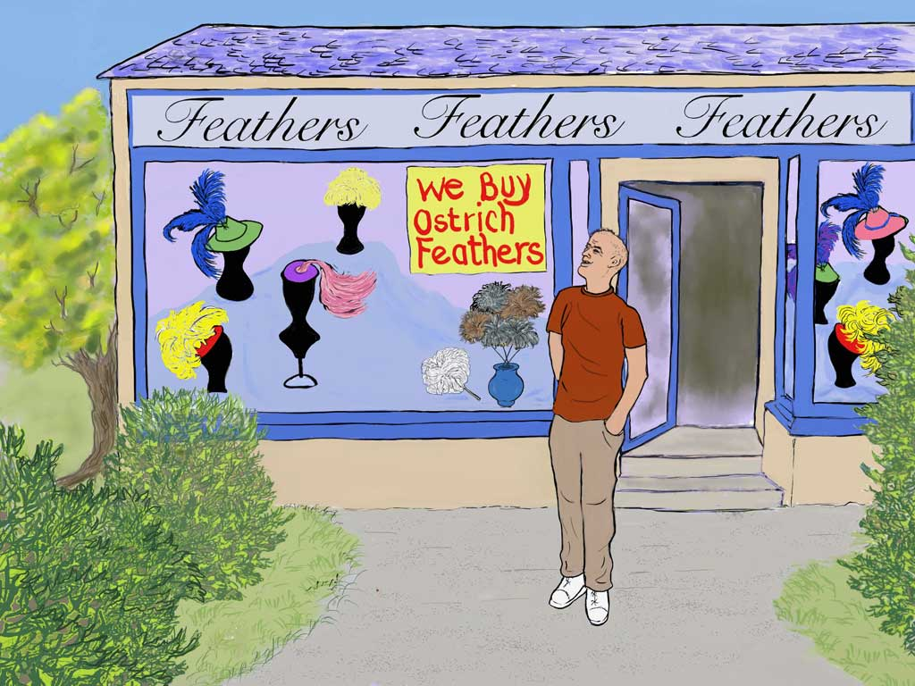
Notes:
A few days before, Bad Bertie, who liked doing bad things, had noticed a shop that sold things made from ostrich feathers.

Slide 23
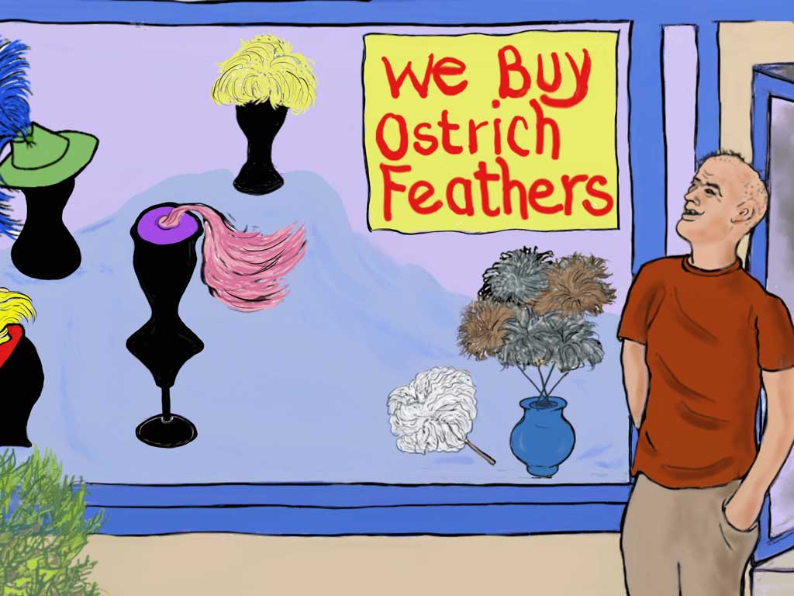
Notes:
But what took his attention was the poster in the window that said 'We buy ostrich feathers'

Slide 24
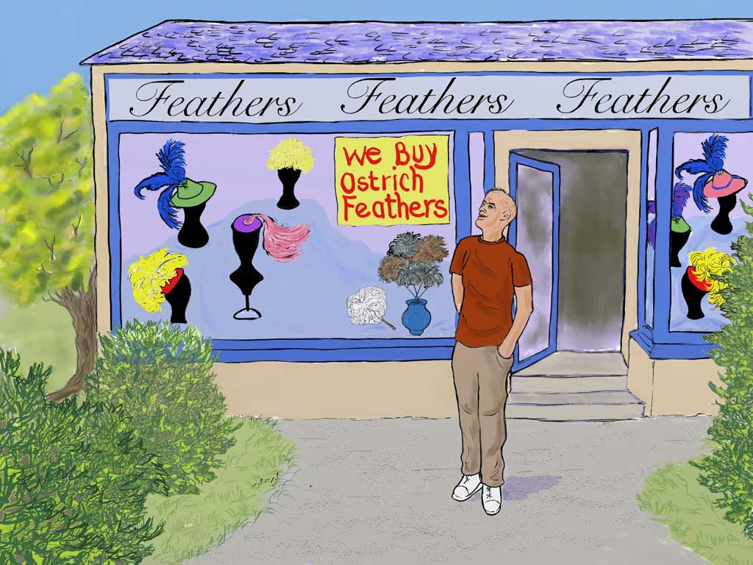
Notes:
Bertie thought, "I know where I can get loads of feathers that will cost me nothing! I'll go to Sunny Valley when it's dark. Some silly ostrich will probably decide to sleep outside the ostrich house. I'll find that bird and pull out its tail feathers then I'll have plenty to sell to this shop. I’ll be rich!"

Slide 25
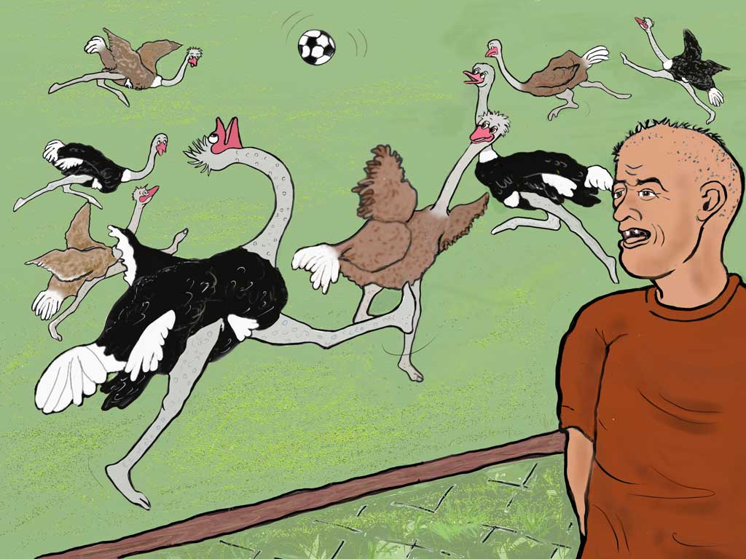
Notes:
So off Bad Bertie went to Sunny Valley to plan how he would break in and steal the feathers. The ostriches were playing football when bad Bertie arrived. But he wasn't interested in the game. He was saying to himself, “I was right. Those ostrich feathers will make me lots of money."

Slide 26
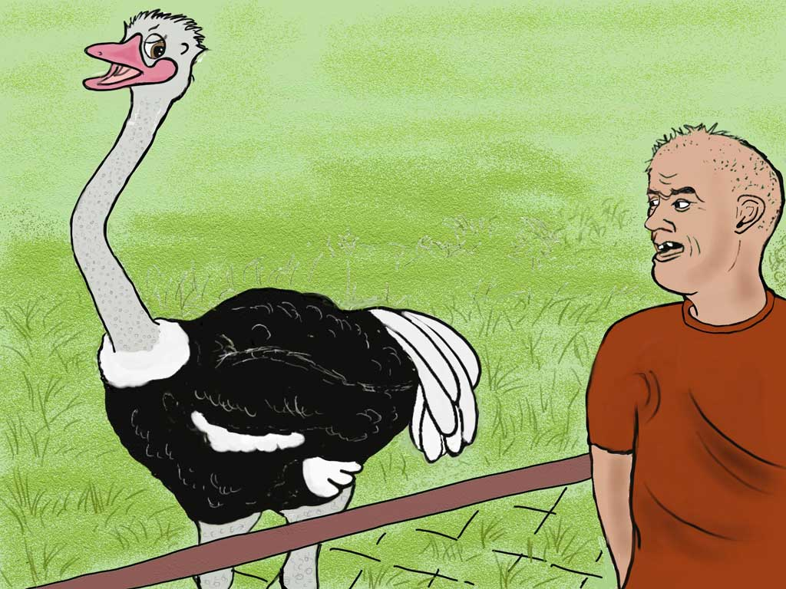
Notes:
Now Bertie was speaking his thoughts out loud and Olly, passing by, heard him. So…

Slide 27
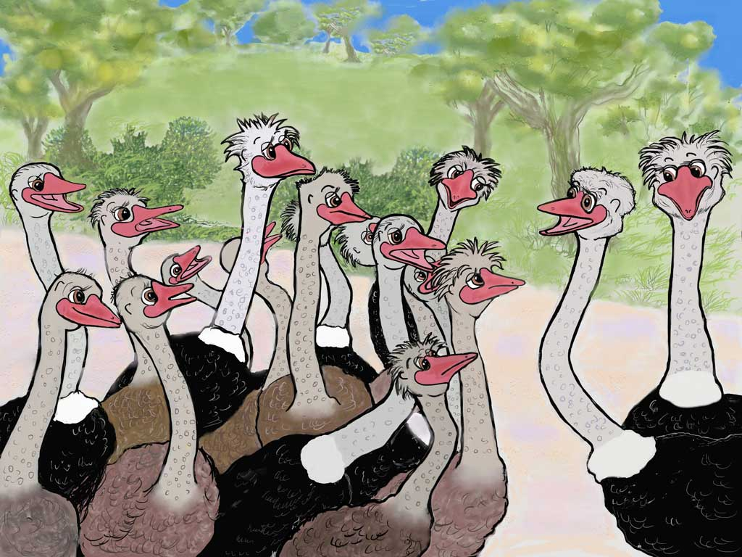
Notes:
…he told Ozzie and all the other ostriches. He said, "Listen guys, we all know that we have our ostrich house where we can sleep safely at night. Let’s make sure we run into that safe place in good time."

Slide 28
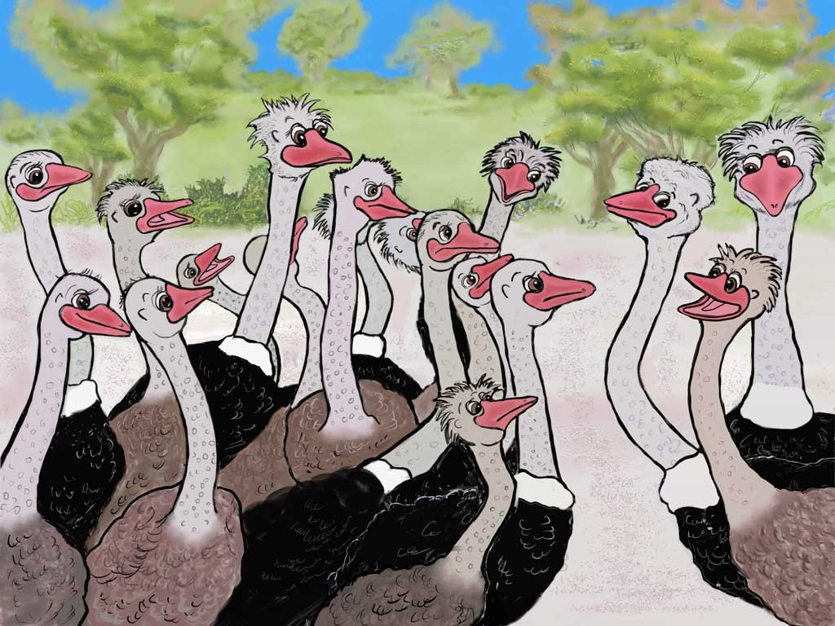
Notes:
"That's right!" said Olive, "Tom, makes sure that no one can get into the house to frighten, hurt or steal from us. So... "

Slide 29
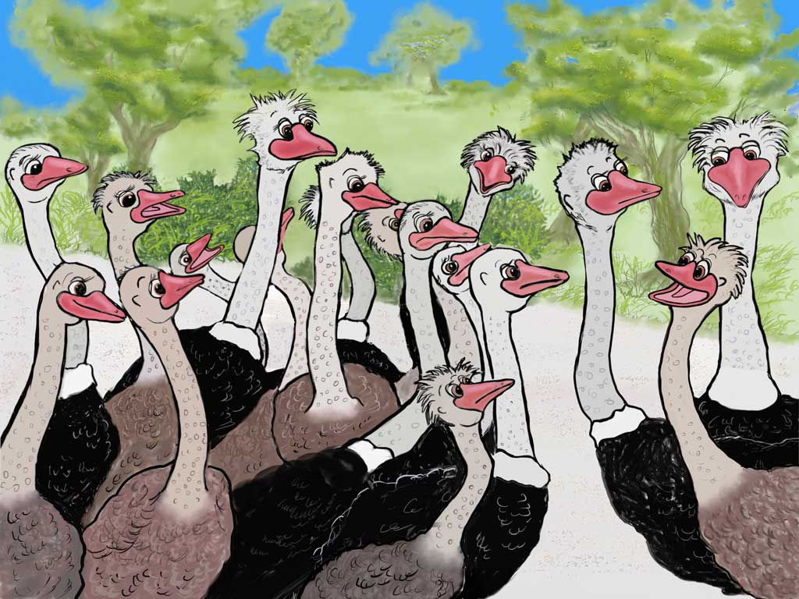
Notes:
"...listen! When it begins to get dark are we are all going to run to our house where Tom keeps us safe at night?"

Slide 30
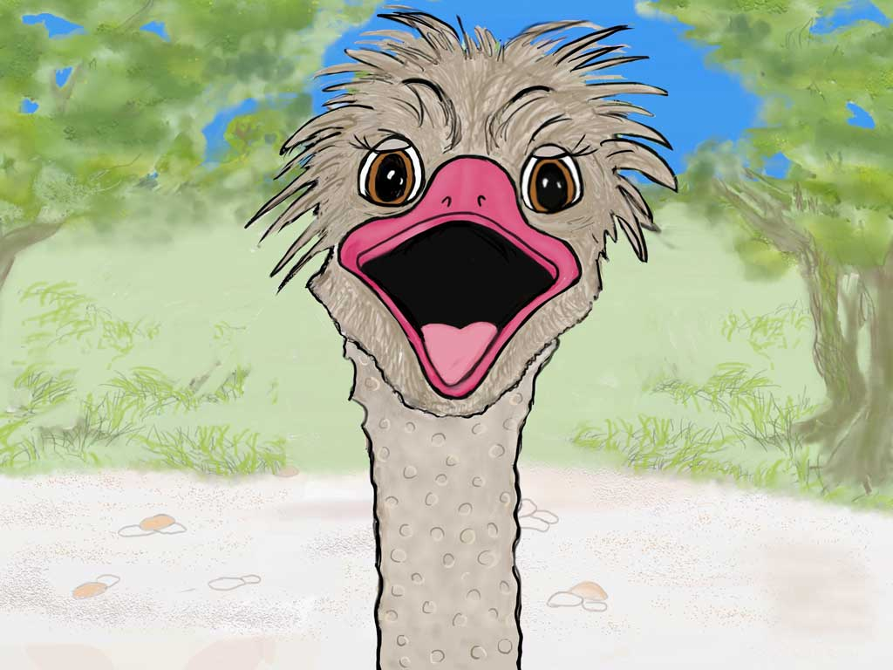
Notes:
"Yes," said Olga "...and we need to get ready right now! Do we all agree?" she asked the others.

Slide 31
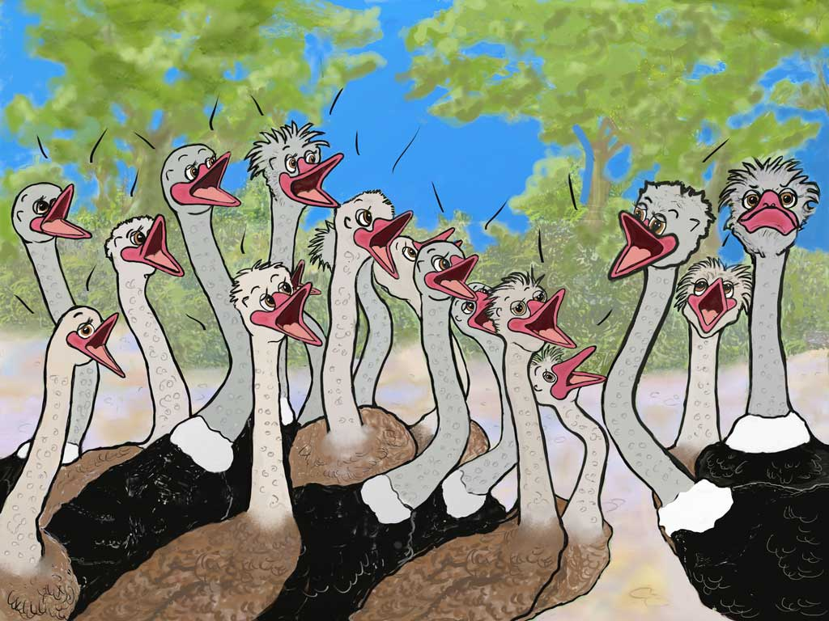
Notes:
And they all took a deep breath and shouted together "Y E S!!" But Ozzie kept very quiet. Can you see him with his beak tight shut? He was thinking hard. He thought, “It will be far more exciting to stay outside when it's dark and that’s what I will do tonight. Wow! What an adventure!”

Slide 32
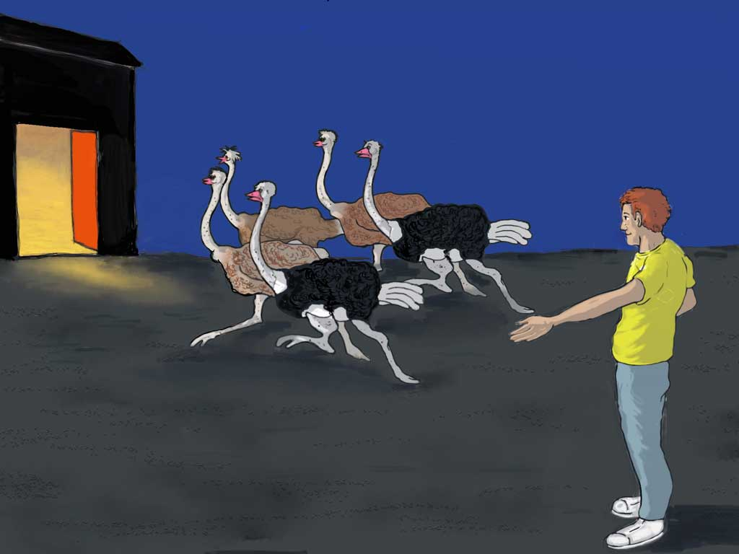
Notes:
By now it was beginning to get dark so all the ostriches trotted into the safe house - that is, all the ostriches except for one - Ozzie!

Slide 33
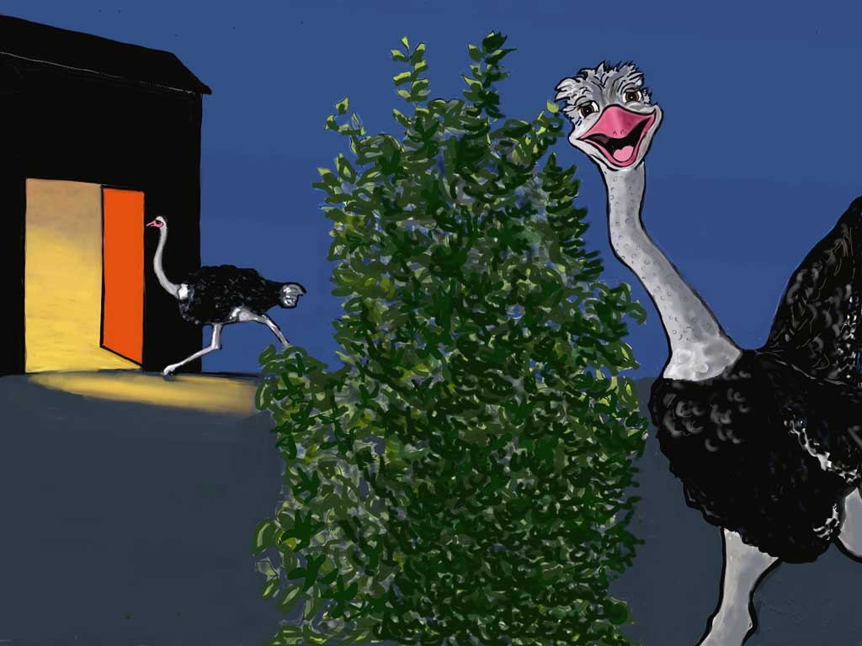
Notes:
Quickly he had run behind a bush. “I'll hide here.” he said to himself. “No one will see me. I'll be safe here."
He laughed as he thought, "I can't wait to see their faces when I tell them tomorrow that I've been outside in the dark by myself all night!"
"They'll have to admit that I'm the very bravest ostrich in the whole of Sunny Valley - maybe even the bravest in the whole world!"
Ozzie thought that he knew better than Tom who took care of them but Ozzie was putting himself in danger and that wasn't a good idea.

Slide 34
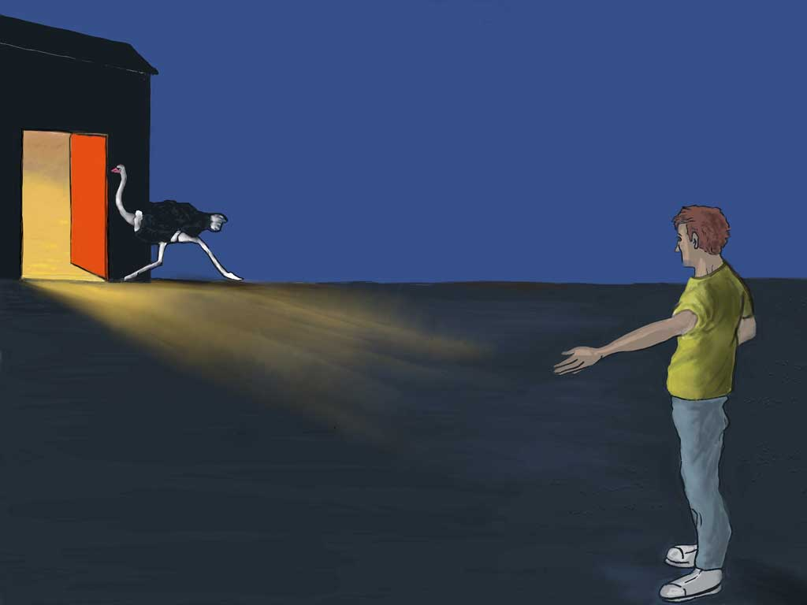
Notes:
Well, the last ostrich went into the safe house while ...

Slide 35
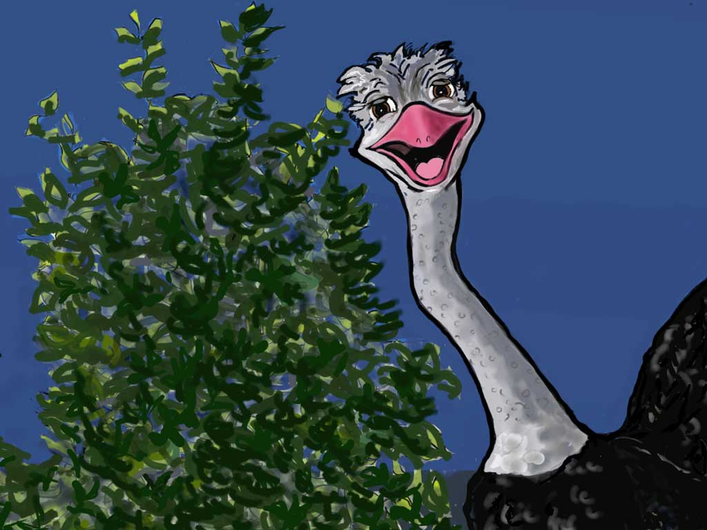
Notes:
... Ozzie behind the bush, is thinking, "I know Tom has said it isn't good to stay outside. But I'm staying outside tonight. One night outside won't harm me." Ozzie wasn't going to do what Tom had told the ostriches they must do to be safe.

Slide 36
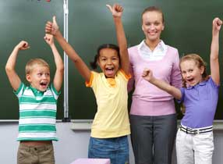
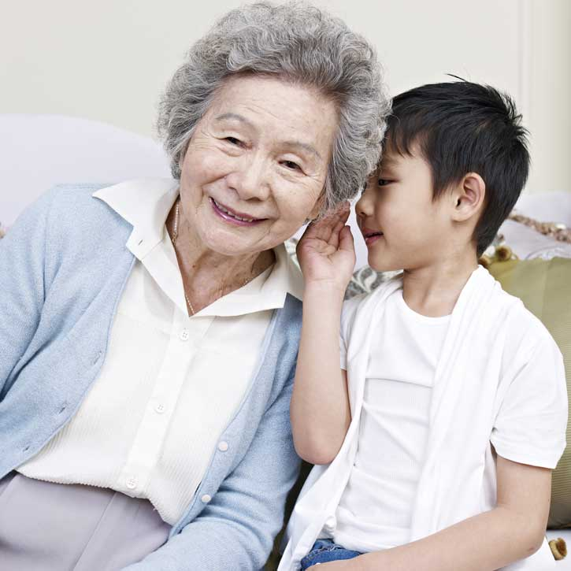
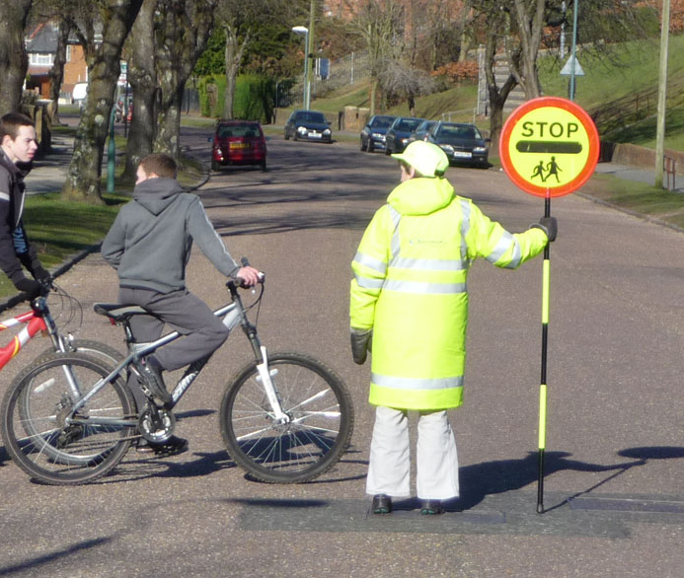
We need to obey the
grown-ups
we can trust
Notes:
And if we don't do what the grownups we can trust tell us, that's not good for us either.
We need to obey those grownups who take care of us - those where we live, those in school and those in other places.

Slide 37
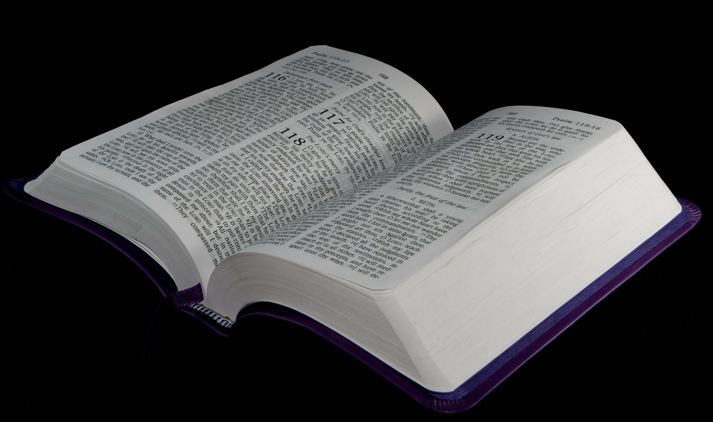
Put your life in God’s care
Obey God
Notes:
And God also tells us in the Bible what we must do to put our lives in his care.
Click Again - [Obey God ]
We need to do what he tells us - that is obey him

Slide 38
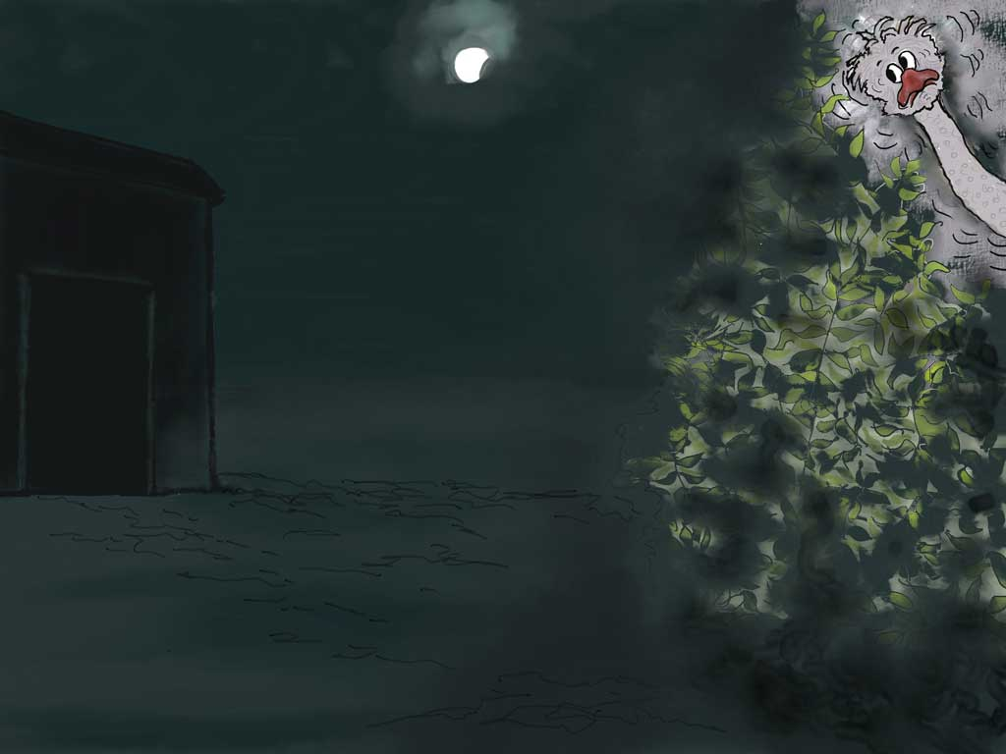
Notes:
Well, that night as the moon slipped behind thick clouds it grew dark. Out in the dark, Ozzie heard noises he didn't hear when he was inside the ostrich house. He was scared and now he shivered with fright. Would he really be safe outside in the dark or would something terrible happen?
[If telling this story in 2 parts this could be the end of Part one. This Slide 38 may be repeated to start Part two.]

Slide 39
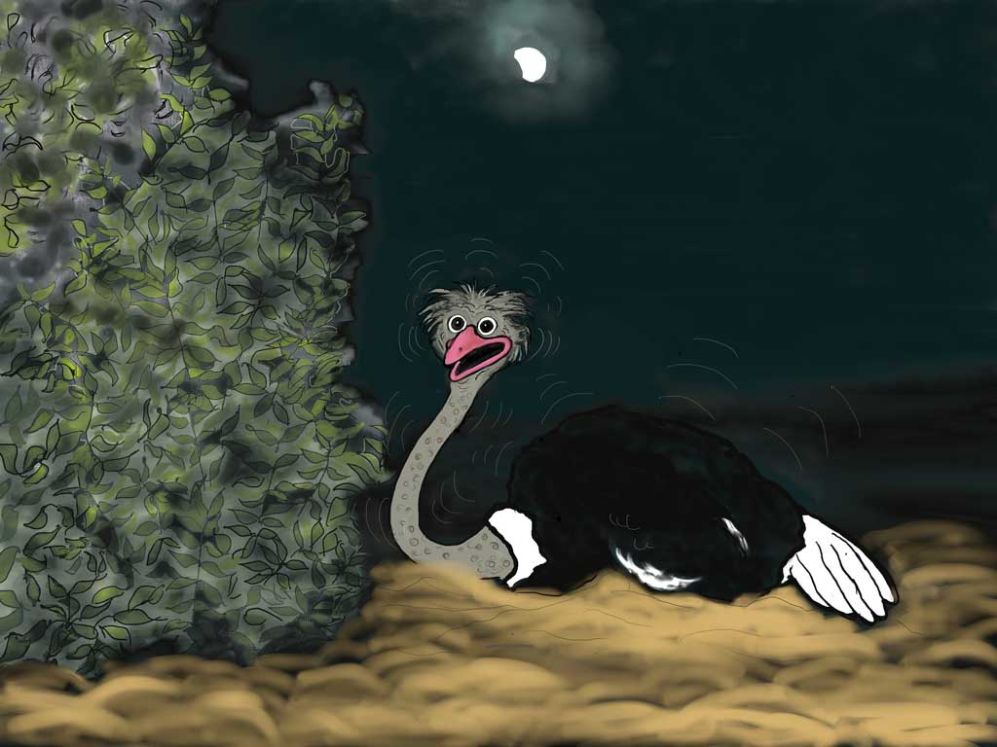
Notes:
"I'll lie down to be better hidden." he thought but he was still shivering. "It's so very dark and not like being in the safe ostrich house."
Then although his voice sounded high and trembling he said, "Still, I'm not scared. I'm the bravest ostrich in the world!"

Slide 40
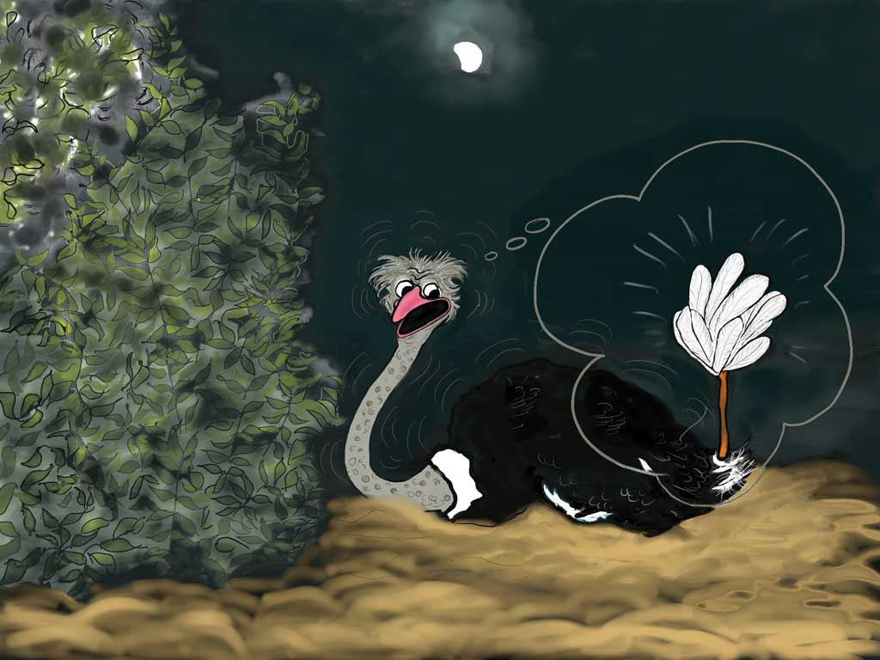
Notes:
But really he was so frightened he was shaking all the more. "I don't want my tail to become a feather duster!" he whimpered.

Slide 41
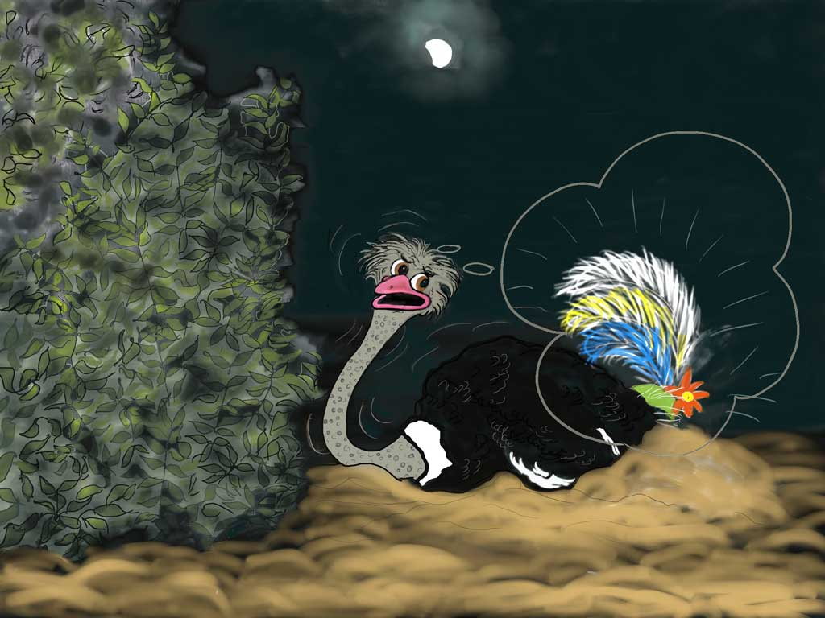
No lady!!!
Notes:
"...or a lady's hat!"

Slide 42
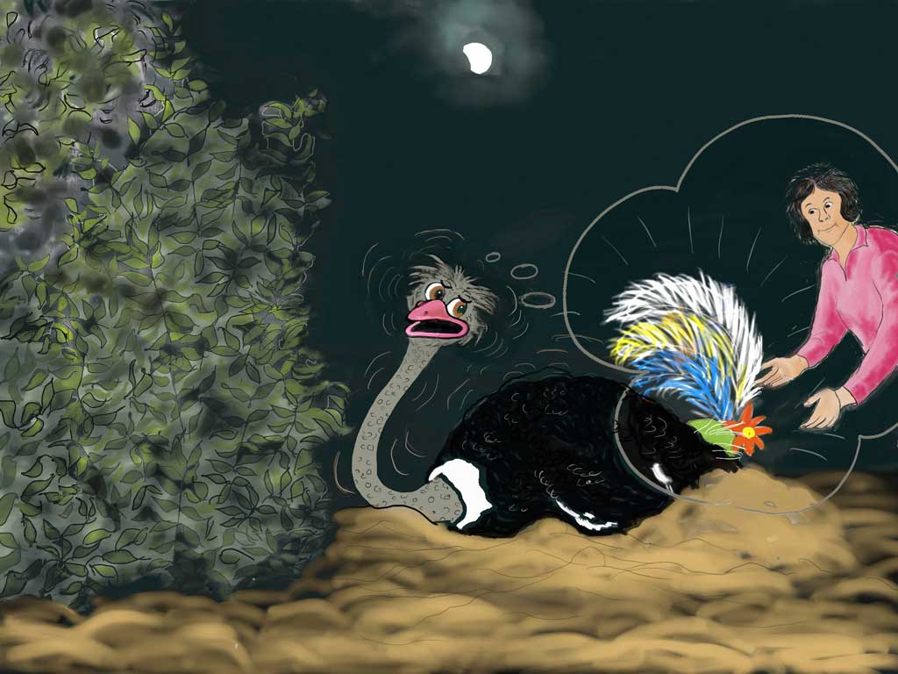
Notes:
"I don't want a lady to get my tail for her hat!"

Slide 43
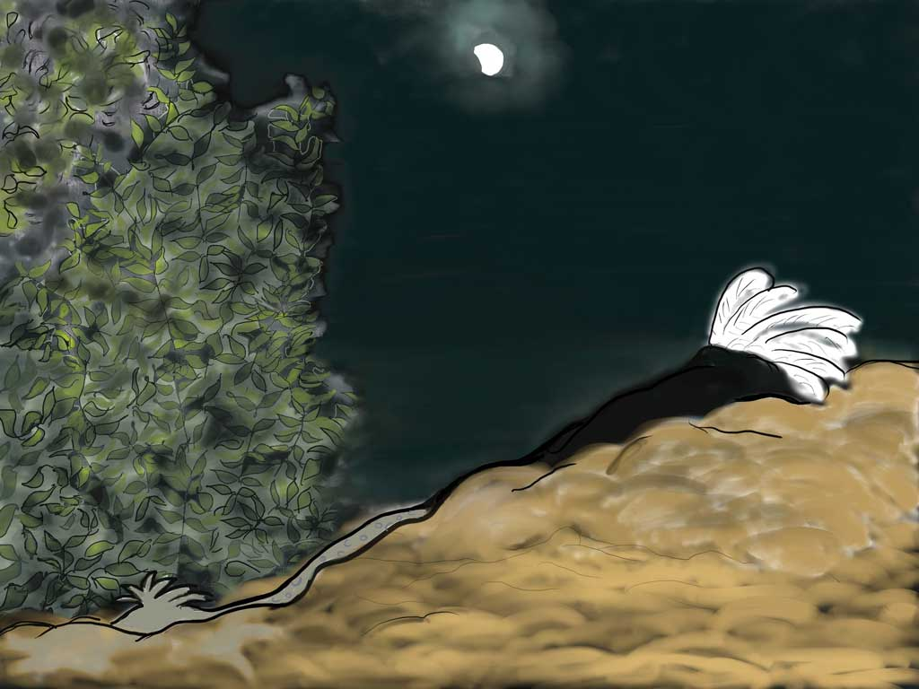
Notes:
"I'll lie down flat in this sandy hollow. I don't want bad Bertie to take my tail! Now I can't see anything so now no one, not even bad Bertie, will see me!”
But is he right? Can you see Ozzie? Of course we can all see Ozzie!!
What a silly bird! He thought that when he couldn't see anyone, no one could see him!

Slide 44
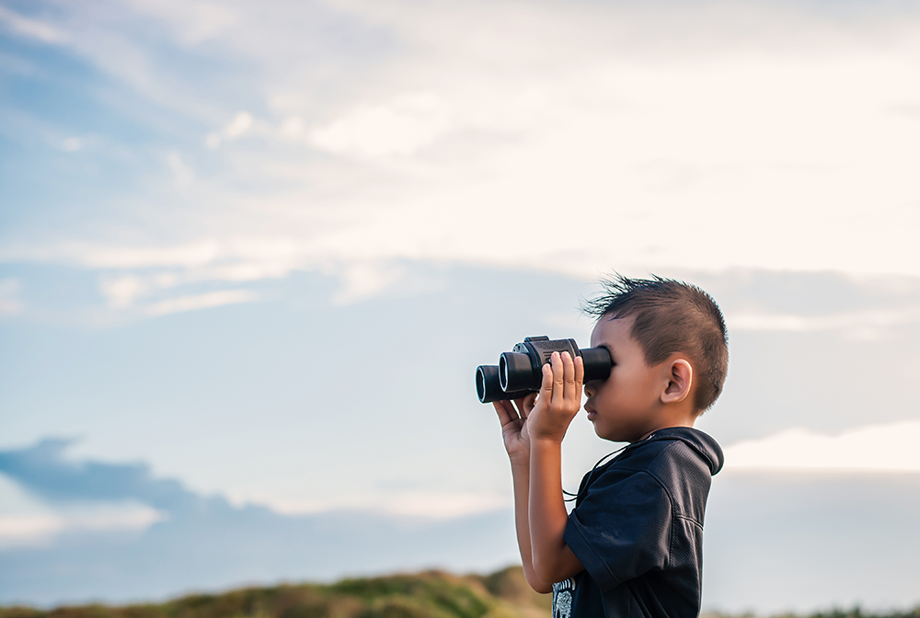
We can’t see God
God sees
everything
Notes:
Now we can't see God but the Bible says that he can see everything.
Click Again [God sees everything]
This means that God can see us at all times.

Slide 45
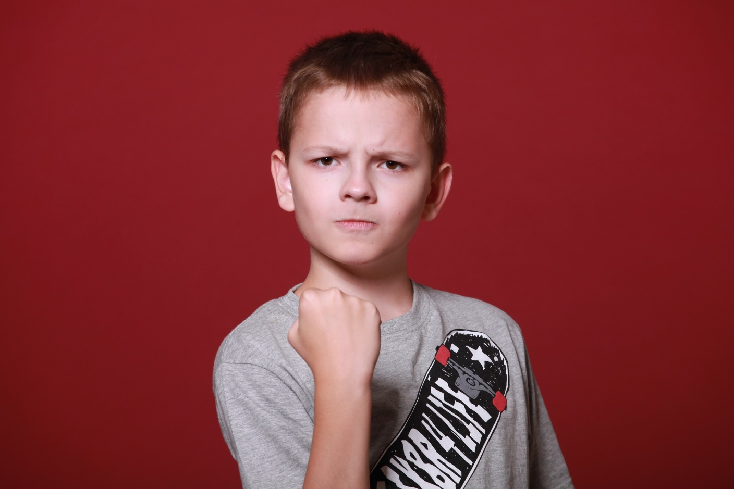
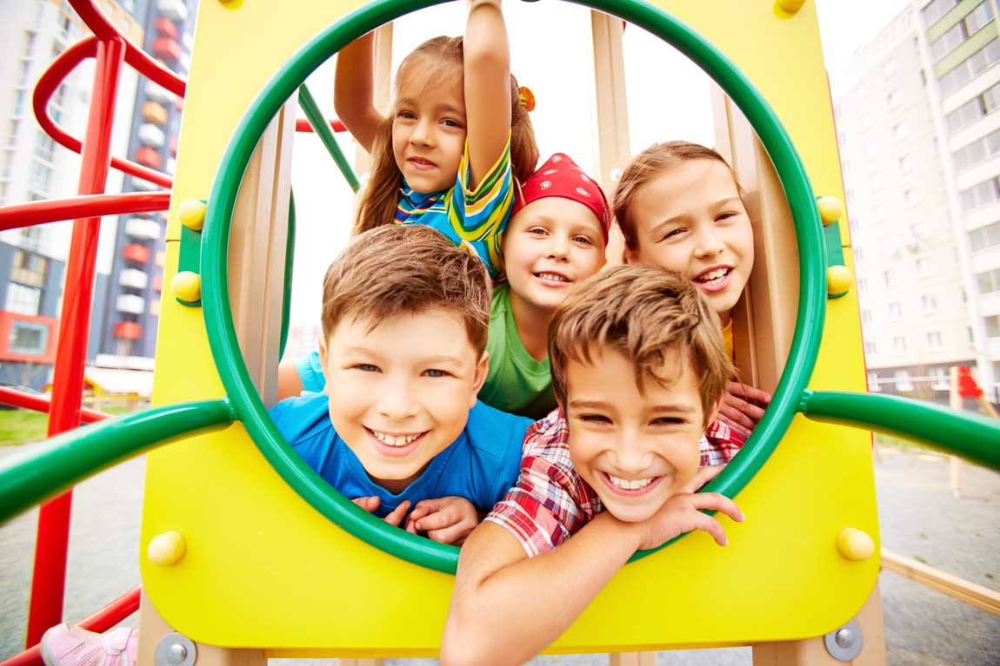
Notes:
He sees us when we do good things…
Click again -[Angry boy]
…or when we do bad. God doesn't promise to help us if we are determined to keep on doing things that are bad.

Slide 46
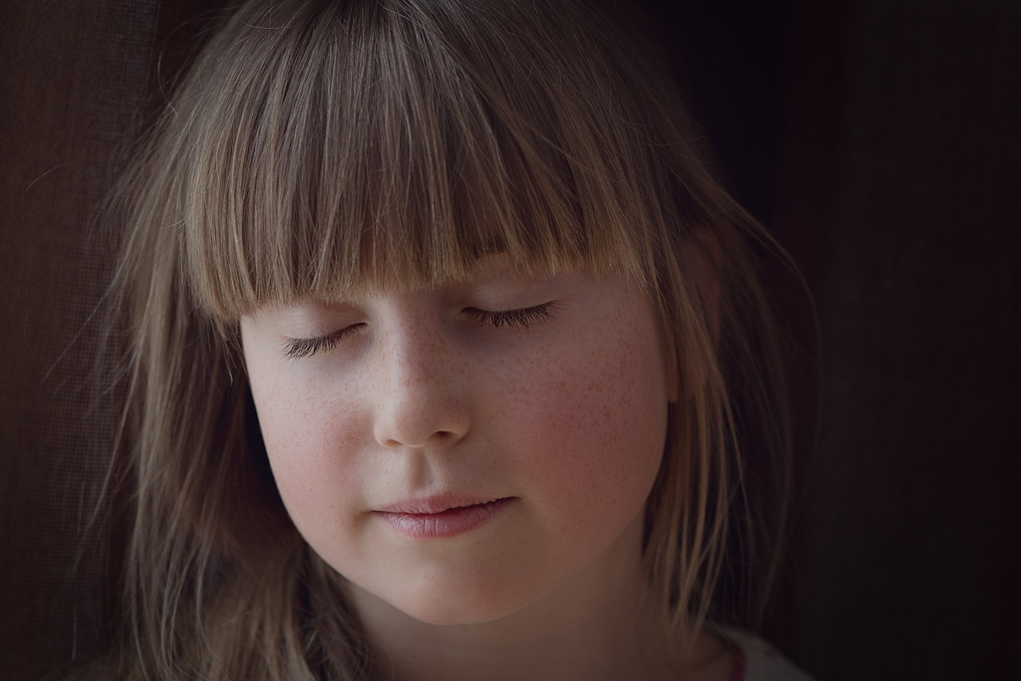
Notes:
But he will forgive us and make us clean from the wrong things we think or say or do if we…

Slide 47
A
Admit I have
done wrong things
Notes:
A - admit we have done wrong things.

Slide 48
B
Be really sorry for my sin
and ask God to
forgive me
Notes:
B - be really sorry for our sin and ask Jesus to forgive us and make us clean.

Slide 49
C
Come to Jesus and ask
him to be the Leader of
my life.
Notes:
C - come to Jesus in our thoughts and ask him to be the Leader of our life. Then from now on ask Jesus’ help us so we can behave differently.

Slide 50

Notes:
Ozzie was miserable and so tired soon he fell sound asleep.

Slide 51

Notes:
It was then that bad Bertie came! He soon saw Ozzie and…

Slide 52

Notes:
…as more clouds drifted over the moon it grew even darker and Bad Bertie was busy. There were soft pinging sounds - ping! ping! ping! Something was happening!

Slide 53

Notes:
Next morning Ozzie woke up! What a shock he got!

Slide 54

Notes:
He looked in horror! His tail was gone!

Slide 55

Notes:
Ozzie wished he had gone to the safe place when Tom called. He was feeling miserable too, because he had let Tom down and he was so ashamed.

Slide 56

Notes:
When his brother and sisters saw what had happened, they couldn't believe their eyes. Olly said “Oh Ozzie, your bottom looks like a plucked chicken! Where has your tail gone?”

Slide 57

Notes:
"I think a lady is wearing it now." Ozzie wailed

Slide 58

Notes:
Then Ozzie realised he what he’d said had sounded funny and he laughed with his brother and sisters. They were all imagining the lady being as shocked as Ozzie was when she finds she’s wearing an ostrich tail on her bottom!
“I meant she’ll be wear my tail on a hat!” he explained.

Slide 59

Notes:
But Ozzie still felt ashamed.
Sometimes bad things happen to us that are not our fault. But this was Ozzie's own fault.
Ozzie knew that he should have done what Tom, who knew best, had said. He should have run to the safe place.
His brother and sisters could see he was still very upset not just because he was feeling sore but because he had let Tom down by being so disobedient and not going to the safe house.
Olly said, “Cheer up Ozzie, you don't need to stay upset. Go to Tom. He will help you.”
"YES!” agreed Olive and Olga, who were smiling too, “You’re sorry that you’ve done wrong and you are also hurting because feathers were pulled out but Tom will help you.”

Slide 60

Notes:
So Ozzie went to Tom to say “Sorry!”
Ozzie didn't want to keep on doing wrong and he decided that from now on he would do what Tom wanted him to do.
Tom was very kind to Ozzie. He said, “Ozzie, I've cleaned away the dirt that’s on you and now I'm going to put on some ointment that will soothe away the soreness from where you hurt. And Ozzie, remember I still love you.

Slide 61

Notes:
So Tom soothed Ozzie's hurts, but, best of all, Ozzie was so happy because when he'd told Tom he was sorry for doing wrong Tom had forgiven him.
Ozzie knew that Tom loved him and was his very close friend and Ozzie was so happy to know he was loved and forgiven he bent down to be closer to Tom.

Slide 62

Notes:
And sometimes we hurt - not because we have done anything wrong, but because of someone else who has said something or done something that has made us hurt inside. And Jesus can help us when we hurt in that way.

Slide 63
“Come to me,
all you who are
weary and burdened,
and I will give you rest.”
Matthew 11:28 New International Version
Notes:
Jesus says “Come to me, all you who are weary and burdened, and I will give you rest.” Matthew 11:28 New International Version (NIV)

Slide 64

Jesus said:
…for I am gentle – and
you will find rest for
your
souls. ”
Matthew 11: 29 NIV
“Take my yoke upon you
and learn from me…
Notes:
Jesus goes on to say, "Take my yoke upon you and learn from me,
CLICK AGAIN [“for I am gentle, etc]
“for I am gentle - and you will find rest for your souls."

Slide 65
Jesus says:
Let me take
control
in your life
Come to me.
Give me
your hurts
and fears.
I’ll give you PEACE
Notes:
And simply, what Jesus is saying to us is:
"Come to me when you're worn out and weighed down by hurt feelings or fears you can't get rid of - they go round and round your mind hurting you. "Come to me - give me your hurts and fears."
Jesus says,
CLICK - Let me take control in your life
CLICK - Learn what I'm really like and I'll give you peace."

Slide 66

Notes:
Someone else had done wrong - bad Bertie! Because he hadn’t been caught stealing the feathers he came again to the ostriches’ yard to pick up some feathers that he’d dropped in the dark the night before…but Olga saw him so ...

Slide 67

Notes:
...she picked him up and held on while Bertie squirmed to get away.

Slide 68

Notes:
Then she dangled him over the fence to drop him out of their yard.

Slide 69

Notes:
But as she dropped Bertie, the piece of his trousers that she'd had in her beak ripped off! "Oh I didn't mean to do that!" thought Olga , “but this wouldn't have happened if he hadn't been stealing feathers and hurting Ozzie.”

Slide 70

Notes:
Bad Bertie ran away terrified and now he knew that he was in trouble. His mother would be angry when she saw his damaged trousers and she would want to know how this had happened.
Bertie never troubled the ostriches and others in Sunny Valley again.

Slide 71

Think
Notes:
Sometimes even when we are Christians we may choose to think wrong things

Slide 72

Say
Notes:
or say things we shouldn't say

Slide 73

Do
Notes:
or do something that is wrong.

Slide 74

Sorry
Notes:
But if we are sorry and want to be forgiven for our sin and change our bad behaviour…

Slide 75

God will forgive
Notes:
We can tell Jesus how we feel - that we are really sorry and don't want to keep making the wrong choices, and he will forgive us.

Slide 76

AND HELP US TO MAKE GOOD CHOICES
Notes:
Then each day, if we tell him we want to live right, he will help us make the right choices for that day.

Slide 77

Notes:
Because Ozzie didn't keep on choosing to do wrong, new feathers began to grow. He was so excited when he saw that now he had a beautiful tail once more. "Wow!” he said. "My tail has grown again!"

Slide 78

Notes:
And Ozzie became the lovely ostrich God meant him to be.

Slide 79

God has a plan for your life
Notes:
Now God means you to enjoy the wonderful plan he has for you.
And day by day his plan for you will work out as you do what he tells us in his book - the Bible.

Slide 80

Notes:
You can tell Jesus right now that you don't want to make wrong selfish choices. Instead, you want to choose to do what he wants, and be the lovely person he means you to be.
People will begin to see the difference in your behaviour and be so glad that they know you.
Keep following Jesus and he will lead you in the wonderful adventure he has planned for your life.

Slide 82
Presentation Notes
The script for this presentation is available
to download, free of charge. Go to
https://freeministryresources.org/ozzies-scary-night
See terms of use on the next slide

Slide 83
Terms of Use
This presentation is the work of Catherine Slight (author and illustrator) and Lin Pearson (PowerPoint), and is copyrighted*, and may be used under the following terms.
Any image which has a copyright line must not have that copyright line removed. Where images have no copyright line, this in no way implies that the images are copyright free.
You may use this presentation unaltered for the purpose of teaching. We will be delighted if you find them of use.
Copying
These resources are for your personal use.
If you know of others who might want this story, please direct them to our website where they can download both PowerPoint and script.
This would benefit our site greatly, as the more visitors the site has, the better it shows up in search engines. This will enable more people to find us and have access to the free resources.
Reuse of images
Please do not extract slides or images from any of our items to use in another presentation you wish to make. Many images are licensed to us on the understanding that they are used only in our resources, and are not to be distributed for the use of others.
Image credits
Many thanks to Pixabay.com and Freepik.com for photographs used in this presentation.
*FreeMinistryResources.org, including all its resources by Catherine Slight and Lin Pearson, is licensed under the following license:
Creative Commons Attribution-Non-Commercial-No Derivative Works 4.0

