Slide 1


Chocolate Hearts
FreeMinistryResources.org

Slide 2































Slide 3

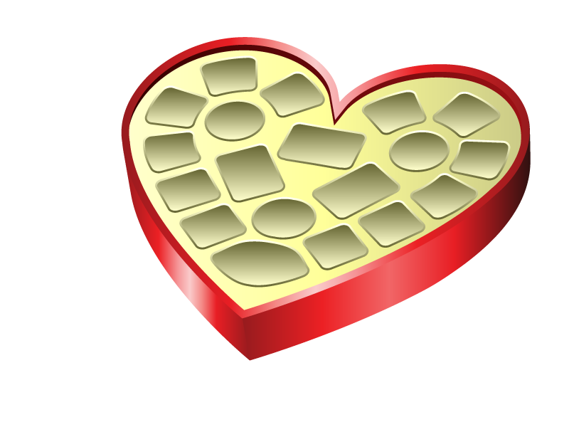
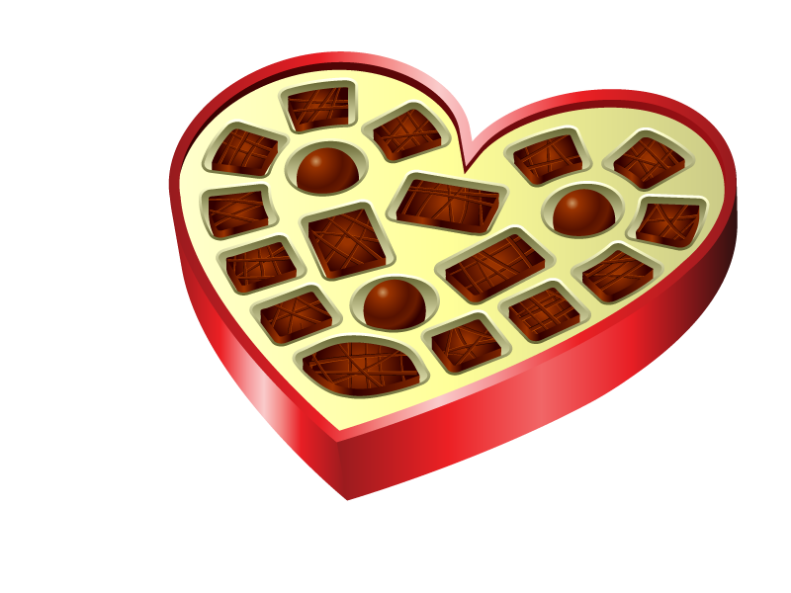
Notes:
When the Valentine's chocolates…
[Click to advance to Empty chocolate box] …have all been eaten;

Slide 4

Notes:
When the fun balloons…
[Click to make Balloon float away] …have floated away or burst;

Slide 5

Notes:
When the soft toys… [Click to make Teddy leave]
…have been forgotten or lost…
there will still be a love that will never fade away or spoil.

Slide 6

Greater love has no one than this,
that he lay down his life for his friends.
(John 15:13)
Notes:
The Bible says "Greater love has no one than this, that he lay down his life for his friends."
[Click to add Calvary banner above text]
And that is exactly what Jesus did for us. He laid down his life and died on the Cross.
He didn't deserve to be killed. But he took all the punishment that our sins deserve.

Slide 7
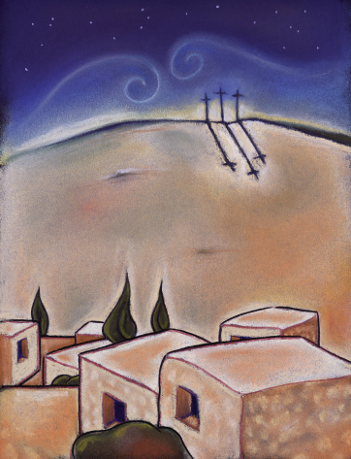
For God so LOVED
the world
that he gave
his one and only Son,
that whoever
believes in him
shall not perish
but have eternal life.
(John 3:16)
Notes:
John 3:16 – You could teach this as a memory verse, or speak about it before closing the presentation.

Slide 9
How to Play
After attracting interest by showing the title slide, move to slide 2 (the numbers).
Take each team in turn. If you are using this as a review game, if the team correctly answers a question, they may select a number.
Click on the number to reveal what is below and award appropriate points. Eg. 25 for an ordinary chocolate, 50 for a heart chocolate.
The winner is the team with most points after the allocated time is over, or your questions have all been answered.
NOTE: There are sufficient numbers for you to have a few extra selections throughout the time the children are with you. Perhaps for good singing, memory verse work, or settling quickly and quietly for the next activity. etc.

Slide 10
Extended Presentation
Several additional slides have been added to this presentation. If you would like to briefly refer to the love of God in sending Jesus, and of Christ's sacrificial death, you may like to use them.
The commentary might go something like this:
  [Chocolate Box] When the Valentine's chocolates… [Click to advance]
  [Empty chocolate box] …have been eaten; [Click to advance]
  [Balloon] When the fun balloons… [Click to advance]
  [Balloon floats away] …have floated away or burst; [Click to advance]
  [Teddy] When the soft toys… [Click to advance]
  [Teddy leaves]…have been forgotten or lost…
  …there will still be a love that will never fade away or spoil. [Click to advance]
  The Bible says "Greater love has no one than this, that he lay down his life for his friends."
  [Click to advance]
  And that is exactly what Jesus did for us. He laid down his life and died on the Cross.
  He didn't deserve to be killed. But he took all the punishment that our sins deserve.
  [Click to advance]
  John 3:16 – Teach this as a memory verse, or speak about it before closing the presentation.

Slide 11
Terms of Use
This presentation is the work of Catherine Slight and Lin Pearson, and is copyrighted* It may be used under the following terms.
Any image which has a copyright line must not have that copyright line removed. Where images have no copyright line, this in no way implies that the images are copyright free.
Copying
These resources are for your personal use.
If you know of others who might want this PowerPoint, please direct them to our website where they can download it and find other free materials.
This would benefit our site greatly, as the more visitors the site has, the better it shows up in search engines. This will enable more people to find us and have access to the free resources.
Reuse of images
Please do not extract slides or images from any of our items to use in another presentation you wish to make. Many images are licensed to us on the understanding that they are used only in our resources, and are not to be distributed for the use of others.
Image credits
Many thanks to the sites who gave us use of their images:
www.all-free-download.com, www.antarasdiary.com, www.shutterstock.com, www.doublejdesign.co.uk
*FreeMinistryResources.org, including all its resources by Catherine Slight and Lin Pearson, is licensed under the following license:
Creative Commons Attribution-Non-Commercial-No Derivative Works 4.0

