Slide 1


The Bible - Part 7
The Apocrypha
and Gnosticism
By Catherine Slight and Lin Pearson
FreeMinistryResources.org

Slide 2
What is the Apocrypha?
The Apocrypha

Slide 3
“Hidden writings”
The Apocrypha
Rejected by the church because
of their wrong teachings

Slide 4
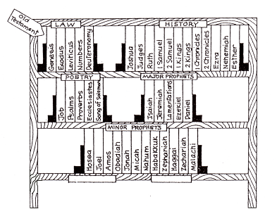
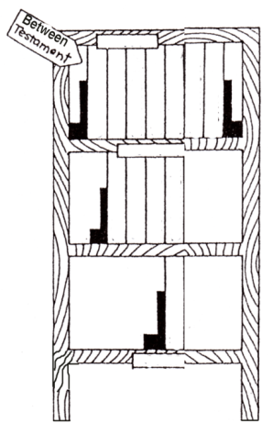
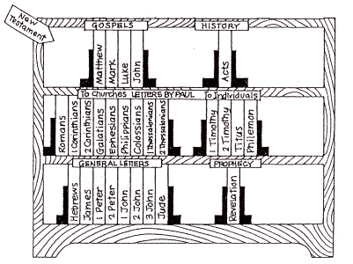
Old testament
Apocrypha
New testament
About 1100 years
About 400 years
About 60 years

Slide 5
Why are the books of the Apocrypha not in our Bibles?

Slide 6

Apocrypha not Accepted
Do not claim divine inspiration
Rejected by the Jews
Poor literary style
Never validated by Christ

Slide 7
Apocrypha not Accepted
Filled with mistakes. They say:
  Jeremiah in Babylon not Egypt
  Tobit died aged 158, but was placed
  at events 210 years apart
  Suicide a good thing
  Magic drives away demons

Slide 8
Apocrypha not Accepted
Unbiblical teaching
  Prayers can save the dead
  Doing good can take away our sin
  We can be sinless and perfect now
  Women are second class

Slide 9

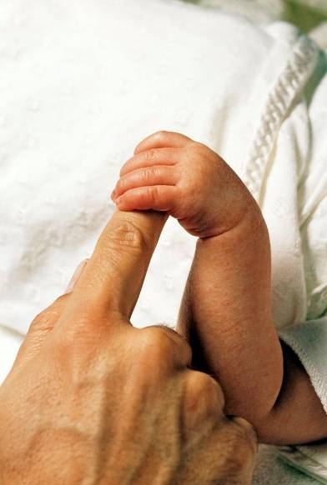
Hold on to the good

Slide 10

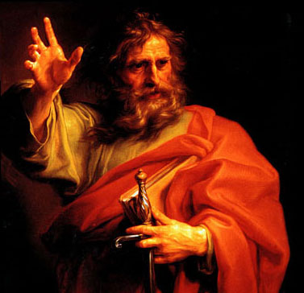
Paul said:
Don’t be gullible.
Check out everything,
and keep only what’s good.
Throw out anything tainted with evil.
1 Thessalonians 5:21 – The Message

Slide 11
Gnostic gospels or
New Testament Apocrypha
The New Testament Apocrypha
“gnosis” = knowledge
“Apocrypha” = hidden writings

Slide 12
“HIDDEN WRITINGS”
The New Testament Apocrypha
Gnostics said:
Too deep
Too hard to understand
Too sacred to be given to anyone

Slide 13
The New Testament Apocrypha
Apostolic
Christians
Gnostics
The Old and New
Testaments
No writings
from
Apostles

Slide 14
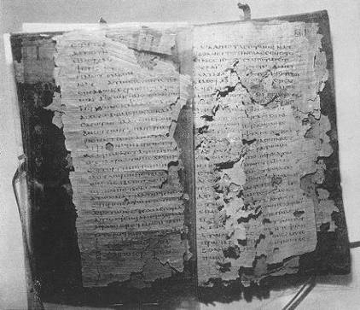
The New Testament Apocrypha
The Gnostic
Gospels
Rejected by the church because
of their false teachings
Photo: Codex Nag Hammadi –Public Domain

Slide 15
Gnosticism Today
Similar to New Age
    - “Truth” is a mystery.
    It is based on your thoughts
    and feelings
Becoming more popular

Slide 16
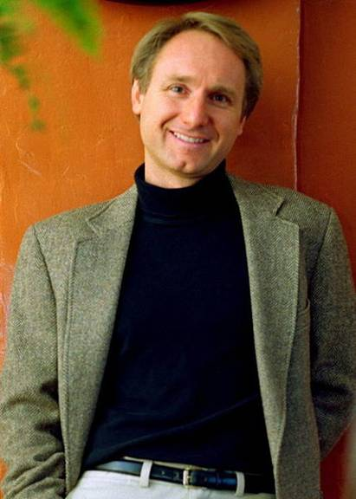

Gnosticism Today
“ By making such profession
some have erred (missed the mark)
as regards the faith.” (1Tim 6:20)
Famous
“easy-to-read” supporters

Slide 17
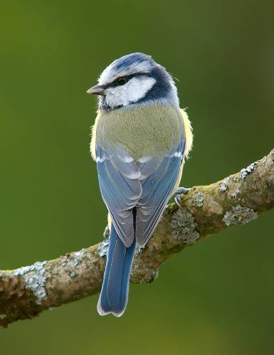
Gnosticism Today
What is Gnosticism?
1. The material world
is evil and to be
shunned.

Slide 18
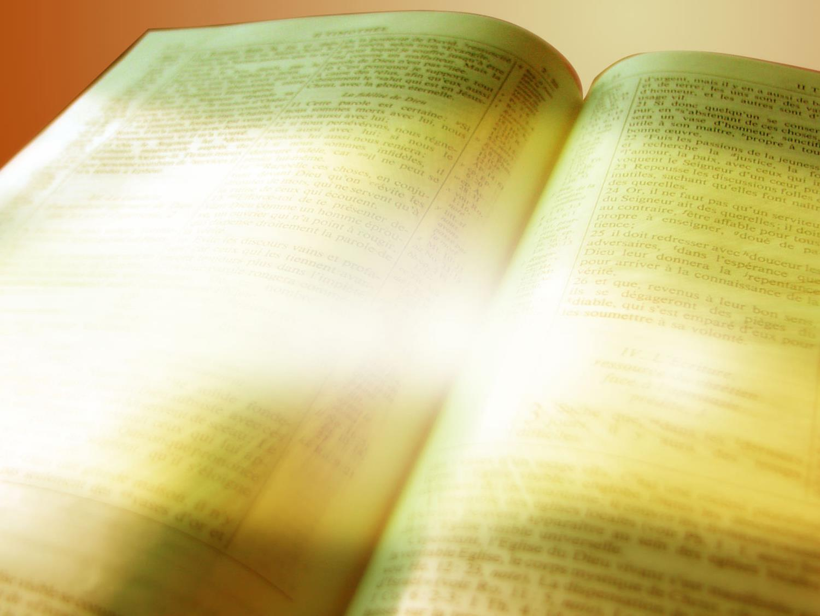
“God saw all that he had made,
and it was very good.”
(Gen 1:31)

Slide 19

Gnosticism Today
What is Gnosticism?
2. The God of
the Bible is a
lower god who
caused all evil
in the world

Slide 20
Evil and sin came through
the devil and Adam and Eve’s
rebellion against God
(Gen. 3)

Slide 21

Gnosticism Today
What is Gnosticism?
3. The Absolute
Supreme Being is unknowable

Slide 22
Jesus replied, “Have I been
with you all this time, Philip,
and yet you still don’t know
who I am?
Anyone who has seen me
has seen the Father!”
(John 14:9)

Slide 23
“For the Lord sees every heart
and knows every plan and thought.
If you seek him, you will find him.”
(1 Chronicles 28:9)

Slide 24
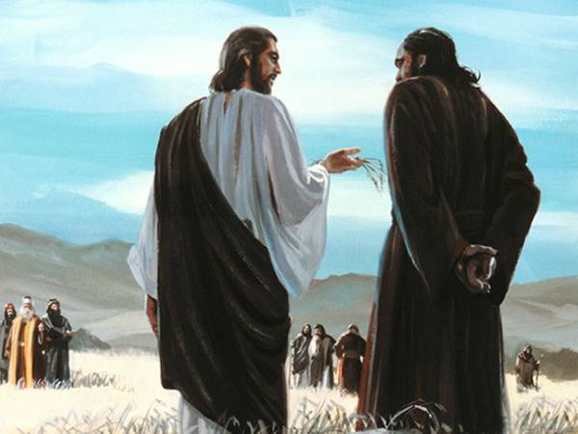
The Apocrypha
What is Gnosticism?
4. Jesus could
not be
God in flesh,
because flesh
is matter and
matter is evil.

Slide 25
"Christ was revealed
in a human body.”
(1 Tim. 3:16)

Slide 26

Gnosticism Today
What is Gnosticism?
5. Salvation is through
mystical knowledge
(“gnosis”)

Slide 27
"Believe on the Lord Jesus Christ,
and thou shalt be saved."
(Acts 16:31)

Slide 28
“There is salvation in no one else!
God has given no other name
under heaven
by which we must be saved.”
(Acts 4:12)

Slide 29
Gnosticism Today
What is Gnosticism?
6. Jesus revealed
truth, but only to
a select few

Slide 30
"For God so loved the world
that he gave his one and only Son,
that whoever believes in him
shall not perish
but have eternal life.”
(John 3:16)

Slide 31

Jesus died for all

Slide 32

“O Timothy, guard and keep
the deposit entrusted [to you]!
Turn away from...
the subtleties and the contradictions
in what is falsely called
knowledge and spiritual illumination.”
1 Timothy 6:20

Slide 33
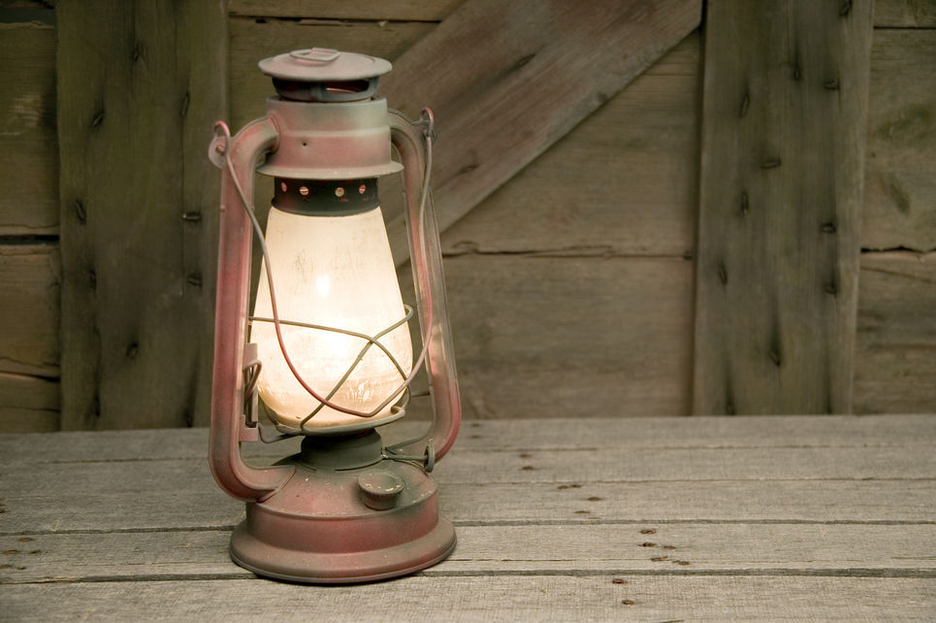
“Thy word is a lamp
unto my feet
And a light
unto my path.”
(Psalm 119:105)
"...the Spirit of truth
...he will guide you
into all truth"
(John 16:13)

Slide 35
TERMS of USE
This presentation is the work of Catherine Slight and Lin Pearson, and is copyrighted*, and may be used under the following terms.
Any image which has a copyright line must not have that copyright line removed. Where images have no copyright line, this in no way implies that the images are copyright free.
You may use our resources unaltered for the purpose of study and teaching. We will be delighted if you find them of use.
Copying
If you produce extra copies of printables or PowerPoints for other members of your team, please ensure that the copyright line or copyright slide is always included, together with the web address of this site.
But please do not pass on extra copies or files for anyone other than your team. Instead, we would be very grateful, and it would benefit our site greatly, if you would direct people to FreeMinistryResources.org, where they can download the materials for themselves.

Slide 36
Reuse of images
Please do not extract slides or images from any of our items to use in another presentation you wish to make.
Many images are licensed to us on the understanding that they are used only in our resources, and are not to be distributed for the use of others.
Script
The script for this presentation may be downloaded from
https://freeministryresources.org/the-apocrypha-and-the-gnostic-writings/
*FreeMinistryResources.org, including all its resources by Catherine Slight and Lin Pearson, may be used under the following license:
Creative Commons Attribution-Non-Commercial-No Derivative Works 4.0

