Slide 1


The Bible - Part 1
Unity of Authors
and Accurate History
By Catherine Slight and Lin Pearson
FreeMinistryResources.org

Slide 2
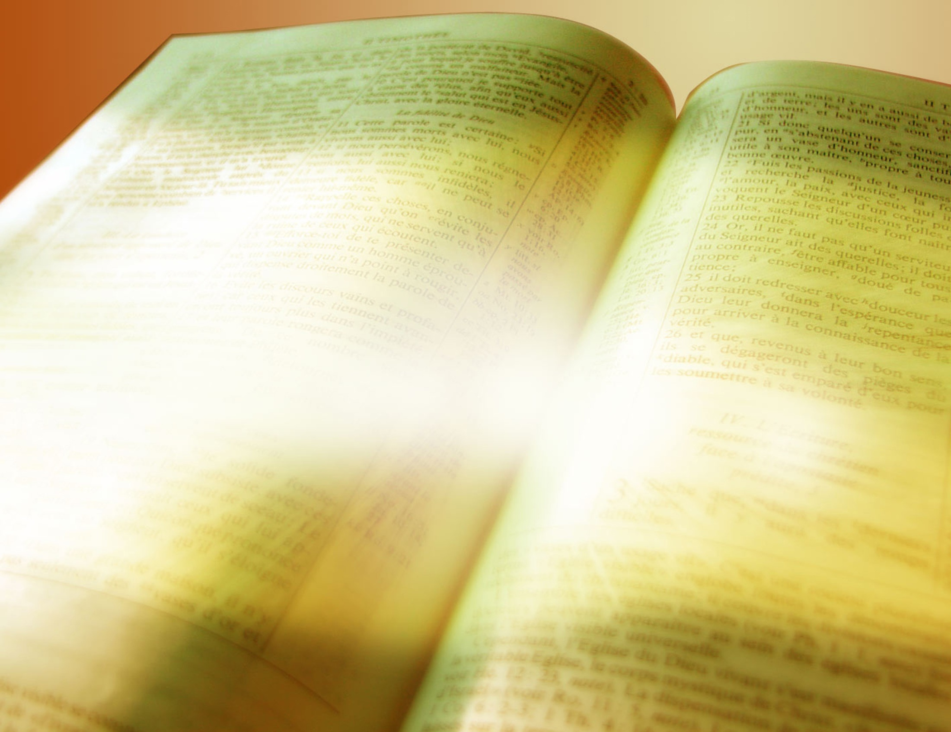

Slide 3
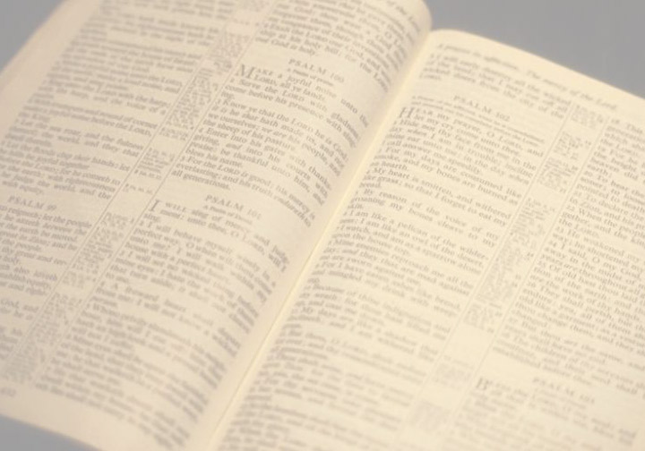
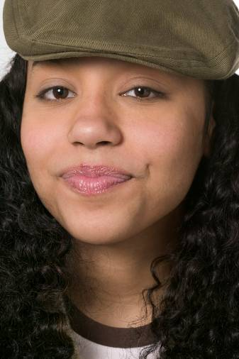
Thinking about the Bible
It isn’t
relevant
any more.

Slide 4
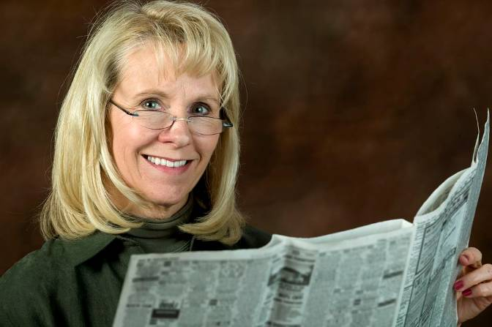
Thinking about the Bible
It’s bang
up-to-date and
relevant to
our culture
today

Slide 5

Thinking about the Bible
It’s full of
myths and
legends

Slide 6

Thinking about the Bible
It’s true,
accurate and
reliable

Slide 7

Thinking about the Bible
It’s beautiful
literature -
but so is
Shakespeare!

Slide 8
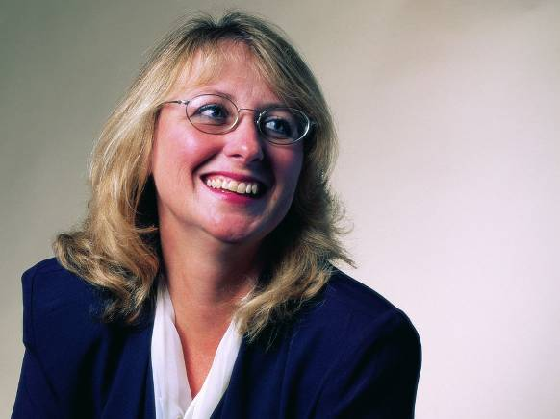
Thinking about the Bible
It’s more than
literature.
It contains
life-changing
principles

Slide 9
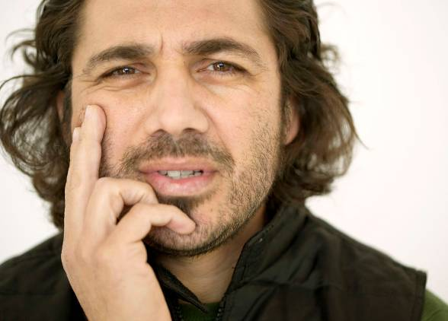
Thinking about the Bible
It’s has a philosophy worth considering – among others

Slide 10
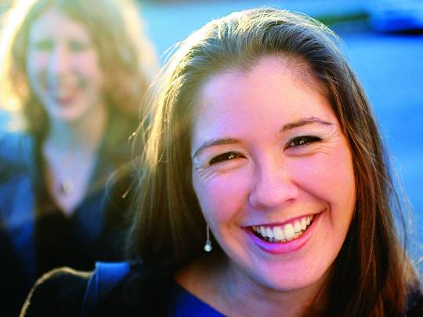
Thinking about the Bible
It’s not the
thoughts of men,
but a message
from God
inspired by him

Slide 11
The Bible is
inspired by God

Slide 12
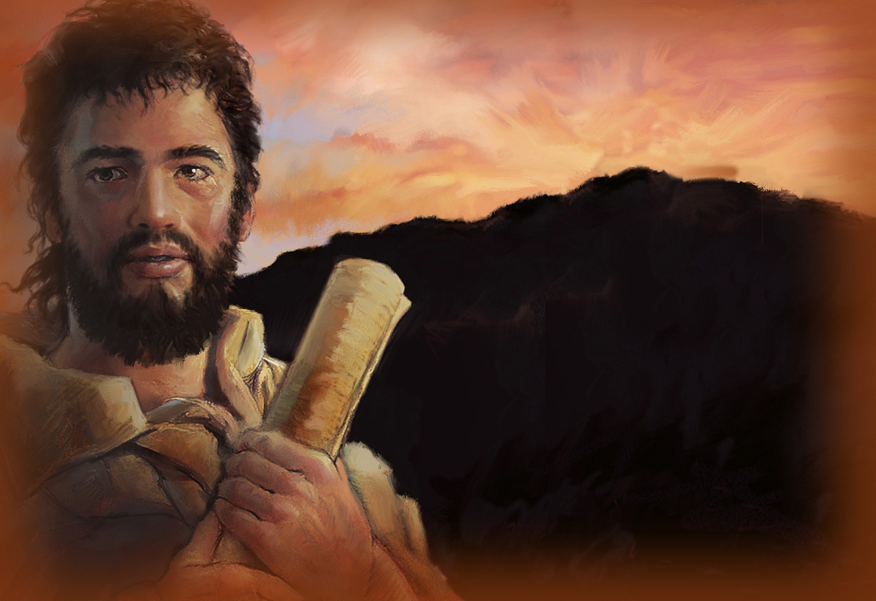
The Bible is inspired by God
1. Unity of Authors

Slide 13

Unity of Authors
40 writers
Different historical periods
– over 1,600 years
Different educational background
Different careers
Different personalities
But they all agreed

Slide 14
Unity of Authors
Their record of history
Their idea of what God was like
Their rules for living
Their view of man’s sinfulness
Their predictions of the future
They all agreed!

Slide 15

“No prophecy in Scripture ever came from
the prophet’s own understanding,
or from human initiative.
No, those prophets
were moved by the Holy Spirit,
and they spoke from God.”
(2 Peter 1:20-21 NIV)

Slide 16
The Bible is inspired by God
1. Unity of Authors
2. Accuracy

Slide 17
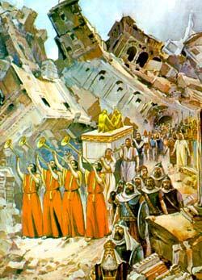
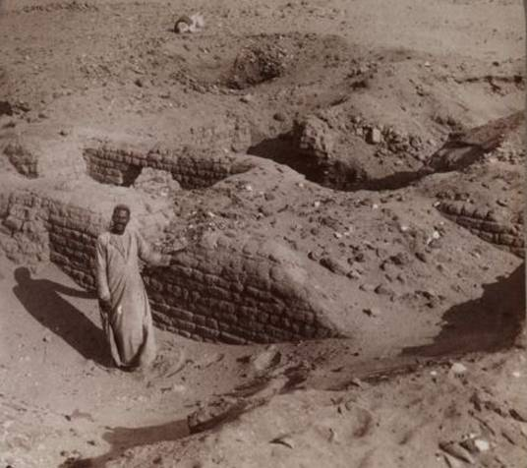
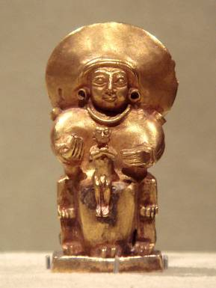
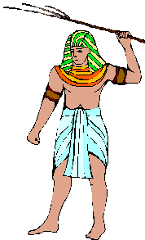
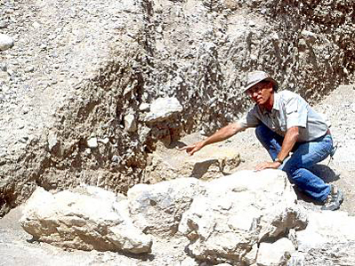
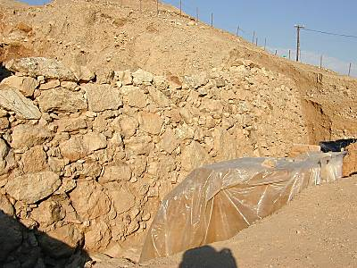
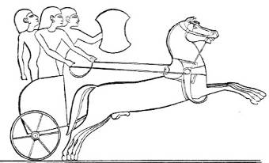
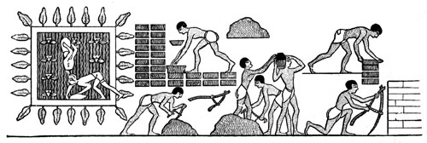
Accurate History
1. Archaeology
The Hittites
Egyptian bricks
Jericho’s
destruction
Photos from www.bibleplaces.com
and Creative Commons license

Slide 18
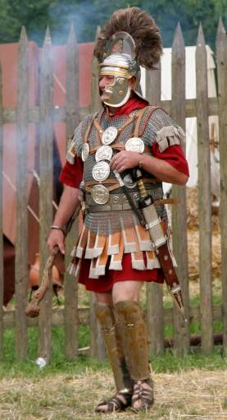
Accurate History
2. Sir William M Ramsay Researched Book of Acts
Structure of Roman government
Titles and names of individual Roman officials
Locations of certain cities

Slide 19
Accurate History
3. Eye-witnesses
Peter said:
“We did not follow cleverly invented stories when we told you about the power and coming of our Lord Jesus Christ, but we were eye-witnesses of his majesty” (2 Peter 1:16) .

Slide 20
Accurate History
3. Eye-witnesses
Luke wrote about things…
“…just as they were handed down to us by those who from the first
were eye-witnesses …”
“I myself have carefully investigated everything from the beginning,. . . so that you may know the certainty of the things you have been taught.’
(Luke 1:1-3).

Slide 21



Slide 23
TERMS of USE
This presentation is the work of Catherine Slight and Lin Pearson, and is copyrighted*, and may be used under the following terms.
Images
Any image which has a copyright line must not have that copyright line removed. Where images have no copyright line, this in no way implies that the images are copyright free.
You may use our resources unaltered for the purpose of study and teaching. We will be delighted if you find them of use.
Copying
If you produce extra copies of printables or PowerPoints for other members of your team, please ensure that the copyright line or copyright slide is always included, together with the web address of this site.
But please do not pass on extra copies or files for anyone other than your team. Instead, we would be very grateful, and it would benefit our site greatly, if you would direct people to FreeMinistryResources.org, where they can download the materials for themselves.

Slide 24
Reuse of images
Please do not extract slides or images from any of our items to use in another presentation you wish to make.
Many images are licensed to us on the understanding that they are used only in our resources, and are not to be distributed for the use of others.
Script
The script for this presentation may be downloaded from
https://freeministryresources.org/two-reasons-for-believing-the-bible-its-harmony-and-accurate-history/
© 2018 Catherine Slight and Lin Pearson
*FreeMinistryResources.org, including all its resources by Catherine Slight and Lin Pearson, may be used under the following license:
Creative Commons Attribution-Non-Commercial-No Derivative Works 4.0

