Slide 1

When I am Afraid
A practical life-application
by Catherine Slight and Lin Pearson
FreeMinistryResources.org
With thanks to those who supplied some of the graphics:
www.VisualBibleAlive.com
Luis Toro – creativemyk.com

Slide 2

When
I am
afraid…

Slide 3

Sometimes…
I can help
myself

Slide 4
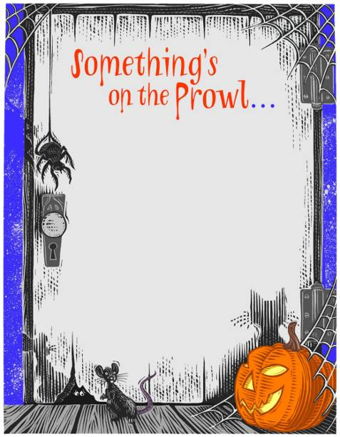
Spooky
stuff

Slide 5

Wasps

Slide 6

Dentist

Slide 7

Storm

Slide 8
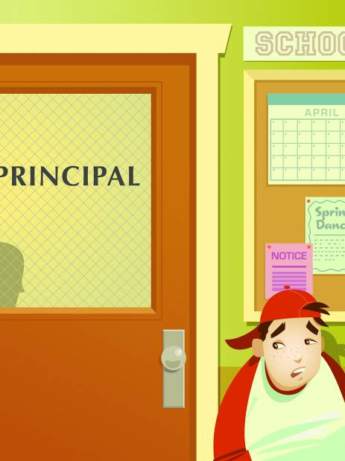
Getting
into
trouble

Slide 9
Sometimes…
I can help
myself
Yes!

Slide 10
But...

Slide 11

Sometimes…
I need others

Slide 12

Dark

Slide 13

Creepy-crawlies

Slide 14
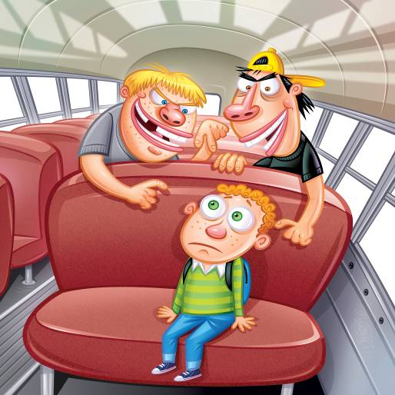
Bullies

Slide 15
Sometimes…
I need others

Slide 16
But...

Slide 17

Sometimes…
Only God
can help

Slide 18
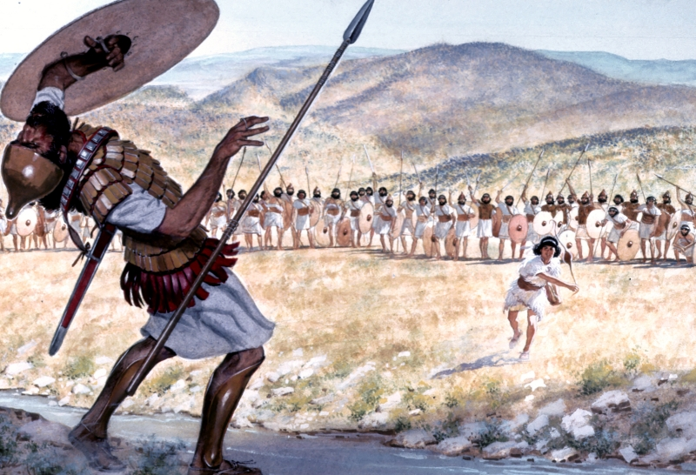
Image from VisualBibleAlive.com

Slide 19

David said:
“I trust in God,
so why
should I be afraid?”
David - Psalm 56:4 NLT

Slide 20
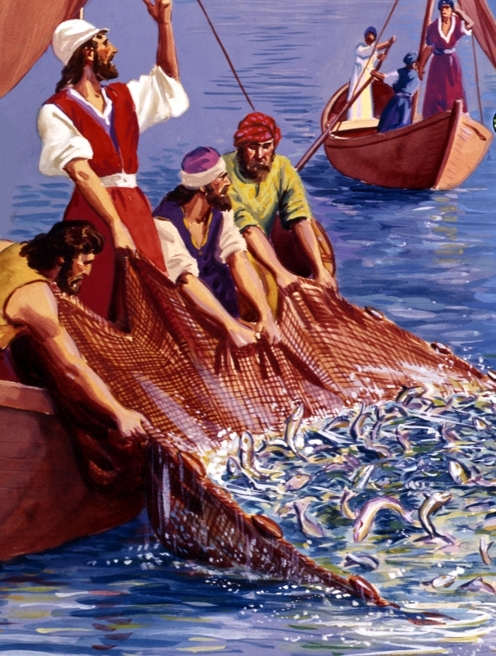

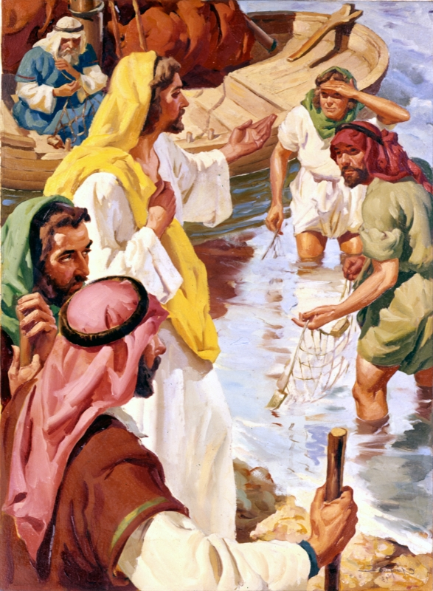

Slide 21

Image by Luis Toro

Slide 22

Image by Bogdi Jurca

Slide 23
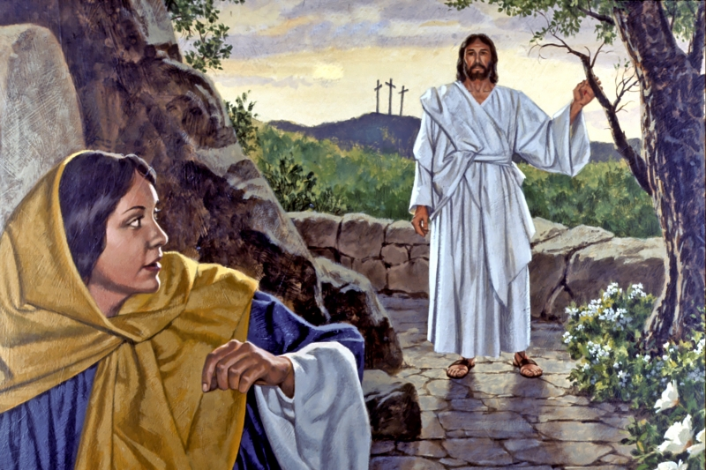

Slide 24


Slide 25

Help myself
Ask someone
to help me
Trust God
to help me

Slide 26

TRUST God
I rely on God
because
I have
confidence
in his power

Slide 27

How to Zap my fears

Slide 28
“I can do all things through
Christ who
strengthens me."
(Philippians 4:13)

Slide 29
“I am the LORD, your God,
who takes hold of your right hand
and says to you,
Do not fear; I will help you.”
(Isaiah 43:13)

Slide 30

How to Zap my fears
1. Write

Slide 31

2. Read

Slide 32
3. Think

Slide 33
“I can do all things through
Christ who
strengthens me."
(Philippians 4:13)

Slide 34
“I , Joe Bloggs, can
walk away from a fight
through Christ who
strengthens me."
(Philippians 4:13)

Slide 35
4. Memorize

Slide 36

5. Trust God
(Rely on him)

Slide 37

Jesus will
always be
with us

Slide 38
He will
change
things
for us

Slide 39
We never
need to be
afraid of
anything

Slide 40
- Even dying

Slide 41
Fear FEARfearFEA
FEARfearFEARfea
fearFEARfearFEA
FEARfearFEARfea

Slide 42


Slide 44
TERMS of USE
This presentation is the work of Catherine Slight and Lin Pearson, and is copyrighted*, and may be used under the following terms.
Any image which has a copyright line must not have that copyright line removed. Where images have no copyright line, this in no way implies that the images are copyright free.
You may use our resources unaltered for the purpose of study and teaching. We will be delighted if you find them of use.
Copying
Please do not pass on extra copies or files to anyone else. Instead, we would be very grateful, and it would benefit our site greatly, if you would direct people to FreeMinistryResources.org, where they can download the materials for themselves.
Reuse of images
Please do not extract slides or images from any of our items to use in another presentation you wish to make.
Many images are licensed to us on the understanding that they are used only in our resources, and are not to be distributed for the use of others.
*FreeMinistryResources.org, including all its resources by Catherine Slight and Lin Pearson, may be used under the following license:
Creative Commons Attribution-Non-Commercial-No Derivative Works 4.0

