Slide 1
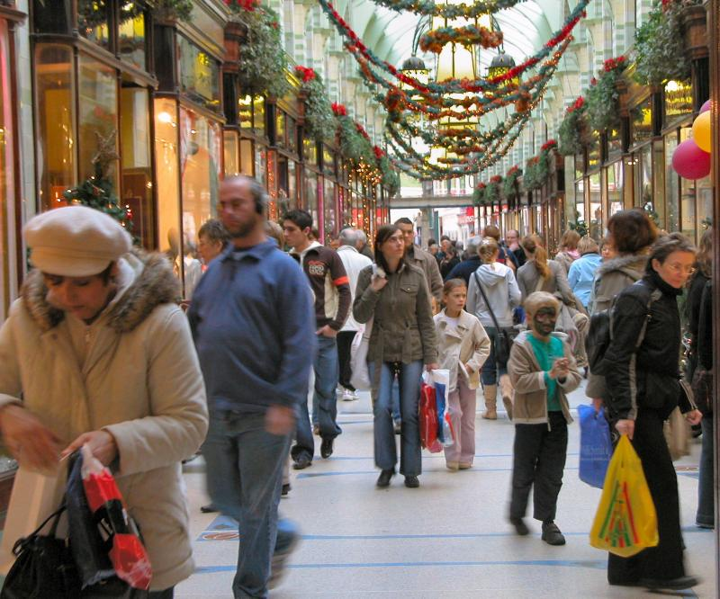

Slide 2

“I love Christmas...
the family time, the peace and goodwill bit .
I just don’t believe in all that
Jesus stuff.”

Slide 3
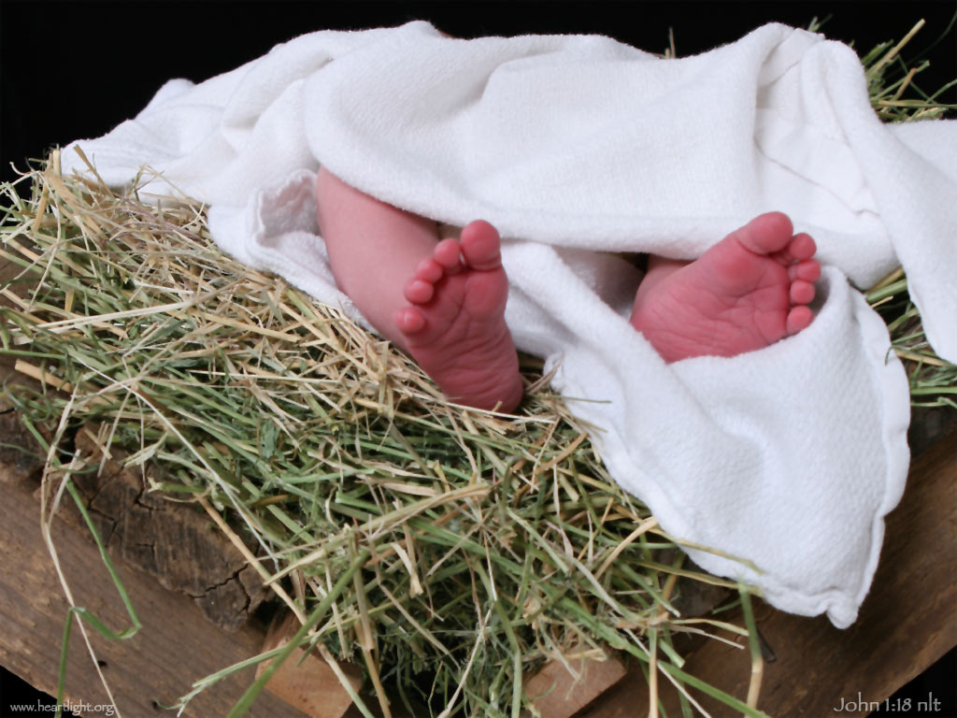
Myth or Truth?
Was the baby in the manger really Jesus Christ, God's Son, the promised Saviour?

Slide 4
Weigh the Evidence
The Prophets

Slide 5
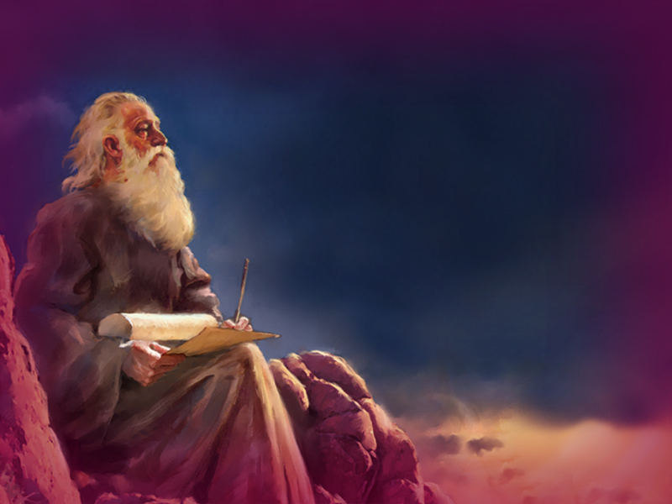
The Prophets
Birth
300 predictions
concerning the
promised Saviour

Slide 6
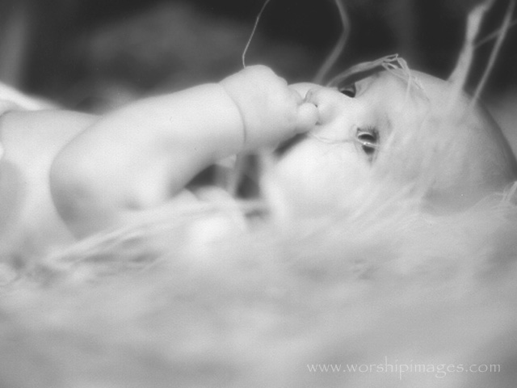
Born to a virgin
King David – his ancestor
Born in Bethlehem Ephratha

Slide 7
The Prophets
Birth
Ministry

Slide 8
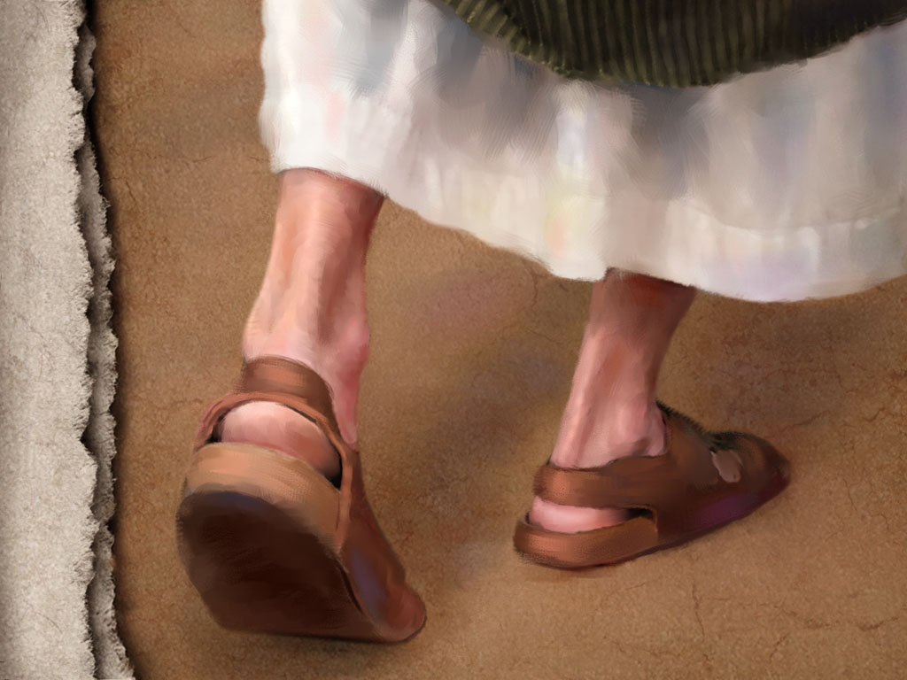
Preach and teach
Care for the poor and oppressed
Heal the sick

Slide 9
The Prophets
Birth
Ministry
Death

Slide 10
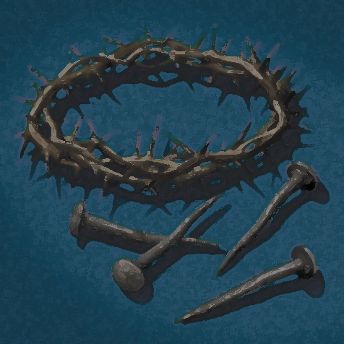
Treated as a criminal
Hands and feet pierced
Clothed gambled for
Buried in a rich man's grave

Slide 11
The Prophets
Birth
Ministry
Death
Resurrection

Slide 12
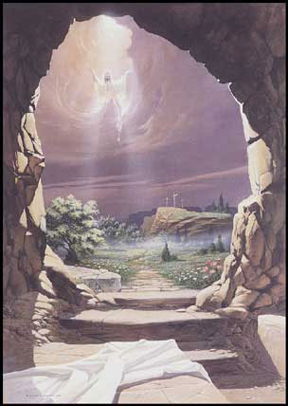
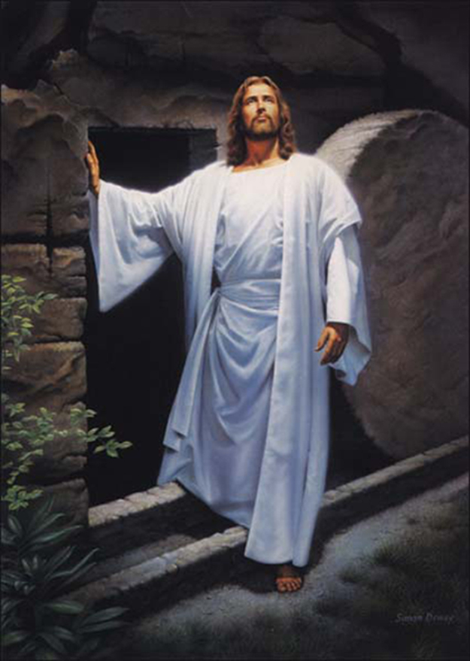

Slide 13

Weigh the Evidence
The Prophets
Eye-witnesses

Slide 14
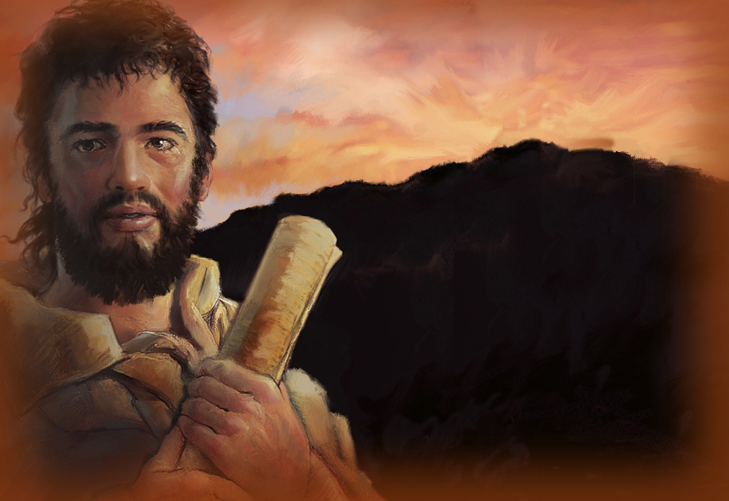
Eye witnesses
Peter said:
“We were eye-witnesses of his majesty”
Luke said:
“I myself have carefully investigated everything”

Slide 15
Weigh the Evidence
The Prophets
Eye-witnesses
God’s declaration

Slide 16
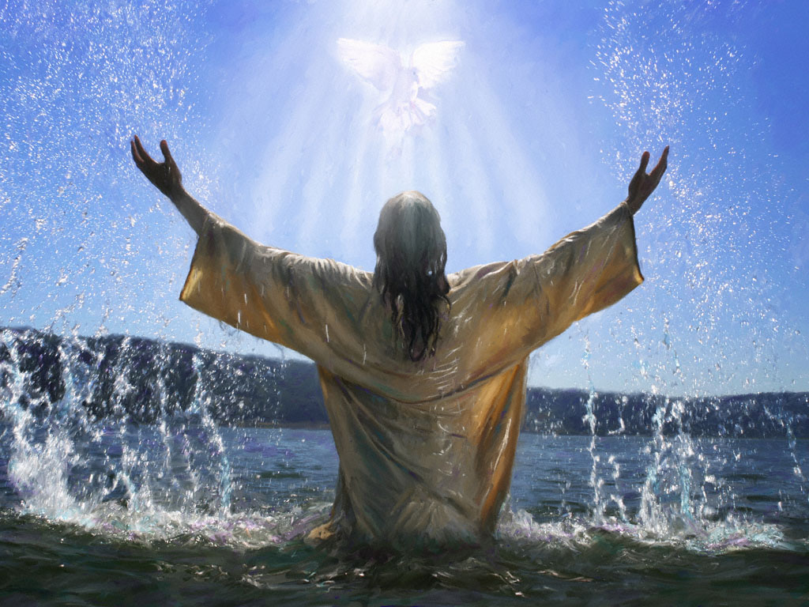
God’s declaration
“This is My beloved Son.
I am well pleased with him.”

Slide 17
Weigh the Evidence
The Prophets
Eye-witnesses
God’s declaration
Christ’s enemies

Slide 18

Christ’s enemies
At the Cross
“Let him save himself!”

Slide 19
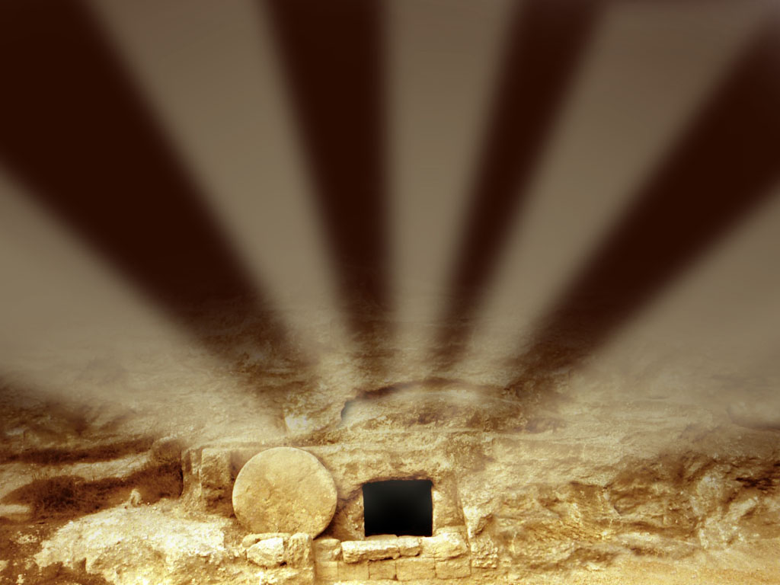
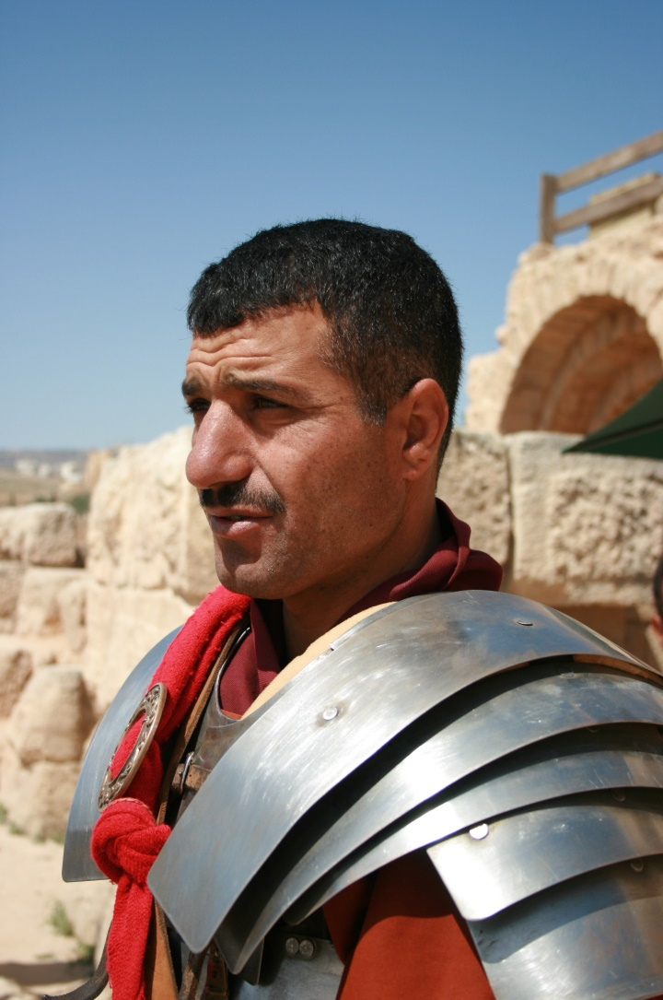
Christ’s enemies
At the Tomb
The Guards at the Tomb saw…
  An earthquake
  The stone rolled back
  An angel
  The tomb was empty!

Slide 20
Christ’s enemies
The religious leaders bribed
the guards to say…
“We fell asleep.”
“Someone stole the body.”

Slide 21
Weigh the Evidence
The Prophets
Eye-witnesses
God’s declaration
Christ’s enemies
Transformed lives

Slide 22

Transformed lives
Healed physically

Slide 23

Transformed lives
Set free
from
Phobias

Slide 24
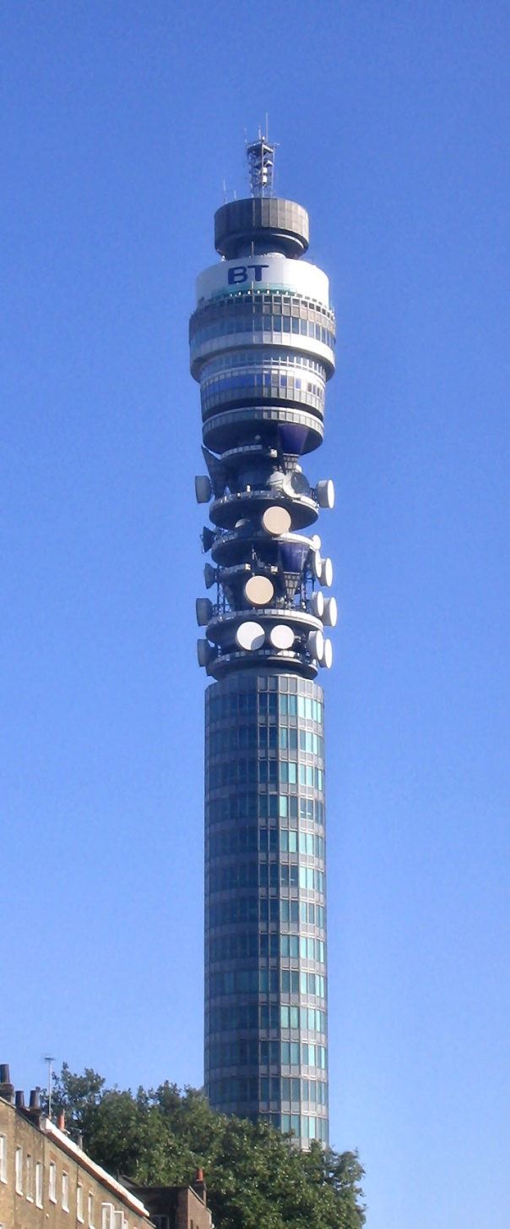
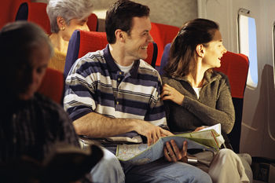
Transformed lives: Set free from phobias

Slide 25
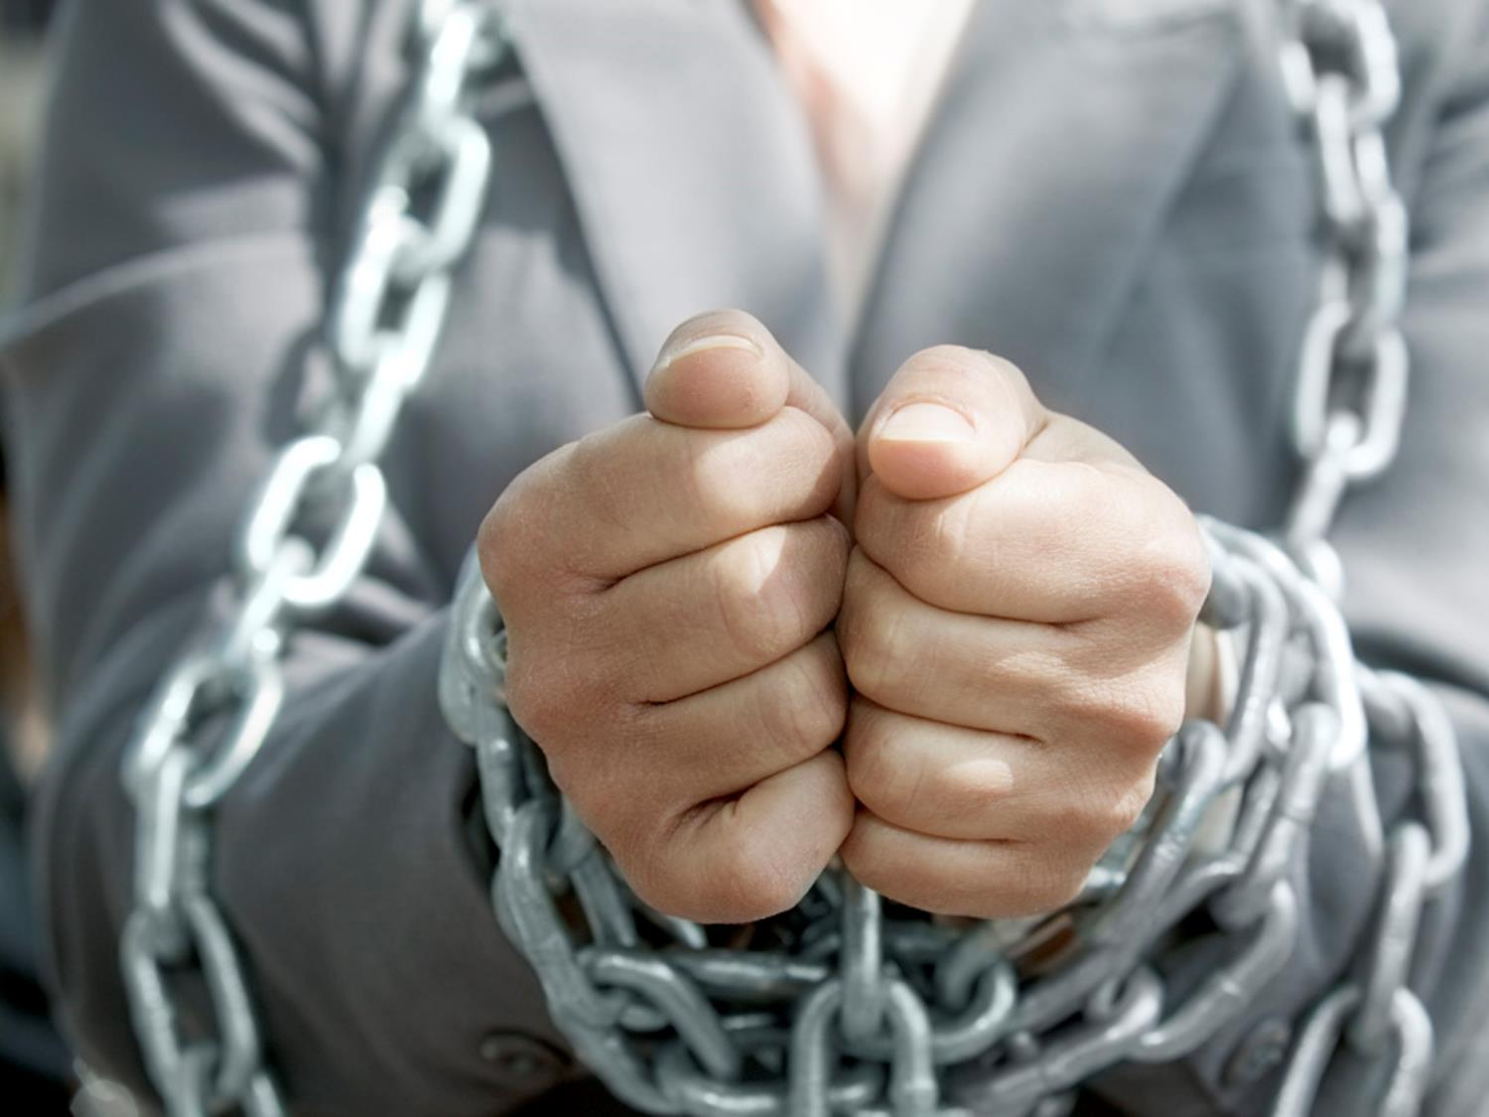
Transformed lives
Set free from
Addiction

Slide 26
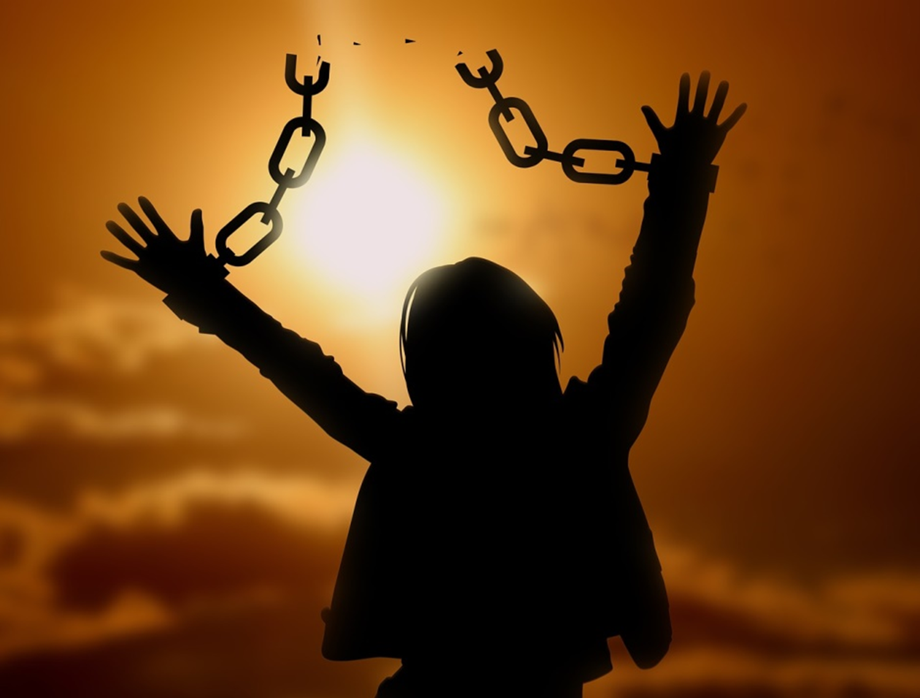
Tobacco
Alcohol
Drugs

Slide 27

Transformed lives
Total Freedom

Slide 28
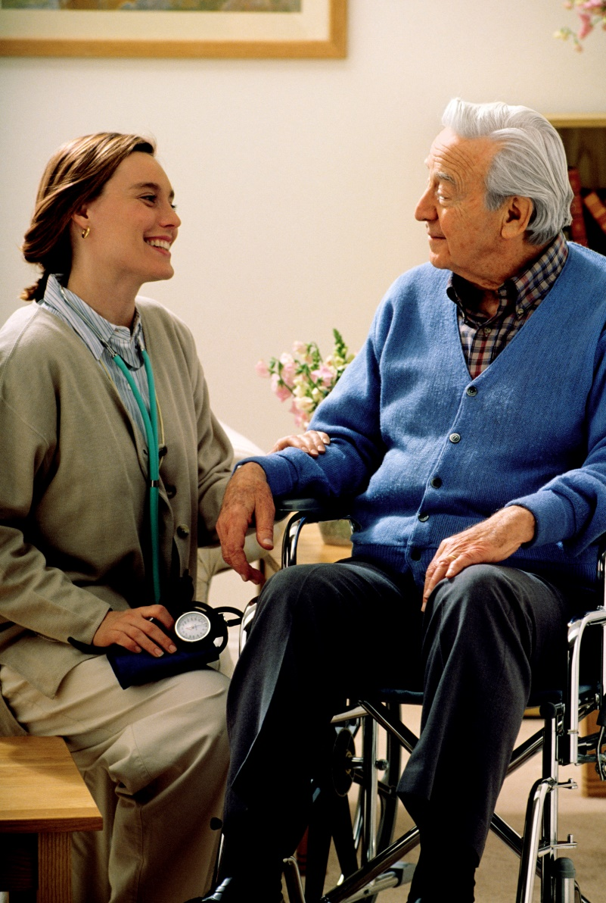
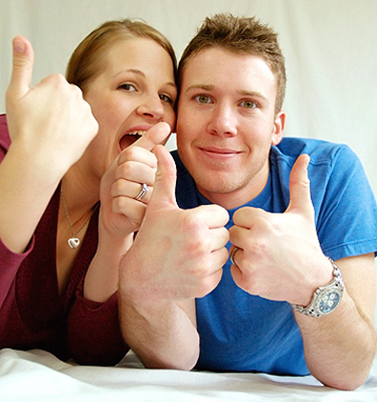
Transformed lives
PEACE…

Slide 29


Slide 30
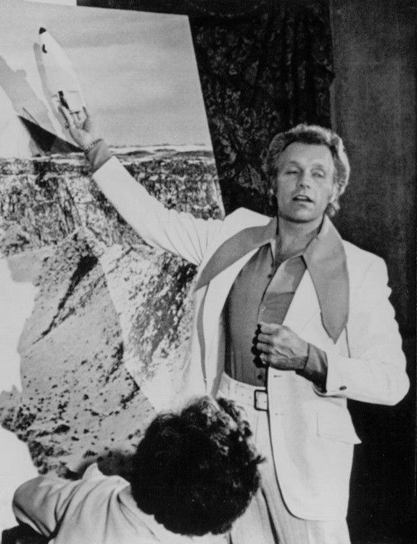
Transformed lives
Evel Knievel
Unknown (Associated Press), Public domain, via Wikimedia Commons

Slide 31
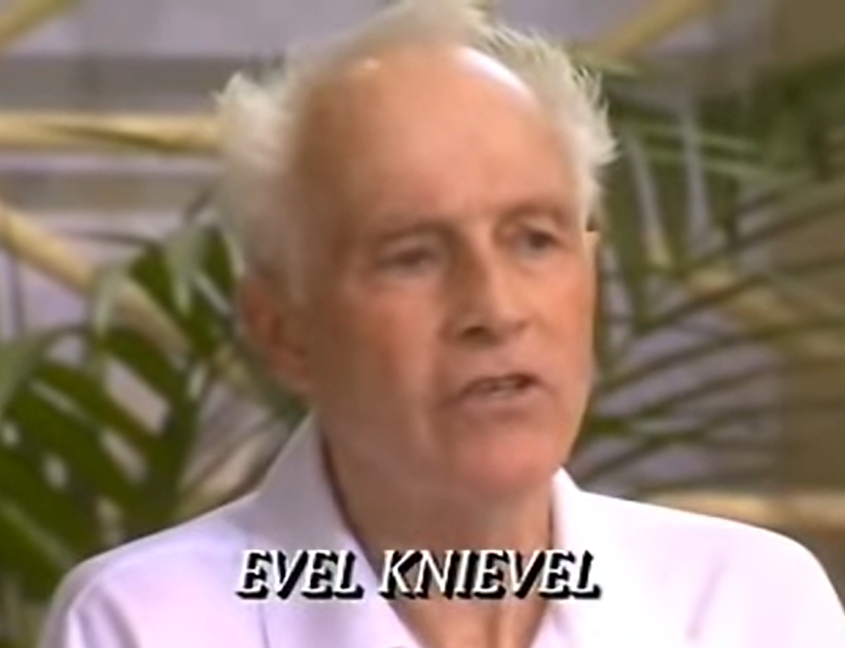
Testifying at his baptism that he had trusted Christ for salvation

Slide 32
Weigh the Evidence
Transformed lives
Christ’s enemies
God's declaration
Eye-witnesses
The Prophets

Slide 33
The Truth
The baby in the manger
really was God's Son, the promised Saviour

Slide 34
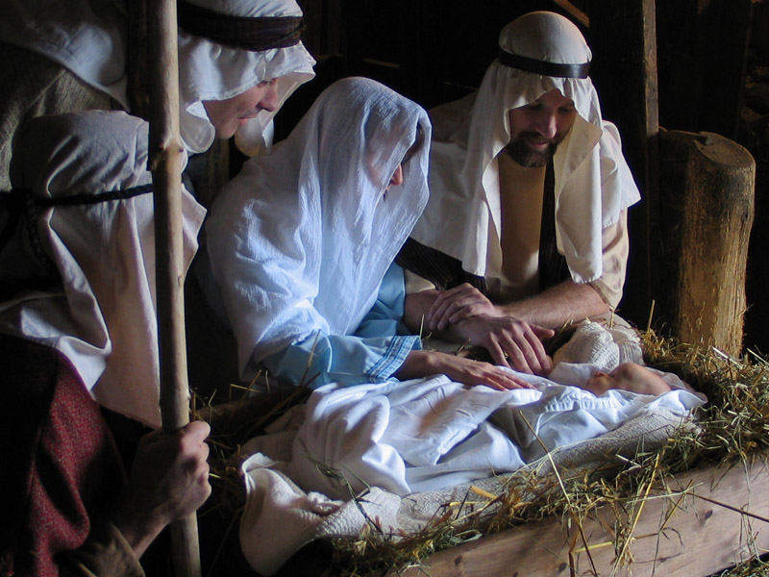

Slide 36
FreeMinistryResources.org
^{Copyright}
This presentation is for your personal use. Please do not pass on copies to others. Instead, we would be very grateful, and it would benefit our site greatly, if you would direct people to our site at FreeMinistryResources.org, where they can download the materials for themselves. This will help the site show up better in search engines, and so enable more people to find us and have access to the free resources.
These materials may not, in any manner, be sold or used to solicit 'donations' from others, nor may they be included in anything you intend to copyright, sell, or offer for a fee.
This copyright is exercised to keep these materials freely available to all. Any exceptions to these conditions must be explicitly approved by the authors.
^{Read more >>>}

Slide 37
Image Credits
We are very grateful to those who have given us permission to use their images, especially Freepik.com and FreeImages.com and their contributors.
Reuse of images
Please do not extract slides or images from any of our items to use in another presentation you wish to make.
Many images are licensed to us on the understanding that they are used only in our resources, and are not to be distributed for the use of others. Please do not remove image credit lines. An image with no credit line does not necessarily indicate that it is free for you to remove and use elsewhere.
Script
The script for this presentation may be downloaded from
https://freeministryresources.org/evidence-for-resurrection-of-jesus-christ-part-1
© 2020 Lin Pearson and Catherine Slight
*FreeMinistryResources.org, including all its resources by Catherine Slight and Lin Pearson, is copyrighted under the following license: Creative Commons Attribution-Non-Commercial-No Derivative Works 4.0

