Slide 1


Slide 2
Christmas…
What do you think of?

Slide 3


Slide 4
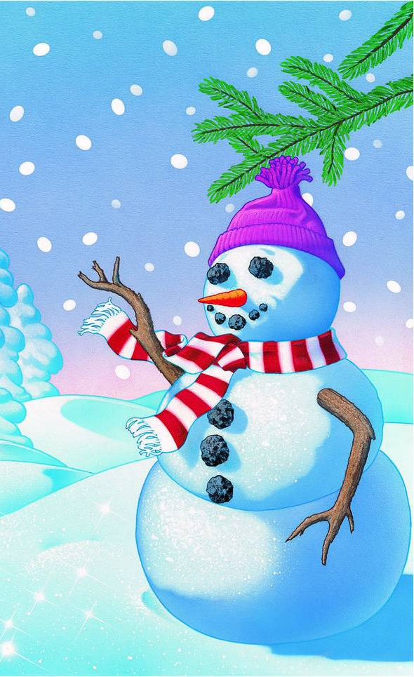

Slide 5
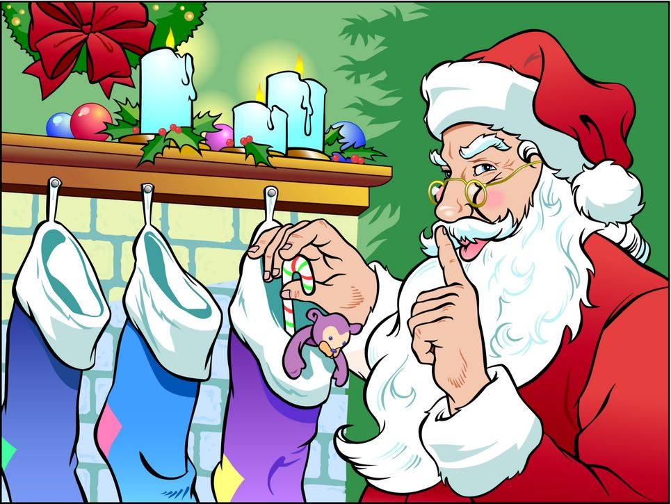

Slide 6

Christmas is a time
for giving

Slide 7

Christmas is a time
for giving

Slide 8
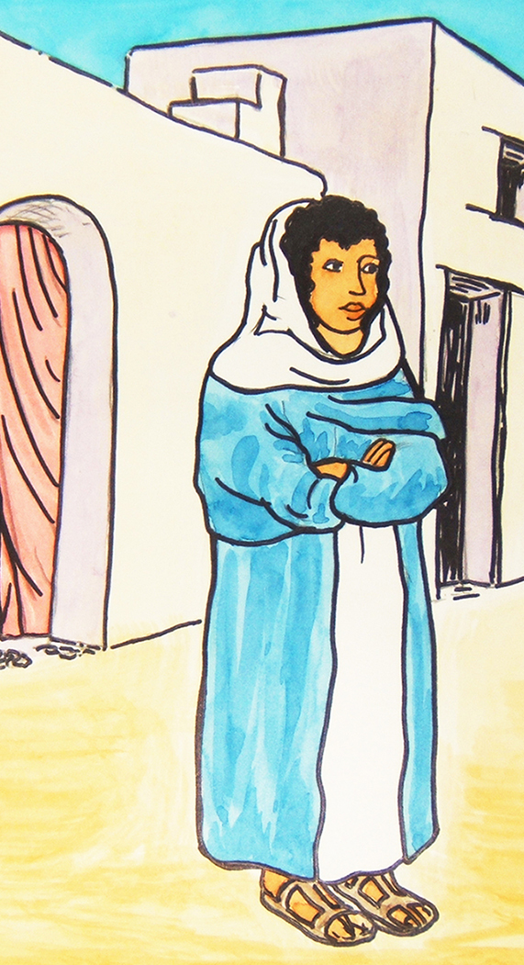
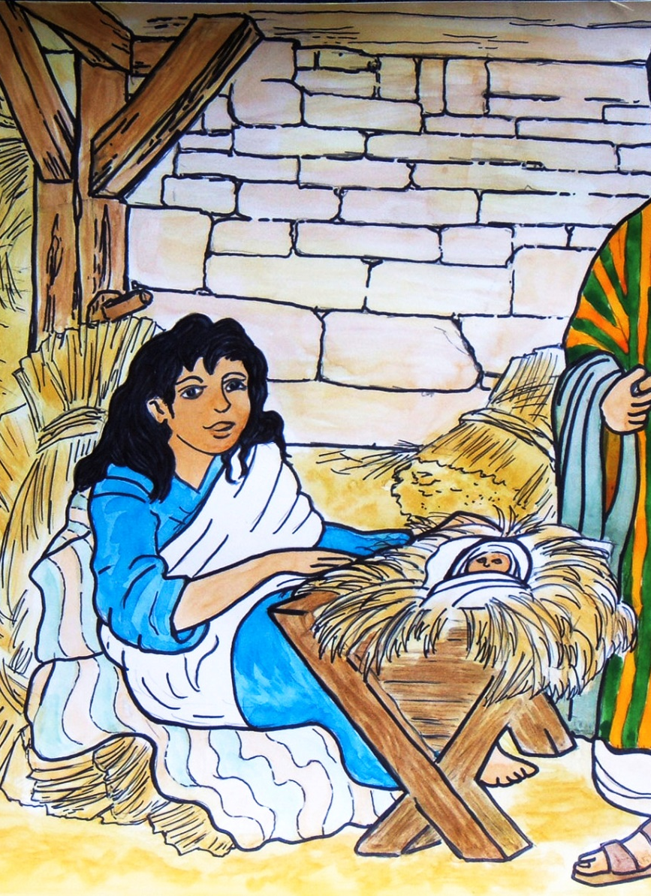
Mary gave ...
her
body

Slide 9
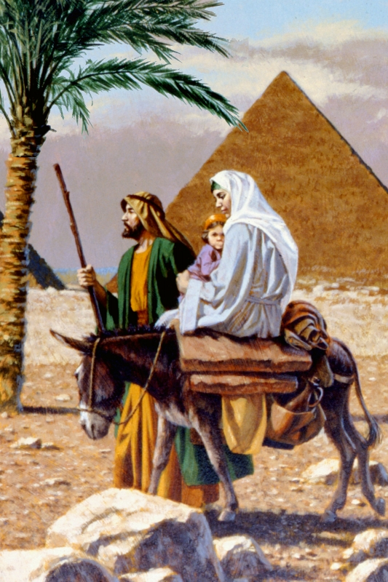
Joseph gave ...
His
reputation

Slide 10
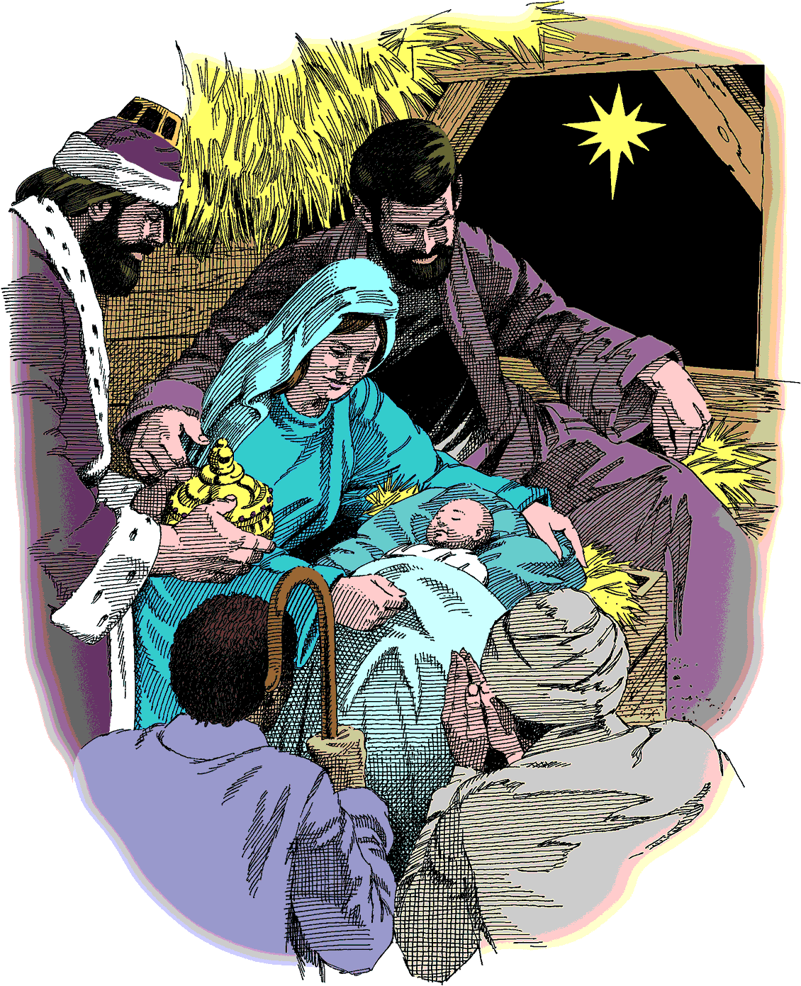
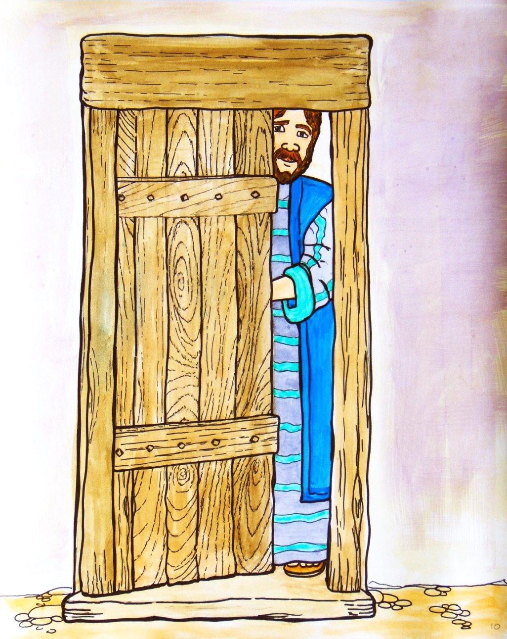
The inn keeper gave ...
his stable

Slide 11

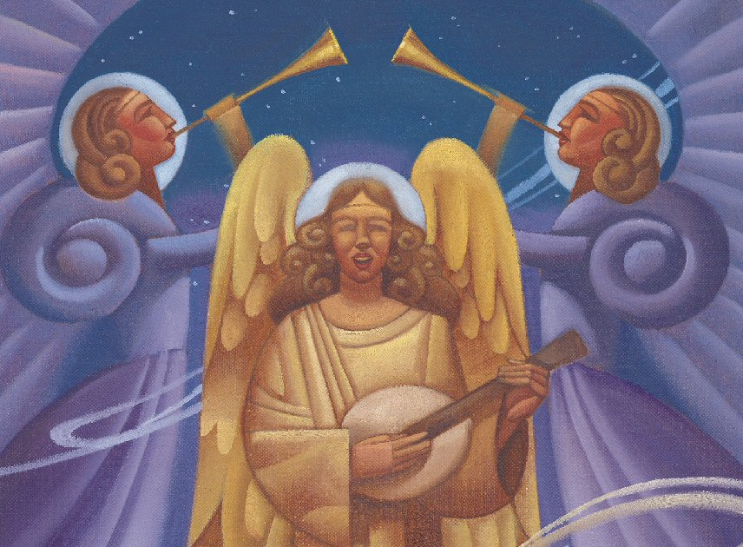
The angels gave ...
their praise

Slide 12
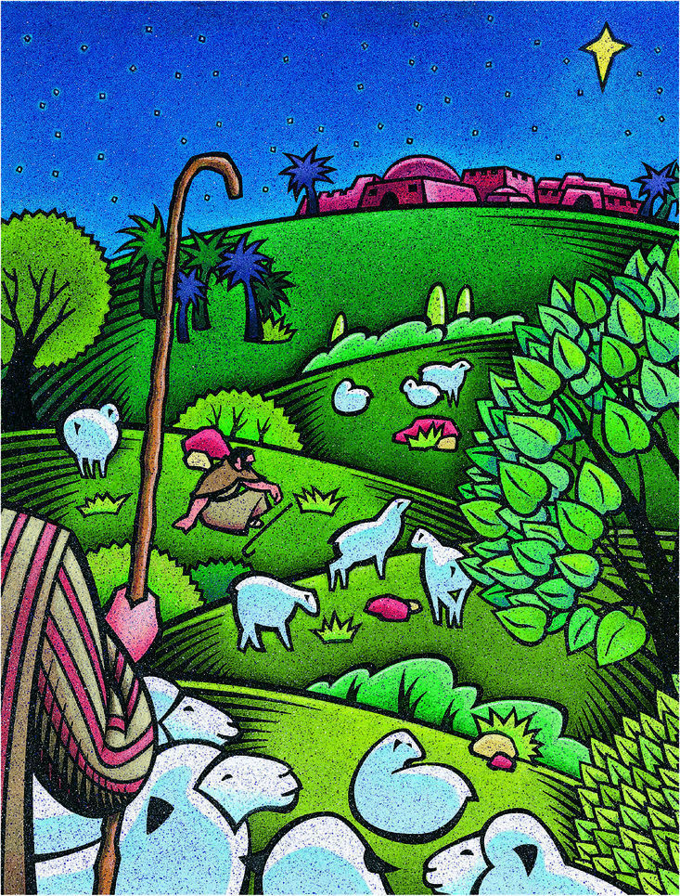
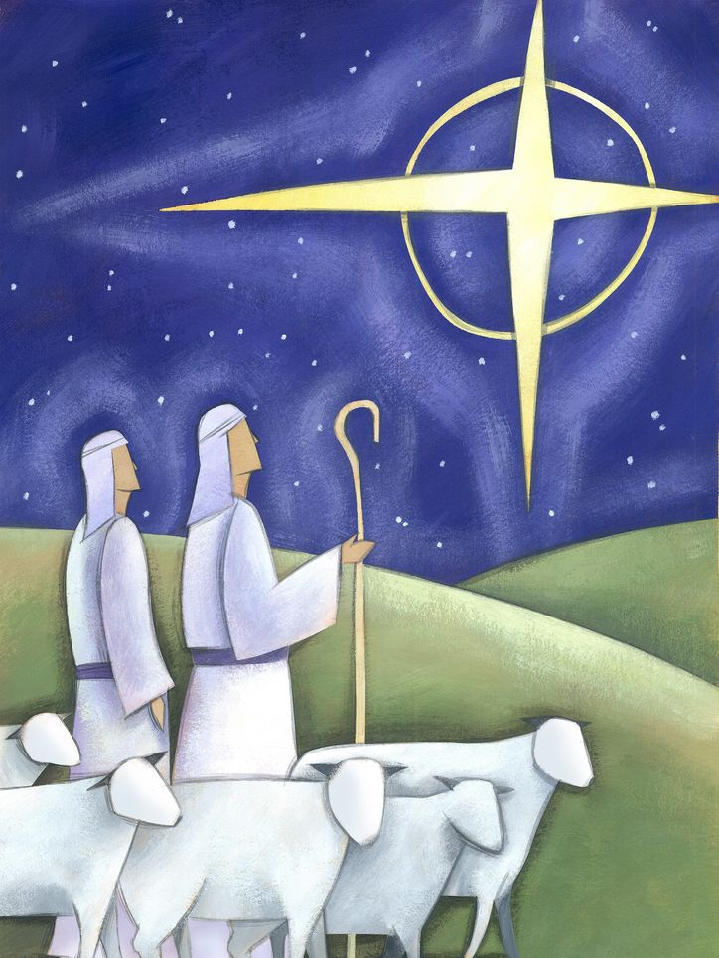
The shepherds gave ...
their witness

Slide 13


The star gave ...
its light

Slide 14
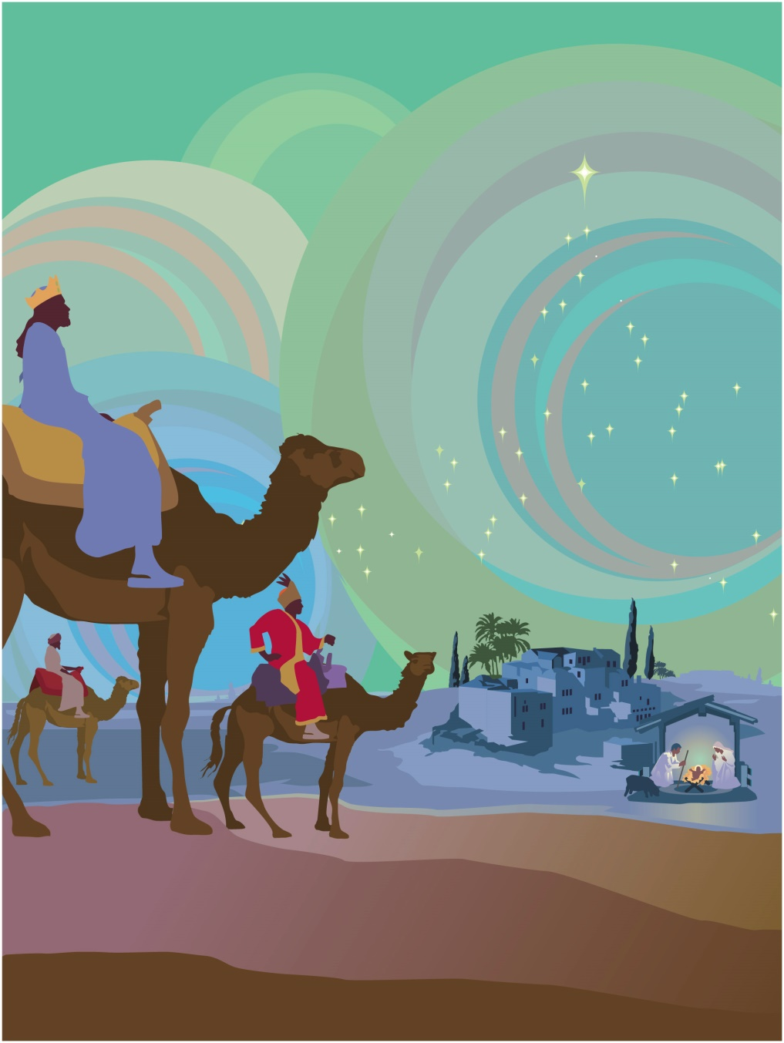

The wise men gave ...
their treasures

Slide 15
God gave ...
“For God so loved the world that He gave ...” John 3:16
“Thanks be to God for His indescribable gift.” 2 Cor 9:15

Slide 16
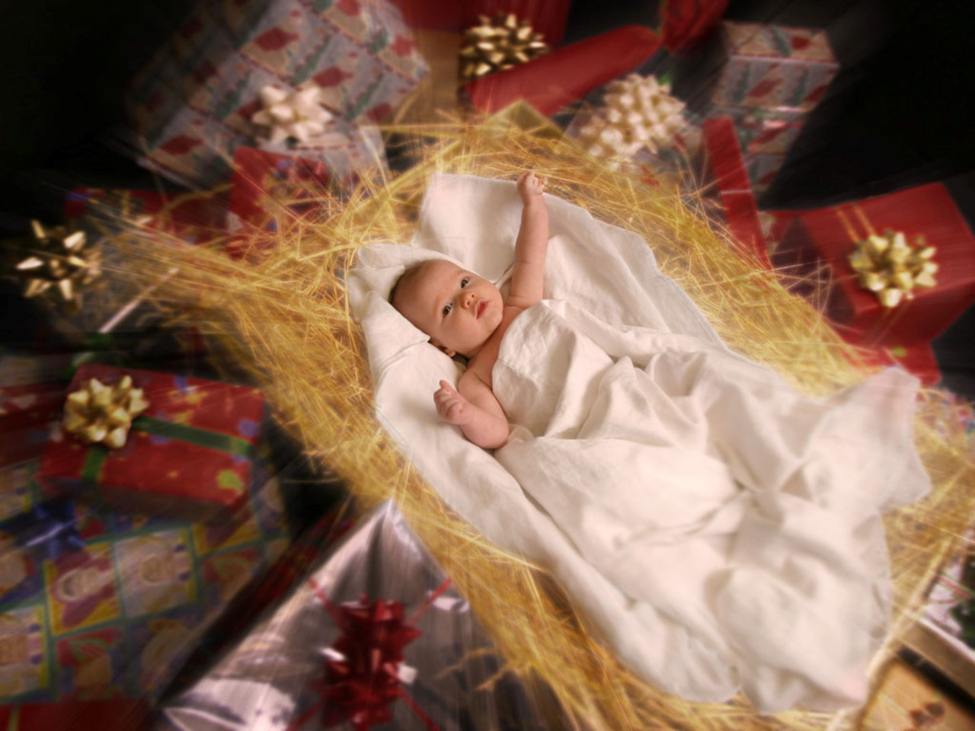
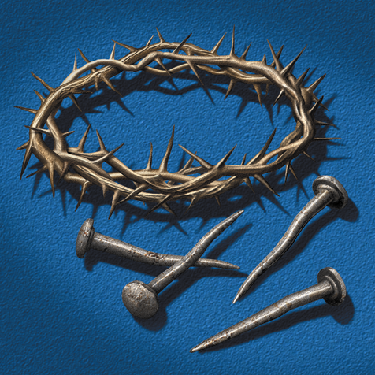

Slide 17

What will you give?

Slide 18



Slide 20
Christmas Gifts
Devised by Mabel Brush
PowerPoint by Lin Pearson
https://freeministryresources.org

Slide 21
TERMS OF USE
This presentation is copyrighted*. It may be used under the following terms.
You may use this and other resources on FreeMinistryResources.org unaltered for the purpose of study and teaching. They may not in any manner be sold or used to solicit “donations” from others. Nor may they be included in anything you intend to copyright, sell, offer for a fee, or make available online. This copyright is exercised to keep our material freely available for all. If you have any questions, or wish to do something not mentioned in these conditions, please contact Catherine and From FreeMinistryResources.org
COPYING
These resources are for your personal use. Please do not pass on copies to others. Instead, we would be very grateful, and it would benefit our site greatly, if you would direct people to our site at FreeMinistryResources.org, where they can download the materials for themselves. This will help the site show up better in search engines, and so enable more people to find us and have access to the free resources.
The outline script which accompanies these notes may be downloaded from our website. https://freeministryresources.org/christmas-gifts.
©2021 Catherine Slight and Lin Pearson
*FreeMinistryResources.org, including all its resources by Catherine Slight and Lin Pearson, is copyrighted under the following license: Creative Commons Attribution-Non-Commercial-No Derivative Works 4.0

