Slide 1
Precision of adaptation
Chris Watkins
Department of Computer Science
Royal Holloway

Slide 2
Nature’s no. 1 learning algorithm: asexual evolution
Nature’s no. 2 learning algorithm: sexual evolution
Machine learning algorithms ….
… any connection?
Evolution ≅ nonparametric Bayesian MCMC
Upper bounds on evolvability via a communication game argument
- Sexual evolution has much higher channel capacity than asexual
- To use this channel capacity requires distributed genetic codes

Slide 3
Genetic Algorithms
Asexual
Copy, mutate
Compute fitnesses, then select
Copy, mutate,
recombine
Sexual
Generation t
Children
Generation t+1
Notes:
Simple algorithms. We can compare sexual vs asexual, with everything the same except recombination, to try to understand the difference between them.
These algorithms not intended to be practical.

Slide 4
Differences between asexual and sexual organisms
Each difference is by multiple orders of magnitude
 | Asexual | Sexual
Genome size: | Small | Large
Population size: | Large | Small
Generation time: | Short | Long
Gene regulation: | Simple | Complex
Development: | None | Complex
Notes:
Can we do a priori biology? How much can we explain by a priori reasoning?

Slide 5
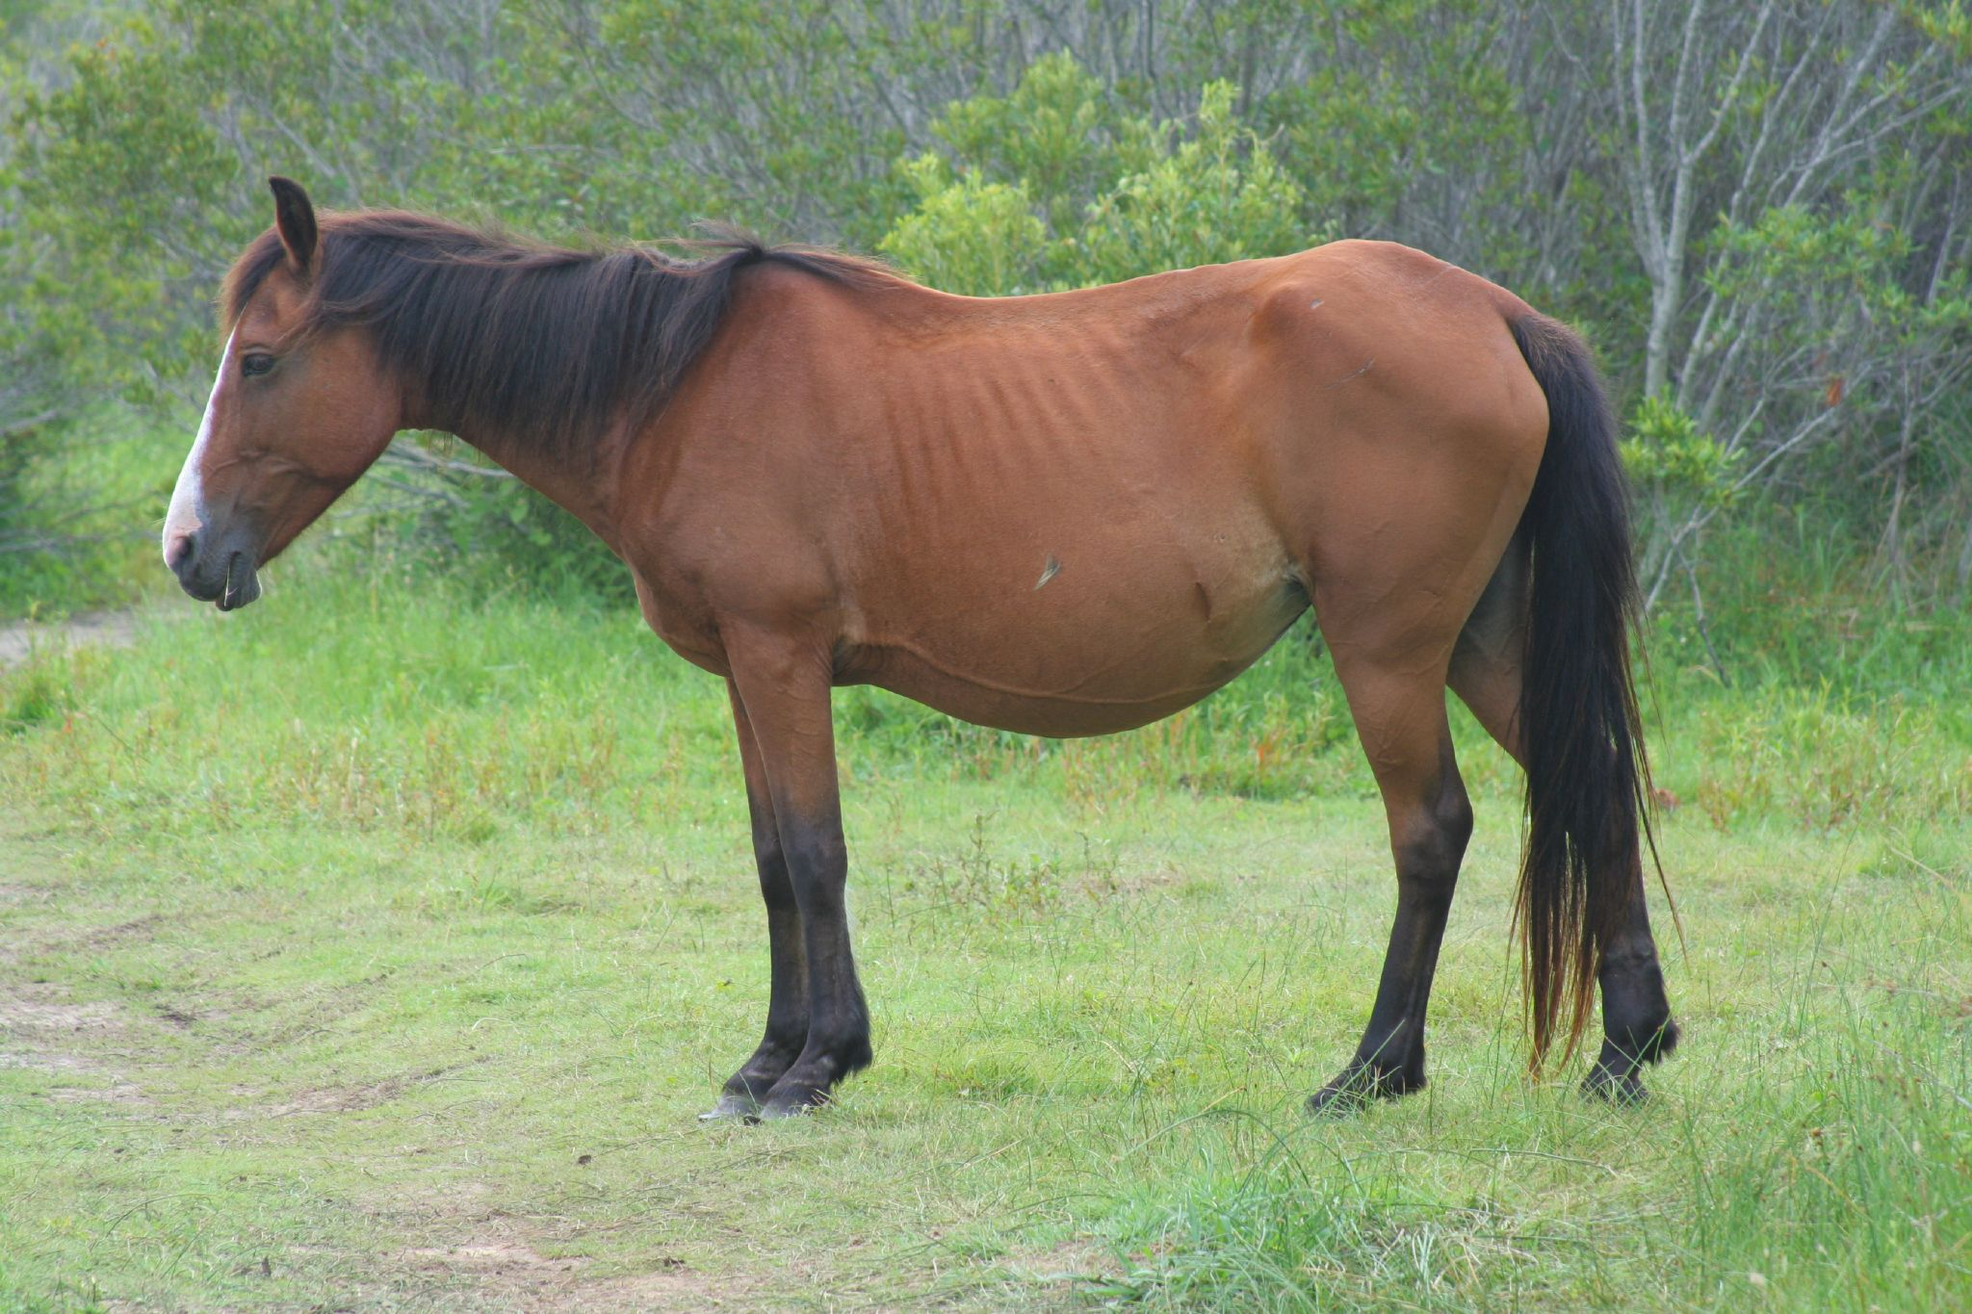
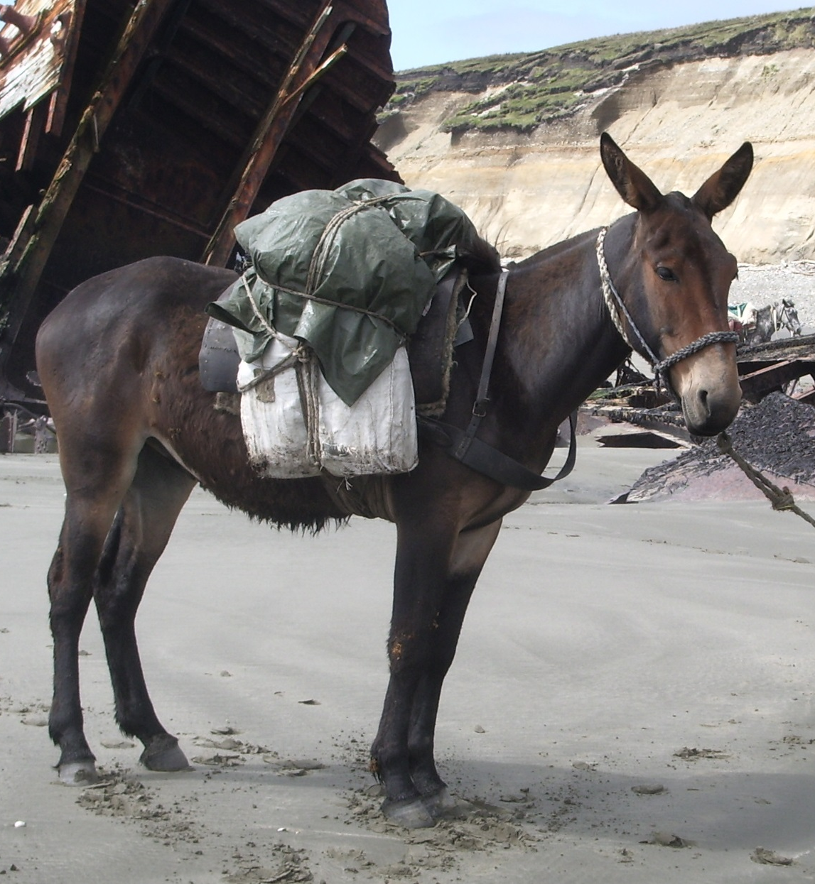
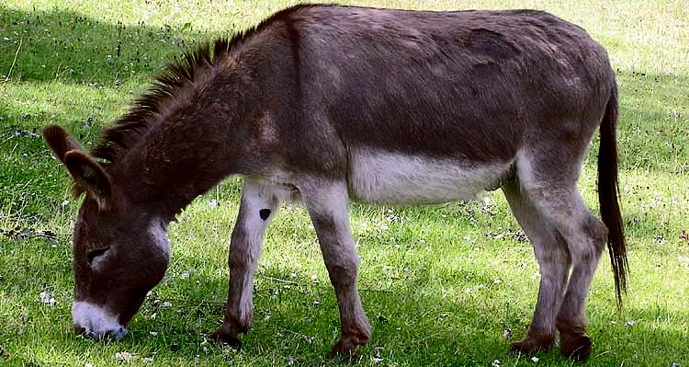
Horse
Mule
By Tania Gail - originally posted to Flickr as Wild Horses of the Outer Banks, CC BY 2.0, https://commons.wikimedia.org/w/index.php?curid=6304229
Donkey
Horses and donkeys diverged 4 million years ago. Mules are stronger than both.
Notes:
Even though horses and mules di

Slide 6


Airbus
Boeing
Can we breed a Boeing with an Airbus by randomly recombining the design files using cut and paste, with ~100 random changes?
Human-designed machines and biological organisms are specified in very different ways.
CC-BY-SA-4.0
Self-published work
Files by User:Gillfoto

Slide 7
The ‘Omnigenic’ hypothesis
Complex traits – such as height – that are the result of long processes of development are affected by genetic variation at millions of loci spread all over the genome.
(Loosely) nearly every part of the genome affects every complex trait.
An Expanded View of Complex Traits: from Polygenic to Omnigenic, Boyle, Li, and Pritchard, Cell 2017

Slide 8
Limitative informational properties of sexual and asexual evolution: a simple model
Consider genomes as binary sequences of fixed length L.
Choose a fixed binary sequence as a ‘target’ or ‘ideal’ genome
In each generation, breed 2N ‘children’, and then select the N that are closest to the target string.
Not intended to be a realistic model: it is a limitative model.
Every assumption is optimistic: in this way, we can get upper bounds on achievable complexity.
Notes:
Very artificial and simple selection scheme. However, has the advantage – for the purposes of comparison – of being perhaps the most efficient selection method.

Slide 9
Bit-error-rate vs genome length
Population size: N = 100 Mutation rate: u = 0.01
Asexual
Fraction of
incorrect
elements
in genome
Sexual
Genome length (log scale)
Notes:
As genome length tends to infinity, both curves will asymptote approaching 0.5 from below.

Slide 10
Same data replotted as channel capacity vs genome length
where p is error rate, and h₂(p) is entropy in bits
Sexual
Adaptive Channel
Capacity
(bits)
(log scale)
Asexual
Genome length
Notes:
Information is already a logarithm, so y axis is a log-log scale, which you don’t often see
As u tends to zero, the asymptotic channel capacity for large enough L is 1/u squared for sexual, and 1/u for asexual
Now here is a big difference !
Note that channel capacity is a difference of entropies, which is a logarithm: these logs are plotted on a log scale.
This is highly suggestive : is this the big and significant difference between sexual and asexual reproduction? is this “channel capacity” real? Can it actually be biologically used?
Suggests sexual organisms should make use of highly redundant distributed genetic codes, and development analogous to error-correction in communication engineering

Slide 11
The Drosophila Game: a thought-experiment
Suppose two geneticists – A and B – wish to communicate.
First, they agree on a code-book of varieties of Drosophila
- could use binary traits: red/black eyes, long/stubby wings, smooth/hairy, etc
- could use a binary code on polymorphic SNPs
A decides on the message to send.
She then breeds a population of N Drosophila in her office; after each generation she has 2N, and she squashes half of them, and continues to breed the rest.
By keeping the flies most similar to the variety she wants, A can breed her population to have the binary trait values she desired.
Finally A sends her message: she releases her final selected population of N flies, and B catches one.
B examines (or sequences) the fly, and determines which variety in the code-book it belongs to, and so decodes A’s message.
If A can reliably set, say, 10 different binary traits, she can produce 1024 different varieties of fly, and so send 10 bits.
The channel capacity measures how precisely the flies can adapt to A’s selective breeding
Notes:
What does this information mean?
The point here is that the Drosophila game is a real communication channel that could actually be used. The Cambridge department of genetics could send messages to the EMBL in Heidelberg, coded as fruit flies.
The significance of the message is that B finds information that must be in each individual fly.

Slide 12
Simple redundancy: 300 bit genome, decoded to 100 bits by majority votes on 100 separate groups of 3 bits.
100-bit genomes with no decoding
Adaptive Channel
Capacity
300-bit genomes decoded by majority
vote in groups of three
Mutation rate
Notes:
It has all gone horribly wrong: the decoding makes things worse.
300-bit genomes get 3x as many mutations. Each 3-bit group acts as a single noisy allele.
Simple repetition coding is effective (but inefficient) for communication over a noisy channel – but it doesn’t work here. Each group of 3 elements accumulates silent mutations until it is on the edge...

Slide 13
Non-linear decoding: 300 bit genomes, decoded to 100 bits using much-simplified LDPC decoding
Error Correction Decoding
No Decoding:
100-bit genomes
Adaptive Channel
Capacity
Mutation rate
Notes:
this shows that “adaptive channel capacity” is (at least partly) real. It IS possible to find non-linear interactions such that the system can evolve to a high-information state.
These

Slide 14
LDPC decoding compared with no decoding for Asexual GA.
Asexual GA has no adaptive channel capacity to access, and cannot optimise the encoding.
No Decoding
Adaptive Channel
Capacity
Error
Correction Decoding
Mutation rate

Slide 15
Stabilising selection: an important case
Selection that maintains a ‘quantitative trait’ – a design parameter – close to an optimal value
Unfit
Fit
Unfit
Optimal value

Slide 16
Decoding from a genome to a number
Simplest model: linear mapping
View genome as a vector
A quantitative trait is determined as
the sum of effects of each element of genome

Slide 17
Stabilising selection: small and large effects
A ‘small’ effect is smaller than the natural range of variation of the trait.
Hard to select one value for gene locus of small effect!
Small effect
Large effect
Unfit
Fit
Unfit
Optimal value

Slide 18
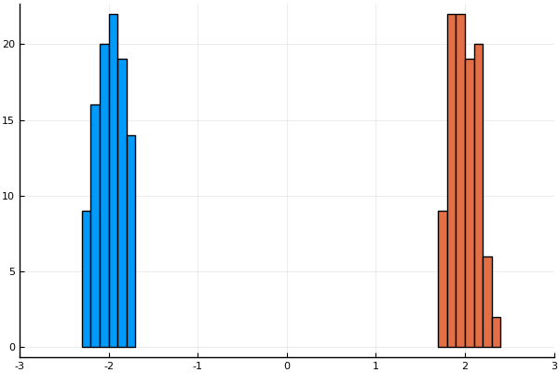
Stabilising selection for two values
Population size: 100
Genome length: 400
Mutation rate: 0.01
Truncation fraction: 1/3
Linear effects are normally distributed, scaled to produce range of variation shown.
Maximum range of adaptation:
-3 to 3, as shown
Precision of adaptation: approx 6 bits
target
target
Histogram of values of the two traits for members of a population at equilibrium.

Slide 19
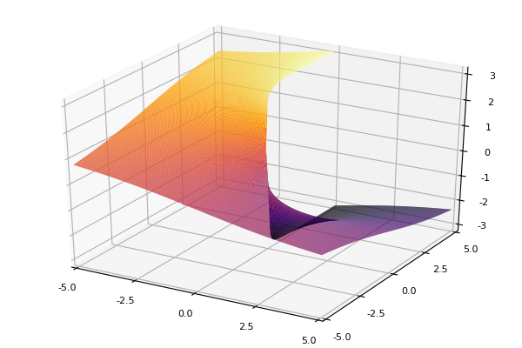
Better than linear decoding? Spiral decoding
Idea: linearly decode genome to two numbers and
then compute

Slide 20
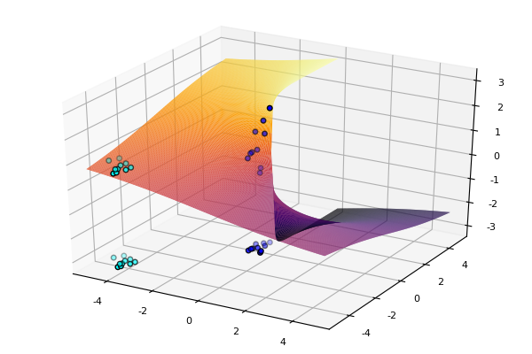
Imprecise values of x₁ and x₂ can yield a more precise value of z

Slide 21
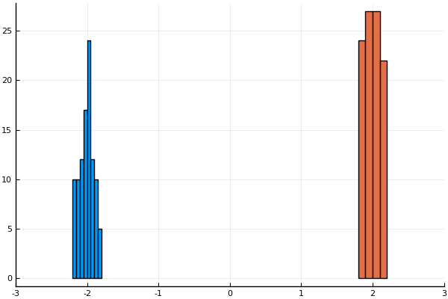
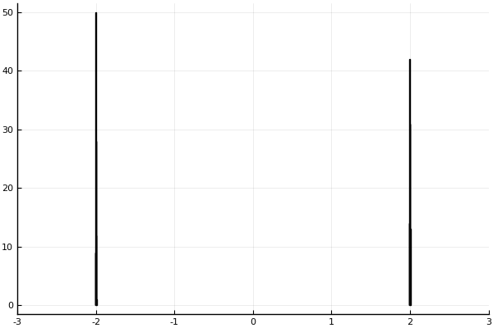
Linear decoding
(small effects)
~ 6 bits
‘Spiral’ decoding
6- stage ‘Spiral’ decoding
~ 14 bits

Slide 22
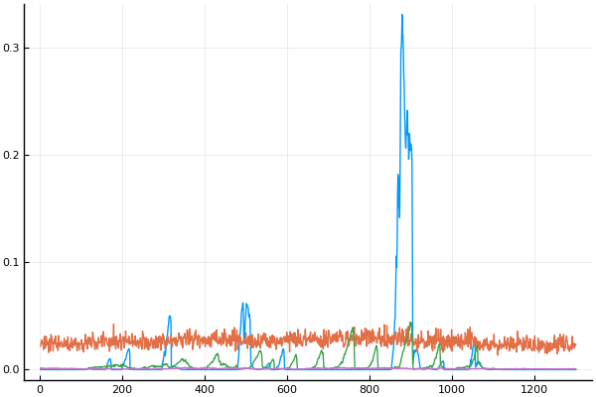
Why not just use binary? A problem with large effects.
In binary, 0111 and 1000 are neighbouring values, but cannot evolve directly from one to the other.
binary
RMS tracking error for stabilizing selection on a slowly varying target value
medium effects
small effects
spiral
Number of generations

Slide 23
Is there a unifying simplicity?
A field of numerous ‘bio-inspired’ genetic algorithms, highly abstracted from genetics.
Each genetic algorithm specifies a Markov chain of populations: these chains are usually intractable to analyse.
In some sense, there has been ‘evolution of evolvability’ – but in what sense?
Is there a framework that puts genetic algorithms within standard Markov-chain Monte Carlo?
Can we construct a genetic algorithm with a Markov chain of populations that satisfies detailed balance, and for which the stationary distribution can be written in closed form?
Can we relate genetic algorithms to existing ideas in machine learning?
Can we put evolutionary and individual learning within the same model?

Slide 24
EBT: Exchangeable Breeding with Tournaments
A tool for studying mutation-selection equilibrium
‘Genetic algorithm’ that satisfies detailed balance.
Exchangeably sample one genome
Reject one genome
Generation t
Generation t+1
Reject genome k with probability

Slide 25
Exchangeable Sampling
“Breeding” is by sampling a genome, conditional upon existing genomes. Joint “breeding distribution” should be exchangeable:
For a ‘Genetic Algorithm’, use a breeding distribution that is a product of Beta-Bernoulli distributions (or Dirichlet Processes).
That is, each element of a new genome is sampled from an independent Dirichlet process: the ‘genome’ consists of a vector containing a sample from each DP.

Slide 26
Design decisions for an evolutionary model to satisfy detailed balance
Propose (i.e. ‘breed’) one genome at a time
Sample each part of the new genome from the whole population, not just from 2 parents
Mutations cannot depend on previous value: a ‘mutation’ is an ‘immigrant’ value sampled from an underlying gene pool.
During breeding, all members of population contribute equally
After proposing a new genome, a genome is selected for rejection: less fit genomes more likely to be rejected. Differences in fitness modelled as differences in lifespan, not fecundity.

Slide 27
Tournament Selection by ‘loser ticket’
If genomes i and j have a ‘tournament’
Suppose there is one ‘loser ticket’. After many tournaments in which the genome currently holding the loser ticket ‘fights’ another genome, and the loser gets the ticket, limit distribution is:

Slide 28
Key point: Stationary Distribution of EBT can be written in closed form
EBT is a Markov Chain of populations.
Stationary distribution is:
Analogous to a Bayesian posterior, with ‘breeding distribution’ as prior, and fitness as likelihood.

Slide 29
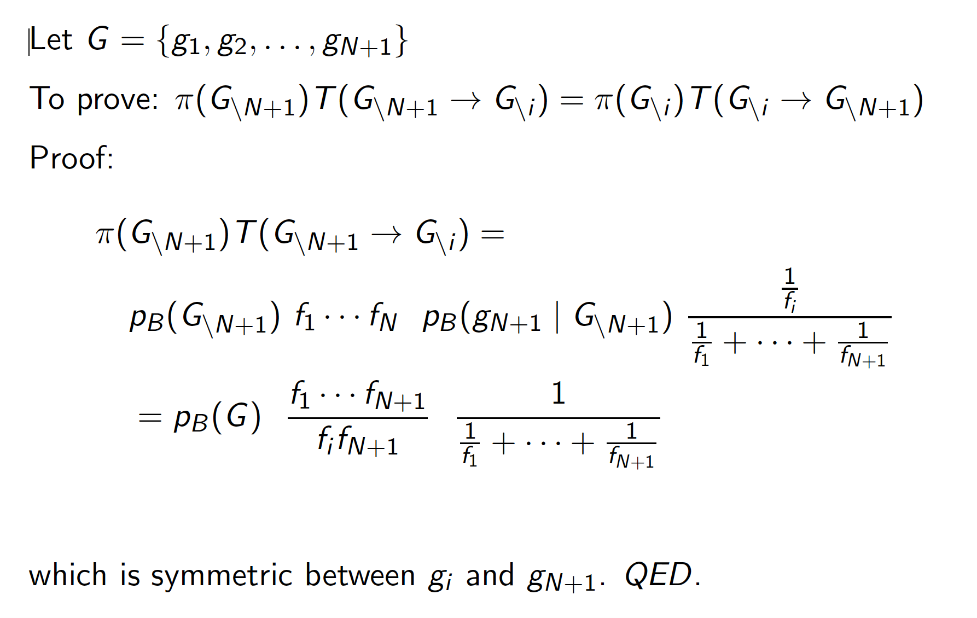
Proof of detailed balance of EBT:

Slide 30
Genetic algorithm with population size 1
Breed two new genomes,
discard existing genome
Select between two new genomes. Bad algorithm!
EBT with population size 1
Sample one new genome,
keep existing genome
Metropolis-Hastings (original version)

Slide 31
Evolution of evolvability: a static hierarchical Bayesian view
Populations with migration from the same gene pool must be similar, and
Population 1
Fitness 1
. . .
. . .
Gene pool
Population N
Fitness N
Hyper-prior
Latent variables
Likelihood models
migration

Slide 32
Conclusions and Further Questions
A suggestive difference between the asexual and sexual genetic algorithms is that recombination gives orders of magnitude more ‘adaptive channel capacity’.
A small demonstration that ‘adaptive channel capacity’ can be accessed with suitable decoder.
Exchangeable Breeding with Tournaments (EBT) is an alternative formulation of GAs, that satisfies detailed balance.
The mechanisms of non-parametric Bayesian MCMC using priors based on Dirichlet distributions can be plausibly interpreted as ‘genetic algorithms’.
Links GAs and MCMC, and enables integrated probability models of evolution and individual learning.
. . .

Slide 33
Learning, intelligence, agency…
For all except a very few highly sophisticated animals,
learning and cognitive development consist of unpacking genetic information into behaviour,
using as little experience as possible.
With the MCMC approach, we can put evolutionary and individual learning into one probability model.

Slide 34
Evolutionary roles of ‘entry-level’ learning
Situation-adaptive
Organisms born into different environments, and must learn from environment to succeed
Learning decodes a compact description of behaviour, e.g. as a reward system.
Decompression
Error-correction
Learning resolves inconsistencies in genetic specification of behaviour, enabling genetic encoding of behaviour of greater complexity
Decompression and error correction valuable even if all organisms in same environment

