Slide 1

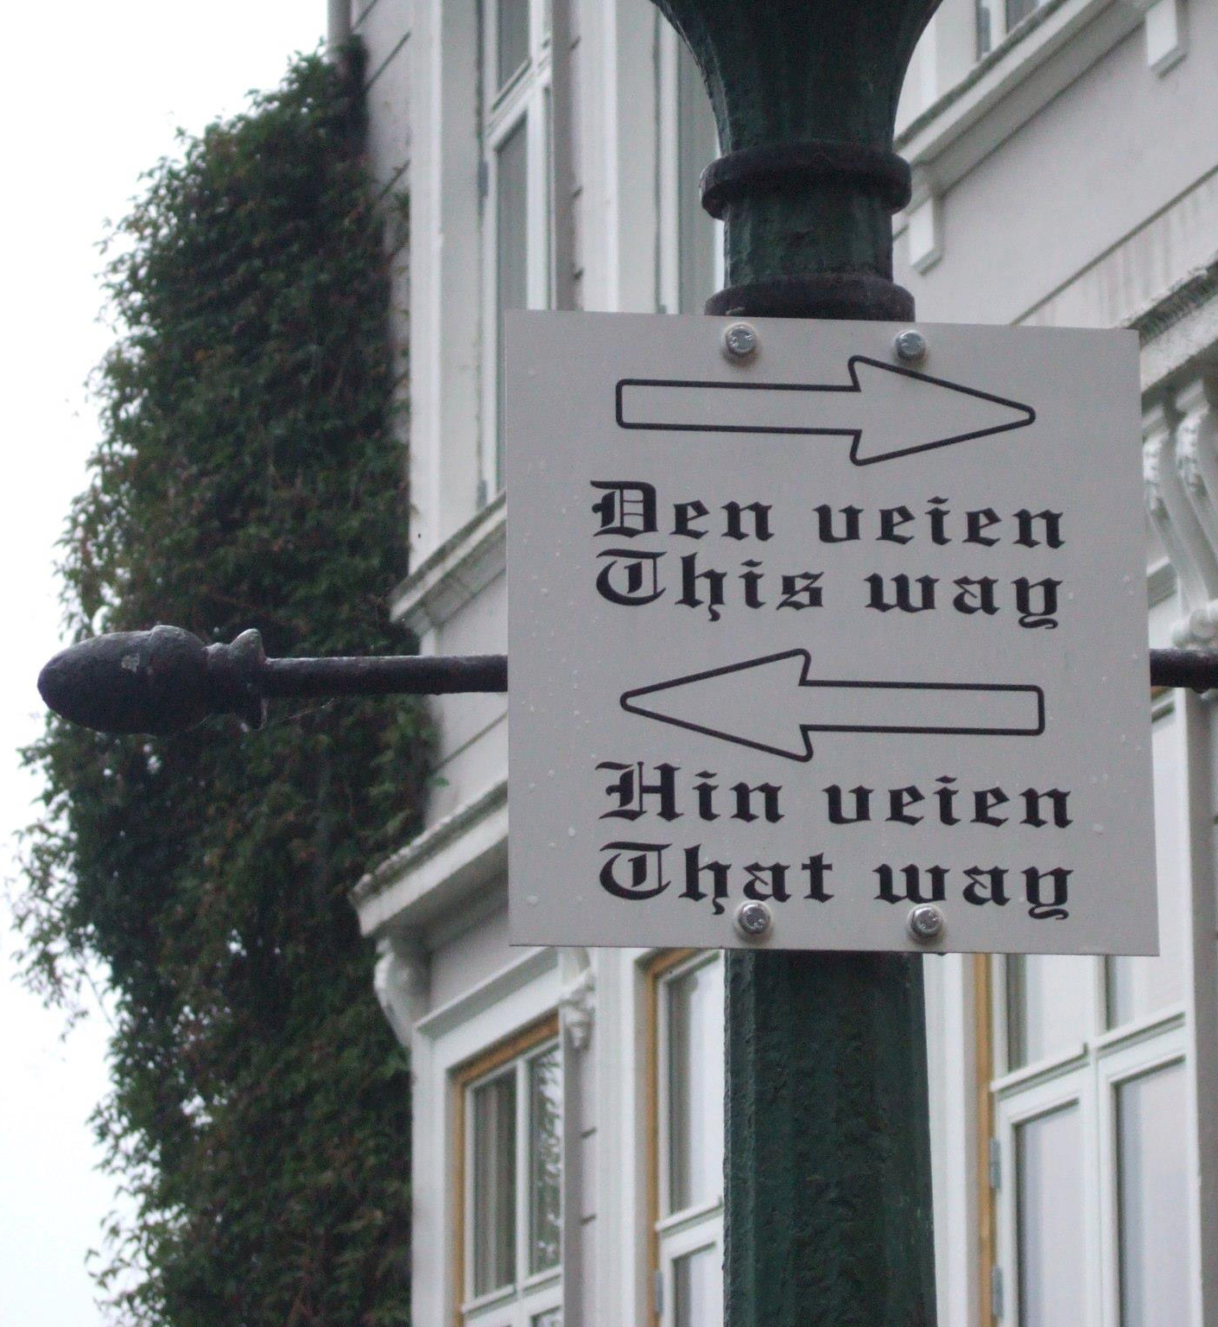


Toward a formal model of free will
Ian Durham

Slide 2
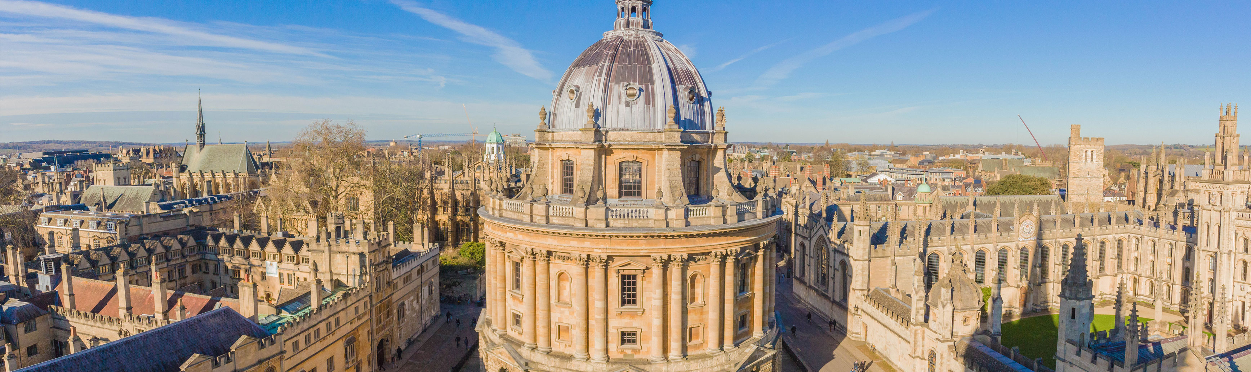
Models of Consciousness
September 9-12, 2019, Oxford University
Speakers include: Roger Penrose, Adrian Kent, Stuart Hameroff, Peter Grindrod, Yakov Kremnitzer, Jonathan Mason, Mauro D’Ariano, William Marshall, Chetan Prakash, Ian Durham, Johannes Kleiner
http://www.models-of-consciousness.org

Slide 3
Simplified free will flow chart
Super-determinism?
Free will: yes or no?
Yes
Probably no.
No
”An action’s being non-determined is not sufficient for it to be free–it might just be a random act.”
–Robert Nozick
Quantum turtles?
Yes*
No
Probably yes.
FQXi, July 20-25, 2019

Slide 4
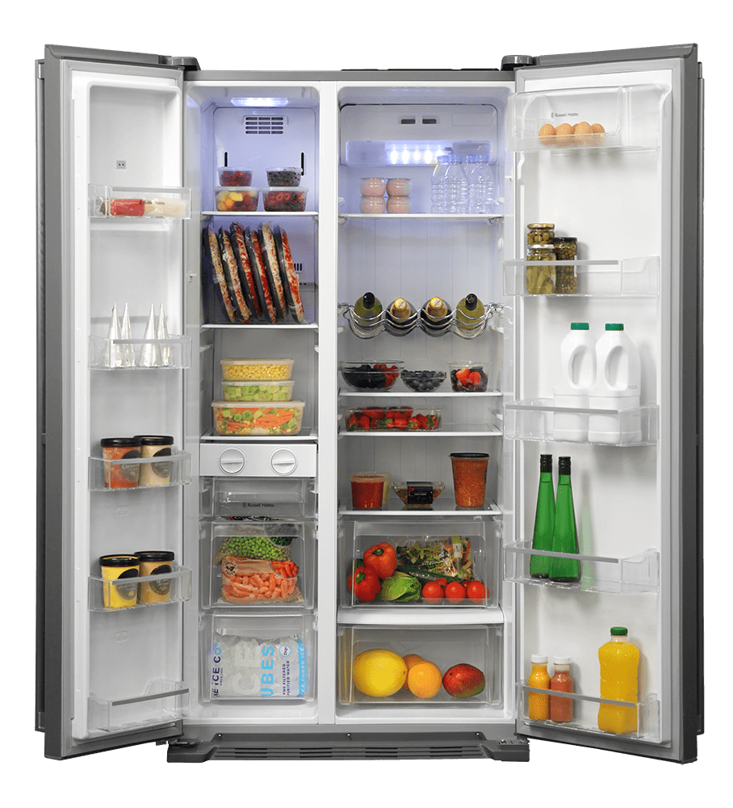
The essence of free will
Carrots?
Peppers?
FQXi, July 20-25, 2019

Slide 5
A continuum of processes
Deterministic process: A (fully) deterministic process is one for which there is only one possible outcome.
Random process: A (fully) random process is one for which there is more than one possible outcome and all possible outcomes are equally probable.
FQXi, July 20-25, 2019

Slide 6
The essence of free will
Free will is based on an agent’s ability to make certain choices freely.
A choice can only be said to be free if the agent can make some judgment about all possible choices in order to weigh them against one another, i.e. they must mean something to us. Otherwise the choice is random (and thus meaningless).
The agent must have a high degree of confidence that the choice will be realized.
An agent for whom a certain percentage of choices is deemed to be free, is said to have free will.
FQXi, July 20-25, 2019

Slide 7
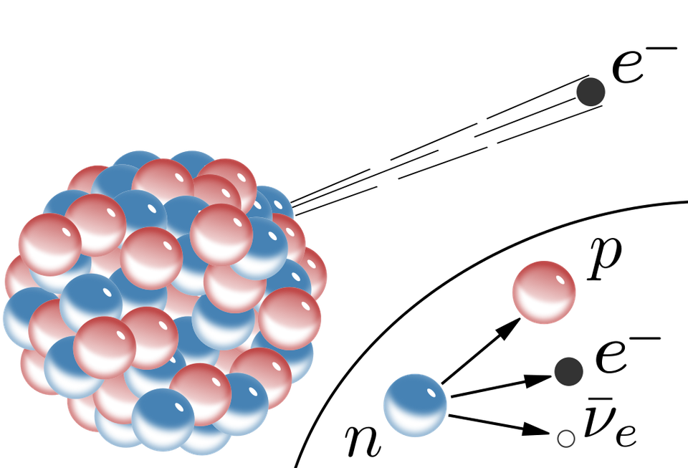
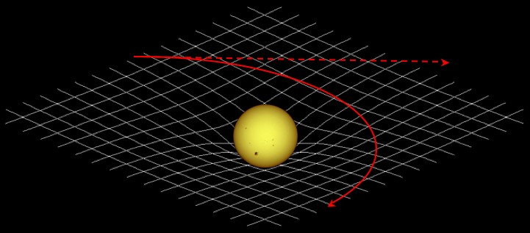
Reality: a continuum of models
Random
Deterministic
FQXi, July 20-25, 2019

Slide 8
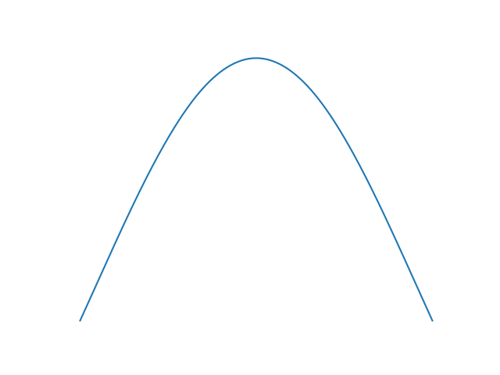
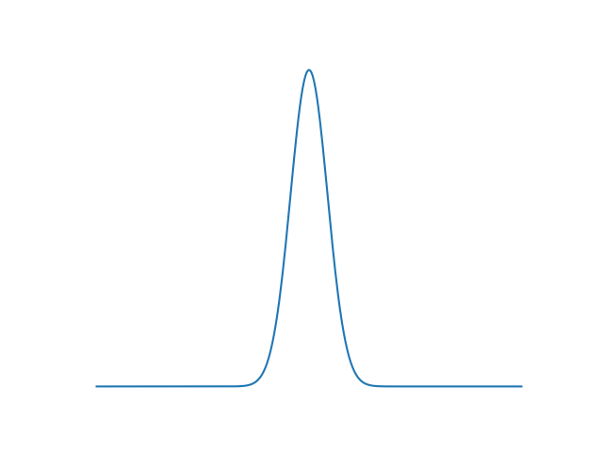
Determinism from randomness
Interacting systems of random processes can converge to deterministic macrostates if the multiplicity is sufficiently high.
FQXi, July 20-25, 2019

Slide 9
Building a model: assumptions
The most fundamental systems are irreducible to other systems, i.e. they contain no interactions and cannot be partitioned.
The microstates (possible configurations) of a fundamental system are all equally likely in the long run.
A (possible) choice is a (macro) process that takes a system from one macrostate to another; different choices represent different processes.
A system’s macrostates are formed from interacting microprocesses.
FQXi, July 20-25, 2019

Slide 10
Building a model: assumptions
The probability that a choice will lead to its macrostate is arbitrarily high if the choice is free, i.e. a free choice is nearly deterministic.
The number n of possible choices that a system has must be small enough to be read into the system’s memory in a finite time.
The choices available to a system are determined by a combination of environmental forcing and internal dynamics.
The choices do not change prior to the decision by the agent.
FQXi, July 20-25, 2019

Slide 11
Building a model: formalism
Consider a set of choices with distribution functions
where
is the mean and
is the variance.
The choices can be represented as a mixed distribution
convex
with weights
FQXi, July 20-25, 2019

Slide 12
Building a model: analysis
The distance between any two choices in the distribution is given by the Mahalanobis distance
where
is the covariance matrix.
Assumption: the larger this value, the more distinct the choices
FQXi, July 20-25, 2019

Slide 13
A measure of free choice
Given a finite number of possible choices n, the ‘freedom’ of choice i is given by the function
where
is the time it takes to read all n choices
into the system’s memory and
is the minimum distance
to another choice among all such choices in the ensemble.
FQXi, July 20-25, 2019

Slide 14
A measure of free will
Given some number of processes that result in choices, a system’s free will is given by a partition function
i.e. the level of free will depends in some way on the freedom of the choices under consideration.
FQXi, July 20-25, 2019

Slide 15
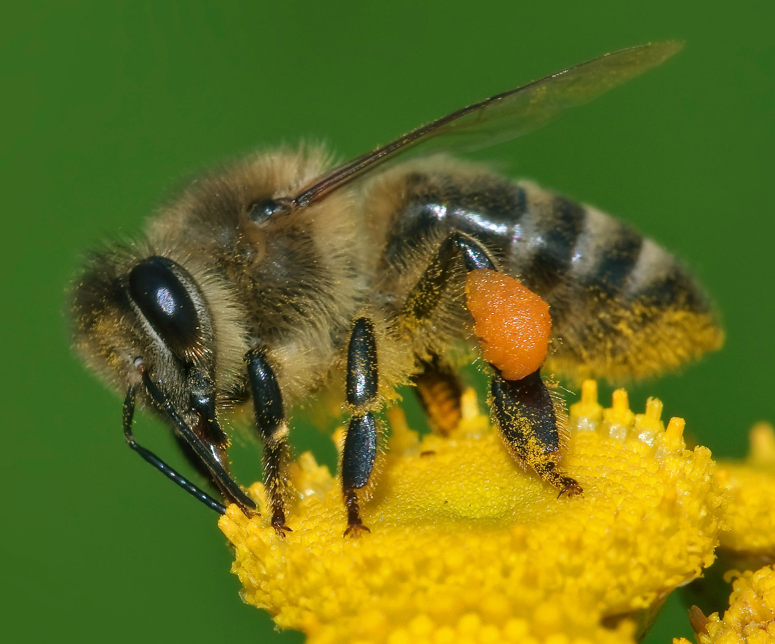
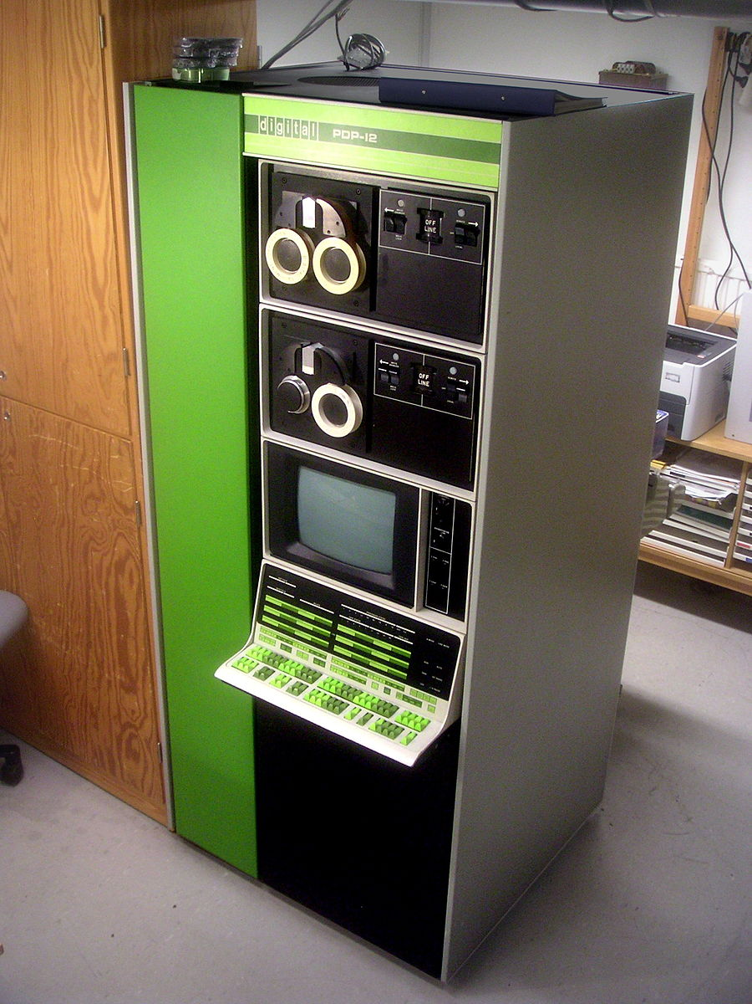

Expectations
We expect that the level of free will and thus the value of Z will increase with increasing system complexity.
FQXi, July 20-25, 2019

Slide 16
Questions
Can this model produce real, measurable results?
Does this model necessarily presuppose a dualist view of consciousness?
Is this model compatible with existing formal models of consciousness?
Does this model make predictions that are consistent with the results of Bell inequality tests?
FQXi, July 20-25, 2019

Slide 17
Acknowledgements and links
Thanks to Robert Prentner for encouraging this project.
Thanks to participants of the Modelling Consciousness Workshop (Dorfgastein, 2019) for helpful discussion.
Thanks to Nate Durham for adding a key point on meaning.
Early ideas:
“God’s Dice and Einstein’s Solids,” in A. Aguirre, B. Foster, and Z. Merali (eds.), Wandering Towards a Goal, Springer, 2018.
“Boundaries of Scientific Thought,” in I. Durham and D. Rickles (eds.), Information and Interaction, Springer, 2017.
FQXi, July 20-25, 2019

Slide 18


Grazie!

