Slide 1
Climate change is real
And you and I can help stop it before it is too late.

Slide 2
Climate change leads to the destruction of habitats

Slide 3
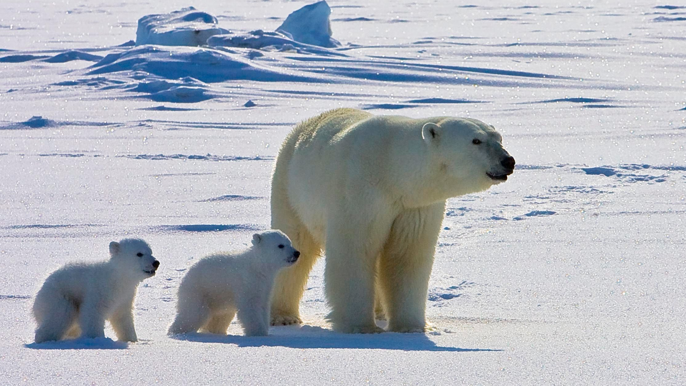
This is a polar bear with it’s cubs at the ice glaciers.
This was Way before the excessive use of carbon.

Slide 4
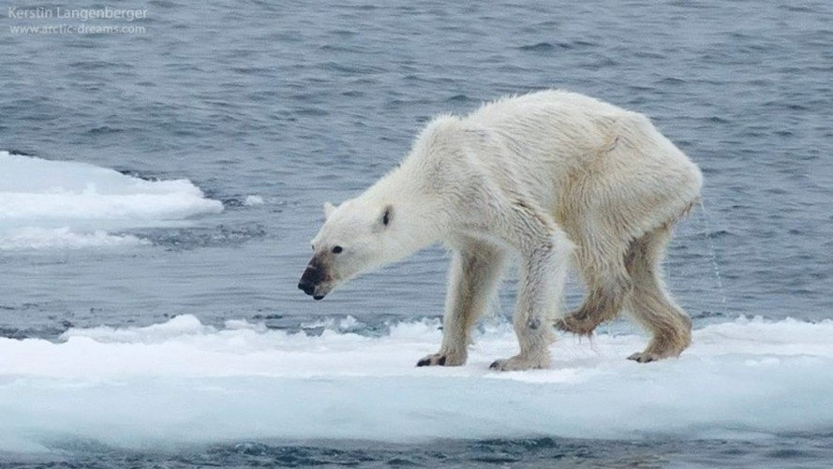
This is a polar bear on pack ice
The pack ice is melting due to global climate change causing the polar bear to be stranded on an ice floe. .

Slide 5
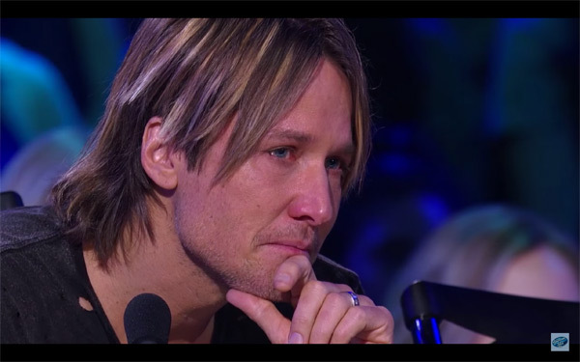
What will happen to it? Where will it go and how will it survive?

Slide 6
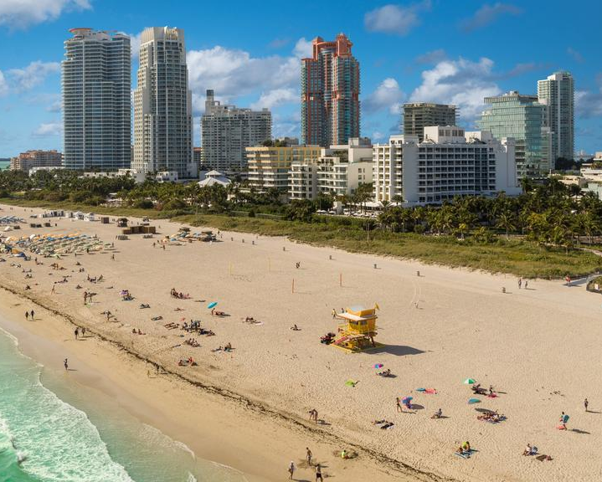
This was a beach in Miami before hurricane irma.
Studies have shown that excessive carbon use can lead to increased occurance of natural disasters like flooding, hurricane and wildfires.

Slide 7
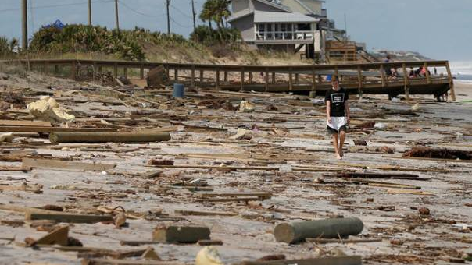
Another beach in Miami.
The picture shows a boy walking on a beach after hurricane irma in Miami with debris seen everywhere.

Slide 8
How can our future generation play and swim in these contaminated beaches?

Slide 9
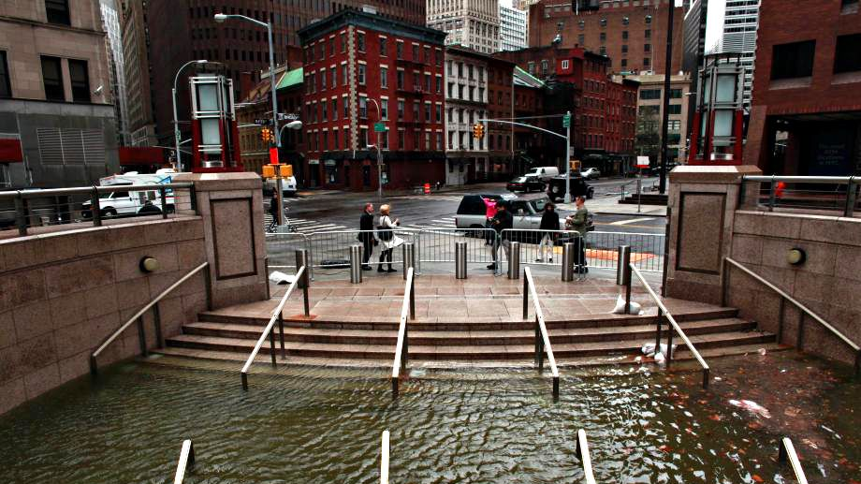
A flooded underground shopping mall in new York city.

Slide 10
Can you imagine the amount of goods that were destroyed?

Slide 11

We can put a stop to all these by doing the following.

Slide 12
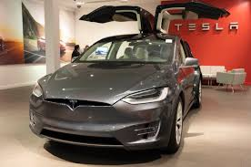
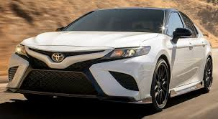
Stop using carbon emission vehicles and switch to electrical vehicles.
Carbon emission vehicles account for the highest amount of carbon percentage in the atmosphere. Meet your car dealers to switch to electric or hybrid cars. This would help lower the percentage of carbon in the atmosphere. By limiting the amount of carbon emission vehicles on the road that emit carbondioxide.

Slide 13

Recycle all plastic products.
By recycling and reusing products this would limit climate change by reducing the amount of Greenhouses Gases emitted during the production of these products.

Slide 14
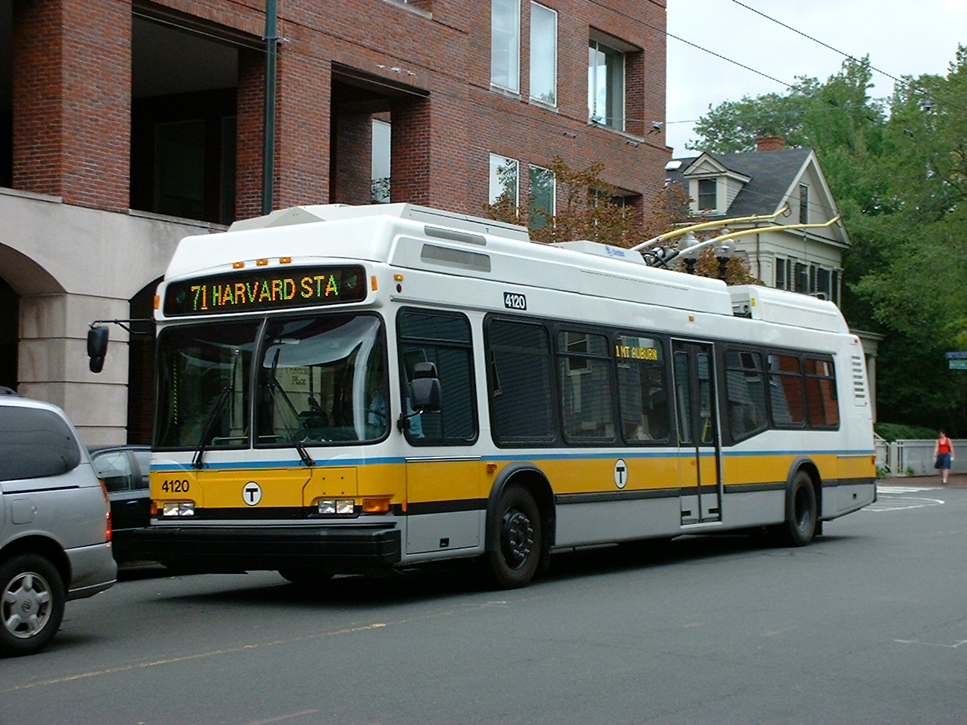
Using public transportations.
This would help reduce the amount of carbon in the atmosphere and would also keep fewer carbon vehicles on the road.

Slide 15
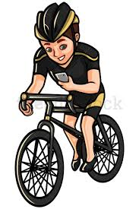
Use other forms of exercise like walking, cycling, skating e.t.c
These are carbon free means of transportation that would help limit climate change. The use of bicycles and scooter is carbon free therefore doesn’t emit carbon into the atmosphere.

Slide 16

Get politically active and vote
This is an important step in containing climate change. This can be archieved by voting leaders that take climate change seriously and have plans to contain climate change. These plans include passing laws against carbon emission companies, putting higher taxes on carbon cars e.t.c

Slide 17

Invest in renewable energy
This is another way to contain climate change because the investing in renewable energy will make people divert from the use of fossil fuels. And it will also provide business opportunities for profits.

Slide 18
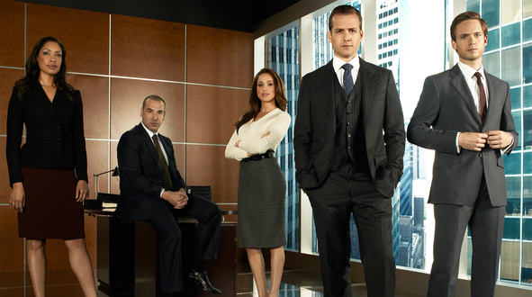
Be an advocate for climate change.

