Slide 1

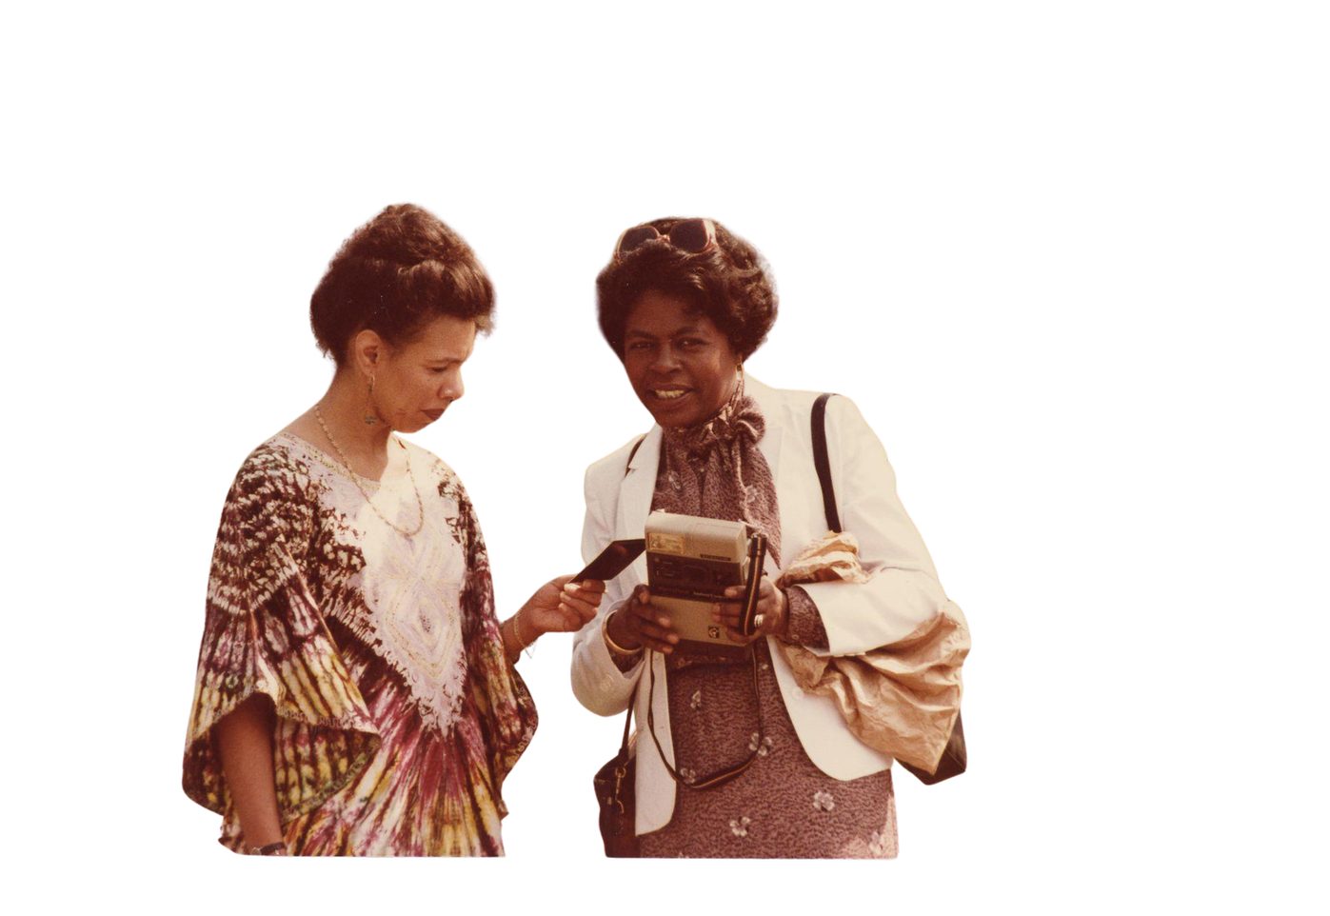
2026
INFO 7401:
Archival Appraisal, Arrangement, and Access
MTW, 6:30-8:35 PM
VIRTUAL AND IN-PERSON, RO-300I, BENJAMIN ROSENTHAL LIBRARY
INSTRUCTOR: DANI NICOLA STOMPOR (THEY/THEM)

Slide 2



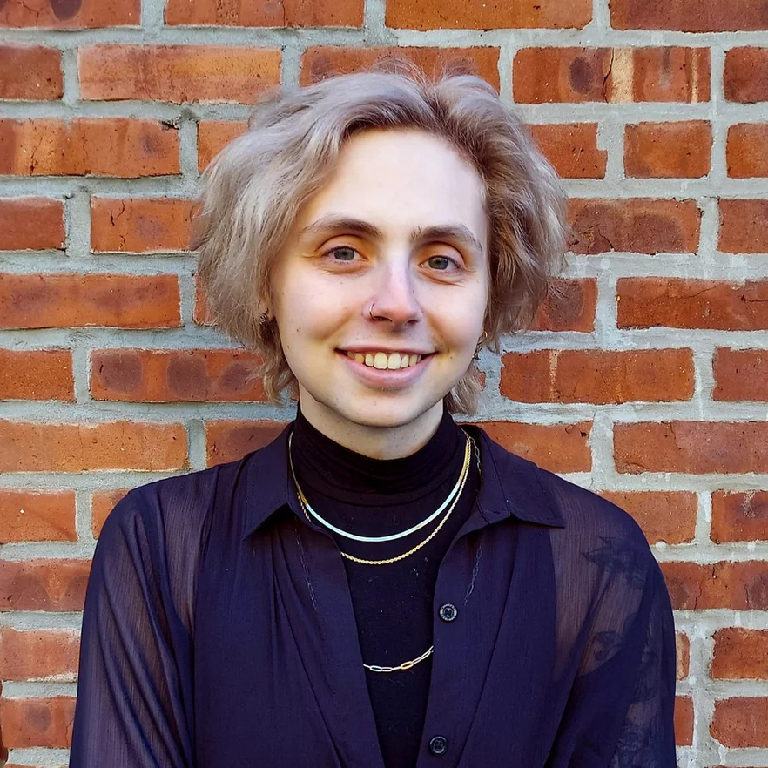
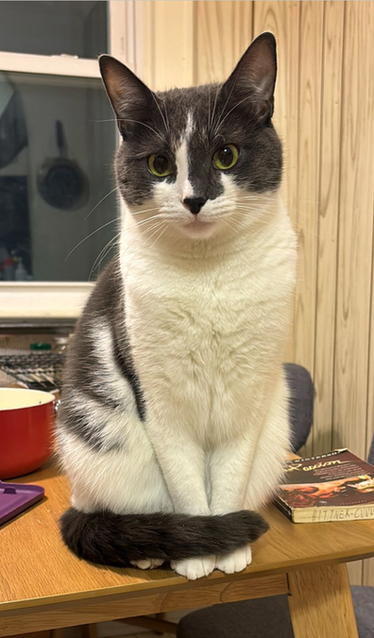

Welcome!
WHO AM I?
WHO ARE YOU?
WHY ARE YOU HERE?
WHAT WOULD YOU LIKE US TO KNOW ABOUT YOU?
THIS IS ME: DANICA STOMPOR
Notes:
1.7.2013
REMEMBER: this course will be taught from a very specific vantage point: institutional, academic, etc etc etc. this course is intended as an introduction, as foundational–i want you all to be able to recognize the words archivists use and how these workplaces function. There are many, many different kinds of archives and archivists, and the work will vary in any other context.
Use this as the base, and travel as far as you like from here–but remember the fundamentals. You don’t even have to follow the fundamentals in your own practice! There is no license that will be revoked if you don’t have a perfect finding aid for someone’s personal papers or decide against using Dublin Core for digitized collections. But you do need to know what they are. Remember that i welcome your own experience and insight, whether you come from community archives, art archives, museums, libraries, local history archives, corporate archives, anywhere–this course is the jumping off point
‹#›

Slide 3

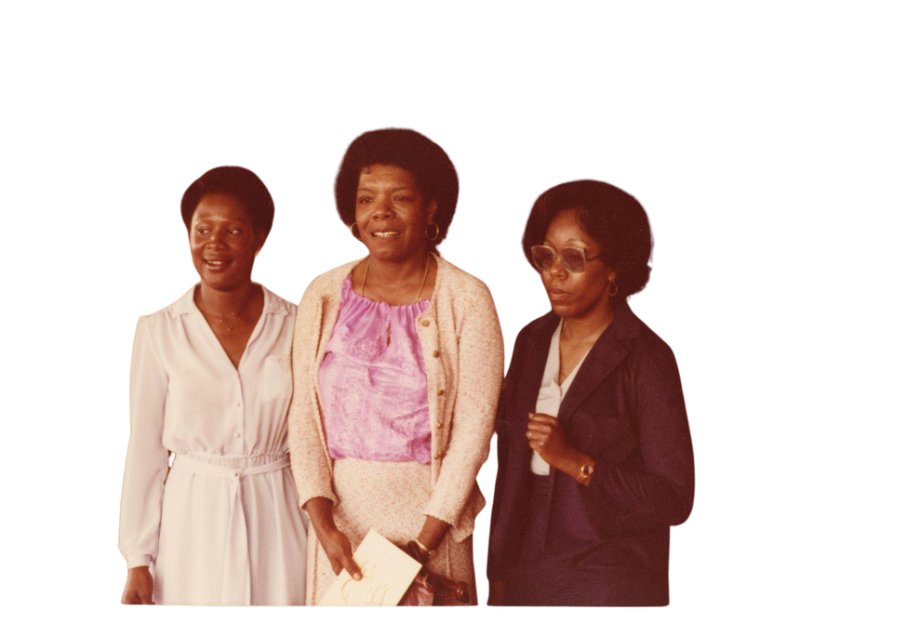
About the Course
INFO 7401 is the introduction to archival practice.
We will cover WHAT archives are, WHAT archiving is, and HOW we do the job of archiving in practice
Notes:
1.7.2013
732 considers questions like:
How do we know what we know? Who/what groups of people are included or excluded by this work and the systems we create and work within? How do power and privilege play a role in these systems? What’s kept? Who keeps it? Who has access? Why or why not?
If you’ve taken 732 or are taking it now, let those questions inform how you respond to the concepts we go over in this class, and vice versa
‹#›

Slide 4
On Notetaking
I highly encourage using a physical notebook for this class. You may use a laptop for notetaking, but please avoid getting distracted during class as it will impact your class participation grade if I see you not engaging in the group discussion or lecture.
Cell phone use during class is not permitted.
Notes:
1.7.2013
If you need to send a message or take a call, please step outside.
‹#›

Slide 5
Learning objectives:
or, what are we trying to do here?

Slide 6
Objective #1:
Understand the basics of archival practice.

Slide 7
Objective #2:
Implement foundational knowledge towards practical archival appraisal, processing, and access work.

Slide 8
Objective #3:
Discuss and critically engage in current issues related to archival practice.

Slide 9
Objective #4:
Communicate the importance of archives in professional and external contexts.
Notes:
1.7.2013
THIS IS THE MOST IMPORTANT ONE
‹#›

Slide 10
Course website
7401summer26.commons.gc.cuny.edu/
This is a Zero-Cost Textbook class. ALL readings will be accessible through the website.

Slide 11
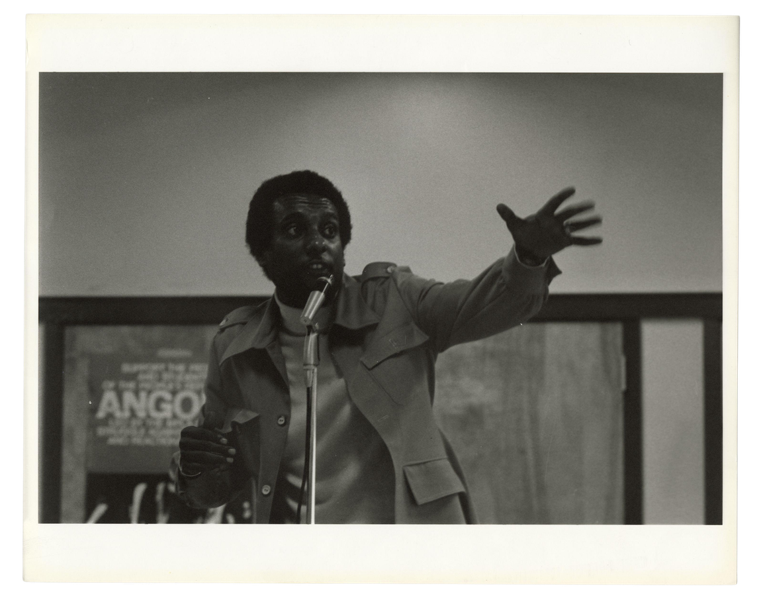
Course Overview
12 class meetings, each class session covers a different topic
    Unit one: foundations
    Unit two: appraisal and users
    Unit three: arrangement and access
Notes:
1.7.2013
EACH TOPIC CAN BE ITS OWN SEMESTER-LONG COURSE
‹#›

Slide 12
Discussion Leadership
Each student will be responsible for leading one class discussion (due to class size, two students may be discussion leads at one time).
I will post the discussion lead schedule on the assignment page, and will not be reminding you before your selected time slot. Please be prepared!
Sign up by next class, 7/7: tinyurl.com/7401sum26

Slide 13
My promise for grading:
I will strive for efficiency, and priorioritize quality of feedback.
My ask for classwork:
You prioritize quality of work, and strive to raise issues to me as early as possible.

Slide 14
AI POLICY
Don’t do it! Please!
The penalty for using AI in any of my assignments is failing the course. Not the individual assignment but the entire course.
I will not use AI checkers in return.

Slide 15


Extension Policy
Late Policy
Must be received at least 24 hours in advance of due date!
    24 hour grace period for late assignments
    2-6 days late: 5% grade reduction
    7-13 days late: additional half grade letter reduction (B+ to B, C to C-)
    Each week an assignment is late: another half grade letter reduction
    All work must be submitted by 7/31 at 4pm
    Appraisal report
    Finding aid analysis
    Final Access and use project
    Discussion lead
    Annotations
    Extra credit
you may ask for an extension
no extensions

Slide 16
Course/GSLIS Policies
    Accessibility and accommodations
    Attendance and late work
    Office hours
    Respect
    Recording and photography in the classroom
    Name/pronoun statement
    Safe zone/diversity/immigration resources statement
    Plagiarism, academic integrity, and AI

Slide 17


Course/GSLIS Policies
Consideration
Respect
Reciprocity
Notes:
1.7.2013
Respect: we are all adults, and i will treat you as such. I will always interface with you in good-faith. I am never trying to trick you
Consideration: things happen, and because of our baseline of respect, we will always start from a place of making it work.
Reciprocity: both of the above apply from me to you, you to your classmates, and you to me
‹#›

Slide 18
Contact me:
danistompor@gmail.com
Office hours: To book time with me, email me!
By appointment only and by phone, zoom, or in-person before class in library lobby area
We can talk: Course questions, career, GSLIS, archives in general
IF (AND ONLY IF) you cannot get into the library for class, you can text me at 630-452-4685.
Notes:
1.7.2013
Contact me–i want you to succeed. This is the best job in the world. The only way to fail this class is by not communicating with me.
‹#›

Slide 19
Hypothes.is annotations
What is it? How do I use it?
tinyurl.com/7401hypo26

Slide 20


Annotation requirement–For tomorrow
Required Reading:
Terry Cook’s “Evidence, Memory, identity, and community: four shifting archival paradigms”
Recommended Reading:
Michelle Caswell’s “‘The archive’ is not an archives’: on acknowledging the intellectual contributions of archival studies”
Elizabeth Yale’s “The History of Archives: The State of the Discipline”
Add 1 original comment to the reading, or a reply to another student. Each week you’ll contribute a total of 2 comments and 1 reply.

Slide 21
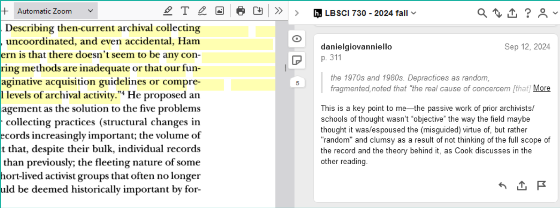
Example original annotation

Slide 22
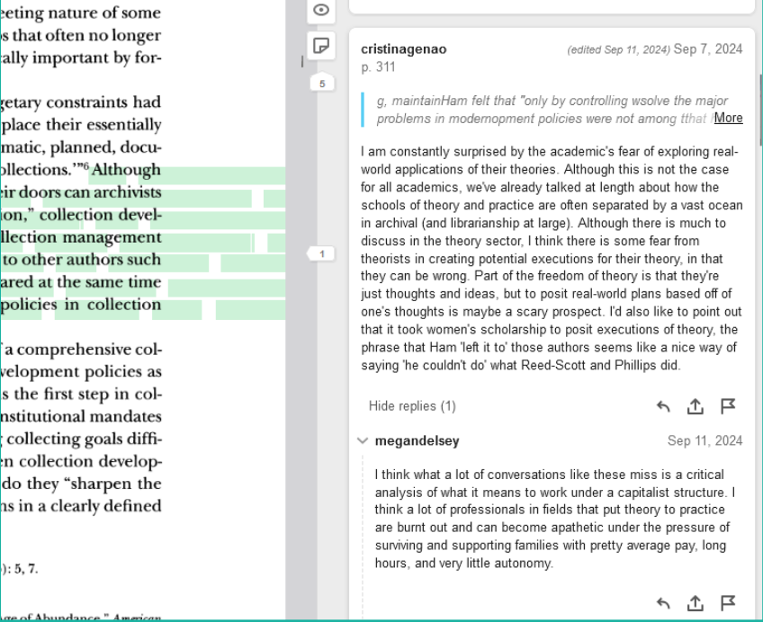
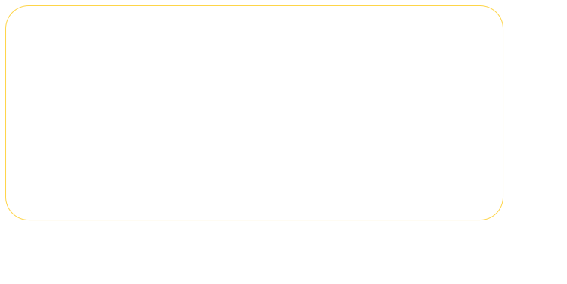
Example reply annotation

Slide 23
Leading Class Discussions
Sign up by tomorrow
tinyurl.com/7401sum26

Slide 24
Practicum 1: Barbara Rosenthal Papers
CONSIDER:
  What are you looking at? What are these items?
  Why are these items here? (in Queens, at Queens College, in the archives)
  What questions do you have when looking at these items?
  Why would these items be useful to an archives user or researcher? Are they useful?

