Slide 1

Session six:
Donors and Users
INFO 7401 Archival Appraisal, Arrangement, and Access

Slide 2
Citing Finding Aids in APA:
Author. (year.) Title of Finding Aid. Name of Repository & Division. www.url.com
if no author listed:
Name of Repository Division. (year.) Title of Finding Aid. Name of Repository. www.url.com
if finding aid has been edited:
Author. (year.) Title of Finding Aid. Name of Repository & Division. Edited by editor. www.url.com

Slide 3
Archivist, donor, and user goals are DIFFERENT
Archivists:
  Preservation
  Access
Donors:
  Legacy
  Transfer materials
  Increase prestige
Patrons, users, researcher, readers:
  Research
  Analyze
  Interpret / write
  Create / publish
Each works to inform or reform history
Notes:
History Is the Study of People and the Choices They Made
History Is a Means to Understand Today’s World
History Combines Storytelling and Analysis
History Is an Ongoing Debate

Slide 4
Who is donating to the archive? Has this changed over time? Why do they donate? What might they (expect to) receive from donating?
Who is missing / could donate in the future?
Donor behavior

Slide 5


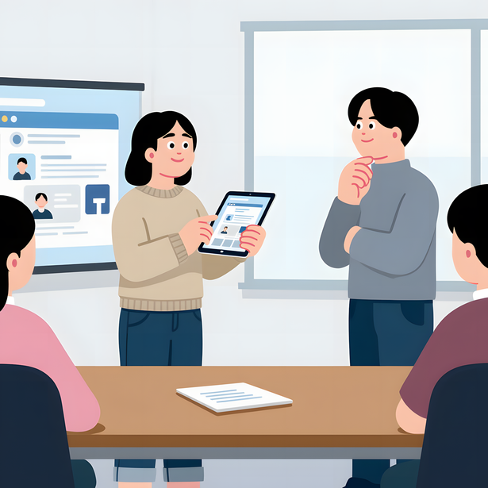

Cultivating Donors
Through existing relationships
Through programming
Through research
Through prospects

Slide 6
Managing Donors: Practicum
You work at a local museum’s archive. A previous donor of collections is interested in donating new materials that are outside of their signed deed of gift. The materials are not particularly high value, nor do they fall within the typical scope of the archive. The individual in question is a recurring financial supporter of the museum.
What questions might you ask? Under what conditions might you accept or refuse the materials?
Notes:
History Is the Study of People and the Choices They Made
History Is a Means to Understand Today’s World
History Combines Storytelling and Analysis
History Is an Ongoing Debate

Slide 7
Users are most often interacted with through reference services
A service to aid patrons in locating materials relevant to their interests; see reference interview.
In archives, like in libraries, the amount of reference work you do depends on your role/the kind of institution you serve.
Reference

Slide 8
The ability to locate relevant information through the use of catalogs, indexes, finding aids, or other tools.
Access
Accessibility
The characteristic of being easily reached or used with a minimum of barriers.
Notes:
Note that this doesnt technically say that the ability to locate relevant information BY THE PUBLIC–archivists can have that info and act as that mediator

Slide 9
In what circumstances can (or should) archivists do research (as opposed to reference) for a patron as part of regular duties?
Collection Knowledge
to understand a set of materials better
Interaction Knowledge to manage a relationship
Research Knowledge
to advance a repository’s direct goals / mission

Slide 10
Collection knowledge, or:
What do we do at the archive?

Slide 11
Collection knowledge
Archivists can provide six kinds of information to users and donors, developed during the processing of a collection:
  Information about the repository
  Information about the holdings
  Information from the holdings
  Information about record creators
  Referrals to other repositories or resources
  Information about laws and ethics regarding the use of information
Notes:
Known knowns
Known unknowns
Unknown unknowns

Slide 12
Interaction knowledge, or:
Who’s, What’s, Will I’s?

Slide 13
Who is using the archives’ materials? Why?
How are they contacting you? How are they asking the question?
Who is the asker to you?
  What is the precedent from previous requests?
  What is your range of realistic outcomes
Who is not using materials? Could they?
User behavior

Slide 14
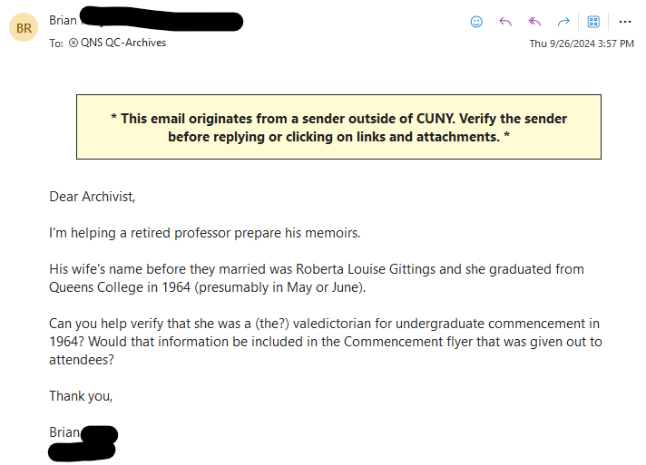

Slide 15
How do archivists know what to retrieve for a user?
What are they asking for?
What do they actually need?
Can we answer the question?
Can someone else answer the question?
How much assistance are you willing to give?
Assessment methodologies

Slide 16
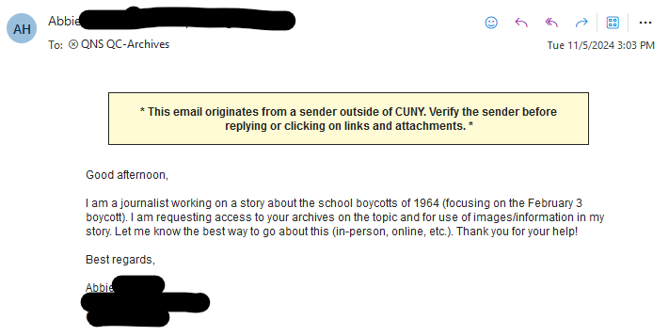

Slide 17
"Ambiguity on the part of users is frequently rooted in feelings of uncertainty or fear of seeming ignorant"
"Negotiating the question provides the opportunity for users to clearly state the research need themselves; it also discourages archivists from jumping to unwarranted conclusions."
"the first step in question negotiation is to analyze the query into component parts as "givens" (the subject) and "wanteds" (the information needed)."
Question negotiation
Assessment methodologies
Question Negotiation in the Archival Setting: The use of interpersonal communication techniques in the reference interview by Linda J. Long

Slide 18
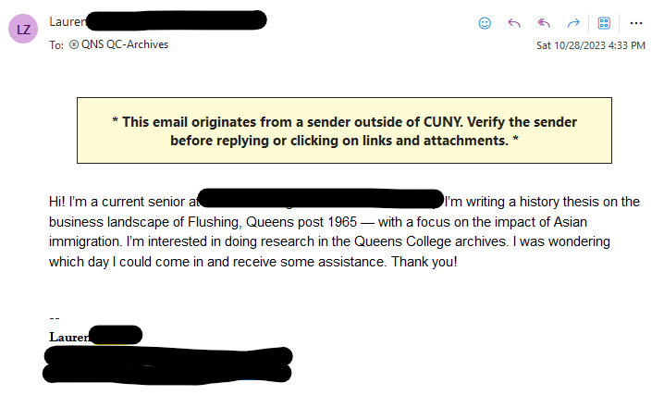

Slide 19
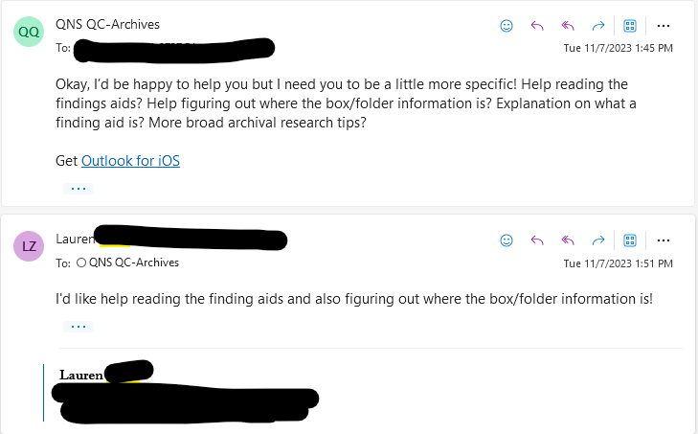

Slide 20
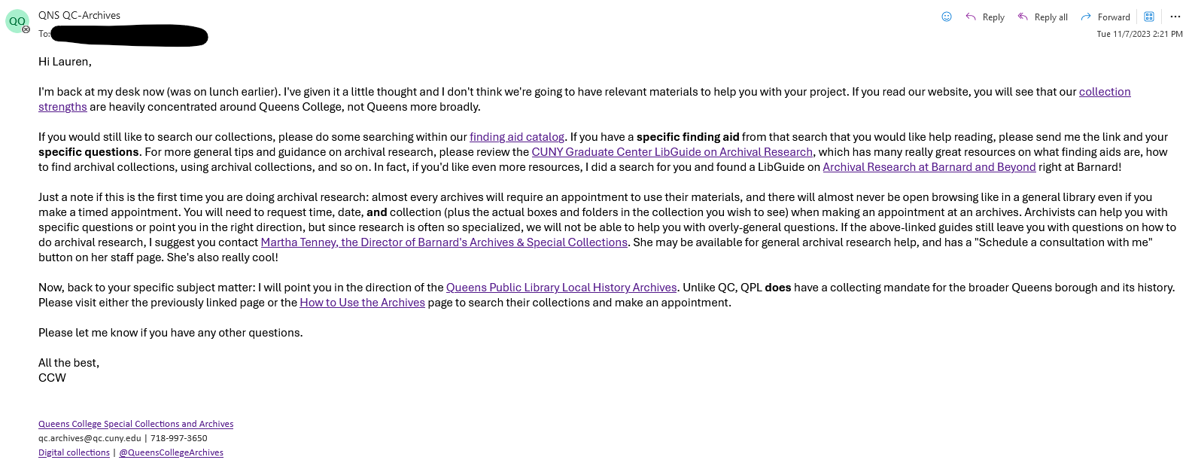

Slide 21
How do archivists efficiently retrieve material?
  What’s in your archive?
  How do you find materials?
  How do you access materials?
  How will the user access materials?
Information retrieval

Slide 22
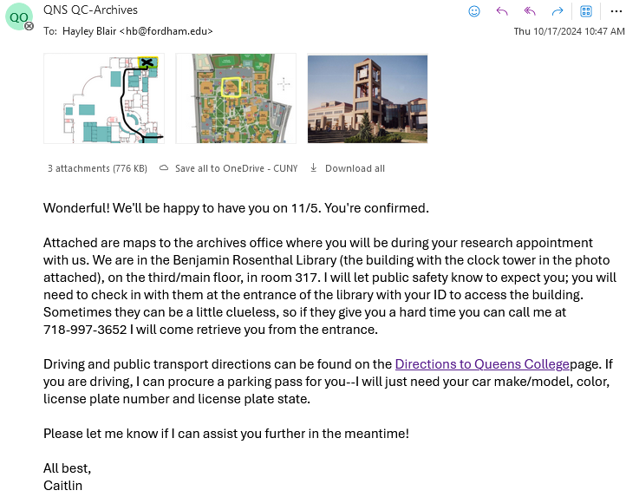

Slide 23
How does the archivist communicate to the user how to use the materials beyond the reference visit?
What are our policies?
  Digital access
  Publication
Relevant legalities

Slide 24
Research knowledge, or:
How to keep getting better at archivism

Slide 25
Subject knowledge; an understanding of the subject being researched by a user.
Domain knowledge

Slide 26
The ability to understand, contextualize, and interpret primary sources, in part by taking into consideration their physical characteristics.
Artifactual literacy

Slide 27
A person’s knowledge of archival principles, practices, and institutions, and an understanding of the relationship between primary sources and their surrogates.
Archival intelligence

Slide 28
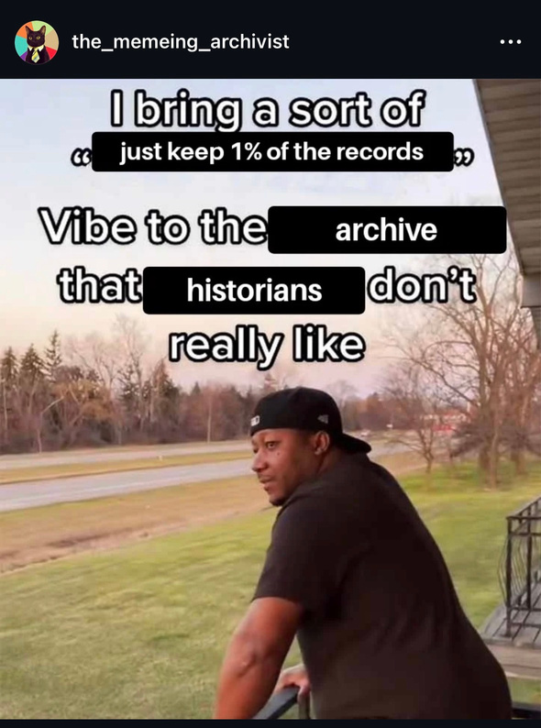
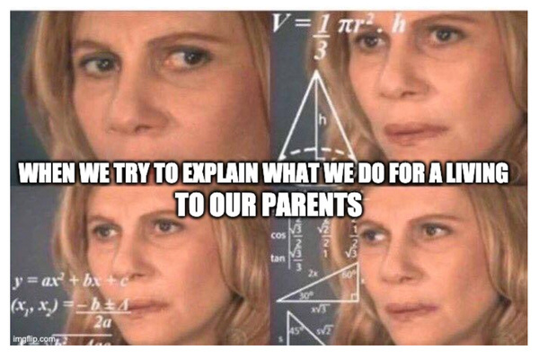
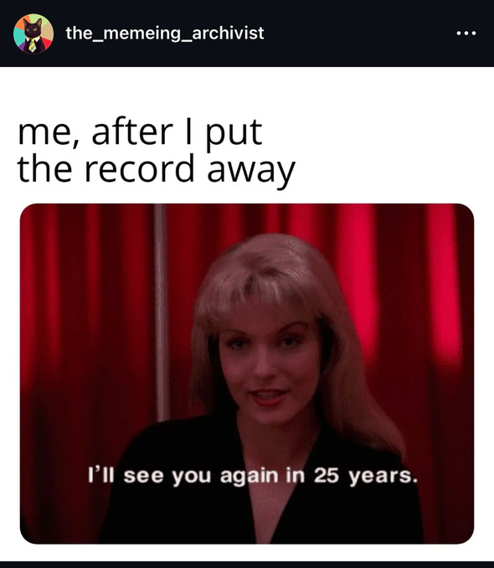
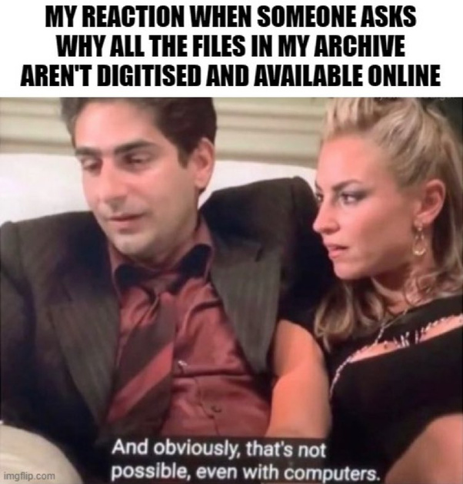
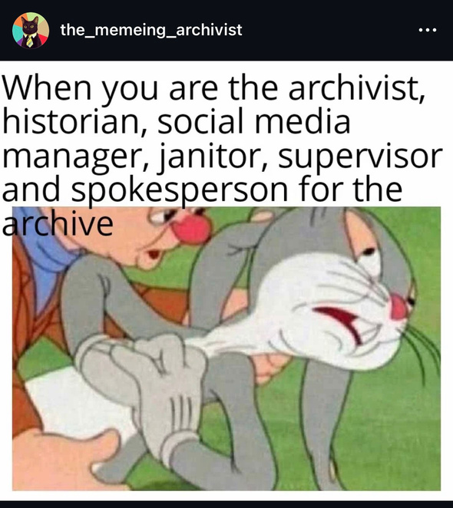
Researcher understanding of archives:
Less than you think!
PATRONS

Slide 29
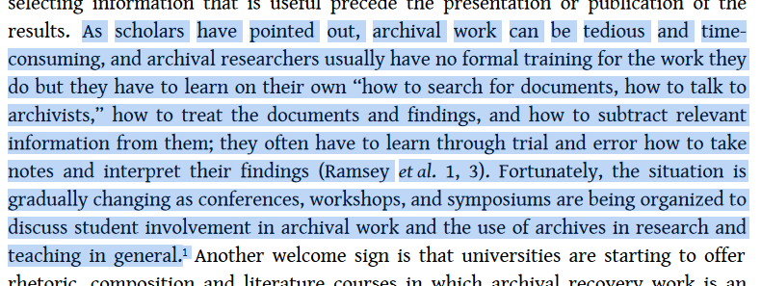
Salenius, S. (2021). On Archival Research: Recovering and Rewriting History. The Case of Sarah Parker Remond. Transatlantica, 1(1). https://doi.org/10.4000/transatlantica.16939

Slide 30
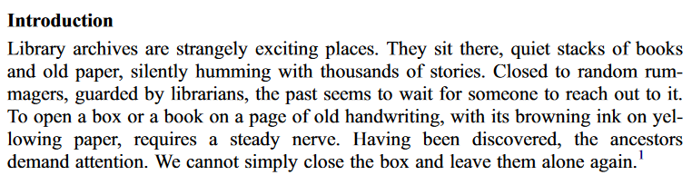
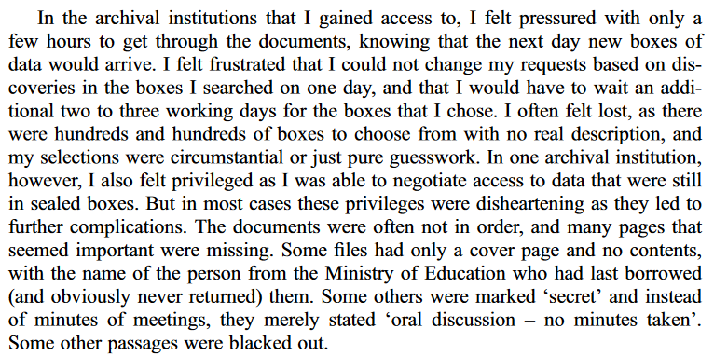
Tesar, M. (2015). Ethics and truth in archival research. History of Education (Tavistock), 44(1), 101–114. https://doi.org/10.1080/0046760X.2014.918185

Slide 31
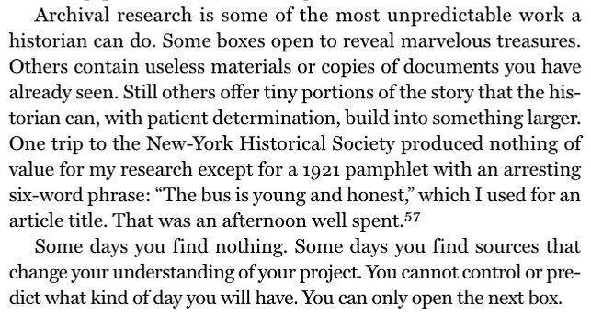
Schrag, Z. M. (2021). The Princeton guide to historical research. Princeton University Press.

Slide 32
In some ways, my research process was random, as I sifted through folders that might or might not yield information useful to my study. In other ways, this research process was ordered; I developed a list of materials to look through, adding to that list as I learned of new resources and searching through these documents sequentially, folder by folder, box by box.
The method itself was organic, shaped by the research process itself and shaped by other key theoretical and pragmatic factors that I discuss in this chapter. In developing this method, I read what I could about archival methodology, but after finding few pragmatic suggestions for conducting archival research, I ultimately found it was my entry into the archives itself that shaped my approach most significantly.
Working in the Archives : Practical Research Methods for Rhetoric and Composition, edited by Alexis E. Ramsey, et al., Southern Illinois University Press, 2009. ProQuest Ebook Central, http://ebookcentral.proquest.com/lib/qc-ebooks/detail.action?docID=1354654.

Slide 33
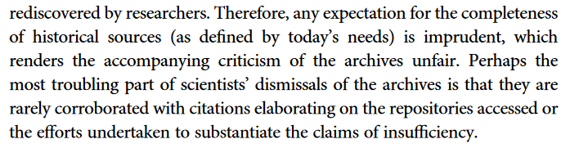
Souchen, A. (2021). Missing from the record: historians, archival research and underwater munitions. Rethinking History, 25(3), 347–371. https://doi.org/10.1080/13642529.2021.1988249

Slide 34
Locating the disconnect:
Two potential approaches

Slide 35
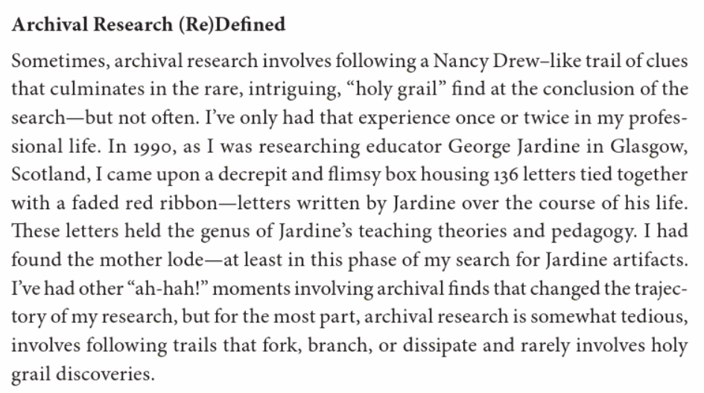
Ramsey, A. E., Sharer, W. B., L'Eplattenier, B., & Mastrangelo-, D. N. U. L. (Eds.). (2009). Working in the archives : Practical research methods for rhetoric and composition. Southern Illinois University Press.

Slide 36
  Encourage users to adjust research strategy from what is sought to what emerges

Slide 37
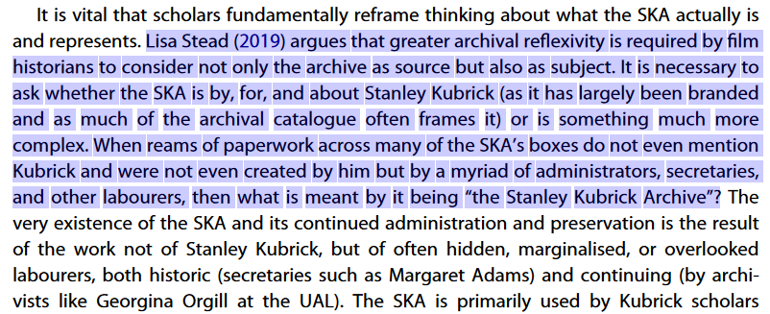
James Fenwick (2023) The exploitation of Sue Lyon: Lolita (1962), archival research, and questions for film history, Feminist Media Studies, 23:4, 1786-1801, DOI: 10.1080/14680777.2021.1996422

Slide 38
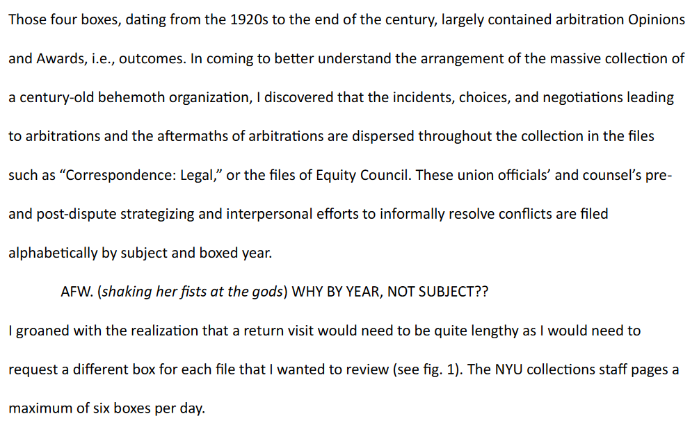

Slide 39
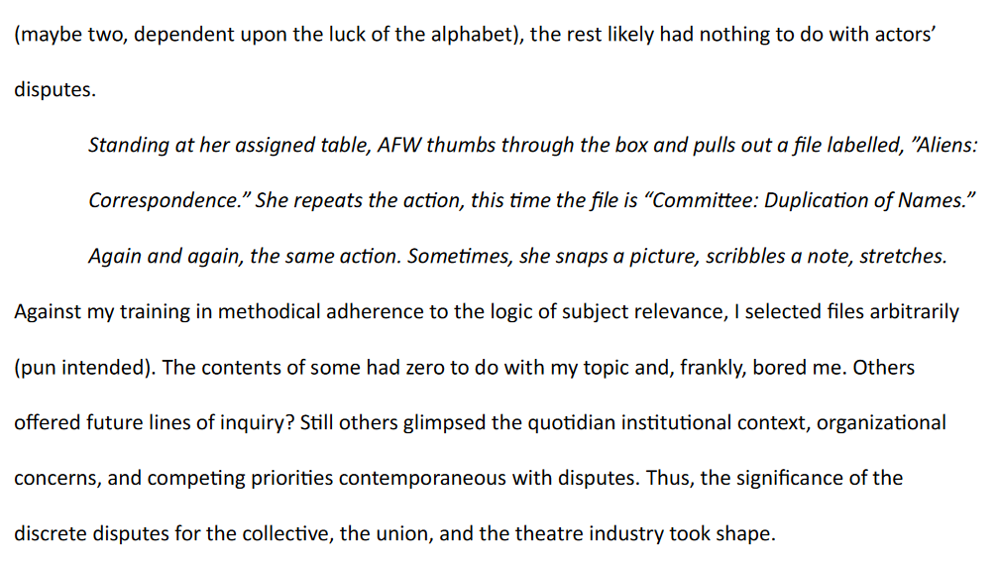
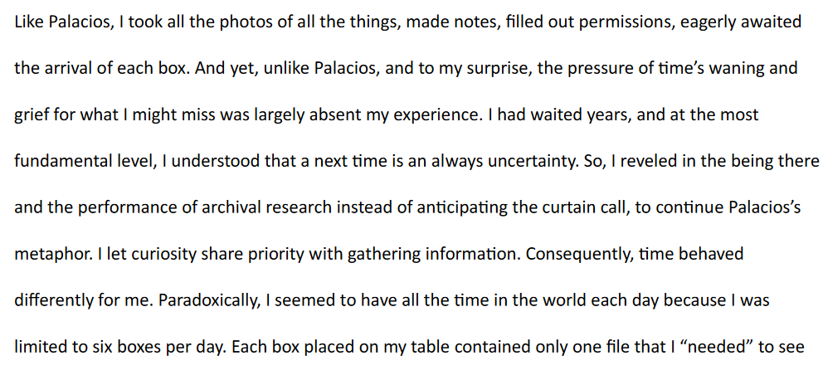

Slide 40
  Demystify archival work & encourage users to better understand what we do

Slide 41
For many researchers, however, the archivist’s processing of collections, which includes all work done by the archivist to make a collection available to researchers, remains a mystery…We believe that if archival researchers know how to recognize the outcomes of archivists’ processing and understand the principles behind processing decisions, they will have a better understanding of the archival materials they study.
Understanding archival theory and principles and knowing the best practices derived from them will help researchers anticipate potential problems and assess the potential usefulness of the archival materials they consult.
Working in the Archives : Practical Research Methods for Rhetoric and Composition, edited by Alexis E. Ramsey, et al., Southern Illinois University Press, 2009. ProQuest Ebook Central, http://ebookcentral.proquest.com/lib/qc-ebooks/detail.action?docID=1354654.
Notes:
How can a researcher approach archival sources that are composed or organized in a way that obscures the issues of most interest to scholars in rhetoric and composition?
What research methods can be used outside of the archive—observations and interviews, for example—to complement and extend research conducted within archival spaces?
What external research should be done in order to understand, as fully as possible, the historical and cultural contexts of archival materials?

Slide 42
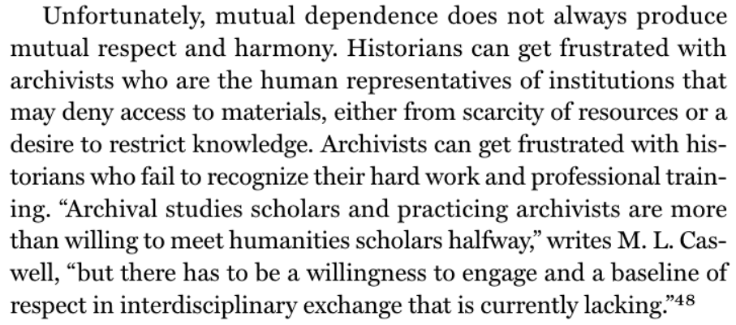
Schrag, Z. M. (2021). The Princeton guide to historical research. Princeton University Press.

Slide 43
How do archivists bridge gaps in archival intelligence to the benefit of all users?
How do we convince users that archival intelligence is important?
How do we get users and researchers to see us and use us as archivists and not just as box jockeys or “handmaidens of history?”

