Slide 1

Session five:
Archives and the law: copyright, licensing, and intellectual property
INFO 7401 Archival Appraisal, Arrangement, and Access

Slide 2
Possession, care, and control, especially for security and preservation.
Often paired with legal custody, where intellectual property rights are decided in addition to physical custody rights.
Physical custody

Slide 3
A type of property representing works of the mind governed by copyright, patent, and trademark law.
Intellectual property

Slide 4
The exclusive right to make, use, or sell an invention that is novel, useful, and not obvious.
The Constitution grants the United States Congress the authority to issues patents. Patents are codified in 35 USC 101-103.
Patent
(new inventions, processes, and compositions of matter, such as medicines)

Slide 5
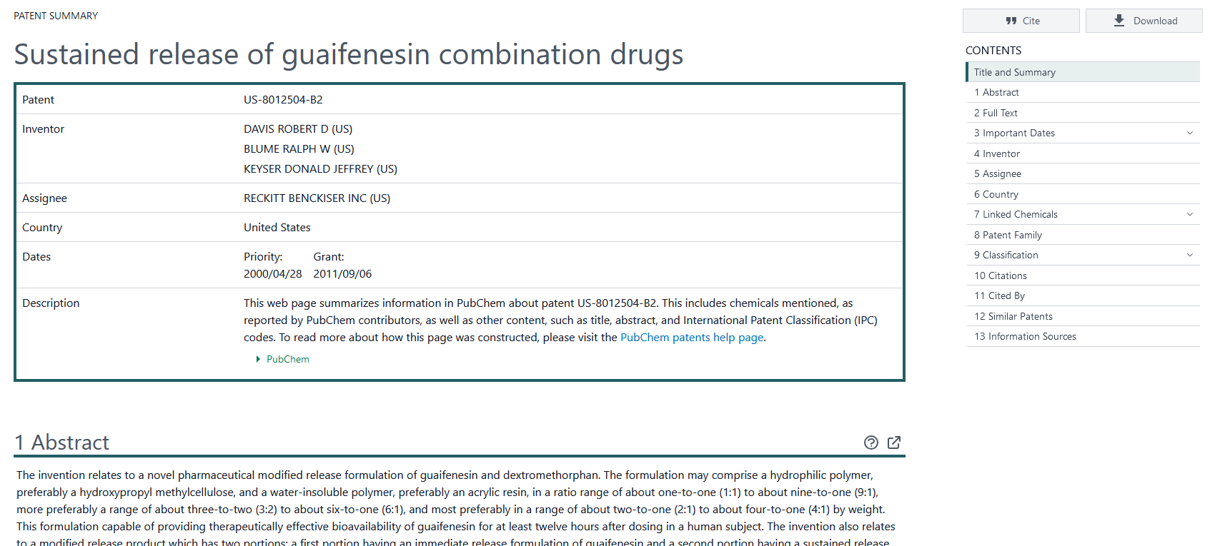
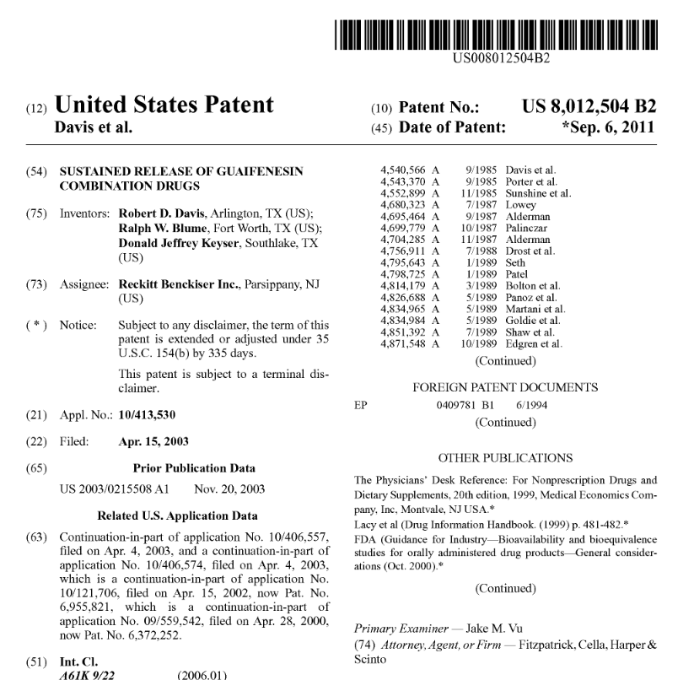
PubChem, Google Patents

Slide 6
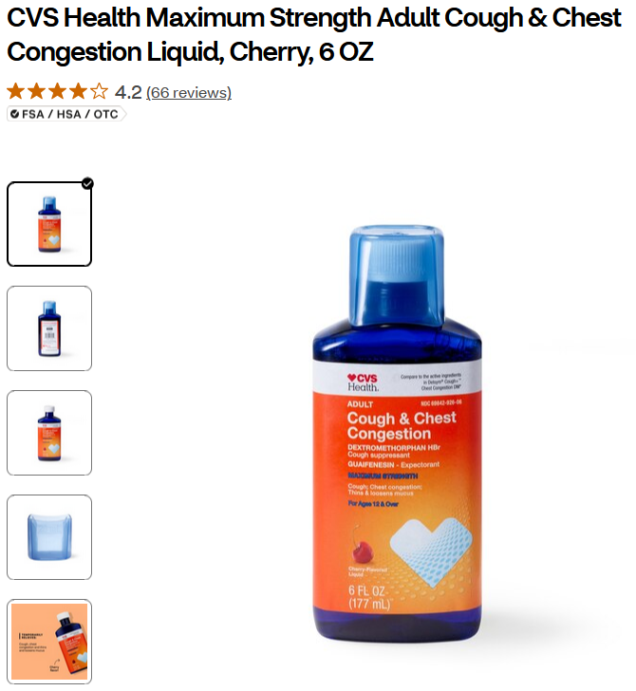
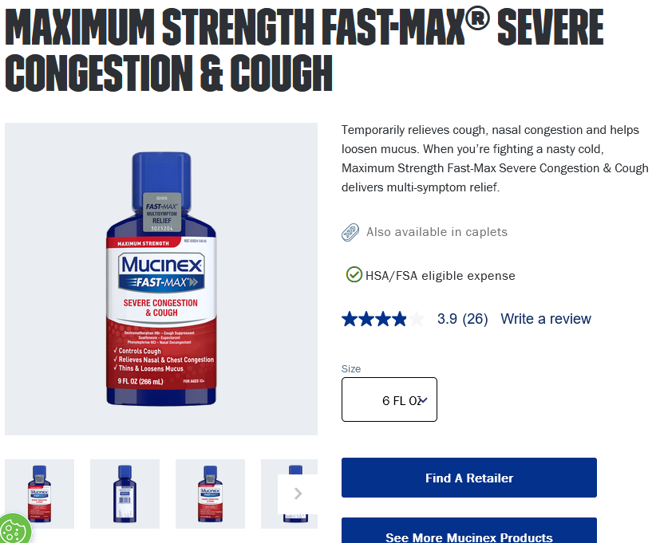
20 years

Slide 7
A word, phrase, or design used to distinguish a manufacturer's or seller's product.
Trademark
(names, short slogans, or logos)

Slide 8
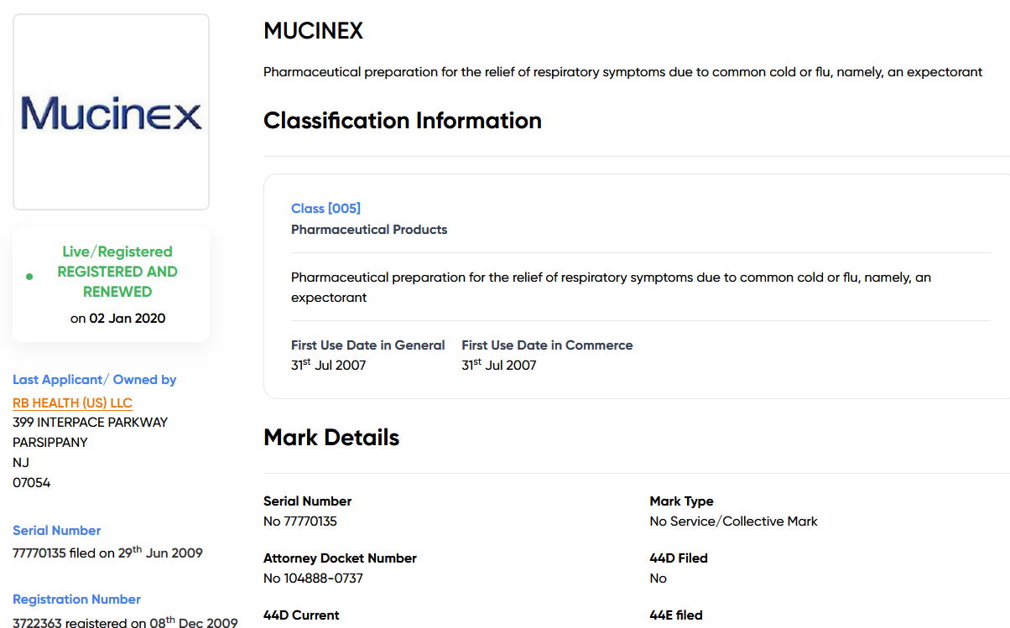
Trademarkia

Slide 9
A legal right protecting the interests of creators or their assignees by granting them control over the reproduction, publication, adaptation, exhibition, or performance of their works in fixed media.
Copyright
(original works, such as art, literature, or other created work)

Slide 10
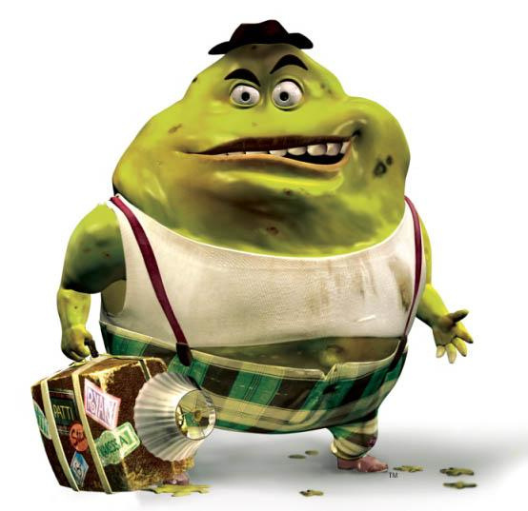
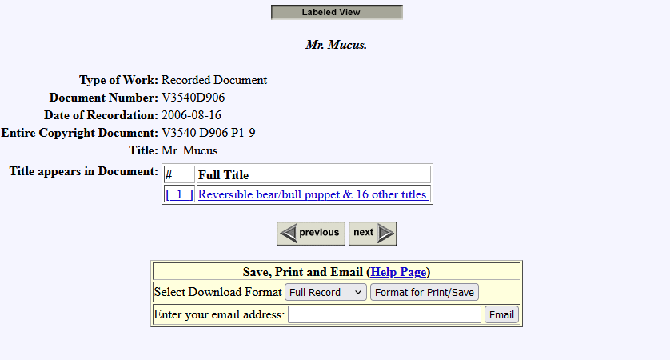
Copyright.gov Catalog

Slide 11
Foundation of copyright, trademark, and patent law in the U.S.:
“To promote the Progress of Science and useful Arts, by securing for limited Times to Authors and Inventors the exclusive Right to their respective Writings and Discoveries.”
Article I, Section 8 of the U.S. Constitution
Notes:
to the authors of the Constitution, “science” meant all learning and “useful arts” included all the inventions and practical devices now protected by patents.) The underlying purpose of copyright in the United States is therefore to encourage progress and the development of knowledge.
In the United States, the primary justification for copyright is utilitarian: copyright law provides the incentives that some creators are thought to need in order to produce and distribute works. Without these incentives, many authors and creators would keep their works to themselves. By limiting the ways in which users can deal with copyrighted works, copyright law is thought to benefit not only creators but also society generally, through facilitating access to these works.

Slide 12
What are the prerequisites for a work to be protected by copyright?

Slide 13
  The work or subject matter must fall within a category of material protected by the Copyright Act
  Copyright must subsist in that particular work or subject matter, having regard to its:
    originality,
    authorship, and
    fixity
  Copyright must not have expired

Slide 14
The work or subject matter must fall within a category of material protected by the Copyright Act (of 1976)

Slide 15
  Literary works
  Musical works, including any accompanying words
  Dramatic works, including any accompanying music
  Pantomimes and choreographic works
  Pictorial, graphic, and sculptural works
  Motion pictures and other audiovisual works
  Sound recordings
  Architectural work
Notes:
FIXED!!!!!! work

Slide 16
Copyright must subsist in that particular work or subject matter, having regard to its originality, authorship, and fixity

Slide 17
Originality, not aesthetic merit, is the basis for copyright protection.
Even banal images and writings are eligible for copyright protection, so long as they meet the threshold requirements.
AI works are generally considered not original.

Slide 18
Authorship refers to the source of the original copyrightable work.
Fixity (or “Fixed in a tangible medium of expression”) means that that work was actually expressed (not just a thought/idea, but written down/produced in some manner).
Notes:
The main concern this part of the statute attempts to control is preventing ideas themselves from being copyrightable, instead requiring the idea to be expressed in a way that others can visually or audibly understand.

Slide 19
Copyright must not have expired

Slide 20
Copyright is a limited right of fixed duration.
Once copyright expires, works enter the public domain and may be dealt with without obtaining any copyright permissions.

Slide 21
The realm of works that are unprotected by copyright or other intellectual property rights.
Public domain

Slide 22
Is it in copyright?
Before 1978
After 1977
Before 1930
Sole creator
Public domain.
70 years after death of creator.
1930 - 1977
Anonymous / pseudonymous work, or a work made for hire
95 years after publication or 120 years after creation, whichever is first.
Typically in copyright for 95 years after publication, if properly renewed.
  Sound recordings pre-1972 are covered by state laws, typically 95 to 100 years. 1972 and on are covered by federal copyright law.
  Architectural drawings pre-1976 and architectural works pre-1990s are subject to individual conditions.
  Check Copyright Office for exceptions.
Work made for hire (WFH)
Projects wherein one entity hires creators who forfeit their copyright, such as films, music, and telvision.

Slide 23
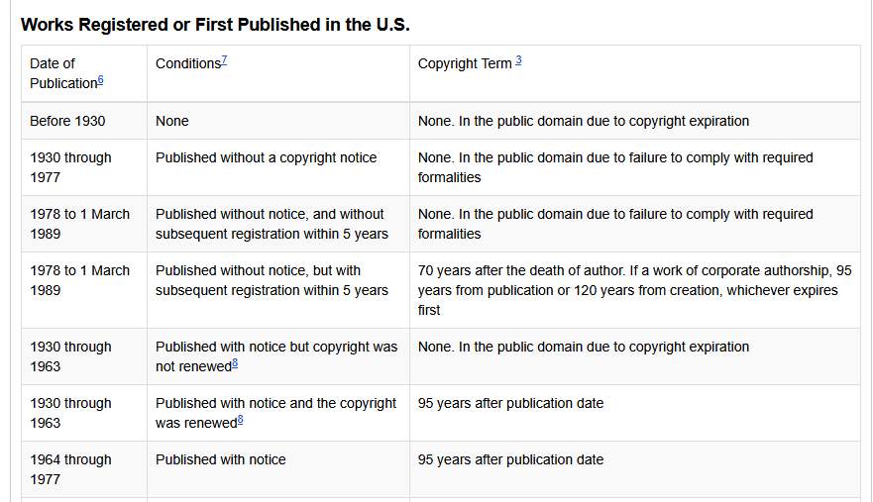
Cornell Copyright LibGuide: Public Domain

Slide 24
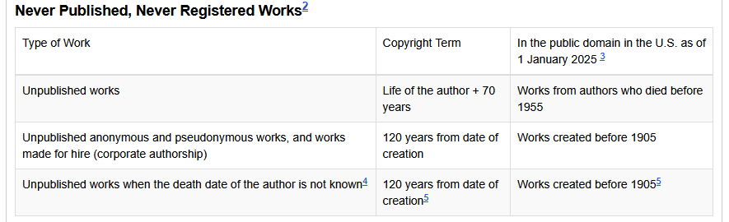
Cornell Copyright LibGuide: Public Domain

Slide 25
But wait… what if it’s not from the United States?
The Berne Convention of 1886 established a codified agreement between signatory nations that sets standardized protections for copyrighted works. It is signed by 182 countries.
The World Intellectual Property Organization (WIPO) meets to discuss matters of protecting copyright and improving creators’ rights.

Slide 26
What are the copyright owner’s exclusive rights?

Slide 27
  Reproduction
  Preparation of derivative works (such as adaptations)
  Distribution
  Public performance (for literary, musical, dramatic, and choreographic works, pantomimes, motion pictures, and other audiovisuals)
  Public display (for literary, musical, dramatic, and choreographic works, pantomimes, and pictorial, graphic, or sculptural works, including the individual images of a motion picture or other audiovisual work)
  Public performance of sound recordings via digital audio transmission

Slide 28
What about AI?
In the U.S., AI-generated works are not able to be copyrighted unless it includes significant human contribution.
Can deep learning models use copyrighted materials? Who benefits if they can or cannot? Who is harmed?

Slide 29
Exemptions to exclusive rights:
Allows individuals to exercise one of the exclusive rights of copyright (reproduction, distribution, creation of derivative works)
  without obtaining the permission of the copyright owner, and
  without the payment of any license fee.

Slide 30
A provision in copyright law that allows the limited use of copyrighted materials without permission of the rights holder for noncommercial teaching, research, scholarship, or news reporting purposes.
Fair use checklist
Fair Use
Section 107 of Copyright Act of 1976

Slide 31
A provision in copyright law that allows for a library or archives to make a certain number of copies of a copyrighted work for preservation or access reasons.
Reproduction by libraries and archives
Section 108 of Copyright Act of 1976

Slide 32
  the reproduction or distribution is made without any purpose of direct or indirect commercial advantage
  the collections of the library or archives are open to the public or available not only to researchers affiliated with the library or archives, but also to other persons doing research in a specialized field
  the reproduction or distribution of the work includes a notice of copyright.

Slide 33
Licensor grants a third-party licensee a license to use a work.
Includes both physical and intellectual property rights.
Permissions are often tied to conditions of use, such as the requirement that any reproduction of material include the name of the repository.
Permissions

Slide 34
Permission or right granted to an individual or organization to enter into a transaction, business, or occupation, or to take an action (allowing a non-copyright holder to use, publish, and/or make money from the copyrighted item).
License

Slide 35
A type of license, built on copyright, that provides a standardized way for creators to give others the right to share and use their work.
Creative Commons
Notes:
Before licensing:
Once applied, the license cannot be revoked
The person/entity deciding on bestowing a CC license must own the copyright to that material
To apply:
Choose the best license for you/donor (may require extra time)
Include license information in metadata/description, with a link to CC

Slide 36

Creative Common licenses

Slide 37
Creative Common licenses
Copyright status: in copyright (CC) or public domain (0)
Attribution status: credit must by given to the creator (BY)
Adaptation status: no derivatives or adaptations of the work are permitted (ND) or adaptations must be shared under the same terms (SA)
Commercial status: only noncommercial uses of the work are permitted (NC)

Slide 38
What are the risks to digitized access efforts?

Slide 39
  The copyright status of the work may be unclear
  It may not be possible to identify all of the subsisting copyrights incorporated into one work
  It may not be possible to locate copyright owners and secure permission
  Works that are in the public domain in the United States may be protected by copyright in other countries
  Individuals and groups may believe they have more rights in material than the law allows, and take umbrage when an institution digitizes the materia

Slide 40
What is the archivist’s role in protecting copyright and intellectual property rights?
Notes:
Concept can be difficult to grasp for some researchers because archival materials are often unpublished, unique, or old.
You as the archivist are responsible for communicating reproduction, use, and publication rights to users!

Slide 41
The principle that access to archival resources should not be restricted unnecessarily.
Open access

