Slide 1

Session four:
Making the appraisal decision
INFO 7401 Archival Appraisal, Arrangement, and Access

Slide 2
Boles and Young “Black Box” appraisal methodology

Slide 3
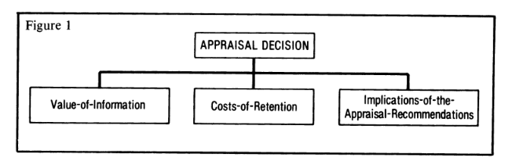
“Black Box” appraisal decision
  Value-of-information
  Costs-of retention
  Implications-of-the-appraisal-recommendations

Slide 4
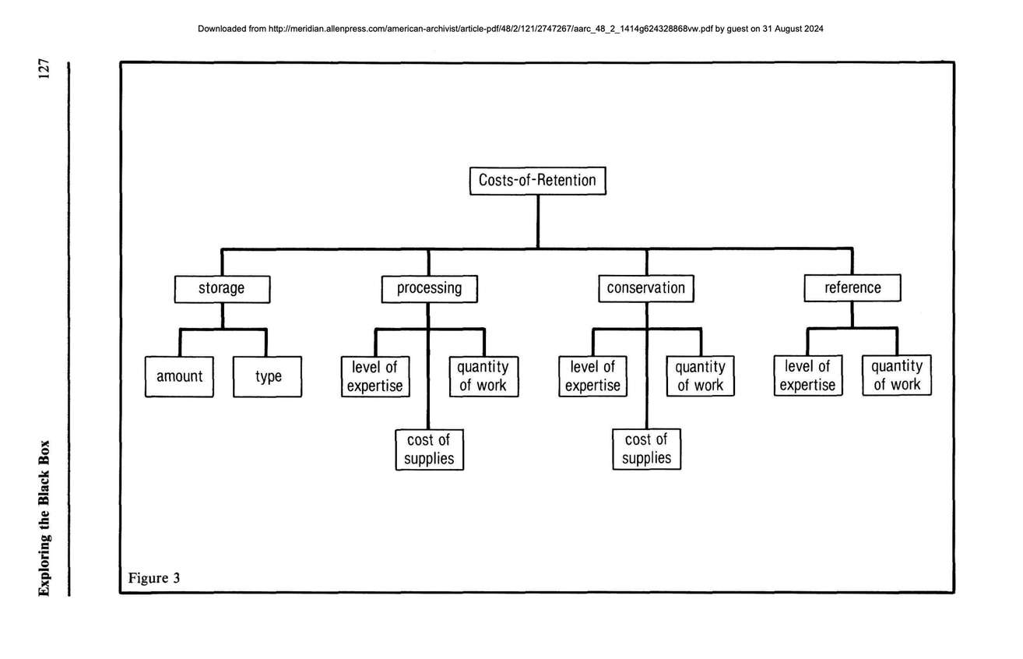
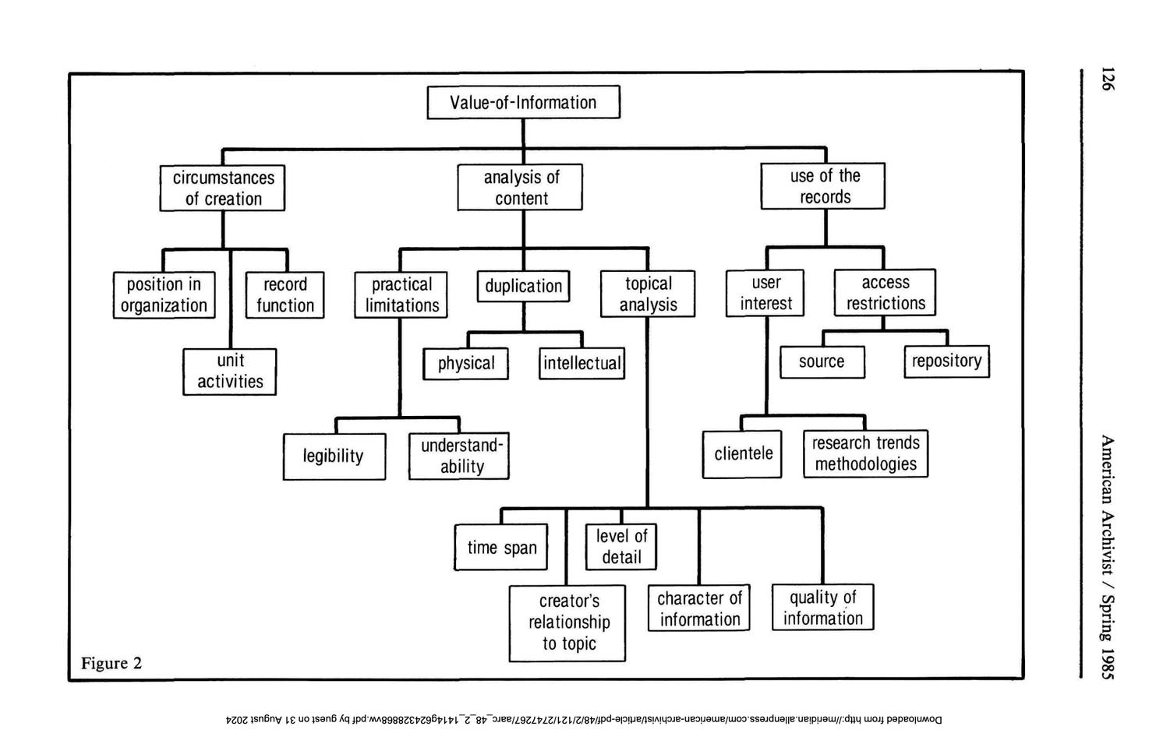
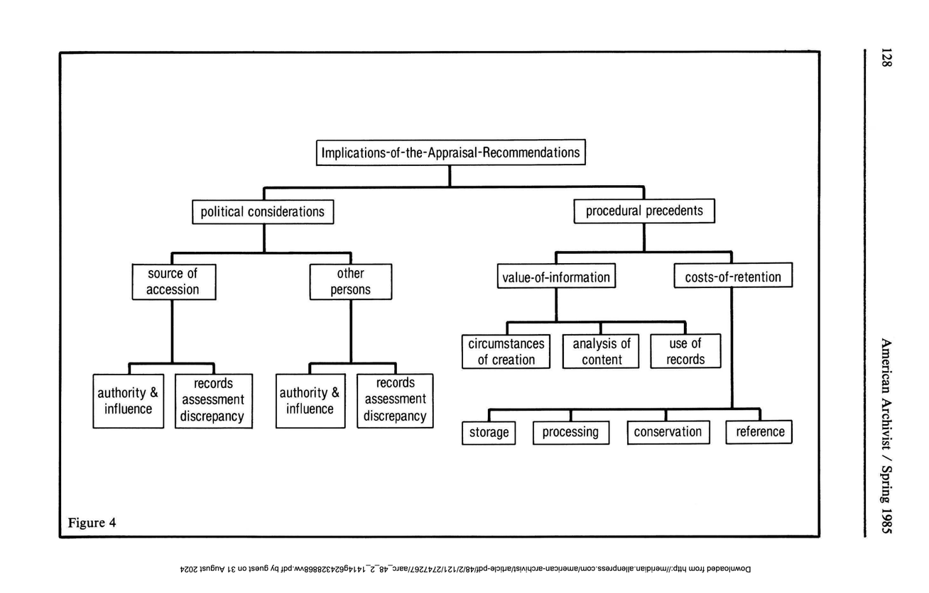
Each node in Boles’ appraisal flowchart is a point of evaluation: it does not give us metrics to do appraisal for selection.
Question to keep in mind: how would you determine those evaluation metrics?

Slide 5
Value of information

Slide 6
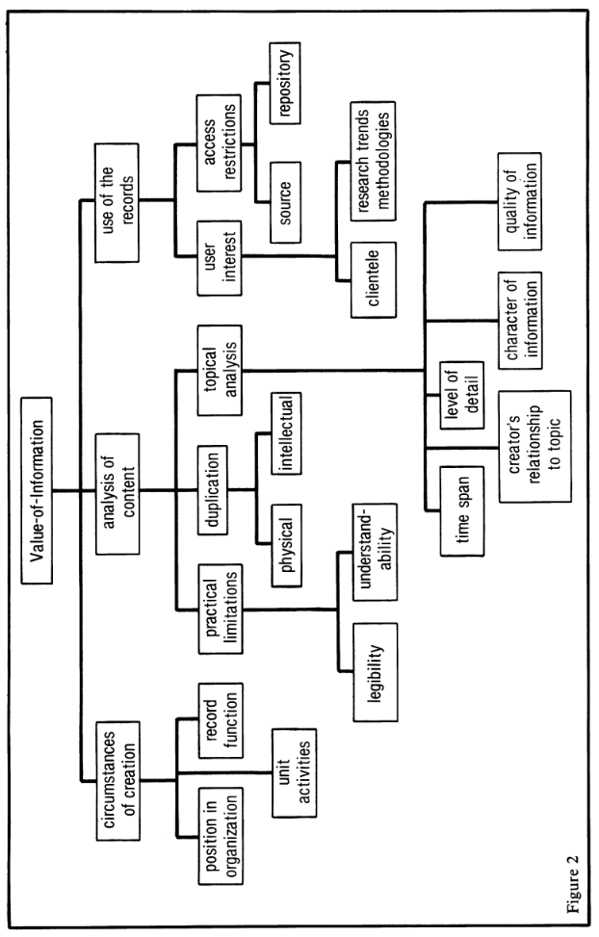
Value of information

Slide 7
Exercise #1: Assessing value
Think about the Sardell collection from last session. Consider:
  Can you understand the content of the record? Is it legible / understandable?
  What is the quality of information in the record?
    What is its primary and secondary value?
    What is its informational and evidentiary value?

Slide 8
Costs of retention

Slide 9
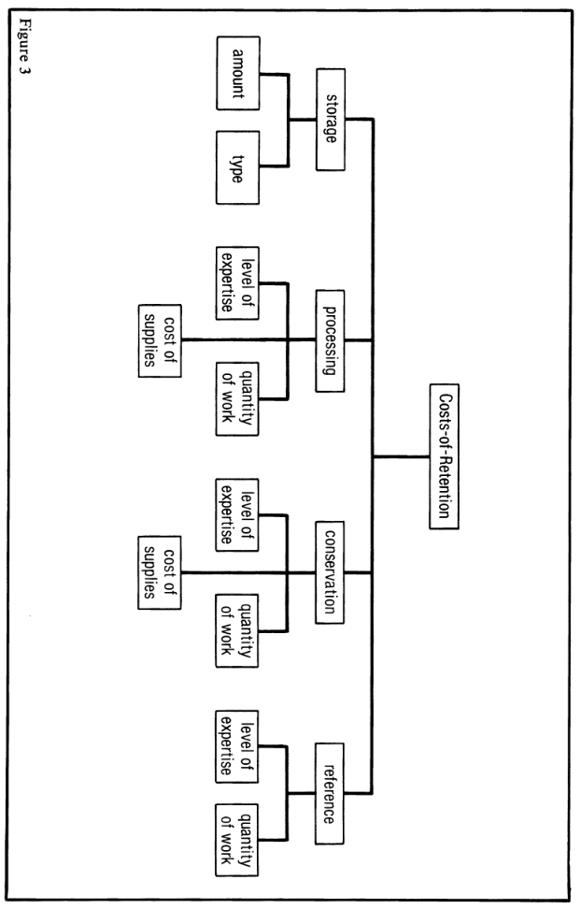
Costs of retention

Slide 10
Exercise #2: Assessing costs
Think about the Sardell collection from last session. Consider:
  Are the materials in need of repair? Do they pose a risk to other collections? How difficult might this be to address?
  What might you need to learn in order to make sense of these materials?
  Are there any physical limitations to accessing materials?

Slide 11
Implications of the appraisal recommendations

Slide 12
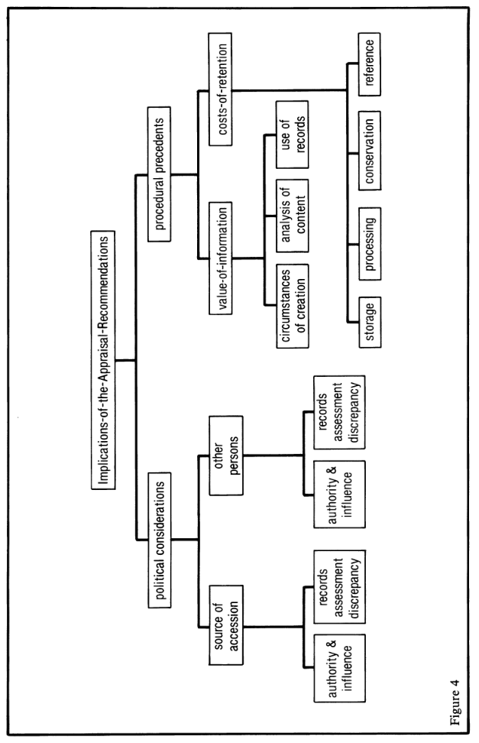
Implications of the appraisal recommendations

Slide 13
Exercise #3: Assessing implications
Think about the Sardell collection from last session. Consider:
  Who benefits from these materials being archived in their current condition?
  What blowback might the archive receive from accepting these materials? Or from turning them down?
  If the archive takes this collection, what might that say about SCA?

Slide 14
Archivist values

Slide 15
SAA code of ethics
  Professional relationships
  Judgment
  Authenticity
  Security and protection
  Access and use
  Privacy
  Trust
Notes:
The Society of American Archivists (SAA) approved its first official code of ethics in 1980. The code was revised in 1992, when an ample commentary was added, then again in 2005, when the commentary was removed (Cox 2008). The most recent iterations were approved in January 2012 and August 2020. The first formal code of ethics for the archival profession, “The Archivist’s Code,” was developed by the National Archives for use in the National Archives Inservice Training Program and printed in the American Archivist in 1955 (Grover 1955, Horn 1989). Other codes exist, such as the code of ethics adopted by the International Council on Archives in 1996. All of these codes try with varying degrees of emphasis to establish guidelines for resolving conflicts which arise from duties owed to the different parties concerned with archives: records creators, donors, researchers, and the archivist’s institution (Dingwall 2004, Jimerson 2006).

Slide 16
SAA core values
  Access and use
  Accountability
  Advocacy
  Diversity
  History and memory
  Preservation
  Responsible stewardship
  Selection
  Service
  Social responsibility
  Sustainability
Notes:
YOU AS MUCH AS ANYONE ELSE CAN ALSO DETERMINE WHAT IS ACCESSIONED IN AN ARCHIVES

Slide 17
Is appraisal an art or a science?

Slide 18
Science:
  Understanding of:
    the methodology of selection
    the tools used
    institutional policies and aspirations
    Art:
  Inspiration/intuition
  Conversation/connections
  Selection
Practicing the science will make the art easier to do

