Slide 1



2026
Session two:
Archives, archivists, and histories of archival practice
INFO 7401 Archival Appraisal, Arrangement, and Access
Notes:
1.7.2013
‹#›

Slide 2
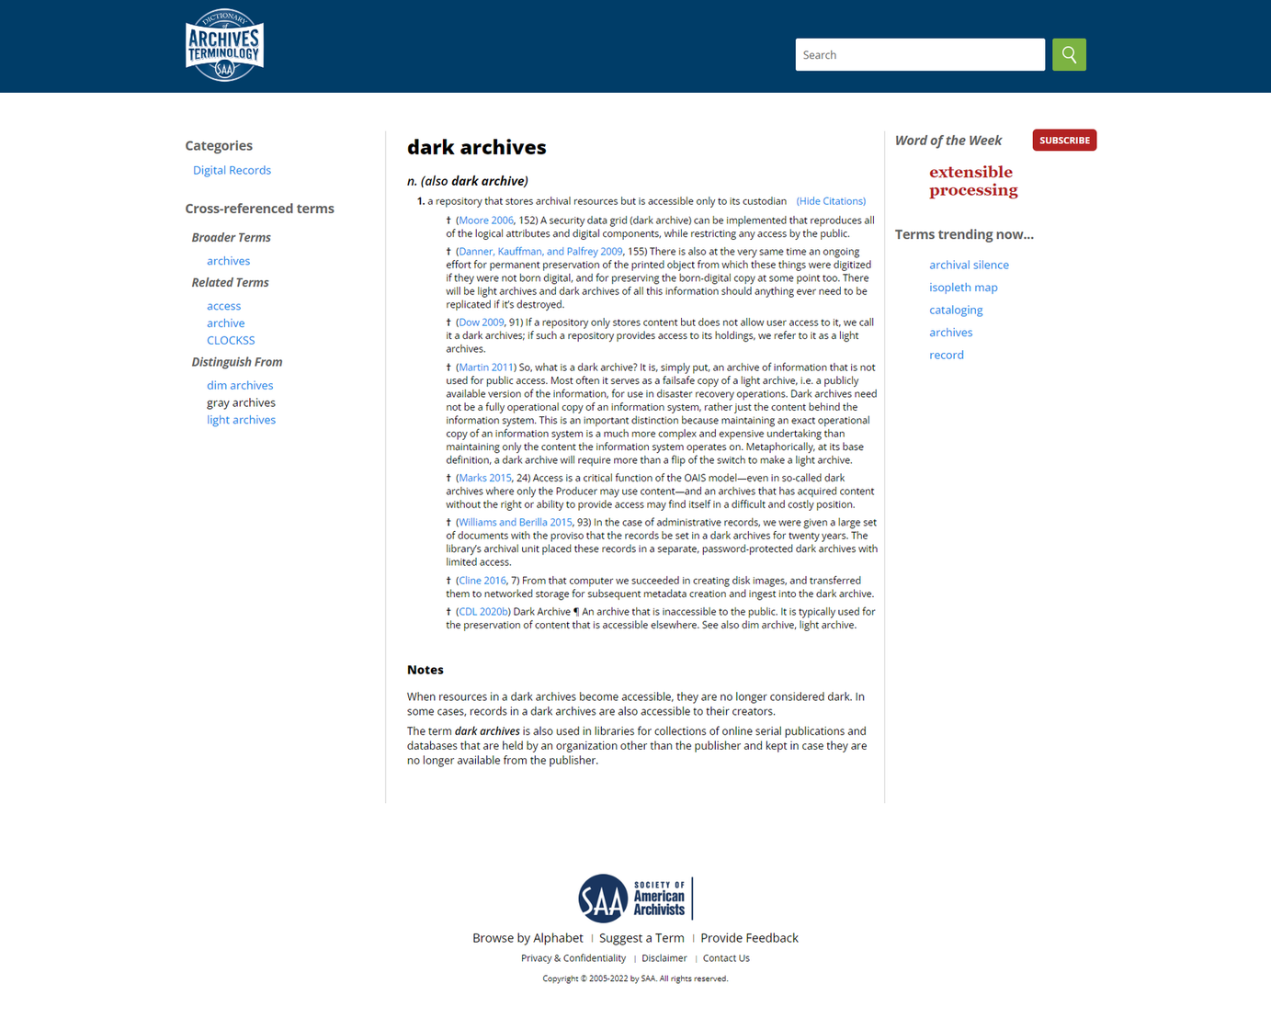
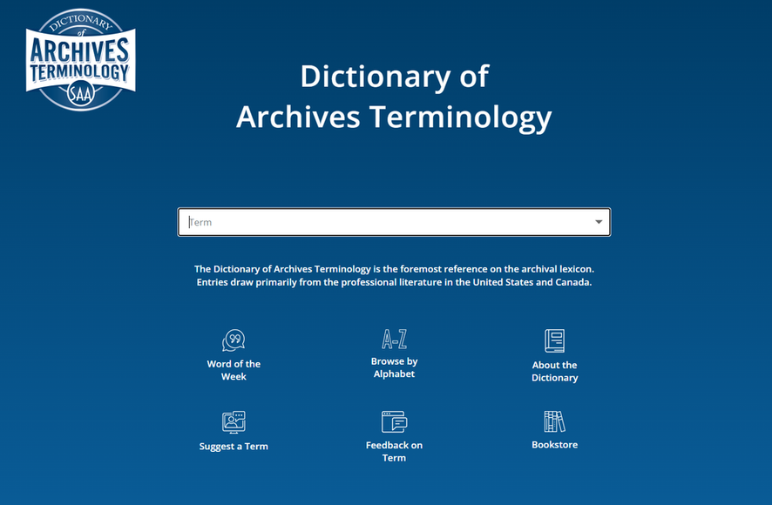
SAA Dictionary of Archives Terminology
Notes:
1.7.2013
‹#›

Slide 3
    Concept: “the archive”
    Materials: “archival matter”
    Practice: “archiving”
    Institution: “an archives”
    Profession: “archivists”
    Discipline: “archival science” “archivy” “archivistics”
What are
archives?
Notes:
1.7.2013
‹#›

Slide 4
The “Archival Concept”
or, what scholars mean when they say archive
Michel Foucault, Archaeology of Knowledge (1969)
    Framework of the Archive as a system, not object or idea
    Archive is what exists “below the discourse”
    In this telling, the Archive is produced through engagement with records
Jacques Derrida, Archival Fever (1995)
    Exploration of the human impulse to archive
    Focuses on the “violence” of archiving
    Do archives create a static past, repressing / destroying alternate views?
produces a body of abstracted “archives” or “Archives,” often with limited engagement with archival theory
Notes:
1.7.2013
‹#›

Slide 5
Data or information that:
    Has been fixed on some medium
    Has content, context, structure
    Is preserved as evidence of an individual or institutional activity
    As recordkeeping proliferated historically, meaning from records emerged from the whole rather than from any one part
What is a record?
Notes:
1.7.2013
‹#›

Slide 6
Three fundamental aspects of a record:
Notes:
1.7.2013
‹#›

Slide 7
The intellectual substance of a document, including text, data, symbols, numerals, images, and sound.
CONTENT
Notes:
1.7.2013
USE Barbara Rosenthal example of photography syllabus–content is what’s on that piece of paper (ask students)
‹#›

Slide 8
The manner in which elements are organized, interrelated, and displayed.
    Internal structure: the relationship of content within a record
    External structure: places a record in the context of an order, a series, and a collection
STRUCTURE
Notes:
1.7.2013
BR photography syllabus - structure is how BR organized it–in those binders with other class materials
‹#›

Slide 9
    The organizational, functional, and operational circumstances surrounding materials' creation, receipt, storage, or use, and its relationship to other materials.
    The circumstances that a user may bring to a document that influences that user's understanding of the document.
CONTEXT
Notes:
1.7.2013
BR photography syllabus - context is who she is as a person–made the syllabus as a teacher, kept in teaching files, she was a teacher because she needed additional income as a working artist
‹#›

Slide 10
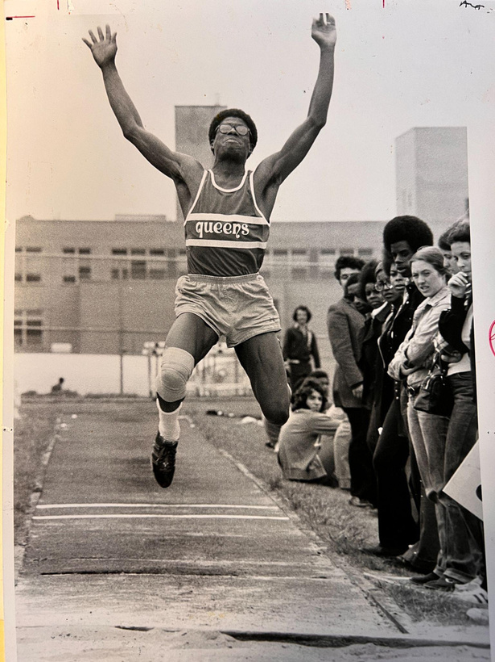
Characteristics of recorded information
    Records are abundant
    Records are created, collected, organized, and pluralized
    Records and recordkeeping institutions are interrelated and interconnected
    We keep records to use records
    Significance and meaning of records is collective
    Records have shifting usefulness
    Records are always in a state of becoming
Notes:
1.7.2013
‹#›

Slide 11
    College and university archives
    Corporate archives
    Government archives
    Medical archives
    Historical societies
    Community archives
    Museum archives
    Religious archives
    Special collections
Where are archives?
(incomplete list)
Notes:
1.7.2013
‹#›

Slide 12
Stuff in archives:
Records
Institutional records, or archives.
Broadly, these are items created by the institution itself, the parent institution.
Notes:
1.7.2013
‹#›

Slide 13
Stuff in archives:
Fonds
The entire body of records of an organization, family, or individual that have been created and accumulated as the result of an organic process reflecting the functions of the creator.
Notes:
1.7.2013
‹#›

Slide 14
Records created and originally kept by an individual or a family.
Although “papers” is the term commonly used to identify the private papers of individuals and families, such papers may include any manner of documentary materials, including even objects/digital material retained as part of such a collection.
Stuff in archives:
Papers
Notes:
1.7.2013
‹#›

Slide 15
Stuff in archives:
Collection
Materials assembled by a person, organization, or repository from a variety of sources; an artificial collection.
Notes:
1.7.2013
‹#›

Slide 16
A cohesive collection of non-circulating research materials held together by provenance or by a thematic focus.
Also the administrative unit of a library responsible for managing materials outside the general library collection, including rare books, archives, manuscripts, maps, oral history interviews, and ephemera.
Special collections
Notes:
1.7.2013
‹#›

Slide 17
    a handwritten document
    an unpublished document
    Any text in handwriting or typescript (including printed forms completed by hand or typewriter) which may or may not be part of a collection of such texts.
    Examples of manuscripts are letters, diaries, ledgers, minutes, speeches, marked or corrected galley or page proofs, manuscript books, and legal papers.
Stuff in archives:
Manuscript
Notes:
1.7.2013
‹#›

Slide 18
    a professional with expertise in the management of records of enduring value
    an individual responsible for records of enduring value
What is an archivist?
Notes:
1.7.2013
‹#›

Slide 19
What do archivists do?
    Save and acquire records:
      Identifying records
      Deciding which should be preserved or discarded
      Transferring to archives
      Preserving physical integrity
    Organize records:
      Intellectual order
      Physical order
      Archival description
    Make the records accessible:
      Publication and databases
      Reference
      Restriction
      Programs
Notes:
1.7.2013
These are archivist interventions–we intervene at each stage. “Intervention” is a specific word, because we make choices, nothing is passive
‹#›

Slide 20



What do archivists do?
APPRAISAL
ARRANGEMENT
ACCESS
Notes:
1.7.2013
‹#›

Slide 21
How are archivists different than other information workers?
Notes:
1.7.2013
All information workers acquire (in their way), arrange (in their way), and make things accessible (in their way).
IT IS IMPORTANT TO KNOW THE DIFFERENCE BECAUSE: 1) SOMETIMES YOU WILL BE HIRED FOR A SPECIFIC JOB AND INSTEAD EXPECTED TO KNOW/EXECUTE COMPETENCIES OF OTHER JOBS, AND 2) IF YOU KNOW THE DIFFERENCE YOU CAN ADVOCATE FOR YOURSELVES AS ARCHIVISTS AND EXPERTISE ADVANTAGES OF OTHERS
‹#›

Slide 22
An individual responsible for acquiring, providing access to, and managing collections of published materials.
While the title connotes work with published materials, many rare books and special collections librarians also work with unpublished materials that range from handwritten inscriptions in books to collections of personal papers.
Librarian
Notes:
1.7.2013
‹#›

Slide 23
An individual responsible for oversight of a collection or an exhibition.The administrative head of a museum or collection.
Often carries the connotation, especially in museums and galleries, of an individual who selects items based on artistic merit or connoisseurship.
Curator
Notes:
1.7.2013
‹#›

Slide 24
An individual responsible for the administration of programs for the efficient and economical handling, protecting, and disposing of records throughout their life cycle.
Records manager
Notes:
1.7.2013
‹#›

Slide 25
An individual who researches, analyzes, interprets, and writes about the past by studying historical documents and sources. They produce knowledge.
Historian
(not an information worker!)
Notes:
1.7.2013
Not an information worker!
‹#›

Slide 26
Fundamental archives principles
Notes:
1.7.2013
‹#›

Slide 27
    ORIGINS
    CUSTODY
    OWNERSHIP
    Materials by a creator (broadly defined) should be kept together.
    This principle holds that that significance of archival materials is heavily dependent on the context of their creation, and that the arrangement and description of these materials should be directly related to their original purpose and function.
Provenance
Notes:
1.7.2013
What is the benefit of keeping materials by one creator together?
Use librarian example
‹#›

Slide 28
The interrelationships between a record and other records resulting from the same activity.
“The creation and accumulation of archival records is always the creation of the reciprocal relationships, since records take part in, are the results of, a flow of activity.”
Archival bond
Notes:
1.7.2013
Gilliland-Swetland 2002, 197, fn. 2Records can be described as authentic in the sense that these are the same original records that were transferred to the archives and that their integrity has not been compromised in any undocumented way since they entered into the archival bond.
‹#›

Slide 29
    ORGANIZATION/SEQUENCE
    Keeping materials in record creator’s order/organization
    Belief that artificial arrangements should be avoided
Original order
Notes:
1.7.2013
What is the benefit of this?
‹#›

Slide 30
By maintaining both provenance and original order,
    “The original organization of the records in the creating institution would correspond in its main outline with the organization of the administration which produced it”
    The organization of the records reflects the organization and working of the creator
Respect des fonds
Notes:
1.7.2013
Reveals information to a researcher about the records and records creator
Instead of organizing archival records according to pre-determined classification schemes based on subject matter or content, French archivists developed the central concept of respect des fonds, in which all records originating from an administrative authority, corporation, or family would be brought together in a fonds based on their origins and function. First articulated by Natalis de Wailly in 1841, in a French archives circular, this principle became the basis for the Prussian concept of provenienzprinzip and still stands as a founding concept for modern archival arrangement. The emergence of archival theory—distinct from bureaucratic, historical, or library approaches to documents—marked the beginning of a nascent new profession of archivists.
‹#›

Slide 31
Some archives idea(l)s
Notes:
1.7.2013
‹#›

Slide 32
The usefulness, significance, or worth that determines a record’s retention
Value
Notes:
1.7.2013
‹#›

Slide 33
The quality of being genuine, not a counterfeit, and free from tampering, and is typically inferred from internal and external evidence, including its physical characteristics, structure, content, and context.
Authenticity
Notes:
1.7.2013
‹#›

Slide 34
What role does the archivist play in determining value and authenticity of records?
Is neutral the same as passive or objective or impartial when thinking about records acquisition, preservation, description, and access?
Was it ever?
Impartiality/
Neutrality
Notes:
1.7.2013
‹#›

Slide 35
Histories of archival practice
Notes:
1.7.2013
‹#›

Slide 36
Institutional origins
Archives as chessboards
Archives for centuries act as explicit agents for legitimizing power and for marginalizing those without power (consciously or unconsciously).
    Who has the time/labor/money/authority to keep records? Why?
    How many records are there? How hard is it to keep track of them?
Roman archives:
    Perpetual memory, “public” faith in government
    Medieval archives:
    Collected, weeded, reconstructed to keep legal and business transactions
    Serve historical and sacral/symbolic purposes
Key Figure:
Jean-Baptiste Colbert, 1619 - 1683, appointee of King Louis XIV
Notes:
1.7.2013
Of course, archives always act as legitimizing documents
‹#›

Slide 37
Revoltuion, Nationalism, & Colonial Empire
“the fellow members of even the smallese nation will never know most of their fellow members, meet them, or even hear of them, yet in the minds of each lives the image of the communion...Communities are to be distinguished, not by their falsity or genuineness, but in the style in which they are imagined.”
Benedict Anderson
Notes:
1.7.2013
732 and 730, respectively
TALK ABOUT DISAPPOINTING WELCOME POST ANSWERS
‹#›

Slide 38
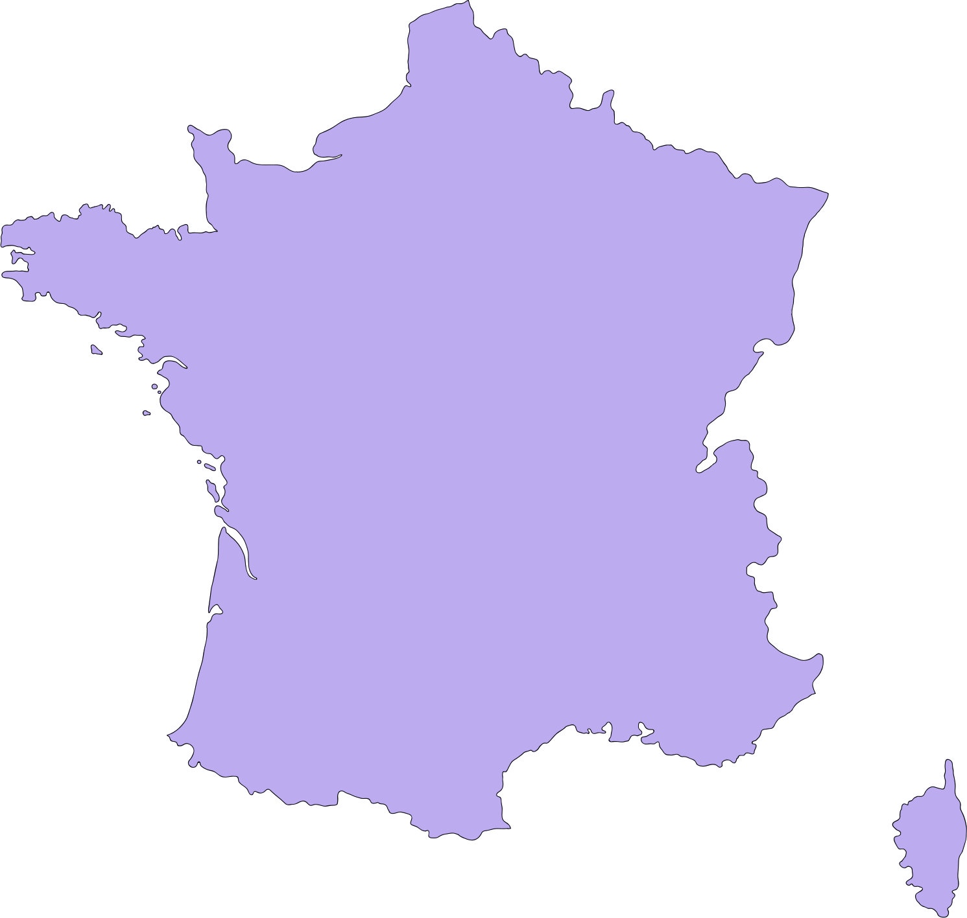

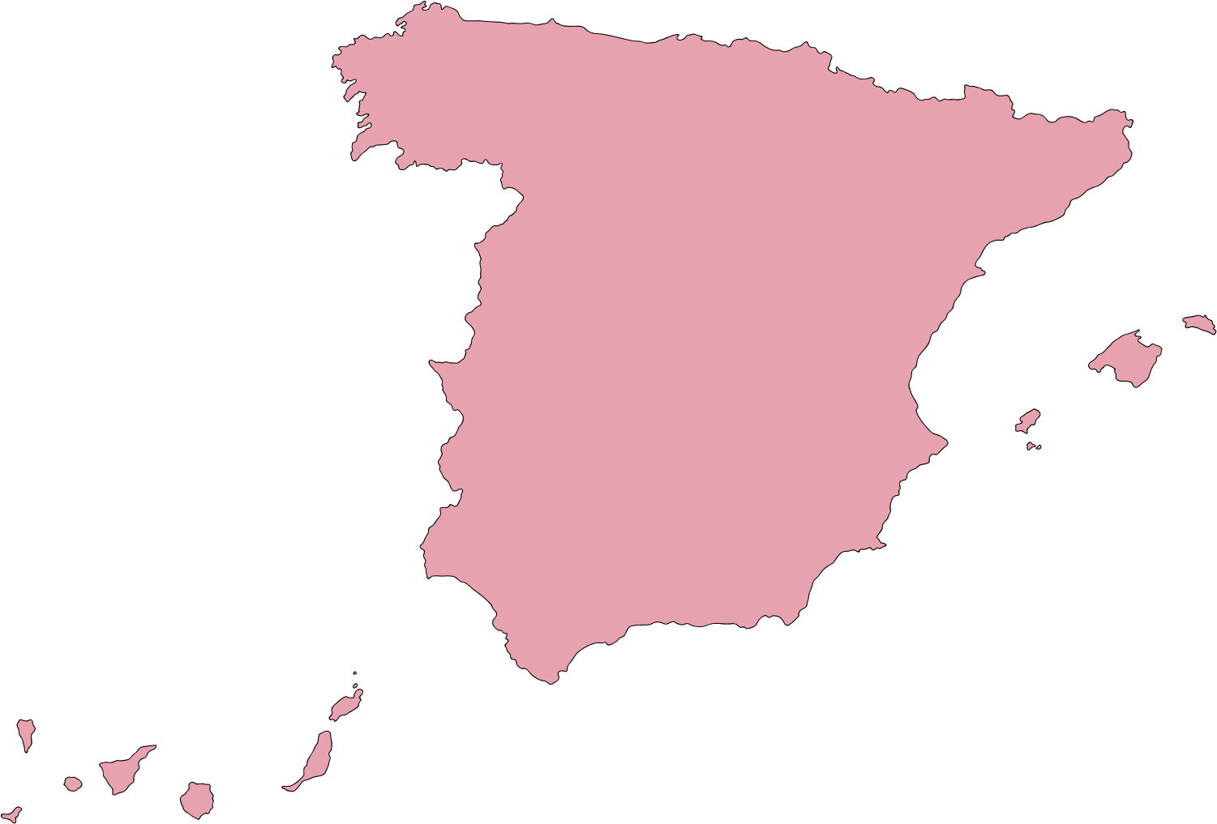
Revoltuion, Nationalism, & Colonial Empire
Archival Developments
    Respect des fonds
    Explicit attachment to nation-making and storytelling
    Records as evidence of a single truth
SPAIN
FRANCE
GERMANY
Colonial expansion
French Revolution
National Consolidation
1492 - 1832
Late 18th Century
Mid - Late 19th Century
Notes:
1.7.2013
732 and 730, respectively
TALK ABOUT DISAPPOINTING WELCOME POST ANSWERS
‹#›

Slide 39
The Dutch Manual, 1898
    Manual for the Arrangement and Description of Archives, by Samuel Miller, Johan Feith, and Robert Fruin
    Written in cooperation with the State Archives of the Netherlands
    Is about government, public, corporate records, not private or personal archives
    Codifies European archival theory
    Sets out a methodology for archival practice
Major contributions to archives practice:
    Provenance
    Original order
Notes:
1.7.2013
Archivists are dealing with records from periods where records were not as widely made, thus making them manageable at even item level
Archives are kept as LEGITIMIZING DOCUMENTS
‹#›

Slide 40
First paradigm: evidence
“...guardianship of ‘‘Truth’’ in records through unaltered and unmediated and unbroken context. Archives thus became defined as a descriptive science whose purpose was to illuminate that contextual origin of records, so that their properties as evidence would not be tainted.” (p. 106)
Terry Cook
Notes:
1.7.2013
‹#›

Slide 41
Evidence: custodian-archivist
Key Figure:
Major contributions/lasting impacts to archives practice:
    Archives are places of impartial evidence
    Archivists are the guardians of that evidence
    Administrator (record creator) is the final say on appraisal, not archivist
Sir Hilary Jenkinson, 1882-1961
    Manual of Archives Administration, 1922
    Worked in the Public Record Office in London in 1906
      British Civil Service
      World War I bureaucracy
    Anti-appraisal
    Archivist as “keeper”
Notes:
1.7.2013
Grows out of dutch manual origins
What are the problems with creator as final arbiter of appraisal?
‹#›

Slide 42
Second paradigm: memory
“The resulting archive, retained by archives, was no natural residue therefore, but a deliberate and conscious creation by the archivist, who made that critical selection decision…Trained in academic history, the archivist tried, following Schellenberg, to reflect in the records chosen as archives their actual or anticipated uses for academic research, primarily by historians.” (p. 107)
Terry Cook
Notes:
1.7.2013
‹#›

Slide 43
Memory: historian-archivist
Key Figure:
Major contributions to archives practice:
    Primary and secondary value of records
    Record group
    Use-defined archives
    Records life cycle
    Records management as separate from archives
T.R. Schellenberg, 1903-1970
    Modern Archives: Principles & Techniques, 1956
    Creator of appraisal theory
    American archivists working at the time of the creation of NARA (National Archives):
      Exploding bureaucracy
      Emphasis on efficiency
      New Deal to WWII
Notes:
1.7.2013
‹#›

Slide 44
The process of determining whether records and other materials have permanent (archival) value.
Appraisal
Notes:
1.7.2013
‹#›

Slide 45





Records life cycle
RECORDS CREATION
The distinct phases of a record's existence, from creation to final disposition.
Different models identify different stages. All models include creation or receipt, use, and disposition. Some models distinguish between active and inactive use, and between destruction and archival preservation.
RECORDS ACTIVE USE
RECORDS INACTIVE USE
RECORDS DESTRUCTION
RECORDS PERMANENT PRESERVATION (ARCHIVES)
Notes:
1.7.2013
‹#›

Slide 46
Third paradigm: identity
“...archival holdings and activities, as well as the profession itself, came to reflect society more directly, in all its pluralism, diversity, and contingent nature. There was no ‘‘Truth’’ to be found or protected in archives, but many truths, many voices, many perspectives, many stories.” (p. 110)
Terry Cook
Notes:
1.7.2013
‹#›

Slide 47
Identity: mediator-archivist
Identity meaning two things:
    Diversity in representation (new identities or awareness of identity(ies)) in archival holdings
    Identity of archivist as a distinct profession
    Instead of historiography trends, archivists shifted focus to the functions of records to guide appraisal and arrangement
    Macroappraisal
    Documentation strategy
    Institutional functional analysis
This era coincides with the rise of globalization, the Civil Rights, Chicano, Women’s Lib, and Lesbian and Gay Lib movements, and the collapse of European Colonial projects
Notes:
1.7.2013
Appraisal was now based not on
anticipating historical research trends or the societal values articulated in retrospect
through historiography, but rather on reflecting the functions and activities of
society itself, based on research by archivists into the features, characteristics, and
ideas of society worth preserving as documentary memory
‹#›

Slide 48
Fourth paradigm: community
“In this new digital, political, and pluralistic universe, professional archivists need to transform themselves from elite experts behind institutional walls to becoming mentors, facilitators, coaches, who work in the community to encourage archiving as a participatory process shared with many in society, rather than necessarily acquiring all the archival products in our established archives.” (p. 114)
Terry Cook
Notes:
1.7.2013
‹#›

Slide 49
Community: activist-archivist
    Archivists are grappling with the idea of their own power and whether/how we are needed as professionals
    Reconciling the roots of the profession with the needs and realities of records-generating institutions and individuals
    Imagining and implementing a way forward
    Greater concern for which records are actively destroyed or passively left unsaved, and why
    Archive as evidence of being, or “paper cadavers”?
    Total archives
    Postcustodial archives
    Community archives
The Internet plays an enormous role connecting communities across space & time
Notes:
1.7.2013
Archivists must give up ideas of control, expertise
Archivists must share archiving with communities
Archivists must understand why community archives might be wary to release physical/intellectual custody of collections to institutional archives
Archivists must become mentors, facilitators, coaches
Archives transforms from acquiring products to participatory processes
‹#›

Slide 50
Appraisal report
Documents the appraisal process and decision in a formal report as part of the institutional records of the archive.
Appraisal Report = Book Report + Preliminary Investigation

Slide 51
Why complete an appraisal report?
Allows future archivists to understand the appraisal decisions that preceded their tenures. Impacts:
  Reappraisal
  Collection development
  Donor cultivation

Slide 52
Section 1: background
Short administrative history/biographical note about records creator.
  Focus on functions/activities of the creator
  Identify significance of creator in the creator’s “realm of activity”

Slide 53
Section 2: methodology
Explain the methodology the archivist (you!) used to examine the set of records
  Who or what initiated transfer/donation?
  Who did the archivist talk to?
  How did the archivist view the records?
  What sources of documentation should be included with the records?
    Manuals, descriptions, diagrams, etc.

Slide 54
Section 3: evaluation
Assessment of the set of records’ content, including:
  Format
  Kind of information saved on the format
  How information was created/saved
  How complete / intact is the information

Slide 55
Section 3: evaluation
Assessment of the set of records’s structure:
  How were these records organized? When, and by whom? Was it changed?
  What are the technical characteristics of the recordkeeping system?
  What are the technical characteristics of the records?
  What is the volume of records?
  How did primary users access & utilize these records?

Slide 56
Section 3: evaluation
Assessment of the set of records’ context:
  How do the records relate to each other?
  How do the records relate to other records?
      Records created by the same entities
      Similar records in this or other repositories
  Are there any relevant laws, regulations, or policies regarding these records (at the time of use, presently, in the future)?
  Who has impacted or been impacted by these records in their lifespan?

Slide 57
Section 3: evaluation
Assessment of how the set of records have been / are / will be used:
  How will future (secondary) users use the records?
      How has this repository’s users used similar records?
  How did primary users use records?
These questions tend to be informed by:
  Richness of records: how much good information is in the records?
  Uniqueness of records: how available is the information?

Slide 58


Section 4: Recommendations or conclusions
Yes / No Flow Chart
Do these records have archival value?
Should this specific archive accession these records?
Reject or destroy records.
Reject or destroy records.
Recommend records for accessioning.

