Slide 1
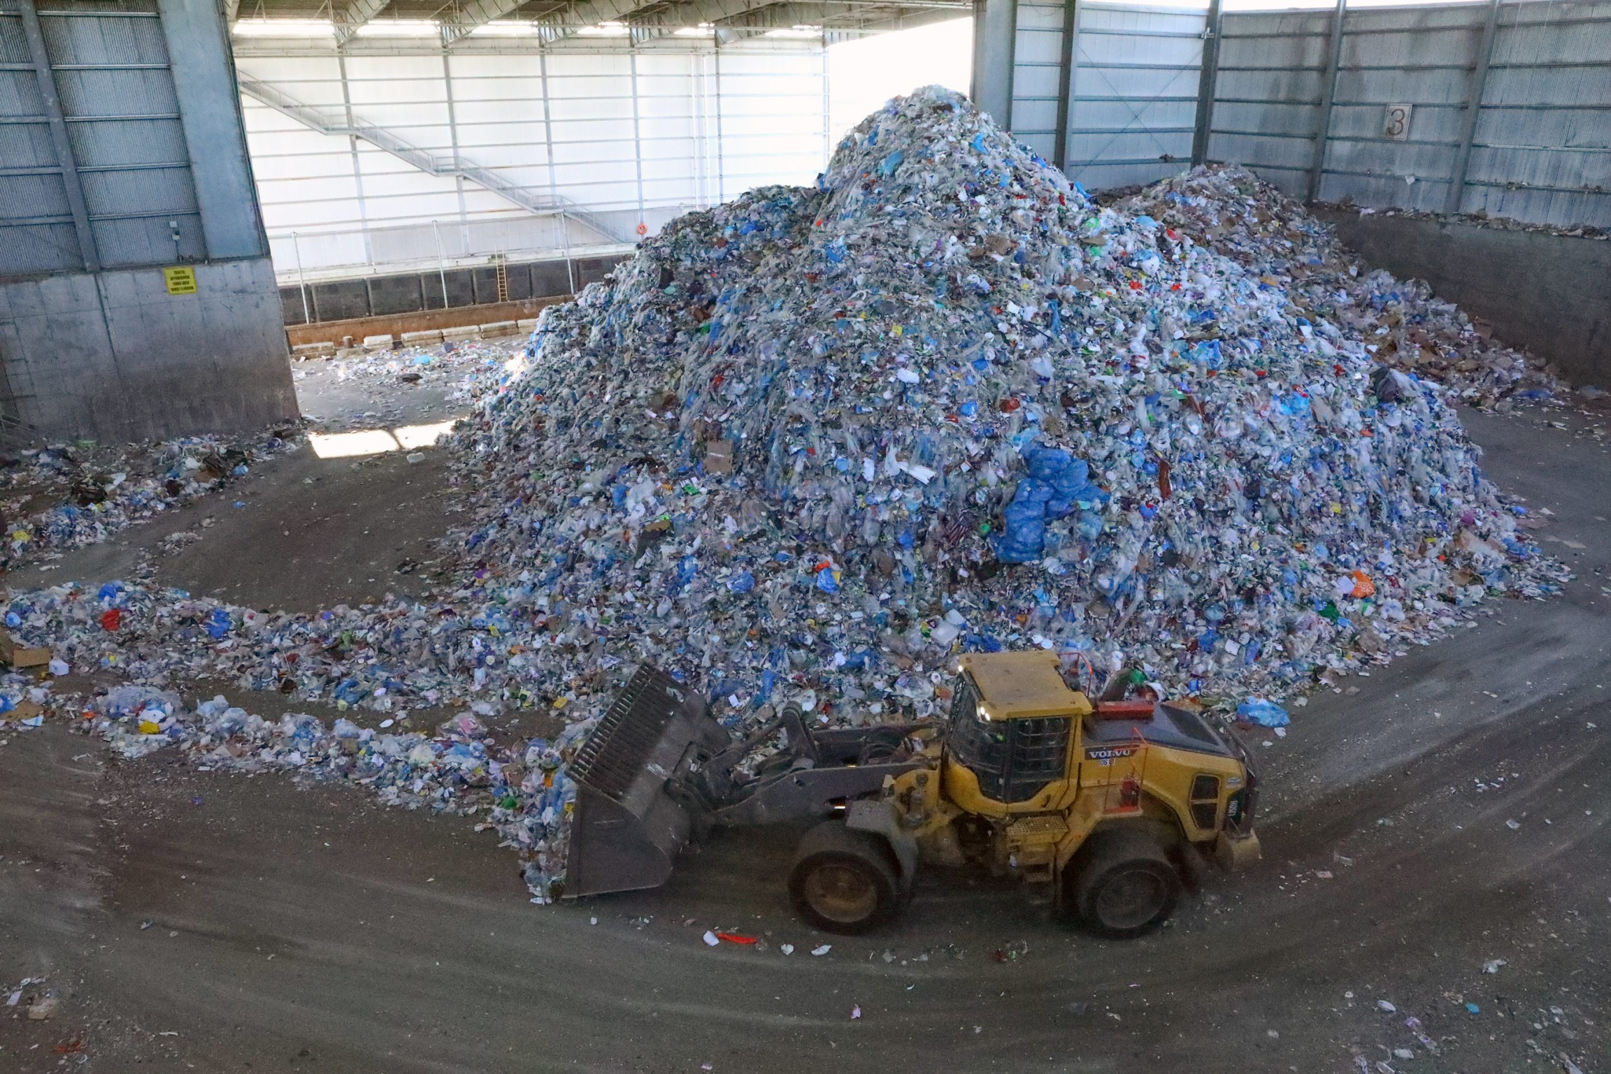

Reducing Plastic Waste in New York City
Why does it matter and what can we do?
Omar R, Milton P, Papa C

Slide 2
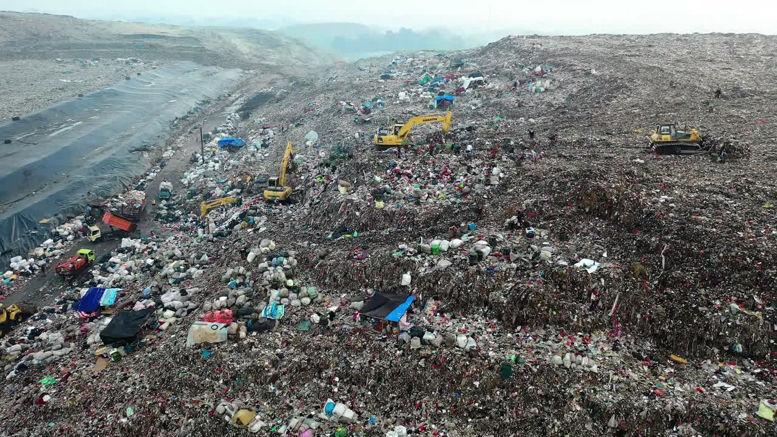
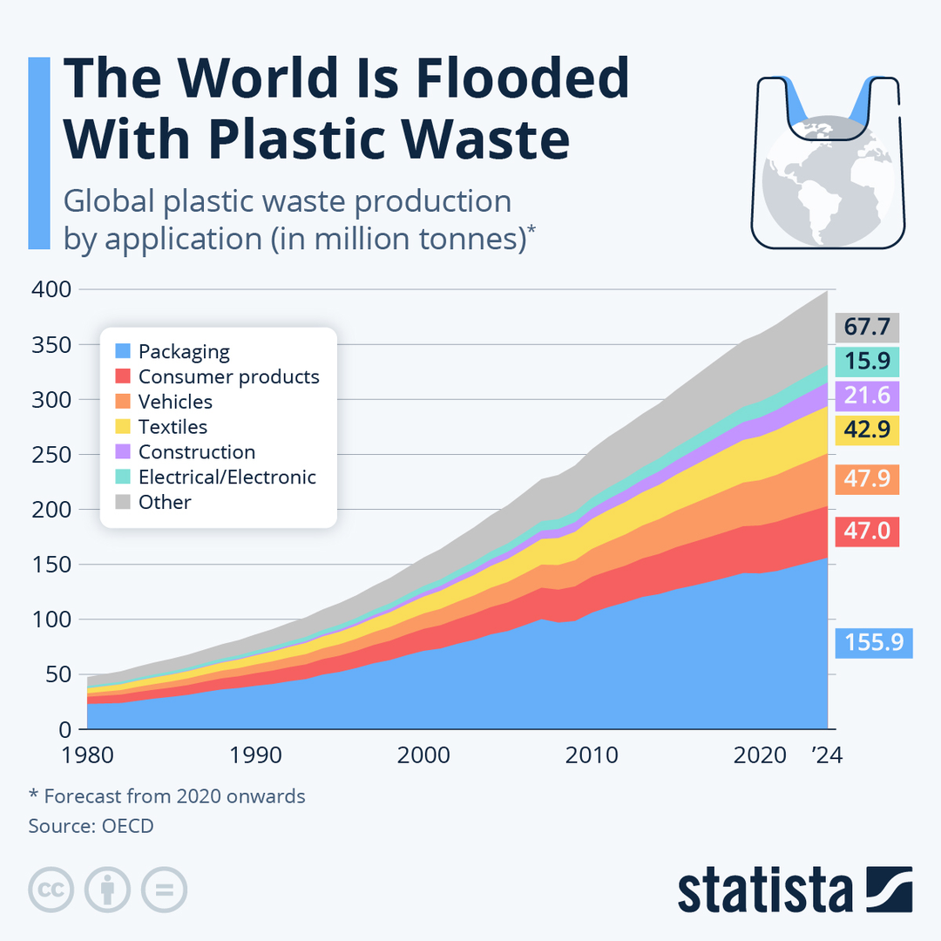
NYC IS DROWNING IN PLASTIC
WILL YOU HELP STOP IT??🥲
https://ourworldindata.org/plastic-pollution
Notes:
The cost comparison between disposable and reusable utensils/bowls, along with the environmental benefits of using reusable mugs and utensils. "44% reduction in life cycle greenhouse gases and similar reductions in water withdrawals and air pollution emissions versus the disposables. Taken alone, the metal utensils resulted in a 77% reduction
in greenhouse gases and water consumption over disposable plastic utensils."
- Every year, schools spend an amount of money on reusable utensils.
It ius not going to be very specific and related to ccny but we can change it to NY.

Slide 3
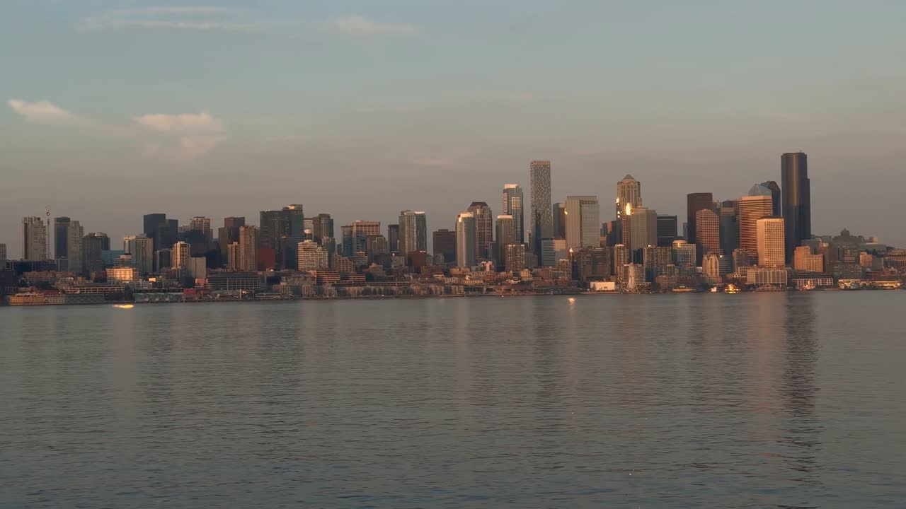
New York City produces more than 420,000 tons of residential plastic waste every year.
nyc.gov
WHY IT MATTERS🧐
“Most plastic is NOT recycled.”
https://hogarecofriendly.com/en/noticias/plastic-not-recycled-global-crisis/

Slide 4
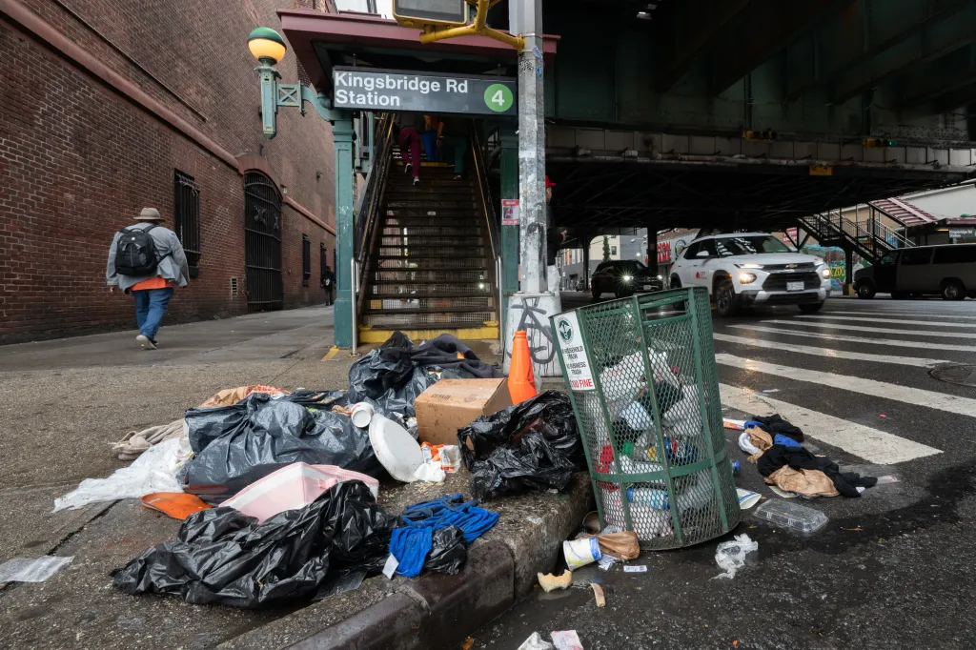
“Plastic pollution affects our city, water, and health.”
What Can 🫵 Do To Help Your City? 🌆

Slide 5
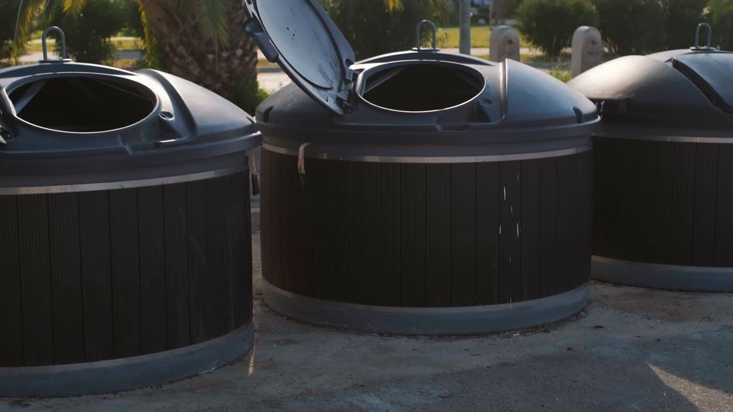
NYC’s “Skip the Stuff” law requires restaurants to provide utensils only upon request. This simple change prevents millions of single-use plastics from entering our waste stream each year. https://portal.311.nyc.gov/articlekanumber=KA-03588

Slide 6

“Packaging Reduction and Recycling Infrastructure Act”
Compared to the Skip the Stuff Act, this act would target companies that
Would reduce plastic packaging
Hold companies responsible for waste
Improve recycling systems
\
https://www.eany.org/

Slide 7


Your voice matters!!!!
Scan HERE to contact your senator and support this bill.
https://www.nysenate.gov/legislation/bills/2025/S1464

Slide 8
