Slide 1
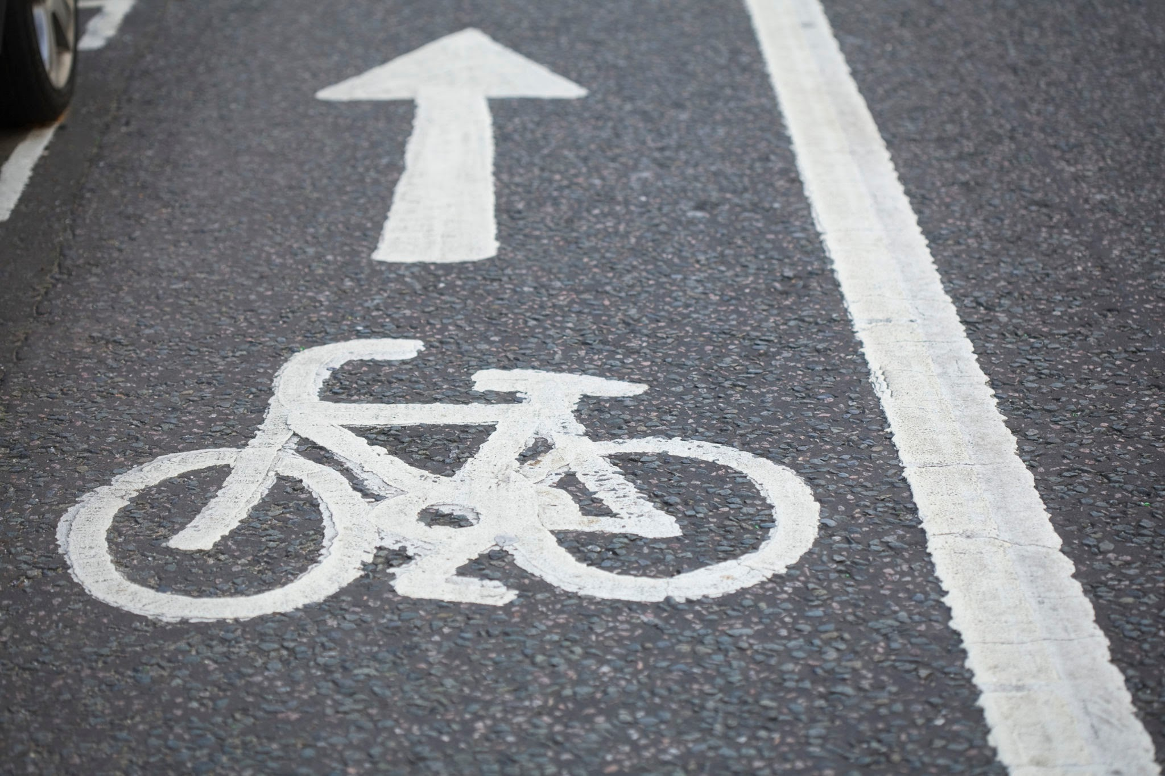
Bike Lane Barriers

Slide 2



INTRODUCTION:
Some of the most common problems include:
obstructions in the bike lane from both pedestrians and motorized vehicles
lack of protection for bike lanes
and multiple intersections that inevitably cause accidents
In Union Square alone, two out of five group members have nearly been involved in bike accidents. It might be a coincidence, or it might be a wake up call to do something about bikes in New York before another group member joins the statistic.
New York is one of the most crowded cities with 27,547 residents per square mile and a total population of 8,336,817(Gregory, 2023); without a doubt the city can be extremely difficult trying to navigate through, especially with a bicycle.
Our goal is to install more protection surrounding bike lanes keeping as many people as safe as possible by installing adequate, efficient and relatively cheaper barriers discouraging people from blindly crossing through bike lanes.

Slide 3
THE PROBLEM
33
Deaths
cyclist & pedestrian fatalities in NYC in 2023 alone
1,300+
Injuries
cyclists injured annually in NYC from vehicle-related crashes
1,500mi
of bike lanes in NYC — many protected only by flimsy plastic posts
Source: NYC DOT, Vision Zero Report 2023

Slide 4
Current Barriers: What's Failing
Current Delineator Failures
Easily Knocked over by vehicles- offer zero physical protection
No energy absorption
Hard to see at night and in bad weather
Only provide psychological deterrence
Current plastic barriers cost $30-$80 each but don't severe their true function. NYC installs thousands annually, but accidents and fatalities remain high

Slide 5
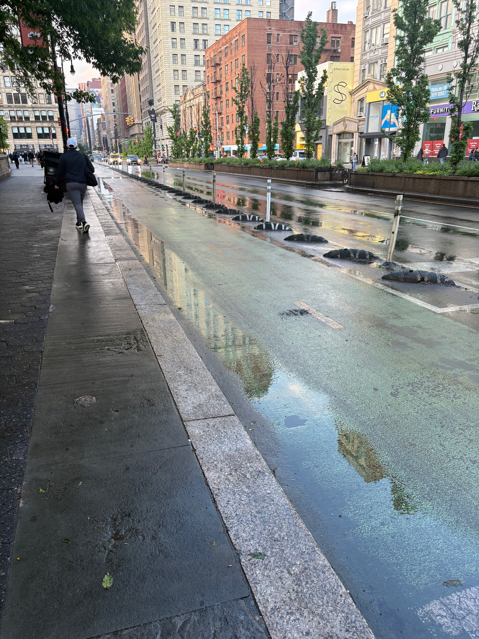
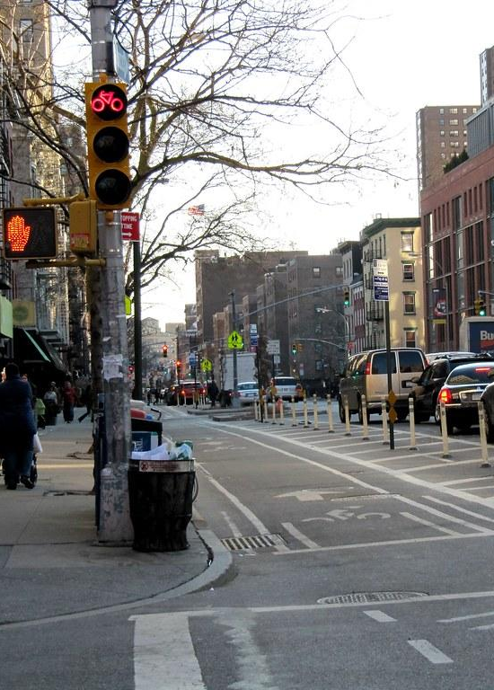
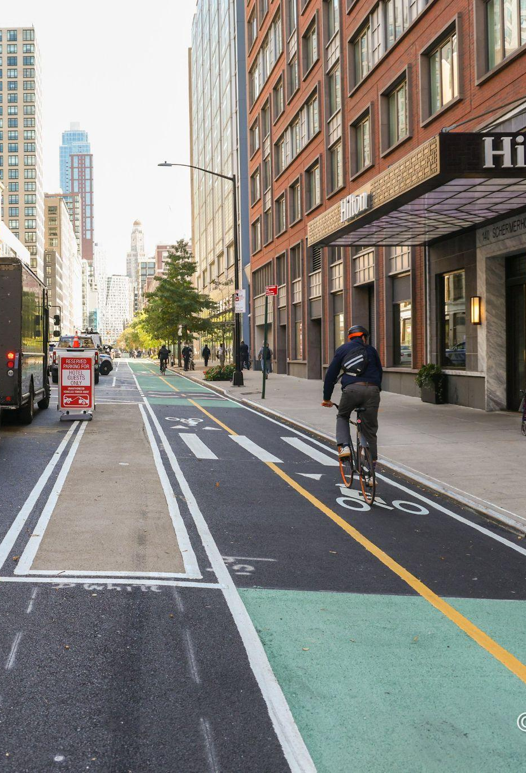
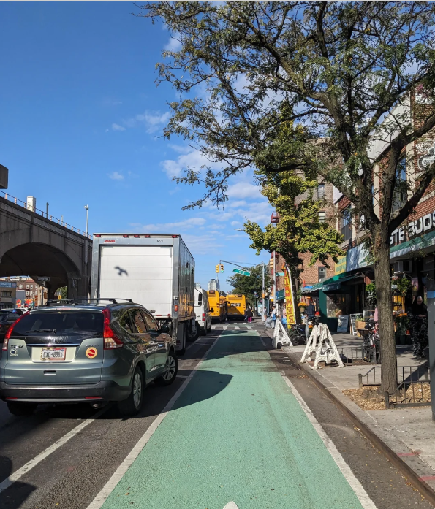
Key Locations of Concern
Broadway (Midtown) — tourist pedestrian overlap
Photograph by Omar Ramirez,2026
9th Ave (Chelsea) — high car-bike conflicts
Photograph by James Schwartz, 2020
Flatbush Ave (Brooklyn) — missing barrier gaps
Photograph by Aaron Ginsburg
October 13, 2022
Queens Blvd — historically most dangerous corridor
Photograph by
Writurr, 2024

Slide 6
Lane Splitter System
Arch-Form ABS Barrier
Low-profile arch design made from impact-grade ABS plastic. Sits flush at the lane boundary — absorbs and reflects vehicle incursion without shattering.
Interlocking Anchor System
Units connect via subsurface ABS base plate bolted to the roadway. Prevents displacement from wind, snow plows, or minor vehicle impact.
Reflective Smart Strips
High-visibility retro-reflective panels embedded in each unit. Color-coded by lane type. Visible 400ft+ at night or in rain.
Aesthetically Pleasing
Compared to other alternative these have a design that can seamlessly fit in to the city environment without having it feel cluttered

Slide 7
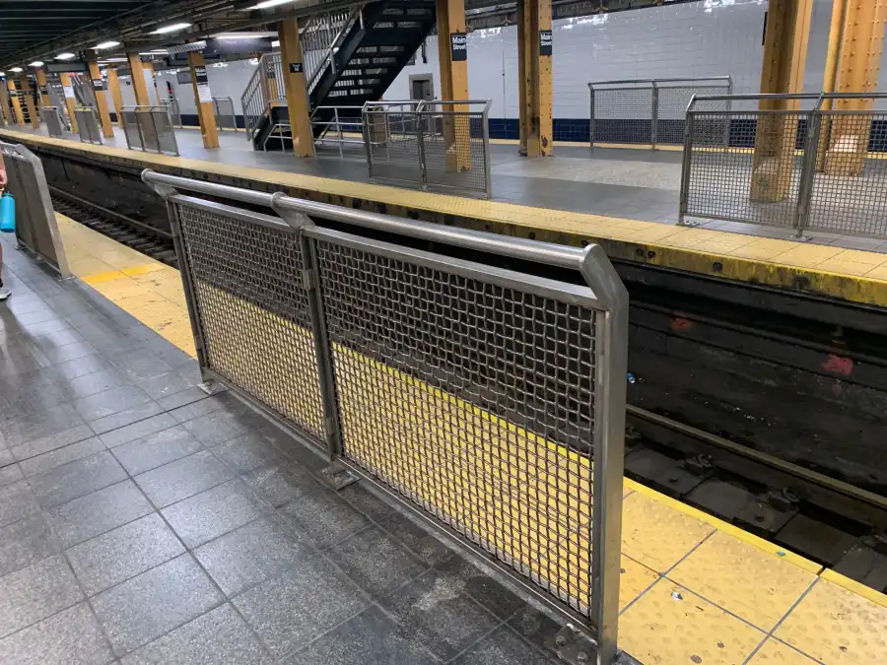
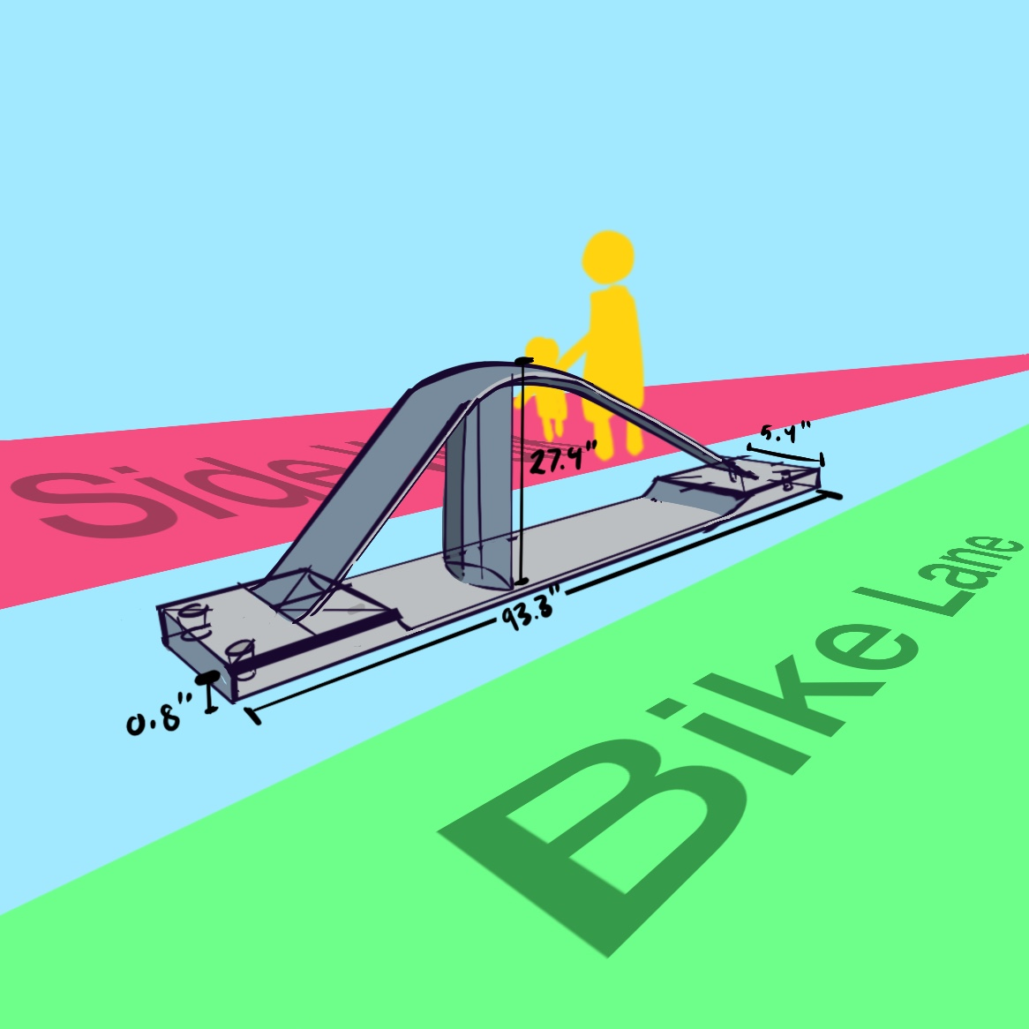
OUR DESIGN MOCKUP
MTA guard rails:
Creating a clear separation between both pedestrian and rider is necessary in preventing tens of thousands of injuries. This is where guard rails come in. Like the guard rails found in many MTA subway stations , a barrier separating pedestrians and bike lanes will deter pedestrians from walking onto the bike lane and risking injury or death.
Metal barrier could be costly; therefore a skeletal design that is made out of a cheaper material like hard plastic would be more ideal for a bike lane barrier. A skeletal design would mean more opening for substances like snow to pass through, while simultaneously reducing the amount of materials needed to manufacture the barriers.
Photograph by Barbara Russo-Lennon, 2025
Mockup of the Proposed Barrier:
Illustration by Brian Narvaez, 2026

Slide 8
Specs & Materials
Cost Estimate (Per Unit)
ABS plastic Body $55
Retro Reflective Panels $22
ABS base plate + steel bolts $25
Installation Labor $45
Total Per Unit $185 ABS plastic is lightweight, weather resistant, recyclable, and lower cost than steel
Specification | Detail
Total Length | 93.8 in (7.8 ft)
Arc Height | 27.4 (=2.3ft)
Base Width | 5.4 in
Base Height | 0.8 in
Primary Material | ABS plastic- impact grade, UV stabilized
Reflectivity | Type IV retro reflective sheeting
Weather Rating | IP67- dust & waterproof, -40 F to 140 F
Anchor Method | M12 stainless bolts through ABS plate

Slide 9
Implementation Plan
Finalize ABS arch specs with NYC DOT
Prototype 3 barriers variations
Community feedback in target neighborhoods
02
Months 4-6
Pilot Installation
Install 50 unit around the city
Gather Data (Crashes, Near Misses, displacement)
03
Months 7-12
Evaluation Scale
Analyze outcomes
Present findings to NYC DOT & city council
01
Months 1-3
Research & Design
02
Months 4-6
Pilot Installation
03
Months 7-12
Evaluation Scale

Slide 10
Why They Work
Existing Problems
Plastic Flex Posts knocked over easily
NO structural protection
May be hard to see in rain, fog , or dark
No alert when missing or damaged
Short life span
Our Bike Lane System
Impact resistant
Visibile in the dark
Sustainable
Long Life Span
Cost efficient
Studies show physical barrier upgrades reduce cyclist fatalities by up to 75% | Oslo, Netherlands, and DC have already proven this works

Slide 11
MAKE NYC'S
BIKE LANES
ACTUALLY SAFE.
Lane Splitters aren’t just better.They're safe,smarter and more functional approach to keeping our city safe.
References:
NYC DOT Vision Zero: nyc.gov/visionzero
NYC Bike Map: nyc.gov/bikemap
NYC DOT: dot.nyc.gov

Slide 12
References
Russo-Lennon, B. (2025). Metal Guard Rails in Flushing Subway Station. Retrieved 2026, from https://www.amny.com/nyc-transit/platform-barriers-nyc-subway-stations/.
Gregory, L. (2023, May 9). The Most Crowded Cities in America. The Rent. Blog : A Renter’s Guide for Tips & Advice. https://www.rent.com/blog/most-crowded-cities-in-america/
Concrete barriers - Concrete jersey barriers for sale. (n.d.). https://www.trafficsafetywarehouse.com/Concrete-Barriers/products/85/
Traffic Cones For Less.com. (n.d.). Traffic delineators, channelizers and vertical panels. Traffic Cones for Less. https://www.trafficconesforless.com/delineators/?gad_source=1&gad_campaignid=803843890&gbraid=0AAAAADL4-dEw75PCzoyChPhTUi5d0-SLy&gclid=Cj0KCQjw8PDPBhCeARIsAOJwmWV0mEqKOvTxqMQDJrn8Z05z0mSt7v15FzHKnhCPCbS8m1Qb8b1cutsaArZREALw_wcB
Vestil OPBOL Orange Plastic Bollards. (n.d.). HOF Equipment. https://hofequipment.com/Vestil-OPBOL-Orange-Plastic-Bollards-p4600.html?gad_source=1&gad_campaignid=20343618891&gbraid=0AAAAADungRB-E5ML4TiijWs_8j0_bkozp&gclid=Cj0KCQjw8PDPBhCeARIsAOJwmWWEBcl4Q5U9IojuttDaMhmt6u1Xyks3SaJ66MttmBV_xjtYXYAujfIaAoEaEALw_wcB
Narvaez, B. (2026c). Mockup of the Proposed Barrier: “Lane Splitter.” Retrieved 2026,.

