Slide 1
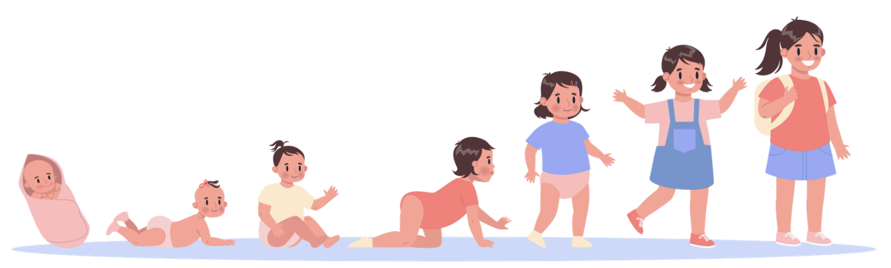
PSY 241
LECTURE ONE
01/29/2026
INTRO TO CHILD DEVELOPMENT

Slide 2

DAILY
CHECK IN!
What Gordon Ramsey are you today?

Slide 3

Question of the Day
How do you personally divide the human lifespan into “stages”?
What stages would you name?
What ages would you assign to each stage?
What makes one stage different from the next?

Slide 4
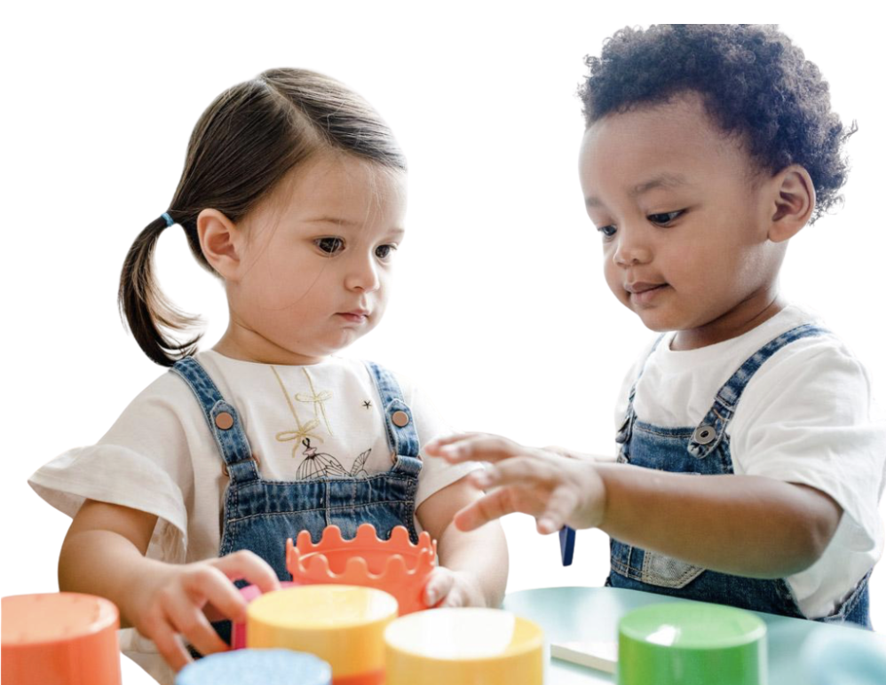
Question of the Day pt. 2
Based on your definition of stages, how do we decide when a behavior is developmentally inappropriate for a particular age or stage?

Slide 5
Principles of Development

Slide 6
Principles
1. Development is lifelong and change occurs all along the lifespan
    - Continues from birth through older adulthood
    - Change does not stop after childhood
    - Each life period includes new adjustments and milestones
Notes:
Development doesn’t stop after childhood—people keep changing physically, cognitively, and socially from birth through older adulthood. think about how different you are now compared to age 10, and how you’ll likely be different again at 30 or 60.

Slide 7
Principles
2. Development is multidirectional
    Some skills increase, others decrease, at the same time
    Growth is not linear – development involves both gains and losses
Notes:
Development is multidirectional, meaning it doesn’t move in one straight line of “constant improvement.”
Instead, different abilities can change in different directions at the same time.
For example, as people grow, they may gain new knowledge, better problem-solving skills, or stronger emotional regulation, while also experiencing declines in other areas like reaction time, physical speed, or memory for small details. So development includes both gains and losses, and it’s normal for some skills to improve while others level off or decrease.

Slide 8
Principles
3. Development is multidimensional
    Change occurs across 3 domains
      Physical, Cognitive, and Psychosocial

Slide 9
Principles
3. Development is multidimensional
    Change occurs across 3 domains
      Physical, Cognitive, and Psychosocial
    Height and Weight, Gross and Fine motor skills, sensory capabilities, the nervous system, propensity for illness and disease

Slide 10
Principles
3. Development is multidimensional
    Change occurs across 3 domains
      Physical, Cognitive, and Psychosocial
    Intelligence, Wisdom, Perception, Problem – solving, Memory, and Language

Slide 11
Principles
3. Development is multidimensional
    Change occurs across 3 domains
      Physical, Cognitive, and Psychosocial
    Emotion, Self-perception, and Interpersonal relationships with families, peers, and friends

Slide 12
Principles
Change occurs in 3 domains
- Impact one another
- Cascading effects
Notes:
The three domains of development are interconnected, meaning they influence one another.
A change in one area can “spill over” and trigger changes in the others as well.

Slide 13
Principles
4. Development is characterized by plasticity
    - which is our ability to change and that many of our characteristics are malleable.
Notes:
Development is characterized by plasticity, which means people have the capacity to change and adapt over time.
Many of our characteristics—like skills, behaviors, and even ways of thinking—are malleable, especially in response to experience, learning, and environmental support.
Plasticity reminds us that development isn’t fixed or predetermined; growth can happen through practice, opportunity, and intervention, even if individuals start out with different strengths or challenges.

Slide 14
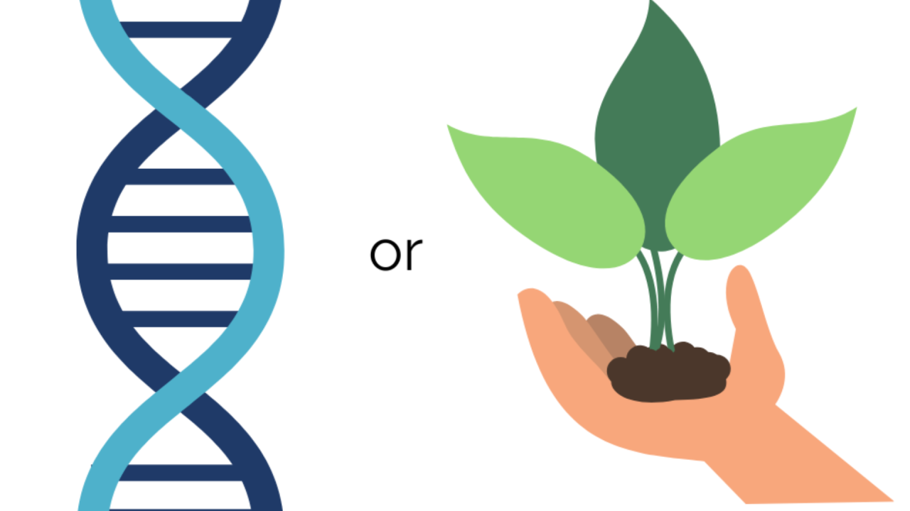
Principles
5. Development is multi-contextual
    Nature
    Nurture
Notes:
Development is multicontextual, meaning it’s shaped by multiple forces working together
We know this as nature vs. nuture
However this understanding is out of date

Slide 15
Principles
5. Development is multi-contextual
    Nature
    Nurture
    Culture
Notes:
A modern way to think about this is nature, nurture, and culture.
Nature refers to our biology and genetics—our built-in traits and predispositions.
Nurture refers to our environment and experiences, like family life, schools, peers, and community resources. And
culture includes the shared values, beliefs, expectations, and norms that influence what behaviors are encouraged, discouraged, or even considered “normal.”
The key idea is that behaviors, motivations, emotions, and choices don’t happen in a vacuum—they reflect a larger picture of the person’s biology, lived experiences, and the cultural world around them.
Cultural Example: Autism Diagnosis rates and interpretation in Japan

Slide 16
Periods of Development

Slide 17

Prenatal
Notes:
Development begins at conception, when the foundation for the body’s major structures starts forming.
During this time, the pregnant person’s health is especially important because it strongly influences fetal growth.
Key topics in the prenatal period include nutrition, exposure to teratogens (environmental substances or conditions that can cause harm or birth defects), and what happens during labor and delivery.

Slide 18

Infancy and Toddlerhood
Notes:
The first two years of life involve incredibly rapid growth and change.
A newborn may arrive with a strong sense of hearing but limited vision, and within a short period, becomes a toddler who can walk, communicate, and explore the world much more independently.
During this time, caregivers also experience a major shift—from focusing mainly on feeding and sleep routines to constantly supervising, guiding, and keeping up with a mobile, energetic child who is learning through movement and exploration.

Slide 19

Notes:
Unlike many animals that can walk or function independently soon after birth, human babies are extremely dependent, making the first two years a period of intense change for both the child and the caregiver.

Slide 20
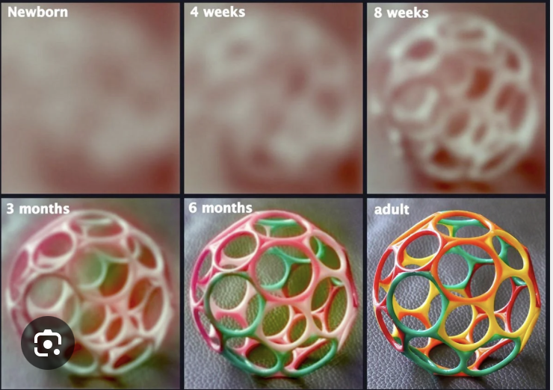

Slide 21

Early
Childhood
Notes:
Early childhood—often called the preschool years—includes the time after toddlerhood and before children begin formal schooling.
During this stage, typically around ages three to five, children are rapidly building language skills, developing a stronger sense of self, and gaining more independence. They’re also starting to make sense of how the physical world works.
That understanding doesn’t develop instantly, though. Preschoolers often have creative or surprising ideas about concepts like size, time, space, and distance
for example, a child might worry they could go down the drain if they sit too close to the front of the bathtub, or show how long something will take by holding their fingers a few inches apart.
Emotionally and socially, this is also a period of change: the intense determination we see in toddlers can shift into a growing awareness of others’ expectations, and children may begin to experience guilt when their actions lead to disapproval

Slide 22

Middle
Childhood
Notes:
Middle childhood typically includes ages six through eleven, and a large part of development during this period is shaped by children’s growing involvement in elementary school.
At this stage, the child’s world becomes centered around learning, practicing, and being evaluated on new academic skills. Children also begin to judge their own abilities by comparing themselves to others, especially in school environments.
Schools often make these comparisons visible through things like grades, test scores, awards, and team sports, which can influence children’s motivation and self-concept.
Physically, growth tends to slow down, and children become more coordinated as they refine their motor skills.
Socially, children expand their relationships beyond the family, forming stronger connections through friendships and interactions with peers and classmates.

Slide 23

Adolescence
Notes:
Adolescence is a period of major development and transformation.
Physically, it is marked by a rapid growth spurt and sexual maturation, known as puberty.
At the same time, adolescents experience important cognitive changes—they become more capable of thinking beyond the here-and-now, imagining new possibilities, and reasoning about abstract concepts like love, fear, identity, and freedom.
Interestingly, even as their thinking becomes more advanced, many adolescents also develop a sense of invincibility—the belief that serious consequences won’t happen to them. This can increase risk-taking behavior and helps explain why adolescence is associated with higher risks such as accidents or exposure to sexually transmitted infections, which can have long-term consequences.

Slide 24
Think – Pair - Share
What stage of development are you most excited to learn about and why?
Reflecting on your life thus far, what stage of development do you think was most impactful in shaping who you are today?

Slide 25
Issues in Development

Slide 26
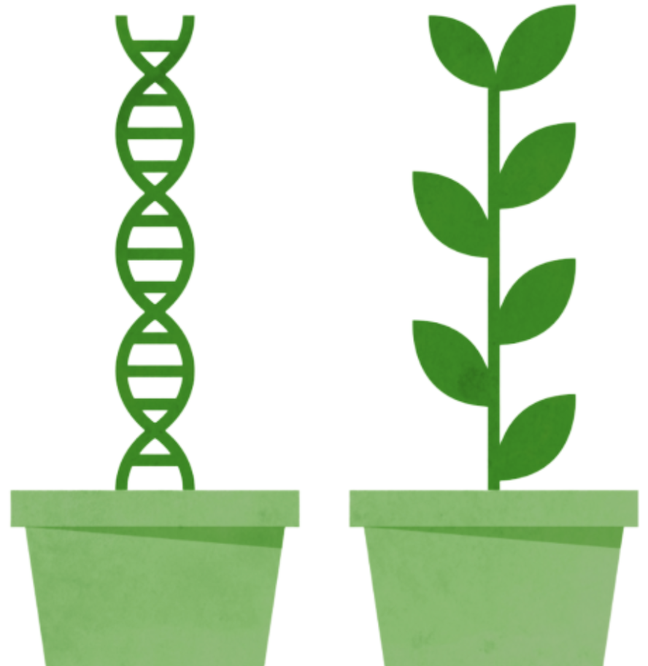
Nature v Nurture
Where do individual differences come from?
In reality, these factors work together in complex processes
Notes:
. A major question in developmental science is where individual differences come from. When we look at traits like growth, health outcomes, temperament, or personality, it’s tempting to ask: is this mostly biology, or mostly experience?
That’s the classic nature–nurture debate.
But today, most researchers don’t treat nature and nurture as competing explanations. Instead, the focus is on how they work together over time.
For example, genetics might influence someone’s baseline sensitivity to stress, but whether that sensitivity leads to anxiety, resilience, or something in between depends heavily on the environment—like parenting, peer support, and chronic stress.
We also now understand that the environment can actually shape how genes operate through epigenetics, which refers to changes in gene expression—meaning genes can be turned “up” or “down”—without changing the DNA itself.
There’s also evidence from major historical events. For example, people exposed to severe famine conditions during pregnancy—like the Dutch Hunger Winter—show long-term differences in health risk, and researchers have found epigenetic differences tied to those prenatal conditions
Things like nutrition, exposure to toxins, and early stress can influence these biological processes, especially during sensitive developmental periods.
So instead of asking “nature or nurture,” a more accurate question is: How do biology and experience interact to shape development across time and contexts?

Slide 27
Continuity v. Discontinuity
Is development gradual or in stages?
Notes:
One major debate in developmental science is whether human development is best described as continuous or discontinuous. In other words, do we develop through slow, gradual change, or do we move through more abrupt shifts where we seem like a different person at different points in life?
In discontinuous development, sometimes called a stage-like view, development happens in distinct stages that are qualitatively different from one another. In this view, you don’t just get “more of the same”—you move into a new way of thinking or behaving that’s meaningfully different from the earlier stage.
In continuous development, development is seen as more gradual. Instead of new stages appearing suddenly, skills and abilities develop through small, steady changes over time. In this view, adults don’t have completely new abilities—they have more developed versions of skills that started earlier in childhood.
Today, many psychologists recognize that development can include both patterns depending on what we’re looking at. Some changes may look gradual, while others appear to shift quickly—because development is shaped by a combination of brain development and experience over time.
For example, height and vocabulary growth often look continuous—kids usually grow a little taller over time, and they gradually learn more words through exposure and practice.
But other changes can feel more discontinuous, or stage-like. A good example is puberty, where physical changes happen relatively quickly during a shorter window of time. Another example is when a child suddenly seems to “get it,” like having a noticeable jump in reading ability or showing a new level of logical thinking after struggling before.

Slide 28
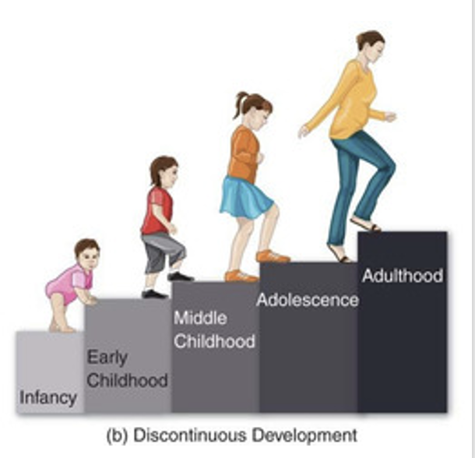
Continuity v. Discontinuity
Is development gradual or in stages?
Discontinuous: distinct stages following a universal sequence
Notes:
One major debate in developmental science is whether human development is best described as continuous or discontinuous. In other words, do we develop through slow, gradual change, or do we move through more abrupt shifts where we seem like a different person at different points in life?
In discontinuous development, sometimes called a stage-like view, development happens in distinct stages that are qualitatively different from one another. In this view, you don’t just get “more of the same”—you move into a new way of thinking or behaving that’s meaningfully different from the earlier stage.
In continuous development, development is seen as more gradual. Instead of new stages appearing suddenly, skills and abilities develop through small, steady changes over time. In this view, adults don’t have completely new abilities—they have more developed versions of skills that started earlier in childhood.
Today, many psychologists recognize that development can include both patterns depending on what we’re looking at. Some changes may look gradual, while others appear to shift quickly—because development is shaped by a combination of brain development and experience over time.
For example, height and vocabulary growth often look continuous—kids usually grow a little taller over time, and they gradually learn more words through exposure and practice.
But other changes can feel more discontinuous, or stage-like. A good example is puberty, where physical changes happen relatively quickly during a shorter window of time. Another example is when a child suddenly seems to “get it,” like having a noticeable jump in reading ability or showing a new level of logical thinking after struggling before.

Slide 29
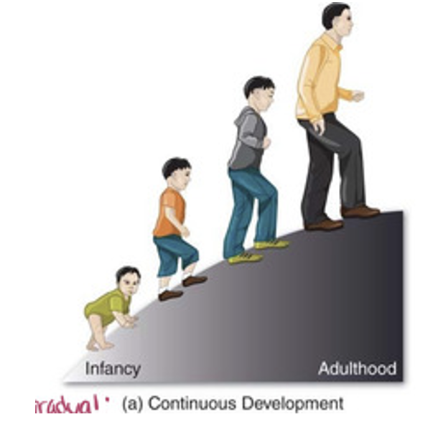
Continuity v. Discontinuity
Is development gradual or in stages?
Continuous: slow and steady, skills become more advanced over time
Notes:
One major debate in developmental science is whether human development is best described as continuous or discontinuous. In other words, do we develop through slow, gradual change, or do we move through more abrupt shifts where we seem like a different person at different points in life?
In discontinuous development, sometimes called a stage-like view, development happens in distinct stages that are qualitatively different from one another. In this view, you don’t just get “more of the same”—you move into a new way of thinking or behaving that’s meaningfully different from the earlier stage.
In continuous development, development is seen as more gradual. Instead of new stages appearing suddenly, skills and abilities develop through small, steady changes over time. In this view, adults don’t have completely new abilities—they have more developed versions of skills that started earlier in childhood.
Today, many psychologists recognize that development can include both patterns depending on what we’re looking at. Some changes may look gradual, while others appear to shift quickly—because development is shaped by a combination of brain development and experience over time.
For example, height and vocabulary growth often look continuous—kids usually grow a little taller over time, and they gradually learn more words through exposure and practice.
But other changes can feel more discontinuous, or stage-like. A good example is puberty, where physical changes happen relatively quickly during a shorter window of time. Another example is when a child suddenly seems to “get it,” like having a noticeable jump in reading ability or showing a new level of logical thinking after struggling before.

Slide 30
Active v. Passive
A child is either passively shaped by external forces in their environment or plays an active role in their own development
Notes:
Another major question in developmental psychology is how much people actively shape their own development. In other words, are we mostly steering our own growth through our choices and actions, or are we mainly shaped by forces outside of us—like genetics and environment?
Some perspectives emphasize that humans play an active role. For example, children aren’t just absorbing information—they’re constantly exploring, experimenting, and trying to make sense of the world. From this viewpoint, learning happens because children actively engage with their environment and build new ways of thinking based on what they experience.
Other perspectives lean toward a more passive role, where development is mostly driven by what happens to us. For example, some approaches focus on how behavior is shaped by the environment—through rewards, consequences, routines, and what behaviors get reinforced over time. In this view, development is largely the product of external influences.
Most modern developmental scientists acknowledge that it’s not one or the other—people are influenced by their environment, but they also respond to it, interpret it, and make choices that shape their path.

Slide 31
Active v. Passive
A child is either passively shaped by external forces in their environment or plays an active role in their own development
Active: Children build understanding through experience. They explore, make choices, and shape their learning
Notes:
Another major question in developmental psychology is how much people actively shape their own development. In other words, are we mostly steering our own growth through our choices and actions, or are we mainly shaped by forces outside of us—like genetics and environment?
Some perspectives emphasize that humans play an active role. For example, children aren’t just absorbing information—they’re constantly exploring, experimenting, and trying to make sense of the world. From this viewpoint, learning happens because children actively engage with their environment and build new ways of thinking based on what they experience.
Other perspectives lean toward a more passive role, where development is mostly driven by what happens to us. For example, some approaches focus on how behavior is shaped by the environment—through rewards, consequences, routines, and what behaviors get reinforced over time. In this view, development is largely the product of external influences.
Most modern developmental scientists acknowledge that it’s not one or the other—people are influenced by their environment, but they also respond to it, interpret it, and make choices that shape their path.

Slide 32
Active v. Passive
A child is either passively shaped by external forces in their environment or plays an active role in their own development
Active: Children build understanding through experience. They explore, make choices, and shape their learning
Passive: Development is shaped mainly by the environment. Behavior changes through reinforcement and consequences
Notes:
Another major question in developmental psychology is how much people actively shape their own development. In other words, are we mostly steering our own growth through our choices and actions, or are we mainly shaped by forces outside of us—like genetics and environment?
Some perspectives emphasize that humans play an active role. For example, children aren’t just absorbing information—they’re constantly exploring, experimenting, and trying to make sense of the world. From this viewpoint, learning happens because children actively engage with their environment and build new ways of thinking based on what they experience.
Other perspectives lean toward a more passive role, where development is mostly driven by what happens to us. For example, some approaches focus on how behavior is shaped by the environment—through rewards, consequences, routines, and what behaviors get reinforced over time. In this view, development is largely the product of external influences.
Most modern developmental scientists acknowledge that it’s not one or the other—people are influenced by their environment, but they also respond to it, interpret it, and make choices that shape their path.

Slide 33
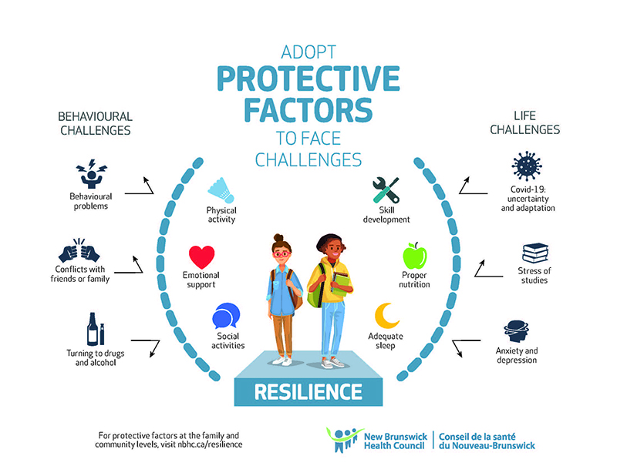
Risk v. Resilience
Risk: experiences that increase the likelihood of negative outcomes
Resilience: positive adaptation despite challenges
Notes:
A more contemporary conversation in child development focuses on risk and resilience—basically, how children respond to adversity and why some children bounce back more successfully than others.
For a long time, the general assumption was that it’s always best to protect children from as much stress, disappointment, and loss as possible. And to be clear: most researchers agree that protecting children from serious trauma, ongoing threat, or major stressors is critically important.
But more recent perspectives emphasize that not all stress is harmful. Smaller, manageable challenges—like struggling with a difficult task, getting left out of a game, not making the team, or experiencing a disappointment—can become opportunities for children to practice coping and problem-solving. Those experiences can help build resilience over time.
A key point is that resilience isn’t something you either have or don’t have. It involves patterns of thinking, behavior, and emotional regulation that can be learned and developed, especially when children have support from caregivers, teachers, and other adults. When children face adversity, helping them interpret the experience as something they can survive—and learn from—can strengthen their confidence and coping skills for future challenges.
So the goal isn’t to eliminate every stressor. The goal is to support children through challenges in a way that builds effective coping strategies and long-term resilience.

Slide 34
Risk v. Resilience
Risk: experiences that increase the likelihood of negative outcomes
Resilience: positive adaptation despite challenges
Resilience is not a fixed trait. It can be learned and strengthened
Notes:
A more contemporary conversation in child development focuses on risk and resilience—basically, how children respond to adversity and why some children bounce back more successfully than others.
For a long time, the general assumption was that it’s always best to protect children from as much stress, disappointment, and loss as possible. And to be clear: most researchers agree that protecting children from serious trauma, ongoing threat, or major stressors is critically important.
But more recent perspectives emphasize that not all stress is harmful. Smaller, manageable challenges—like struggling with a difficult task, getting left out of a game, not making the team, or experiencing a disappointment—can become opportunities for children to practice coping and problem-solving. Those experiences can help build resilience over time.
A key point is that resilience isn’t something you either have or don’t have. It involves patterns of thinking, behavior, and emotional regulation that can be learned and developed, especially when children have support from caregivers, teachers, and other adults. When children face adversity, helping them interpret the experience as something they can survive—and learn from—can strengthen their confidence and coping skills for future challenges.
So the goal isn’t to eliminate every stressor. The goal is to support children through challenges in a way that builds effective coping strategies and long-term resilience.

Slide 35
Think – Pair - Share
What are your opinions on these issues?
  What do you think is stronger: Nature or Nurture?
  Do you think development is more continuous or discontinuous or a mix of both?
  Are we actively shaping our development or passively shaped by it?
  How much risk should we be having kids take to build up resilience? How much of resilience is inherent?

Slide 36
Activity

Slide 37
Let's Review
A child who becomes more coordinated at sports over time is an example of:
  A. Discontinuous change
  B. Continuous change
  C. Regression
  D. Intermittent development

Slide 38
Let's Review
A child who becomes more coordinated at sports over time is an example of:
  A. Discontinuous change
  B. Continuous change
  C. Regression
  D. Intermittent development

Slide 39
Let's Review
Two children have the same genetic risk for anxiety, but only one develops anxiety symptoms. The best explanation is:
  A. Genetics play no role in the development of the disorder
  B. The environment overrides genetics completely
  C. Nature, Nurture, and Culture likely interact to influence outcomes
  D. Anxiety disorders form when cultural practices fail to provide enough risk for resilience growth

Slide 40
Let's Review
Two children have the same genetic risk for anxiety, but only one develops anxiety symptoms. The best explanation is:
  A. Genetics play no role in the development of the disorder
  B. The environment overrides genetics completely
  C. Nature, Nurture, and Culture likely interact to influence outcomes
  D. Anxiety disorders form when cultural practices fail to provide enough risk for resilience growth

Slide 41
Let's Review
Which situation best illustrates the idea that stage boundaries are partly shaped by culture?
  A. Growth Spurts during puberty
  B. The age children begin walking
  C. Different societies defining adulthood at different ages
  D. Babies developing depth perception

Slide 42
Let's Review
Which situation best illustrates the idea that stage boundaries are partly shaped by culture?
  A. Growth Spurts during puberty
  B. The age children begin walking
  C. Different societies defining adulthood at different ages
  D. Babies developing depth perception

Slide 43
Let's Review
A college student becomes more emotionally regulated than they were at age 15, but also reports worse sleep and slower recovery after all-nighters. This best demonstrates:
  A. Development moves in one direction
  B. Multidirectional development
  C. Discontinuous development only
  D. A lack of plasticity

Slide 44
Let's Review
A college student becomes more emotionally regulated than they were at age 15, but also reports worse sleep and slower recovery after all-nighters. This best demonstrates:
  A. Development moves in one direction
  B. Multidirectional development
  C. Discontinuous development only
  D. A lack of plasticity

