Slide 1

Introduction to Child Development Cont.

Slide 2


Make a name tent with your first name in large letters. Write down the name you wish to be called.

Slide 3

Question of the Day

Slide 4
Question of the Day
What is childhood for?
Is childhood something to be protected—or something to be prepared?
Notes:
What I want you to notice is that none of your answers are wrong — but they are not timeless.”
“The idea that childhood has a purpose at all is actually a historical and cultural invention.”
“Depending on the time period, childhood has been about survival, contribution, moral training, schooling, protection, or rights.”
“When life is fragile, childhood looks different than when life is stable.”
“When societies need labor, children are contributors. When societies need educated workers, children become students.”
“And when societies begin to think about rights and well-being, childhood becomes something to protect.”
“So when we ask whether childhood should be protected or prepared, the answer has changed over time — and it hasn’t changed equally for everyone.”
“As we go through each time period, I want you to keep your original answer in mind and ask: Which version of childhood does this reflect?”

Slide 5
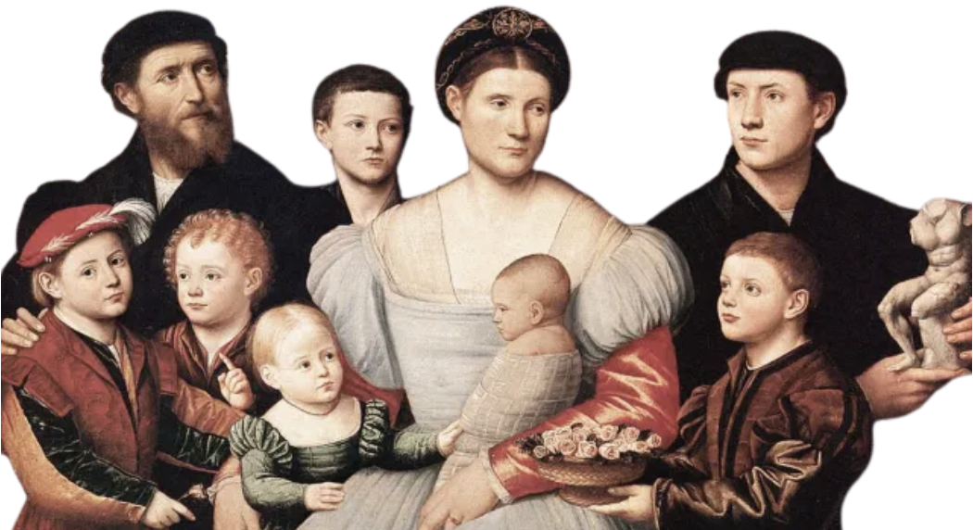
History of Childhood
Notes:
“Up to this point, we’ve been talking about development as if childhood is a natural, universal stage of life.”
“But before we can talk about childhood across cultures, we need to talk about childhood across history.”
“The way we understand childhood today — as a protected, structured, and developmentally important period — is actually very recent.”
“For most of human history, childhood looked very different than it does now.”
“And those differences weren’t because people didn’t care about children — they were because societies faced different realities and had different priorities.”
“In this section, we’re going to walk through how childhood has been understood at different points in history.”
“As we do that, I want you to keep thinking about the question we started with: What is childhood for?”
“You’ll see that the answer to that question changes depending on what a society needs from children — and what it can afford to give them.”
“Understanding this history helps us see that many of our assumptions about childhood are not universal truths, but products of a specific time and place.”
“And that insight is going to matter a lot once we start talking about culture and development.”

Slide 6
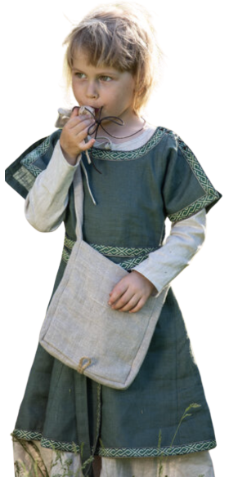
Childhood isn’t Timeless
Childhood is a social and historical concept
Expectations for children have changed across time
Ideas about childhood reflect:
  Survival needs
  Economic structures
  Cultural values
Notes:
“When we think about childhood today, it feels natural — almost biological.”
Children are biological beings
Childhood is how societies organize and interpret children’s lives
Social and historical concept: shaped by norms and beliefs, not just age
Expectations change: what children do, learn, and are responsible for
Childhood Reflects society: what children are expected to become mirrors what society needs
“Many of the things you wrote down would not have made sense in earlier time periods.”
“By the end of this, you should be able to see childhood as something that has a history — not something that’s always looked the same.”

Slide 7
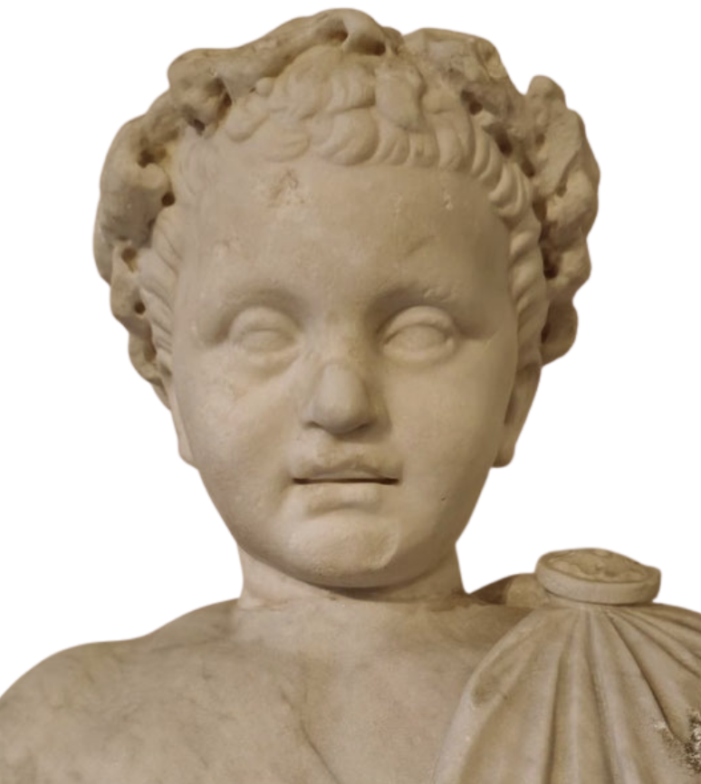
Early History: Survival Over Childhood
Ancient Times - Middle Ages - Early Modern Period
Life was harsh and unpredictable
Extremely high infant and child mortality
Families prioritized survival
Children were valued for their ability to contribute
Notes:
“In early historical periods, childhood was not understood as a protected or prolonged stage of life.”
“This wasn’t because people didn’t value children — it was because daily life itself was extremely fragile.”
“Infant and child mortality rates were very high.”
Many children did not survive past early childhood
Causes included:
Malnutrition
Infectious disease
Poor sanitation
Lack of medical knowledge or care
“When survival is uncertain, families organize life differently.”
Emotional investment often had to be balanced with realism
Long-term planning for childhood development was less feasible
“The primary focus of families during this time was survival.”
Producing food
Maintaining the household
Ensuring continuity of the family
“Children were valued largely for their ability to contribute to these goals.”
Helping with household labor
Working in agriculture or family trades
Caring for younger siblings
“This does not mean children were unloved or ignored.”
Historical records show evidence of parental grief and attachment
But expectations for children were different from today
“There was little concept of childhood as a separate developmental stage.”
Children were often integrated quickly into adult roles
Few distinctions between children’s and adults’ daily activities
“In other words, childhood was short — not because adults wanted it to be, but because circumstances demanded it.”
“This period helps us see that ideas about childhood are deeply tied to social conditions.”
When survival dominates, childhood emphasizes contribution
Protection and prolonged development become possible only later
Transition line to next slide:
“As societies became more stable and complex, we begin to see the earliest shifts toward viewing childhood as something distinct — especially through changes in education.”

Slide 8
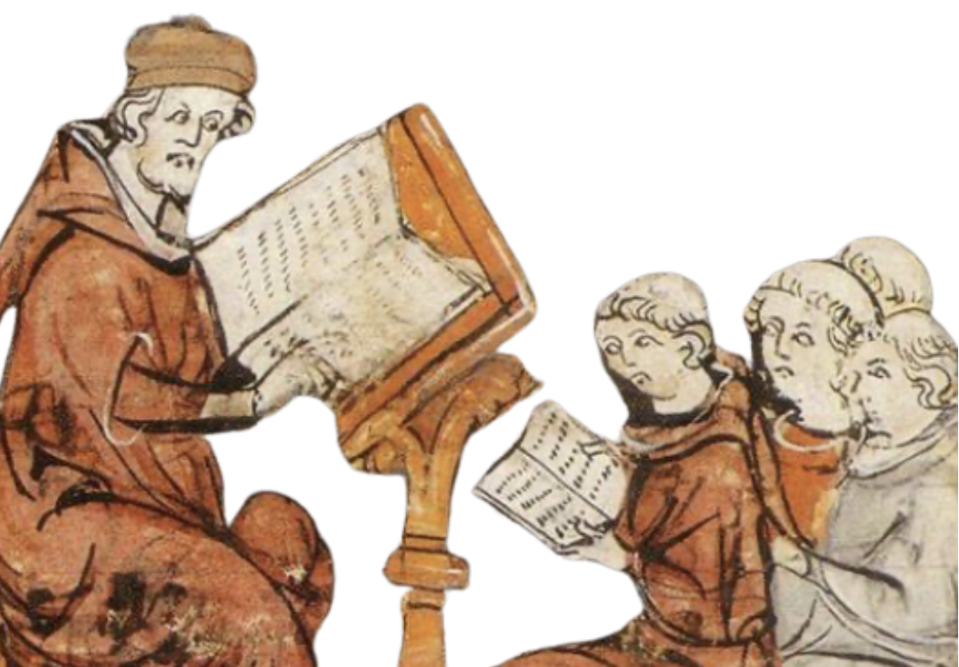
Education Was Rare and Unequal
Education Before the 16th Century
Formal education was uncommon
Mostly reserved for:
  Clergy, Government officials, Physicians
Most children learned through:
  Work, Apprenticeship, Observation
Notes:
(Before the 16th Century)
“Up through most of early history, formal education was not a standard part of childhood.”
“The idea that all children should go to school is a very modern one.”
“Formal education was largely reserved for a small segment of the population.”
Members of the clergy
Government officials
Physicians and scholars
“These roles required literacy and specialized knowledge, so education was seen as vocational, not developmental.”
“For the majority of children, learning happened informally.”
Through work in the household
Through apprenticeships
Through observation and participation in daily life
“Children learned the skills they needed to survive and contribute.”
Farming
Craft work
Household management
“There was little separation between learning and labor.”
“Importantly, education was not viewed as something children needed simply because they were children.”
It was a privilege
Not a right
Not a universal expectation
“This helps explain why childhood was not yet framed as a period of structured development.”
No age-graded classrooms
No standardized curricula
No developmental benchmarks
“Without schools grouping children by age, there was less focus on comparing children to one another.”
Fewer expectations about what children should be able to do at a specific age
“This historical context matters because it shows that schooling didn’t create childhood — but it profoundly reshaped it.
It isn’t until Enlightenment thinking and broader social change that we begin to see childhood reimagined as a stage worth investing in and protecting.

Slide 9
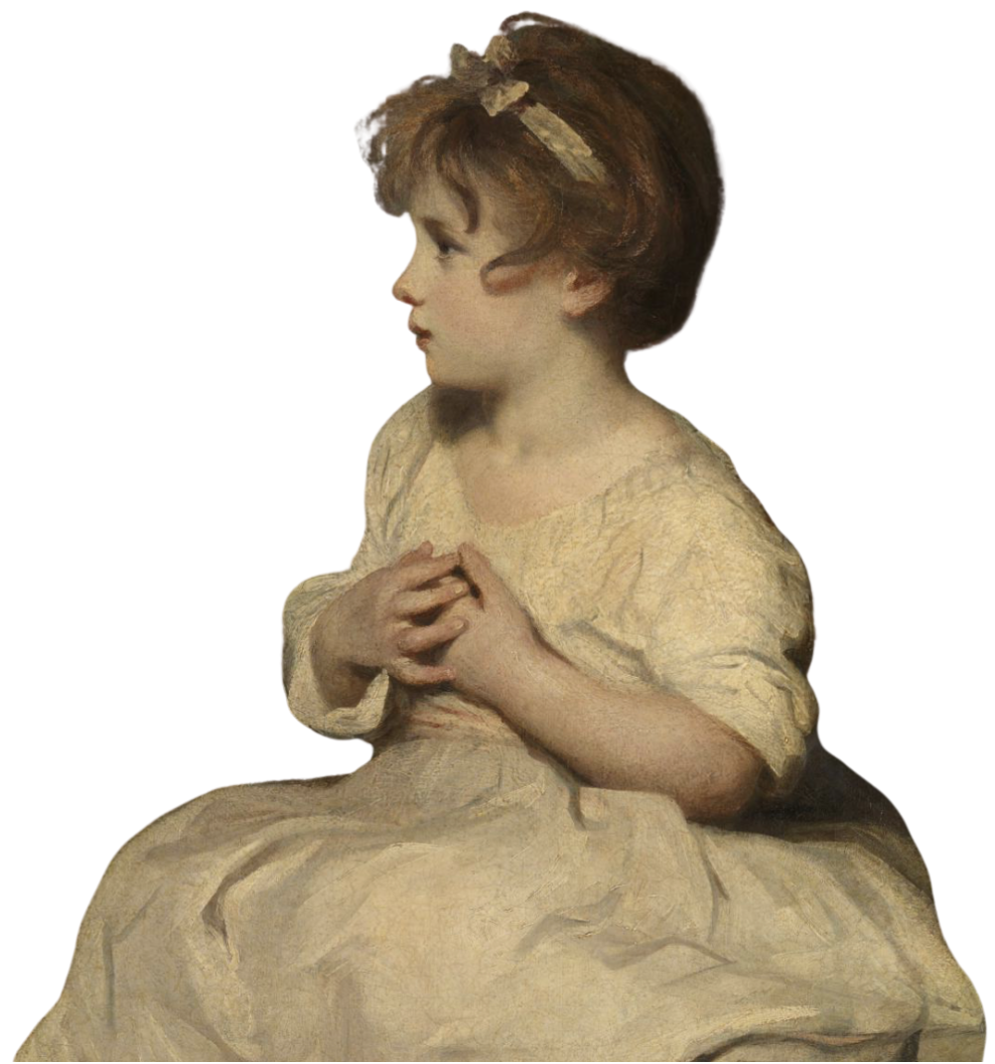
Enlightenment Shift: 1700-1800s
A New Way of Thinking About Children
Childhood recognized as a distinct life stage
Children viewed as vulnerable and innocent
Growing focus on: Education, Morality, Character development
Belief that childhood should not be rushed
Notes:
“Beginning in the 1700s, particularly in Western societies influenced by Enlightenment thinking, we start to see a noticeable shift in how childhood is understood.”
“For the first time, childhood is increasingly viewed as a distinct and meaningful stage of life, rather than simply a brief transition into adulthood.”
“Children begin to be seen as vulnerable and impressionable.”
Not fully rational
Not fully formed
In need of guidance and care
“This is where the idea of childhood innocence becomes culturally prominent.” “The notion of innocence reflects a belief that children should be protected from adult responsibilities and moral corruption.”
“As a result, there is growing attention to how children are raised.”
What kinds of experiences they have
What kind of education they receive
How their character and morality develop
“During this period, people increasingly believe that childhood should not be rushed.”
Development is seen as something that unfolds over time
Childhood becomes a period of preparation, not immediate contribution
“Importantly, this shift did not happen overnight.”
Nor did it apply equally to all children
Many working-class children continued to work
“So this new view of childhood was uneven and deeply shaped by social class.”
“Nevertheless, this period laid the foundation for modern beliefs about parenting and education.”
That children need protection
That adults are responsible for shaping development
That childhood experiences matter for who a person becomes
“This way of thinking sets the stage for later changes during industrialization, when schooling becomes central to childhood.
“As societies industrialized, these ideas about protecting and educating children came into tension with economic demands — and that tension reshaped childhood once again.”

Slide 10
THINK-PAIR-SHARE
Who benefits from this view of childhood — and who might be excluded?
Write down your answer
Turn to a nearby classmate and share what you wrote
Get ready to share: you can share what you wrote or what a classmate shared with you
Notes:
Those assumptions become much harder to maintain once societies industrialize — which brings us to the next period

Slide 11
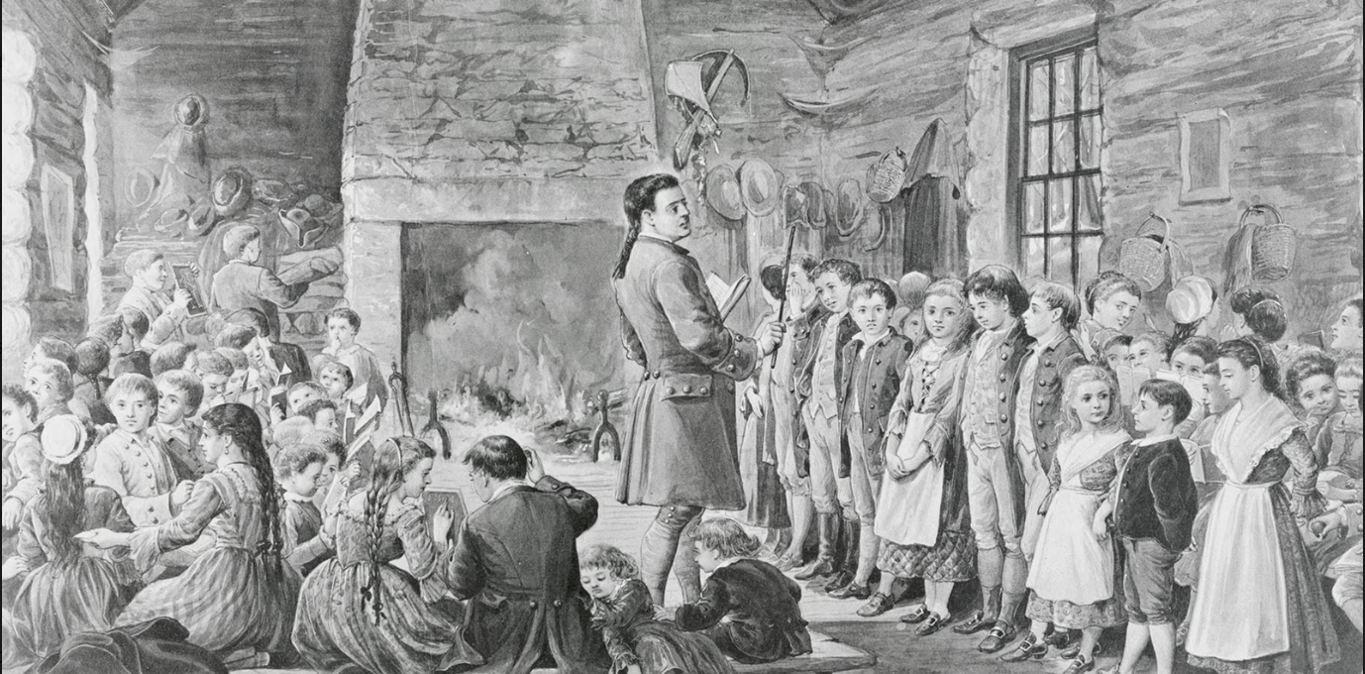
Education Becomes a Social Responsibility
Late 1500s to 1700s
Expanding societies needed skilled workers
Education seen as socially valuable
Families required institutional support
Early forms of modern schools emerged
Notes:
(Late 1500s → 1700s)
“As we move out of the early Enlightenment period, we start to see a subtle but important shift.”
“Education begins to be viewed not just as an individual or family matter, but as something that benefits society as a whole.”
“As societies became more complex, they needed people with specialized skills.”
Literacy
Numeracy
Administrative and technical knowledge
“This made education economically and socially valuable in new ways.”
“Families alone could no longer meet these educational demands.”
Teaching advanced skills takes time and resources
Not all parents had the knowledge or ability to educate their children formally
“As a result, communities and governments began to support schooling.”
Early public schools
Church- or state-supported education
“This is the beginning of schooling as an institution tied to childhood.”
“Importantly, this does not yet mean that all children went to school.”
Access was still uneven
Social class, gender, and location mattered
“But the idea that children should be educated was gaining ground.”
“This marks a key transition in how childhood is understood.”
Children are increasingly seen as future citizens and workers
Childhood becomes a period of preparation, not just survival or contribution
“This shift sets up a major tension we’ll see in the next period.”
Children are seen as needing education and protection
But economic realities still push many children into labor
That tension becomes especially visible during the Industrial Era, when childhood is pulled in two very different directions — work and school.

Slide 12
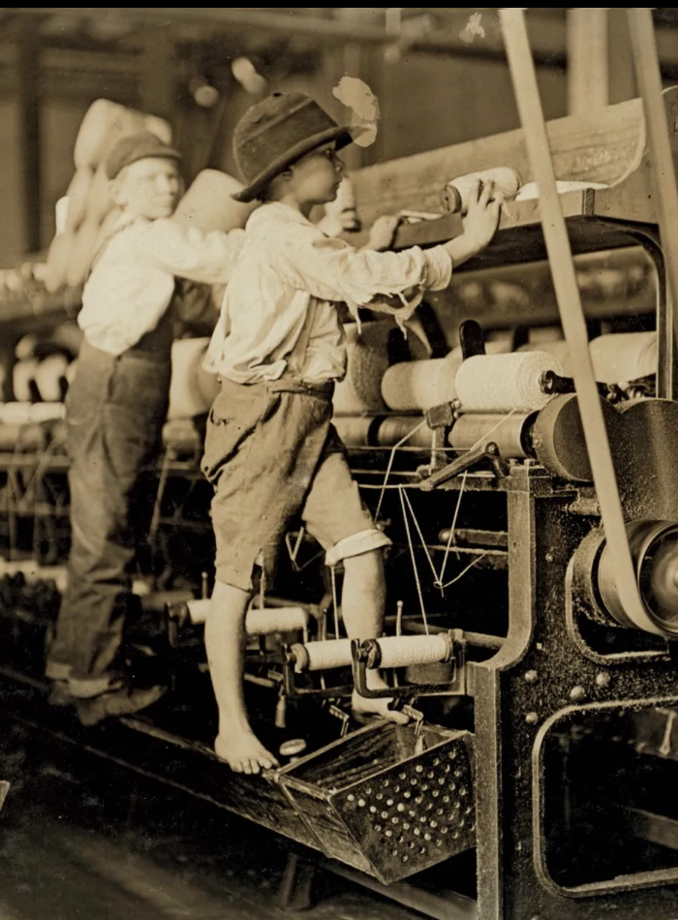
Industrial Era: Childhood Under Pressure
Schooling, Labor, and Reform
Widespread child labor in factories and mines
Growing concern about child welfare
Reform movements push for:
  Labor laws
  Compulsory education
Childhood increasingly defined by school attendance
Notes:
(1800s → Early 1900s)
“The Industrial Era dramatically reshapes childhood, especially in Europe and the United States.”
“This period creates a major contradiction in how children are viewed.”
“On one hand, industrialization increased the demand for labor.”
Factories, mines, and mills needed workers
Children were inexpensive, physically small, and easily controlled
“As a result, many children worked long hours in dangerous conditions.”
Factory work
Mining
Urban labor
“For many families, children’s labor was essential for survival.”
“On the other hand, this same period saw growing concern about children’s welfare.”
Reformers began documenting:
Physical harm
Exhaustion
Lack of education
“These concerns sparked major child welfare and labor reform movements.”
“This tension—children as workers versus children as developing individuals—became central.”
Should children contribute economically?
Or should they be protected and educated?
“One major outcome of this tension was the expansion of compulsory schooling.”
In the U.S., Massachusetts passed the first compulsory education law in 1852
This helped establish schooling as a normative expectation of childhood
“Once children are expected to be in school, childhood becomes increasingly defined by education.”
Children are grouped by age
Learning becomes structured and standardized
Differences between children become more visible
“This is a crucial moment for developmental science.”
People begin asking:
How do children learn?
What should children know at each age?
What counts as typical or atypical development?
“In other words, childhood shifts from being primarily about work to being about development.”
Education becomes the central organizing feature of childhood
Development becomes something to observe, measure, and manage
“This shift doesn’t eliminate inequality.”
Access to schooling still varies
Child labor continues for many children
“But the idea of childhood has changed in a lasting way
These changes set the stage for the modern view of childhood, where development, protection, and eventually rights become central concerns

Slide 13
Childhood as Development
A Major Conceptual Shift
  Childhood becomes a period of:
    Learning, Growth, Development
Increased attention to:
  Age norms
  Individual differences
  “Healthy” development
Scientific study of children expands
Notes:
“As schooling becomes more central to childhood, the idea of development itself takes on new importance.”
“Childhood is no longer just a time to be protected or educated — it becomes a period that is actively studied.”
“Once children are grouped by age in classrooms, differences between children become more visible.”
Some children learn faster than others
Some struggle
Some behave differently
“This creates a need to understand what is typical versus atypical at different ages.”
“During this period, we see the rise of age norms and developmental benchmarks.”
Expectations about what children should know or be able to do
At specific ages
“Development becomes something that can be observed, tracked, and compared.”
“This is also when scientific interest in children expands.”
Psychology
Education
Pediatrics
“Children become legitimate subjects of scientific study.”
“Importantly, development starts to be framed as something that can be supported — or hindered — by the environment.”
School quality
Parenting practices
Social conditions
“This period lays the groundwork for modern developmental psychology.”
Theories of learning
Ideas about stages
Concepts of individual differences
“But it also introduces new risks.”
Labeling
Comparison
Pathologizing difference
These concerns about development and well-being eventually lead to a broader, more rights-based view of childhood.

Slide 14
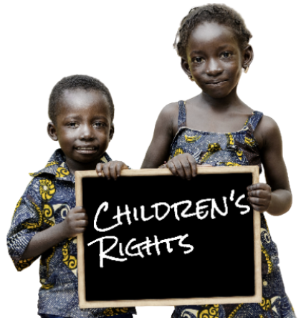
Modern Childhood: Rights, Not Just Protection
Late 1900s to Today
Childhood framed around:
  Protection, Well-being, Rights
Governments increasingly responsible for child welfare
Childhood understood as socially and politically shaped
Notes:
(Late 1900s → Today)
“In the modern era, childhood is increasingly understood not just in terms of development, but in terms of rights.”
“This reflects a broader shift in how societies think about human dignity and well-being.”
“Children are no longer seen only as individuals who need protection.”
They are also seen as individuals with inherent rights
“This includes rights to safety, education, healthcare, and respect.”
“This view expands responsibility beyond families.”
Governments
Institutions
International organizations
“Childhood becomes a public and political concern.”
“Another key feature of the modern view is attention to context.”
Development is not one-size-fits-all
Children grow up in very different conditions
“We now recognize that development is shaped by multiple layers of context.”
Family resources
Culture and community
Schools
Neighborhoods
Identity
Media and technology
“This challenges earlier ideas of universal developmental pathways.”
What is typical in one context may not be typical in another
“It pushes developmental science to ask harder questions about universality versus variation.”
“This modern view sets up the central tension of developmental psychology today.”
What aspects of development are universal?
What aspects are shaped by experience and context?
This tension is exactly why documents like the UN Convention on the Rights of the Child become so influential.

Slide 15
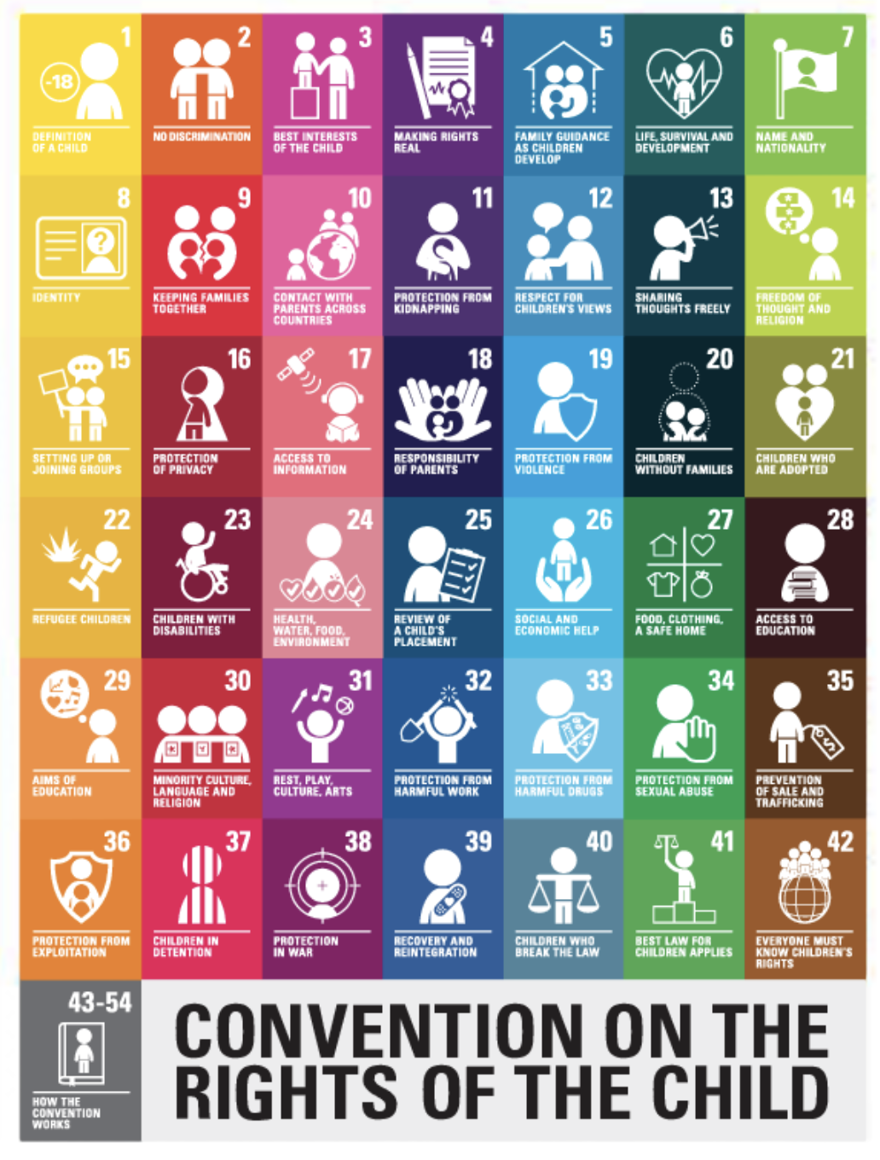
Rights of the Child
UN Convention on the Rights of the Child (CRC)
Adopted by the United Nations in 1989
Most widely ratified human rights treaty in history
Applies to all children under age 18
Establishes children as rights-holders
Notes:
“By the late 20th century, childhood becomes framed not just around development, but around rights.”
“One of the most important markers of this shift is the UN Convention on the Rights of the Child, adopted in 1989 by the United Nations.”
“This document is one of the most widely ratified human rights treaties in history.
Nearly every country in the world has agreed to it
“It applies to all individuals under the age of 18.”
“The CRC represents a major conceptual shift.”
Children are not just dependents
They are rights-holders
“This means children are recognized as individuals with inherent dignity and worth.”
“This is a dramatic contrast to earlier historical views.”
Survival
Contribution
Schooling
“Now, childhood is framed as something that deserves protection and respect.”
“This document strongly influences modern policies around education, child welfare, healthcare, and protection.”

Slide 16
What Rights are Defined
Core Rights of the Child
Protection
  From abuse, neglect, exploitation
Provision
  Healthcare, education, basic needs
Participation
  Voice in decisions affecting their lives
Notes:
“The CRC organizes children’s rights into three broad categories.”
“These categories help us understand how modern societies conceptualize childhood.”
Protection
“Children have the right to be protected from abuse, neglect, and exploitation.”
“This reflects the idea that children are vulnerable and need safeguarding.”
Provision
“Children have the right to basic resources.”
Education
Healthcare
Nutrition
“Development is seen as something society has an obligation to support.”
Participation
“This is one of the most significant and newer ideas.”
“Children have the right to express their views and have those views considered.”
“Participation rights challenge the idea that children are passive.”
Children are not just future adults
They are current social actors
“This shift raises important questions.”
How much agency should children have?
How do we balance protection with participation?

Slide 17
Childhood as Contextual
Development Depends on Context
Culture
Family resources
Community and neighborhood
Education systems
Identity
Technology and media
Notes:
“Another defining feature of the modern view of childhood is attention to context.”
“Development is no longer understood as unfolding the same way for all children.”
“Children’s experiences vary dramatically depending on context.”
Culture
Family resources
Community and neighborhood
Schools
Social identity
Technology and media
“This means there is no single ‘typical’ childhood experience.”
“What supports development in one context may not look the same in another.”
“This perspective challenges earlier ideas of universal developmental milestones.”
A behavior that looks delayed in one context
May be adaptive or typical in another
“For developmental psychology, this creates both opportunities and challenges.”
Better understanding of diversity
Greater risk of bias if context is ignored
“This is why modern developmental science places so much emphasis on environment and experience.

Slide 18
Putting the Timeline Together
Time Period | Dominant View
Pre-Modern | Survival & contribution
Enlightenment | Innocence & protection
Industrial Era | Schooling & development
Modern Era | Rights & context
Notes:
“Each of these views reflects what societies needed from children at that time.”
And what they were able to provide
“None of these views are ‘wrong.’”
They are responses to historical conditions
“But each view also carries assumptions.”
About what children should do
About what development should look like
“Recognizing this history helps us question our own assumptions.”
What we take for granted
What we label as normal or abnormal
If childhood has changed across history, the next question is whether it should look the same across cultures — and that’s where we’re headed next

Slide 19
THINK-PAIR-SHARE
Which expectations about childhood from this timeline are most likely to be treated as “universal” in psychology — even though they come from specific cultures?
Write down your answer
Turn to a nearby classmate and share what you wrote
Get ready to share: you can share what you wrote or what a classmate shared with you
Notes:
“What you just identified are not small differences — they are fundamentally different ways of organizing childhood.”
“Many of the expectations you named come from a specific cultural context: Western, industrialized societies with formal schooling.”
“When psychologists study children across cultures, these expectations often travel with the science.”
“So the key question becomes:”
“Are we studying child development…”
“Or are we studying how closely children match one cultural model of childhood?”
“That’s why we now shift from childhood across history to childhood across cultures.”
“Because different cultures prioritize different goals for children — and that shapes what development looks like.”

Slide 20
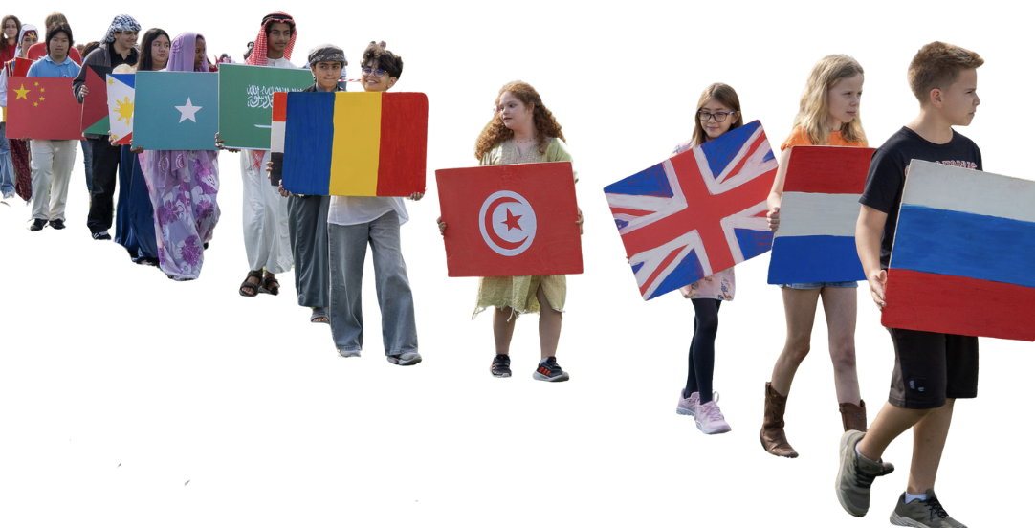
Childhood
Across Cultures

Slide 21

Notes:
https://www.youtube.com/watch?v=gIZ8PkLMMUo

Slide 22

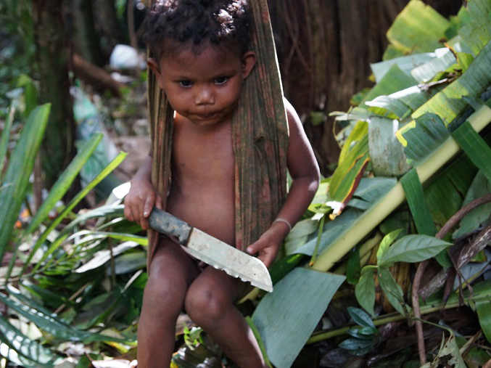
Childhood across Cultures
There is no single “normal childhood”
Notes:
Dusun parents raising their children in ways that violated the basic beliefs by which we were raised…We consistently checked our…exclamations of concern or disgust…and [resisted] the temptation to take a “dangerous” object, such as a knife, from a toddler…knowing that in terms of the local culture, children are believed to die from accidents whether they play with knives or not and besides, as one Dusun father put it, “How can you learn to use a knife if you do not use it”
“Now we’re shifting from how childhood has changed across time to how it varies across cultures today.”
“Just as childhood hasn’t always looked the same historically, it does not look the same across societies right now.”
“Developmental psychology has often assumed that childhood follows a single, universal path.”
“But cross-cultural research shows that childhood is shaped by cultural goals, values, and constraints.”
“This doesn’t mean biology doesn’t matter.”
Children everywhere grow, learn, and form relationships
“But how those processes look — and what counts as success — varies widely.”
Key framing sentence (say slowly):
“Different cultures organize childhood around different priorities.”
“The question is not whether one version of childhood is better.”
“The question is: better for what?

Slide 23
What is Childhood Preparing Children for?
Independence and self-expression
Interdependence and family responsibility
Economic contribution
Social harmony
Notes:
“One of the clearest ways cultures differ is in what they see childhood as preparing children for.”
“In many Western, industrialized societies, childhood often emphasizes:”
Independence
Choice
Self-expression
“Children are encouraged to speak up, make decisions, and stand out.”
“In many other cultural contexts, childhood emphasizes:”
Interdependence
Family obligation
Social responsibility
“Children may be expected to help with siblings, household work, or community tasks.”
“Importantly, these are not deficits.”
They are different developmental goals
“Each set of goals produces different skills.”
Autonomy vs. responsibility
Assertiveness vs. cooperation
Emphasize this line:
“Culture answers the question: What kind of adult should this child become?”

Slide 24

Cultural Practice around the Globe
Solapur, India - Okali
Notes:
Families practice "Okali" in India where priests toss babies off a temple roof and into a crowd that catches the child below.
there have been no reported fatal incidents in the 500 years they have carried on this tradition.

Slide 25
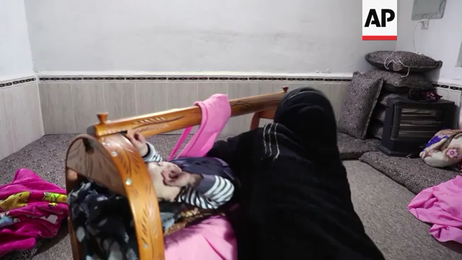
Cultural Practice around the Globe
Northern Iraq- Lank
Notes:
When its time to tuck the baby in, more parents in Dohuk prefer to rock their infants to sleep in a traditional cradle. Residents of Dohuk, which lies in the northern Kurdish region of Iraq, call it the lank. Babies are tucked in and a cloth is wrapped around them to fasten them to the cradle. There are alternatives but the local rocking cradle remains the most popular option there. The traditional cradle offers babies comfort and is cheaper than imported alternatives according to the families who use it.

Slide 26
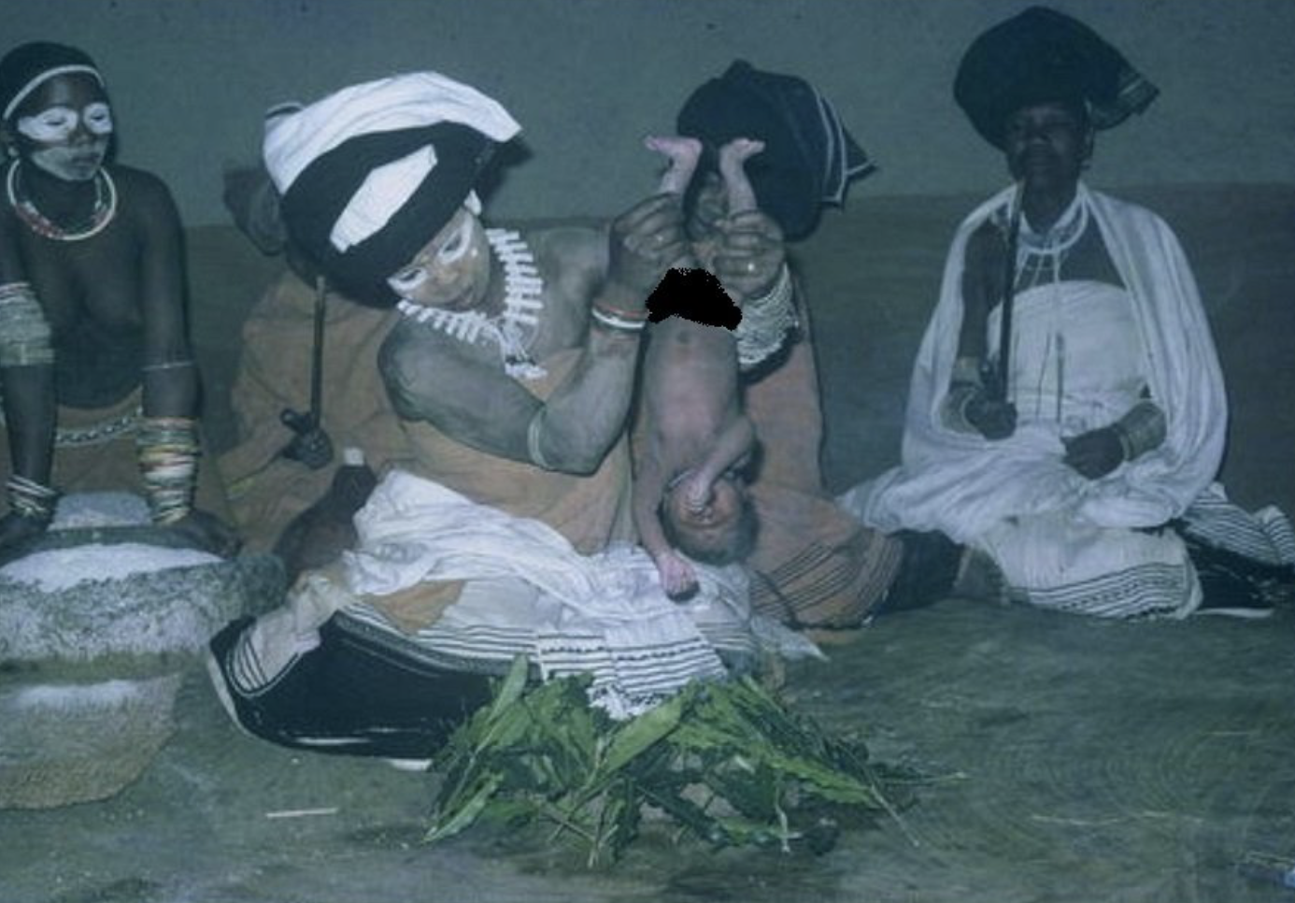
Cultural Practice around the Globe
Eastern Cape of South Africa - Sifudu
Notes:
SIB –EHHH-DUH
Sifudu (or isifudu) is
a traditional postpartum purification ritual practiced by the Xhosa (Kow - suh and Umtata people in the Eastern Cape of South Africa. Between 3 and 14 days after birth, a newborn is passed through the smoke of burning, pungent Sifudu leaves to instill fearlessness, strength, and courage, while protecting them from evil spirits.
When it’s time to introduce the baby to the female family members, a ritual called isifudu (ee-see-doo-doo) is performed to clean and purify the baby. A fire is made, and some of the leaves from a sacred pungent tree are burnt. The baby will be held naked upside down and passed over the smoke three times. During this time, the mother of the child is sitting down. The baby will then be passed to her under her right leg first, and the baby will be bathed and smeared with Ingceke (ee-G-!EH-keh) (white ochre powder made from umthombothi (um-tom-bo-tee) wood – with spiral spikes). This ritual is significant to the Xhosa community to protect the child from evil spirits.

Slide 27
ACTIVITY
Notes:
“This is where culture becomes especially important for developmental psychology.”
“Many milestones and norms are based on children from Western, educated, industrialized societies.”
“When those milestones are applied universally, problems can arise.”
“A behavior that looks like a delay in one context may be:”
Typical
Adaptive
Even valued in another context
Examples you can mention verbally:
Quiet children in classrooms
Limited direct speech to adults
Early caregiving responsibilities
Learning through observation rather than instruction
“If we ignore culture, we risk confusing difference with deficit.”
“This is why we need to look critically at the tools we use to measure development.”

Slide 28
Your Task
1. Identify a cultural assumption in a developmental milestone
2. Explain how it could mislabel a child
3. Redesign the milestone to reduce cultural bias
Notes:
We’re going to put everything we’ve just talked about — history, culture, and bias — into practice.”
“This activity is designed to show you how cultural assumptions get built into developmental tools, even when that’s not intentional.”
“You’ll be working with a realistic developmental milestone, like the kinds used in screening, education, or assessment.”
“Your job is not to decide whether the milestone is good or bad.”
“Your job is to analyze what it assumes about childhood.”

Slide 29
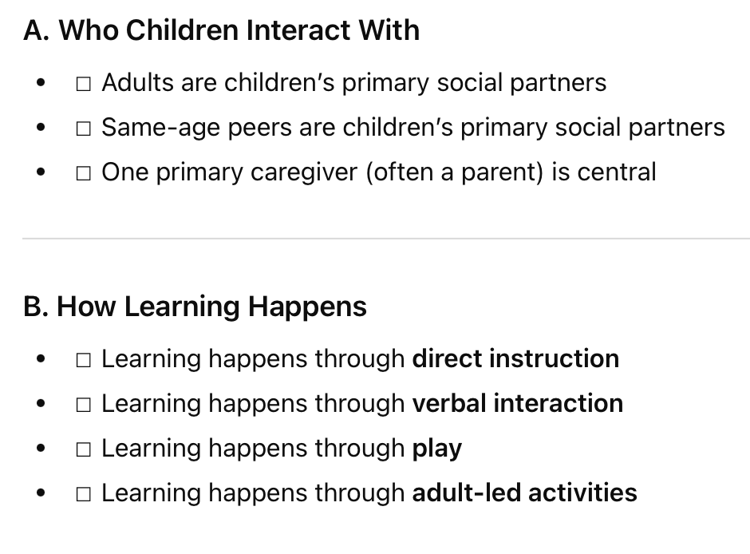
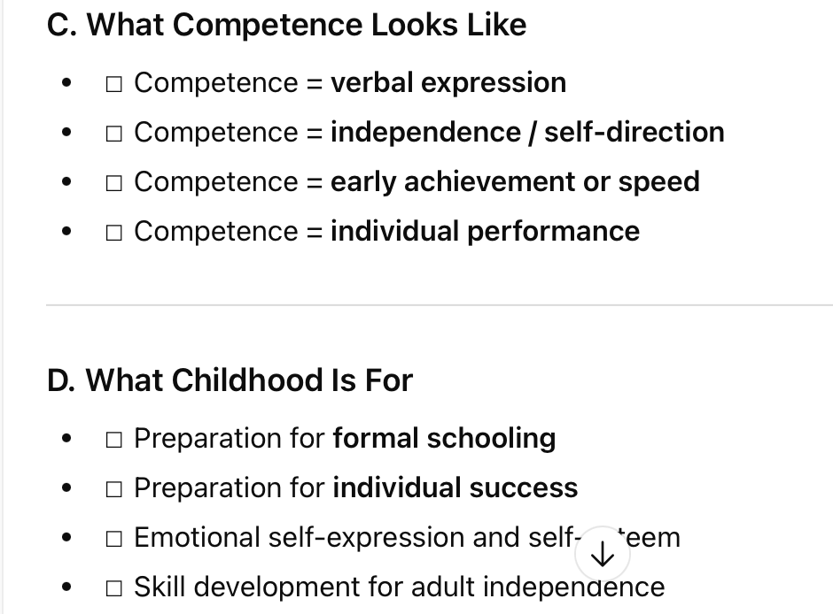
Assumption Menu
Notes:
We’re going to put everything we’ve just talked about — history, culture, and bias — into practice.”
“This activity is designed to show you how cultural assumptions get built into developmental tools, even when that’s not intentional.”
“You’ll be working with a realistic developmental milestone, like the kinds used in screening, education, or assessment.”
“Your job is not to decide whether the milestone is good or bad.”
“Your job is to analyze what it assumes about childhood.”

Slide 30
What is Coming Up?
Homework 1 is Due
And Annotating the textbook for extra credit as we go along
Next Tuesday: Chapter 2 – Theorist
Next Thursday: CUNY CLOSED
Please keep this slide for attribution

