Slide 1
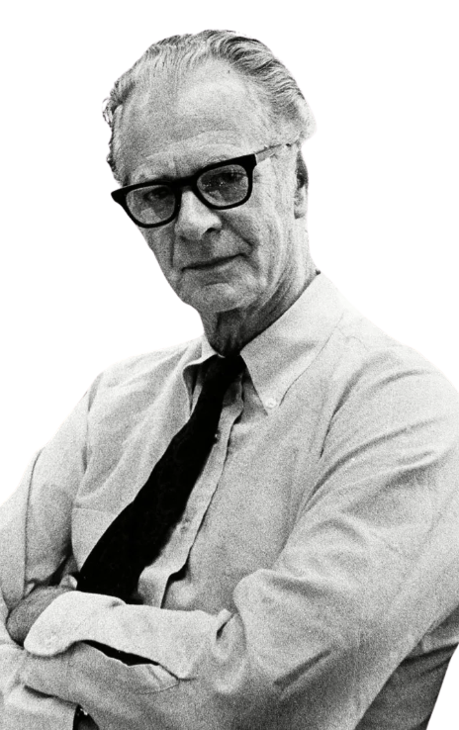
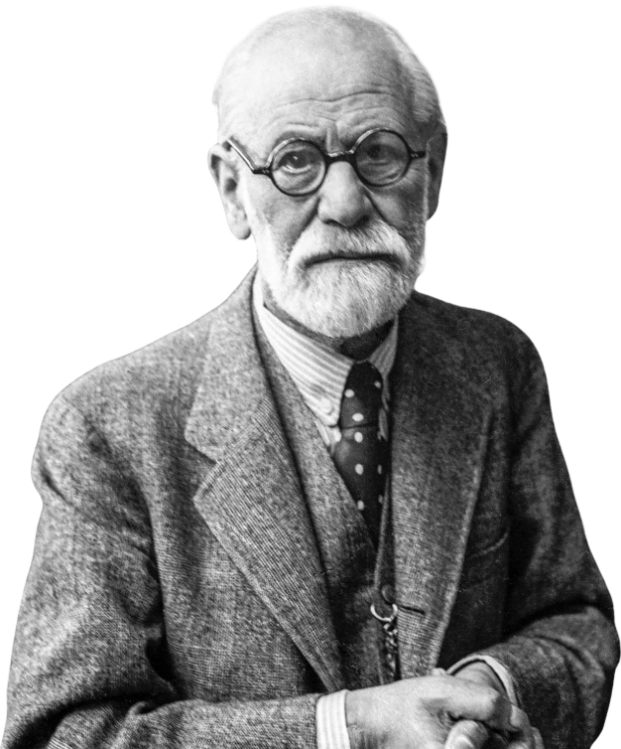
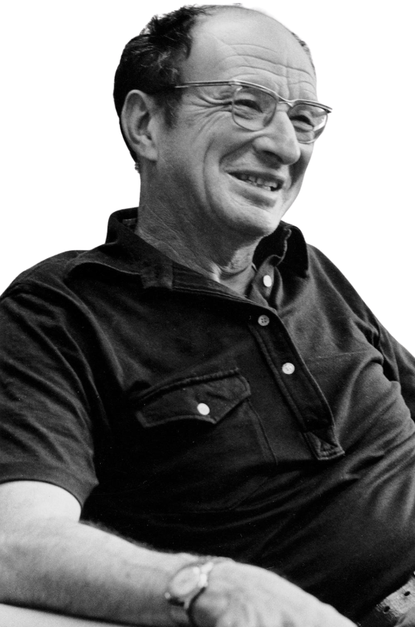
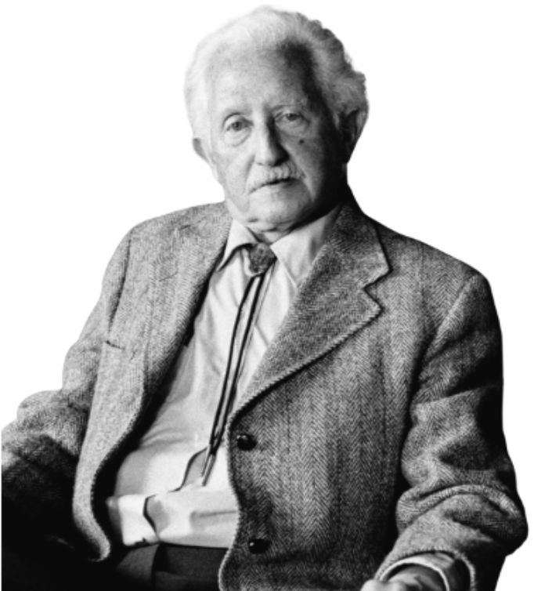
THEORIST AND THEORIES

Slide 2

Make a name tent with your first name in large letters. Write down the name you wish to be called.

Slide 3

Question of the Day

Slide 4
Question of the Day
Why do we need theories to understand development? Why not just observe what children do?
Can two different theories both be correct about development, even if they disagree?
Notes:
Transition: Notice that we all observed the same behavior, but we came up with different explanations. Different theories would explain this behavior in different ways.
For example:
Behaviorist → child wasn’t reinforced
Cognitive theory → child’s thinking limits them
Growth mindset → child believes ability is fixed
Sociocultural theory → child hasn’t received enough support

Slide 5
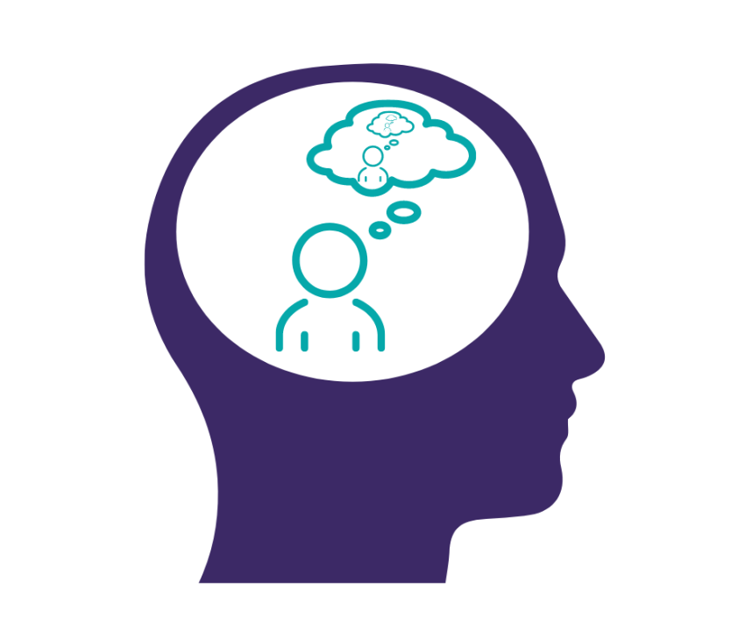
What is a Theory?

Slide 6
What is a Theory?
Developmental theories help us:
Explain why development happens
Understand how children change over time
Interpret behavior in meaningful ways
Guide research and scientific investigation
Provide a framework for understanding development
Theories are tools – not facts – but ways of understanding development
Notes:
Theory is not inherently abstract or complicated. But theories are actually practical tools that help us understand real-world behavior.
At their core, theories are explanations for the how and why of development.
For example, you might ask questions like:
Why do toddlers ask so many questions?
Why do some children struggle socially while others don’t?
Why do children learn differently from one another?
Theories help us answer these kinds of questions.
They provide frameworks that help us interpret behavior. Without theory, we might observe behavior, but we wouldn’t have a way to explain what it means or why it happens.
Theories also guide research. They act like blueprints that help researchers design studies, interpret findings, and build knowledge over time.
It’s best to think of theories like instruction manuals. If you were assembling furniture without instructions, it would be much harder, but not necessarily impossible. Theories help us organize information and show how different pieces fit together.
Theories are developed by observing patterns in behavior and identifying consistent relationships. Researchers then test theories to see whether they accurately explain development.
It’s important to understand that theories are not facts. They are evidence-based explanations. They remain useful as long as they help explain behavior and are supported by research.
Today, we’re going to explore several major theories and see how each one offers a different perspective on development.

Slide 7
THINK-PAIR-SHARE
A 5-year-old refuses to try a difficult puzzle and says,
“I can’t do it.”
What do you observe? Observations only!
Why is the child doing this?
Notes:
Observation tells us what happened. In this case, we observed a child refusing to try a difficult puzzle and saying, “I can’t do it.”
But theory helps us answer a deeper question: Why did this happen?
Theories provide explanations for behavior. They help us organize observations, identify patterns, and understand the underlying processes that drive development.
Without theory, we would simply have a list of behaviors. Theory allows us to interpret those behaviors in meaningful ways.
Different theories emphasize different explanations. Some focus on internal emotional processes. Others focus on environmental influences, thinking, motivation, or social interaction.
In other words, theories provide frameworks for understanding development. They help psychologists move beyond describing behavior to explaining it.

Slide 8
Branches of Theories
The “Psycho” Theories
The Environmental Learning Theories
The Cognitive Theories
The Humanistic Theories
The Contextual Theories

Slide 9
Branches of Theories
The “Psycho” Theories
The Environmental Learning Theories
The Cognitive Theories
The Humanistic Theories
The Contextual Theories
Notes:
Psycho… theories are grouped together because they share the same core assumption: that development is driven primarily by internal psychological processes, especially emotions, internal conflict, and the development of the self.
Psycho… theories also emphasize the importance of early experiences. They argue that experiences in early childhood have lasting effects on personality, emotional development, and behavior later in life. This idea—that early emotional development lays the foundation for later functioning—is a defining feature of this perspective.
So, even these theories differ in their specific focus, they are grouped together because they both explain development as the result of internal psychological processes, unfolding through stages, and shaped by early emotional experiences.

Slide 10
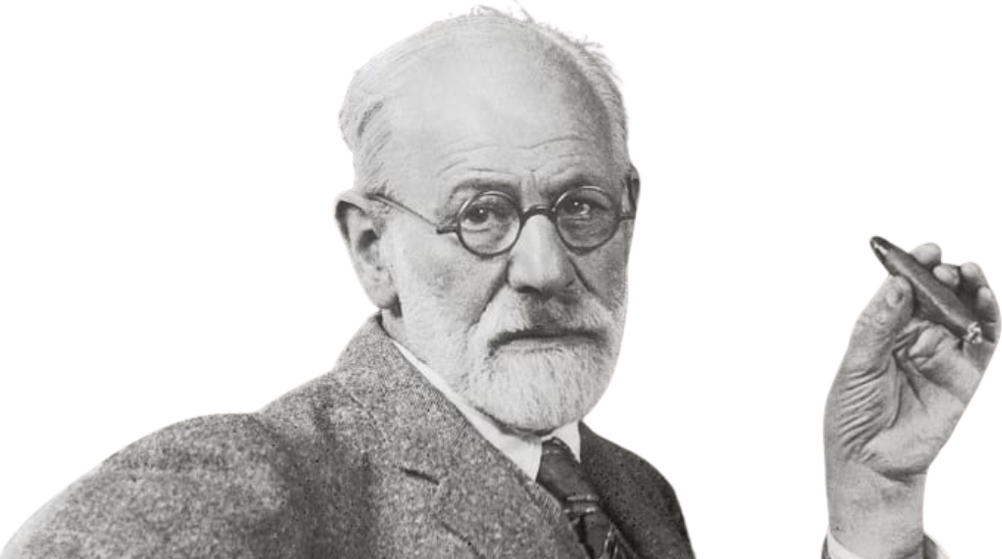
Sigmund Freud’s Psychosexual Theory
Notes:
Sigmund Freud was born in 1856 in what is now the Czech Republic, but he spent most of his life in Vienna, Austria. He was trained as a neurologist, meaning he originally studied the brain and nervous system from a medical perspective.
Early in his career, Freud worked with patients who were experiencing psychological symptoms, such as anxiety, emotional distress, and physical symptoms that had no clear medical cause. This led him to become interested in how the mind, especially unconscious mental processes, could influence behavior and emotional functioning.
Freud eventually developed a new approach called psychoanalysis, which focused on exploring unconscious thoughts, early childhood experiences, and internal psychological conflict. He believed that many emotional and behavioral problems could be traced back to unresolved conflicts from childhood.
Freud was also influenced by his cultural and historical context. He lived during a time when emotional and mental health issues were not well understood, and many of his ideas challenged existing beliefs about human behavior.
Although many of Freud’s specific claims are debated today, his work had a profound influence on psychology. He was one of the first theorists to emphasize the importance of early childhood experiences, the unconscious mind, and internal psychological development.

Slide 11
Sigmund Freud
Sigmund Freud (1856–1939)
Founder of psychodynamic/psychanalytic theory
Emphasized unconscious processes and early childhood experiences
Proposed that personality develops in early childhood
Early caregiver relationships shape emotional development
Influenced psychology, education, and clinical practice
Freud’s ideas were highly influential, though not all are supported today
Notes:
Sigmund Freud was one of the most influential figures in the history of developmental psychology and psychiatry. His theory, known as psychodynamic theory, was one of the first to propose that early childhood experiences play a critical role in shaping personality and emotional development.
Freud believed that personality develops largely during the first few years of life. He argued that interactions with parents and caregivers during early childhood have lasting effects on emotional development, relationships, and psychological functioning.
A key part of Freud’s theory was the idea that much of human behavior is influenced by unconscious processes. This means that individuals may not be fully aware of the psychological forces influencing their behavior.
Freud’s ideas dominated psychology and psychiatry for many decades, especially before the rise of behaviorism in the mid-20th century. His work influenced not only psychology, but also education, parenting, and clinical practice.
Today, psychologists recognize that Freud’s theory is not entirely supported by modern research. For example, we now know that early childhood experiences do not always determine personality outcomes, and many individuals demonstrate resilience even after difficult early experiences.
However, Freud’s contributions remain extremely important. He was one of the first theorists to emphasize the importance of early childhood, emotional development, and internal psychological processes. His work laid the foundation for many later theories, including Erikson’s psychosocial theory.
Even when psychologists disagree with Freud’s specific claims, his influence on the field of developmental psychology has been profound.

Slide 12
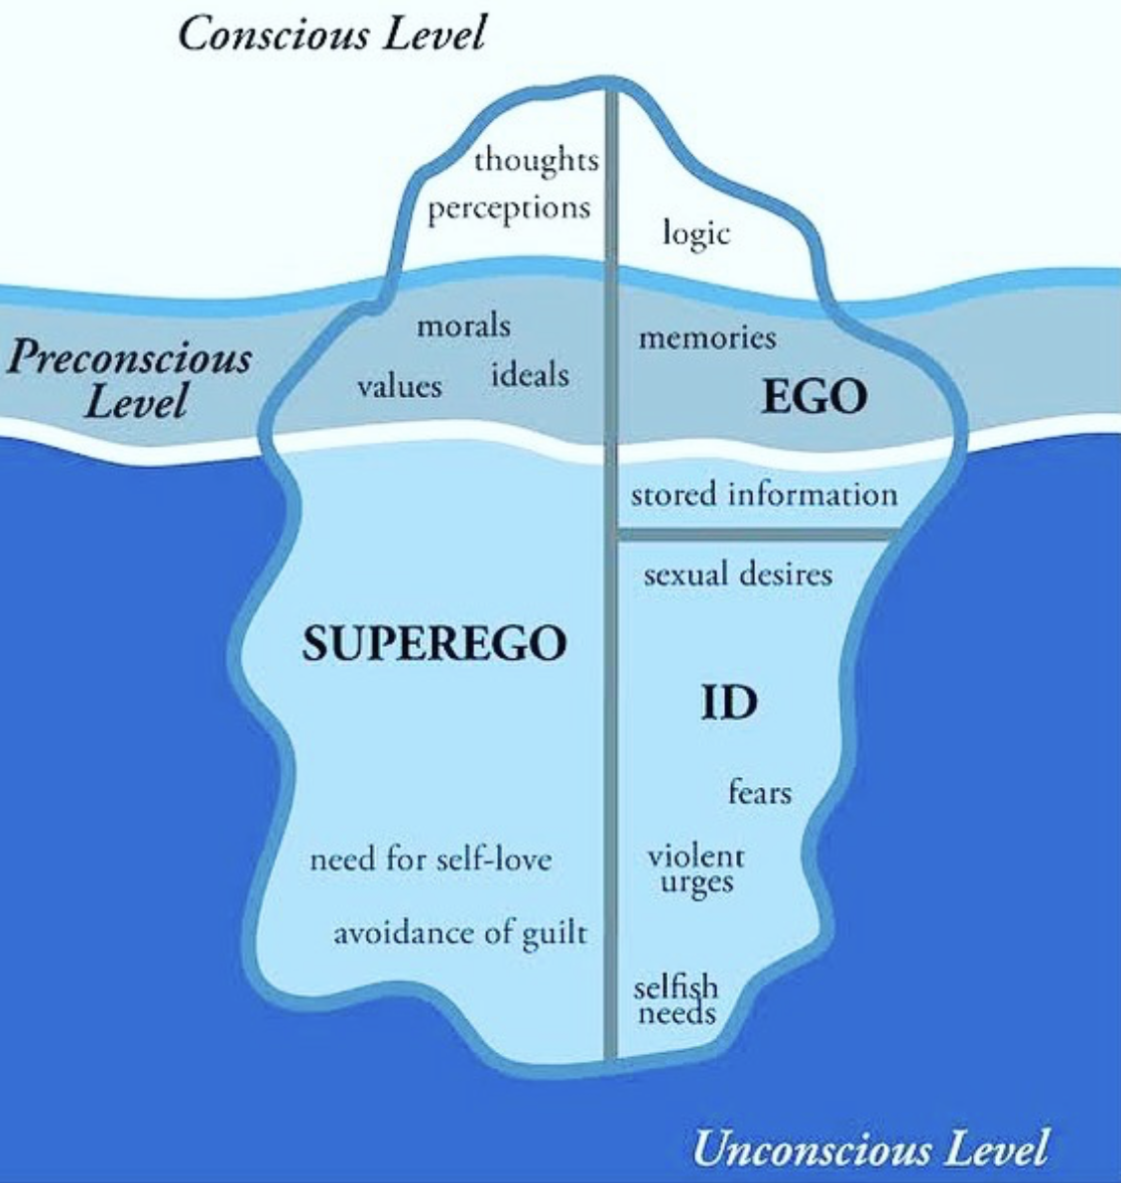
Theory of
“Self”
Notes:
Freud believed that much of human behavior is influenced by psychological forces that operate outside of our conscious awareness. He used the iceberg metaphor, shown here, to illustrate how the mind is structured.
The small portion above the water represents the conscious mind. This includes thoughts, perceptions, and awareness—things we are actively thinking about and aware of at any given moment.
Just below that is the preconscious level. This includes memories, knowledge, and information that we are not currently thinking about, but can easily bring into awareness.
The largest portion, below the surface, represents the unconscious mind. Freud believed this was the most powerful part of the mind. It contains hidden desires, fears, urges, and unresolved conflicts that influence behavior, even though we are not aware of them.
Freud also proposed that personality is made up of three interacting components: the id, the ego, and the superego.
The id is the most primitive part of the personality. It is present at birth and operates based on the pleasure principle. The id seeks immediate gratification of basic needs and desires, without considering consequences. For example, a hungry infant crying immediately to be fed is driven by the id.
The superego develops later and represents internalized moral standards. It reflects what we believe is right and wrong, based on societal rules and expectations. The superego creates feelings such as guilt when we violate those standards.
The ego develops to balance the id and the superego. It operates based on the reality principle. The ego helps us make decisions that satisfy our needs in ways that are socially appropriate and realistic.
According to Freud, behavior results from the constant interaction and tension between these three components.
This model emphasizes Freud’s central idea that much of our behavior is influenced by internal psychological forces, many of which operate outside of conscious awareness.

Slide 13
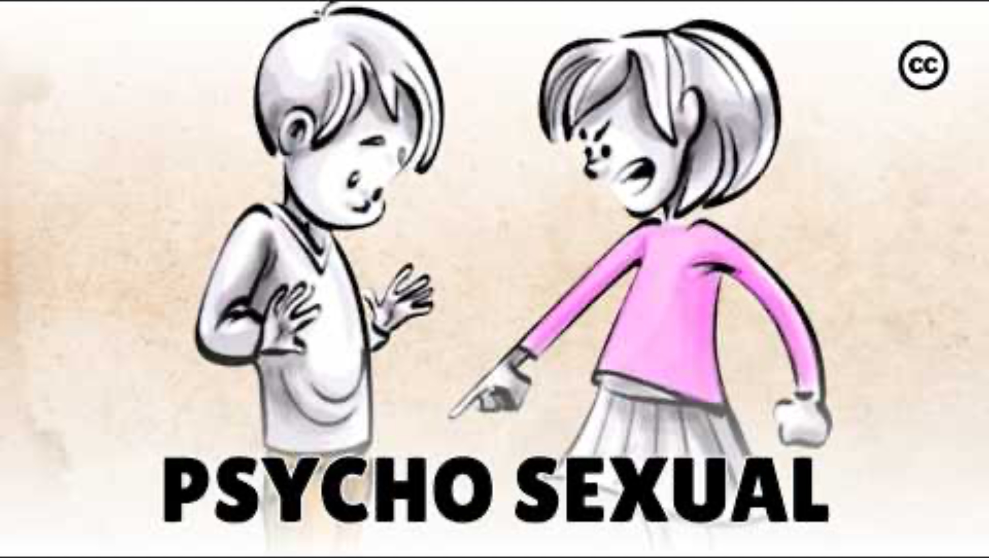
Notes:
https://www.youtube.com/watch?v=mhG-twzaE_g

Slide 14
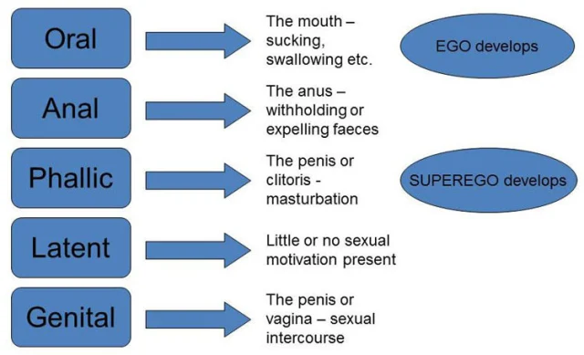
Stages
Notes:
The oral stage occurs during the first year of life, and during this stage, the infant’s primary source of pleasure and interaction is through the mouth. This includes behaviors such as sucking, feeding, and putting objects into the mouth.
These oral behaviors are essential not only for feeding, but also for comfort and exploration. For example, infants may suck their thumb or chew on toys as a way to soothe themselves.
During this stage, the infant is highly dependent on caregivers. Freud believed that the quality of caregiving during this stage, especially feeding and comfort, influences the child’s sense of trust and security.
If the child’s needs are either over-gratified or under-gratified, Freud believed fixation could occur. This may lead to oral behaviors in adulthood, such as nail biting, overeating, smoking, or excessive dependency on others.
This stage highlights Freud’s emphasis on how early caregiving experiences shape later development.

Slide 15
Stages
Notes:
The anal stage occurs between approximately ages one and three, and it centers around control of bowel movements. During this stage, toilet training becomes a major developmental task.
Freud believed that toilet training is the child’s first experience with societal expectations and self-control. The child must learn to delay gratification and regulate bodily functions.
The way caregivers handle toilet training is important. If caregivers are too strict or controlling, the child may develop excessive rigidity, perfectionism, or a need for control later in life.
If caregivers are too lenient, the child may develop impulsive or disorganized tendencies.
Freud believed this stage helps shape a child’s developing sense of autonomy and control.

Slide 16
Stages
Notes:
The phallic stage occurs between ages three and six. During this stage, children become more aware of their bodies and differences between males and females.
Freud believed children begin to identify strongly with their same-sex parent. This identification helps children develop gender identity and internalize social roles and expectations.
He also believed that children begin developing the superego during this stage. The superego represents internalized moral standards and helps guide behavior.
This stage is important for developing identity, gender roles, and moral understanding.

Slide 17
Stages
Notes:
The latency stage occurs during middle childhood, from about age six until puberty.
During this stage, sexual impulses are less prominent, and children focus more on developing skills, friendships, and academic abilities.
Children invest their energy in learning, social relationships, and building competence.
This stage is important for developing confidence, social skills, and intellectual abilities.
Freud believed this period allows children to strengthen their ego and social functioning.

Slide 18
Stages
Notes:
The genital stage begins during adolescence and continues into adulthood.
During this stage, individuals develop mature relationships and experience sexual maturity.
The focus shifts toward forming meaningful relationships, emotional intimacy, and contributing to society.
Freud believed that the successful resolution of earlier stages allows individuals to develop healthy relationships, emotional stability, and psychological maturity.
If earlier stages were not successfully resolved, unresolved conflicts may affect relationships and emotional functioning.
This stage represents the development of a mature adult personality.

Slide 19
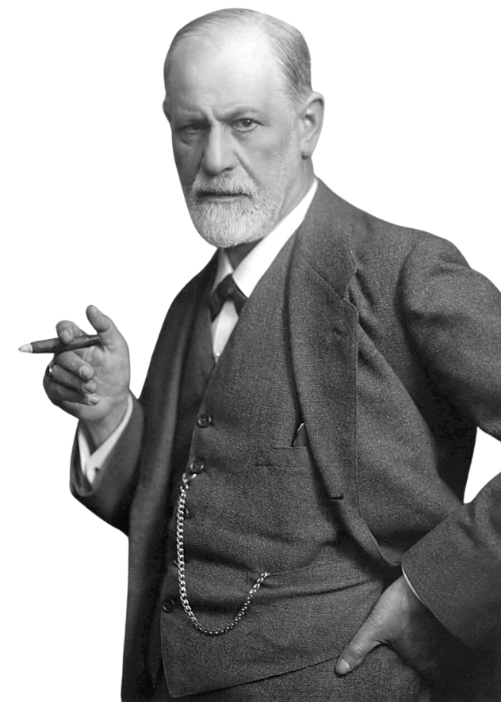
Pros & Cons
Strengths
Emphasized importance of early childhood
Highlighted role of unconscious processes
Influenced psychology, education, and parenting
Provided foundation for later theories
Limitations
Difficult to test scientifically
Lacks strong empirical evidence
Considered sexist and culturally biased
Overemphasizes unconscious conflict and negative drives
Notes:
One of the major strengths of Freud’s theory is that he was one of the first theorists to emphasize the importance of early childhood experiences. Today, developmental psychology strongly supports the idea that early relationships and experiences can influence later emotional and psychological development.
Freud also introduced the idea that unconscious processes influence behavior. While modern psychology does not fully accept Freud’s specific claims, research does support the idea that not all mental processes are fully conscious.
Additionally, Freud’s work laid the foundation for many later theories, including Erikson’s psychosocial theory. His ideas helped shape psychology, education, and parenting practices.
However, Freud’s theory also has important weaknesses. One major criticism is that it is difficult to test scientifically. Many of his ideas, such as unconscious conflicts or early psychosexual experiences, cannot be directly observed or measured.
His theory is also considered culturally biased and sexist, particularly in how he described female development.
Freud also placed a strong emphasis on unconscious conflict and negative drives, which many psychologists today believe does not fully capture the complexity of human development.
Despite these criticisms, Freud’s theory remains important because it introduced key ideas that continue to influence developmental psychology. His work provided a framework that later theorists expanded, modified, and improved.

Slide 20
THINK-PAIR-SHARE
A student has an important exam tomorrow, but stays up late scrolling on their phone instead of studying.
What is the student doing? Observations only!
How would Freud explain this behavior?
Notes:
Freud would explain this behavior as a conflict between different parts of the personality.
The id seeks immediate pleasure and gratification. In this case, the student may want the immediate reward of entertainment and relaxation.
The superego represents responsibility and moral expectations, such as knowing they should study.
The ego is caught in the middle, trying to balance these competing demands.
Freud would argue that behavior results from this internal psychological conflict, and that unconscious desires often influence our decisions, even when we consciously know what we should do.

Slide 21
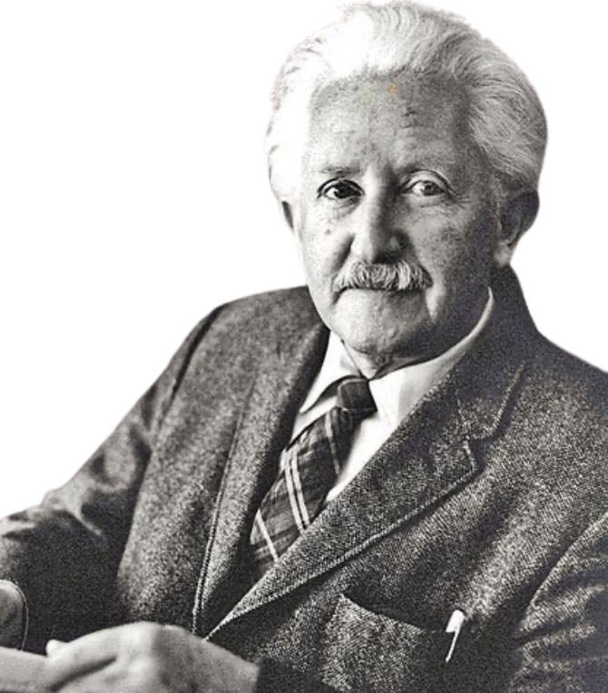
Erik
Erikson’s Psychosocial Theory
Notes:
Erik Erikson was born in Germany in 1902, but he was not born with that name. His birth name was Erik Salomonsen.
His biological father was Danish and left before Erikson was born. His mother later married a physician named Theodor Homburger, who became Erikson’s stepfather. As a child, Erikson was known as Erik Homburger.
However, Erikson struggled with his identity growing up. He did not feel fully connected to his biological father, whom he never knew, and he did not fully identify with his stepfather either.
When he became an adult and began developing his professional identity, he chose to rename himself Erik Erikson, which literally means “Erik, son of Erik.”
This name symbolized his effort to create his own identity, rather than defining himself through his biological or stepfather’s name.

Slide 22
Erik Erikson
Erik Erikson (1902–1994)
Expanded Freud’s psychodynamic theory
Emphasized social and emotional development
Proposed development occurs across the entire lifespan
Developed 8 stages of psychosocial development
Each stage involves a psychosocial conflict
Development continues from infancy through old age
Notes:
Erik Erikson was a major developmental theorist who expanded on Freud’s psychodynamic theory. While Freud focused primarily on early childhood and psychosexual development, Erikson believed development continues throughout the entire lifespan.
This was a major shift in thinking. Erikson was one of the first theorists to propose that development does not stop in childhood, but continues through adolescence, adulthood, and even old age. This perspective is especially important today as people live longer and we increasingly study development across the lifespan.
Erikson developed what is known as the psychosocial theory of development. He proposed that individuals move through eight stages, and each stage involves a psychosocial conflict. These conflicts involve challenges related to identity, relationships, independence, and purpose.
For example, infants face the conflict of trust versus mistrust, where they learn whether the world is safe and reliable. Adolescents face the conflict of identity versus role confusion, where they develop a sense of who they are.
Erikson believed that successfully resolving these conflicts leads to healthy psychological development. However, unresolved conflicts do not disappear permanently—they can re-emerge later in life, especially during times of stress or major life changes.
Unlike Freud, who focused on biological drives, Erikson emphasized the role of social relationships and experiences in shaping development. His theory highlights the importance of social interaction, identity, and emotional development across the lifespan.
Erikson’s theory remains highly influential because it provides a framework for understanding development not just in childhood, but throughout the entire life course.

Slide 23

Notes:
https://www.youtube.com/watch?v=aYCBdZLCDBQ

Slide 24
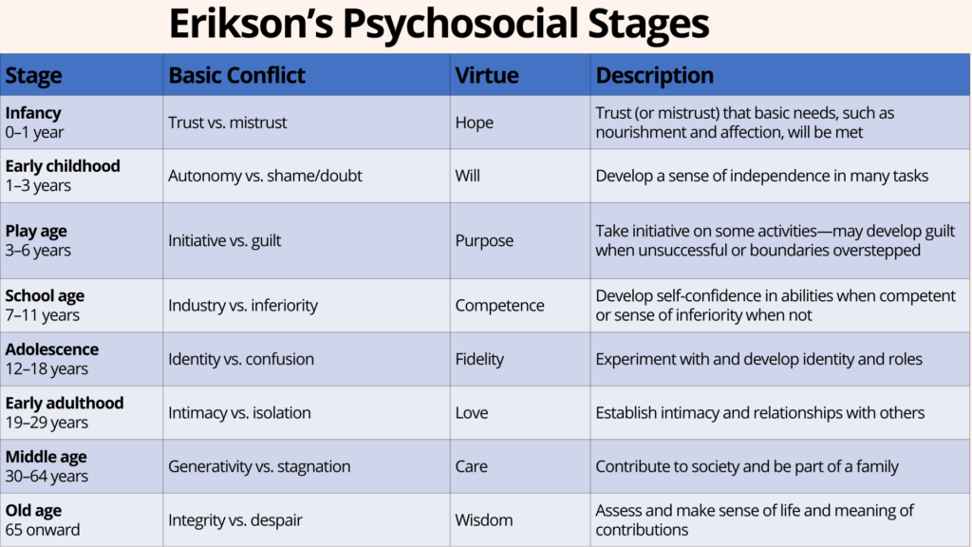
Notes:
The first stage of Erikson’s psychosocial theory is trust versus mistrust, and it occurs during the first year of life. At this stage, infants are completely dependent on caregivers for survival. They rely on caregivers to meet their basic physical and emotional needs, including feeding, comfort, warmth, safety, and soothing.
Through repeated interactions, infants begin forming expectations about the world. Specifically, they learn whether others are reliable and whether their needs will be met. This forms the foundation of trust.
If caregivers are responsive, consistent, and sensitive—for example, feeding the infant when they are hungry, comforting them when they cry, and responding to distress—the infant develops a sense of trust. This trust becomes a fundamental emotional foundation that supports later relationships, emotional regulation, and confidence in exploring the environment.
For example, when a caregiver consistently picks up and comforts a crying infant, the infant learns that distress can be resolved and that others can be depended on.
However, if caregiving is inconsistent, neglectful, or unpredictable, the infant may develop mistrust. For example, if caregivers ignore crying, respond unpredictably, or fail to meet basic needs, the infant may learn that the world is unreliable or unsafe.
This does not mean mistrust is entirely negative. A healthy balance of trust and mistrust helps individuals develop caution and realistic expectations. However, too much mistrust can lead to anxiety, insecurity, and difficulty forming relationships later in life.
This stage is foundational because it shapes how individuals approach relationships and challenges throughout life.

Slide 25
Notes:
The second stage occurs during toddlerhood, when children begin developing independence and physical control over their bodies. During this period, children develop motor skills such as walking, climbing, feeding themselves, and manipulating objects.
Toddlers also begin asserting independence. They want to do things themselves and may frequently say “no” as a way of expressing autonomy.
One of the most important developmental tasks during this stage is toilet training. Toilet training represents the child’s first major experience with societal expectations and self-control.
If caregivers encourage independence while providing appropriate structure and support, children develop autonomy. This means they develop confidence in their ability to control their own actions and make decisions.
For example, when a toddler tries to put on their own shoes, supportive caregivers allow them to try, even if they struggle.
However, if caregivers are overly critical, controlling, or punitive, children may develop shame and doubt. For example, if a caregiver scolds a child harshly for accidents during toilet training, the child may feel embarrassed and doubt their abilities.
This can result in reduced confidence, hesitation, and fear of making mistakes.
This stage is critical for developing independence, self-control, and confidence.

Slide 26
Notes:
During early childhood, children begin initiating activities independently. They become more curious, imaginative, and socially engaged. They begin asking many questions, exploring their environment, and engaging in pretend play.
Initiative refers to the ability to plan, act, and take leadership in activities. Children may initiate games, invent stories, or attempt new tasks.
For example, a child may decide to build something with blocks or create an imaginary game with friends.
If caregivers encourage exploration and support children’s efforts, children develop initiative and confidence in their ability to take action.
However, if caregivers frequently criticize, discourage, or punish children’s attempts to explore, children may develop guilt. They may begin to believe their desires or actions are wrong.
For example, if a child is repeatedly told “stop that” or “don’t do that” when exploring, they may become hesitant to try new things.
This stage is critical for developing confidence, leadership, creativity, and independence.

Slide 27
Notes:
This stage occurs during middle childhood and is strongly influenced by school and social comparison. Children begin developing academic skills, social skills, and practical abilities.
They begin comparing themselves to peers and evaluating their competence.
Industry refers to developing competence, confidence, and pride in one’s abilities.
For example, learning to read, solving math problems, playing sports, and completing school assignments all contribute to industry.
When children receive encouragement, recognition, and opportunities to succeed, they develop confidence and motivation.
However, if children experience repeated failure, criticism, or lack of support, they may develop feelings of inferiority. They may begin to believe they are incapable or less competent than others.
For example, a child who struggles academically and receives negative feedback may lose confidence and motivation.
This stage is critical for developing self-esteem, competence, and motivation.

Slide 28
Notes:
his stage occurs during adolescence and focuses on developing a sense of identity. Adolescents explore who they are, what they believe, and what they want to become.
This exploration may include experimenting with different social roles, peer groups, interests, values, and career aspirations.
For example, adolescents may change clothing styles, friend groups, hobbies, or career interests.
This exploration is normal and necessary for developing a coherent identity.
If adolescents successfully resolve this stage, they develop a strong sense of identity and direction.
However, if adolescents fail to develop a clear identity, they may experience role confusion. They may feel uncertain about their future, beliefs, or place in society.
This stage is critical for developing self-concept, independence, and direction.

Slide 29
Notes:
This stage focuses on forming close, meaningful relationships. This includes romantic relationships, friendships, and emotional connections.
Intimacy involves emotional closeness, trust, and vulnerability.
For example, forming a committed romantic relationship requires emotional openness and trust.
If individuals successfully develop intimacy, they experience strong emotional bonds.
However, if individuals struggle to form relationships, they may experience isolation, loneliness, and emotional distance.
This stage builds on identity development. Individuals must understand themselves before forming deep relationships.

Slide 30
Notes:
This stage focuses on contributing to society and helping future generations.
Generativity involves parenting, mentoring, teaching, or contributing to society through work.
For example, raising children, mentoring younger individuals, or contributing to the community reflects generativity.
If individuals fail to contribute, they may experience stagnation, feeling unproductive or disconnected.
This stage focuses on purpose and contribution.

Slide 31
Notes:
This stage involves reflecting on one’s life.
If individuals feel satisfied and fulfilled, they develop integrity, which involves acceptance and peace.
If individuals feel regret or dissatisfaction, they may experience despair.
This stage focuses on reflection and life satisfaction.

Slide 32
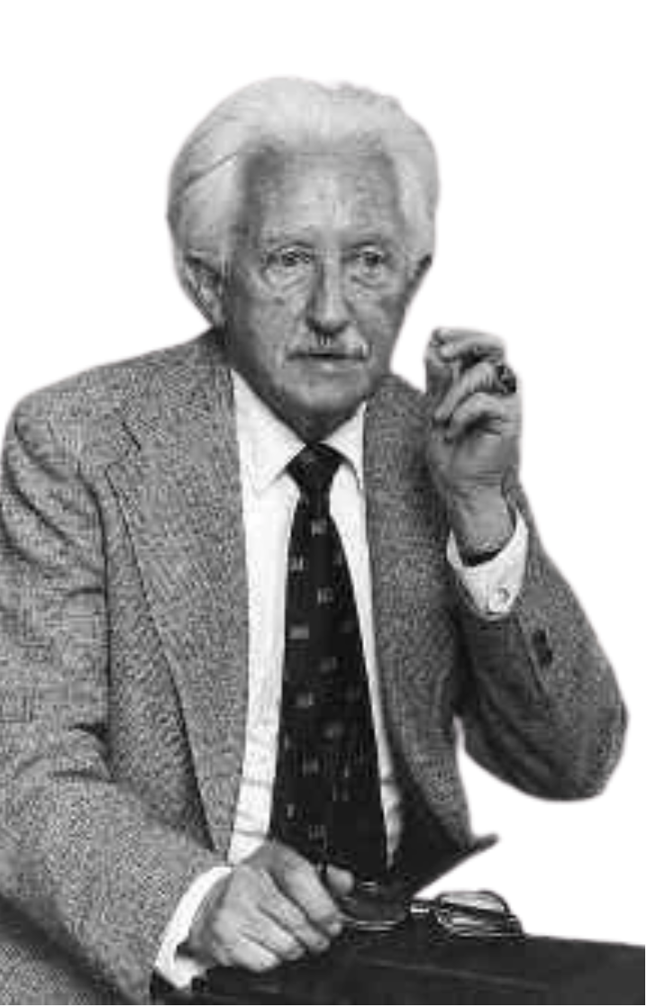
Pros & Cons
Strengths
Weaknesses
Emphasizes development across the entire lifespan
Highlights the importance of social relationships
Explains identity development, especially in adolescence
More culturally and socially relevant than Freud’s theory
Difficult to test scientifically
Stages may not apply equally across cultures
Development may not occur in clearly defined stages
Does not fully explain individual differences
Notes:
Erikson’s theory has several important strengths that make it highly influential in developmental psychology.
One major strength is that Erikson expanded the study of development beyond childhood. Unlike Freud, who focused mainly on early childhood, Erikson proposed that development continues throughout the entire lifespan, including adolescence, adulthood, and old age. This makes his theory especially useful for understanding identity development and life transitions.
Another strength is his emphasis on social relationships. Erikson recognized that development is influenced by interactions with others, such as parents, peers, and society. His theory highlights the importance of social experience in shaping identity and emotional development.
Erikson’s theory is especially valuable for understanding adolescence. His concept of identity versus role confusion helps explain why adolescents explore different roles, beliefs, and identities as they develop a sense of self.
However, Erikson’s theory also has limitations. One criticism is that it is difficult to test scientifically. Concepts like identity conflict or psychological resolution are not always easy to measure directly.
Additionally, Erikson proposed that development occurs in stages, but real development is often more gradual and flexible. People may revisit earlier challenges or experience stages differently depending on their life circumstances.
His theory may also not apply equally across all cultures, since ideas about identity, independence, and adulthood can vary widely.
Despite these limitations, Erikson’s theory remains highly influential because it provides a useful framework for understanding social and emotional development across the lifespan.

Slide 33
THINK-PAIR-SHARE
A 16-year-old tries out different friend groups, clothing styles, and career interests, and often changes their mind about who they want to be.
What is the adolescent doing? Observations only!
How would Erikson explain this behavior?
Notes:
Freud would explain this behavior as a conflict between different parts of the personality.
The id seeks immediate pleasure and gratification. In this case, the student may want the immediate reward of entertainment and relaxation.
The superego represents responsibility and moral expectations, such as knowing they should study.
The ego is caught in the middle, trying to balance these competing demands.
Freud would argue that behavior results from this internal psychological conflict, and that unconscious desires often influence our decisions, even when we consciously know what we should do.

Slide 34
Branches of Theories
The “Psycho” Theories
The Environmental Learning Theories
The Cognitive Theories
The Humanistic Theories
The Contextual Theories
Notes:
Environmental learning theories focus on the idea that development is shaped primarily by the environment and by experience. Unlike psychodynamic theories, which emphasize internal emotional processes, environmental learning theories emphasize external influences.
Overarchingly, these theories emphasize that development is strongly influenced by environmental experience and that behavior is learned through interaction with the world.

Slide 35
Branches of Theories
The “Psycho” Theories
The Environmental Learning Theories
The Cognitive Theories
The Humanistic Theories
The Contextual Theories
Notes:
Cognitive theories focus on how thinking changes over time. These theories emphasize mental processes such as reasoning, memory, problem-solving, and understanding.
Unlike environmental learning theories, which focus on observable behavior and external reinforcement, cognitive theories focus on what is happening inside the child’s mind.
Together, cognitive theories emphasize that development involves changes in thinking, and that children actively construct their understanding of the world.

Slide 36
Branches of Theories
The “Psycho” Theories
The Environmental Learning Theories
The Cognitive Theories
The Humanistic Theories
The Contextual Theories
Notes:
Humanistic theories focus on the idea that humans are naturally motivated to grow, develop, and reach their full potential. Unlike behaviorist theories, which emphasize external reinforcement, or psychodynamic theories, which emphasize internal conflict, humanistic theories emphasize positive growth and internal motivation.
Humanistic theorists believe that individuals are not simply shaped by their environment or unconscious drives. Instead, they are active agents in their own development, motivated by a desire to improve, learn, and achieve.

Slide 37
Branches of Theories
The “Psycho” Theories
The Environmental Learning Theories
The Cognitive Theories
The Humanistic Theories
The Contextual Theories
Notes:
Contextual theories emphasize that development does not occur in isolation, but instead occurs within a broader social and environmental context. These theories focus on how relationships, culture, and environment shape development over time.
Unlike cognitive theories, which focus primarily on internal thinking, contextual theories emphasize that development is strongly influenced by interaction with others and the surrounding environment.

Slide 38
What is Coming Up?
Homework 1 already ‘due’
Homework 2 due Feb 20th
No Class on Thursday
And annotating the textbook for extra credit as we go along!
Please keep this slide for attribution

