Slide 1
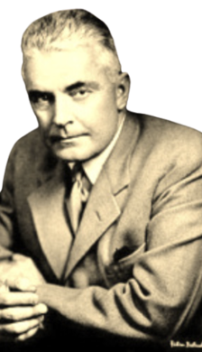
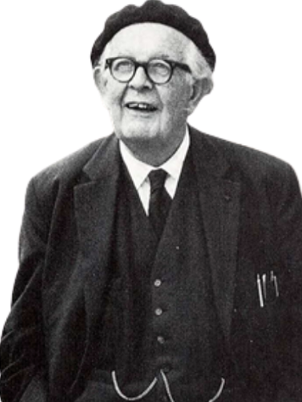
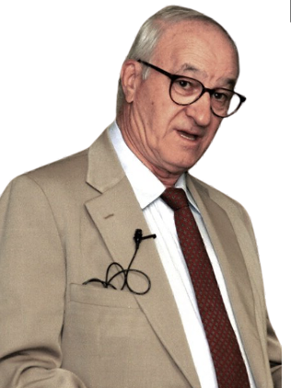
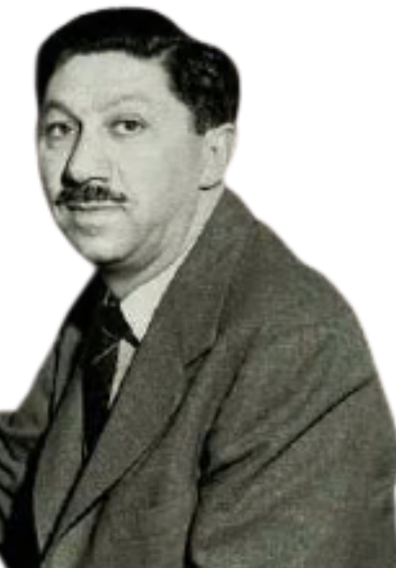
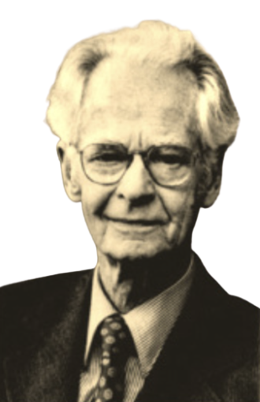
THEORIST AND THEORIES
CONTINUED

Slide 2
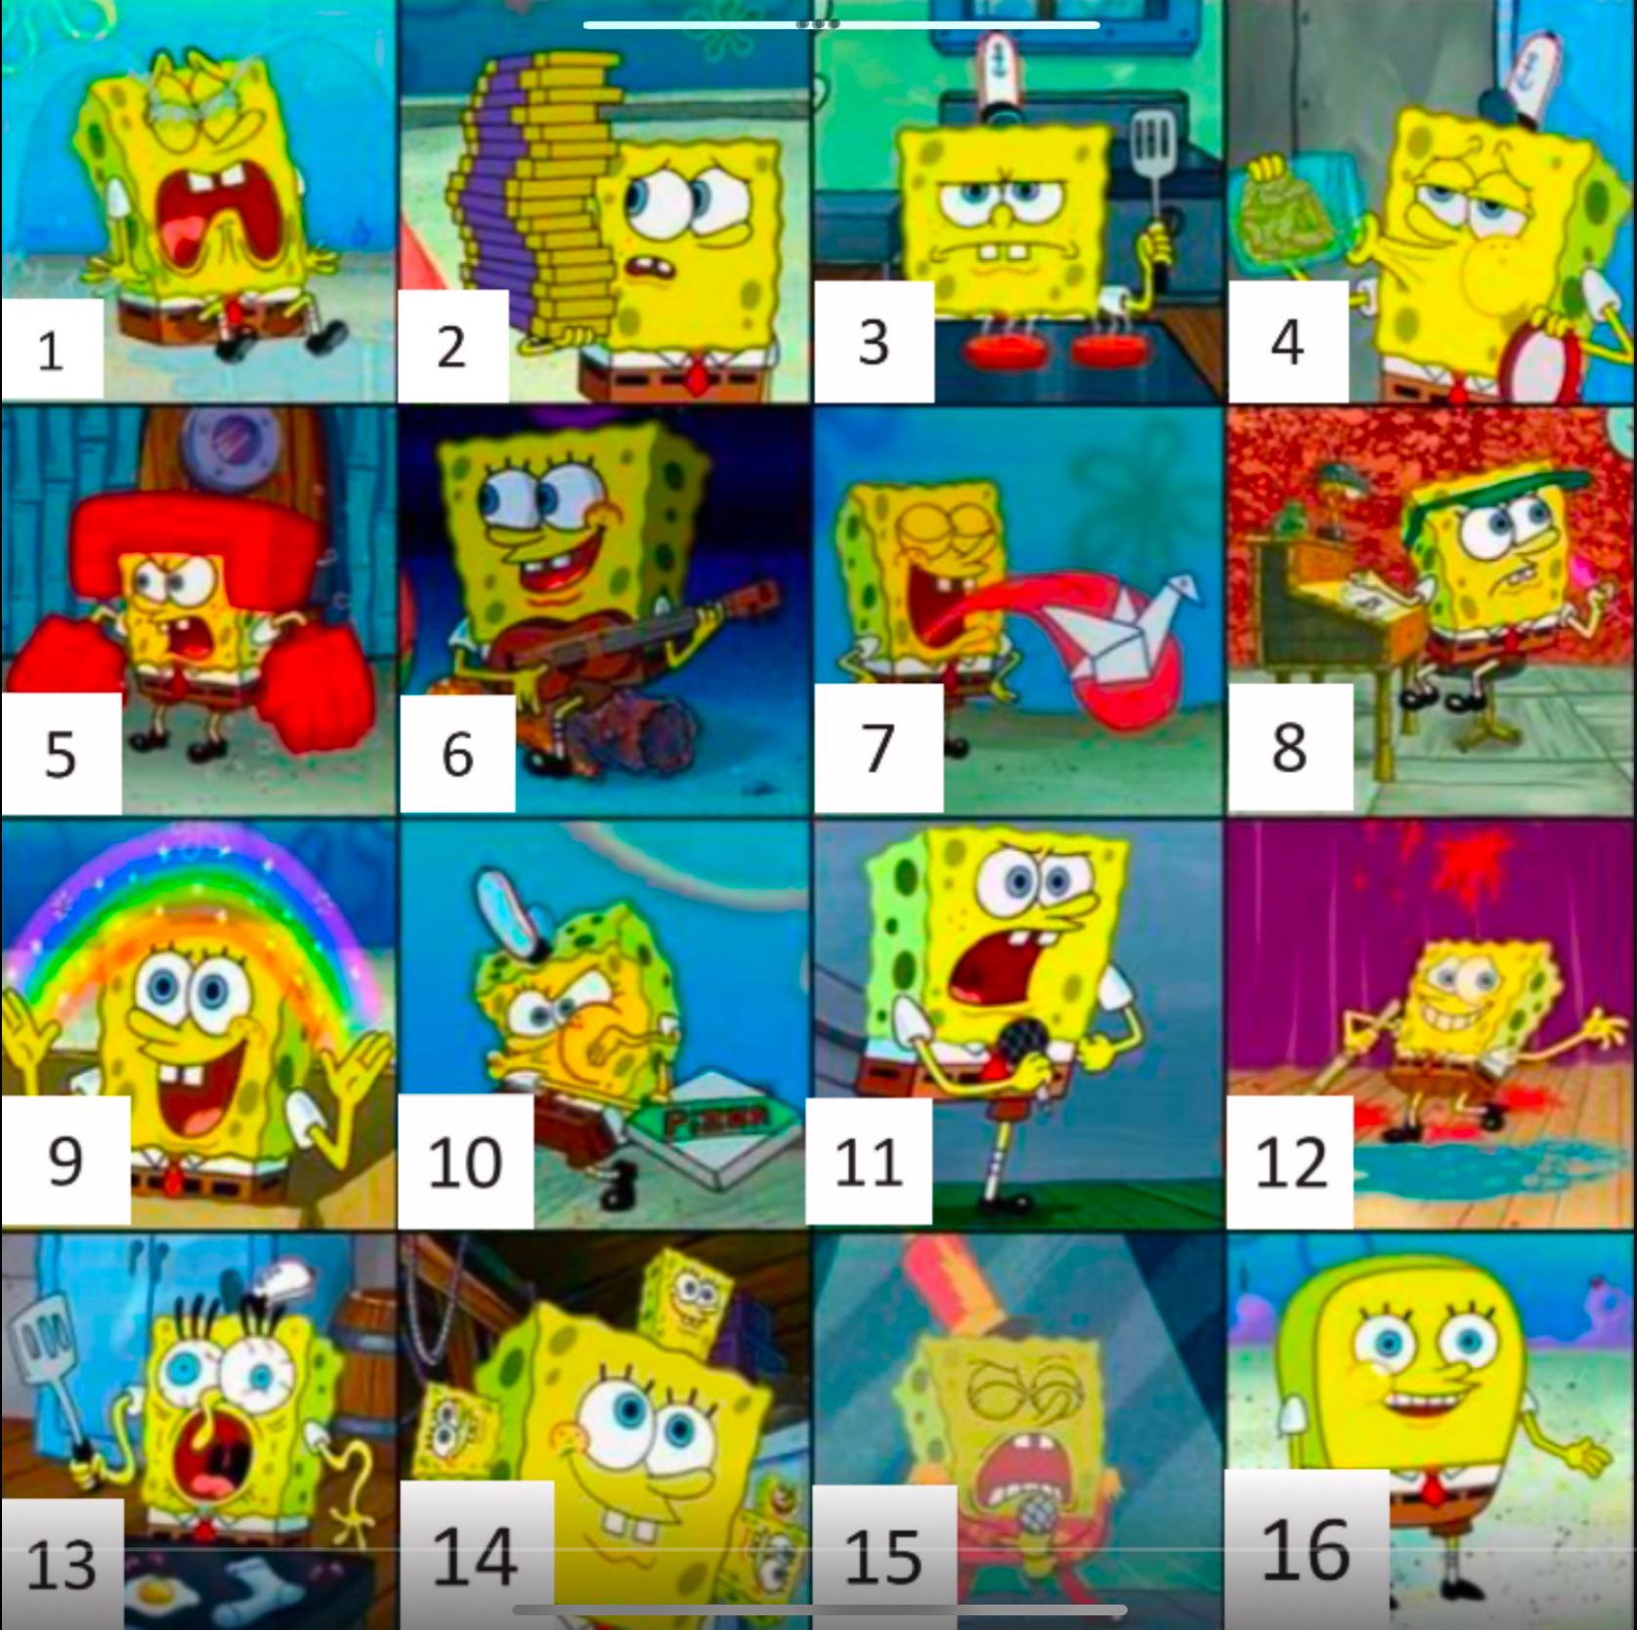

Make a name tent with your first name in large letters. Write down the name you wish to be called.

Slide 3

Question of the Day

Slide 4
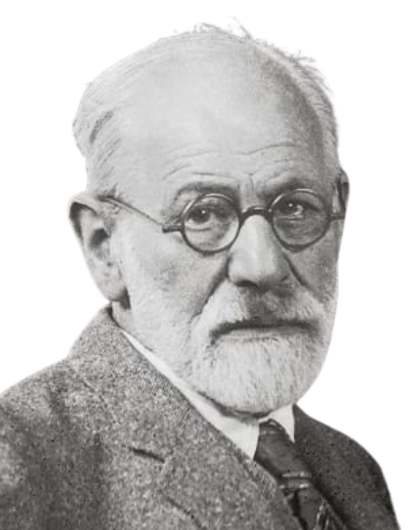
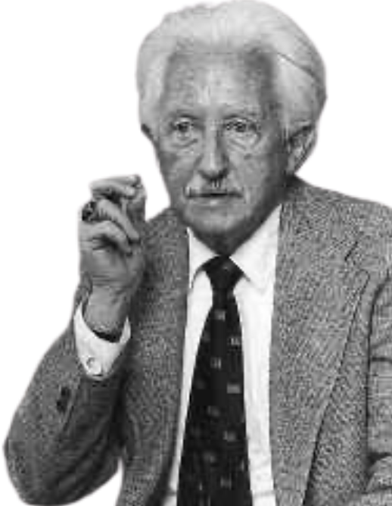
Question of the Day
Think about something you learned as a child, such as language, social skills, or emotional regulation. How might Erikson and Freud explain how you learned that skill? What might each theory emphasize differently?
Notes:
Freud, for example, would emphasize unconscious processes and early emotional experiences, while Erikson would focus more on social relationships and the psychological challenges we encounter at different stages of life.
Unlike the “Psycho” theories, which believe development is driven primarily by internal conflicts or emotional stages. Some psychologists argued that development is shaped much more directly by the environment—by what children experience, what they are rewarded for, what they are punished for, and what they observe around them.
These theorists believe that behavior is learned through interaction with the environment. This perspective became known as the Environmental Learning Theories, which is where we are starting off today

Slide 5
Branches of Theories
The “Psycho” Theories
The Environmental Learning Theories
The Constructionist Theories
The Humanistic Theories
The Contextual Theories
Notes:
Environmental learning theories focus on the idea that development is shaped primarily by the environment and by experience. Unlike psychodynamic theories, which emphasize internal emotional processes, environmental learning theories emphasize external influences.
Overarchingly, these theories emphasize that development is strongly influenced by environmental experience and that behavior is learned through interaction with the world.
Let’s start with Behaviorism

Slide 6
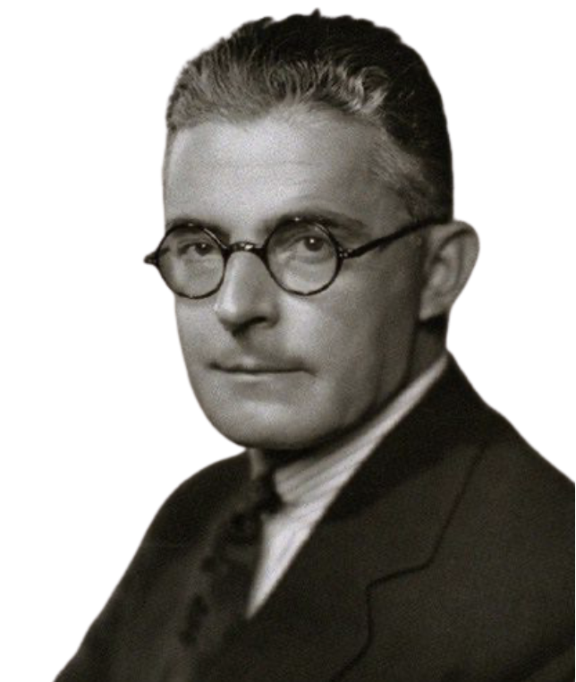
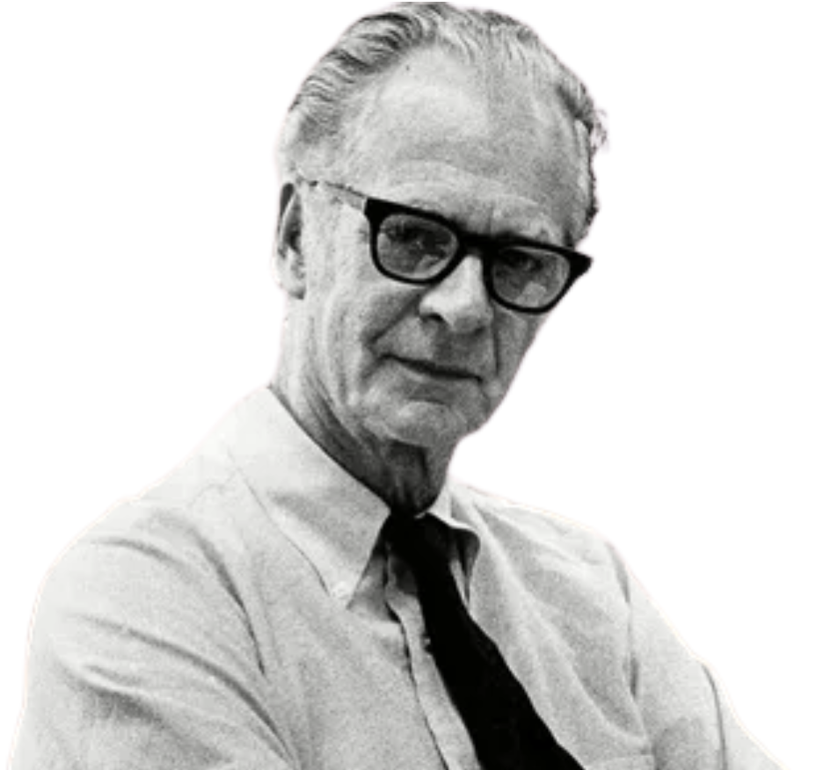
Watson
&
Skinner
Behaviorism

Slide 7
Watson & Skinner
John B. Watson (1878–1958)
Founder of Behaviorism
“Give me a dozen healthy infants, well-formed, and my own specified world to bring them up in and I’ll guarantee to take any one at random and train him to become any type of specialist I might select — doctor, lawyer, artist, merchant-chief, and yes, even beggar-man and thief, regardless of his talents, penchants, tendencies, abilities, vocations, and race of his ancestors.”
B.F. Skinner (1904–1990)
Expanded Behaviorism
Notes:
Behaviorism was founded by John B. Watson in the early 20th century and later expanded significantly by B.F. Skinner.
John Watson was an American psychologist working in the early 1900s, during a time when psychology was still heavily influenced by Freud’s ideas about the unconscious mind. Watson strongly disagreed with Freud’s approach. He argued that psychology should be a natural science, similar to biology or chemistry. That meant focusing only on things that could be directly observed and measured.
Watson believed that studying thoughts, emotions, or unconscious motives was too subjective and not scientifically rigorous. Instead, he argued that psychologists should study observable behavior. If you can’t see it or measure it, he believed it shouldn’t be the focus of scientific psychology.
He also made a bold claim about human development. Watson argued that environment is the primary force shaping behavior. He famously stated “Give me a dozen healthy infants, well-formed, and my own specified world to bring them up in and I’ll guarantee to take any one at random and train him to become any type of specialist I might select — doctor, lawyer, artist, merchant-chief, and yes, even beggar-man and thief, regardless of his talents, penchants, tendencies, abilities, vocations, and race of his ancestors.”B.F. Skinner, working a few decades later, expanded Watson’s ideas. Skinner was also deeply committed to making psychology scientific and experimental. He conducted highly controlled laboratory experiments, often using animals like rats and pigeons, to study how behavior changes based on consequences.
Skinner agreed that behavior is learned, but he focused specifically on how reinforcement and punishment shape behavior over time. He argued that behavior is not random—it is predictable and shaped by patterns of reward and consequence in the environment.
Both Watson and Skinner shared a core assumption:
Behavior is learned through environmental interaction. It is not primarily driven by unconscious conflict or internal developmental stages.
Their work marked a major shift in psychology—from focusing on hidden mental processes to focusing on measurable behavior

Slide 8
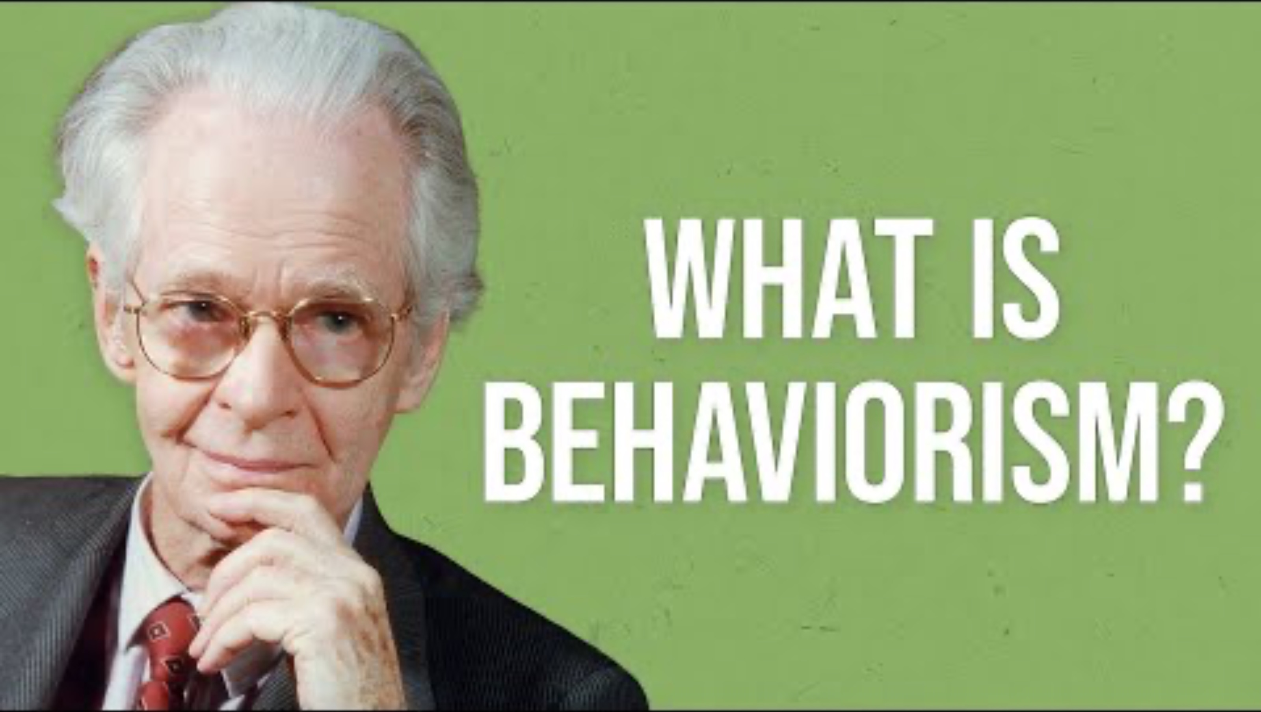
Notes:
An Overview of behaviorism:
https://www.youtube.com/watch?v=pb4Ut1VLL98

Slide 9
Key Features of Behaviorism
Behavior is learned through experience
The environment shapes behavior
Behavior can be learned and unlearned
Learning occurs through stimulus–response associations
Focus on observable behavior
2 forms of Conditioning: Classical and Operant
Stimulus = Environmental Event
Response = Behavioral Reaction

Slide 10
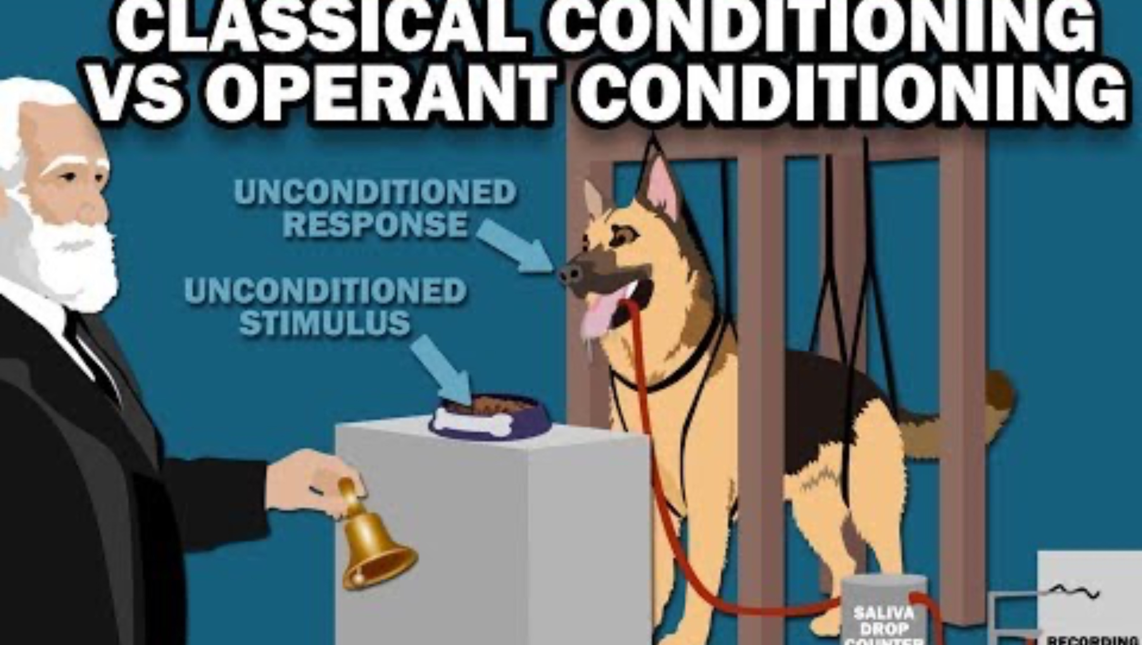
Notes:
https://youtu.be/PRdCowYEtAg?si=JoZXbB3gWt9UA51J

Slide 11
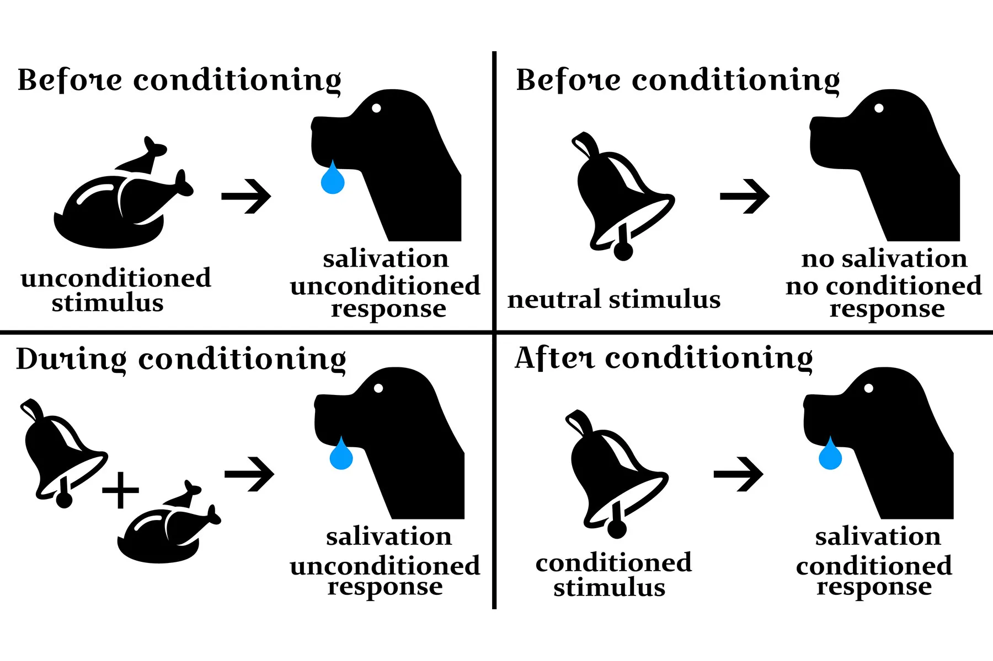
Notes:
Classical Conditioning
---------------------
Let’s walk through this diagram step by step.
Start in the top left: Before conditioning.
Food is presented to the dog.
Food naturally causes salivation.
Food is called the unconditioned stimulus — because it automatically produces a response.
Salivation is the unconditioned response — because it happens naturally, without learning.
Now look at the top right.
Before conditioning, the bell is just a neutral stimulus.
It does not cause salivation.
There is no learned response yet.
Now move to the bottom left: During conditioning.
The bell is repeatedly paired with the food.
So now we have:
Bell + Food → Salivation.
The salivation is still technically an unconditioned response at this stage, because food is still causing it.
But the key is repetition.
Over time, the dog begins associating the bell with the food.
Now look at the bottom right: After conditioning.
The bell alone is presented.
Now the bell causes salivation.
The bell has become the conditioned stimulus.
Salivation is now the conditioned response.
This response is learned.
The dog learned to associate the bell with food.
That’s classical conditioning:
Learning through association between stimuli.

Slide 12
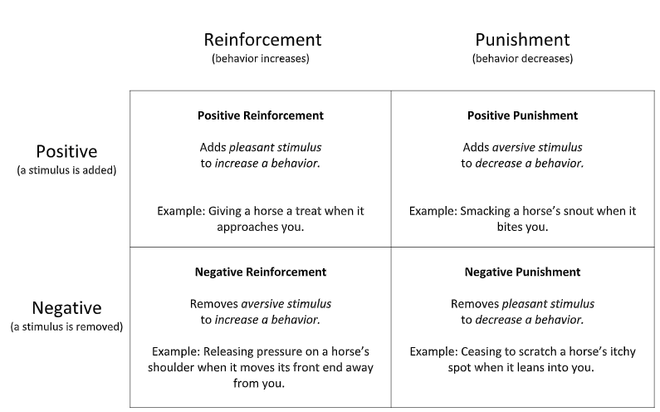
Notes:
Operant Conditioning
---------------------
First, look at the top of the chart.
On the left side we have Reinforcement — which means behavior increases.
On the right side we have Punishment — which means behavior decreases.
That’s the first distinction.
Now look at the side labels.
Positive means something is added.
Negative means something is removed.
Positive does not mean good.
Negative does not mean bad.
Positive = add.
Negative = remove.
Now let’s go quadrant by quadrant
Top left quadrant.
Positive reinforcement means: You add something pleasant to increase a behavior.
Example: A child cleans their room and receives praise. Because praise was added, cleaning increases. That’s positive reinforcement. This is the most common form of reinforcement in classrooms.
Bottom left quadrant.
Negative reinforcement means: You remove something unpleasant to increase a behavior.
Example: A student does homework to stop their parent from nagging. Nagging is removed. Homework behavior increases. So negative reinforcement still increases behavior. It is not punishment. This is where students often get confused
Top right quadrant.
Positive punishment means: You add something unpleasant to decrease a behavior.
Example: A child talks back and gets extra chores. Something aversive was added. The behavior decreases. That’s positive punishment
Bottom right quadrant.
Negative punishment means: You remove something pleasant to decrease a behavior.
Example: A teenager breaks curfew and loses phone privileges. Phone access is removed. The unwanted behavior decreases. That’s negative punishment

Slide 13

Pros & Cons
Strengths
Highly scientific and testable
Strong experimental support
Clear explanation of how habits form
Practical applications in education and therapy
Limitations
Overly deterministic and simplistic view of behavior
Ignores internal psychological and mental processes
Cannot account for learning without environmental input
Conditioning principles are not universally applicable

Slide 14
THINK-PAIR-SHARE
A 6-year-old begins cleaning their room more often after receiving praise and stickers from a parent
What do you observe? Observations only!
How would Watson or Skinner explain this behavior?
Notes:
A behaviorist would say the child’s behavior increased because it was reinforced.
Specifically, this is positive reinforcement.
The parent added something pleasant — praise and stickers — and as a result, the cleaning behavior increased.
Skinner would argue that behavior is shaped by its consequences. When a behavior leads to a rewarding outcome, it becomes more likely to occur again.
The key idea here is that the child is not cleaning because of internal motivation, unconscious conflict, or developmental stage. From a strict behaviorist perspective, the behavior increased because it was rewarded.
So the explanation focuses entirely on the environment and the consequences following the behavior

Slide 15
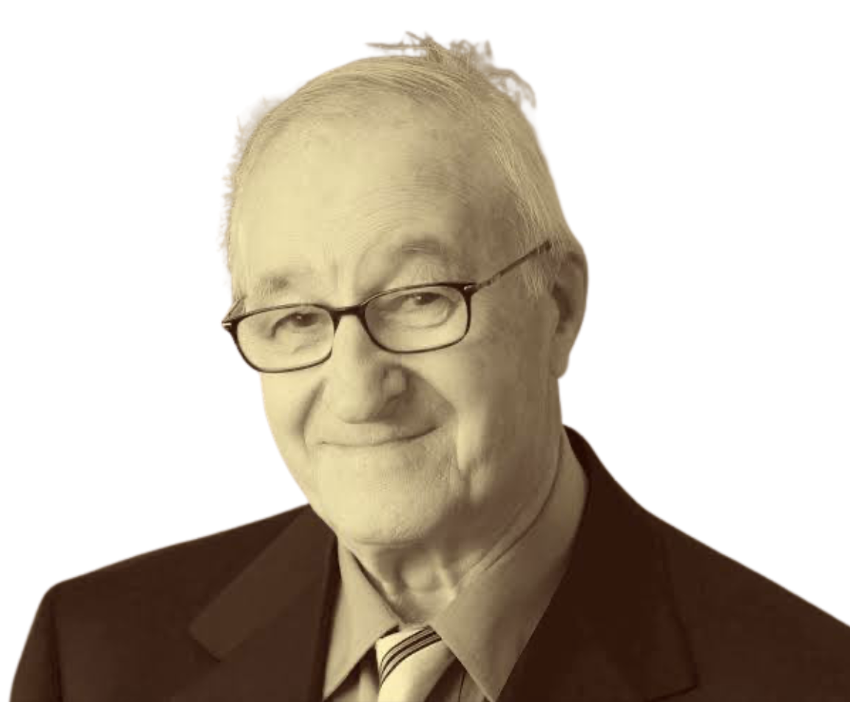
Albert Bandura’s
Social
Cognitive
Theory
Notes:
Albert Bandura developed Social Cognitive Theory in the 1960s. At the time, behaviorism was the dominant perspective, emphasizing learning through reinforcement and punishment.
Bandura agreed that the environment matters, but he argued that people also learn by observing others.
He became most famous for the Bobo Doll experiments, which showed that children imitate behaviors they see, even without direct reinforcement.
His theory bridges behaviorism and cognitive psychology by emphasizing that learning involves not just behavior and environment, but also thinking.

Slide 16

Social Cognitive Theory
Learning occurs through observation
Modeling and imitation shape behavior
Cognitive processes guide learning
Vicarious reinforcement
Reciprocal determinism
Self-efficacy influences behavior
Notes:
Social Cognitive Theory proposes that people learn not only through direct experience, but also by observing others.
This is called observational learning.
Children and adolescents constantly watch parents, teachers, peers, celebrities, and influencers. Those individuals serve as models. But imitation is not automatic. Bandura emphasized that learning involves cognition. There are mental processes involved.
A learner must:
Pay attention to the model.
Retain or remember what they observed.
Be able to reproduce the behavior.
Be motivated to perform it.
So learning is an active, cognitive process.
Another key concept here is vicarious reinforcement.
This means we don’t need to be rewarded ourselves in order to learn. We can observe someone else being rewarded or punished and adjust our behavior accordingly. If we see someone gain popularity for a behavior, we may imitate it. If we see someone criticized for a behavior, we may avoid it.
Bandura also introduced reciprocal determinism.
This is the idea that behavior, cognition, and environment all influence each other.
The environment affects how we think. Our thinking affects how we behave. Our behavior changes the environment.
It’s a dynamic loop, not a one-way cause-and-effect relationship.
Finally, Bandura emphasized self-efficacy — our belief in our ability to succeed.
If someone believes they are capable, they are more likely to attempt a task and persist.
So Social Cognitive Theory is not just about copying — it’s about observing, interpreting, evaluating, and deciding

Slide 17
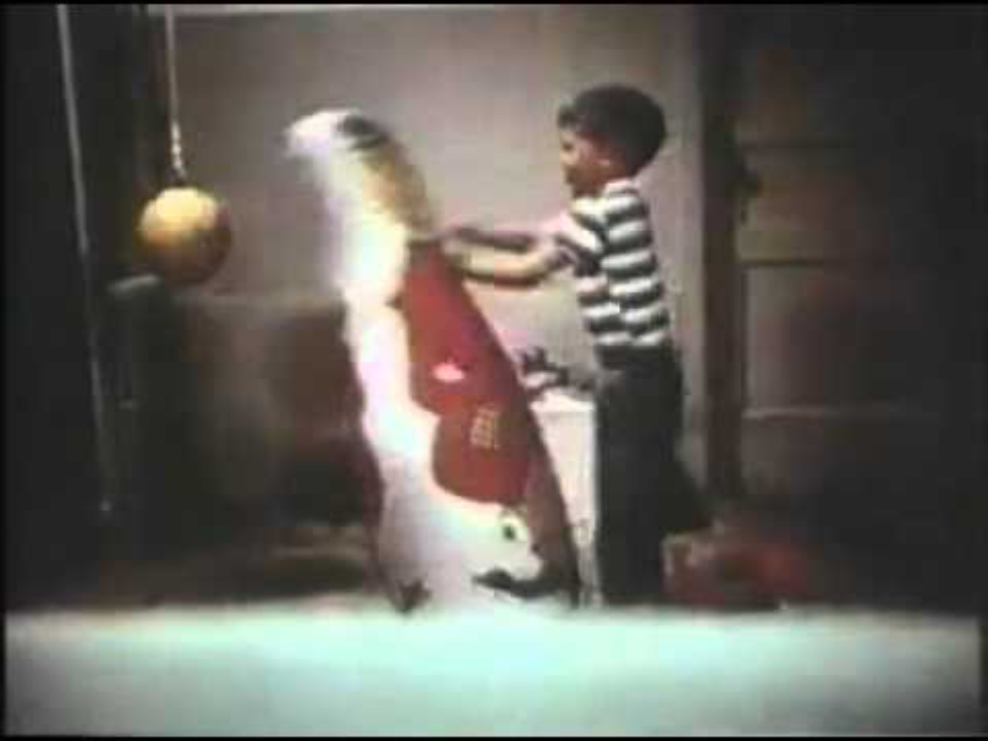
Notes:
https://www.youtube.com/watch?v=dmBqwWlJg8U
In the early 1960s, Bandura conducted what became known as the Bobo Doll experiment.
Children were shown a video or live demonstration of an adult interacting with a large inflatable doll called a Bobo doll. In one condition, the adult acted aggressively — hitting the doll, kicking it, yelling phrases like ‘Pow!’ or ‘Sock him!’
In another condition, the adult behaved calmly and non-aggressively. After watching the adult, the children were placed in a room with the same doll.
Here’s the key finding: Children who observed the aggressive model were significantly more likely to imitate the aggressive behavior.
They hit the doll. They used the same phrases. They even invented new aggressive actions. And here’s the critical point: The children were not directly rewarded or punished for their behavior. They learned simply by observing.
Behaviorism would predict that learning requires reinforcement.
Bandura showed that learning can occur without direct reinforcement — through modeling.
So this experiment demonstrated two major ideas:
First, observational learning is real.
Second, cognition matters — children are not just reacting automatically. They are attending, remembering, and deciding whether to imitate.
This is what separates Social Cognitive Theory from pure behaviorism.

Slide 18
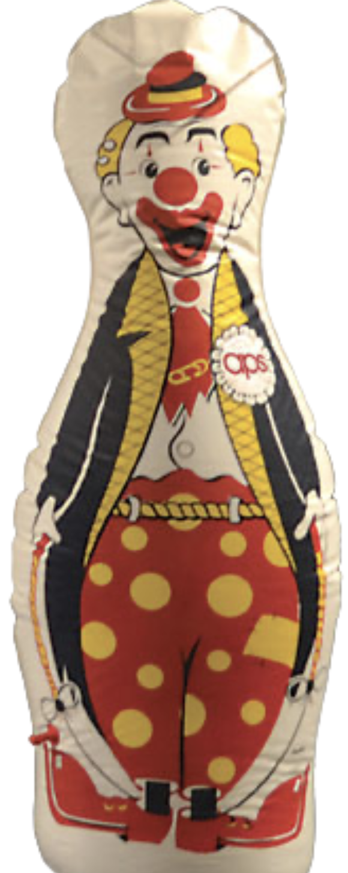
Pros & Cons
Strengths
Weaknesses
Cognitive processes are difficult to measure
Broad and less predictive than stage theories
Underemphasizes biological factors
Does not fully explain the developmental change
Strong experimental support
Integrates behavior and cognition
Explains real-world learning
Accounts for social and media influence
Emphasizes self-efficacy
Notes:
Social Cognitive Theory has several important strengths.
First, it has strong experimental support.
The Bobo Doll experiment and many follow-up studies provide evidence for observational learning. it integrates behavior and cognition.
Unlike strict behaviorism, Bandura recognizes that thinking, attention, memory, and interpretation matter. it explains real-world learning.
We clearly see modeling in classrooms, families, peer groups, and media environments. it accounts for social and media influence.
This makes it highly relevant in modern contexts — including social media, online platforms, and cultural modeling. Bandura introduced the concept of self-efficacy — the belief in one’s own ability to succeed.
This is hugely important in education and motivation research.
Now, the limitations.
Cognitive processes are harder to measure directly than observable behavior.
We cannot see attention or interpretation in the same way we see behavior. Second, the theory is broad. It explains how learning occurs, but does not provide clear developmental stages like Piaget or Erikson. Third, it underemphasizes biological influences.
Temperament, genetics, and neurological development are not central in the model. Finally, it does not fully explain why development changes qualitatively over time.
It explains learning, but not necessarily structural developmental shifts

Slide 19
THINK-PAIR-SHARE
A middle school student starts using slang and clothing styles they see popular influencers wearing on TikTok.
What is the student doing? Observations only!
How would Bandura explain this behavior?
Notes:
Bandura would say:
The student is engaging in modeling.
They observed a model (the influencer), attended to the behavior, remembered it, and then reproduced it.
“What had to happen cognitively for this to occur?”
“Was the student directly rewarded for copying?”
“How might this behavior now influence their environment?”

Slide 20
Branches of Theories
The “Psycho” Theories
The Environmental Learning Theories
The Constructionist Theories
The Humanistic Theories
The Contextual Theories
Notes:
The Constructionist theories focus on how thinking changes over time. These theories emphasize mental processes such as reasoning, memory, problem-solving, and understanding.
Unlike environmental learning theories, which focus on observable behavior and external reinforcement, cognitive theories focus on what is happening inside the child’s mind.
Together, cognitive theories emphasize that development involves changes in thinking, and that children actively construct their understanding of the world.

Slide 21
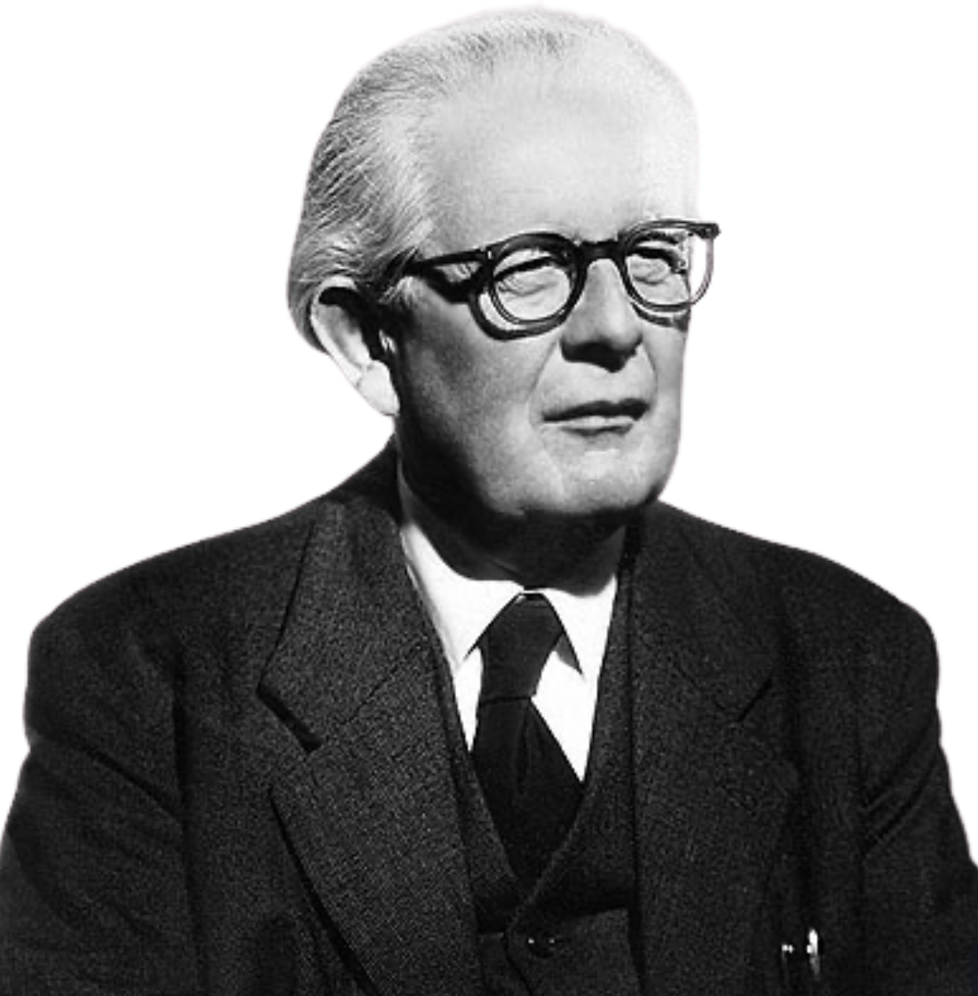
Jean Piaget’s Theory of Cognitive Development

Slide 22

Jean Piaget
Jean Piaget (1896–1980)
Foundation of Constructivist Theory
Swiss Psychologist
Studied cognitive development in children
Founder of genetic epistemology
Children actively construct knowledge
“Play is the work of childhood.” – Jean Piaget
Considered Children “Little Scientists”
Notes:
Jean Piaget was a Swiss psychologist and one of the most influential figures in developmental psychology.
He is best known for his work on cognitive development — how children think and how their thinking changes over time.
Piaget was one of the first psychologists to systematically observe children in order to study cognition.
He described his work as genetic epistemology — which means the study of the origins and development of knowledge.
Piaget was interested in how children come to know what they know.
One of his most important contributions was the idea that children are not passive recipients of knowledge.
Instead, they actively construct their own understanding of the world.
This idea became the foundation for constructivist theory — the belief that knowledge is built by the learner, not simply absorbed.
Piaget even based many of his early observations on watching his own children — carefully documenting how their thinking changed as they grew.

Slide 23
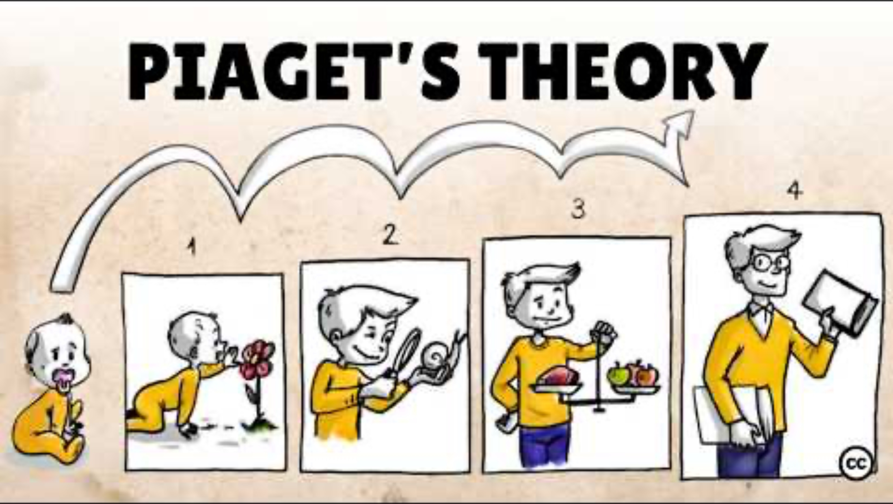
Notes:
Overview of Piaget’s theory:
https://youtu.be/IhcgYgx7aAA?si=gSTdPMxSH8Sx-3yf

Slide 24
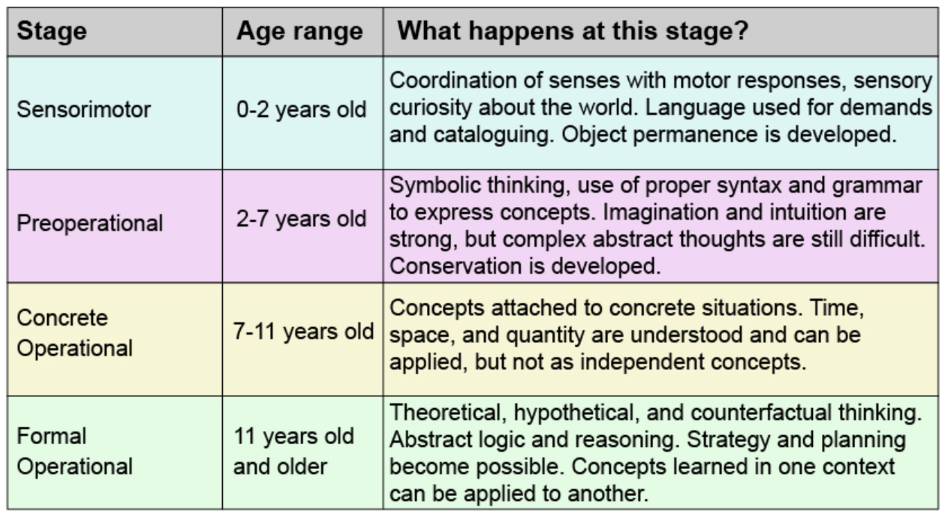
Stages of Cognitive Development
Notes:
The sensorimotor stage occurs from birth to about age two.
During this stage, infants learn primarily through sensory experiences and motor actions. Everything they know comes from what they can see, hear, touch, taste, or physically manipulate.
Their thinking is practical and action-based. They are not yet thinking symbolically — they are interacting directly with objects.
A key concept in this stage is object permanence — the understanding that objects continue to exist even when they are out of sight.
Before object permanence develops, if you hide a toy, the infant behaves as though it no longer exists.
Another hallmark of this stage is trial-and-error learning. Infants shake objects, drop objects, mouth objects — they are experimenting constantly.
This stage lays the foundation for all later cognitive development because it establishes the idea that the world is stable and predictable.

Slide 25
Stages of Cognitive Development
Notes:
The preoperational stage occurs roughly from ages two to seven.
This is when children begin using symbols — especially language.
They engage in pretend play. A stick becomes a sword. A box becomes a spaceship.
Symbolic thinking is expanding rapidly.
However, thinking is still intuitive rather than logical.
Children in this stage struggle with conservation — the idea that quantity remains the same even if appearance changes.
For example, if you pour water from a tall glass into a short glass, they may believe the amount has changed.
They also display egocentrism — difficulty taking another person’s perspective.
If you ask them what someone else sees, they often assume others see exactly what they see.
This stage shows enormous growth in language and imagination, but logical reasoning is still limited.

Slide 26
Stages of Cognitive Development
Notes:
In the concrete operational stage, roughly ages seven to eleven, children begin thinking logically — but only about concrete, tangible things.
This is when conservation is mastered.
They understand that mass, volume, and number stay the same even if appearance changes.
They can mentally reverse operations — understanding that addition and subtraction undo each other.
Thinking becomes less egocentric.
Children can now consider perspectives beyond their own.
However, their thinking is still tied to real objects and concrete examples.
They struggle with abstract reasoning.
So if you give them a hypothetical scenario with no real-world anchor, they may have difficulty.

Slide 27
Stages of Cognitive Development
Notes:
The formal operational stage begins in adolescence and continues into adulthood.
At this stage, individuals can think abstractly and hypothetically.
They can consider multiple variables at once.
They can formulate hypotheses and test them systematically.
This is when scientific reasoning develops.
Adolescents can think about concepts like justice, morality, identity, and hypothetical futures.
They are no longer limited to what is concrete and physically present.
Piaget believed that once formal operational thought is achieved, no new cognitive structures are needed — though knowledge can continue expanding.
However, research shows not all adults consistently use formal operational thinking in every context.

Slide 28

Pros & Cons
Strengths
Pioneered systematic study of children’s cognition
Introduced stage-based cognitive development
Emphasized active learning (constructivism)
Strong influence on education
Limitations
Stages may be too rigid
Underestimated children’s abilities
Cultural bias
Limited explanation of adult cognition
Notes:
Piaget’s theory has several major strengths.
First, he was a pioneer. He was one of the first psychologists to systematically observe children in order to study cognition.
Second, he introduced the idea that cognitive development occurs in stages — that thinking changes qualitatively over time, not just quantitatively.
Third, he emphasized that children are active learners. They construct knowledge rather than passively absorbing it. This idea became foundational for constructivist theory.
Fourth, his work had enormous influence on education. Hands-on learning, discovery learning, and developmentally appropriate instruction all stem from Piaget’s ideas.
However, there are important limitations.
Research suggests development may be more continuous than stage-like.
Children don’t always move neatly from one stage to the next.
Many studies show children can perform certain tasks earlier than Piaget predicted — meaning he may have underestimated children’s cognitive abilities.
His theory has also been criticized for cultural bias. Much of his work was based on Western children, and cognitive development may vary across cultural contexts.
Finally, Piaget argued that formal operational thought is the highest level of development. However, some researchers propose a postformal stage in adulthood, where thinking becomes more contextual and integrated with emotion

Slide 29
THINK-PAIR-SHARE
A 5-year-old watches you pour juice from a tall, thin glass into a short, wide glass. The child says, “Now there’s less juice.”
What is the student doing? Observations only!
How would Piaget explain this behavior?
Notes:
Piaget would say:
The child is in the preoperational stage.
Their thinking is intuitive and perception-based.
They focus on one dimension of the situation — usually height.
They lack conservation — the understanding that quantity remains the same despite changes in appearance.
They also cannot mentally reverse the action (reversibility).
They don’t think, “If you poured it back, it would look the same.”

Slide 30
Branches of Theories
The “Psycho” Theories
The Environmental Learning Theories
The Constructionist Theories
The Humanistic Theories
The Contextual Theories
Notes:
Humanistic theories focus on the idea that humans are naturally motivated to grow, develop, and reach their full potential. Unlike behaviorist theories, which emphasize external reinforcement, or psychodynamic theories, which emphasize internal conflict, humanistic theories emphasize positive growth and internal motivation.
Humanistic theorists believe that individuals are not simply shaped by their environment or unconscious drives. Instead, they are active agents in their own development, motivated by a desire to improve, learn, and achieve.

Slide 31
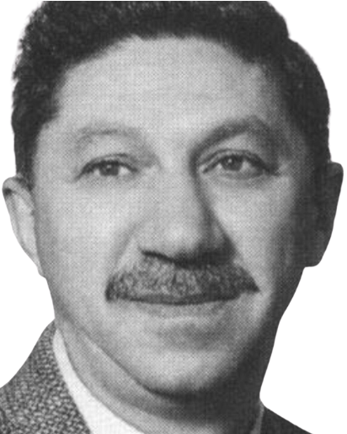
Maslow’s
Hierarchy of Needs
Notes:
Lets switch to talking about Abraham Maslow’s humanistic theory of motivation.
Maslow proposed that human behavior is driven by a structured hierarchy of needs.
His model shifted psychology from pathology (what’s wrong with people) to growth and potential (what people can become).

Slide 32
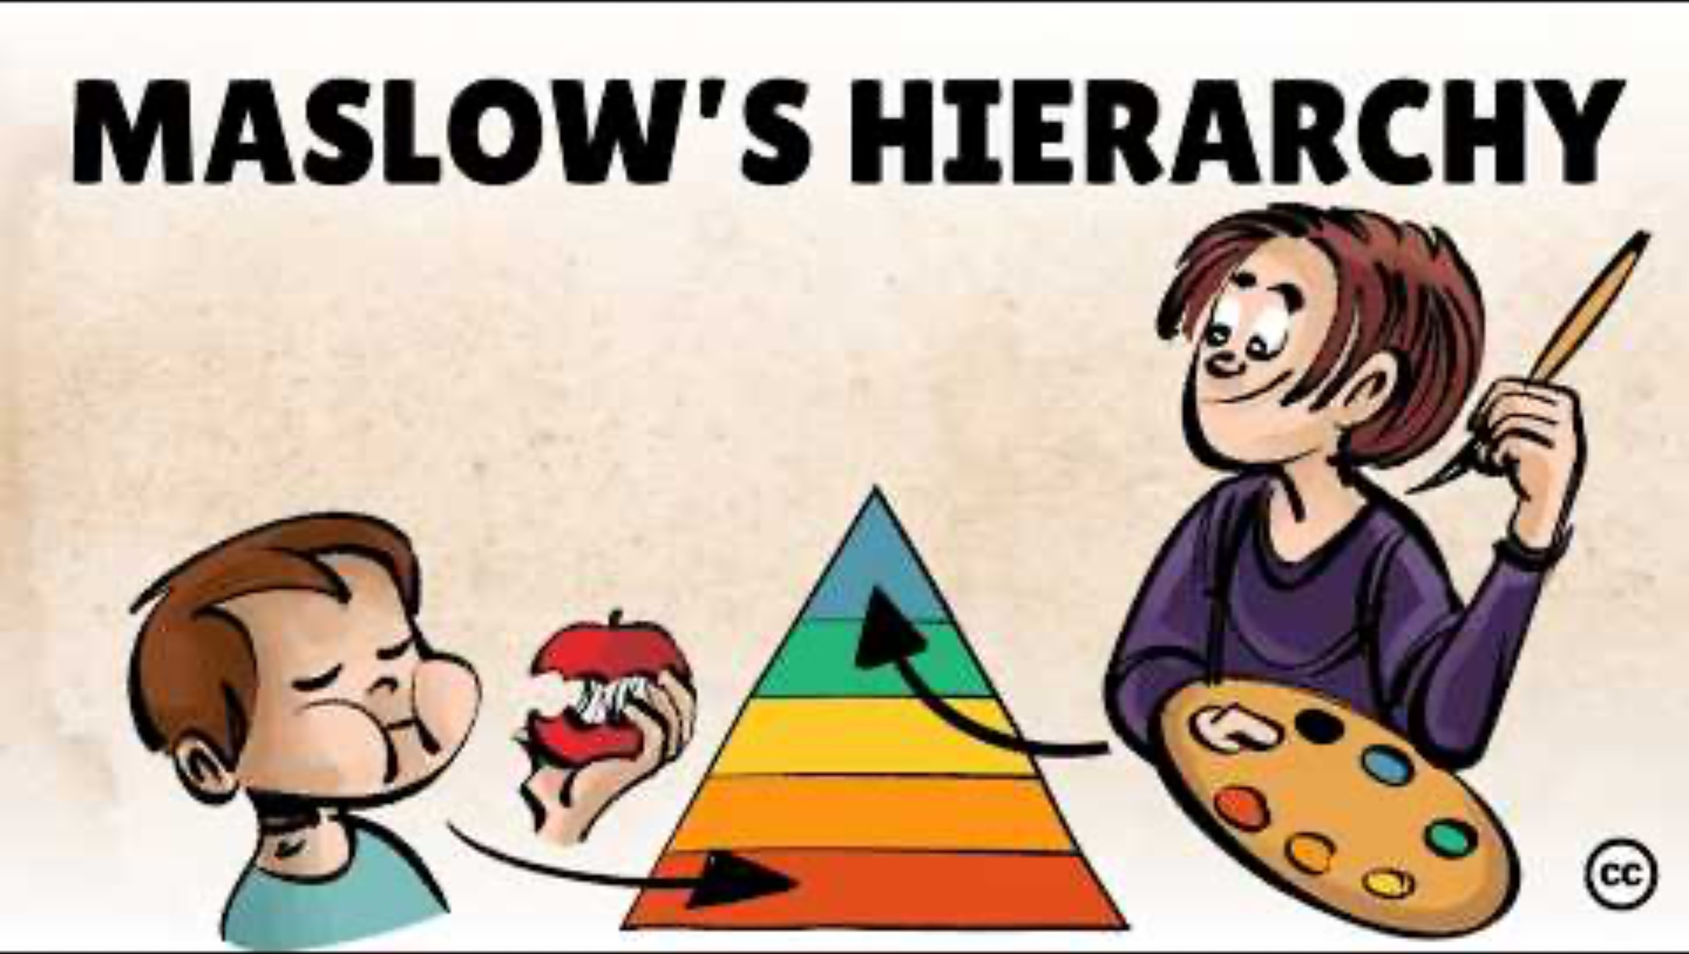
Notes:
Overview of hierarchy of needs:
https://youtu.be/O-4ithG_07Q?si=xin4BDk2kyWGOFb_

Slide 33
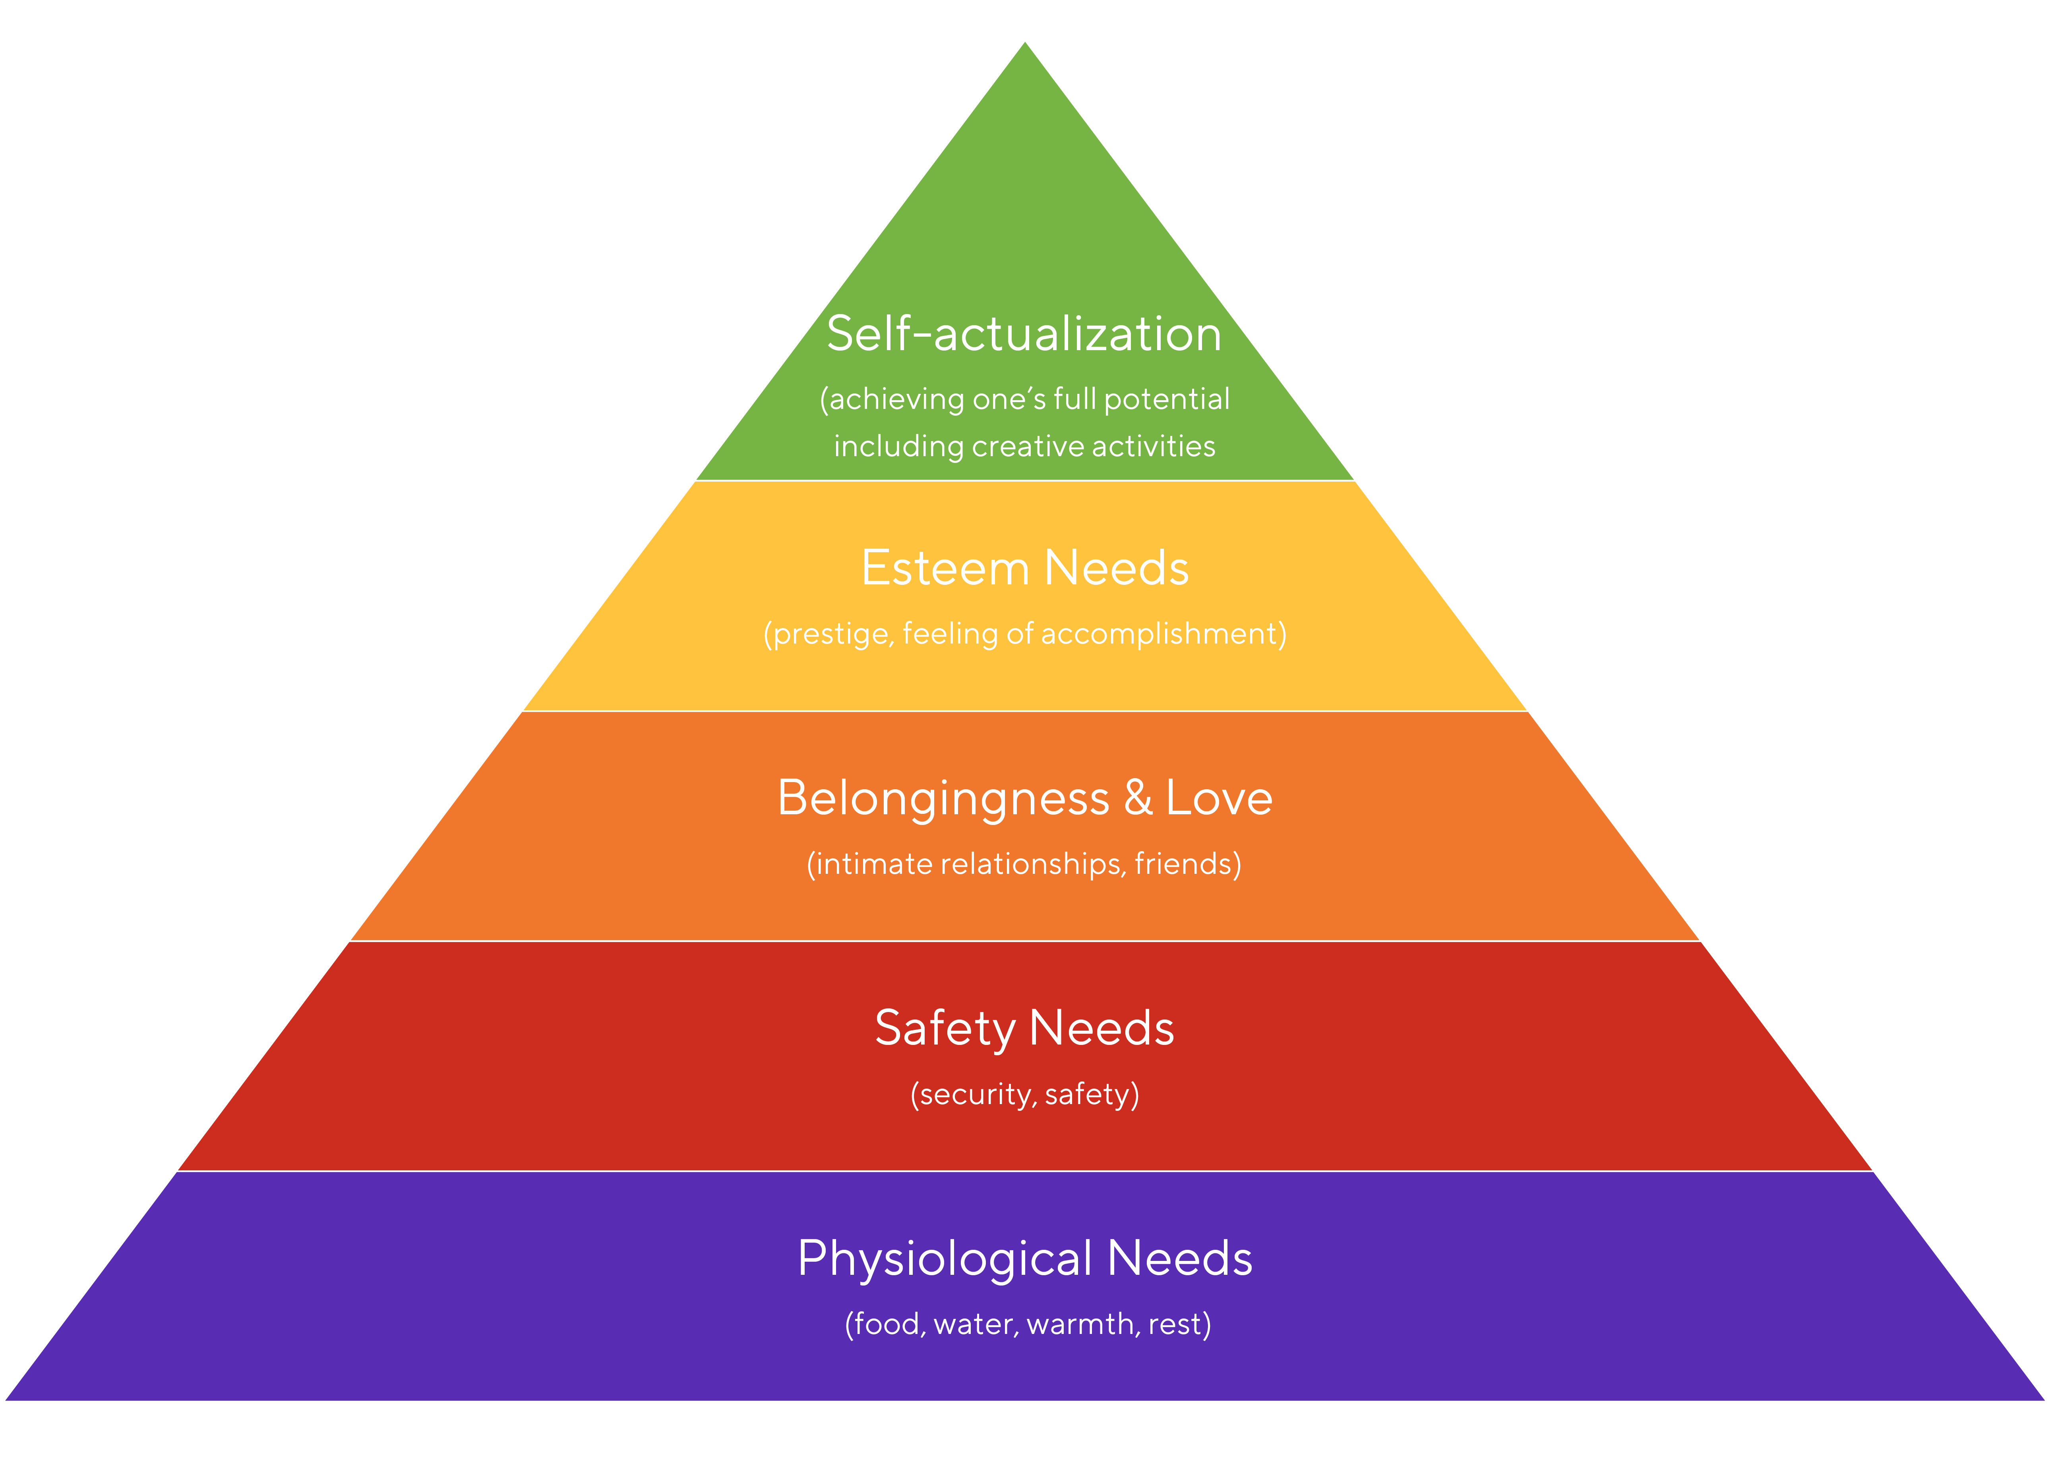
Hierarchy of Needs
Abraham Maslow (1908-1970)
Focus on the “whole person.”
Emphasis on growth and potential
Motivation toward fulfillment
Inherent drive toward self-actualization
Notes:
Humanistic psychology emerged as a “third force” after behaviorism and psychoanalysis.
It emphasizes agency, meaning, and subjective experience.
Maslow believed humans are inherently motivated toward growth—not just driven by deficits or conditioning.
Maslow conceptualized needs as hierarchical but not strictly rigid.
Motivation shifts depending on which needs are unmet.
The hierarchy is often depicted as a pyramid, but Maslow later clarified it is more dynamic.

Slide 34
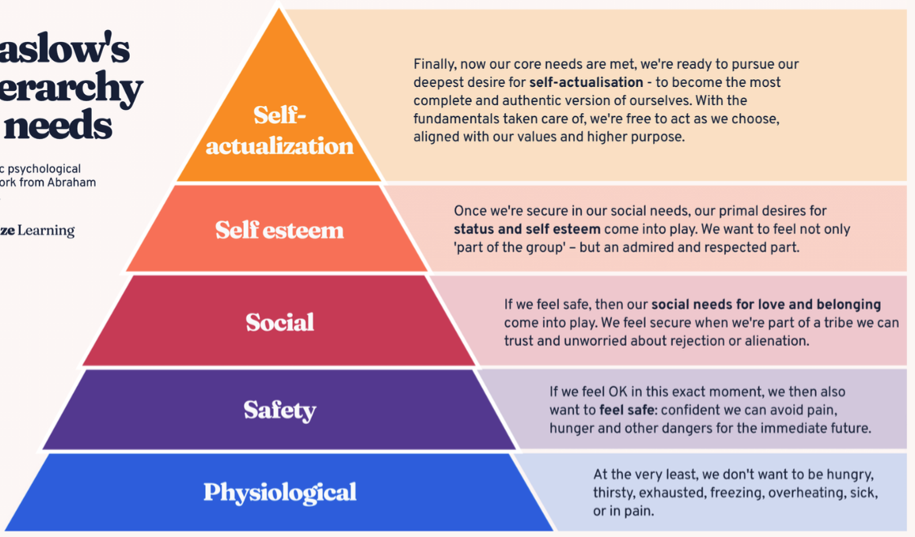
Notes:
Physiological Need is the foundation of Maslow’s hierarchy and includes biological survival needs: food, water, sleep, shelter, warmth, and physical regulation.
When these needs are unmet, they dominate attention and motivation. Cognitive resources are redirected toward survival.
In developmental contexts, think about:
A child who is sleep-deprived struggling with executive functioning.
Food insecurity affecting attention and academic performance.
Maslow argued that higher-level goals—like belonging or esteem—cannot meaningfully motivate behavior if survival is threatened.
Importantly, these needs are not “less sophisticated” psychologically—they are simply more fundamental.

Slide 35
Notes:
Once physiological stability is achieved, individuals seek safety and predictability.
This includes:
Physical protection from harm.
Emotional security.
Consistency in environment.
Structure, rules, and stability.
In children, safety is largely dependent on caregiving systems.
Consistent routines.
Reliable attachment figures.
Safe school environments.
Chronic stress, trauma, or instability can prevent progression toward higher-order needs.
In adolescence, safety can also include social safety—freedom from bullying or social exclusion.

Slide 36
Notes:
This level is also called “belonging and love” as well as social
At this level, humans are motivated by connection and social integration.
Core components include friendship, intimacy, acceptance, trust, and group membership.
From a developmental perspective:
Early childhood → attachment bonds with caregivers.
Middle childhood → peer relationships become central.
Adolescence → peer acceptance strongly predicts self-concept.
Loneliness and social rejection can significantly impair mental health.
Maslow emphasized that belonging must be authentic—status without connection does not satisfy this need.

Slide 37
Notes:
Maslow divided esteem into two components:
Internal self-respect (competence, mastery, independence).
External recognition (status, prestige, reputation).
In adolescence especially, external validation may precede stable internal self-esteem.
Achievement motivation, academic performance, and leadership roles often reflect this level.
Chronic failure or lack of recognition may contribute to feelings of inferiority.
Importantly, this level marks a transition from social dependence toward individual identity formation.

Slide 38
Notes:
This is the drive to realize one’s fullest potential.
It involves growth, creativity, authenticity, and meaningful engagement.
Self-actualization is not about fame or wealth—it is about becoming “everything one is capable of becoming.”
Maslow described self-actualized individuals as:
Autonomous
Creative
Purpose-driven
Accepting of themselves and others
He believed relatively few people reach sustained self-actualization.
Developmentally, this level becomes most salient in adulthood when survival and identity are more stable.

Slide 39
Later Additions
Expanded Needs (Post 1954)
Cognitive Needs
Curiosity
Knowledge and understanding
Exploration and meaning-making
Aesthetic Needs
Appreciation of beauty
Order, symmetry, balance
Desire for harmony
Transcendence Needs
Helping others self-actualize
Service beyond the self
Moral or spiritual commitment
Notes:
Later in his career, Maslow revisited and refined his hierarchy.
He argued that the original five-level pyramid did not fully capture the complexity of human motivation.
He introduced cognitive needs, emphasizing that humans are driven not only by survival and belonging but by a desire to understand the world. This aligns with intrinsic motivation and curiosity research.
He added aesthetic needs, suggesting that people seek beauty, balance, and structure—something we see in art, design, and even preference for orderly environments.
Most significantly, he proposed transcendence needs—the motivation to move beyond the self and contribute to others’ growth.
This reframes the hierarchy from individual achievement to collective flourishing.
Conceptually, this anticipates modern positive psychology, particularly research on purpose, meaning, and prosocial behavior.
It also challenges the common misconception that Maslow’s theory ends at self-actualization; for Maslow, the highest form of development involved helping others grow.

Slide 40
Pros & Cons
Strengths
Weaknesses
Intuitive and easy to understand
Emphasizes growth and human potential
Influential in education, counseling, and organizational psychology
Highlights importance of belonging and psychological safety
Introduced positive, strengths-based perspective to psychology
Limited empirical support for strict hierarchical order
Culturally biased toward Western individualism
Constructs are difficult to operationalize
Oversimplifies motivation as stage-like
Does not fully account for structural inequality and systemic barriers
Notes:
Strengths
One reason Maslow’s theory remains widely taught is its accessibility. The pyramid is conceptually clear and pedagogically useful.
It shifted psychology toward a strengths-based framework, focusing on potential rather than pathology.
In education, the model highlights how unmet basic needs interfere with learning.
It foregrounded belonging decades before contemporary social neuroscience and belongingness research validated its importance.
It laid conceptual groundwork for modern positive psychology.
Limitations
Empirical research does not consistently support a rigid, sequential progression through levels.
Cross-cultural studies suggest that collectivist cultures may prioritize belonging over individual esteem, challenging the hierarchy’s universality.
Self-actualization is difficult to define and measure reliably.
The model can oversimplify complex motivational systems that are often simultaneous and dynamic.
It does not explicitly address socioeconomic or structural constraints that limit access to basic needs.

Slide 41
THINK-PAIR-SHARE
A student falls asleep in class and hasn’t completed their homework.
When asked about it, they say they were up late because their family recently had to move and they don’t have a stable place to sleep yet.
What is the student doing? Observations only!
How would Maslow explain this behavior?
Notes:
According to Abraham Maslow, unmet physiological and safety needs are interfering with higher-level functioning.
Sleep and shelter are physiological needs.
Housing stability relates to safety needs.
When these foundational needs are unmet, academic motivation (esteem or self-actualization) becomes secondary.
The student is not “lazy” — their motivational system is prioritizing survival.

Slide 42
Changes Because of the Snow Day
The Exam on Thursday is becoming a take-home exam
  It will open at Noon today
  You will have 2 hours to complete it
  It is still a closed note, but you can use your theorist “cheat sheets.”
2. Do not come into class on Thursday!
3. The in-class assignment will move to our class on Tuesday

Slide 43
Branches of Theories
The “Psycho” Theories
The Environmental Learning Theories
The Constructionist Theories
The Humanistic Theories
The Contextual Theories
Notes:
Contextual theories emphasize that development does not occur in isolation, but instead occurs within a broader social and environmental context. These theories focus on how relationships, culture, and environment shape development over time.
Unlike cognitive theories, which focus primarily on internal thinking, contextual theories emphasize that development is strongly influenced by interaction with others and the surrounding environment.

Slide 44
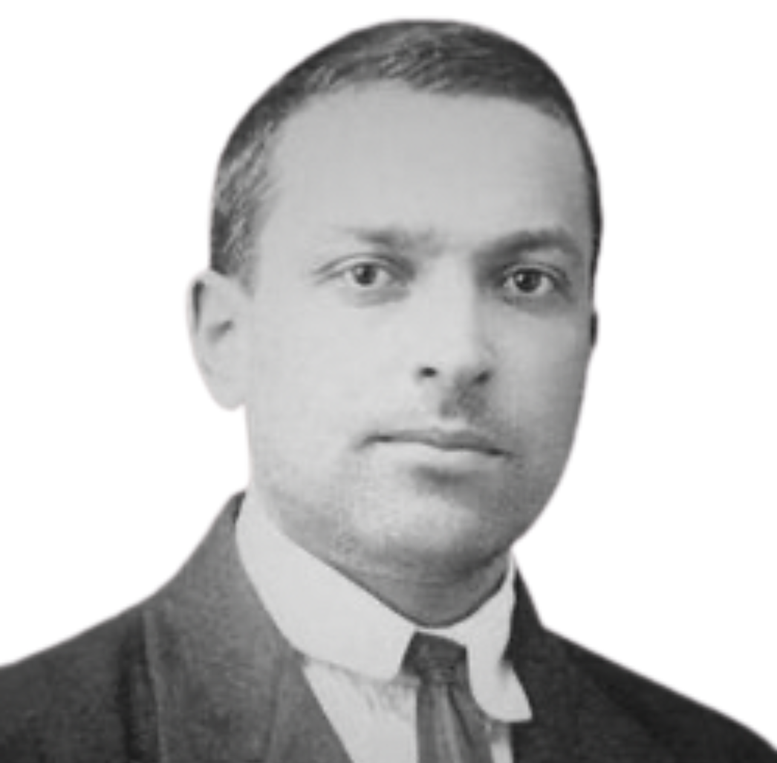
Vygotsky’s Sociocultural
Theory
Notes:
Unlike Piaget, Vygotsky argued that development is fundamentally social.
Cognitive growth occurs through interaction with others within cultural contexts.
Called the “Mozart of Psychology”
Vygotsky’s work was not widely known in the West until decades after his death. As it was suppressed by the soviet union
His interdisciplinary background (law, literature, linguistics, sociology) shaped his holistic theory.
Died young (age 37), in 1934

Slide 45
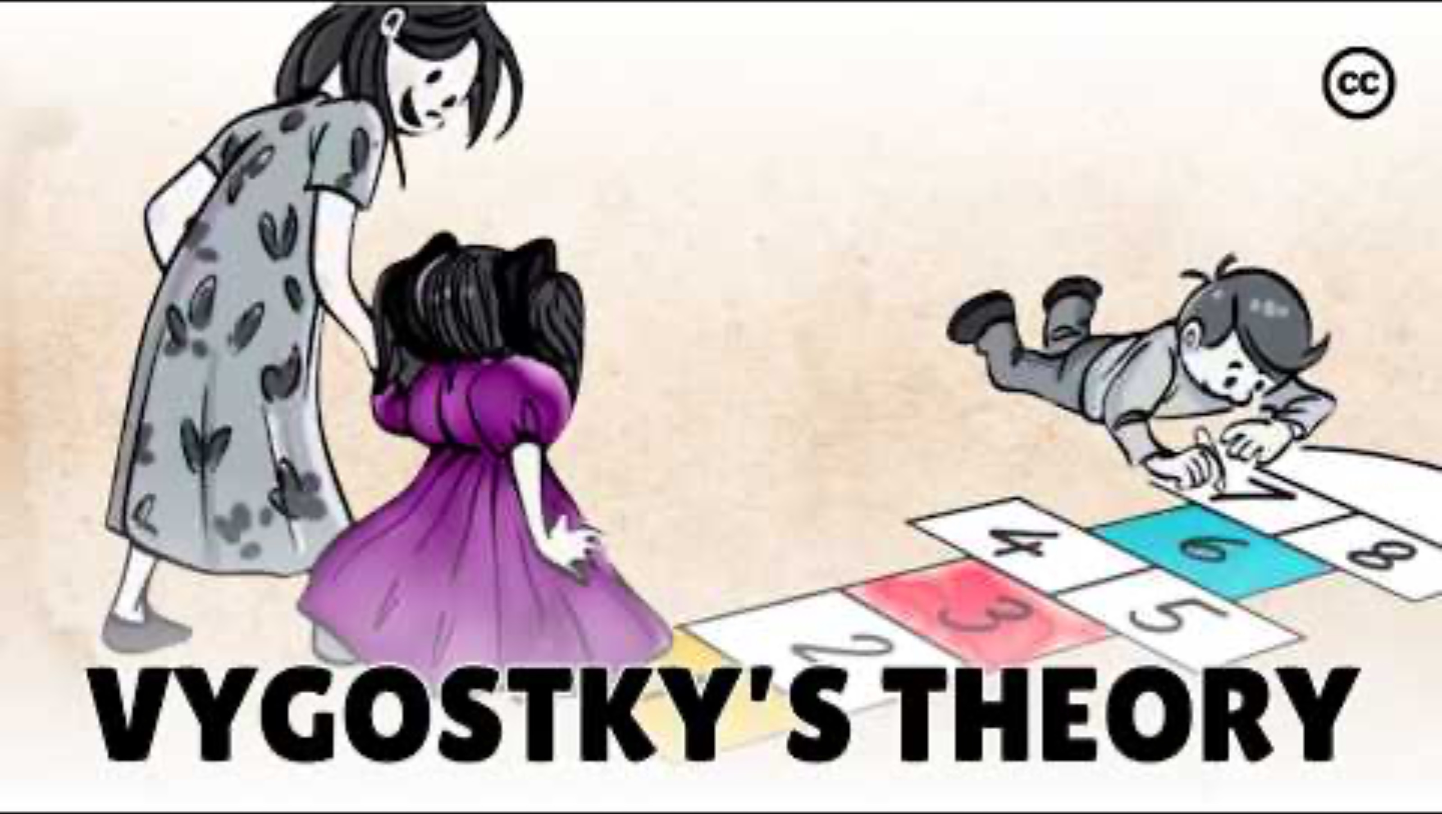
Notes:
Overview of Vygotsky:
https://youtu.be/O-4ithG_07Q?si=xin4BDk2kyWGOFb_

Slide 46
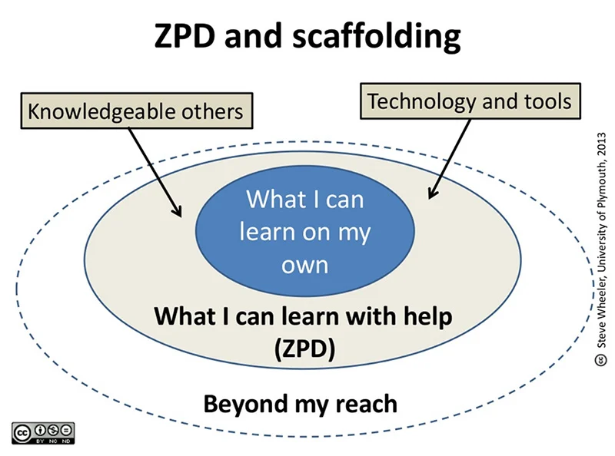
Core Assumptions of Theory
Cognitive development is socially mediated
Culture shapes how children think
Language is the primary psychological tool
Learning leads development
Private speech → internal speech (internalization process)
Abraham Maslow (1908-1970)
Notes:
Vygotsky’s theory rests on the idea that development is fundamentally social.
Children do not construct knowledge in isolation; they develop through interaction with adults and more capable peers.
Culture provides the tools of thinking—these include symbols, values, norms, and especially language.
Unlike Piaget, Vygotsky argued that learning actually drives development. When children engage in guided learning experiences, their cognitive abilities expand.
Language is central to this process. It is not just a communication tool; it structures thought itself.
Initially, children use language socially—talking with caregivers and teachers.
Then they engage in private speech, speaking aloud to guide their own behavior.
Over time, private speech becomes internalized as inner speech, forming the basis of conscious thought and self-regulation.
This internalization process is one of the most important mechanisms in Vygotsky’s model.

Slide 47
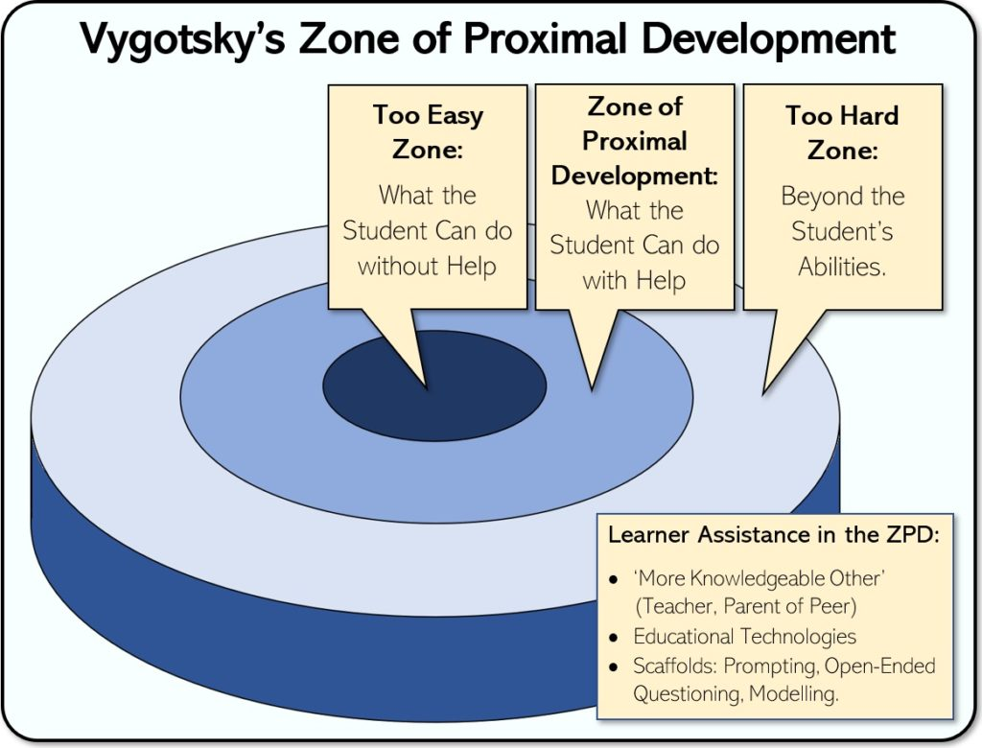
Zone of Proximal Development
The gap between what a child can do independently and what they can do with guidance
Independent ability
Assisted performance
Beyond current capacity
Abraham Maslow (1908-1970)
Notes:
The Zone of Proximal Development, or ZPD, is one of Vygotsky’s most influential contributions.
It refers to the gap between what a child can do independently and what they can do with guidance from a more knowledgeable other.
There are three levels to keep in mind:
What a child can do independently – this reflects mastered skills.
What a child can do with assistance – this is the ZPD.
What a child cannot yet do, even with help – this is beyond current developmental readiness.
Vygotsky believed that meaningful learning occurs within the ZPD.
If a task is too easy, there is no cognitive growth.
If it is too difficult, even with support, frustration occurs without learning.
The optimal instructional space is the “just beyond” level—where guidance stretches the child’s abilities.
Importantly, the ZPD is dynamic, not fixed.
As children internalize new skills, yesterday’s ZPD becomes today’s independent ability.
This means assessment should focus not only on static performance but also on learning potential.
The ZPD shifts depending on:
The task
The context
The quality of support
The child’s prior knowledge
A simple analogy:
Learning within the ZPD is like riding a bike with training wheels. The support allows success until independence becomes possible.

Slide 48

Scaffolding
Scaffolding = Structured Support
Guidance from adults or more capable peers
Gradual withdrawal of support
Temporary instructional framework
Abraham Maslow (1908-1970)
Notes:
Scaffolding refers to the structured support provided by a more knowledgeable other to help a learner accomplish a task within their Zone of Proximal Development.
Although Vygotsky did not use the term “scaffolding” himself, later researchers developed it to operationalize his ZPD concept.
The key idea is temporary support.
The adult or peer provides guidance.
The support is gradually reduced.
Eventually, the learner performs independently.
Effective scaffolding requires:
Assessing the learner’s current level.
Breaking tasks into manageable components.
Modeling strategies.
Providing hints or prompts.
Gradually transferring responsibility.
Importantly, scaffolding is responsive.
It adjusts to the learner’s needs in real time.
It is not a fixed script.
The amount of support depends on the learner’s competence.

Slide 49
THINK-PAIR-SHARE
A 6-year-old is trying to solve a math problem and says out loud,
“Okay… first I count these… now I add two more… wait… no, that’s wrong…”
What is the student doing? Observations only!
How would Vygotsky explain this behavior?
Notes:
According to Lev Vygotsky, this is private speech.
Private speech is when children talk to themselves to regulate thinking.
It is not meaningless — it is a tool for problem-solving.
It represents a transitional stage between:
Social speech (talking with others)
Inner speech (silent thought)
So what you are witnessing is the process of internalization.

Slide 50
Pros & Cons
Strengths
Weaknesses
Emphasizes the central role of social interaction
Highlights importance of language in shaping thought
Accounts for cultural variation in cognitive development
Strong educational applicability Integrates cognition with social and historical context
Underemphasizes biological maturation and temperament
Theory of language development less fully articulated
Some concepts (e.g., ZPD) difficult to measure precisely
May overgeneralize cultural universality
Less attention to independent discovery learning
Notes:
Strengths
One of the theory’s greatest contributions is repositioning cognitive development as fundamentally social.
It moves beyond stage-based maturation and recognizes dynamic learning environments.
The emphasis on language as a psychological tool has influenced research on self-regulation and executive functioning.
The ZPD and scaffolding are highly practical for classroom instruction.
The theory allows for cultural variability, making it more flexible than universal stage models.
Limitations
Critics argue Vygotsky may have minimized biological influences on development.
Because he died young, some of his theoretical mechanisms were not fully elaborated.
The ZPD is conceptually powerful but challenging to operationalize empirically.
Some argue scaffolding assumes verbal mediation, which may not function identically across all cultures.
Compared to Piaget, Vygotsky places less emphasis on independent exploration and spontaneous discovery.

Slide 51
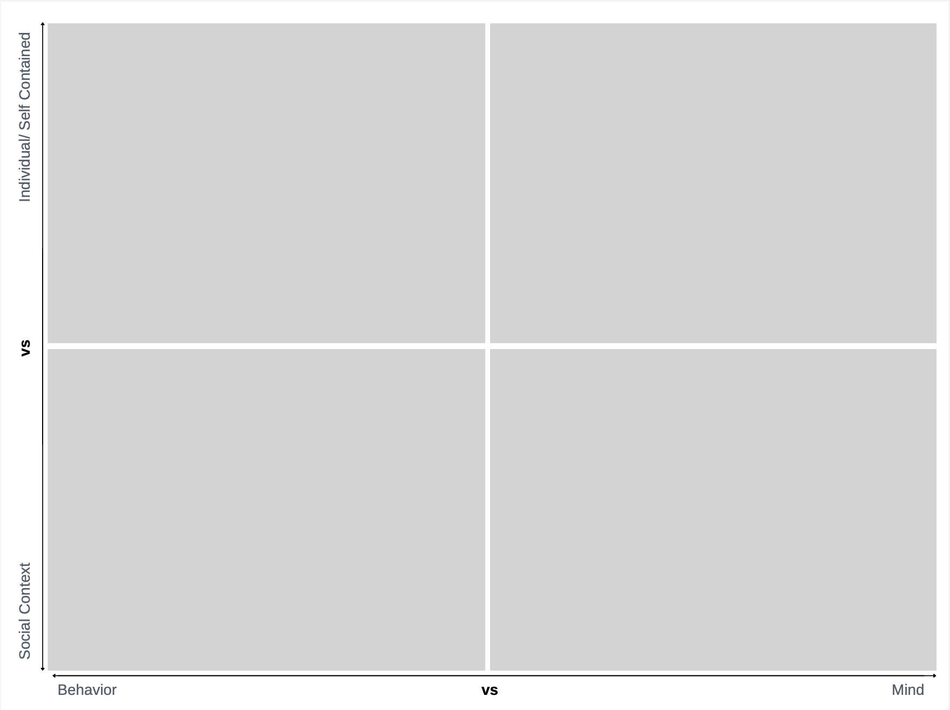

Slide 52
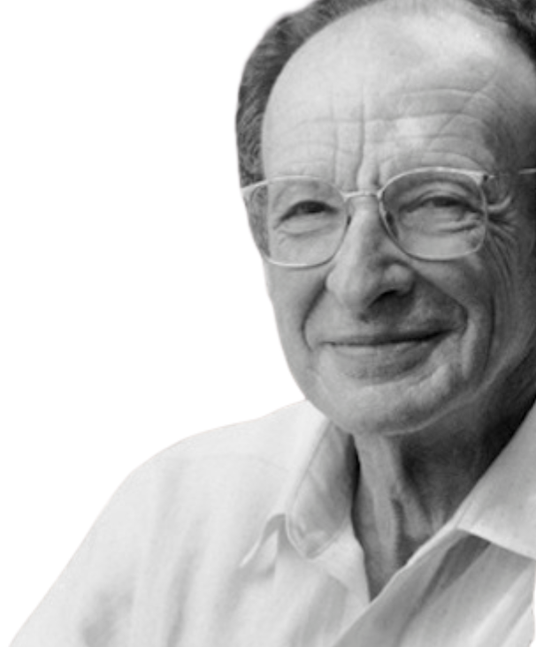
Bronfenbrenner Ecological
Model
Notes:
Bronfenbrenner argued that development cannot be understood by looking only at the individual.
Instead, children exist within interconnected systems.
These systems range from immediate environments to broad cultural influences.
The model is often visualized as concentric circles.

Slide 53
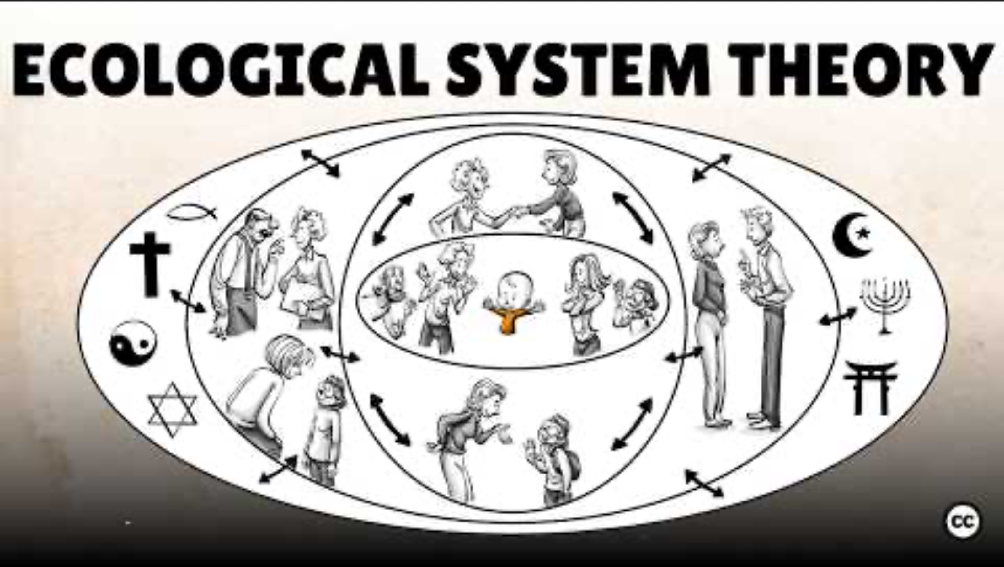
Notes:
Overview of Bronfenbrenner:
https://youtu.be/g6pUQ4EDHeQ?si=Y8W-CtJbSC7qxMda

Slide 54
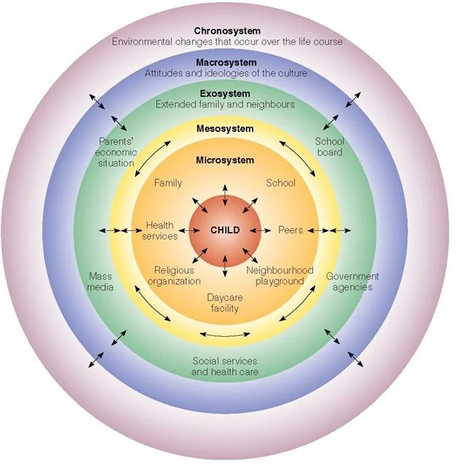
Notes:
The microsystem includes settings where the child has direct interaction.
These relationships are bidirectional.
Example: A supportive teacher can improve confidence; a stressed child can strain family dynamics.
This is the most immediate level of influence.

Slide 55
Notes:
Connections Between Microsystems
Parent–teacher relationships
Family–peer interactions
School–community collaboration
The mesosystem represents interactions between microsystems.
For example, conflict between home and school values can create stress.
Strong communication between caregivers and teachers supports development.
It’s about the linkages between environments.

Slide 56
Notes:
Indirect Environmental Influences
The child does not directly participate in this system.
However, it still affects them.
Example: A parent losing a job may increase household stress.
Public policy and institutional structures matter here.

Slide 57
Notes:
Broader Cultural Context
The macrosystem includes overarching belief systems and societal structures.
It shapes expectations about education, gender roles, and family.
For example, cultural attitudes toward independence affect parenting styles.
This level frames all other systems.

Slide 58
Notes:
Time and Life Transitions
The chronosystem reflects change over time.
Timing matters—experiencing divorce at age 4 differs from age 14.
Historical context also matters (e.g., growing up during a pandemic).
Development is dynamic and unfolds across time.

Slide 59
Pros & Cons
Strengths
Weaknesses
Emphasizes contextual and environmental influences on development
Accounts for multiple levels of influence (family → culture → policy)
Highlights bidirectional relationships
Integrates social, cultural, and historical factors
Highly applicable to education, social work, and public policy
Descriptive rather than predictive
Does not specify mechanisms of change
Difficult to empirically test all systems simultaneously
Broad constructs can lack precision
Limited focus on biological and cognitive processes
Notes:
Strengths
One of the major contributions of Urie Bronfenbrenner’s theory is that it moves beyond the individual.
It recognizes that development is embedded in layered systems.
It captures how policy decisions, economic conditions, and cultural norms shape children’s lives.
The theory emphasizes bidirectionality—children influence their environments, not just the other way around.
It has strong practical relevance for schools, intervention programs, and social policy.
Limitations
The theory describes where influences occur but not how they operate psychologically.
It does not offer specific cognitive or biological mechanisms of development.
Empirically isolating and testing all system interactions is methodologically challenging.
Some critics argue it is conceptually broad and difficult to falsify.
Compared to other developmental theories, it provides less detail on internal developmental processes.

Slide 60
THINK-PAIR-SHARE
A 10-year-old student’s grades suddenly drop.
Around the same time, their parents begin going through a divorce, and the school district changes its after-school program funding.
What is the student doing? Observations only!
How would Bronfenbrenner explain this behavior?
Notes:
This child is being influenced by multiple systems:
Microsystem → Immediate environments (family conflict, school performance)
Mesosystem → Interaction between microsystems (stress at home affecting school)
Exosystem → Indirect environments (school district funding decisions)
Macrosystem → Cultural values, policies, economic conditions
Chronosystem → Timing of life events (divorce as a major transition)
Bronfenbrenner would argue:
The drop in grades is not just about the child.
It reflects dynamic interactions across environmental systems.
Development is shaped by context, not just internal traits.

Slide 62
What is Coming Up?
Homework 1 already ‘due’
Homework 2 ‘due’ Feb 20th
In Class Assignment 1: Tuesday the 24th
Exam 1: Thursday the 26th
ALL LATE WORK FOR PART 1 DUE 27th
And annotating the textbook for extra credit as we go along!
Please keep this slide for attribution

