Slide 1




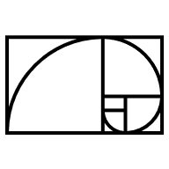
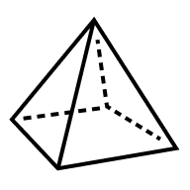

Ocean Khandaker
Applied Mathematics Student | Quantitative Problem-Solver | Queens, NY
About me
I am an applied mathematics student who enjoys learning through hands-on experimentation. I developed my problem-solving skills by modding games and testing Android operating systems, which taught me how to analyze systems and learn independently.
How I think
• Learn by experimenting and building
• Use pattern recognition and trial-and-error
• Break complex problems into smaller parts
• Stay persistent until systems work
My goals
Translating abstract ideas into real technology. I am especially interested in optimization, AI, and infrastructure that turns mathematical theory into practical tools.
Contact : khandakerocean@gmail.com
Thank you for viewing my visual introduction.

