Slide 1

Phase #4 - 3D Printer
Aksha Mia, Maliha Hoque

Slide 2

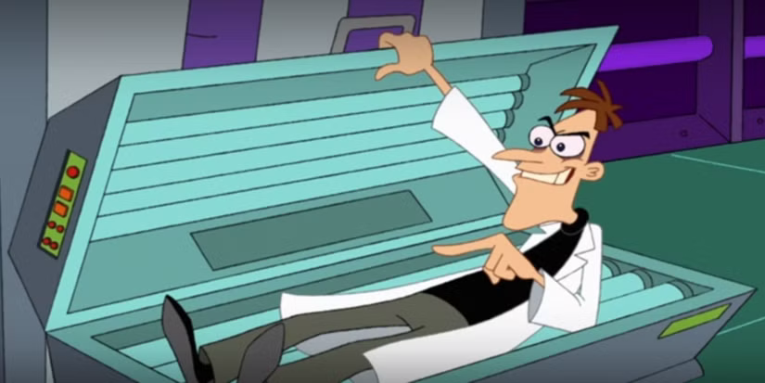
Inspiration
Phineas and Ferb follows two stepbrothers who spend their summer vacation inventing things while their sister, Candace, tries to bust them
Meanwhile, their pet platypus, Perry, secretly lives a double life as Agent P and battles the evil scientist, Dr. Doofenshmirtz
Dr. Doofenshmirtz’s CopyandpasteINATOR was chosen for its similarities to a 3D printer
Both the CopyandpasteINATOR and the 3D printer create a physical copy of something by using a blueprint and automated processes

Slide 3

Invention in Action

Slide 4

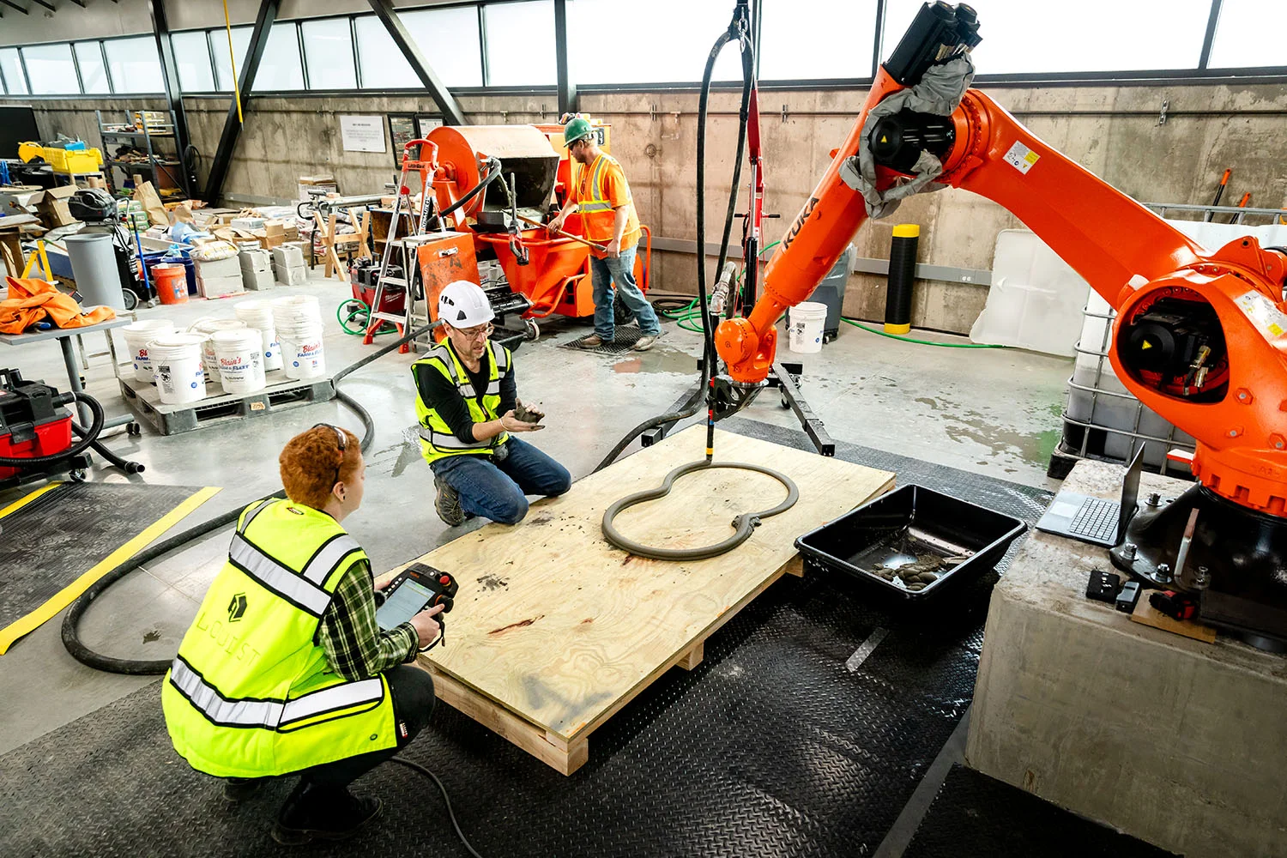
Alquist –
3D Printer

Slide 5
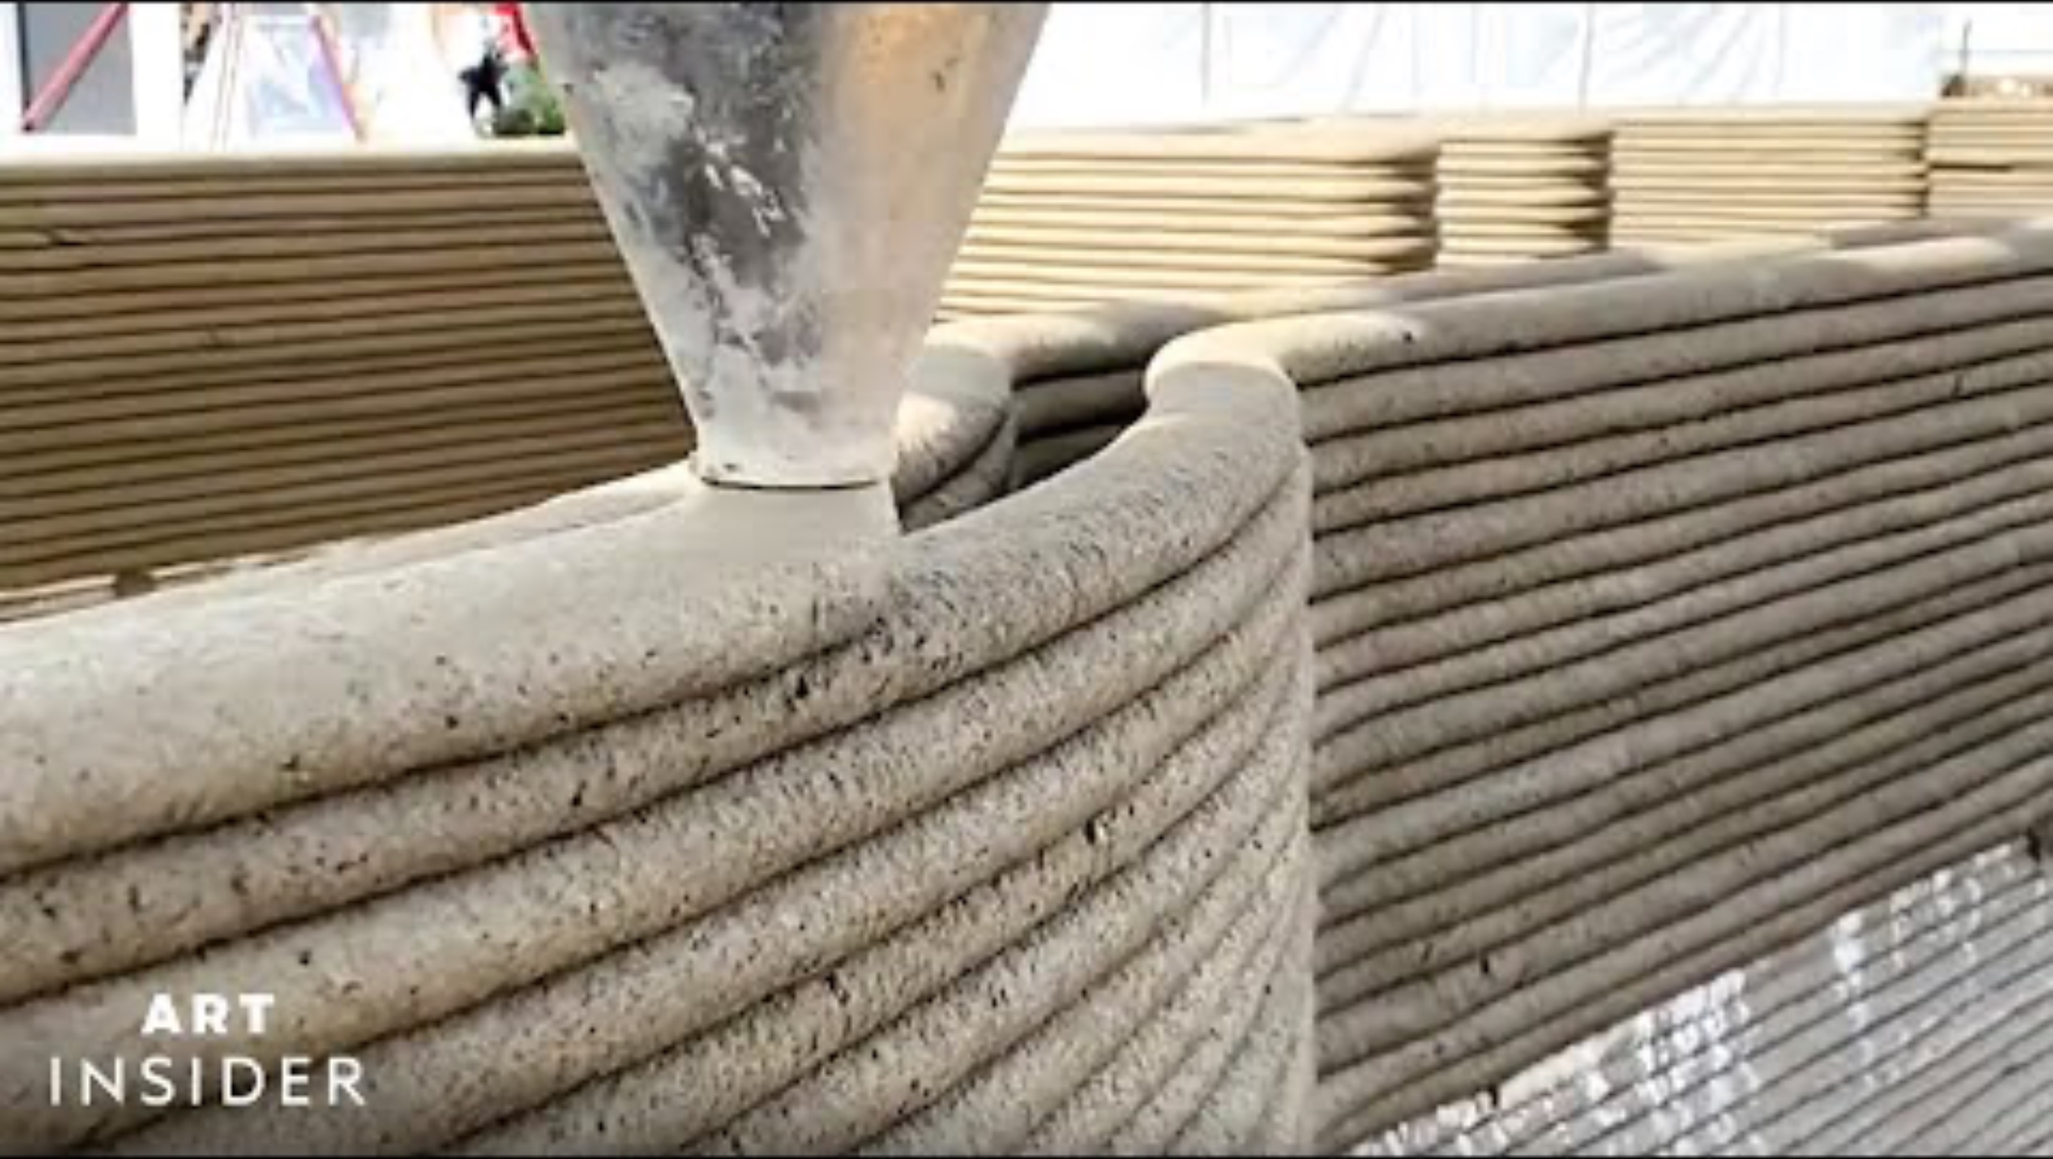
The Premise
The 3D printer creates physical three-dimensional objects based on a digital model
It can manufacture parts, such as the blades of a model airplane
It can also make bigger, full-fledged things and help solve the world’s problems by making concrete homes

Slide 6
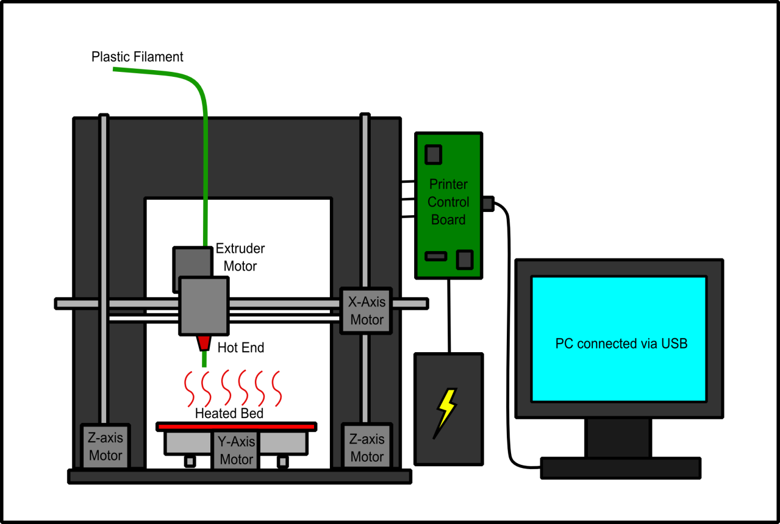
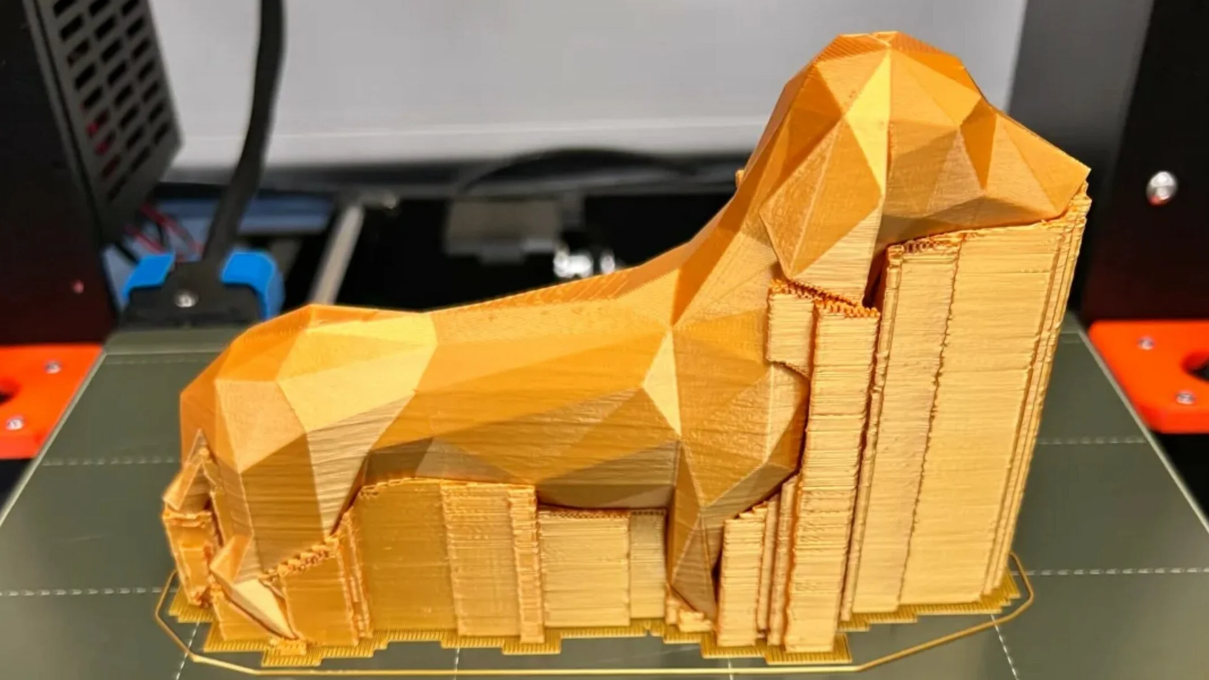
From Vision to Reality
Primary Functions:
(Relatively) quick prototypes
Customized parts
Current Limitations:
Difficult to be detailed depending on the type of 3D printer
Support needed for overhangs
Future Improvements:
Stronger and lighter 3D printing materials
Advancement in printing speed
Mass customization at scale

Slide 7
Prototype Development Plan
Design/Planning
Assembly
Put together the hardware
Testing
Conduct basic electrical checks
Print test models
Connect electronics
Level the print bed
Decide on printer specifications (e.g., sizing)
Put together the bill of materials
Source parts

Slide 8
Budget and Funding Request
The Budget necessary for a concept like this depends on its usage. In our scenario, we plan to use 3d printing to develop robotics, and parts for vehicles. These automations, and material costs require an upfront investment of 5 million dollars.
The printer itself has to be large and must imitate its program. With those two components, the parts themselves require 1 million dollars.
The material for the parts are two million. Imagine being able to make silver, and precious metals malleable in the process. This requires a high heat-resistant infrastructure.
The two million left is for a facility, along with marketing costs to advertise the creation of the idea. Imagine companies buying parts for cheap, without worrying about shipping costs, or labor costs. Being able to advance every field of mechanics with reduced pricing is the dreams that we can uphold for many companies that rely on 3d printing.
Our research will include how to melt metal while designing, and how to add wires in the design, to allow full functionality and operation.

Slide 9
Conclusion
You want something that builds the infrastructure for humanity....well you have that foundation in an advanced 3D printer
Being able to create tech and help build AI while your at it. Well this is an infinity dollar industry, because if you have an idea or product, you can build it whenever you want.
Imagine a 3D printer that can make food, that can create your favorite items, that can make you invincible, that can create the life that you can dream.
Oh wait, we already have that.
Who shouldn’t invest in our product? Investors that are afraid of making money.

