Slide 1
AI House Safety & Security
Jennifer Chino, Leonor Fuentes, Nusrat Fatima Khan

Slide 2
How does AI Help us? In Our daily life
How do people use ai in their daily life?
Google home and smart speakers use AI.
-People use these devices to ask questions, to set on alarms, play music, and control smart home devices.
Navigation Apps
-

Slide 3
In what ways Does the AI Home Security Safety Affects us
Like any other device, it is more uncomplicated into being hacked, which means the person would have access into spying what you do.
Devices listen to what you say which can make AI tools attack you by using your private information

Slide 4
It detects and alerts us with cybersecurity .(analyzing codes or patterns)
Helps us communicate with other through the camera.
Transportation such as self driving cars.

Slide 5
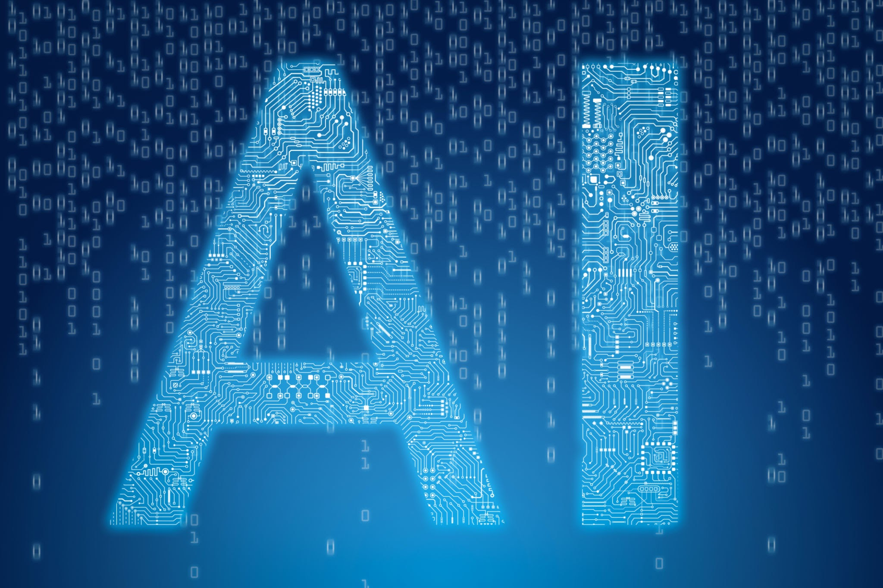
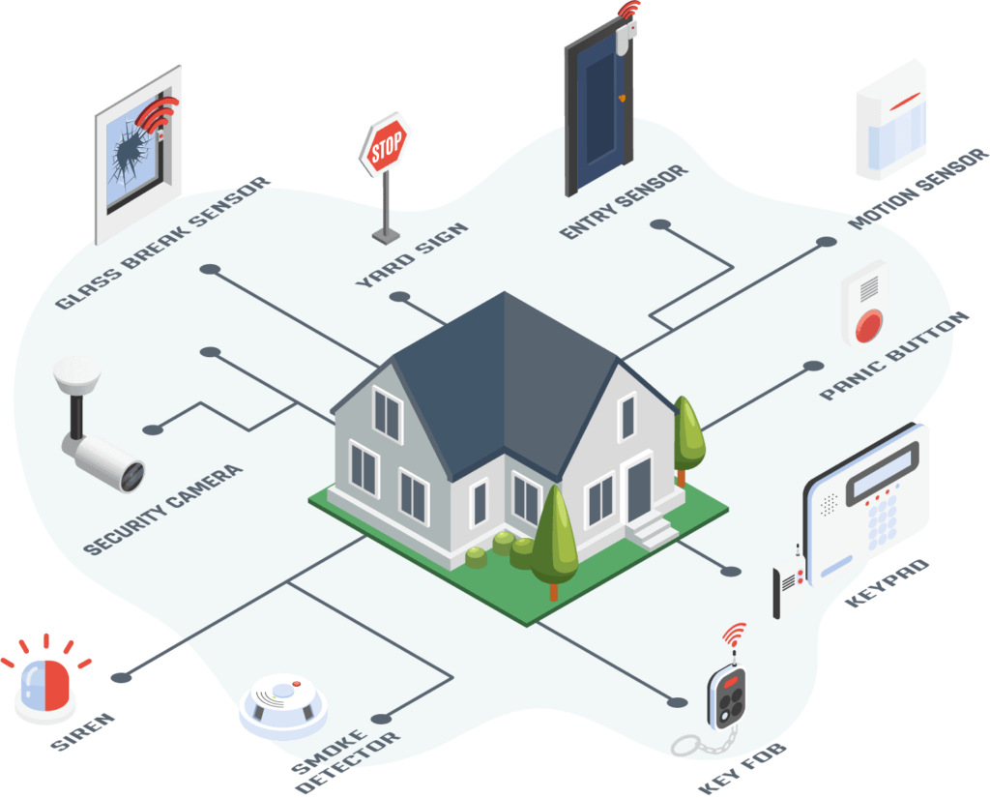
What is AI House Security System?
Ex:
When people are waiting outside the door through cameras it helps us recognize those people.
It helps people lock your house through your phone.
An AI House Security System is a machine that helps monitor your home.

Slide 6
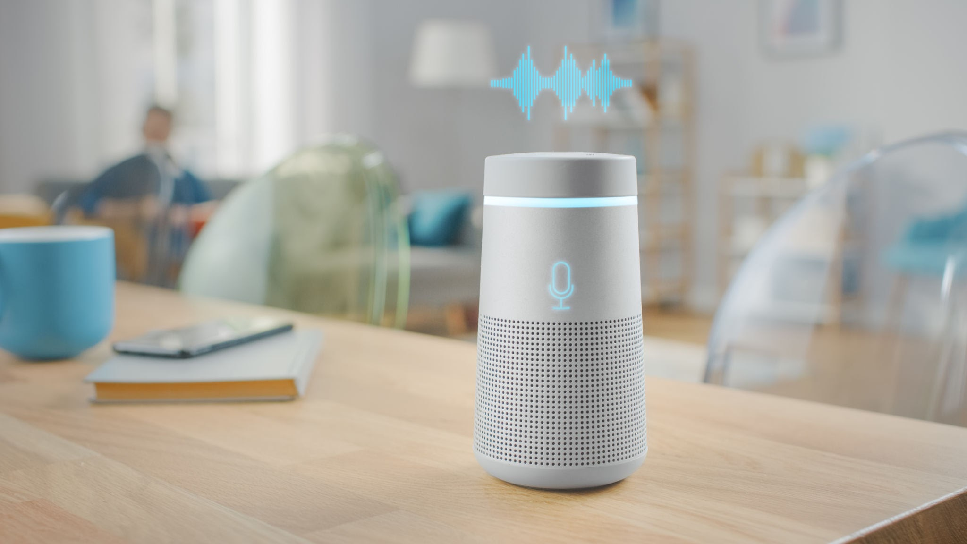
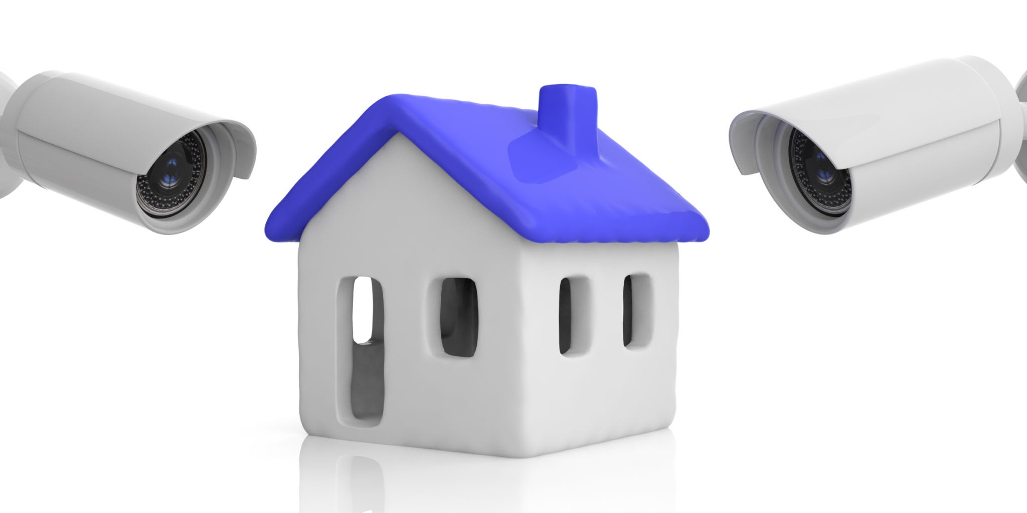
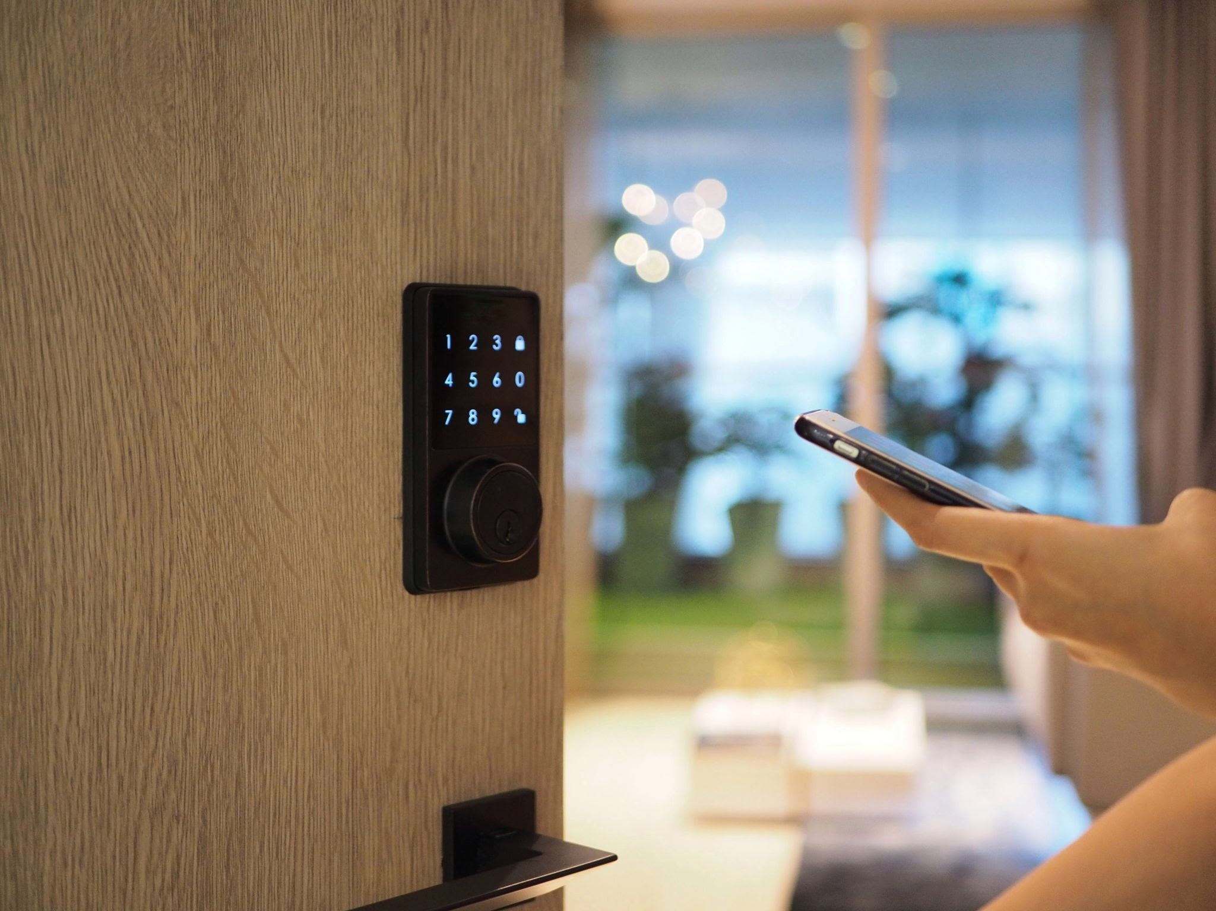
Smart SPeakers : Alexa, google and even siri are AI users by understanding the orders given and knowing how to fully respond.
Security cameras: Ring, arlo, etc. are used to detect movement whether its a human or a pet.
devices

Slide 7
How does AI help us with AI House safety & Security
AI Security Cameras
-It uses Artificial Intelligence to analyze what’s recording in real-time. It identifies people,objects, an the behaviours of people or animals.
Home Automation
-It uses “smart” connected devices with technology to remotely control like lighting
Motion Detection
-
Threat Detection
-
Face Recognition
-
Threat Detection
-
Face Recognition
-

Slide 8
ARticles Credit
https://insider.augusta.edu/ai-privacy-guide/

