Slide 1
Sociocultural perspective
-Margerth Crucey Benjamin

Slide 2
What's sociocultural perspective?
Explains how thoughts, behaviors, and identities are shaped by the social and cultural environment.
Notes:
In this presentation, we will explore how culture, family, and religion influence the way we think, feel, and act, often without us even realizing it.

Slide 3
Reference or social groups
1
2
3
Family
Culture
Religion
Family influence
Cultural belief
Religious restrictions
Notes:
The sociocultural perspective in psychology explains how our thoughts, behaviors, and identities are shaped by the people and environments around us. We are not formed in isolation our beliefs, habits, and emotions are deeply influenced by culture, family, and religion. These groups play a key role in guiding the way we think, feel, and act.

Slide 4
Family
Shape our core values early in our childhood
Teaches respects for elderly
Influence emotional expression and communication style
norms / avoid some topics

Slide 5
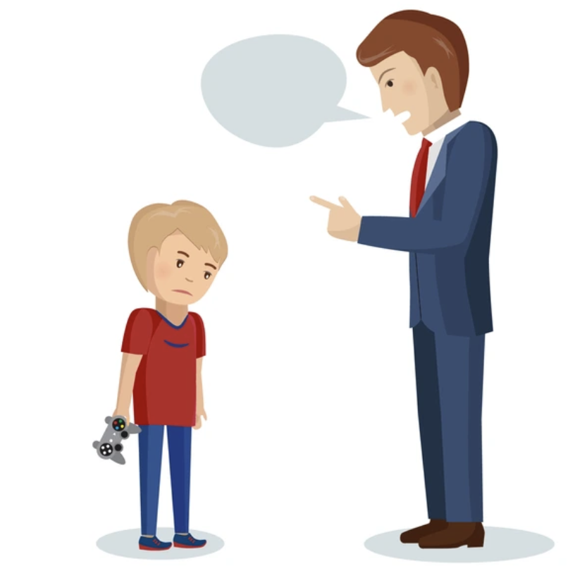
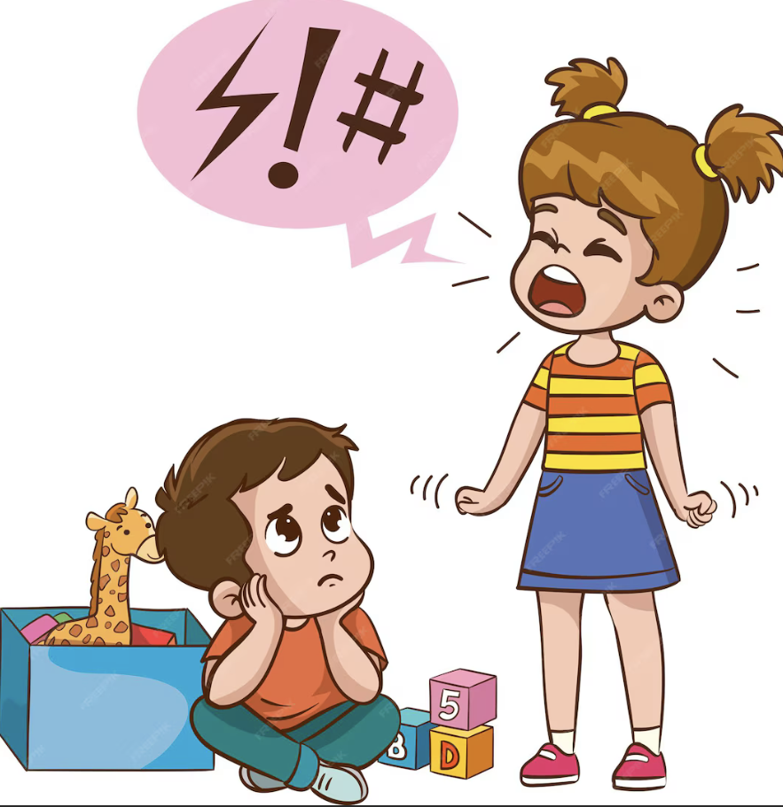
Example

Slide 6
Culture
Traditions
Consider what is normal or acceptable behavior
Unspoken rules
Affects interpersonal interactions and social roles

Slide 7
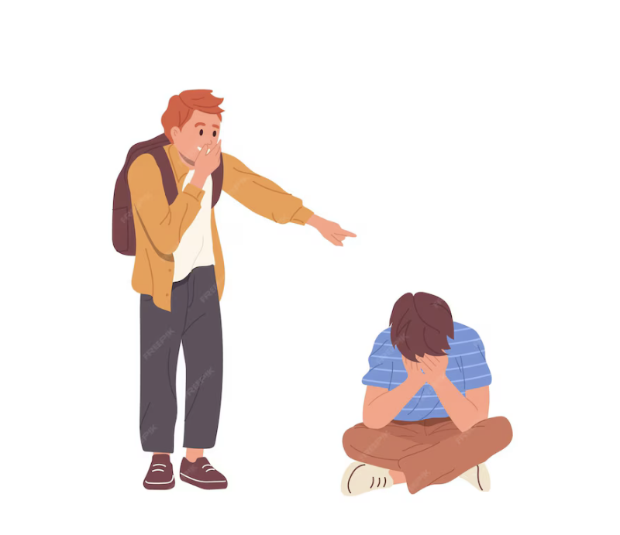
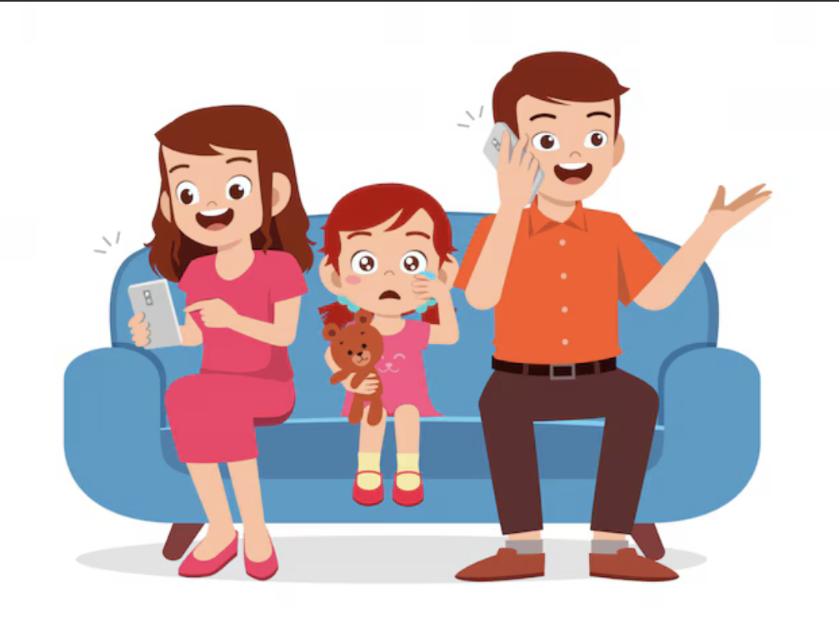
Example

Slide 8
Religion
Shared belief, values and moral guidelines
Personal development and decision making
Concepts of right and wrong
Encourage people to follow rules even if they doesn’t want to
Social expectations

Slide 9
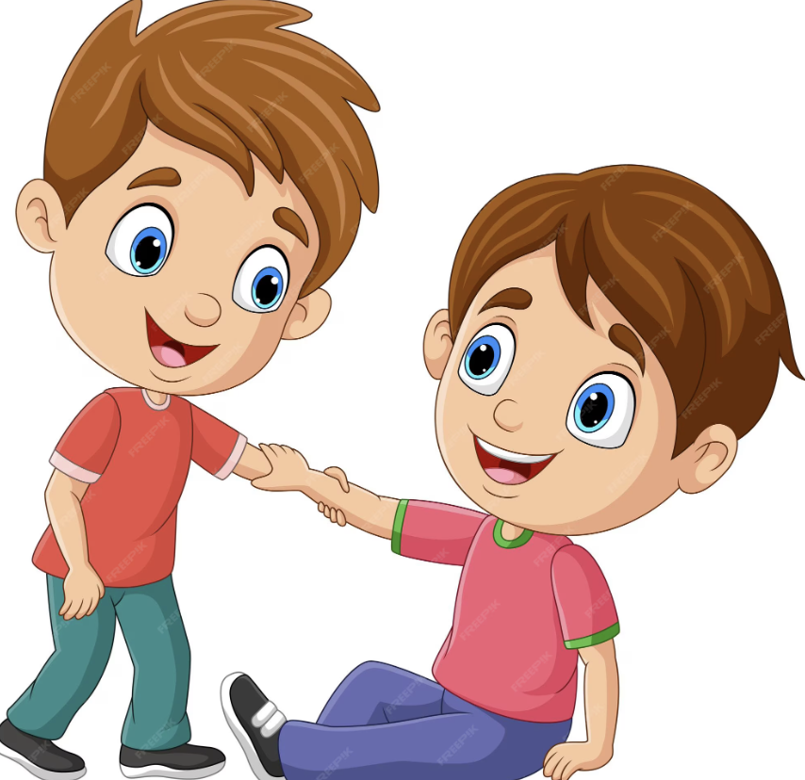
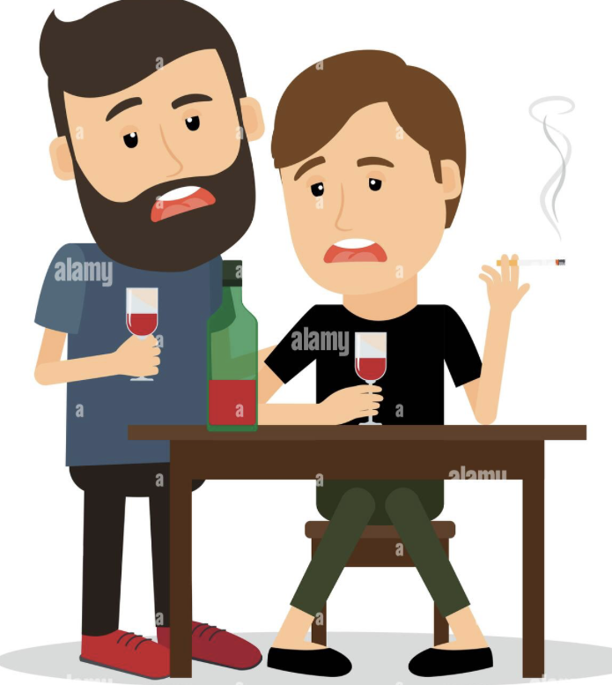
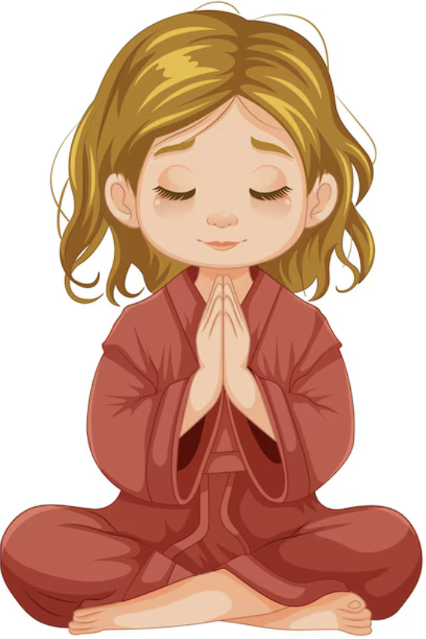
Example
Wrong
Right

Slide 10
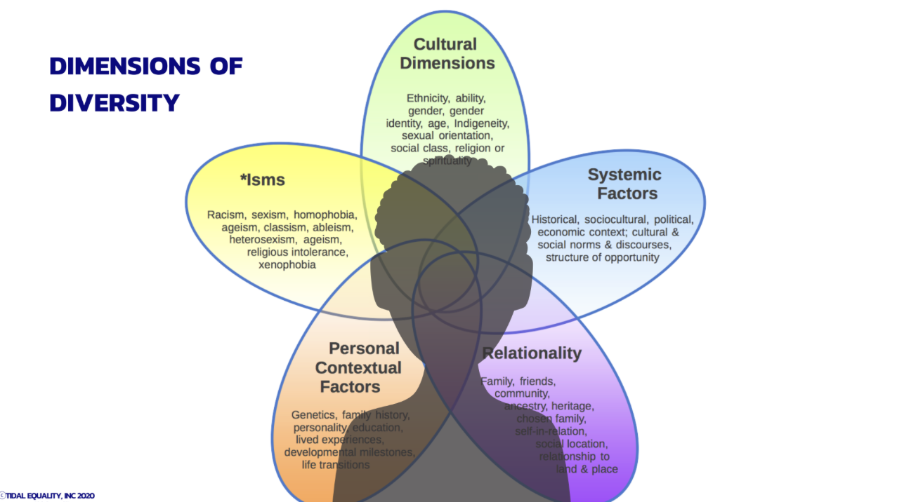
How this connects to sociocultural perspective
Family, Religion, and culture shape who we are.
The way we think
The way we feel
Things you let affect yourself

Slide 11
Learning how our surroundings shape the way we think and express ourselves helps me see the world differently, making me more open to new ideas and perspectives, and encourages me to pause and reflect before judging someone's actions or feelings. This is because who we are is not shaped only by ourselves but also by the influences around us, such as our environment and what we absorb as we grow.
—Margerth Crucey Benjamin

Slide 12
How did your environment shape you?

Slide 13
Get Involved!
Culture
Religion
Friends
Thoughts
Belief
Family

Slide 14
Thanks!

