Slide 1
Shaped by Genes, Guided by Life
By Ashley Meikle

Slide 2

Agenda
Environment
Genes
Habits & Routines
How family, culture, and surroundings shape how we grow
How inherited traits influence personality, behavior and potential
How daily actions and patterns guide learning and independence

Slide 3
There are five perspectives used to study psychology, one of them is the biological perspective which is defined as any explanation of behavior and mental processes that uses life processes.
Introduction
Behavioral genetics is the sub-field that investigates how genes passed through generations influence personalities and how the environment shapes what we believe in.

Slide 4

Environment
The environment we grow up in plays a major role in shaping who we become as individuals. From birth, children are constantly taking in information. Research shows that until about the age of six, they absorb the world around them almost like sponges. This process is known as socialization and observational learning, which explains why kids so often copy what they see.

Slide 5
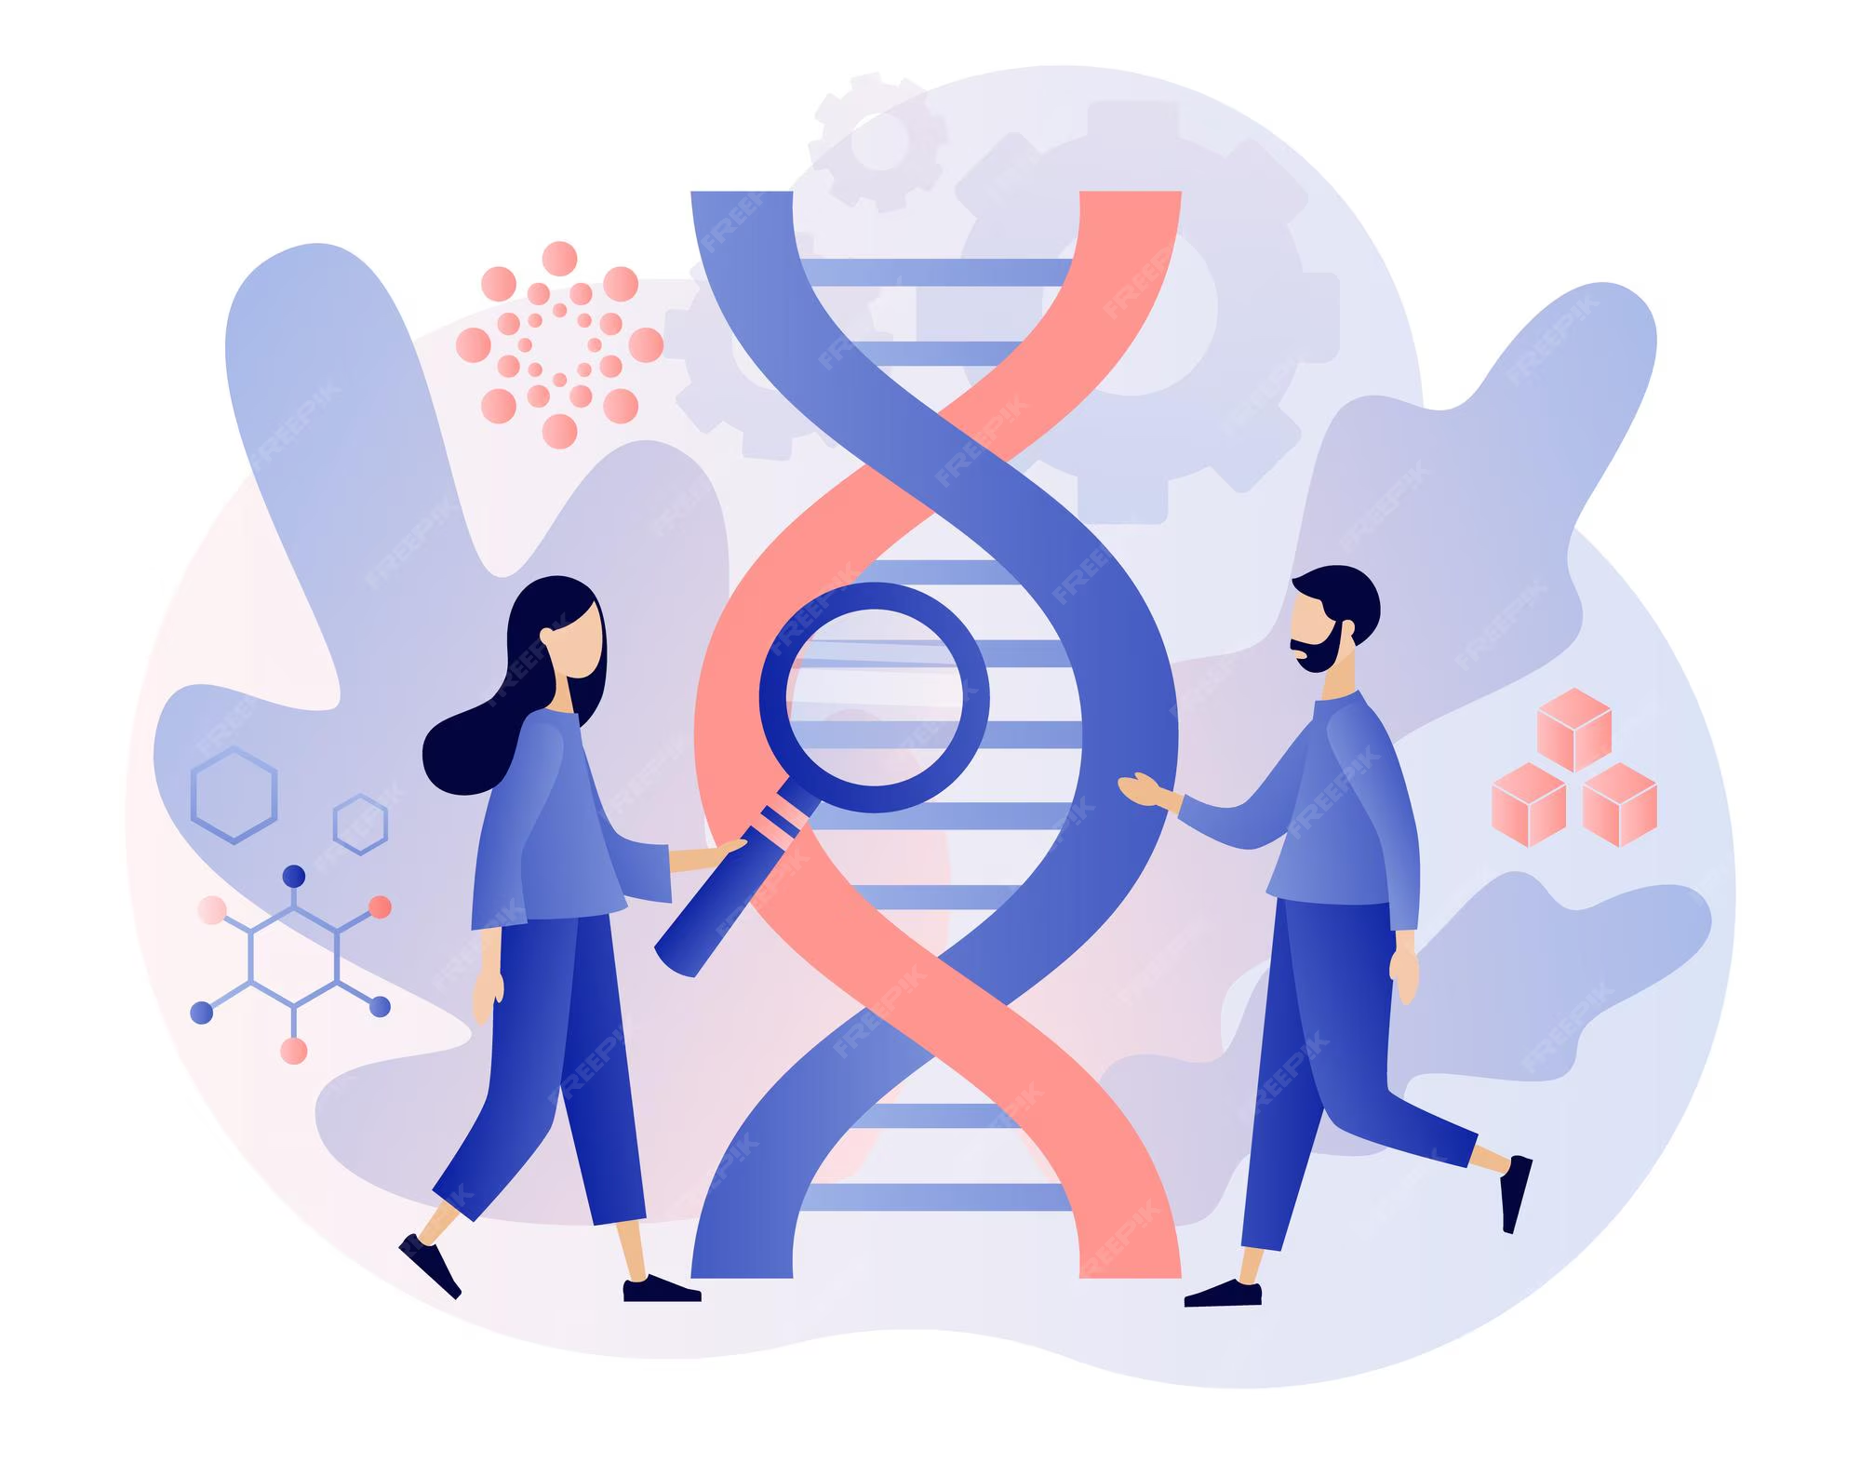
Our Biological Blueprint:
Genetics
Our genes play a big role in shaping who we are, from how we look to parts of our personality and even our mental health. Sometimes, mental and emotional disorders like depression, anxiety, schizophrenia, or bipolar disorder can run in families because of chemical imbalances that get passed down through our genes.

Slide 6
Heredity passes traits from parents to children, setting the range of possibilities we’re born with, but the environment determines how much of that potential is realized.
Genetics set the range of a person's intellectual potential, but education, nutrition, encouragement, and opportunities determine where within that range they actually develop—either creating obstacles or promoting growth in their mental development.
Environment Realizes Potential

Slide 7
Research examining nearly 50,000 American families found that chores remained a consistent responsibility from age nine through the end of high school.
Habits & Routines
Main point
Routines like these can help establish patterns that can have lasting effects, guiding children as they learn to navigate life into adulthood. Positive habits encourage growth, learning, and resilience, while negative ones—such as too much screen time or poor sleep—can hinder development.

Slide 8
Conclusion
Understanding human behavior means looking at both our biology and the environments we grow up in, as well as the habits we form along the way. Our genes set the foundation, but our experiences and daily routines shape how that potential turns out. The different perspectives in psychology, like the biological and behavioral approaches, help explain these influences from different angles.

