Slide 1
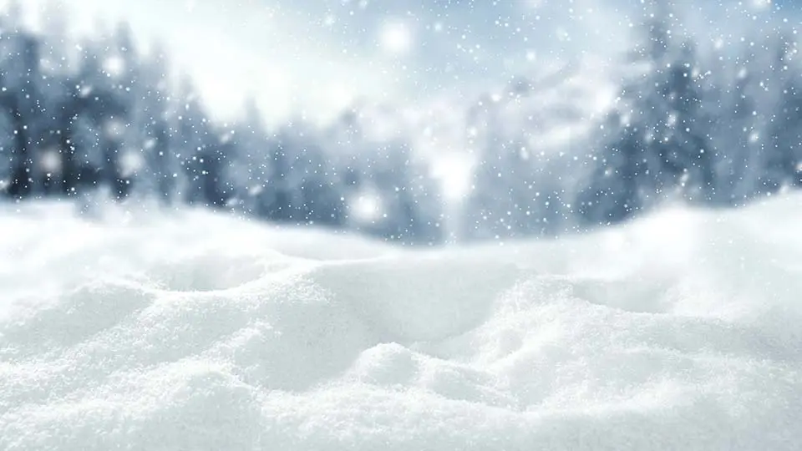
A Look At The Lyrics Of Snow
By: Riquelmi Camilo

Slide 2
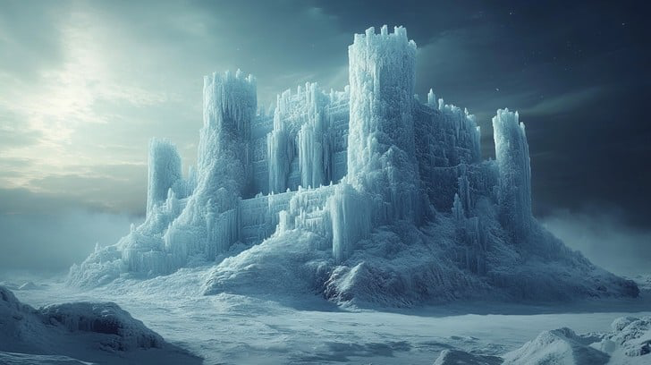
A proof of imagination!
“Ice castles”
“Snow Falling from the sky”
“Snow swirling in the ground”

Slide 3
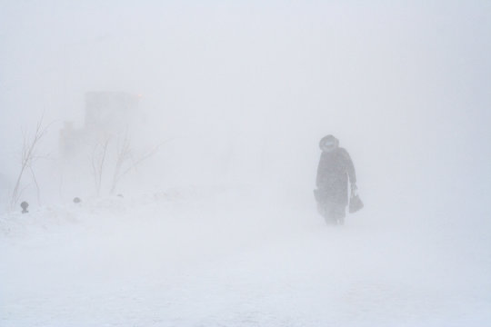
“No are you crazy, it is wet”
“It is dirty and sometimes yellow”
“Real snow”
Reality is hard!

Slide 4

Friendship
“We are like real friends”
“Besties”
“We will play in the snow”

Slide 5


