Slide 1
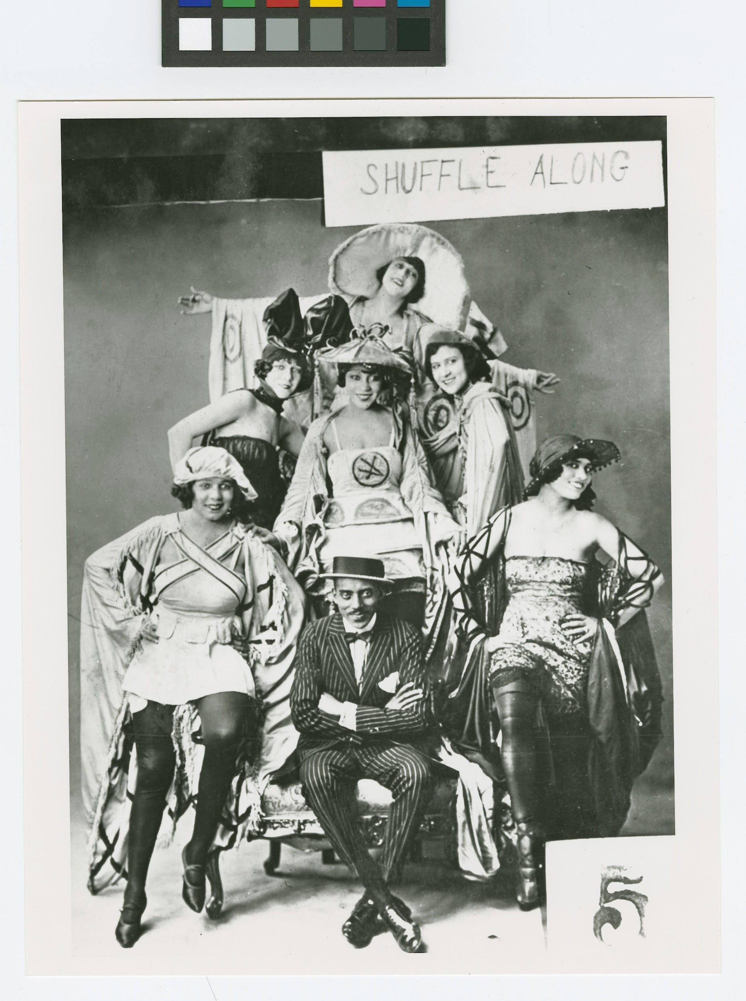
Shuffle Along
“Election Day” - Noble Sissle
Naziah Rahman

Slide 2

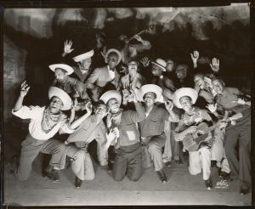
What is Shuffle Along?
(a summary on the musical)
Shuffle Along tells a story that is political yet optimistic. Expressing romance and rivalry that has a far deeper meaning to it. In this fictional town we see the racial barriers and challenges black artists went through through.

Slide 3
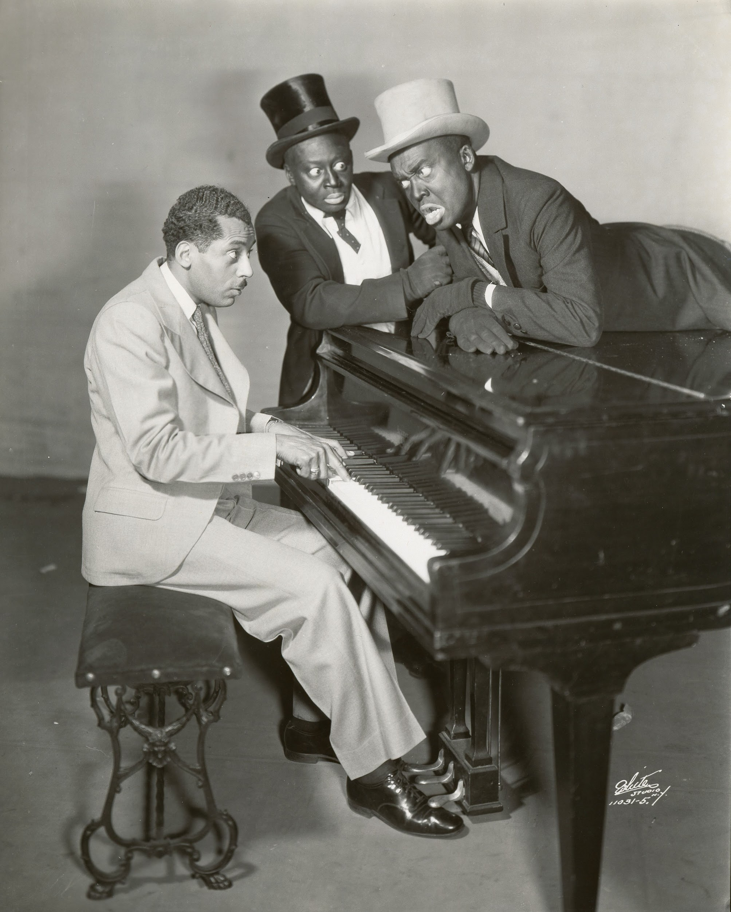
“Election day”
A photo from the musical, not from “Election Day” specifically.
“Election Day” is one of the songs from Shuffle Along that highlights the issues that they were facing as a community. The song creates more meaning to the musical, expressing racism that they faced. The song provides commentary, energetic with it’s upbeat tempo yet the lyrics spoke higher volumes than any instrument being played.

Slide 4
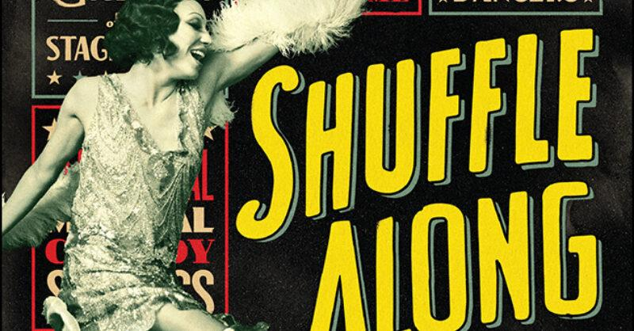
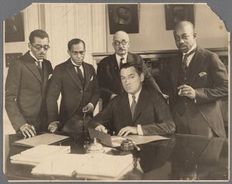
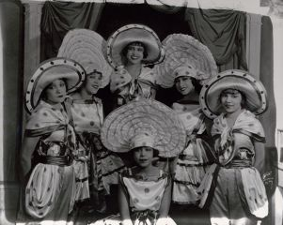
https://youtu.be/hXVPVJoP8SE?si=4xa8OsLNkmldAQ6k
“Election Day”

Slide 5

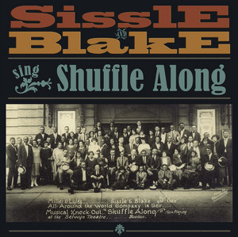
The Importance of Tone
The tone of the song is joyful. Parts of the song switches, with their tones, going from everyone being happy to betrayal. However, the entirety of the song is mostly satire.
“You are thinking of the politicians whom last year you trusted, And when they got into positions, promises they busted.” This specific part of the song is significant, and stood out the most to me because it truly expresses the reality of the things communities had to go through.

Slide 6
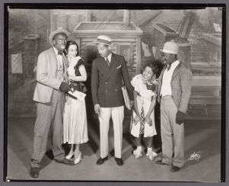
Instruments
Each instrument has its own important role in the song. The upbeat tempo brings a cheerful element into the song. Each instrument brings the song together because each instrument has adds its own element to the song.

Slide 7

The piano brings an optimistic and joyful theme into the song.

Slide 8
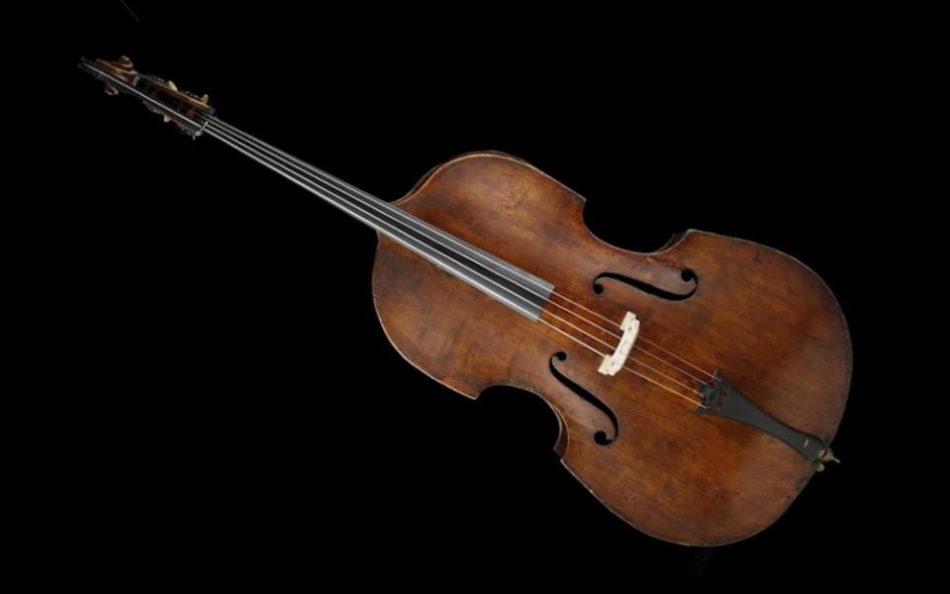
The double bass guitar adds a rich and grounded feeling to the song, which kept a steady rhythm.

Slide 9

The trumpet adds to the happy portions of the song and it also adds a more political element to the song

Slide 10

The drums and bass add foundation and a rhythmic beat that keeps the listener grounded and adds energy.

Slide 11
Key Takeaways
Shuffle Along was a historic milestone within the world of musical theatre. It offered not only a sense of entertainment but it also offered a powerful stance on society and the political issues of the time it was made in. The song “Election Day” emphasized this musical by pushing the stance further through lyrics, tone and instruments.
The End

