Slide 1
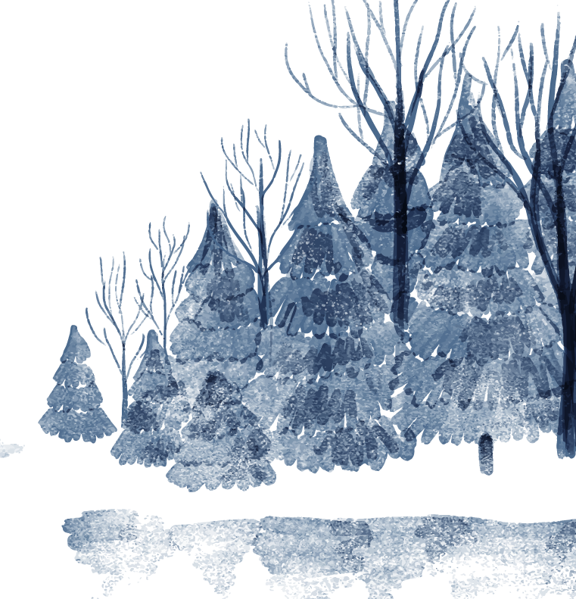
Analysis of “Snow”
By: Lianny Machuca

Slide 2

Introduction
The song “Snow” by Ty Defoe and Tidtaya Sinutoke, from their piece titled “Clouds are Pillows for the Moon,”
It’s about two girls, one an exchange student from Thailand and the other from New York, are complete opposites, shown through their singing and movement while performing these songs about the snow.
Girl from Thailand
Girl from New York
They come together through the girl from Thailand’s excitement about the snow
In the end, they were able to share their love of snow, even if it took some warming up for the girl from New York, and were able to form a friendship.

Slide 3

The Beginning
While performing “Snow,” the girl from Thailand in the beginning explains to the girl from New York why she chose to be an exchange student, which was because she wanted to experience snow since she was never able to due to the hot climate of her country.

Slide 4
Throughout the Song
Throughout the rest of the song, the girl from Thailand talks about how excited she is to see the snow and actually experience it. The girl from Thailand makes big movements when she describes what she would like to do in the snow, like dancing in it, licking it, and throwing it. The girl from New York maintains a tone and smile of disbelief in what the girl from Thailand is saying about the snow and tells her the harsh truth about the snow.
The girl from Thailand always replies with the word “Awesome” after each time she learns something new, even if the way she is told the information is rude and cold. This repetition demonstrates the genuine love the girl from Thailand has for the snow and also how desperate to see it because she doesn’t let the girl from New York change her love for the snow, but instead takes it as a learning opportunity.

Slide 5
The End

Slide 6
Conclusion
The girl from Thailand's bright and positive attitude was able to help the girl from New York come out of her shell, and out of this cold and stoic attitude she had before. Through the body movements to their singing, it was very clear to see how the characters were supposed to be portrayed and how, even though they are complete opposites, they were still able to find something in common, which was their love of snow.

