Slide 1
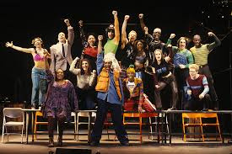
THE POWER OF COSTUME IN MUSICAL THEATER:
A LOOK AT “RENT”
Bre Bailey

Slide 2

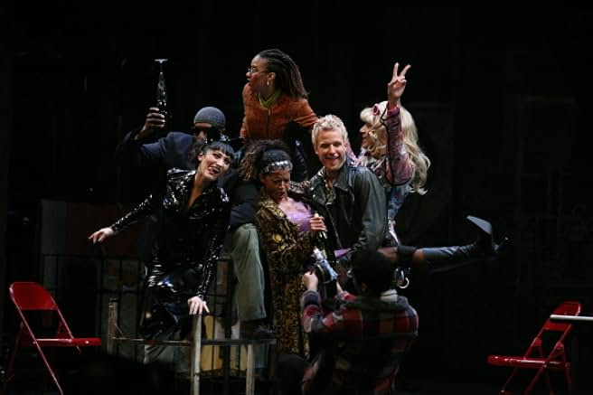
INTRODUCTION
  In RENT, costumes are visual representations of each character's personality, backstory, and emotional journey.
  The costumes help to instantly tell us who these people are and what they're going through.

Slide 3
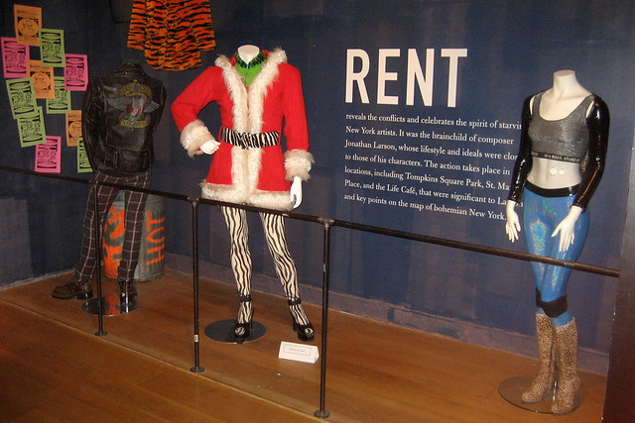
INTRODUCTION PT 2
For me, three characters whose costumes made an impression were
  Mimi
  Angel
  Roger.

Slide 4
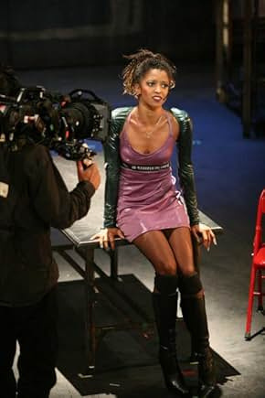
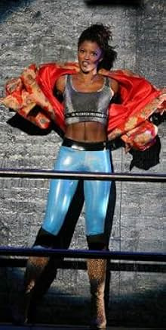
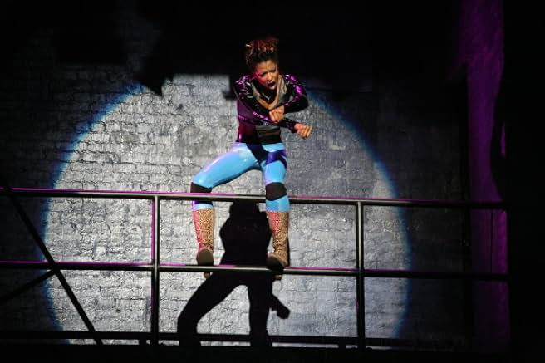
Mimi

Slide 5
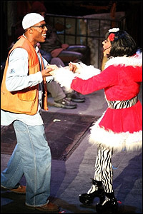
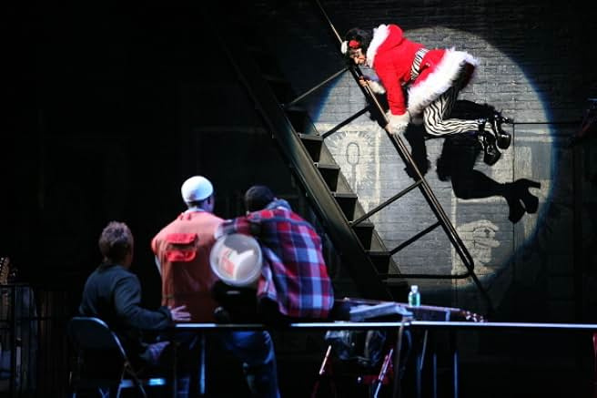
Angel

Slide 6
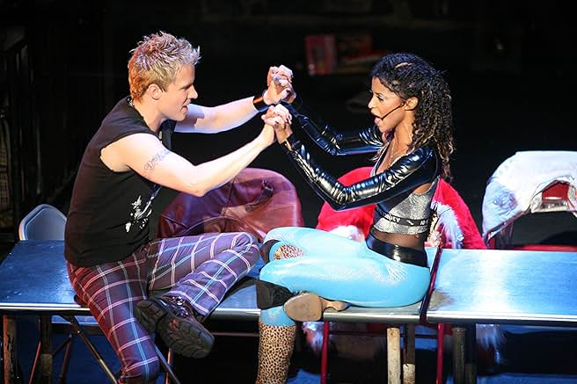
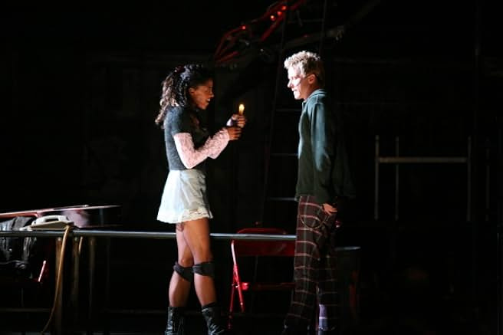
Roger

Slide 7
Conclusion:

Slide 8
THANK YOU FOR LISTENING!

Slide 9


UPCOMING SPEAKERS

Slide 10













RESOURCE
PAGE
SET:NAEN_ZZGG84
Use these design resources in your Canva Presentation. Happy designing!
Delete or hide this page before presenting.

