Slide 1
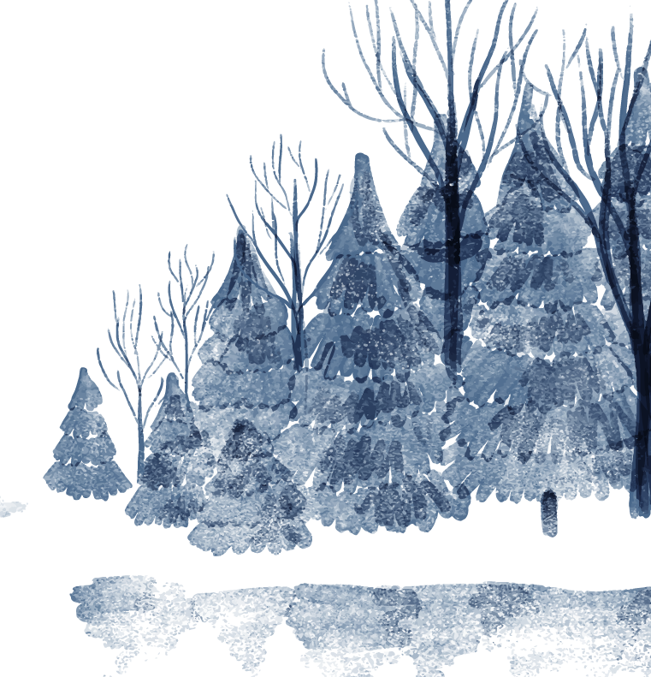
The Metamorphosis of Dialogue in “Snow”

Slide 2
01
Summary of Snow

Slide 3

Summary
In “Snow” by Tidtaya Sinutoke & Ty Defoe, it explores two individuals, who are both students. One from Thailand and the other from a northern state. The two students P and Ella have opposing views of snow and later on Ella grows to agree with P’s views on snow.

Slide 4
02
The Dynamic Between P and Ella

Slide 5
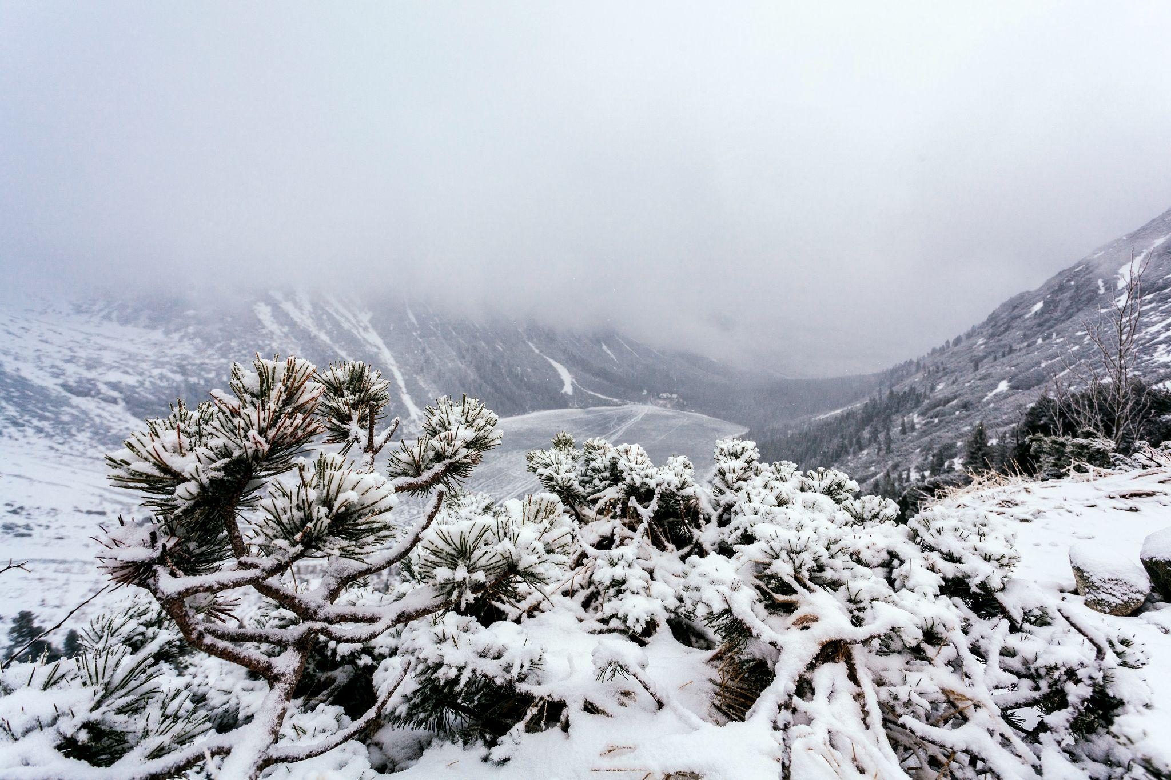
How Snow Influences their Relationship
P had never experienced snow, while Ella had. This led to constant romanticization from P about snow and the magic and wonders it will bring. Despite Ella putting these thoughts down, P still dreams on.

Slide 6

A key point in the presentation of “Snow” is how Tidtaya and Defoe illustrate each individual characters’ current state. They utilize dialogue, changing the way vocally the dialogue is expressed to show this.

Slide 7
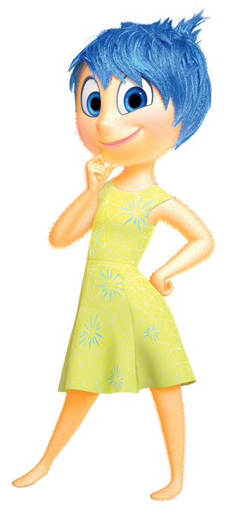
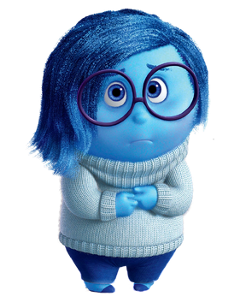

Singing V. Talking
At the start the audience only hears P sing, while Ella only talks.
The singing is a tool used to express joy or glee for snow. On the other hand, the talking conveys a gloomy feeling for snow.

Slide 8
03
Ella’s transformation

Slide 9
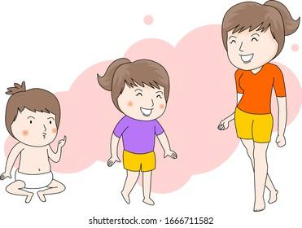
As the song progresses, P imagines the snow once more, describing how magical the snow will be. Finally, Ella comes back to her original affection for snow, one that was not shown to the audience prior.

Slide 10
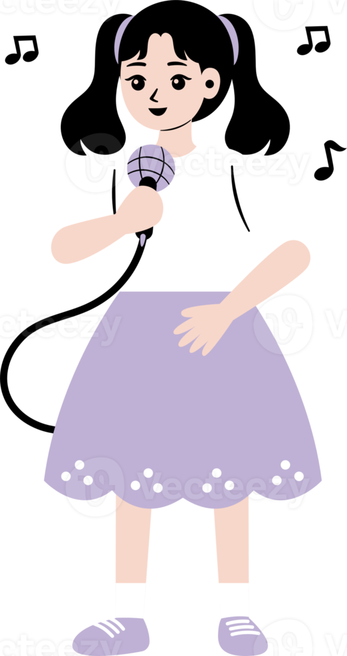
Ella coming back to her childlike love for snow, expresses herself using singing now. Ella sings about her memories with her late mother, verbalizing vulnerability to not only P, but the audience as well.

Slide 11
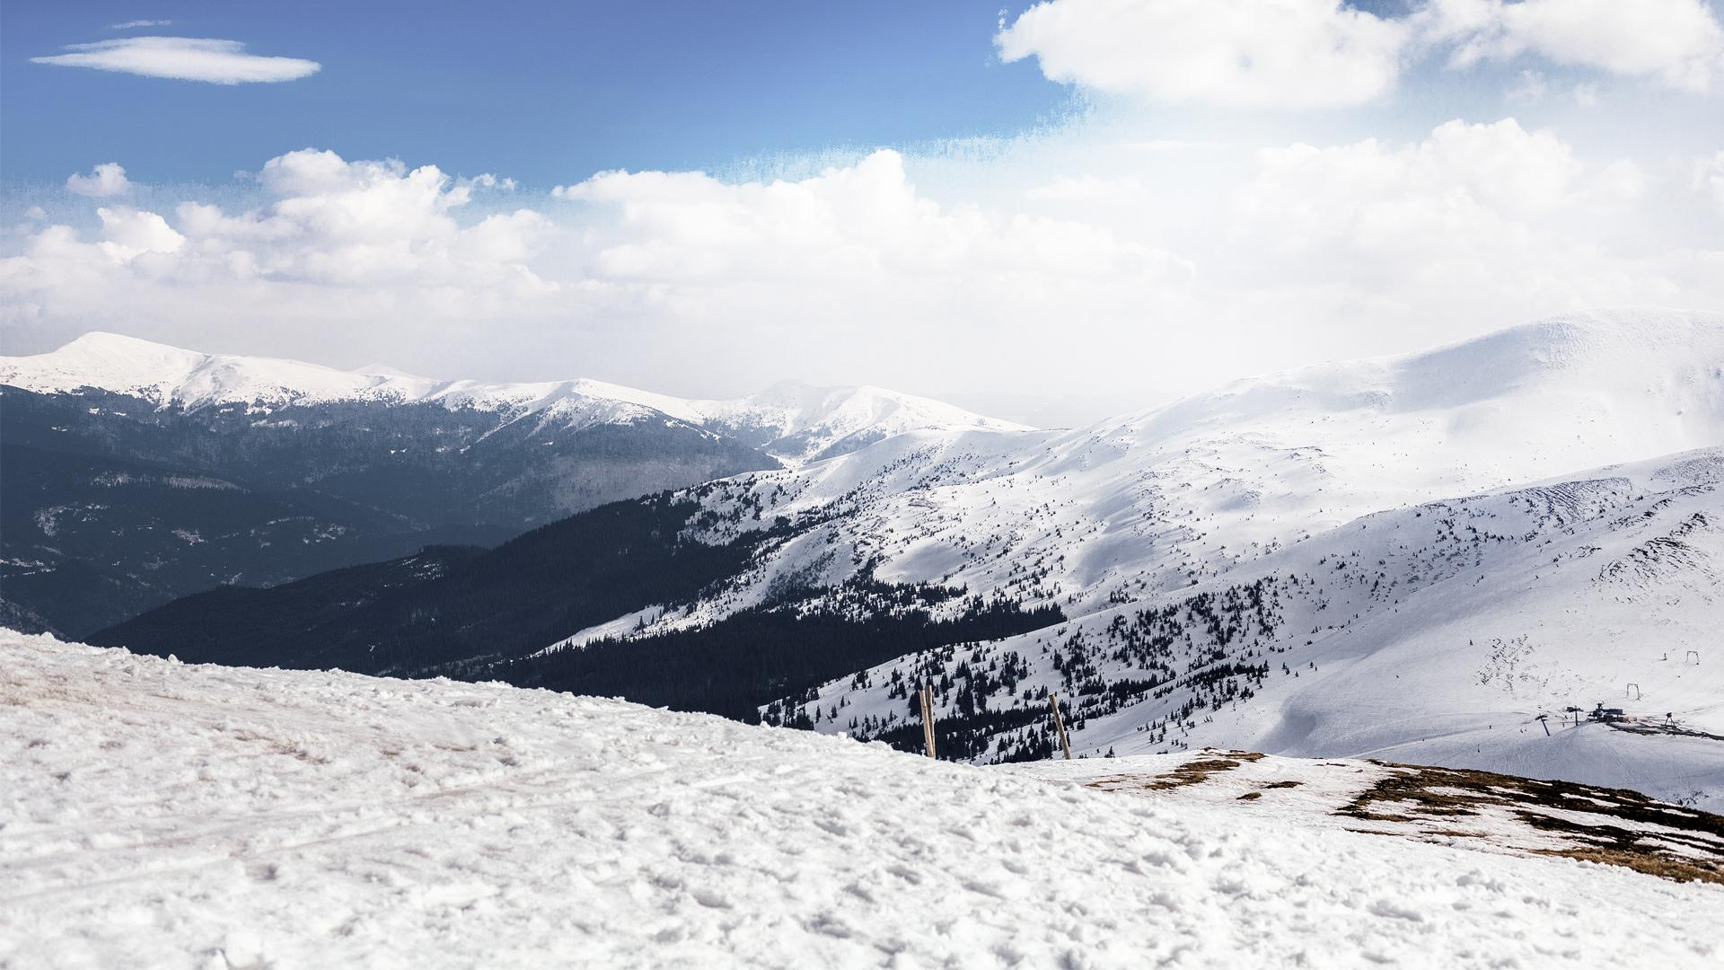
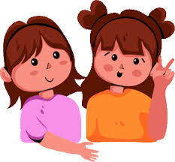
The lyrics originally sang solely by P, “Play the snow. Dance the snow. Sing the snow”, end up being sang by both P and Ella.
The lyrics start off with “We will”.
As they end the song with those lyrics, the word together is added towards the conclusion, establishing their friendship.

Slide 12
Dialogue helps the audience really connect with the musical, allowing for greater understanding in these characters.
Slight changes in speech are recognizable for audience to feel the change in emotions.

Slide 13
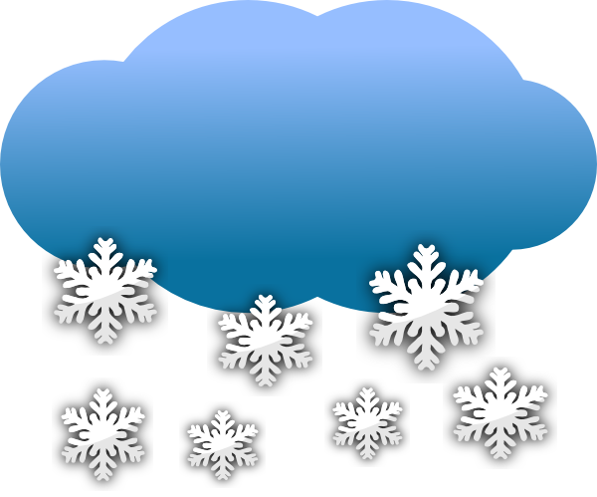
Thanks for listening!

