Slide 1
TRANSLATION 1
Lorena Bregu

Slide 2

About my essay
In my essay I take the reader through my journey of writing my college essay.
I start off talking about how much of a toll said essay had on my mental health. I was offered help which I took hesitantly, but it didn’t help at first. Insecurity took the best of me when I was first offered help making me question my intelligence.
As I continued my journey people like my mom and a faculty member were the reason, I began to gain confidence in my writing.
After submitting my college essay, I spoke about the outcomes that came out from it.

Slide 3
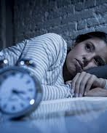
“I spent multiple sleepless nights trying to figure out how to tell my own mother I didn’t get into any colleges because I’m simply just stupid”
This was my first big anxiety moment when writing my essay.
It really represents how restless I was when it came to my essay and how much I craved my mother's validation; I just wanted her to be proud.

Slide 4
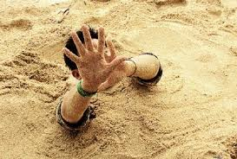
“Every minute that went by, I’d slowly sink into my seat increasingly, as if quicksand was engulfing my body, suffocating me.”
-This is a perfect representation on how I felt about my thoughts on writing my college essay
-I love how I used metaphors and imagery to explain that suffocating feeling
- It’s one of my favorite lines in my essay

Slide 5

“Neni, you sound so smart in English, you are so lucky”
When my mother said this to me it was a turning point in my writing career, even though she didn't speak perfect English that validation from her was a different feeling
I felt like I accomplished something so big in that moment

Slide 6

“In each application, I embraced the fact that I knew three languages and that I wasn’t born in New York.”
This was a big step in my life, although I did joke about knowing three languages as a flex this was when I was serious about my linguistic skills

Slide 7

“It wasn't the way I wrote that limited me; it was me”
This was a big self-realization moment that took a while to come to terms with
I was blessed with the resources to learn and get a higher education which my family didn’t, so I took it for granted because of insecurities

Slide 8
THE END
And more

