Slide 1

Headline for the Birds: Archiving NYC’s Urban Pigeons
Michael Nieves

Slide 2
Project Overview
Creating a digital archive of NYC urban pigeon-related headlines
Examine how pigeons narratives are framed over time: trusted messengers, public health concerns, “pests”, cultural icons
Leverage archival curation methods, metadata tagging key information, creating interactive timeline
Highlights how pigeons, despite being non-human shaped our urban environment and everyday experience in NYC

Slide 3
Goals and Work Plan
Phase 1:
Gather NYC Pigeon related headlines from local Newspaper publications, (NY Times, NY Post, etc.) Collect basic metadata
Phase 2:
Build metadata standard categorization. (Tone, theme, location, interaction type). Begin designing template on digital platform using Omeka
Phase 3:
Upload headlines, curate into collection themes, and develop interactive timeline. Adding only metadata information where permissions unavailable

Slide 4
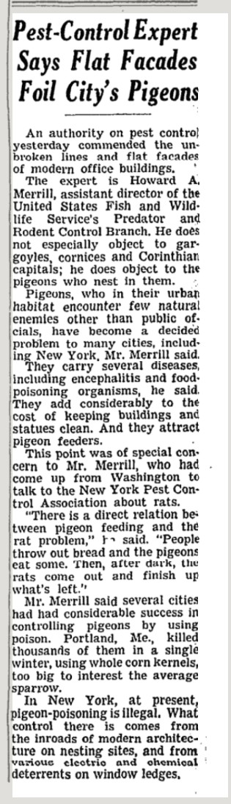
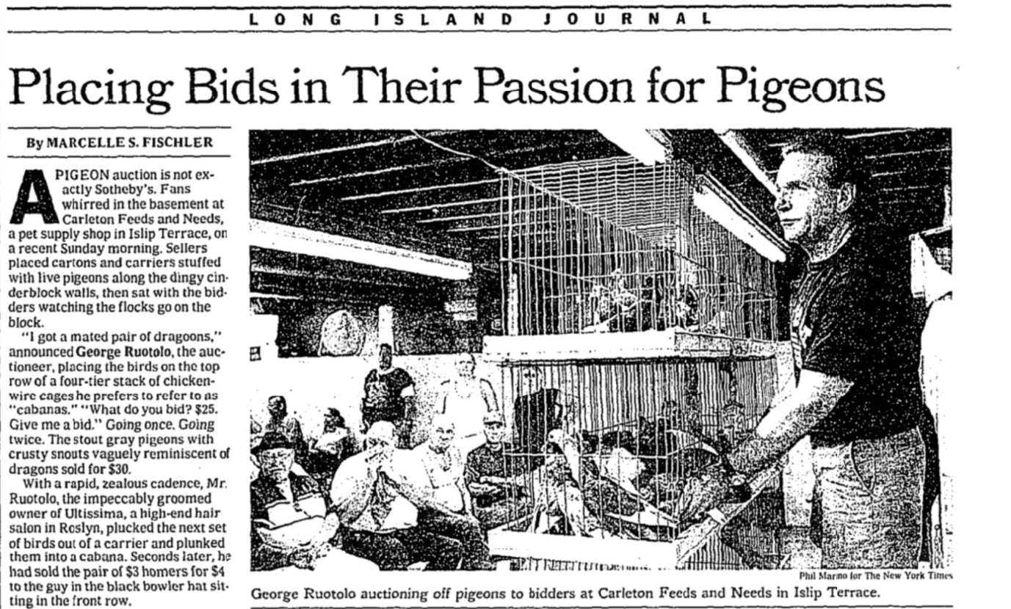
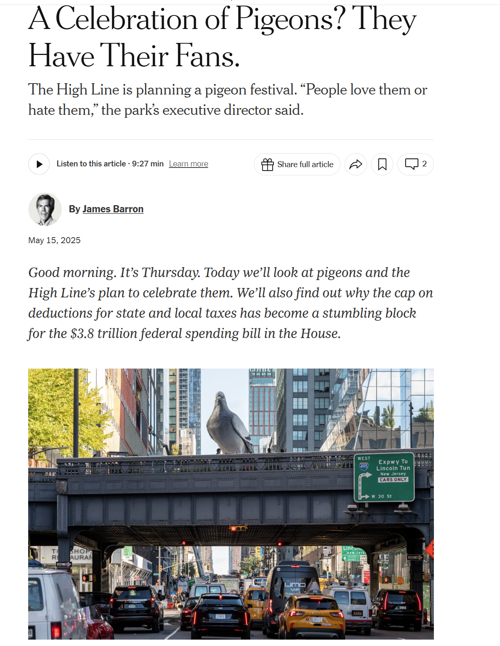
Timeline Example
1960
Pigeon Public Policy – Pest Control
2001
Pigeon Racing Bidding
2025
Pigeon Fest

