Slide 1
Ch 3
Oragnic Compounds:
Alkanes
and
Their Stereochemistry

Slide 2
1. Functional Groups
2. Alkanes and Isomers
3. Alkyl Groups
4. Naming Alkanes
5.Properties of Alkanes
6.Cpnformationa of Ethanes
7. Conformation of other alkanes

Slide 3
Functional Groups
Functional group: an atom or group of atoms within a molecule that shows a characteristic set of physical and chemical properties
Functional groups are important for three reason; they are
  1. the units by which we divide organic compounds into classes
  2. the sites of characteristic chemical reactions
  3. the basis for naming organic compounds

Slide 4
Alcohol
contains an -OH (hydroxyl) group

Slide 5
Amine
contains an amino itrogen bonded to one, two, or three carbon atoms
  may by 1°, 2°, or 3°

Slide 6
Aldehyde and Ketone
contains a carbonyl (C=O) group

Slide 7
Carboxylic Acid
contains a carboxyl (-COOH) group

Slide 8
Carboxylic Ester
a derivative of a carboxylic acid in which the carboxyl hydrogen is replaced by a carbon group

Slide 9
Structure
Hydrocarbon: a compound composed only of carbon and hydrogen
Saturated hydrocarbon: a hydrocarbon containing only single bonds
Alkane: a saturated hydrocarbon whose carbons are arranged in a open chain
Aliphatic hydrocarbon: another name for an alkane

Slide 10
Structure
Shape
  tetrahedral about carbon
  all bond angles are approximately 109.5°

Slide 11
Nomenclature - IUPAC
Suffix -ane specifies an alkane
Prefix tells the number of carbon atoms

Slide 12
Nomenclature
Alkanes

Slide 13
Alkanes (contd.)

Slide 14
Constitutional isomers: compounds with the same molecular formula but a different connectivity (order of attachment of their atoms) example: C₄H₁₀

Slide 15
Prob 2.19
Which sets represent pairs of constitutional isomers?

Slide 16
Constitutional Isomerism

Slide 17
Parent name: the longest carbon chain
Substituent: a group attached to the parent chain
  alkyl group: a substituent derived by removal of a hydrogen from an alkane; given the symbol R-

Slide 18
Nomenclature
  1.The name of a saturated hydrocarbon with an unbranched chain consists of a prefix and suffix
  2. For branched alkanes, the parent chain is the longest chain of carbon atoms
  3. Each substituent is given a name and a number
  4. If there is one substituent, number the chain from the end that gives it the lower number

Slide 19
  6. If there are two or more different substituents,
  list them in alphabetical order
  number from the end of the chain that gives the substituent encountered first the lower number

Slide 20
7. The prefixes di-, tri-, tetra-, etc. are not included in alphabetization
8. Substituents are named by the same set of rules.

Slide 21
Alkyl groups

Slide 22
Classification of C & H
Primary (1°) C: a carbon bonded to one other carbon
  1° H: a hydrogen bonded to a 1° carbon
Secondary (2°) C: a carbon bonded to two other carbons
  2° H: a hydrogen bonded to a 2° carbon
Tertiary (3°) C: a carbon bonded to three other carbons
  3° H: a hydrogen bonded to a 3° carbon
Quaternary (4°) C: a carbon bonded to four other carbons

Slide 23
Cycloalkanes
General formula C_{n}H_{2n}
  five- and six-membered rings are the most common
Structure and nomenclature
  to name, prefix the name of the corresponding open-chain alkane with cyclo-, and name each substituent on the ring
  if only one substituent, no need to give it a number
  if two substituents, number from the substituent of lower alphabetical order
  if three or more substituents, number to give them the lowest set of numbers and then list substituents in alphabetical order

Slide 24
Cycloalkanes
Line-angle drawings
  each line represents a C-C bond
  each angle represents a C

Slide 25
Cycloalkanes
Example: name these cycloalkanes

Slide 26
Physical Properties
Intermolecular forces of attraction
  ion-ion (Na⁺ and Cl⁻ in NaCl)
  ion-dipole (Na⁺ and Cl⁻ solvated in aqueous solution)
  dipole-dipole and hydrogen bonding
  dispersion forces (very weak electrostatic attraction between temporary dipoles)

Slide 27
Physical Properties
Low-molecular-weight alkanes (methane....butane) are gases at room temperature
Higher molecular-weight alkanes (pentane, decane, gasoline, kerosene) are liquids at room temperature
High-molecular-weight alkanes (paraffin wax) are semisolids or solids at room temperature

Slide 28
Physical Properties
Constitutional isomers have different physical properties

Slide 29
Oxidation of Alkanes
Oxidation is the basis for their use as energy sources for heat and power
  heat of combustion: heat released when one mole of a substance in its standard state is oxidized to carbon dioxide and water

Slide 30
Heat of Combustion: Isomers

Slide 31
Sources of Alkanes
Natural gas
  90-95% methane
Petroleum
  gases (bp below 20°C)
  naphthas, including gasoline (bp 20 - 200°C)
  kerosene (bp 175 - 275°C)
  fuel oil (bp 250 - 400°C)
  lubricating oils (bp above 350°C)
  asphalt (residue after distillation)
Coal

Slide 32
Gasoline
Octane rating: the percent 2,2,4-trimethylpentane (isooctane) in a mixture of isooctane and heptane that has equivalent antiknock properties

Slide 33
IUPAC - General
prefix-infix-suffix
  prefix tells the number of carbon atoms in the parent
  infix tells the nature of the carbon-carbon bonds
  suffix tells the class of compound

Slide 34
Prob 2.22
Write the IUPAC name of each compound.

Slide 35
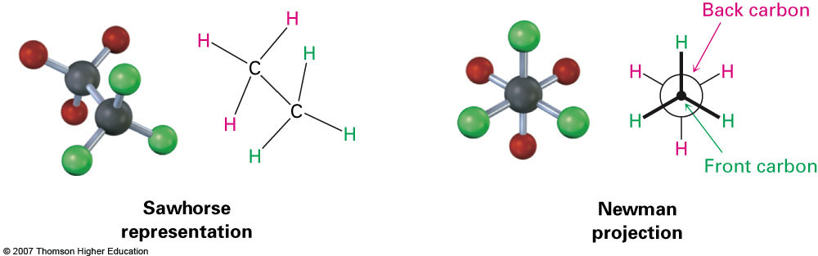
Conformers
Conformation- Different arrangement of atoms resulting from bond rotation
Conformations can be represented in 2 ways:

Slide 36
Conformations
Conformation: any three-dimensional arrangement of atoms in a molecule that results from rotation about a single bond
Newman projection: a way to view a molecule by looking along a carbon-carbon bond

Slide 37
Conformations of ethane
Staggered conformation: a conformation about a carbon-carbon single bond in which the atoms on one carbon are as far apart as possible from the atoms on an adjacent carbon

Slide 38
Conformations of ethane
Eclipsed conformation: a conformation about a carbon-carbon single bond in which the atoms on one carbon are as close as possible to the atoms on an adjacent carbon

Slide 39
Conformations
Torsional strain: the force that opposes the rotation of one part of a molecule about a bond while the other part of the molecule is held fixed
  the torsional strain between eclipsed and staggered ethane is approximately 12.6 kJ (3.0 kcal)/mol

Slide 40
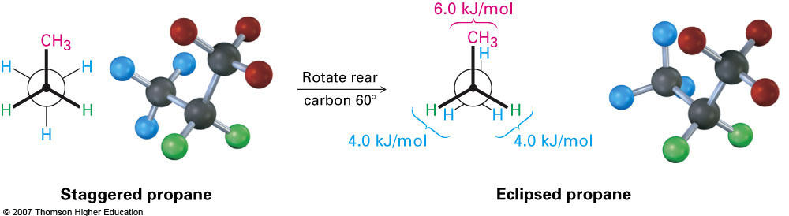
Conformation of propane
The eclipsed conformer of propane has 3 interactions: two ethane-type H-H interactions, and one H-CH₃ interaction

Slide 41
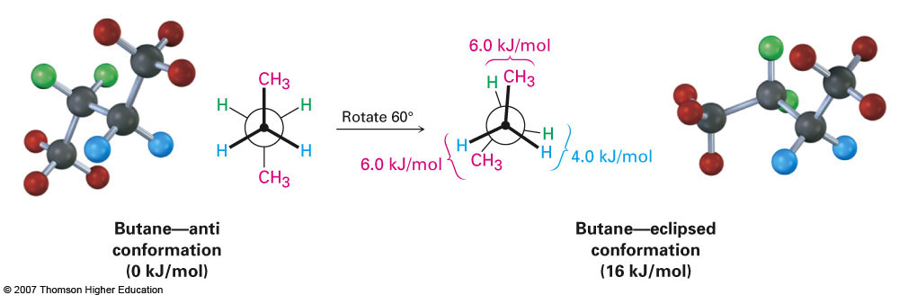
Conformations of butane
• Conformational situation is more complex for larger alkanes
• Not all staggered conformations has same energy, and not all
eclipsed conformations have same energy

Slide 42
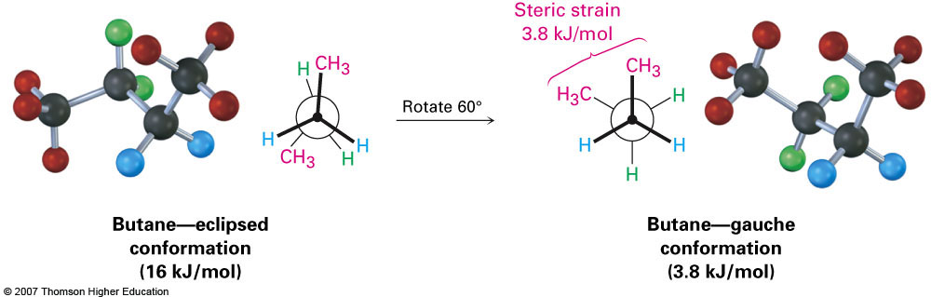
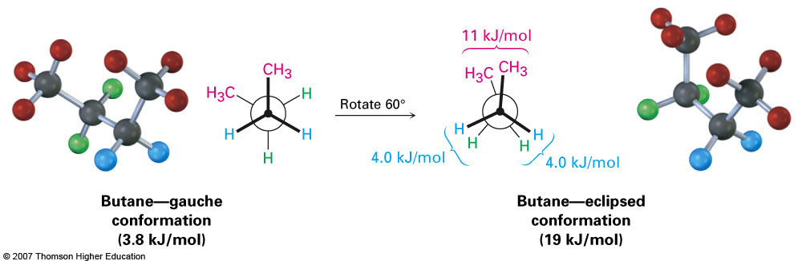
Conformations of Butane
Anti conformation- methyl groups are 180˚ apart
Gauche conformation- methyl groups are 60˚ apart
Which is the most energetically stable?

Slide 43
Conformations of Butane
anti conformation
  a conformation about a single bond in which the groups lie at a dihedral angle of 180°

Slide 44
Conformations
Nonbonded interaction strain:
  the strain that arises when atoms not bonded to each other are forced abnormally close to one another
  butane - gauche conformation; nonbonded interaction strain is approx. 3.8 kJ (0.9 kcal)/mol

Slide 45
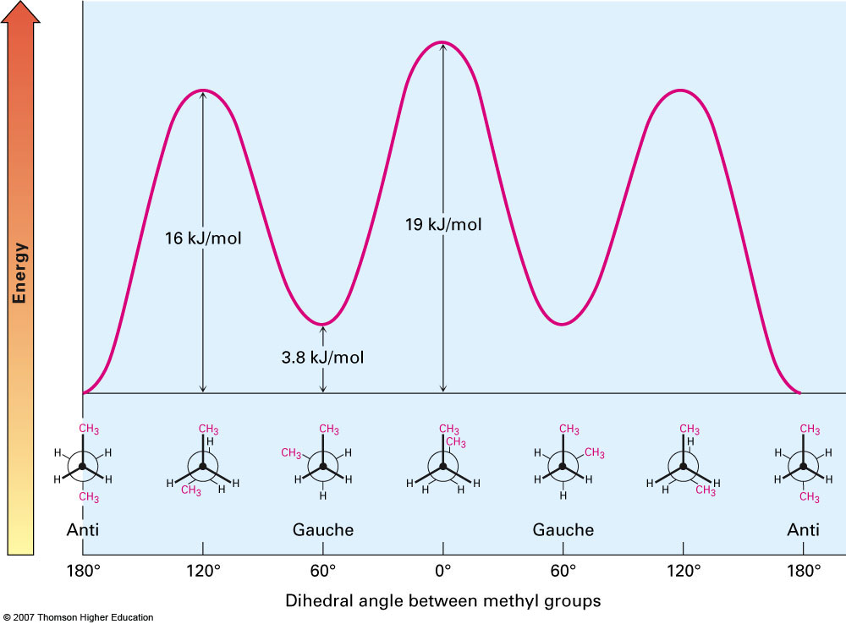
Steric Strain
Steric strain- repulsive interaction occurring between atoms that are forced closer together than their atomic radii allow

Slide 46
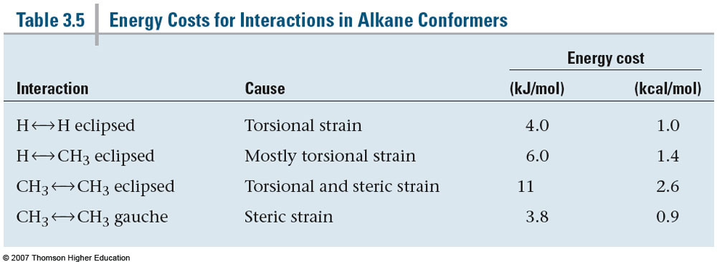

Slide 47
Prob 2.24
Explain why each is an incorrect IUPAC name, and write the correct IUPAC name.
(a) 1,3-dimethylbutane
(b) 4-methylpentane
(c) 2,2-dimethylbutane
(d) 2-ethyl-3-methylpentane
(e) 2-propylpentane
(f) 2,2-diethylheptane
(g) 2,2-dimethylcyclopropane
(h) 1-ethyl-5-methylcyclohexane

