Slide 1
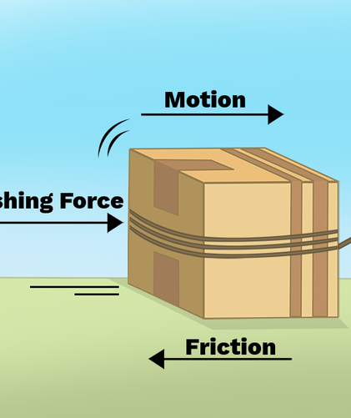
Friction on Surfaces and Distance Travelled
City College of New York
Budget: $25.55
May 04, 2025
Mechanically Speaking

Slide 2
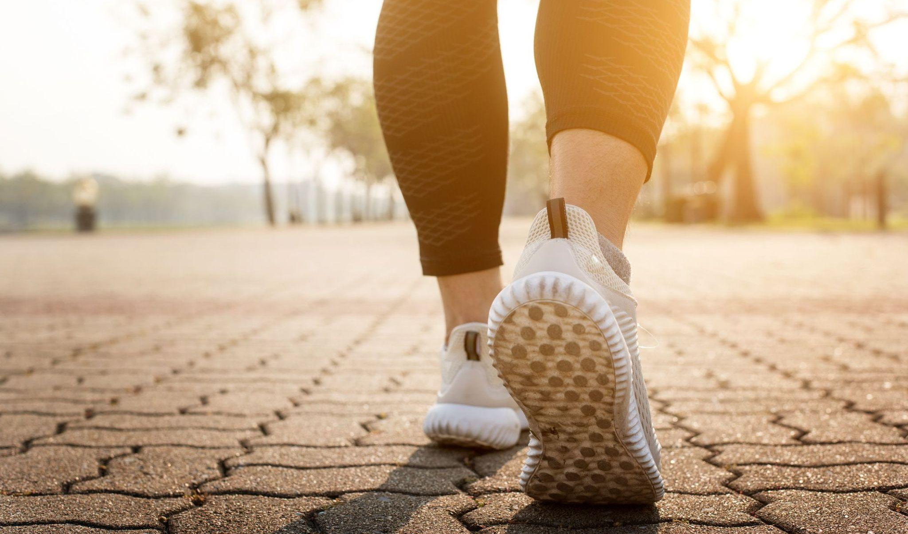
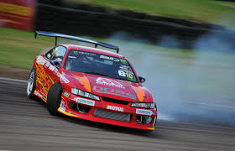
What is Friction?
A resistive force that affects objects in motion
Goes against the object in motion, slowing down its speed.
Caused by different surfaces/materials interacting with each other

Slide 3
How can Friction affect us?
1
2
3
4
Slows Motion Down
Creates Grip
Generates Heat
Allows smooth movement

Slide 4
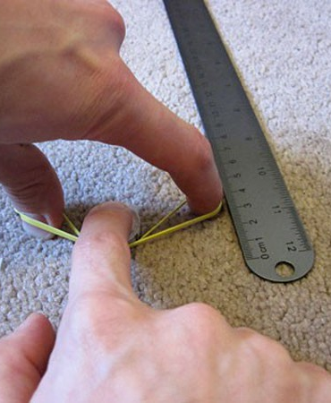
Experiment
We will test how friction affects an object’s travelled distance
Using different materials and surfaces, we will shoot different objects and record how far they went
Through this experiment, we will better understand how surface texture affects an object in motion and how that applied to bigger objects like cars and shoes.

Slide 5
Materials Used
Objects Tested
Surfaces Tested
Other Expenses
Dice
Water Bottle Cap
Coins
Paper Box
Wooden Box
Eraser
Sandpaper
Felt Fabric
Aluminum Foil
Cloth Fabric
Rubber Band
Ruler/Tape Measure
Tape

Slide 6
Methods
We gathered the materials: dice, cap, coin, boxes, and erasers. Also the surface materials which is sandpaper, felt, foil, and fabric.
We adjusted each object’s weight to 50g using coins and secured them with tape.
A rubber band was used to launch each object from a fixed point.
We launched each object 10 times on each surface and measure how far it traveled using a ruler.
All these tests were recorded in a chart and used to analyze the effect of surface texture. on motion.

Slide 7
Our Chart (Sandpaper)
Object Tested | Material | Trail 1 (cm) | Trail 2 (cm) | Trail 3 (cm) | Trail 4 (cm) | Trail 5 (cm) | Trail 6 (cm) | Trail 7 (cm) | Trail 8 (cm) | Trail 9 (cm) | Trail 10 (cm) | Average Distance Travelled (cm)
Dice | Plastic | 18 | 20 | 19 | 21 | 17 | 20 | 18 | 22 | 19 | 21 | 19.5
Water Bottle Cap | Plastic | 30 | 28 | 31 | 29 | 30 | 32 | 27 | 30 | 31 | 29 | 29.7
Coin | Metal | 12 | 13 | 14 | 11 | 13 | 12 | 14 | 13 | 12 | 11 | 12.5
Paper Box | Paper | 7 | 6 | 8 | 7 | 5 | 6 | 7 | 6 | 7 | 5 | 6.4
Wooden Box | Wood | 10 | 11 | 10 | 9 | 12 | 11 | 10 | 10 | 9 | 11 | 10.3
Eraser | Rubber | 5 | 4 | 6 | 5 | 4 | 5 | 5 | 6 | 4 | 5 | 4.9

Slide 8
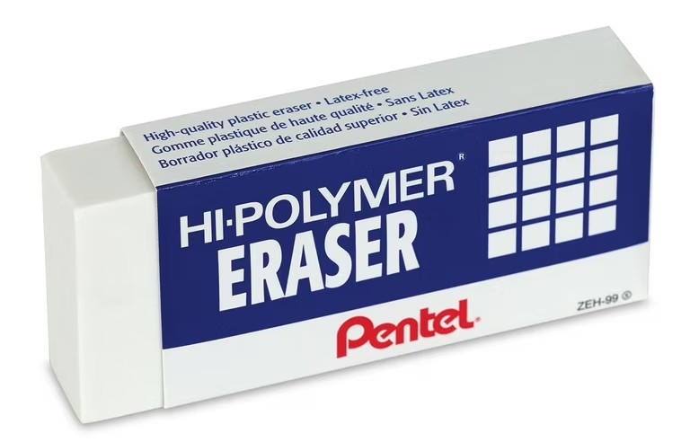
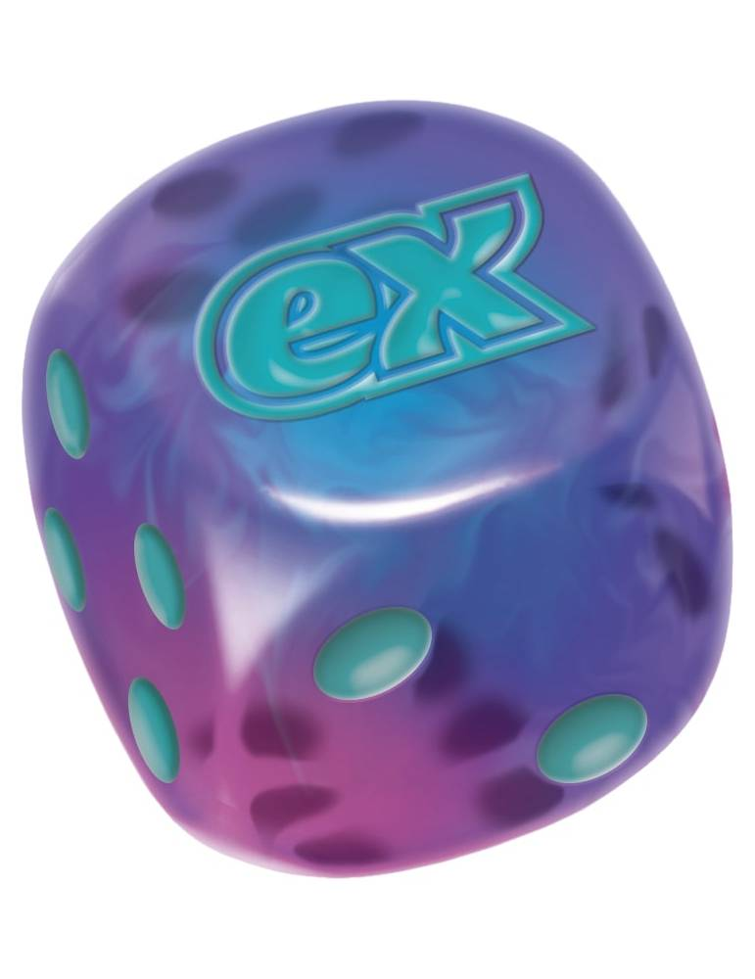
Our Results
Overall, we found that objects travelling on sandpaper went the shortest distance
Objects travelling on wood went the furthest most likely because of the smooth wooden tables on campus
The object that travelled the least was the eraser
The object that travelled the most was the plastic dice.

Slide 9
Why it matters and Real Life Applications
Car Tires
Footwear Design
Rubber is used in tires because it provides high grip on roads, which is essential for safety, especially in wet conditions.
Designers use different materials for the soles of shoes depending on their purpose – sports, hiking, or fashion – balancing grip and movement.
Rock Climbing Gear
Robotics/Machinery
Shoes with rubber soles help climbers grip rocks better, preventing slips and injuries.
Grip pads help climbers to hold on to surfaces
Choosing the right materials for wheels or grippers/claws ensures robots can move efficiently on different terrains.
Right materials also help mechanical parts like gears move smoothly

Slide 11
Thank You!
Shirley Lin, Karol Jablonski, Sajid A. Salam, Shuvo C. Barmon

