Slide 1
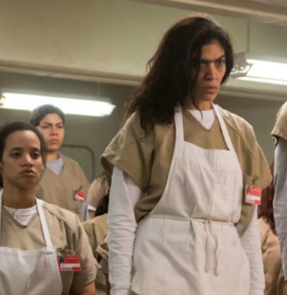
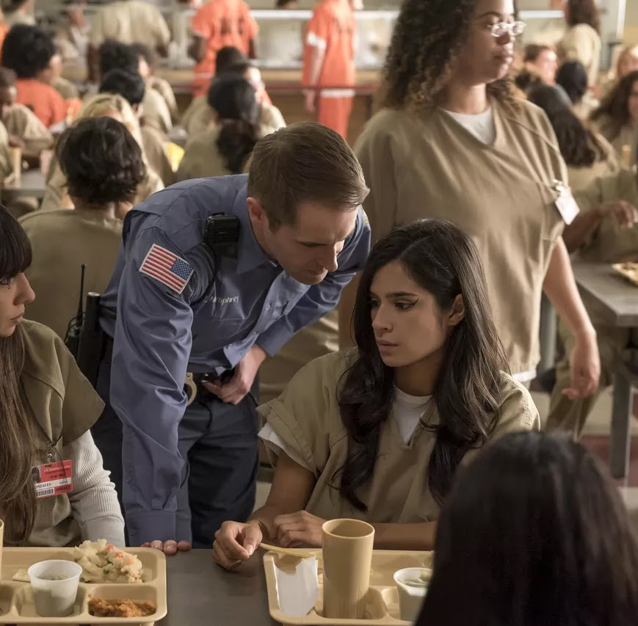
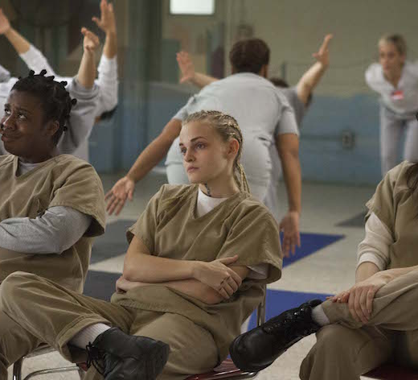
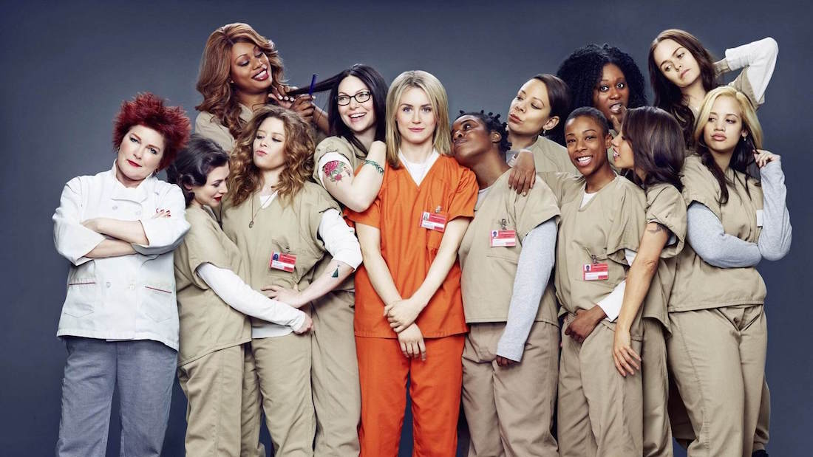
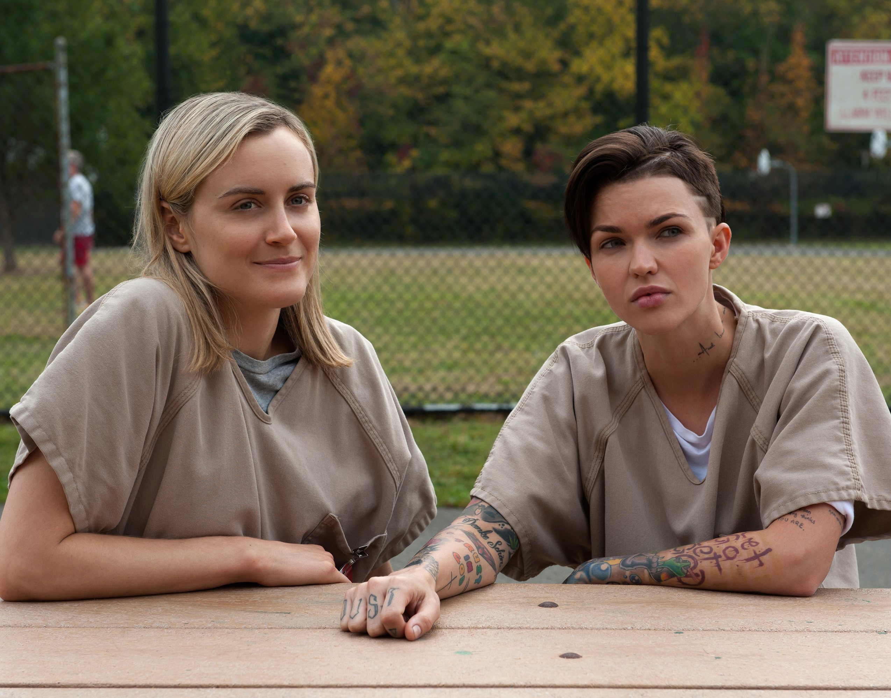
Netflix Lies, Rikers Cries
What Orange Is the New Black Left Behind
Kacey Weng
This Photo by Unknown Author is licensed under CC BY-SA-NC
This Photo by Unknown Author is licensed under CC BY-SA-NC
This Photo by Unknown Author is licensed under CC BY-NC-ND
This Photo by Unknown Author is licensed under CC BY-NC-ND
This Photo by Unknown Author is licensed under CC BY-NC-ND

Slide 2

Introduction
What is Orange Is the New Black?
Cultural impact
Diversity, systemic issues, and social injustices
1
This Photo by Unknown Author is licensed under CC BY-SA

Slide 3
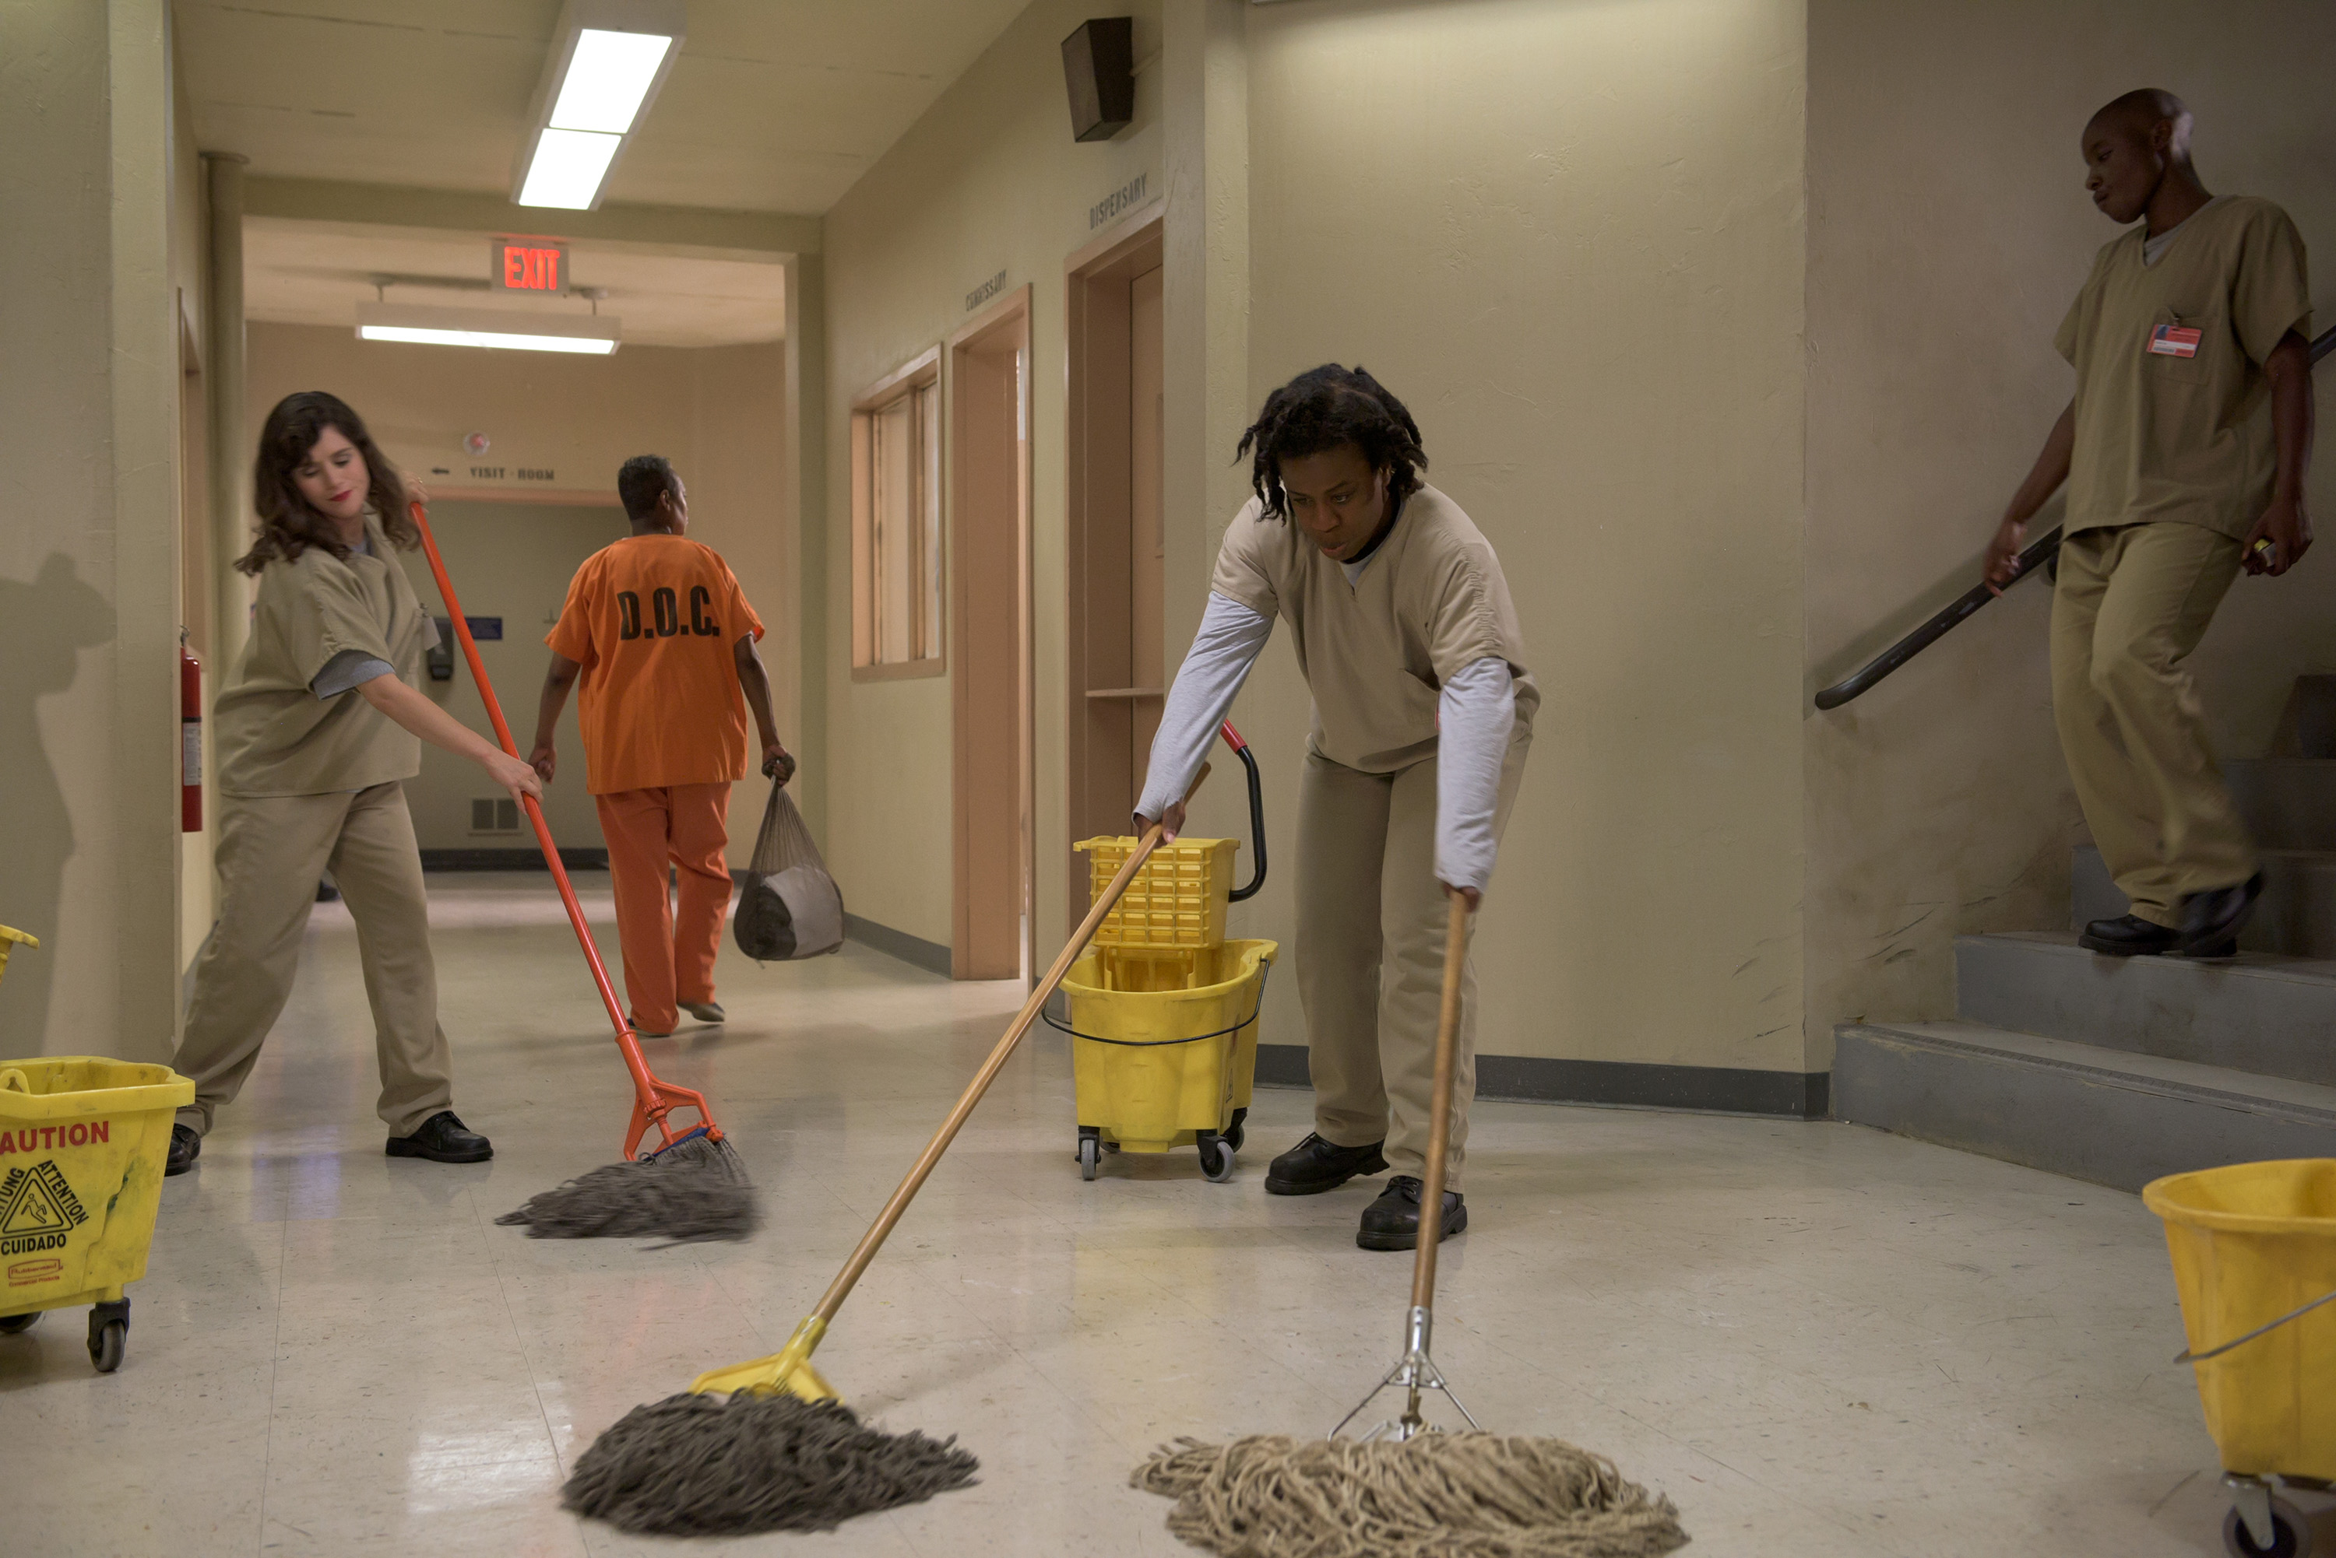
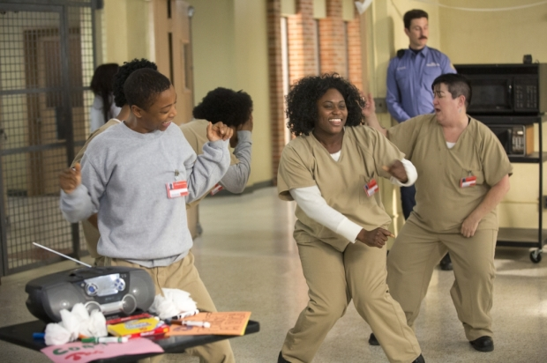
Media Representation vs. Reality
OITNB gives simplified and dramatic portrayals
Prison appears like a "fun summer camp"
Unrealistic freedoms: clean spaces, access to weapons, close staff relationships
2
This Photo by Unknown Author is licensed under CC BY-NC-ND
This Photo by Unknown Author is licensed under CC BY-SA-NC

Slide 4
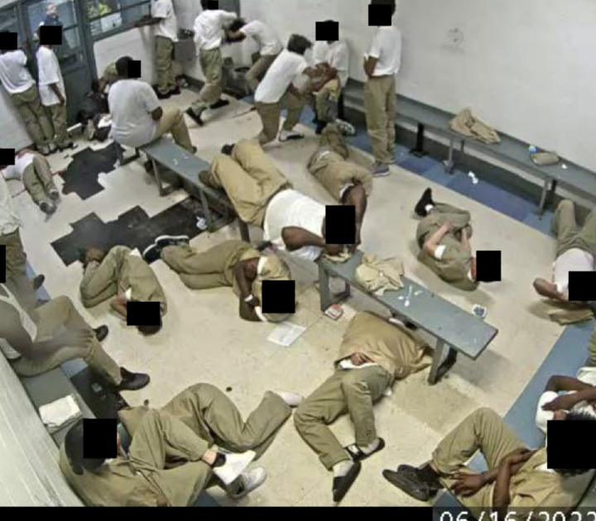
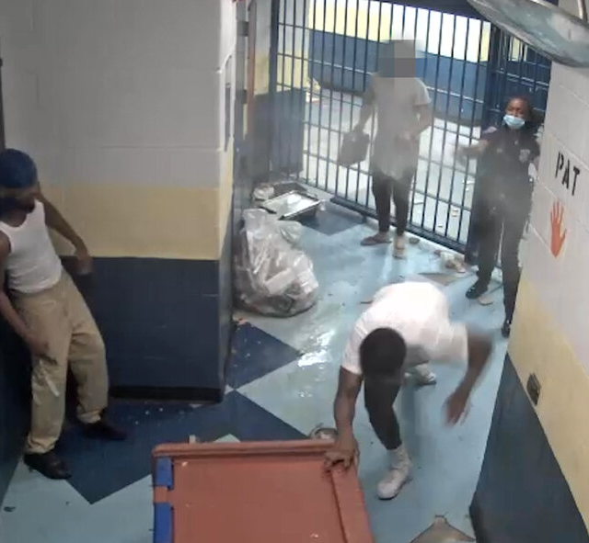
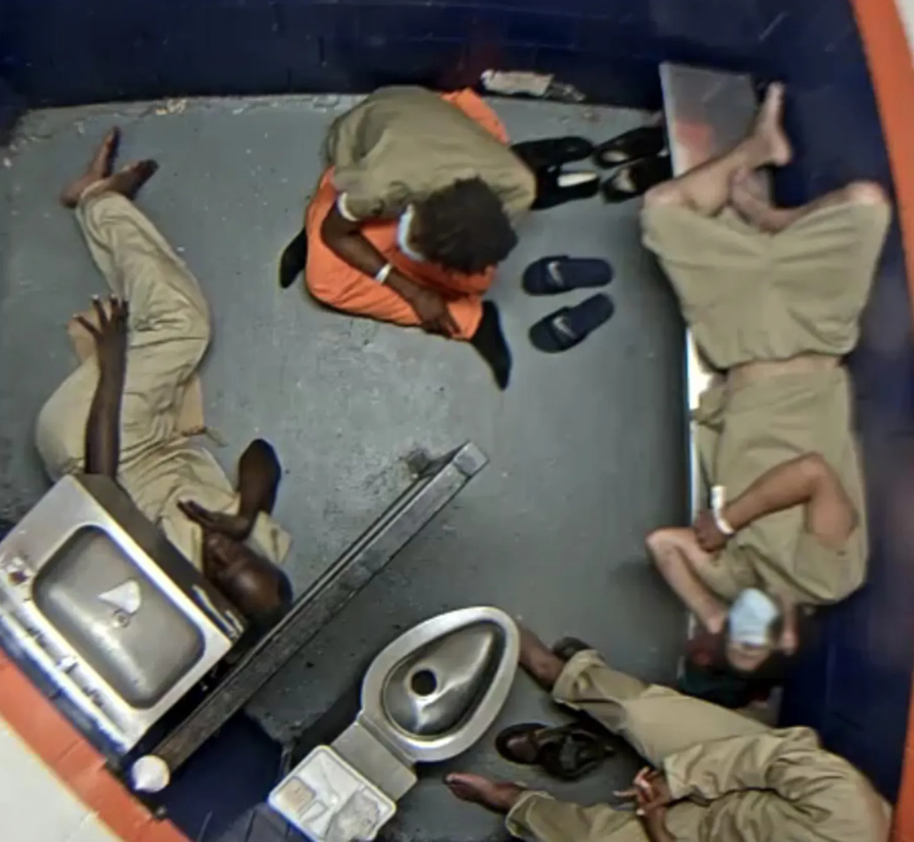
Realities at Rikers Island
Overcrowding, violence, survival struggles
Lack of basic necessities: food, beds, healthcare
Reality: Fear, abuse, and neglect — NOT personal growth retreats
3
Notes:
Fight Night/Gang Rule
Inmates locked in showers

Slide 5
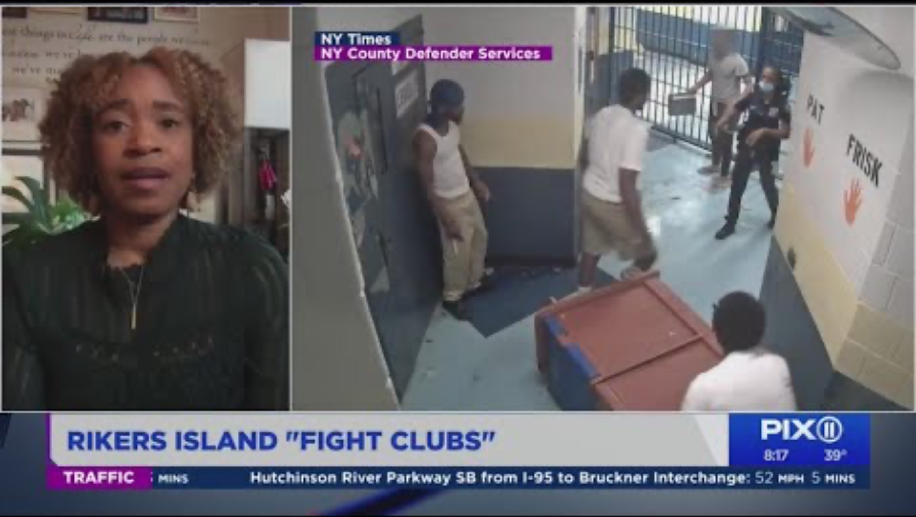

Slide 6
Impact on Public Perception
Media shapes how people view prisons
OITNB risks romanticizing incarceration
Misrepresentation slows prison reform discussions
This Photo by Unknown Author is licensed under CC BY-NC-ND

Slide 7
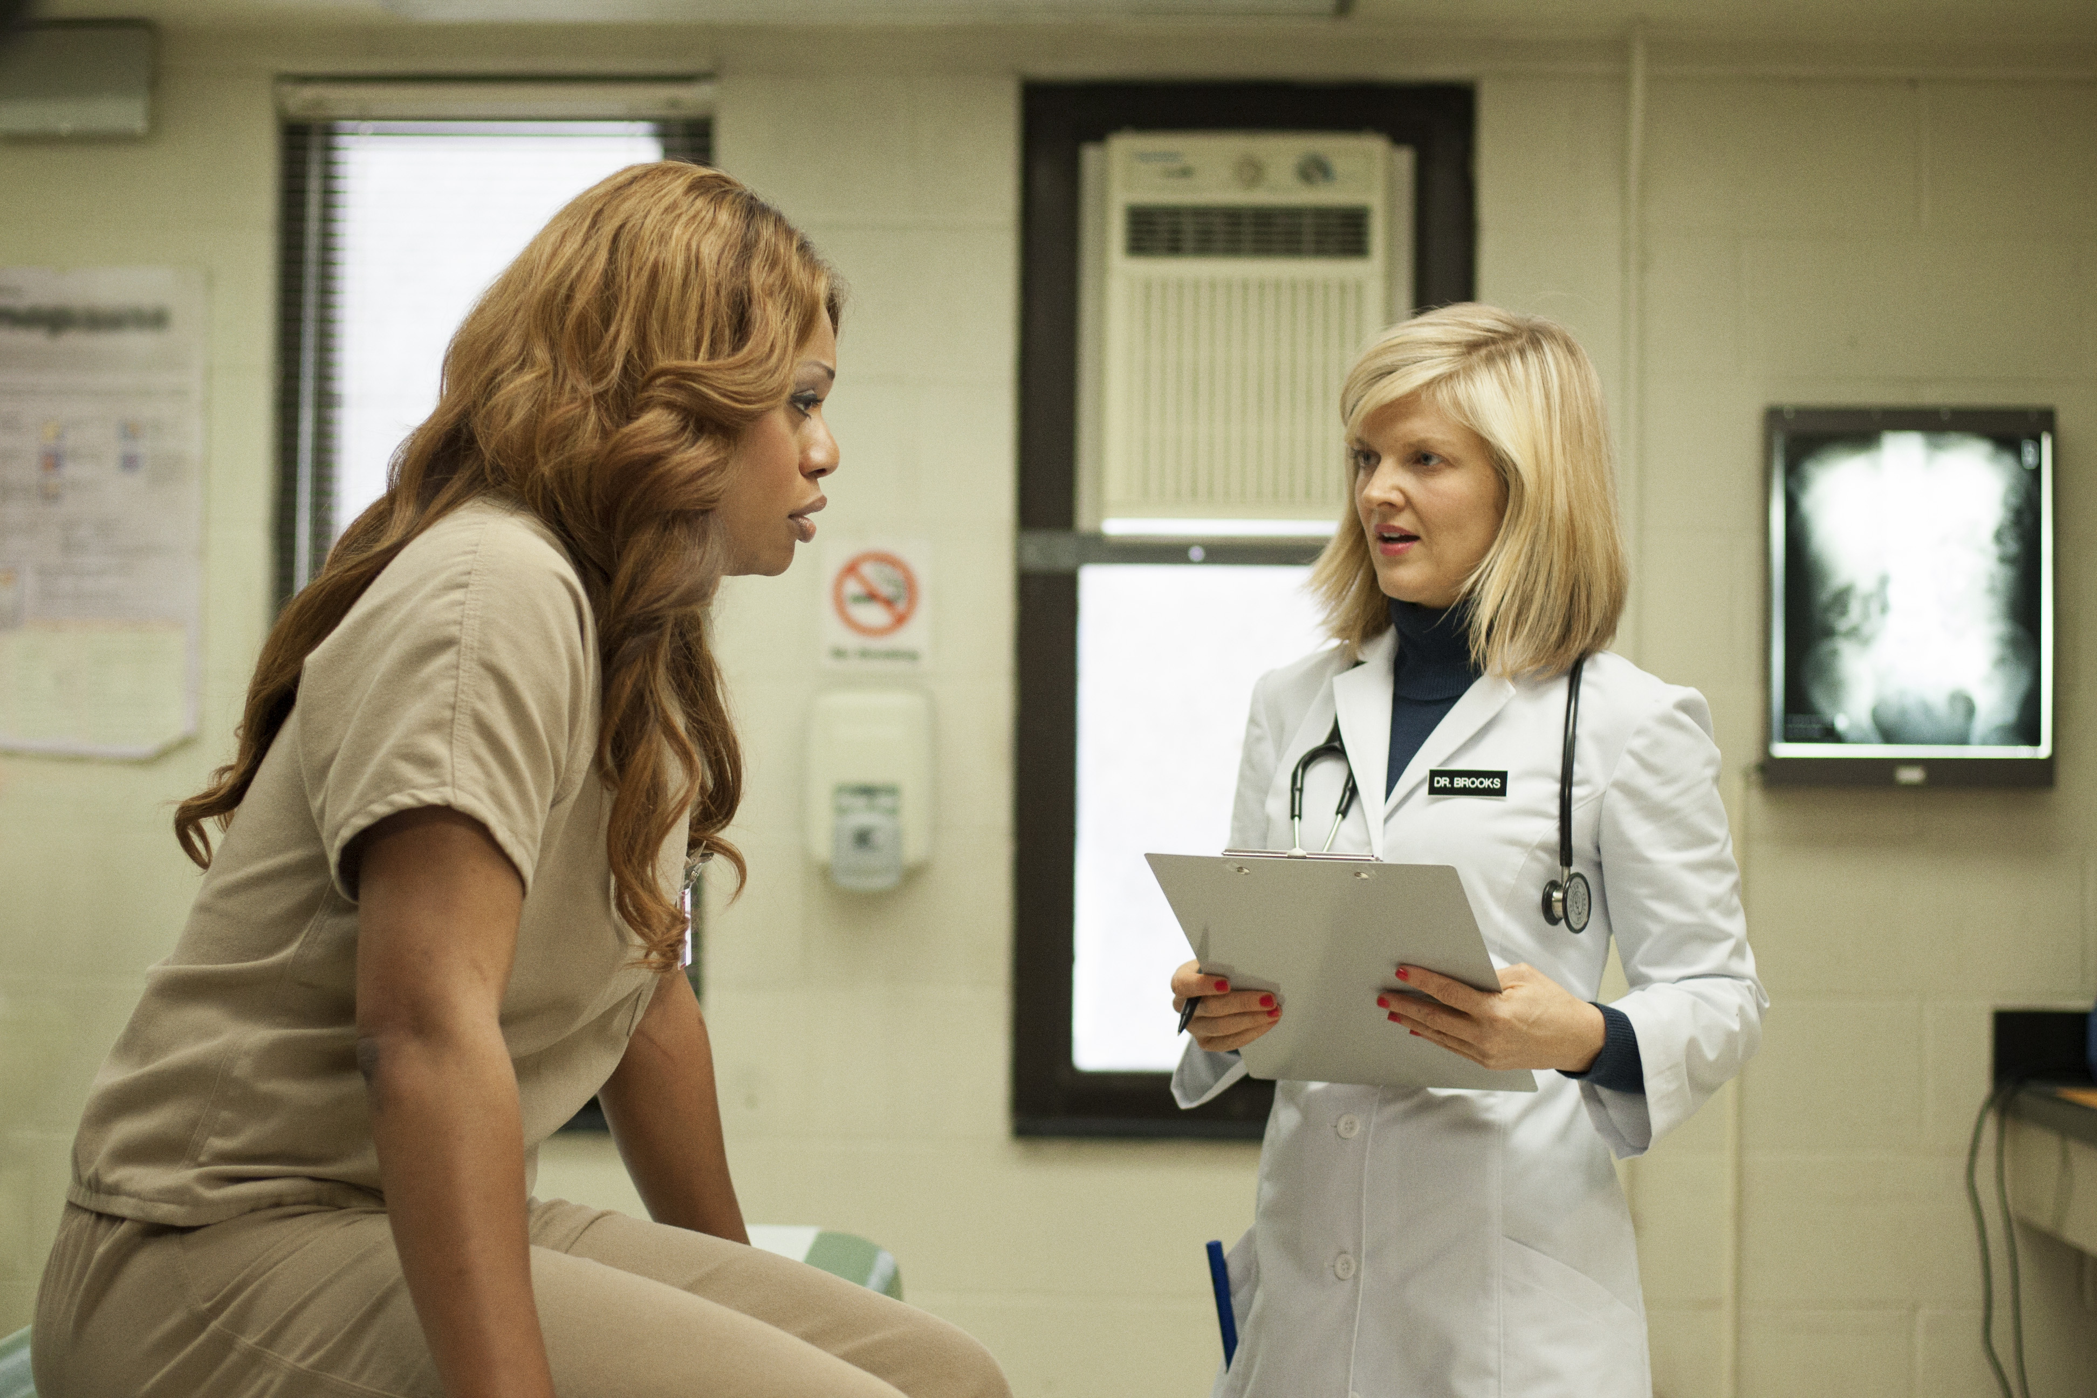
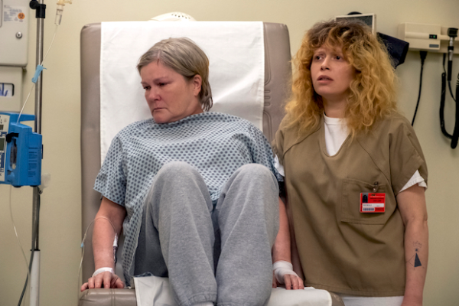
Healthcare Misrepresentation
- OITNB: Easy medical access
- Rikers Reality:
- Delayed care (1 month for a broken bone)
- Inadequate treatment for transgender inmates
- Severe consequences: deaths due to neglect

Slide 8
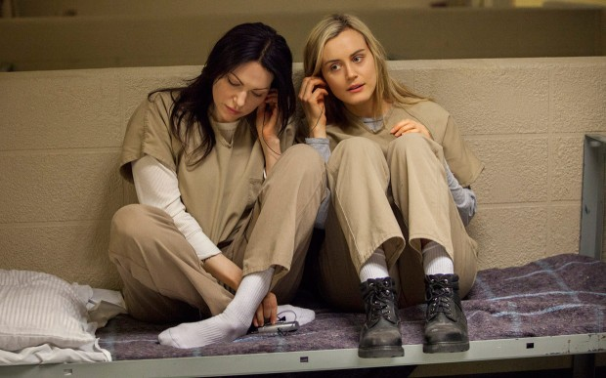
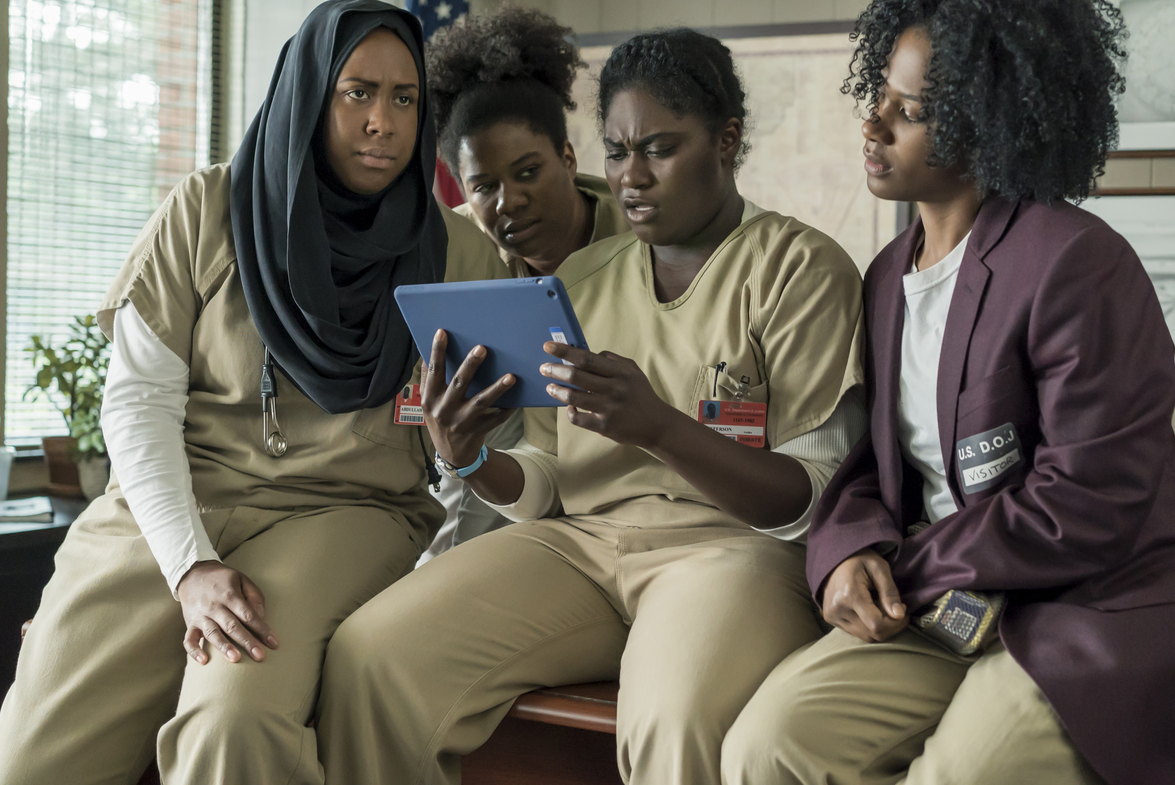
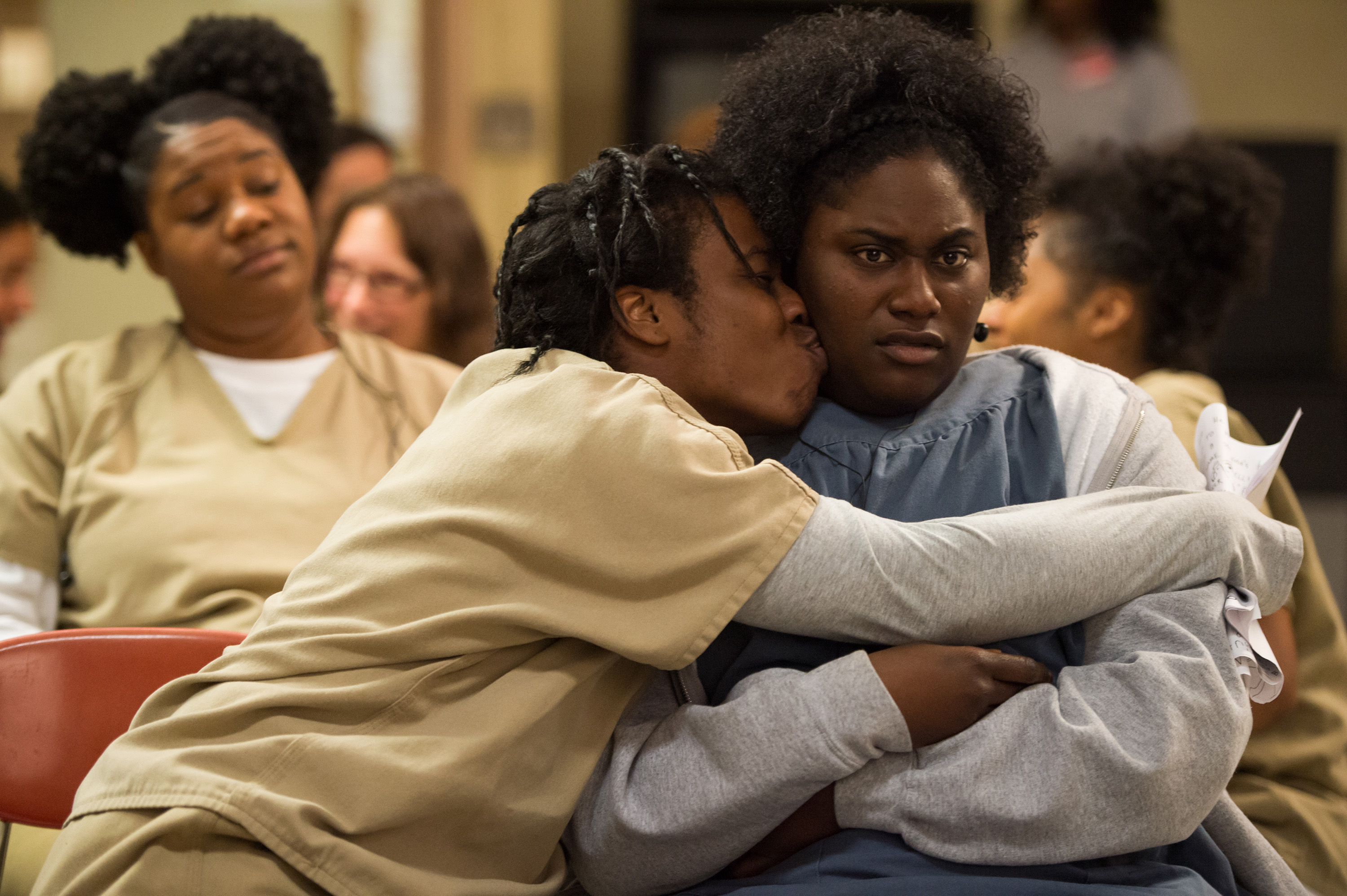
Ignoring Psychological Toll
This Photo by Unknown Author is licensed under CC BY-NC-ND
- OITNB: Focus on relationships & drama
- Missing: severe mental health struggles in real prisons
- Rikers: High prevalence of untreated mental illness → fatal neglect
This Photo by Unknown Author is licensed under CC BY-SA-NC
This Photo by Unknown Author is licensed under CC BY-SA-NC

Slide 9
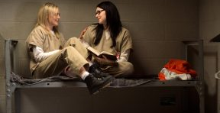
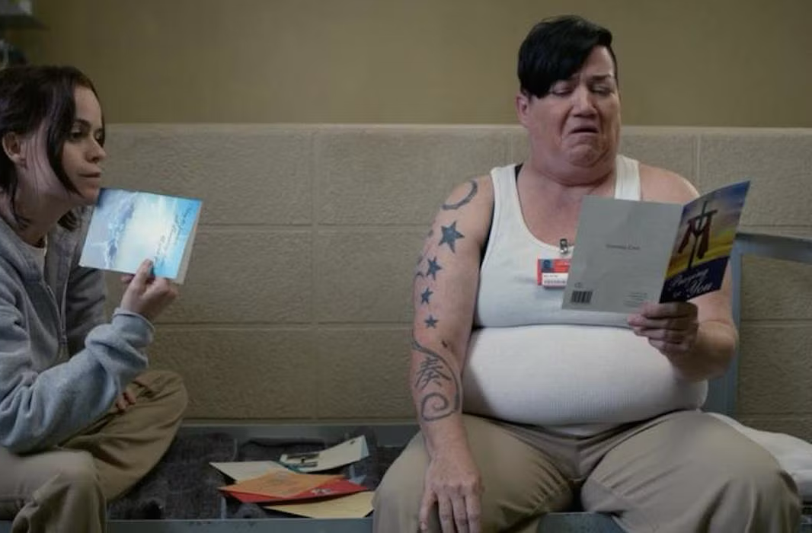
Overcrowding and Delayed Trials
This Photo by Unknown Author is licensed under CC BY-SA-NC
- OITNB: Personal space, clean environment
- Reality: Severe overcrowding at Rikers
- Pre-trial detainees held months to years without conviction

Slide 10
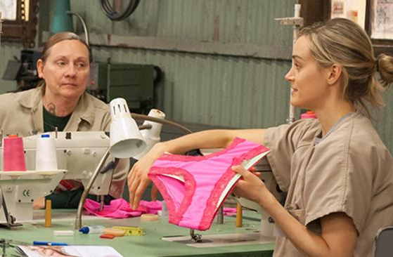
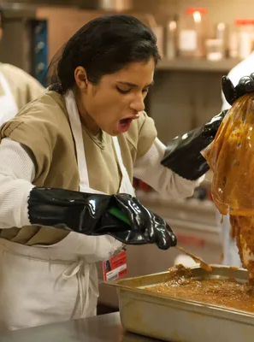
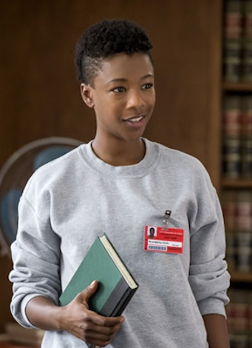
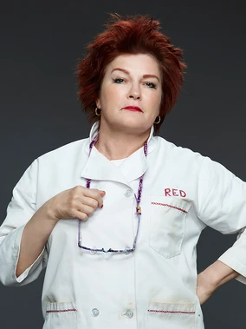
Labor Exploitation
- OITNB: Jobs with access to commissary
- Reality:
- Forced labor with little to no pay
- Rooted in slavery history
- Black and Latino inmates disproportionately exploited

Slide 11
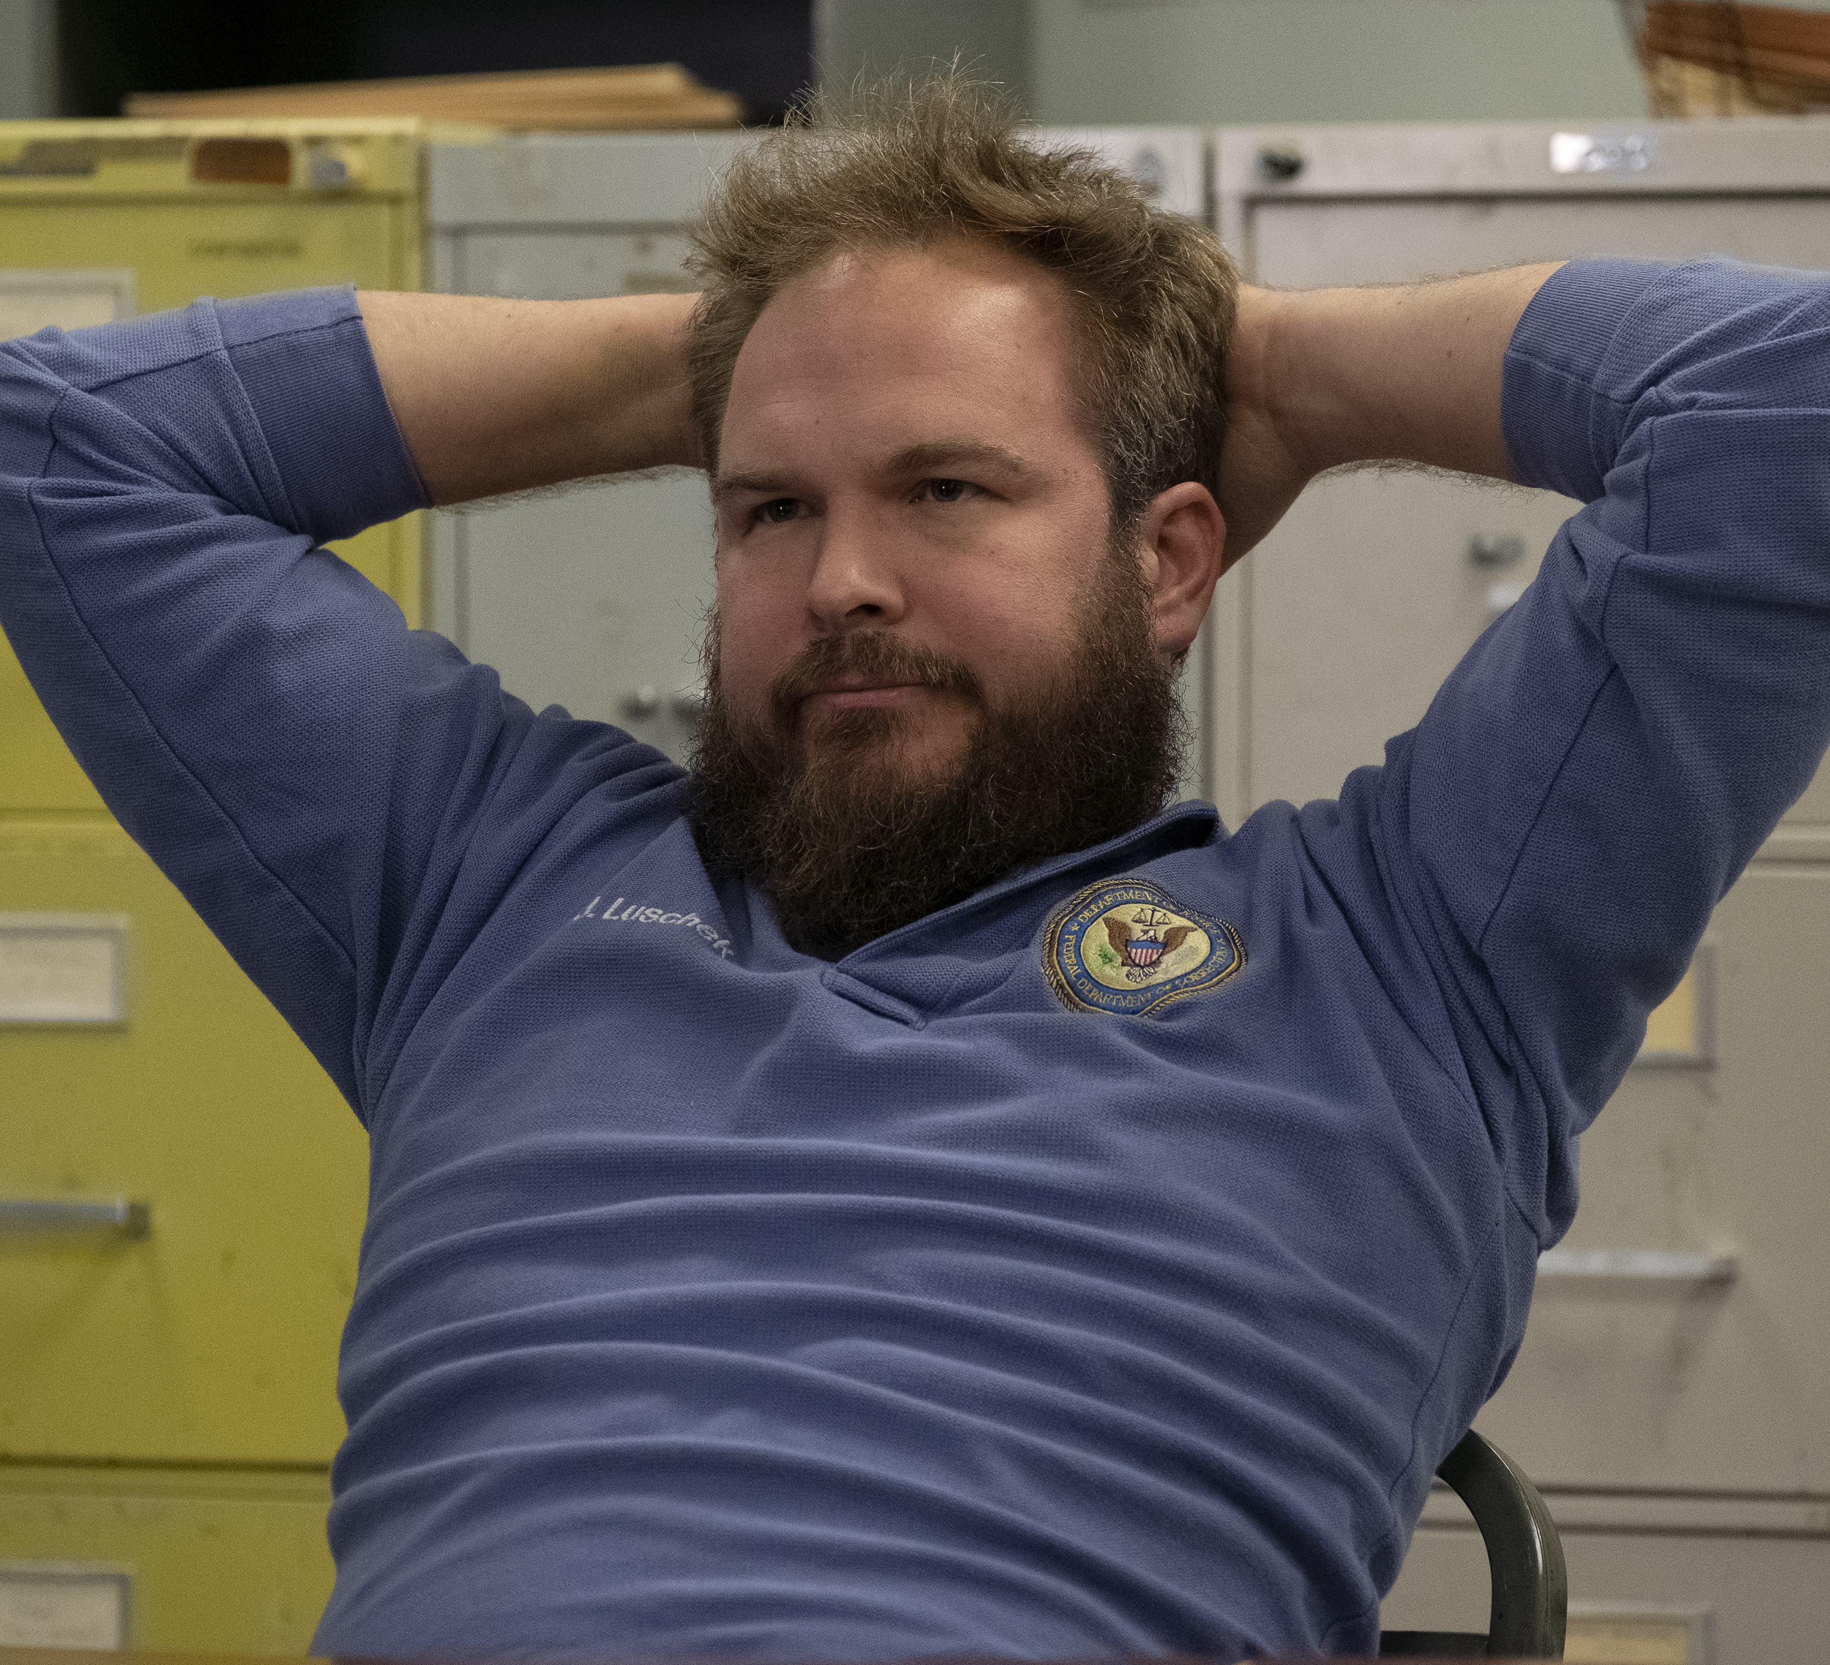
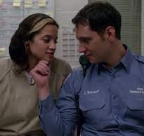
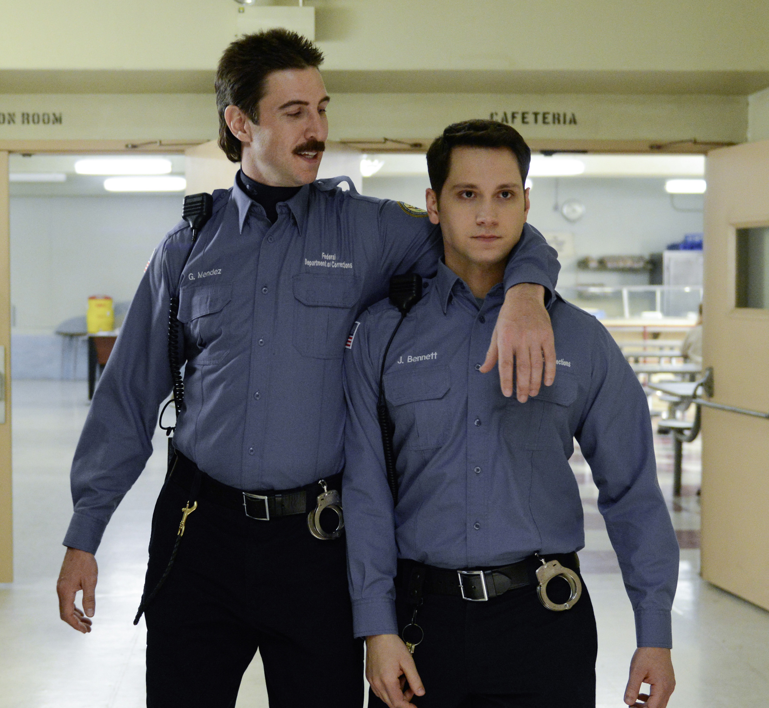
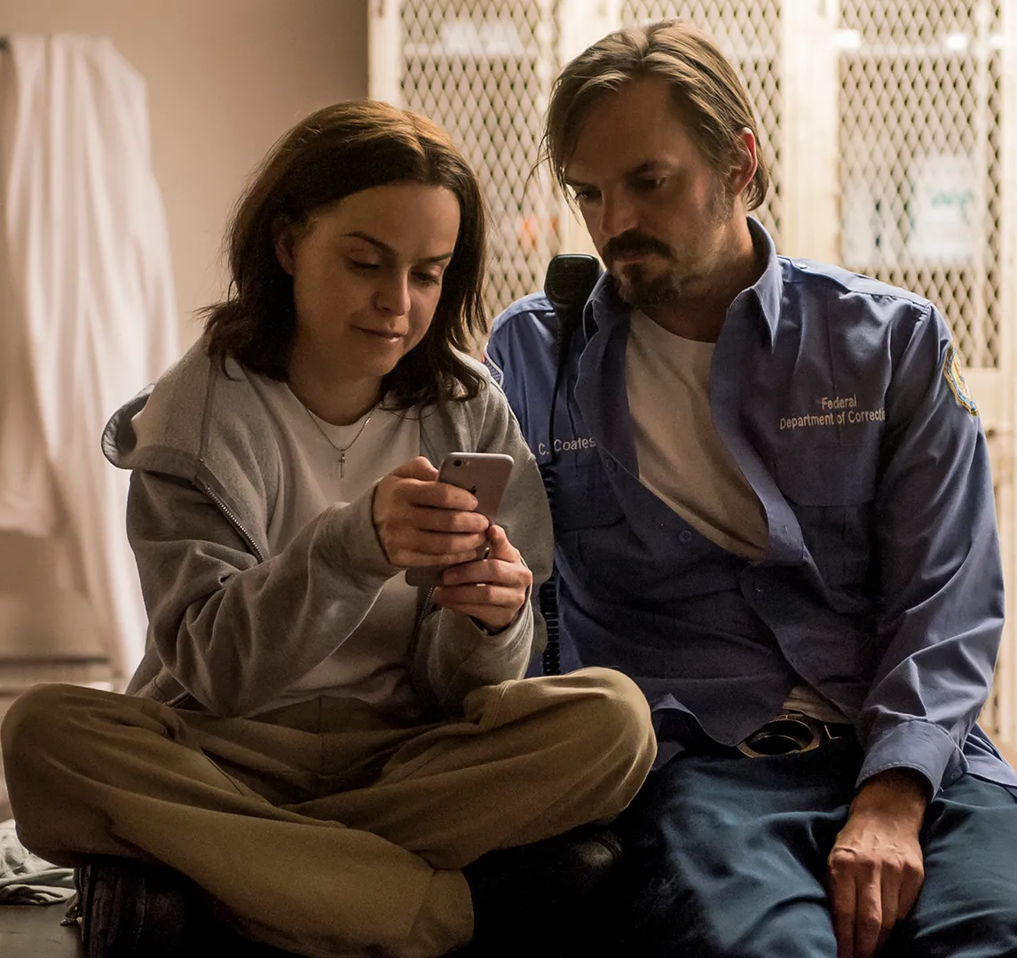
Correctional Staff Misrepresentation
- OITNB: Guards shown as humanized, sometimes friendly
- Reality: Systemic abuse, corruption, and violence at Rikers
- Important narratives missing
This Photo by Unknown Author is licensed under CC BY-SA-NC

Slide 12
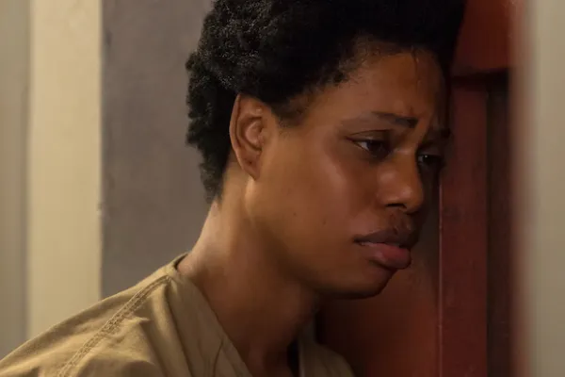
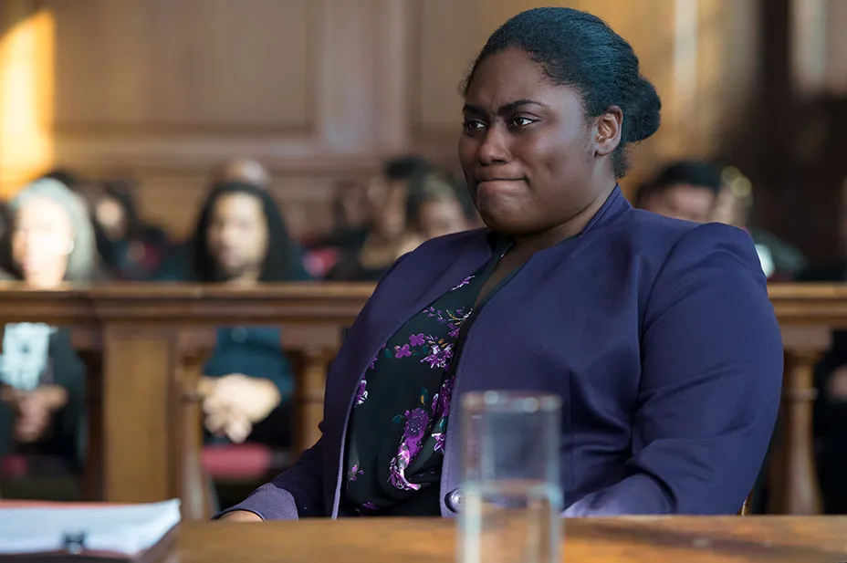
Conclusion
- OITNB brought attention to some prison issues
- Failed to fully expose realities: violence, neglect, exploitation
- Importance of authentic and responsible storytelling in shaping reform efforts

Slide 13
References
- Mooney, J., & Shanahan, J. (2020). *Rikers Island: The Failure of a 'Model' Penitentiary*. The Prison Journal.
- NPR Reports (Garsd, 2025)
- Browne, J. (n.d.). *Rooted in Slavery: Prison Labor Exploitation.*
"New York Mayor Announces Plan To Reduce Rikers Island Jail Population." All Things Considered, 14 Apr. 2015. Gale In Context: Opposing Viewpoints, link.gale.com/apps/doc/A411047163/OVIC?u=cuny_ccny&sid=summon&xid=1b9cbd15. Accessed 10 Apr. 2025.
United States Attorney’s Office, Southern District of New York. CRIPA Investigation of the New York City Department of Correction Jails on Rikers Island. U.S. Department of Justice, Aug. 4, 2014, https://www.justice.gov/sites/default/files/usao-sdny/legacy/2015/03/25/SDNY%20Rikers%20Report.pdf
Bordere, T. C. (2021). “Not Just the Actions of a Few Bad Apples:” Reflections on institutionally sanctioned violence and medical neglect in Rikers Island. Death Studies, 45(8), 665–668. https://doi.org/10.1080/07481187.2021.1915157

