Slide 1
Nate GTM
by Nathan Prudente

Slide 2
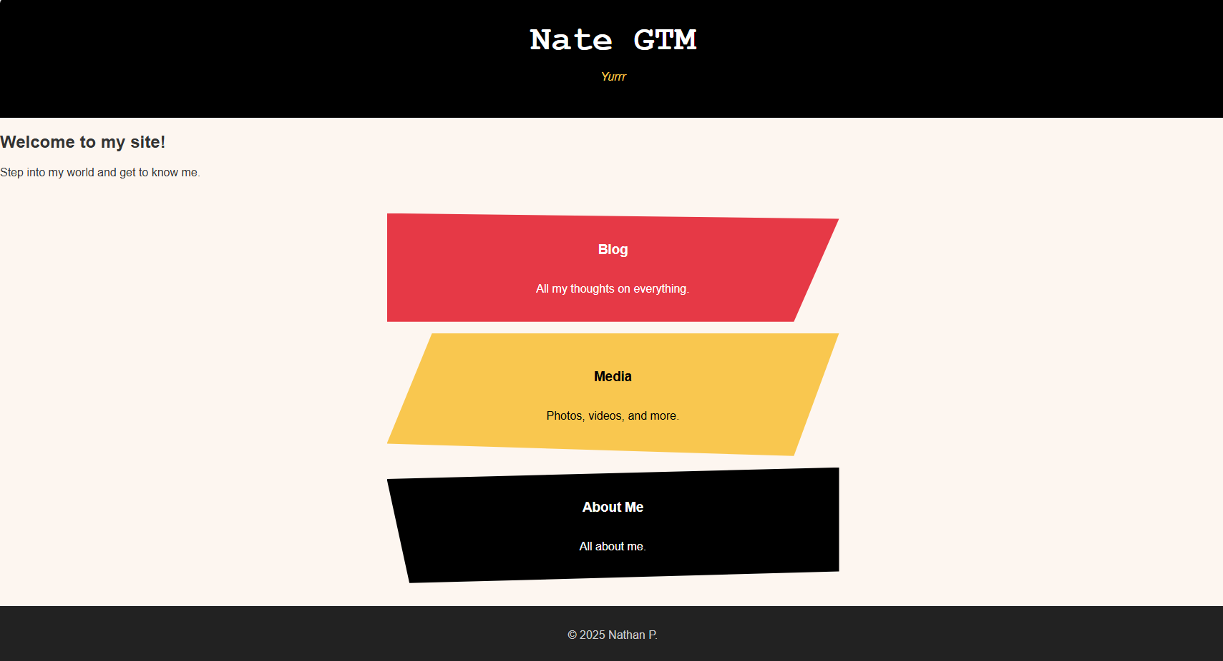

Slide 3
Palette & Typography
Headings: Courier New – 3 rem (~48pt)
Body: Helvetica Neue – 1 rem (~16pt)

Slide 4
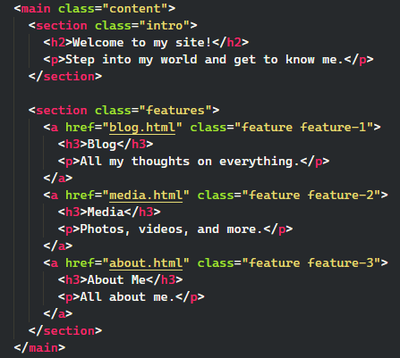
HTML/CSS Asymmetrical Design

Slide 5
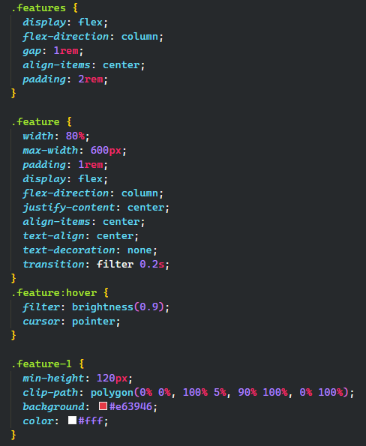
HTML/CSS Asymmetrical Design

Slide 6
Visit my site!

