Slide 1
M. M. Bakhtin's
"Discourse of the Novel"
(1934-1935)

Slide 2
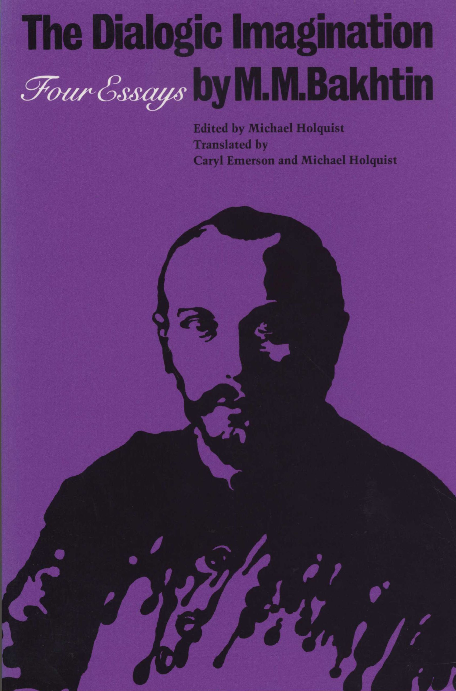

Slide 3
What is the "Discourse of the Novel"?
"Literary language is a highly distinctive phenomenon, as is the linguistic con­sciousness of the educated person who is its agent [the author]; within it, intentional diversity of speech (which is present in every living dialect as a closed system) is transformed into diversity of language; what results is not a single language but a dialogue of languages" (1025).
Notes:
Discourse is the language of the novel. What this quote evinces, ironically towards the end of the text, is the process by which diversity of speech is re-worked, or transformed (importantly transformed, and not reflected, in the novel).
All the elements of Bakhtin's theory I see here. The dialogue of languages is what the novel is composed of, is the supra-language that it speaks, thinks, and transforms.

Slide 4
Stratification of Language(s)
Within the novel's dialogue between languages, "any single national language" is presented as split, refracted, and stratified into its "social dialects, characteristic group behaviors, professional jargons, generic languages, languages of generations and age groups, tendentious languages, languages of the authorities, of various circles and of passing fashions, lan­guages that serve the specific sociopolitical purposes of the day, even of the hour (each day has its own slogan, its own vocabulary, its own emphases)—this internal stratification present in every language at any given moment of its historical existence is the indispensable prerequisite for the novel as a genre" (1002).
Notes:
Although Bakhtin does refer to the explicit polyglossia that can be exemplified in the novel, the languages that he is referring to in the quote—and where the complexity of his theory lies—are the internally stratified "single national languages" that interanimate each other. These form Bakhtin's "heteroglossia."
Read quote.
The many and various Englishes, Russians, Spanishes, which are not also differentiated by accent or geographical location, but differentiated by social axes/cross-sections. And these many languages exist in addition, or alongside, coupled, to all of their historical manifestations. Horizontal/vertical stratification, or specification, of any single national language.

Slide 5
"Language—like the living concrete environment in which the consciousness of the verbal artist lives—is never unitary. It is unitary only as an abstract grammatical system of normative forms, taken in isolation from the concrete, ideological conceptualizations that fill it, and in isolation from the uninter­rupted process of historical becoming that is a characteristic of all living language" (1021).
Notes:
On the question of historical existence, Bakhtin's literary language is filled with ideological conceptualizations deriving from this very placement in history.
Each of the language(s) mentioned in slide #3 retain these charges of ideological conceptualizations, reflections of a world-view, a mode of seeing, a history, a presence, of a witnessing. All languages, within and without national borders, have unique ways of conceptualizing and expressing objects, value, judgment or any focal point which they are gesturing towards, facing. And this is one of the main reasons that derive why language and the word, for Bakhtin, is so unstable, so in flux, so unique in anyone's use, not stamped with "a universal approval," from the Saussure.

Slide 6
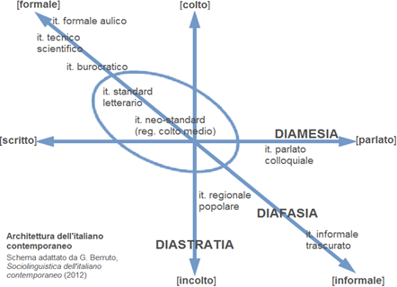
Sociolinguistics Axes
"Any stylistics capable of dealing with the distinctiveness of the novel as a genre must be a sociological stylistics" (1029).

Slide 7
"From the Prehistory of Novelistic Discourse" (the second essay in Dialogic Imagination)
Characters operate in "voice-zones" (46).
The language of the novel is "a system of intersecting planes," between which the central narration (the author's gesture of writing) can move (48).
"This novelistic image of another's style ... must be taken in intonational quotation marks within the system of direct authorial speech (postulated by us here), that is, taken as if the image were parodic and ironic (44).
Notes:
What does the stratification, heteroglossia within a given "single national language" concretely look like, in the novel?
Topography of the novel as a recurrent theme —

Slide 8
Free Indirect Discourse
Free indirect discourse inherently involves the "slippage" into another's language, whether between characters or in/out of a character. And in Bakhtin's words from "Prehistory," the novel's characteristic "indirect discourse … the representation of another's word, another's language in intonational quotation marks, was known in the most ancient times; we encounter it in the earliest stages of verbal culture" (50).
In the history of the novel, two factors "prove to be of decisive importance: one of these is laughter, the other polyglossia. The most ancient forms for representing language were organized by laughter—these were originally nothing more than the ridiculing of another's language and another's direct discourse. Polyglossia and the interanimation of languages associated with it elevated these forms to a new artistic and ideological level, which made possible the genre of the novel" (50-51).
Notes:
The intonational quotation marks can be seen as an enactment of free indirect discourse, the slippage of the narration into a character's style, voice-zone, as we mentioned before. The novel is born through, and by, language that imitates another's, that slips into, that moves into the heteroglossia of discourse and language.
Read slide.
It is from these two factors, laughter (parody, ridicule, double-meaning, policemia) and polyglossia (the interanimation of languages, the evolution and translation of languages from Latin to the formation and consolidation of dialect , to then national language) that the word of the novel genre was essentially "split open," open to absorb, to reflect, to contain more than what Saussure called the dual elements of signification, signifier and signified, which was subverted, unsettled, and exploded. The subversive force of laughter, in particular, "forced men to experience beneath" strict categories or boundaries of genre, style, and language, "a different and contradictory reality that is otherwise not captured in them. Such laughter paved the way for the impiety of the novelistic form."

Slide 9
The Author's Ventriloquism
"He can make use of language with­out wholly giving himself up to it, he may treat it as semi-alien or completely alien to himself, while compelling language ultimately to serve all his own intentions. The author does not speak in a given language (from which he distances himself to a greater or lesser degree), but he speaks, as it were, through language, a language that has somehow more or less materialized, become objectivized, that he merely ventriloquates" (1029).
Notes:
Because of the word opening up, breaking free, due to laughter and polyglossia, there has formed a distance between the language of a novel and its source, as if the author were detaching himself from the word, peering from behind, saying, I'm slipping into another's words, the intonational quotation marks again.
Read slide.
From Prehistory, again, "Language in the novel not only represents, but itself serves as the object of representation. Novelistic discourse is always criticizing itself," observing itself, putting itself and the word under its scrutiny (49).

Slide 10
Palimpsest, External Dialogism of the Word
"The word, directed toward its object, enters a dialogically agitated and tension-filled environment of alien words, value judgments and accents, weaves in and out of complex interrelationships, merges with some, recoils from others" (1012).
Notes:
Just as Bakthin's theory of novelistic discourse posits the existence of intersecting planes of language, he constructs his own argument in its own planes, moving from the larger system of a nation, to a language , and then to the very word itself, and even further … The dialogue and interanimation is not just between large-scale languages but between, and within, words themselves.
The complete impossibility of a vacuum in speech in general. The word is in argument with other words. But especially when we see the word reaching or gesturing towards an object, the external dialogism of the word, here, has to do with a tension, a struggle, with all of the previous words uttered, directed, addressed towards a given object, which are conjured in the moment of novel description. Palimpsest metaphor?

Slide 11
"For the prose writer, the object is a focal point for heteroglot voices among which his own voice must also sound; these voices create the background necessary for his own voice, outside of which his artistic prose nuances can­ not be perceived, and without which they 'do not sound'" (1014).
Notes:
This background of words, this field of circulating meaning, exists in the object already—the novel utterance touches upon, and recalls, these heteroglot voices that have come before as a necessity for creating sound.
There are many dialogic encounters in Bakhtin's Discourse in the Novel, between writer-reader, writer-word, writer-character, word-object, word-reader and so on... this one here only talked about objects, but the same structures apply with people, too. And the word doesn't just reach the object, but to the "apperceptive backgrounds" of all listeners and readers. The concepts are contained within objects but carried by people.
Something I was thinking about is how much we can refer to this pre-existing, pre-conceived collection of words as a Kantian concept. If so, is Bakhtin's new word contributing to the existing concept while also creating, appropriating, its own within its system of language?

Slide 12
Internal Dialogism of the Word
"The prose writer does not purge words of intentions and tones that are alien to him, he does not destroy the seeds of social heteroglossia embedded in words, he does not eliminate those language characterizations and speech mannerisms ... glimmering behind the words and forms" (1028).
Notes:
The Internal dialogism of the word, here, The word is in continuous tension and argument with itself, explosion of meaning in its very utterance. And all of these tensions are maintained, collected, in the word. The possibility/impossibility of being another word, and also all the ambiguities that may be contained within the chosen word.

Slide 13
Poetic / Novelistic Discourse
"In genres that are poetic in the narrow sense, the natural dialogization of the word is not put to artistic use, the word is sufficient unto itself and does not presume alien utterances beyond its own boundaries" (1018).
" … a certain latitude for heteroglossia exists only in the 'low' poetic genres— in the satiric and comic genres and others. Nevertheless, heteroglos­sia (other socio-ideological languages) can be introduced into purely poetic genres, primarily in the speeches of characters. But in such a context it is objective. It appears, in essence, as a thing, it does not lie on the same plane with the real language of the work: it is the depicted gesture of one of the characters and does not appear as an aspect of the word doing the depicting" (1020).
For Bakhtin, the question in poetry is: What is the poet saying, not what is the word, or the language, saying?
Notes:
For Bakthin, the stylistics, the linguistic study of poetry, cannot be transposed onto the more complex language of the novel. The entrapments of poetry in style, form, meter do not allow the poetic capacity to host the heteroglossia, stratification, and dialogism of the language in the novel.
The arrogance of poetry, as a call back to Nietzsche's metaphors, "What is more, the very movement of the poetic symbol (for exam­ple, the unfolding of a metaphor) presumes precisely this unity of language, an unmediated correspondence with its object" (1028). And also, the domination of the poet onto the language — next slide on translation

Slide 14
Bakhtin and Translation
Bakhtin renders fluency/mastery irrelevant.
In comparison to the novel's language, "the language of the poet is his language, he is utterly immersed in it, inseparable from it, he makes use of each form, each word, each expression according to its unmediated power to assign meaning … no matter what 'agonies of the word' the poet endured in the process of creation, in the finished work language is an obe­dient organ, fully adequate to the author’s intention" (1019).
The pre-determination, and complete stability, of language is exposed as a fallacy, as an "activity of select­ing a language and rest[ing] assured in the inviolability of [it], the conviction that his language is predetermined" (1026). De-sanctifying of the concept of the "original."
" … then the inviola­bility and predetermined quality of these languages came to an end, and the necessity of actively choosing one's orientation among them began" (1027). As with ordinary, day-to-day speech within one national language, translation across languages is a question of choices between, amongst, and through "specific verbal-ideological movements" (1007).
Notes:
By sanctifying or elevating the individual's unique, historical, cultural, contextual experience with and between languages, the question of fluency or domination of a language appears to be irrelevant in Bakhtin. Rather, it seems to be in the purview of poetical stylistics.
The necessary "entrance" of heteroglossia into the novel form de-authorizes the ownership of language, removing it from the singular control, or responsibility, of the author.

Slide 16
Bakhtin / Saussure
"The very possibility of putting the things that relate to language into graphic form allows dictionaries and grammars to represent it accurately, for language is a storehouse of sound-images, and writing is the tangible form of those images" (824) — Saussure
" … the word does not exist in a neutral and impersonal language (it is not, after all, out of a dictionary that the speaker gets his words!), but rather it exists in other people’s mouths" (1025) — Bakhtin

