Slide 1
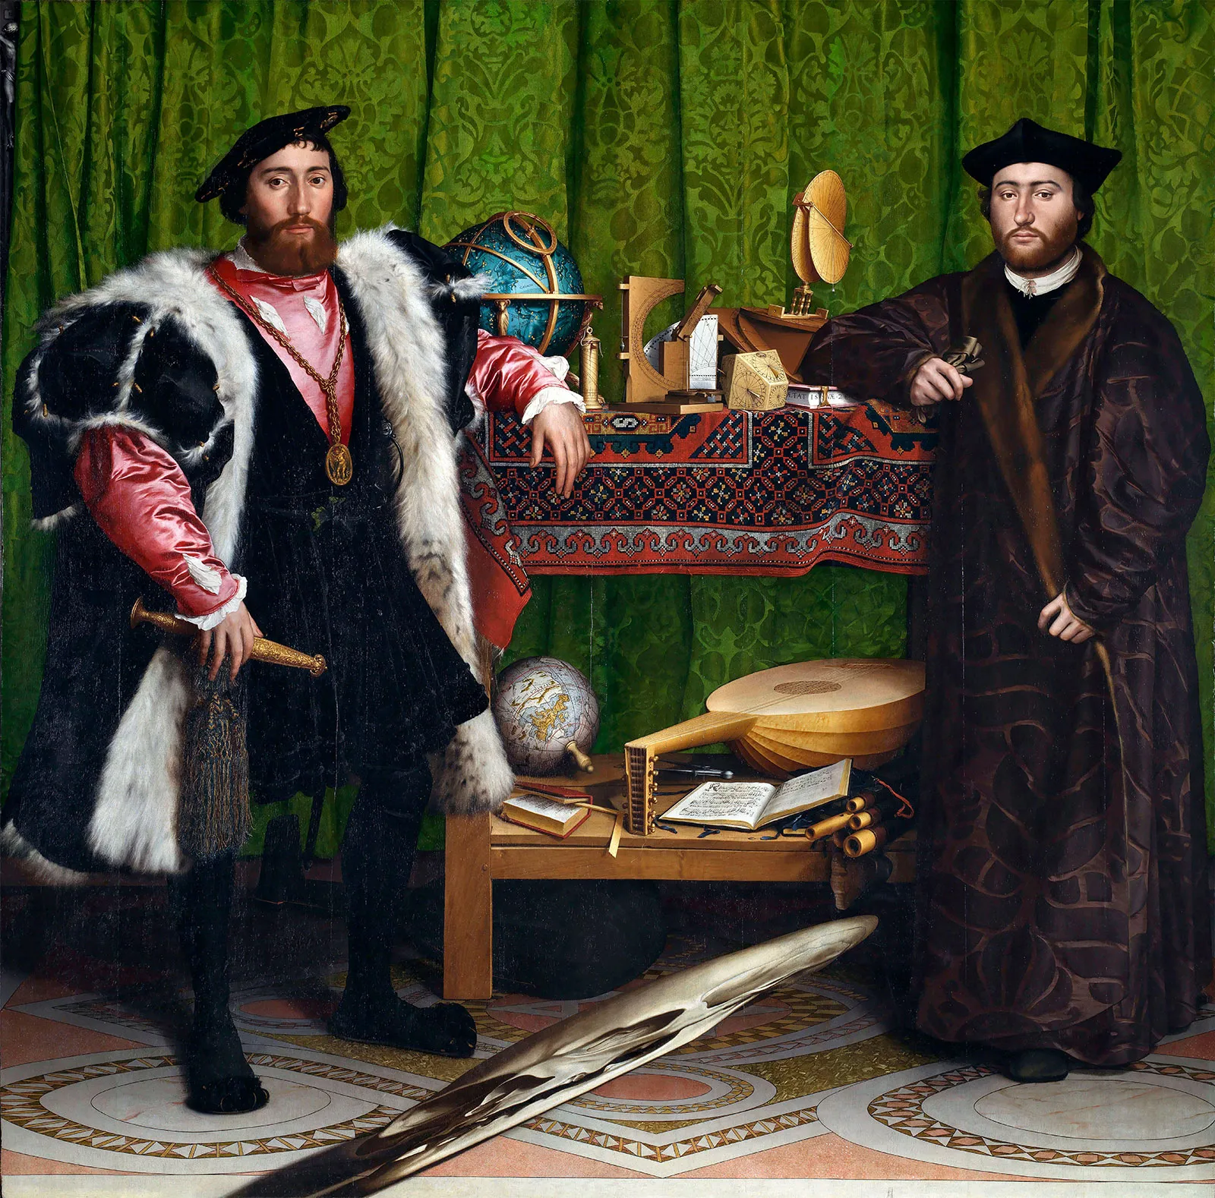
SCRC
South Central Renaissance Conference
Exploring the Renaissance 2026:
An International Conference
Queen Elizabeth I Society
Andrew Marvell Society
Society for Renaissance Art History
June 8-10, 2026 ◆ St. Louis University, St. Louis, MO
CALL FOR PAPERS
The SCRC, affiliated with the Renaissance Society of America and the Sixteenth Century Society, announces its 2026 conference, which will be held at St. Louis University in partnership with the SMRS. We welcome 15- to 20-minute papers on all aspects of Renaissance studies. See submission information on the website.
Deadline: December 30, 2025
An SCRC membership (purchasable online and on site) is required to attend.
Papers cannot be read in absentia.
Graduate students who are presenting at the conference are encouraged to apply for a graduate travel fellowship. Apply to the Vice-President by e-mail, attaching the complete text of a paper,
by January 31, 2026.
Undergraduates must e-mail the complete text of their papers, with a faculty letter of recommendation, to the program chair
by December 15, 2025.
Contacts Past President / Acting Program Co -Chair: Susan Dunn-Hensley, Wheaton College, susan.dunnhensley@wheaton.edu
Vice President / Acting Program Co-Chair: Margaret Oakes, Furman University
Margaret.oakes@furman.edu
Local Hosts: Tim Moylan (University of Health Science and Pharmacy, St. Louis) and Donald Stump (St. Louis University)
Tim.Moylan@uhsp.edu
We encourage speakers to submit developed versions of their papers to SCRC’s fully refereed, independent scholarly journal, Explorations in Renaissance Culture.
Information about submissions and local arrangements will be available on the SCRC website:
Invited Speakers
Louis L. Martz Lecturer:
Susan Doran
University of Oxford
William B. Hunter Lecturer:
Valerie Schutte, Independent Scholar
Keynote Lecturer:
Evelyn Tribble
University of Connecticut
The Ambassadors, 1533
Hans Holbein the Younger
southcentralrenaissanceconference.org

