Slide 1


How to Create a Short Biography:
A text-based task demo for language teaching using the model text “Tintoretto” by Encyclopædia Britannica
STEP 2 TEACHING SLIDES
Task created in 2023 by
Chiara Montera, assistant professor, University of Pittsburgh
textbasedtasks.commons.gc.cuny.edu
CILC projects are funded in part by a U.S. Department of Education grant.

Slide 2
How to write a short biography of a painter
Step 2 – Guided Reading

Slide 3
Learning objectives for today
We will learn main events in Tintoretto’s life and work
We will learn how Michelangelo and Titian influenced Tintoretto’s style

Slide 4
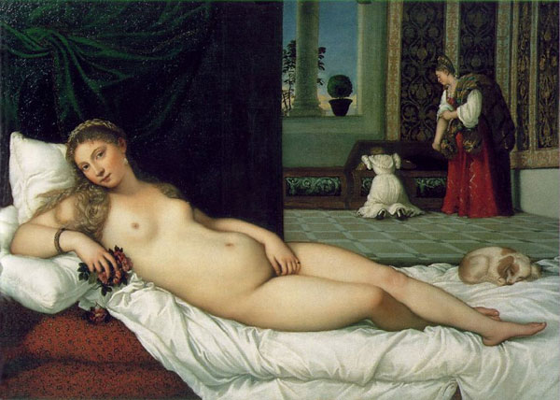
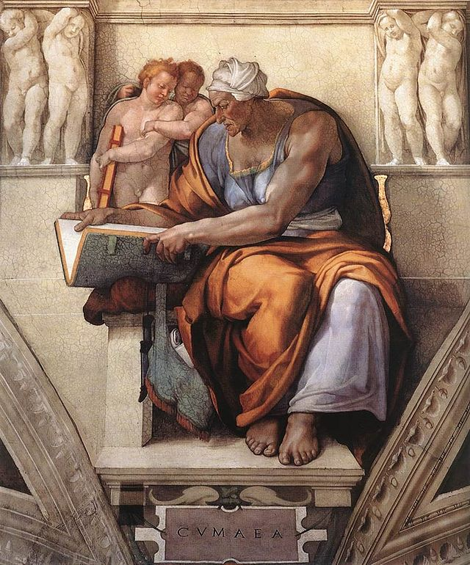
Tintoretto’s style: Michelangelo’s Design (Central-Italian tradition)
Compare the appearance of these two female figures, from two different artists, Titian and Michelangelo, exponents of the two major artistic traditions at the time, respectively the Venetian tradition
and the Central-Italian tradition.
What are the main differences in the
representation of these female bodies?
Titian, Venus of Urbino
1534, Florence
Michelangelo,
Cumaean Sybil
circa 1508-1510, Rome
Notes:
The Venetian tradition is more fleshy while the central Italian one is more muscular.
The Venetian tradition focuses on color, on a feminine and soft style. The colors are soft and the bodies fleshy.
The Central Italian Tradition focuses on drawing. The characters seem sculpted like statues, the bodies are muscular

Slide 5
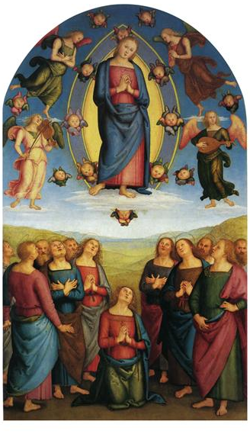
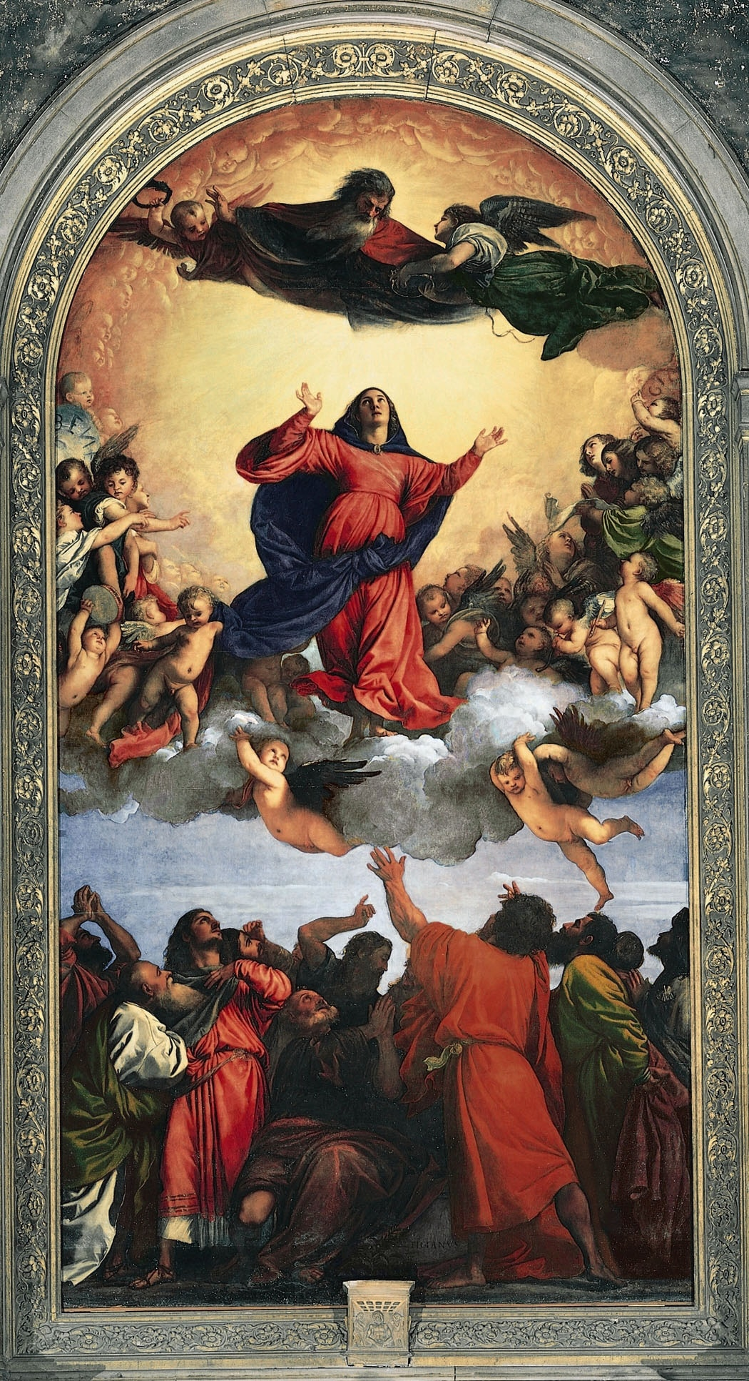
Tintoretto’s style: Titian’s color (Venetian tradition)
Perugino, Assumption of the Virgin
1506, Naples
Compare the colors in these two paintings.
Then match the descriptors with
the correct work of art:
saturated
modulated shadow
low contrast
high and dramatic contrast
uniform hue
muted
Titian,
Assumption of the Virgin
c. 1516-1518, Venice
Notes:
Tintoretto learned the use of color from Titian, a Venitian master. Ask the students to compare the colors in tere

Slide 6
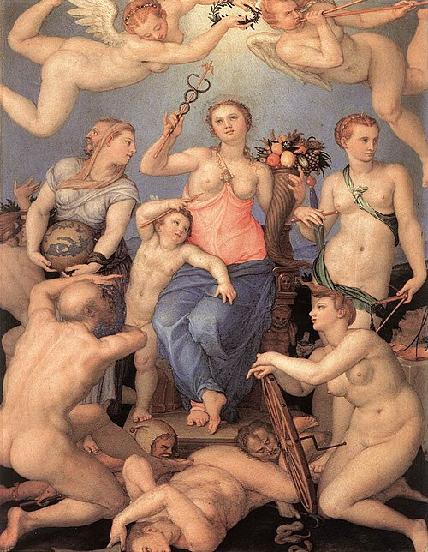
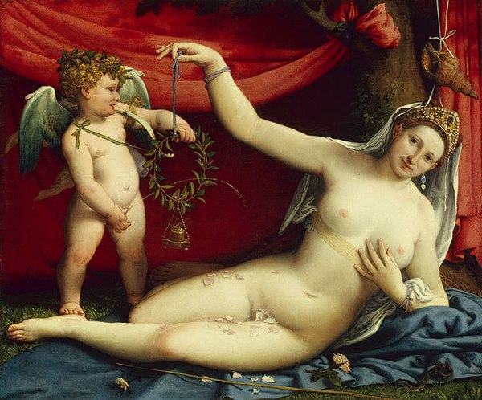
Tintoretto’s style:
Michelangelo’s Design and Titian’s Color
Which work of art belongs to the Venetian tradition and
which to the Central-Italian tradition? Explain why.
Bronzino, Allegory of Happiness
c. 1567, Florence
Lorenzo Lotto, Venus and Cupid
c. 1520, NY

Slide 7
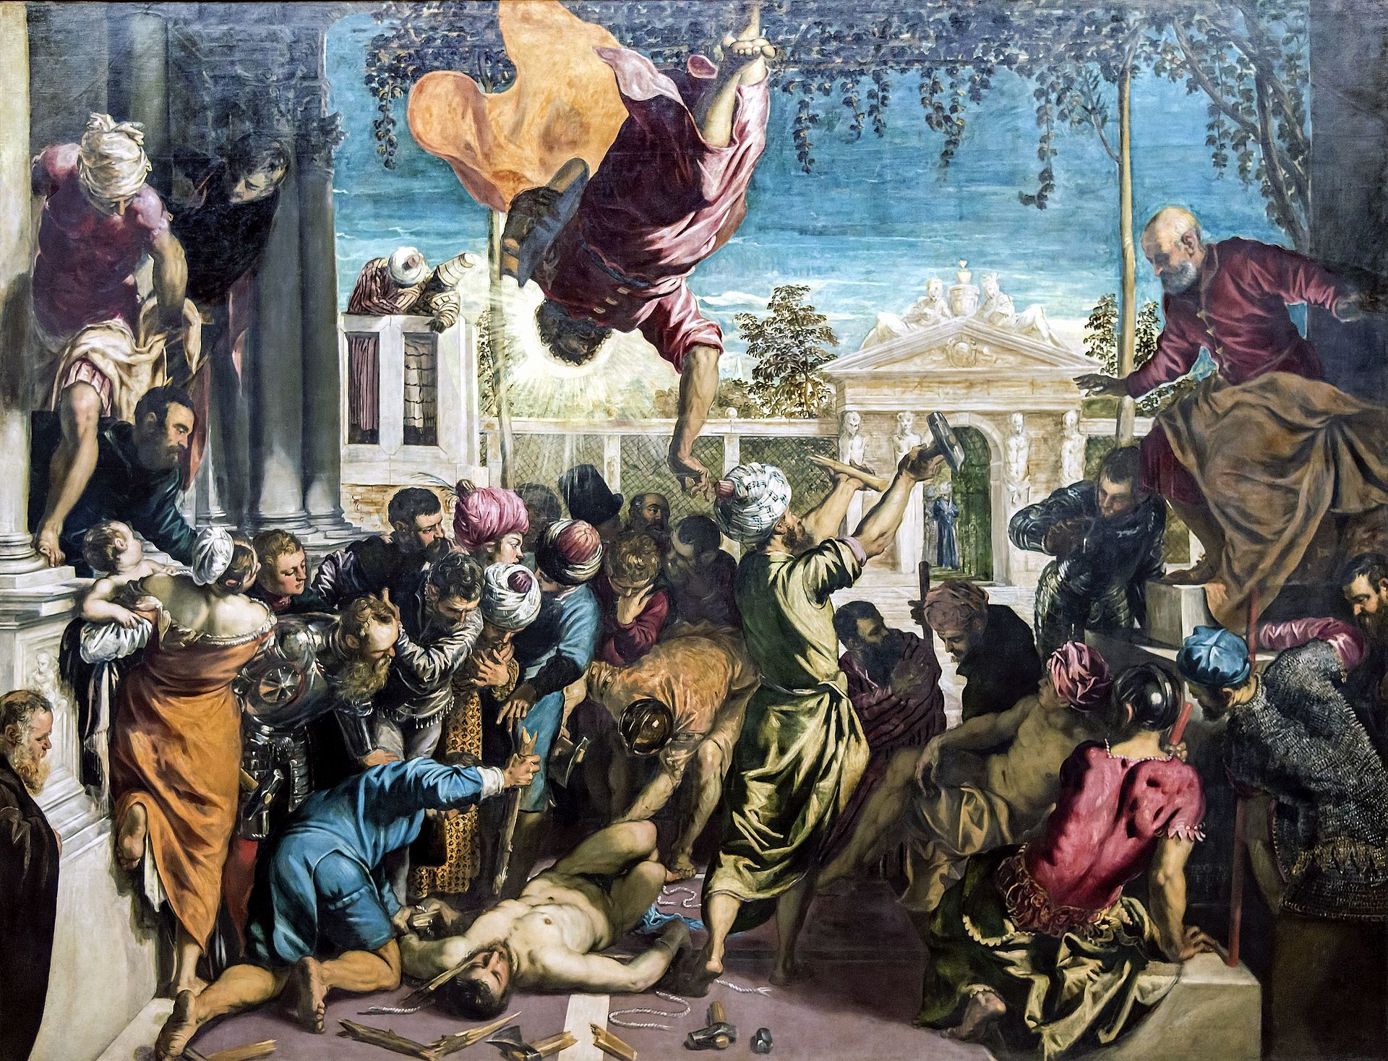
+
=
Central-Italian tradition
(design)
Venetian tradition
(color)
Tintoretto

Slide 8
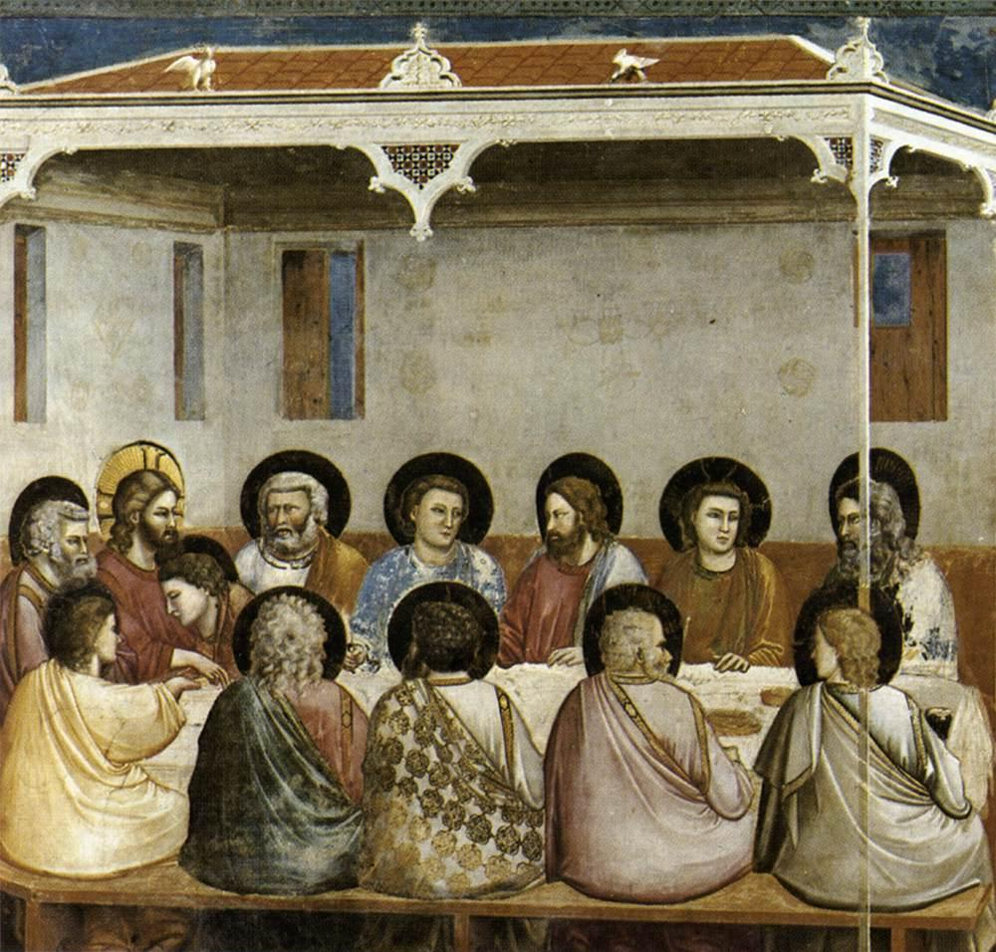
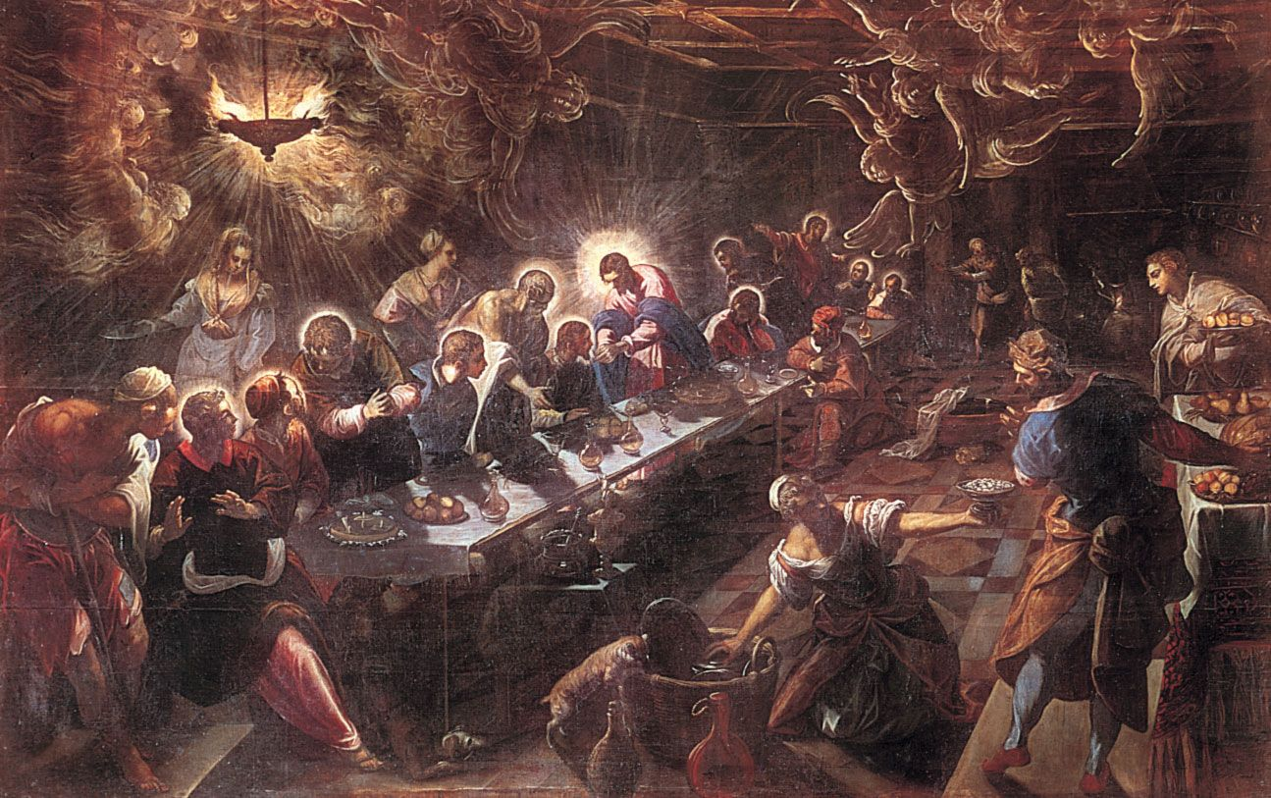
Tintoretto’s style:
differences with painters of the previous period (Middle Age)
Tintoretto, The Last Supper, 1592-94, Venice.
Giotto, The Last Supper,
circa 1303-1305, Padua.

Slide 9
Date | Event (from the text) | Event (in your own words)

Slide 10
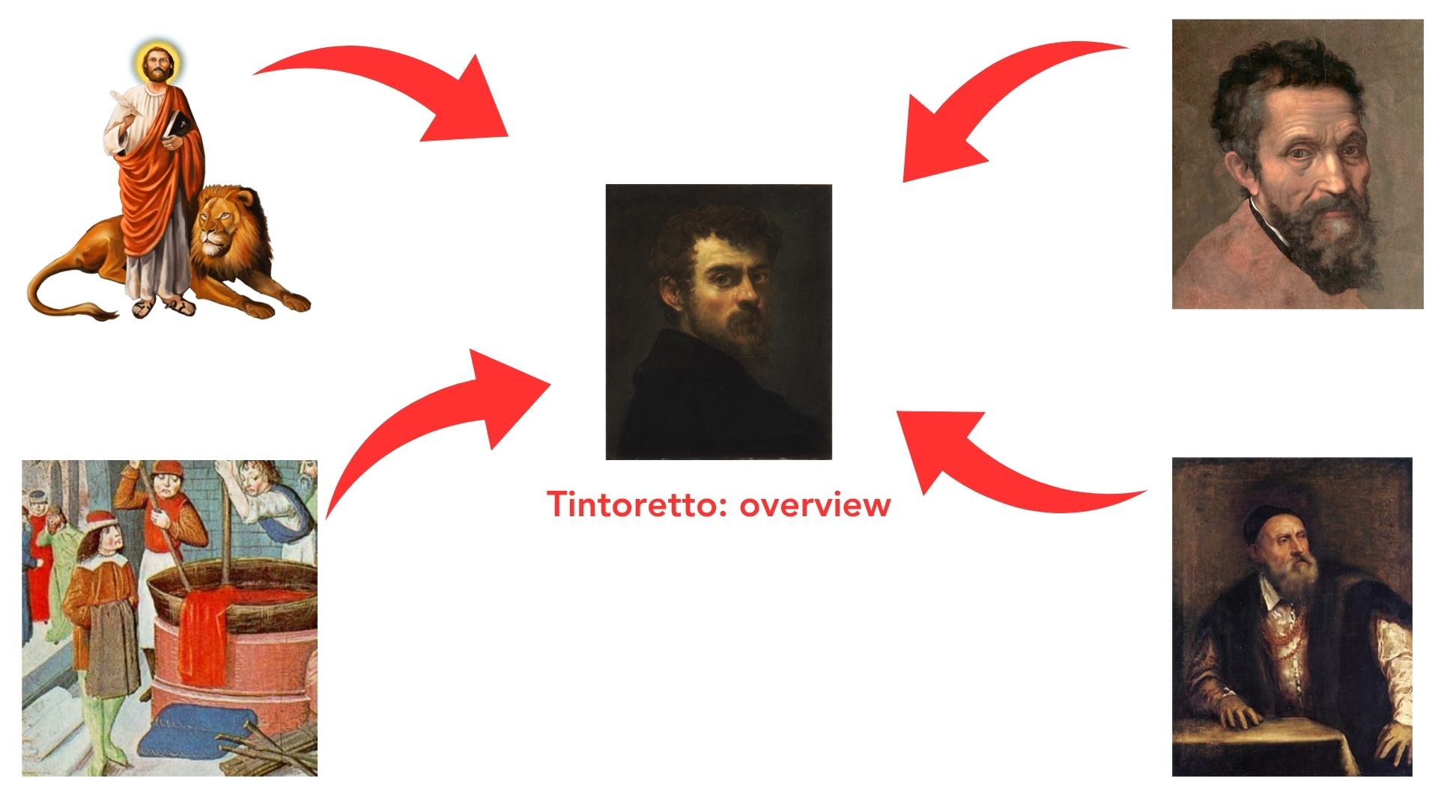
Notes:
For every image in every map find the correspondent phrase, name, line etc in the model text

Slide 11
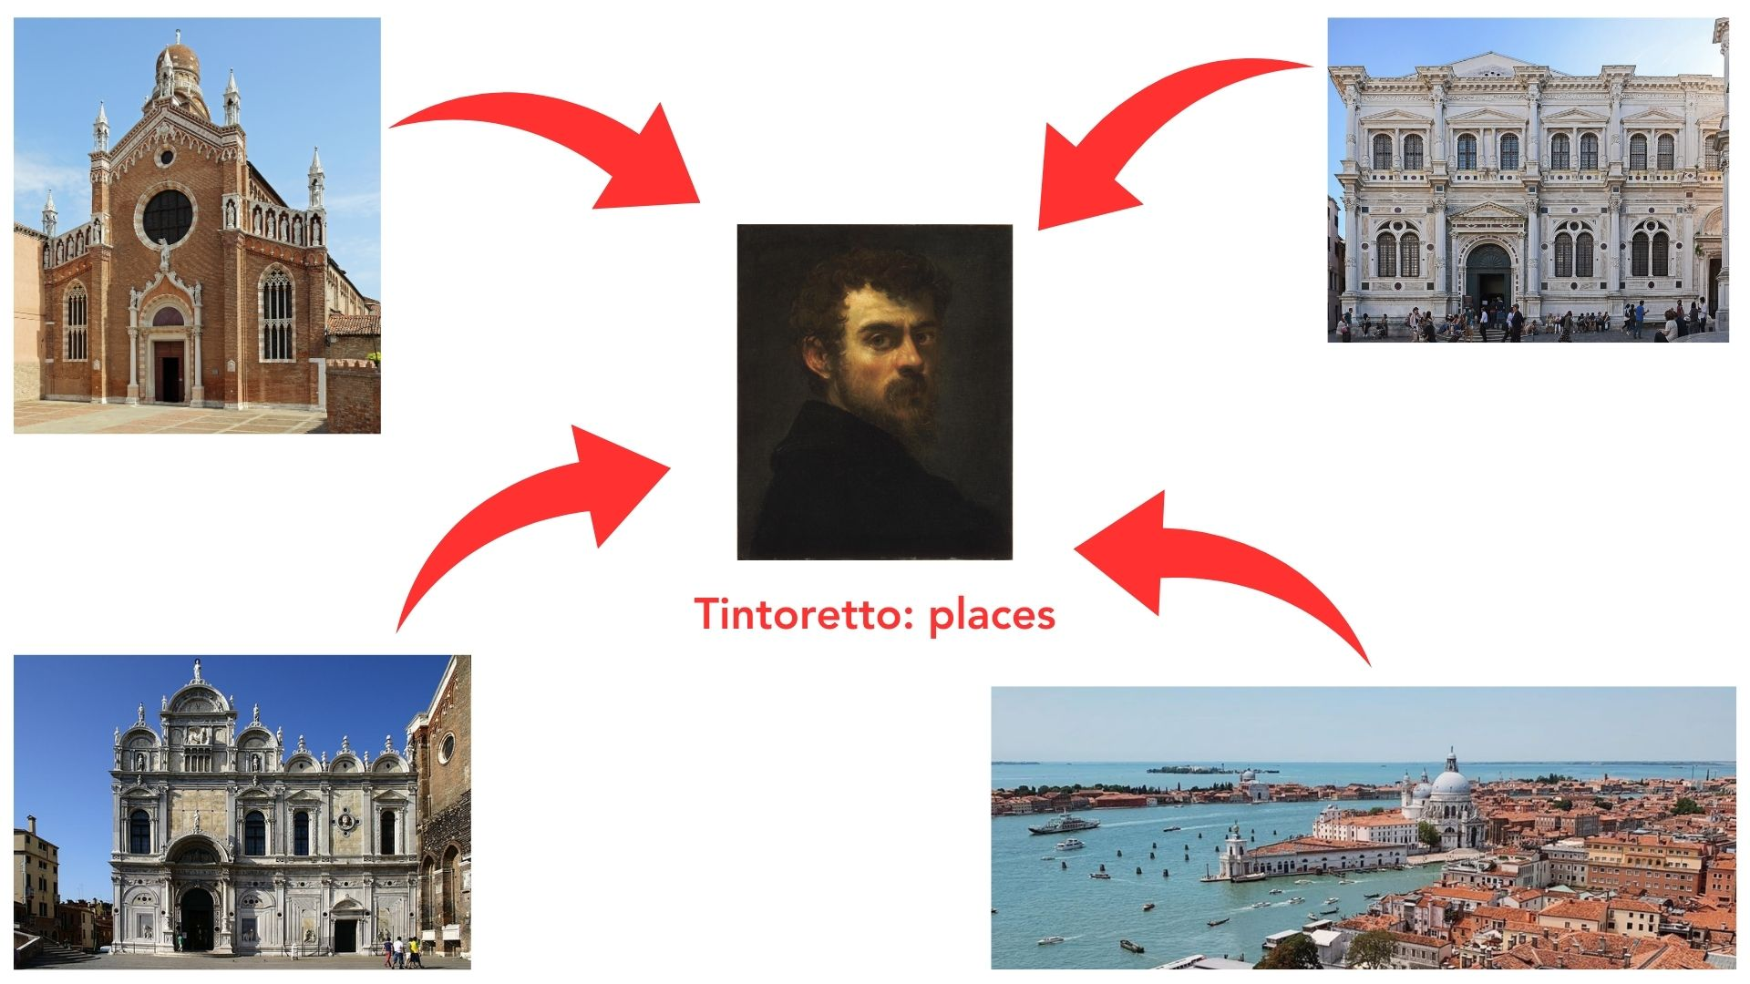
Notes:
For every image in every map find the correspondent phrase, name, line etc in the model text

Slide 12
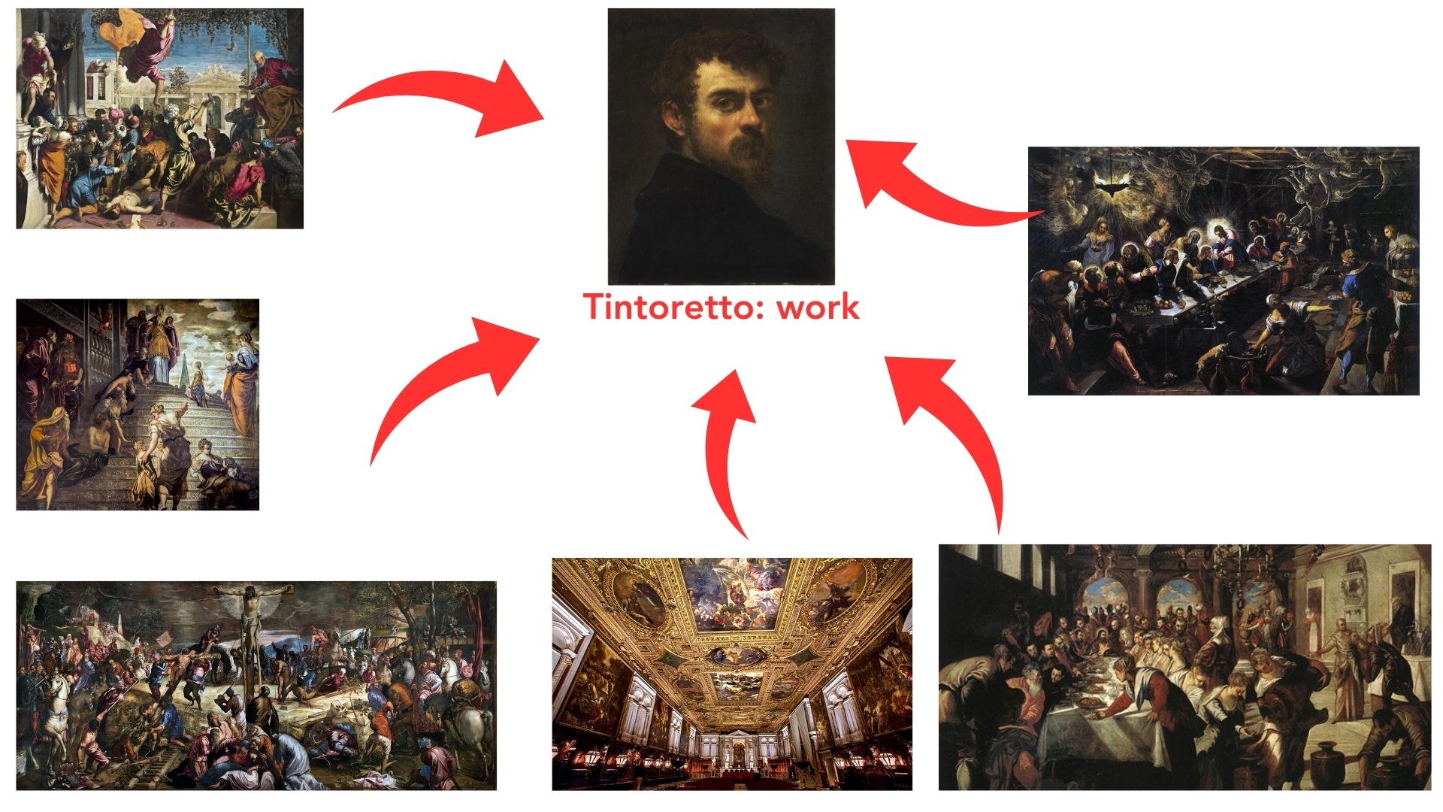
Notes:
For every image in every map find the correspondent phrase, name, line etc in the model text

