Slide 1


How to Create a Short Biography:
A text-based task demo for language teaching using the model text “Tintoretto” by Encyclopædia Britannica
STEP 1 TEACHING SLIDES
Task created in 2023 by
Chiara Montera, assistant professor, University of Pittsburgh
textbasedtasks.commons.gc.cuny.edu
CILC projects are funded in part by a U.S. Department of Education grant.

Slide 2
How to write a short biography of a painter
Step 1 - Building knowledge of the field

Slide 3
Learning objectives for today
- We will learn vocabulary specific to the field of painting
- We will learn some basic information about Italian Renaissance
- We will learn about an important work of art by painter Tintoretto

Slide 4


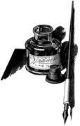
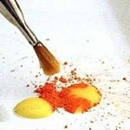
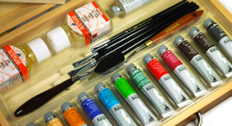
2
1
MATERIALS
PASTELS
4
3
INK
EGG TEMPERA
5
OIL PAINT
CHARCOAL
Notes:
The activities in slides 3-8 can be quickly done in plenum
1 – charcoal
2 – pastels
3 – ink
4 – egg tempera
5 – oil paint

Slide 5
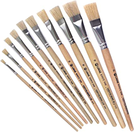
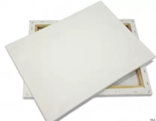
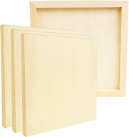


2
1
MATERIALS
CANVAS
4
PEN
3
PAPER
WOOD PANELING
5
BRUSHES
Notes:
1 – brushes
2 – canvas
3 – pen
4 – wood paneling
5 - paper

Slide 6
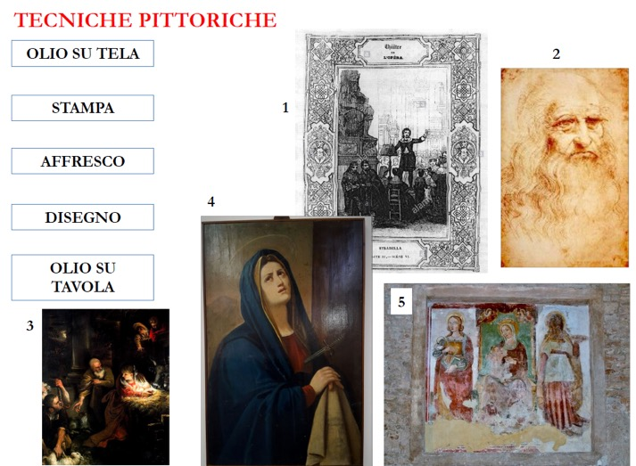
2
PAINTING TECHNIQUES
1
OIL ON CANVAS
PRINT
FRESCO
DRAWING
4
OIL ON WOOD PANELING
5
Notes:
1 – print
2 – drawing
3 – oil on canvas
4 – oil on wood paneling
5 - fresco

Slide 7
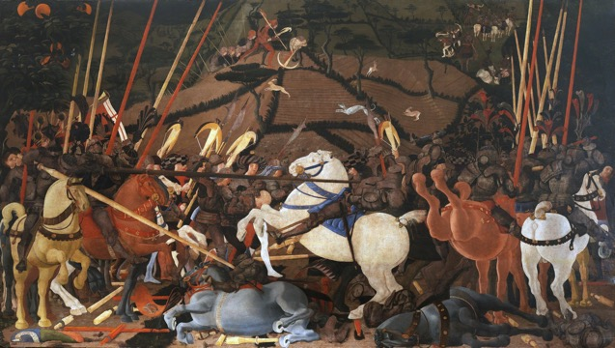
SUBJECTS
Is this…
…a historical subject
or
… a religious subject?
Paolo Uccello,
The Battle of san Romano,
1438
Notes:
Historical subject
You can ask follow up questions to the learners: why do you think this is historical? What elements make you say it?

Slide 8
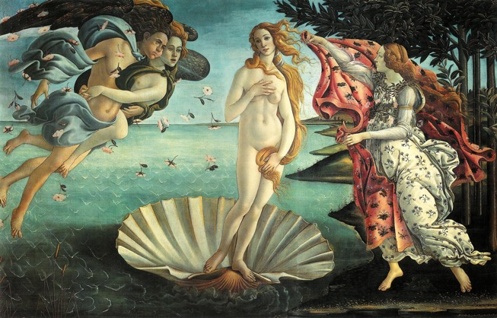
SUBJECTS
Is this…
…a mythological subject
or
… a historical subject?
Sandro Botticelli,
The Birth of Venus, 1486
Notes:
Mythological
You can ask the same follow up questions as in the previous slide

Slide 9
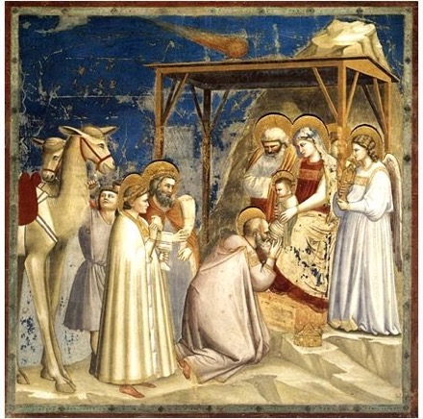
SUBJECTS
Is this…
…a mythological subject
or
… a religious subject?
Giotto, Adoration of the Magi, 1303-1305
Notes:
Regarding painting techniques, what do you think? Is it a fresco or an oil on canvas?
What do you think, this work belongs to the Middle Ages or the Renaissance?
Ask the students to make hypotheses, and then allow them to use Google to find the correct answers

Slide 10
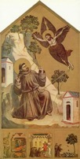
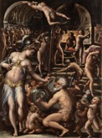
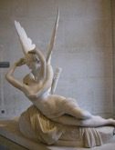
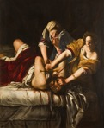
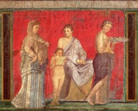
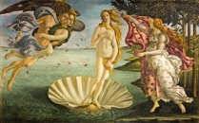
TIMELINE
MIDDLE AGE
NEOCLASSICISM
BAROQUE
LATE RENAISSANCE
ROMAN EMPIRE
RENAISSANCE
476
1400
1520
1600
1700
1800
Notes:
«Let's try to put these periods in chronological order on a timeline, and make hypothesis about which painting matches with which period»

Slide 11


TIMELINE
ROMAN EMPIRE
RENAISSANCE
BAROQUE
476
1400
1520
1600
1700
1800
MIDDLE AGE
LATE RENAISSANCE
NEOCLASSICISM
Notes:
Roman empire: fresco from the Villa of Mysteries in Pompeii
Middle age: Saint Francis Receiving the Stigmata, Giotto
Renaissance: The birth of Venus, Sandro Botticelli
Late Renaissance: The Forge of Vulcan, Giorgio Vasari
Baroque: Judith Slaying Holofernes, Artemisia Gentileschi
Neoclassicism: Psyche Revived by Cupid's Kiss, Antonio Canova (we chose a sculpture instead of a painting because painting is not very representative of this artistic period in Italy, while the sculptures of Antonio Canova are iconic of Italian Neoclassicism)

Slide 12
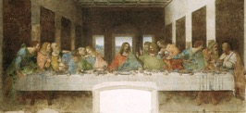
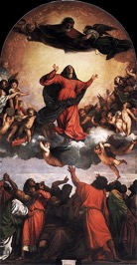
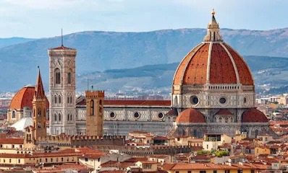
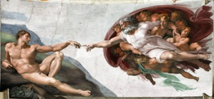
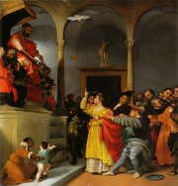
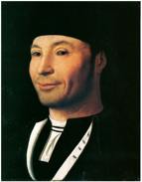
Where did the Renaissance originate from?
Milan
Venice
Roma
Originated in Florence, but then it spreaded all over Italy
Sicily
Le Marche
Notes:
After this brief in plenum activity, the learners have to read a short article from the Encyclopaedia Britannica and complete the related activity (see doc Text-based tasks: Sample in English. Worksheet, activity n.1 “Renaissance Art”)

Slide 13
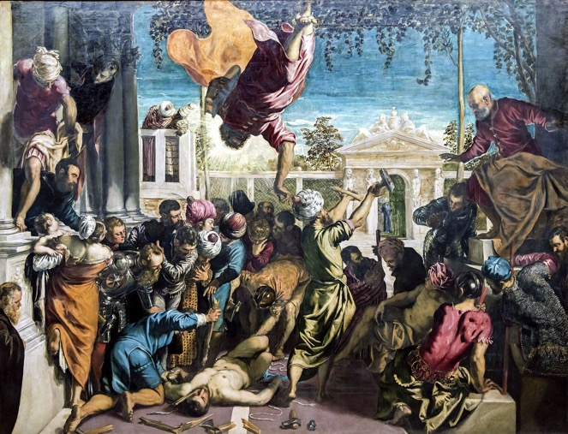
Let’s observe
one of the most famous paintings by Tintoretto
What’s the subject?
Religious, historical, mythological etc?
Could you describe the scene using three adjectives?
Can you describe the people in the scene? How do they look? Happy, mad, sad, amused, etc?
Where is the scene taking place?
Who are the main characters in this painting?
Miracle of the slave or
St. Mark freeing the slave
Notes:
What is the subject?
Could you describe the scene using 3 adj: the scene is quiet? chaotic? confusing? funny?
Cna you describe the people in the scene? How do they look? Happy? Mad? Sad? Amused? Confused?
Where is the scene taking place? Inside a house? In a garden? In a public or private space? In a city square?
Who are, in your opinion, the main characters of the scene?

Slide 14

IN THE BACKGROUND
Describe what’s on different levels of the painting, what’s in the background,
what’s in the middle ground, etc.
IN THE MIDDLE GROUND
IN THE FOREGROUND
AT THE FRONT EDGE OF THE PICTURE’S SPACE
Miracle of the slave or
St. Mark freeing the slave
Notes:
Ok, very good. Now, what do you see in the background? A garden, a Palace, …

Slide 15
1
4
Can you find these main characters in the painting?
The slave
St. Mark
The judge
The executioner
The painter Tintoretto
5
2
3
Miracle of the slave or
St. Mark freeing the slave
Notes:
The slave 2
St Mark 1
the judge 4
executioner 3
Tintoretto 5

