Slide 1
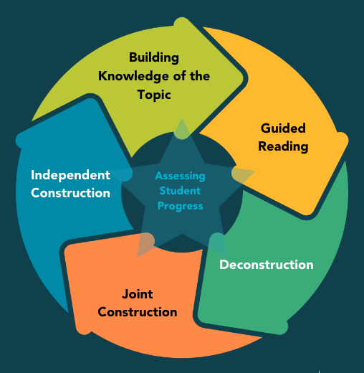


How to Create a Biographical Profile:
A text-based demo task for heritage language teaching using the model text “Overlooked No More: Jovita Idár, Who Promoted Rights of Mexican-Americans and Women” by Jennifer Medina
COMPANION TEACHING SLIDES
Task created in 2023 by
Alberta Gatti, associate professor, CUNY Graduate Center
textbasedtasks.commons.gc.cuny.edu
CILC projects are funded in part by a U.S. Department of Education grant.

Slide 2
Building Knowledge of the Topic
STEP 1

Slide 3
GUIDED READING
STEP 2

Slide 4
Step 2 - content chart
Who is this text about? | Jovita Idár, …
What happens?
When?
Where?
Enter all the social achievements of Jovita Idár (e.g., what she did for women).
Enter some of Idár’s ideas about society, women, and minorities.

Slide 5
Step 2 - Timeline chart
YEAR | EVENT
1885 | Birth

Slide 6
Step 2 - GENRE
TEXT A
Once upon a time there was a witch who lived in a house in the forest. Everyday she…
TEXT B
First, peel the hoe-hoe and cut it in thin slices.
Then, slightly season the alai…
TEXT C
My dearest, I am writing to tell you that my life is empty without you. When we…

Slide 7
DECONSTRUCTION
STEP 3

Slide 8
STEP 3
JOVITA IDÁR GENRE TABLE
Part name | Purpose and form | Evidence from the text
Title

Slide 9
STEP 3
JOVITA IDÁR TEXTUAL FEATURES TABLE
Textual feature | Purpose and form | Evidence from the text
Apposition
Time markers
Reported speech

Slide 10
APPOSITION
Providing information in an efficient, succinct way
TEXTUAL FEATURES

Slide 11
APPOSITION - PURPOSE
Version 1 (Original)
Version 1 (Original)
When the Texas Rangers showed up outside the office of the newspaper El Progreso in 1914 with the intent of shutting it down, Jovita Idár, a writer and editor, was waiting at the front door to block them from entering.
Jovita Idár
was a writer and editor of El Progreso
was waiting for the Texas Rangers at the door of the paper
A DESCRIPTION
AN ACTION

Slide 12
APPOSITION - PURPOSE
Version W/O Apposition
Jovita Idár was a writer and editor at El Progreso. When the Texas Rangers showed up outside the office of the newspaper in 1914 with the intent of shutting it down, she was waiting at the front door to block them from entering.
What is the difference between the two versions?

Slide 13
Apposition - Form
Always refers to/says something about an antecedent (underlined)
Two options for order
  Antecedent, apposition (1)
  Apposition, antecedent (2)
Always between commas (unless it starts the sentence)
Often starts with “a” or “one”, sometimes with “who”
(1) Jovita Idár , a writer and editor , …
(2) A writer and editor , Jovita Idár …

Slide 14
TIME MARKERS
Organizing events in a text
TEXTUAL FEATURES

Slide 15
JI life chronology
Jim Crow era
1880 1960
moved to San Antonio,
established
democratic club
joined the First
Mexican Congress
Texas Rangers showed
up at El Progreso
teaching
certificate
got married
left Laredo
birth
died
1885
?
1911
1913
1914
1917
?
1946

Slide 16
JI Text’s chronology
joined the First
Mexican Congress
joined the First
Mexican Congress
Teaching certificate
Texas Rangers showed
up at El Progreso
Jim Crow era
left Laredo
got married
birth
died
1885
?
1911
1913
1917
?
1946
1914
1880-1960

Slide 17
Time markers - FORM
Series of actions in the simple past: received, went, became…(¶ 7, 24)
Dates
Expressions:
  the next day,
  by then,
  went on to,
  when/after something happened –> something else happened, etc.

Slide 18
REPORTED SPEECH
Introducing the words of others
Giving legitimacy to the information
TEXTUAL FEATURES

Slide 19
Reported Speech - Form
Direct speech
    XXX said “ xxxx ”.
    Quote exactly from the source, between quotation marks
Indirect speech
    XXX said that xxx.
    What someone said is paraphrased, introduced by “that” or equivalent

Slide 20
Reported Speech - Form
Both direct and indirect speech are introduced by verbs of communication
    Say, write, express, affirm, comment, etc.
The verb of communication can go before or after the words of others
    XX said “xxxx”
    “xxx”, said XX

Slide 21
JOINT CONSTRUCTION
STEP 4

Slide 22
REMEDIOS VARO
SHORT BIOGRAPHY OUTLINE
TITLE
Caption
Introduction
Life Events
Event 1
Event 2
Event 3, etc.
Reorientation/Closing

Slide 23
INDEPENDENT CONSTRUCTION
STEP 5

Slide 24
Acknowledgments
CILC gratefully acknowledge the support of the U.S. Department of Education.

