Slide 1
Patterns of Immigration, Migration, and Marginalization (1840-1920)

Slide 2
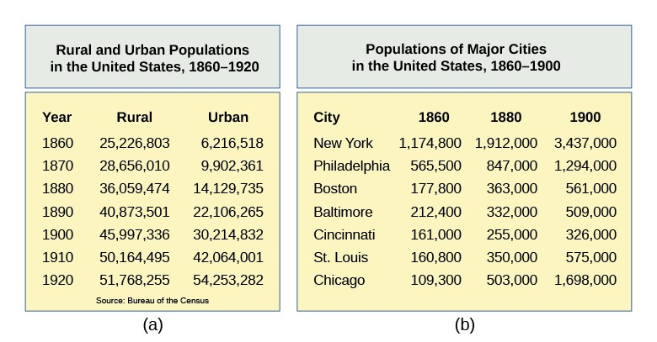
Becoming an Immigrant Urban Society
Agenda
Treatment of Irish, Chinese, Jewish and Italian immigrants to U.S. cities
Goals of dehumanizing these groups
Repercussions for these immigrants
Resistance strategies employed by activists from these communities
“History doesn’t repeat itself, but it often rhythms” – Mark Twain

Slide 3
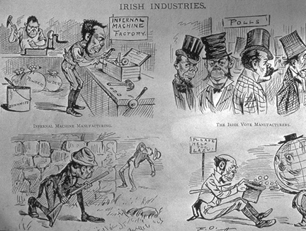
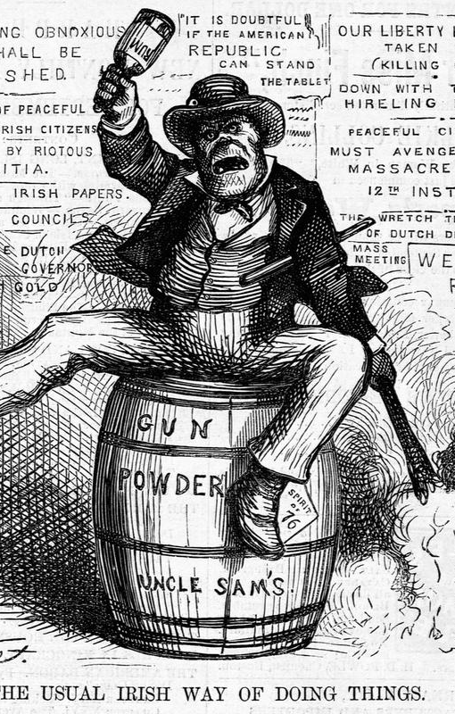
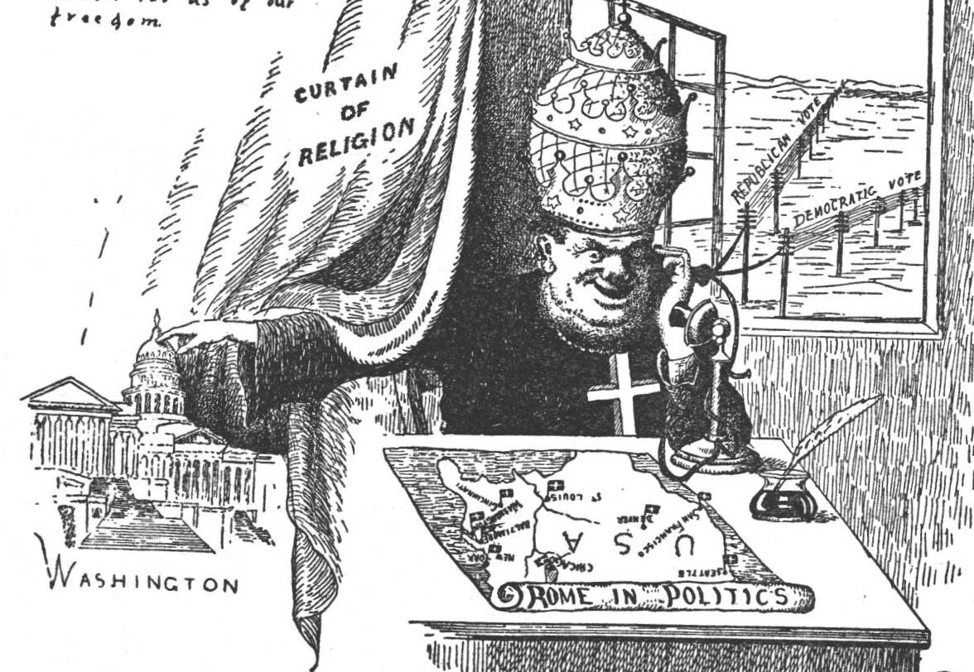
Irish Immigrants

Slide 4
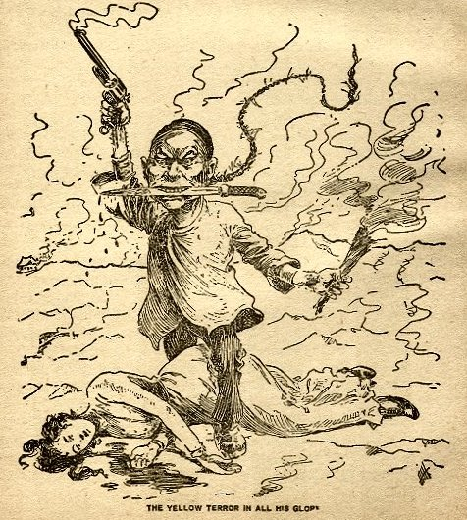
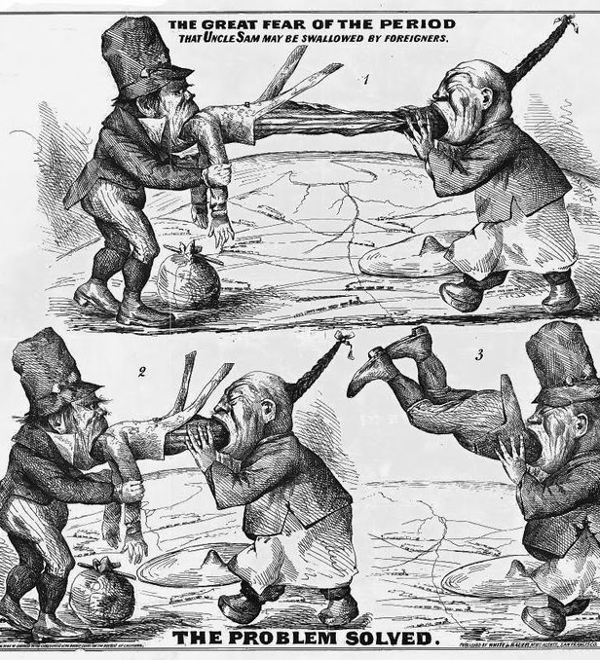
Chinese Immigrants

Slide 5
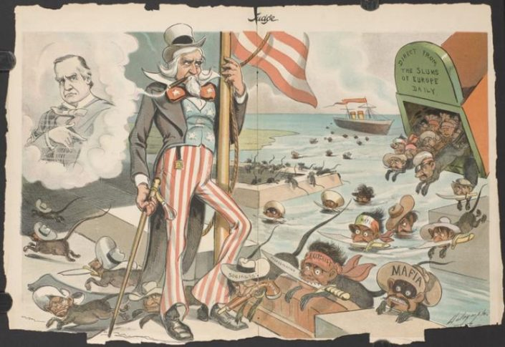
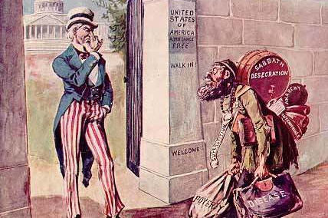

Eastern and Southern European Immigrants

Slide 6
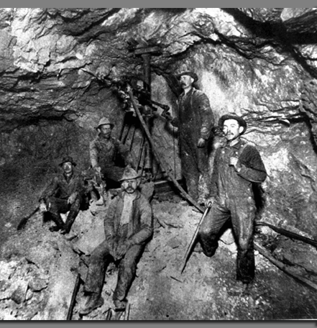
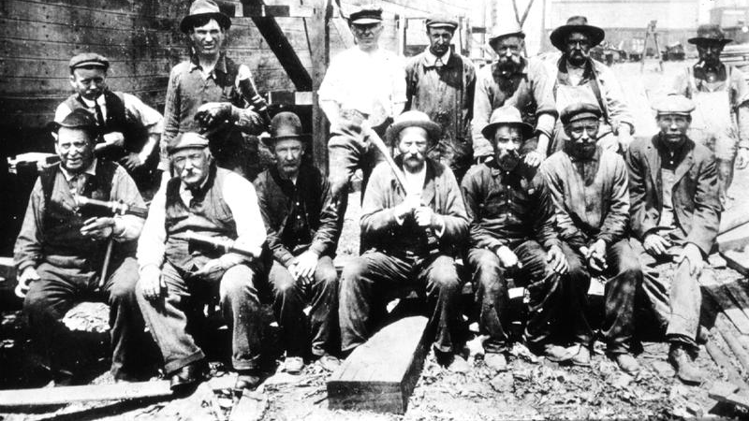
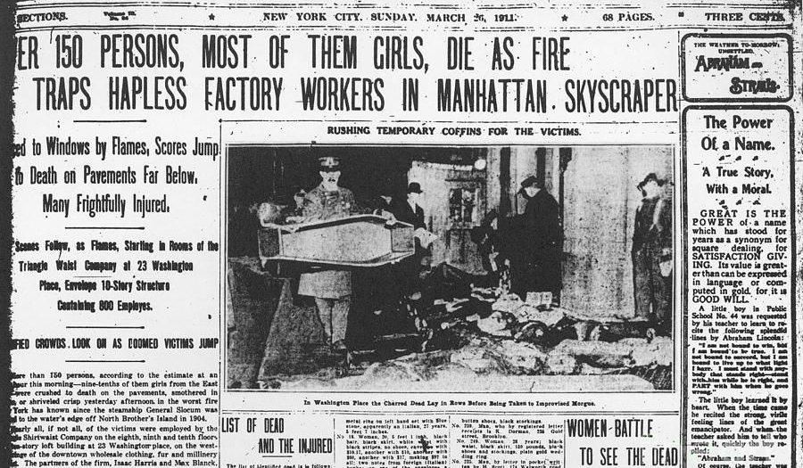
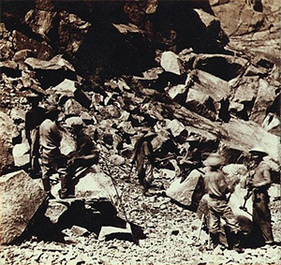
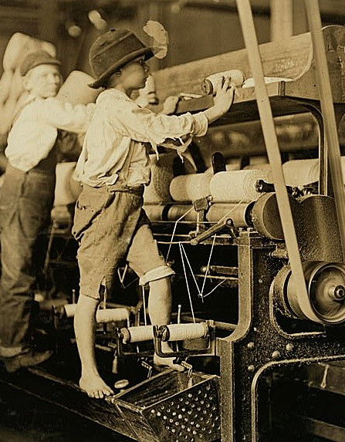
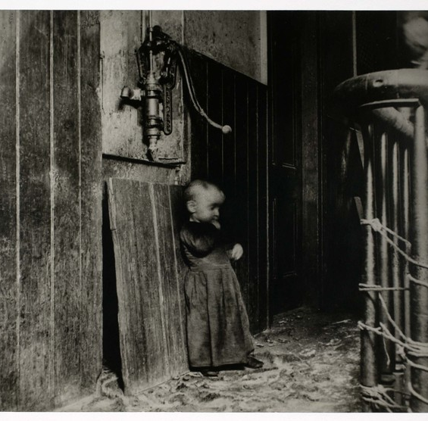
Who benefits if an immigrant or marginalized group is dehumanized?

Slide 7
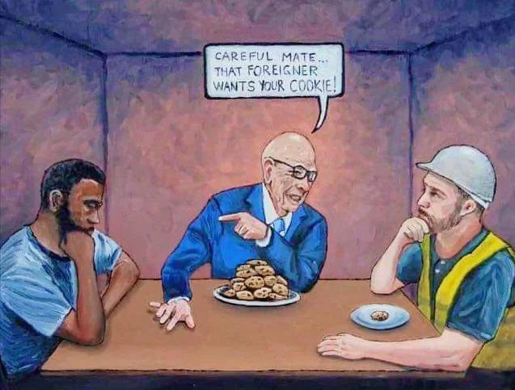
Pitting Working People Against Each Other Distracts from Gross Inequity

Slide 8
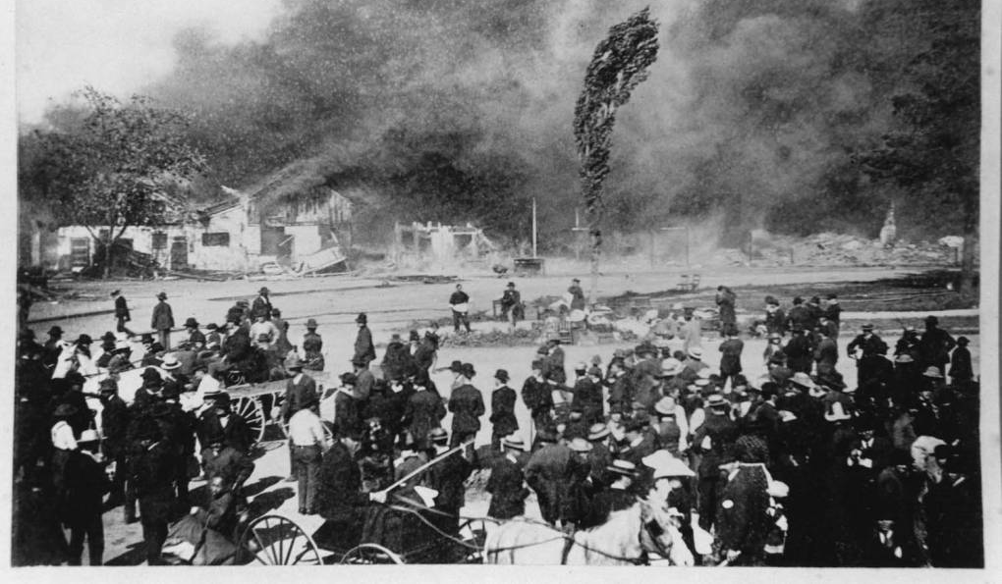
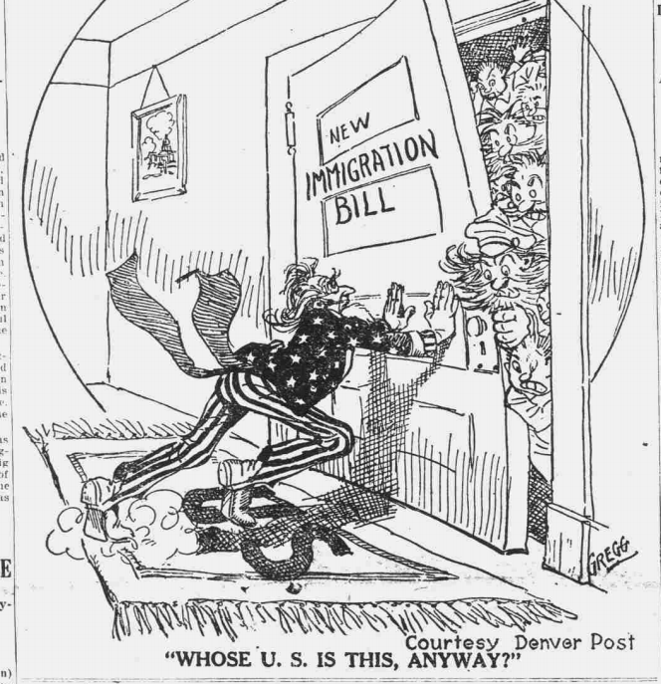
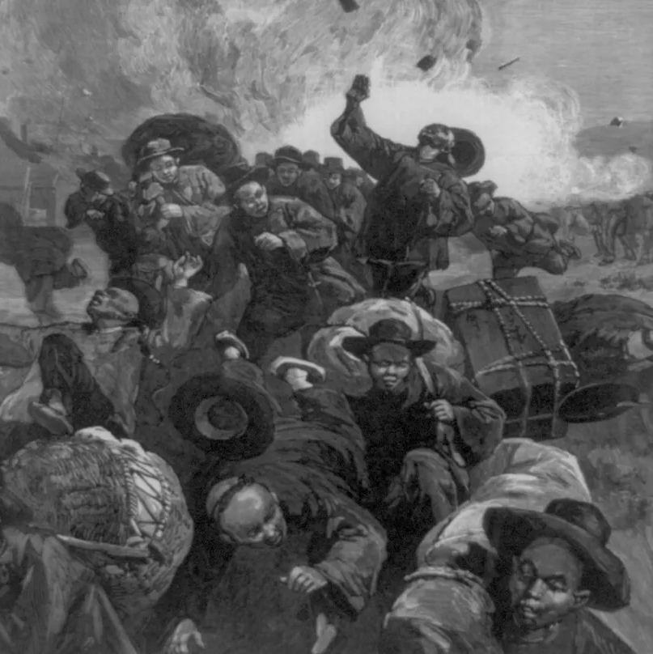
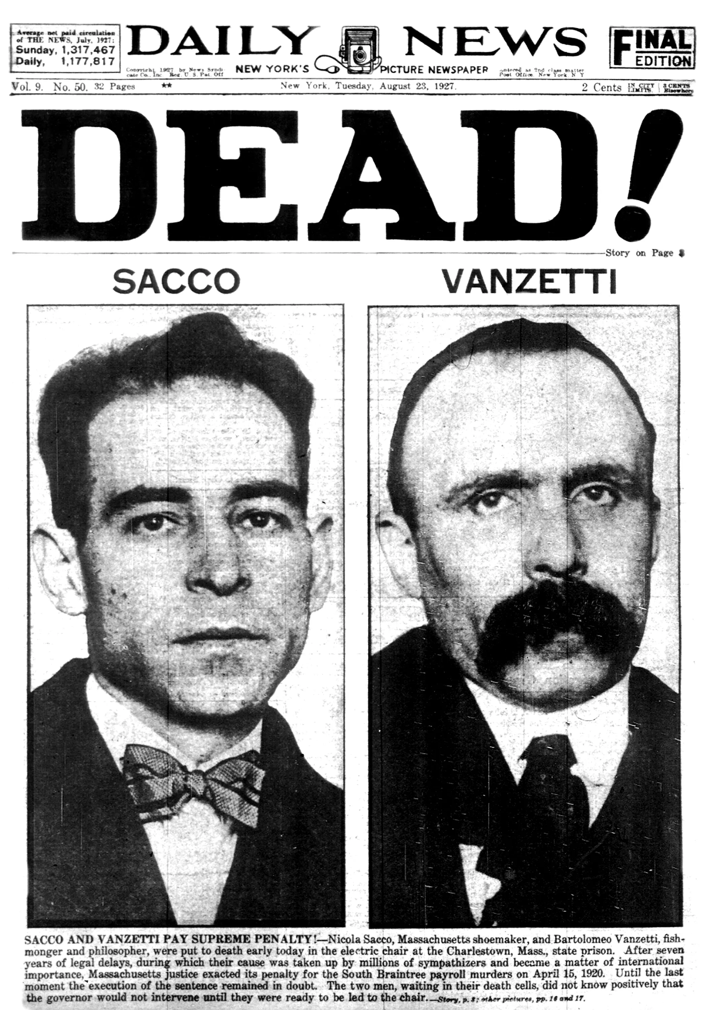
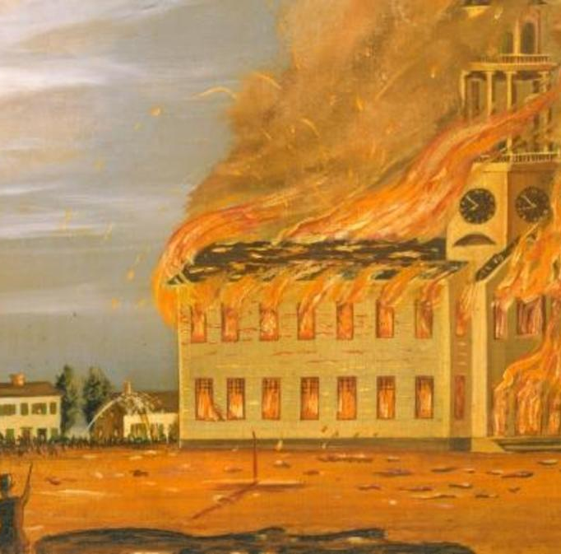
Violence and Exclusion

Slide 9
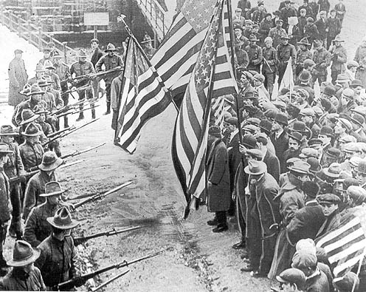
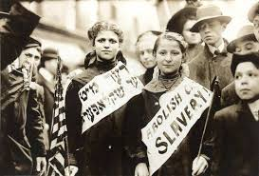
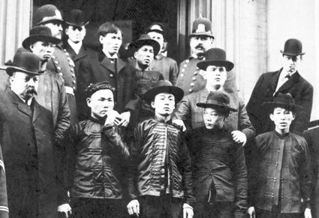
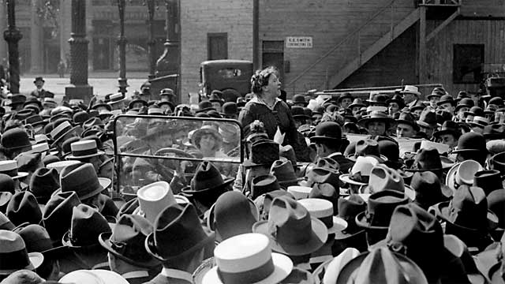
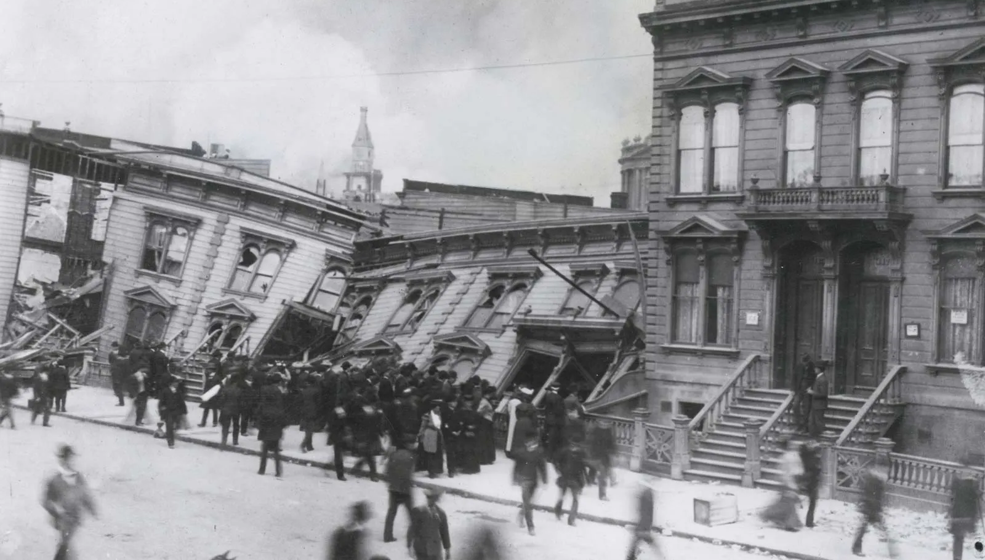
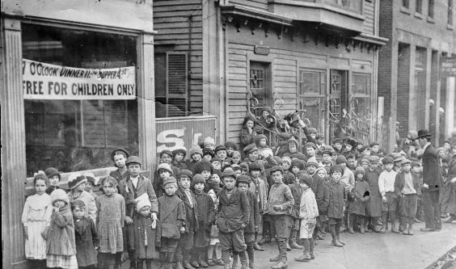
Resisting Oppression

Slide 10

Could the marginalization of immigrant workers still happen today?

Slide 11

Upcoming Agenda
Due Sunday – Oral History Part III: The Transcript
Next Week
  The Great Depression and Great Migrations
  Immigration and Migration from the Caribbean to U.S. Cities

